Slide 1
ECE467: Natural Language Processing
Vector Space Models,
Information Retrieval,
and Text Categorization

Slide 2
If you are following along in the book…
Part of this topic, on vector space models, is related to Sections 5.2 through 5.4 of the current draft of the textbook
However, in this topic, we are using vectors to represent documents (as was common in conventional NLP), not words (as is common in modern NLP)
Information retrieval (IR) is mentioned throughout various chapters, and the conventional approach to IR is discussed in Sections 11.1 – 11.2 of the current draft
Section 11.3 discusses newer methods of IR, and the rest of the chapter relates to question answering (QA); we will cover these topics later in the course (not necessarily the same way as the current draft of the book)
The naïve Bayes approach to text categorization has been moved to Appendix B of the textbook, and part of this topic is related to Sections B.1 through B.8
Other methods of text categorization are not discussed in the book (earlier versions of the textbook were also weak on this task, in my opinion)
The textbook semi-recently condensed some of its material about these subtopics, so some of the formulas and examples in my slides are from earlier drafts
Information retrieval and text categorization (especially the latter) are highly related to the work I personally did as a graduate student; therefore, I have also largely relied on my own knowledge for this topic

Slide 3
Information Retrieval
Information retrieval (IR) is the task of returning, or retrieving, relevant documents in response to a natural language query
A document in the context of IR can generally pertain to all types of media, including text, photographs, audio, video, etc.
In this course, we are only concerned with the retrieval of text documents (or at least, documents that contain text)
Depending on the application, these text documents might be web pages, news articles, technical papers, encyclopedia entries, or smaller units such as paragraphs or sentences
A collection refers to a set of documents being used to satisfy user requests
A term refers to a lexical item (typically a word or token, but optionally a phrase) that occurs in the collection
The textbook says that a query "represents a user's information need expressed as a set of terms"
I add: However, for NLP applications, the user is generally not constrained to use terms from the collection when they express their query; they can type whatever they want
IR has been an extremely important application of NLP; some colleges have offered entire courses on IR
Although modern methods of IR make use of embeddings, conventional methods also worked quite well (clearly, web search engines such as Google were popular long before deep learning!)

Slide 4
Conventional IR
The earliest IR systems only allowed Boolean queries; e.g., "information AND retrieval AND NOT vector"
However, this approach has multiple short comings, and we will not discuss it further
Many conventional IR systems assume that the meaning of a document resides solely in the set of terms that it contains
Because such systems ignore syntactic (and arguably, semantic) information, these are often said to use bag-of-words approaches
We will see that conventional text categorization methods also use bag-of-words approaches
Some modern IR systems involving embeddings also make a bag-of-words assumption, if the ordering of embeddings is not considered

Slide 5
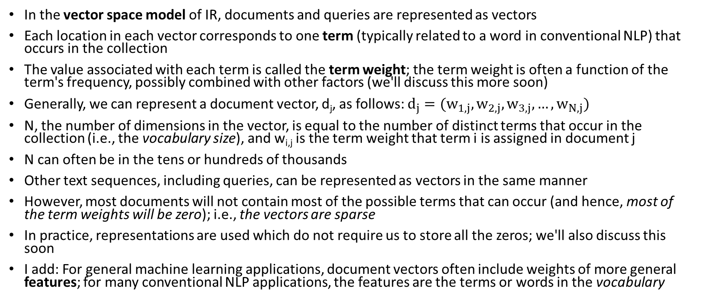
Vector Space Models
In the vector space model of IR, documents and queries are represented as vectors
Each location in each vector corresponds to one term (typically related to a word in conventional NLP) that occurs in the collection
The value associated with each term is called the term weight; the term weight is often a function of the term's frequency, possibly combined with other factors (we'll discuss this more soon)
Generally, we can represent a document vector, d_{j}, as follows: $d_{j}=(w_{1,j},w_{2,j},w_{3,j},…,w_{N,j})$
N, the number of dimensions in the vector, is equal to the number of distinct terms that occur in the collection (i.e., the vocabulary size), and w_{i,j} is the term weight that term i is assigned in document j
N can often be in the tens or hundreds of thousands
Other text sequences, including queries, can be represented as vectors in the same manner
However, most documents will not contain most of the possible terms that can occur (and hence, most of the term weights will be zero); i.e., the vectors are sparse
In practice, representations are used which do not require us to store all the zeros; we'll also discuss this soon
I add: For general machine learning applications, document vectors often include weights of more general features; for many conventional NLP applications, the features are the terms or words in the vocabulary

Slide 6
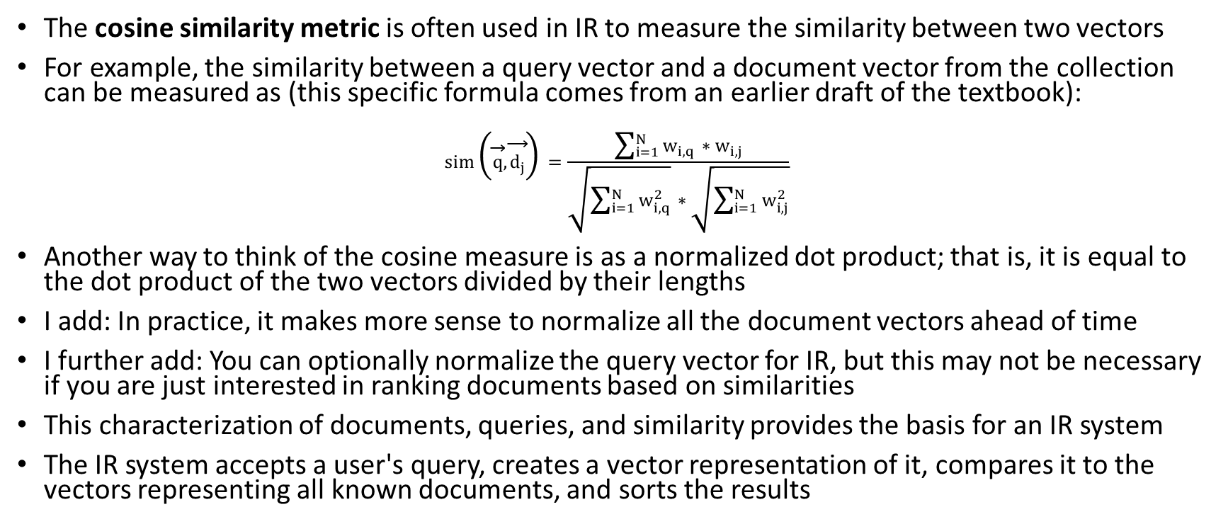
Measuring Similarity Between Vectors
The cosine similarity metric is often used in IR to measure the similarity between two vectors
For example, the similarity between a query vector and a document vector from the collection can be measured as (this specific formula comes from an earlier draft of the textbook):
$$sim\left(\vec{q},\vec{d_{j}}\right)=\frac{\sum_{i=1}^{N}{w_{i,q}∗w_{i,j}}}{\sqrt{\sum_{i=1}^{N}{w_{i,q}^{2}}}∗\sqrt{\sum_{i=1}^{N}{w_{i,j}^{2}}}}$$
Another way to think of the cosine measure is as a normalized dot product; that is, it is equal to the dot product of the two vectors divided by their lengths
I add: In practice, it makes more sense to normalize all the document vectors ahead of time
I further add: You can optionally normalize the query vector for IR, but this may not be necessary if you are just interested in ranking documents based on similarities
This characterization of documents, queries, and similarity provides the basis for an IR system
The IR system accepts a user's query, creates a vector representation of it, compares it to the vectors representing all known documents, and sorts the results

Slide 7
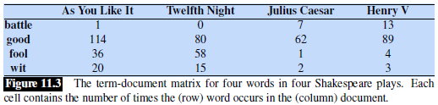
Term-document Matrices
We can also consider the entire collection of documents to be represented as a sparse matrix of weights, where w_{i,j} represents the weight of term i in document j
This is known as a term-document matrix; interestingly, this topic (once considered very important in NLP) had been mostly dropped from the third edition of the textbook, but the current draft brought it back
Here is a simplified example (from the current draft of the textbook) of a small term-document matrix:
Each column represents a document in the collection, and each row represents a term
Here, the term weights are just simple counts; we will look at more complex term weights soon
In a real term-document matrix, most term weights would be 0

Slide 8
Inverted Indexes
In practice, you would not store the entire matrix, since it is huge and sparse
Rather, you use a data structure called an inverted index, and this is still a very important concept for modern search engines
The inverted index efficiently maps each term in the vocabulary to a list of document IDs (or some other reference to relevant documents)
Each entry in the list represents a document in which the term appears at least once
Each entry in the list can also optionally include the term's count or weight in the document and/or a list of the term's positions in the document
Including positions is important if you want the user to be able to search for exact phrases (I'll discuss how this can be done in class)
An inverted index is often implemented as a hash table (the book refers to it a dictionary)

Slide 9
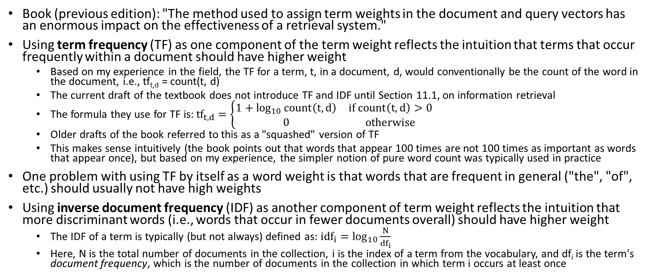
TF and IDF
Book (previous edition): "The method used to assign term weights in the document and query vectors has an enormous impact on the effectiveness of a retrieval system."
Using term frequency (TF) as one component of the term weight reflects the intuition that terms that occur frequently within a document should have higher weight
  Based on my experience in the field, the TF for a term, t, in a document, d, would conventionally be the count of the word in the document, i.e., tf_{t,d} = count(t, d)
  The current draft of the textbook does not introduce TF and IDF until Section 11.1, on information retrieval
  The formula they use for TF is: ${tf}_{t,d}=\left\{\begin{matrix}1+\log_{10}{count\left(t,d\right)} & if count\left(t,d\right)>0 \\ 0 & otherwise\end{matrix}\right.$
  Older drafts of the book referred to this as a "squashed" version of TF
  This makes sense intuitively (the book points out that words that appear 100 times are not 100 times as important as words that appear once), but based on my experience, the simpler notion of pure word count was typically used in practice
One problem with using TF by itself as a word weight is that words that are frequent in general ("the", "of", etc.) should usually not have high weights
Using inverse document frequency (IDF) as another component of term weight reflects the intuition that more discriminant words (i.e., words that occur in fewer documents overall) should have higher weight
  The IDF of a term is typically (but not always) defined as: ${idf}_{i}=\log_{10}{\frac{N}{{df}_{i}}}$
  Here, N is the total number of documents in the collection, i is the index of a term from the vocabulary, and df_{i} is the term's document frequency, which is the number of documents in the collection in which term i occurs at least once

Slide 10
TF*IDF
Combining TF and IDF leads to the common scheme known as TF*IDF weighting (our textbook denotes this as tf-idf)
To combine the TF and IDF into a single weight, we simply multiply the two
Thus, the term weight of word i in document j becomes: w_{i,j}=tf_{i,j}*idf_{i}
With this weighting scheme, the highest weights are assigned to words that are frequent in the current document but rare throughout the collection as a whole
The book also discusses one alternative weighting scheme, called BM25, that they call "a slightly more complex variant in the tf-idf family"; we will not discuss this
Book (previous edition): "With some minor variations, this tf-idf weighting scheme is used to assign term weights to documents in nearly all vector-space-retrieval models."
This is no longer true, of course, but it is worth noting how dominant TF*IDF used to be in NLP
I add: When I was a graduate student, many state-of-the-art NLP applications, at the time, used Bayesian approaches; I'd say that most of the rest relied on TF*IDF in some form

Slide 11

A TF*IDF-based IR System
Using TF*IDF weights and only iterating over the words in the query, we obtain:
Note that the outer summation, which only affects the numerators, only needs to loop through words in the query (and there are generally very few), since all others will have zero weight in the query
The denominators effectively normalize the query and document vectors
I add: If documents in the collection have been pre-normalized, the second denominator can be left out
I further add: If we also only care about rankings, both denominators can be left out
The book points out that sometimes the IDF term is only included in one numerator, to lessen the importance of IDF
In practice, given a query, an IR system using the vector space model can therefore proceed as follows:
  Loop through the terms in the query
  For each term, use an inverted index to find all documents from the collection containing the term
  Increase the similarity score of each document that contains each query word
  At the end, sort the documents based on their similarities to the query

Slide 12
Other Issues
As with other conventional NLP applications, the developers of an IR system must decide how to tokenize the text, whether to apply stemming (common), whether to apply lemmatization (uncommon), whether to convert all letters to the same case, etc.
Whichever text normalization techniques have been applied to the collection must also be applied to the query
Many conventional IR systems also used stop lists, containing stop words, which are lists of very common words to exclude from the computation
This doesn't change results much, since these words tend to have very low IDF values; this could make the system more efficient, but it also makes it more difficult to search for exact phrases
Some conventional IR systems applied query expansion, which adds synonyms of query terms, or other related words, to the queries to help locate relevant documents that don't use overlapping terms
The vector space model is not the only way to implement a conventional IR system
Another approach (more common for earlier IR systems) relied on a Bayesian model, but we will not cover Bayesian methods for IR
For text categorization, we will consider a Bayesian approach called naïve Bayes, in addition to two approaches that use a vector space model and TF*IDF term weights
Another important issue is how to evaluate the performance of IR systems
The textbook covers evaluation of IR in section 11.2 (current draft), but we will mostly skip this (I'll talk about it a little in class)
Later in the topic, we will discuss how to evaluate text categorization systems, which uses some of the same metrics as IR, but text categorization doesn't share all the issues that make evaluation of IR more difficult

Slide 13
Ranking Web Pages
I add: Another issue not discussed in the textbook is ranking algorithms that are specific to web search (e.g., how Google ranks its results)
Such ranking could just be based on similarity metrics (e.g., sort the magnitudes using the cosine metric to compare TF*IDF vectors)
Historically, early web retrieval search engines did this, but they could easily be fooled
Some websites, for example, put invisible, popular search terms in their pages to fool early search engines
Popular web search engines today view the web as a directed graph
Intuitively, good pages will tend to be more popular and have more incoming directed links pointing to them relative to bad web pages
One example is the Hyperlinked-Induced Topic Search (HITS) algorithm, developed by Kleinberg in 1998
The HITS algorithm utilizes authorities (pages that have a lot of incoming links from other good pages) and hubs (pages that point to a lot of authorities)
Given a query, the algorithm first determines an initial set of web pages that are relevant to the query, and then uses an iterative approach to determine authorities and hubs
One drawback compared to PageRank (which we will discuss on the next slide) is that HITS doesn't compute a websites score until after the initial retrieval phase

Slide 14
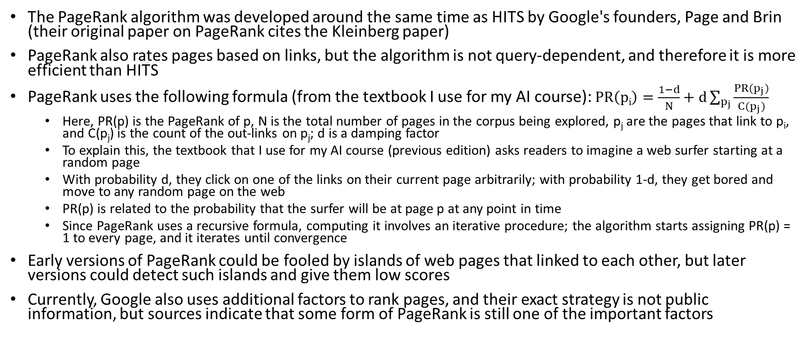
PageRank
The PageRank algorithm was developed around the same time as HITS by Google's founders, Page and Brin (their original paper on PageRank cites the Kleinberg paper)
PageRank also rates pages based on links, but the algorithm is not query-dependent, and therefore it is more efficient than HITS
PageRank uses the following formula (from the textbook I use for my AI course): $PR\left(pi\right)=\frac{1−d}{N}+d\sum_{p_{j}}{\frac{PR(p_{j})}{C(p_{j})}}$
  Here, PR(p) is the PageRank of p, N is the total number of pages in the corpus being explored, p_{j} are the pages that link to p_{i}, and C(p_{j}) is the count of the out-links on p_{j}; d is a damping factor
  To explain this, the textbook that I use for my AI course (previous edition) asks readers to imagine a web surfer starting at a random page
  With probability d, they click on one of the links on their current page arbitrarily; with probability 1-d, they get bored and move to any random page on the web
  PR(p) is related to the probability that the surfer will be at page p at any point in time
  Since PageRank uses a recursive formula, computing it involves an iterative procedure; the algorithm starts assigning PR(p) = 1 to every page, and it iterates until convergence
Early versions of PageRank could be fooled by islands of web pages that linked to each other, but later versions could detect such islands and give them low scores
Currently, Google also uses additional factors to rank pages, and their exact strategy is not public information, but sources indicate that some form of PageRank is still one of the important factors

Slide 15
Text Categorization
Text categorization (TC) is the automatic labeling of documents based on text contained in, or associated with, the documents into one or more predefined categories, a.k.a. classes
Some sources use the term text classification to refer to this task; however, text classification is also commonly used in a more general sense to include TC, IR, and sometimes clustering
Some TC tasks assume that the categories are independent, i.e., binary or Boolean
Each document can then be assigned to zero, one, or multiple categories; most of the conventional NLP literature on TC dealt with such categories
Other TC tasks assume mutually exclusive and exhaustive categories; each document is then assigned to exactly one category (the best fit)
If a task involves exactly two mutually exclusive and exhaustive categories (e.g., Indoor vs. Outdoor), you can alternatively view the task as involving one binary category
One special case of TC involves categories that form a hierarchy or taxonomy; a conventional example was the Yahoo! directory of web pages (which eventually became defunct)
Some researchers have found benefit using a ladder approach for this sort of categorization; each individual decision is simpler, but there are more stages at which an error might occur

Slide 16
Applications of Text Categorization
Some (of the many) applications of text categorization include:
  Spam filtering, i.e., the classification of e-mail as spam or not spam (a.k.a. ham)
  Classification of news into topical sections (e.g., Google News, Columbia Newsblaster)
  The classification of websites as pornography or not pornography
  The classification of reviews as positive or negative (a type of sentiment classification, which can also apply to tweets or news reports, and may involve more fine-grained categories)
  The automatic grading of essays (this has been used by ETS for decades)
One interesting early application of text categorization was authorship attribution
  Mosteller and Wallace, statisticians from Harvard University and the University of Chicago, examined a subset of the Federalist Papers
  They published their results in 1964 (some sources say 1963)
  This work was related to an ongoing historical dispute about whether the author of these articles was James Madison or Alexander Hamilton
  They used techniques that were very different than later conventional techniques, involving words such as "of" and "upon" (I'll discuss the approach more in class)
  They definitively concluded that Madison was the author, ending the dispute

Slide 17
Some Machine Learning Terminology
As mentioned in the intro lecture, artificial intelligence (AI) is considered a subfield of computer science
Machine learning (ML) and natural language processing (NLP) are both considered subfields of AI; of course, these two subfields overlap
Casually speaking, when a software system (or other AI agent) learns, that is an example of ML
Generally, parameters of ML models are learned based on a training set
An ML model can be evaluated using a test set
There should be no overlap between the training set and the test set; if there is, this can introduce large inaccuracies and make a model seem much better than it really is
For models that include hyperparameters (we’ll see an example later), a development set (a.k.a. tuning set or validation set) can be used to tune the hyperparameters
Another possibility for setting hyperparameters is to use cross-validation (I'll discuss this in class)
Broadly speaking, two important types of ML that we will encounter in this course are:
  Supervised machine learning involves learning a function that maps inputs to outputs based on a training set that includes labeled examples (we'll discuss this in more detailed on the next slide)
  Unsupervised machine learning involves learning patterns from a training set without labels
  Some modern methods follow unsupervised pretraining with supervised fine-tuning (we will discuss this later in the course)

Slide 18
Supervised Machine Learning for TC
All the TC methods we discuss in this topic are examples of supervised machine learning
  Supervised machine learning approaches learn functions that map inputs to outputs
  If the outputs are discrete and have a finite domain, this is called classification or categorization, and each output can be called a label
  If the outputs have an infinite domain (either discrete or continuous), this is called regression
The input for a categorization task is usually in the form of a vector of features
In conventional (pre-deep-learning) NLP, the features of a text document often represented the distinct terms or words in the vocabulary (so there could be hundreds of thousands of features)
For TC, each input represents a text document (or at least, a document containing text)
According to our textbook (currently in Appendix B), "we have a training set of N documents that have each been hand-labeled with a class: {(d₁, c₁); ….; (d_{N}, c_{N})}"
Here, d_{i} is one document from the training set, each c_{i} is the label (a.k.a. class or category) assigned to d_{i}, and N is the number of training documents
Each label, c, is a member of a set, C, of possible categories/classes (i.e., c ∈ C)
After a TC system is trained, it can be used to predict categories for future documents

Slide 19
Creating Training Sets for TC
As previously mentioned, all the TC approaches we will cover use supervised machine learning techniques; i.e., the training data is in the form of labeled documents
If the categories are independent and binary, you need positive and negative examples for each category
If the categories are mutually exclusive and exhaustive, you need examples of each category
The notation used on the previous slide (from Appendix B) assumes mutually exclusive and exhaustive categories (i.e., there is exactly one label for each document)
One advantage of machine learning (ML) for TC is that it is general; to move to a new set of categories, you only need a new training set
Sometimes it is possible to create or obtain a training set without manually labeling any documents, but often this is not the case; you may need to recruit volunteers to label documents
Creating a proper training set is often the most expensive part of creating a TC system, but resources like Amazon Mechanical Turk can make it simpler
Some issues: How large should the training set be? How should labels be collected? How many volunteers will label each document? What instructions are they given? What level of agreement is required? Etc.
Once a TC system is trained, most text categorization approaches can be applied to new documents one at a time; sometimes this is necessary (e.g., for spam filtering)

Slide 20
Text Normalization for TC
As with IR, you must decide what constitutes a term (i.e., what tokenization and other text normalization strategies to use)
Some related issues that TC shares in common with IR include:
  How to handle punctuation
  Whether or not to make the system case sensitive (not always obvious, since capitalization could indicate a proper noun or the start of a sentence)
  Whether to use stemming (e.g., Porter stemming), lemmatization, or neither
  Whether or not to use a stop list
Most conventional TC approaches that rely on a vector space model normalize document vectors; some also normalize category vectors

Slide 21
Conventional TC Approaches
As with IR, many conventional TC methods rely on a bag-of-words approach to represent documents
Also as with IR, some methods use a vector space model
Some TC tasks rely on alternative, task-specific approaches or representations; for example, authorship attribution typically uses very few words, and essay grading typically considers other features of documents
Most conventional TC systems used single words (a.k.a. unigrams) as terms; larger N-grams (referring to sequences of N consecutive terms or words) typically did not improve results
We will briefly discuss N-grams as an excursion when we learn about neural language models
Different weighting schemes are possible for vector space models; for several TC strategies, TF*IDF weights were the most common for conventional TC systems relying on vector space models
We will cover three conventional, supervised machine learning approaches for TC; namely, Rocchio/TF*IDF, k-nearest neighbors, and naïve Bayes; of these approaches, only naïve Bayes is discussed in our textbook
Other conventional approaches that have been applied to TC include decision trees, support vector machines, and conventional (feedforward) neural networks
In modern NLP, deep learning approaches involving word embeddings or subword embeddings are applied to TC, often for tasks involving shorter sequences of text (e.g., tweets and individual sentences)
We will learn about deep learning approaches for TC later in the course

Slide 22
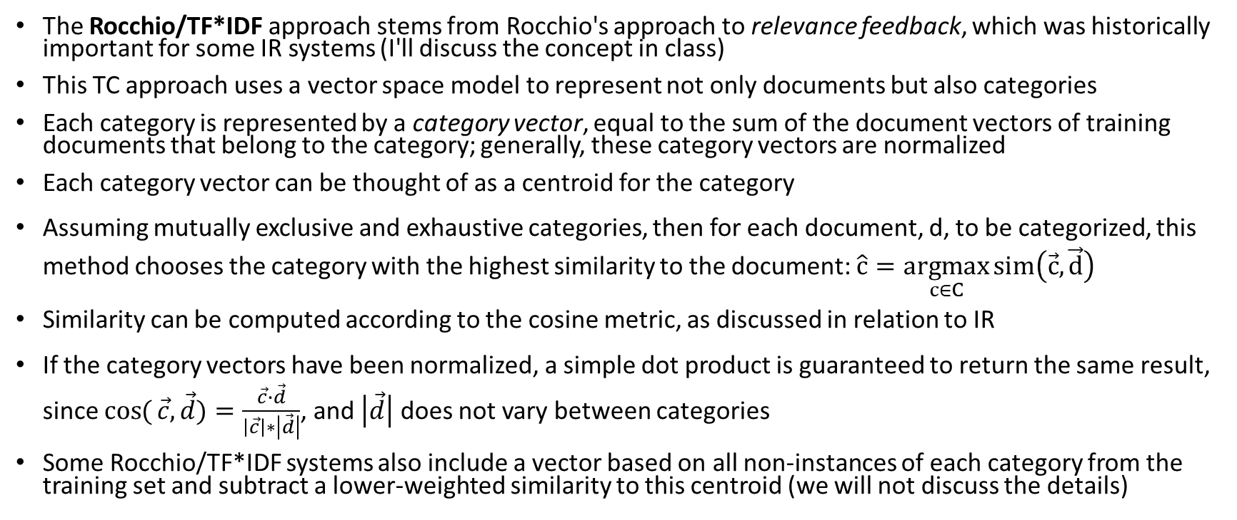
Rocchio/TF*IDF
The Rocchio/TF*IDF approach stems from Rocchio's approach to relevance feedback, which was historically important for some IR systems (I'll discuss the concept in class)
This TC approach uses a vector space model to represent not only documents but also categories
Each category is represented by a category vector, equal to the sum of the document vectors of training documents that belong to the category; generally, these category vectors are normalized
Each category vector can be thought of as a centroid for the category
Assuming mutually exclusive and exhaustive categories, then for each document, d, to be categorized, this method chooses the category with the highest similarity to the document: $\hat{c}=\underset{c∈C}{argmax}{sim\left(\vec{c},\vec{d}\right)}$
Similarity can be computed according to the cosine metric, as discussed in relation to IR
If the category vectors have been normalized, a simple dot product is guaranteed to return the same result, since $\cos{(}\vec{c},\vec{d})=\frac{\vec{c}∙\vec{d}}{\left|\vec{c}\right|∗\left|\vec{d}\right|}$, and $\left|\vec{d}\right|$ does not vary between categories
Some Rocchio/TF*IDF systems also include a vector based on all non-instances of each category from the training set and subtract a lower-weighted similarity to this centroid (we will not discuss the details)

Slide 23
Rocchio/TF*IDF with Binary Categories
The Rocchio method for TC is more complicated when dealing with independent, binary categories than when dealing with mutually exclusive, exhaustive categories
The system needs to convert similarity scores to YES/NO decisions
There are at least three possible methods of doing this:
  The SCUT method calculates an optimal cutoff for each category based on the training data (this could be based on a separate development set, a.k.a. tuning set or validation set)
  The PCUT method computes the percentage of training documents in each category and assigns the same percentage of test documents to category
  Using the PCUT method requires access to the entire test set at once
  A third method (I am not aware of a name for it) creates a second category for each real category consisting of all documents not in category
  This third method then decides, for each category, if the document is more similar to the category vector or to the non-category vector
In my experience, Rocchio/TF*IDF did not work as well for binary categories as for mutually exclusive categories
The Rocchio/TF*IDF method is specifically intended for text categorization; the next two TC approaches we discuss are more general ML approaches for categorization

Slide 24
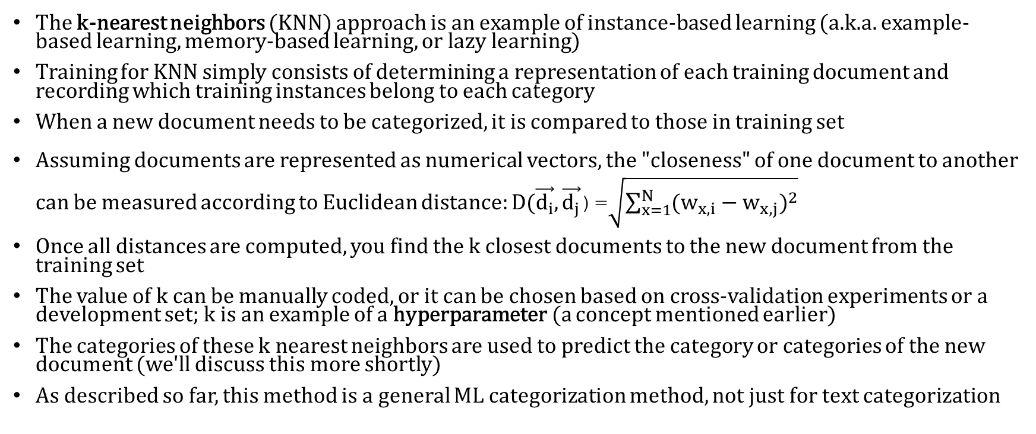
K-Nearest Neighbors
The k-nearest neighbors (KNN) approach is an example of instance-based learning (a.k.a. example-based learning, memory-based learning, or lazy learning)
Training for KNN simply consists of determining a representation of each training document and recording which training instances belong to each category
When a new document needs to be categorized, it is compared to those in training set
Assuming documents are represented as numerical vectors, the "closeness" of one document to another can be measured according to Euclidean distance: $D(\vec{d_{i}}, \vec{d_{j}}$)=$\sqrt{\sum_{x=1}^{N}{{(w_{x,i}−w_{x,j})}^{2}}}$
Once all distances are computed, you find the k closest documents to the new document from the training set
The value of k can be manually coded, or it can be chosen based on cross-validation experiments or a development set; k is an example of a hyperparameter (a concept mentioned earlier)
The categories of these k nearest neighbors are used to predict the category or categories of the new document (we'll discuss this more shortly)
As described so far, this method is a general ML categorization method, not just for text categorization

Slide 25
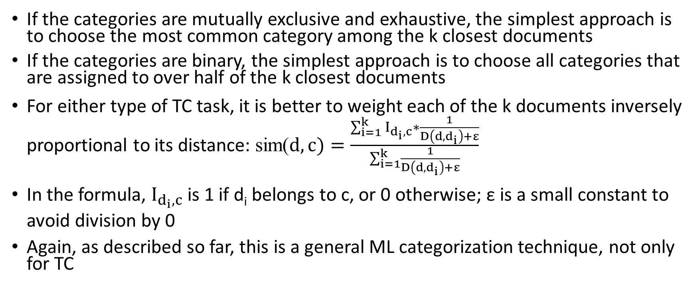
Choosing a Category with KNN
If the categories are mutually exclusive and exhaustive, the simplest approach is to choose the most common category among the k closest documents
If the categories are binary, the simplest approach is to choose all categories that are assigned to over half of the k closest documents
For either type of TC task, it is better to weight each of the k documents inversely proportional to its distance: sim($d,c)=\frac{\sum_{i=1}^{k}{I_{d_{i},c}∗\frac{1}{D\left(d,d_{i}\right)+ε}}}{\sum_{i=1}^{k}{\frac{1}{D\left(d,d_{i}\right)+ε}}}$
In the formula, $I_{d_{i},c}$ is 1 if d_{i} belongs to c, or 0 otherwise; ε is a small constant to avoid division by 0
Again, as described so far, this is a general ML categorization technique, not only for TC

Slide 26
KNN Applied to TC and Efficiency of KNN
The KNN approach has performed very well in the literature for conventional text categorization, although I saw mixed (mostly poor) results in my own work
  For conventional text categorization, the document vectors would often be TF*IDF vectors, as with the Rocchio/TF*IDF approach
  I personally found that it is often better to use similarity (e.g., cosine similarity) instead of distance to find and weight the k-nearest neighbors
  Documents can then be weighted proportional to their TF*IDF similarity instead of inversely proportional to their Euclidean distance
  The literature at the time I was a graduate student mostly used one specific dataset, involving many independent, binary categories, to evaluate TC techniques (we'll talk a bit about this dataset later)
  In my one work, I was dealing with a small number of mutually exclusive, exhaustive categories (you will encounter these during the first programming project)
Efficiency is a major problem with KNN; it is generally considered to be computationally intensive
  Training for KNN is trivial and fast, but conventionally, that was not considered too important, because training only needs to be performed once
  To classify a document, however, it must be compared with every document in the training set, and this was computationally expensive
  To combat this, there have been some efforts to find approximate nearest neighbors more efficiently; this can be significantly faster with only a small decrease in accuracy

Slide 27
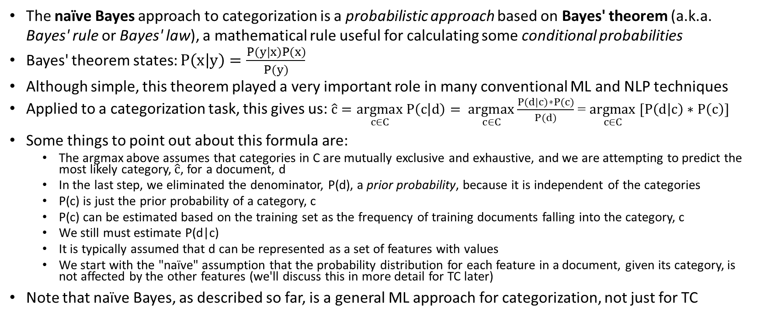
Naïve Bayes
The naïve Bayes approach to categorization is a probabilistic approach based on Bayes' theorem (a.k.a. Bayes' rule or Bayes' law), a mathematical rule useful for calculating some conditional probabilities
Bayes' theorem states: $P\left(x | y\right)=\frac{P(y|x)P(x)}{P(y)}$
Although simple, this theorem played a very important role in many conventional ML and NLP techniques
Applied to a categorization task, this gives us: $\hat{c}=\underset{c∈C}{argmax} P\left(c | d\right)= \underset{c∈C}{argmax}\frac{P(d|c)∗P(c)}{P(d)}$= $\underset{c∈C}{argmax} [P\left(d | c\right)∗P\left(c\right)]$
Some things to point out about this formula are:
  The argmax above assumes that categories in C are mutually exclusive and exhaustive, and we are attempting to predict the most likely category, $\hat{c}$, for a document, d
  In the last step, we eliminated the denominator, P(d), a prior probability, because it is independent of the categories
  P(c) is just the prior probability of a category, c
  P(c) can be estimated based on the training set as the frequency of training documents falling into the category, c
  We still must estimate P(d|c)
  It is typically assumed that d can be represented as a set of features with values
  We start with the "naïve" assumption that the probability distribution for each feature in a document, given its category, is not affected by the other features (we'll discuss this in more detail for TC later)
Note that naïve Bayes, as described so far, is a general ML approach for categorization, not just for TC

Slide 28
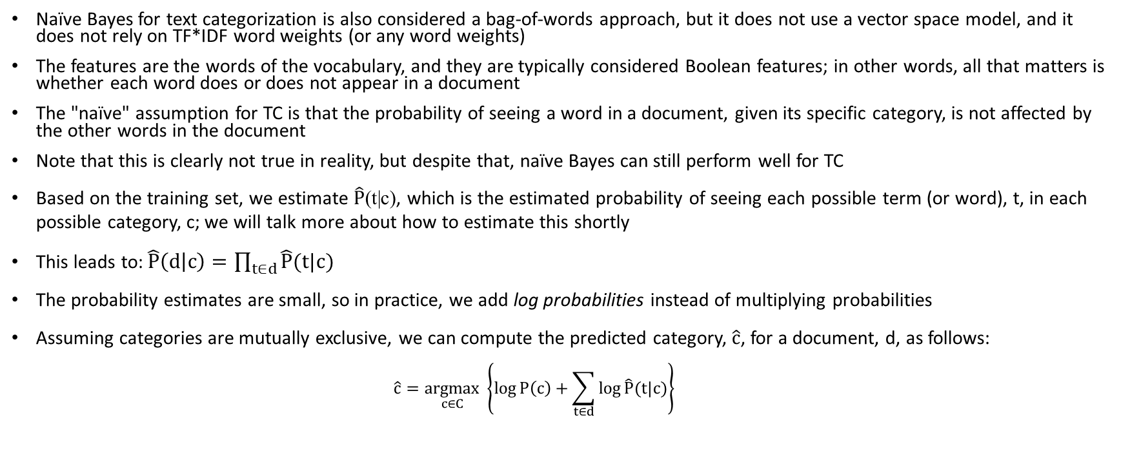
Naïve Bayes Applied to TC
Naïve Bayes for text categorization is also considered a bag-of-words approach, but it does not use a vector space model, and it does not rely on TF*IDF word weights (or any word weights)
The features are the words of the vocabulary, and they are typically considered Boolean features; in other words, all that matters is whether each word does or does not appear in a document
The "naïve" assumption for TC is that the probability of seeing a word in a document, given its specific category, is not affected by the other words in the document
Note that this is clearly not true in reality, but despite that, naïve Bayes can still perform well for TC
Based on the training set, we estimate $\hat{P}$(t|c), which is the estimated probability of seeing each possible term (or word), t, in each possible category, c; we will talk more about how to estimate this shortly
This leads to: $\hat{P}\left(d | c\right)=\prod_{t∈d}{\hat{P}(t|c)}$
The probability estimates are small, so in practice, we add log probabilities instead of multiplying probabilities
Assuming categories are mutually exclusive, we can compute the predicted category, $\hat{c}$, for a document, d, as follows:
  $$\hat{c}=\underset{c∈C}{argmax} \left\{\log{P\left(c\right)+\sum_{t∈d}{\log{\hat{P}(t|c)}}}\right\}$$

Slide 29
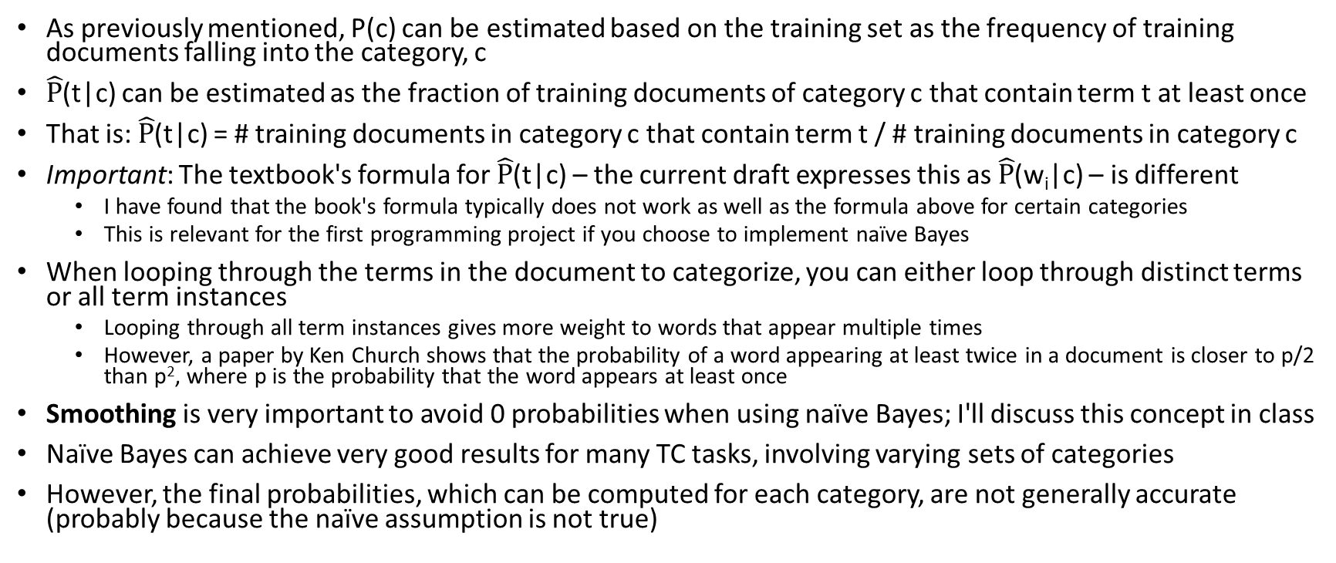
Implementation Details of Naïve Bayes for TC
As previously mentioned, P(c) can be estimated based on the training set as the frequency of training documents falling into the category, c
$\hat{P}$(t|c) can be estimated as the fraction of training documents of category c that contain term t at least once
That is: $\hat{P}$(t|c) = # training documents in category c that contain term t / # training documents in category c
Important: The textbook's formula for $\hat{P}$(t|c) – the current draft expresses this as $\hat{P}$(w_{i}|c) – is different
  I have found that the book's formula typically does not work as well as the formula above for certain categories
  This is relevant for the first programming project if you choose to implement naïve Bayes
When looping through the terms in the document to categorize, you can either loop through distinct terms or all term instances
  Looping through all term instances gives more weight to words that appear multiple times
  However, a paper by Ken Church shows that the probability of a word appearing at least twice in a document is closer to p/2 than p², where p is the probability that the word appears at least once
Smoothing is very important to avoid 0 probabilities when using naïve Bayes; I'll discuss this concept in class
Naïve Bayes can achieve very good results for many TC tasks, involving varying sets of categories
However, the final probabilities, which can be computed for each category, are not generally accurate (probably because the naïve assumption is not true)

Slide 30
Evaluating TC Systems
Evaluating a TC system is generally easier than for IR, partly because there is typically a labeled test set
Overall accuracy is often a reasonable metric for mutually exclusive and exhaustive categories, especially if no single category is dominant, and none are extremely small
However, this metric is not generally reliable for binary categories; most documents generally do not belong to most categories, so a trivial system that says no to everything might appear to do very well
This was true, for example, of the most common conventional TC corpus, the Reuters dataset
  The version I used as a graduate student included 9,603 training documents and 3,299 test documents
  There were 135 "economic subject categories" of varying sizes
Therefore, for many TC tasks, for each category, it is common to measure precision, recall, and a metric called F1 (or the more general F-measure); we'll define these metrics soon
These metrics can be used for categorization in general, not just TC
Consider a confusion matrix (which is a type of contingency table) where rows represent a system's predictions, and the columns represent the actual categorizations of documents
The next slide shows a generic example of such a confusion matrix for a single binary category
We will define each of the metrics mentioned above in relation to such a confusion matrix; formulas are shown on the next slide

Slide 31
TC Evaluation Metrics (per category)
Consider the following confusion matrix for a single binary category:
Based on such a table, we can define the following per-category metrics:
  Overall accuracy = (A + D) / (A + B + C + D); this is the fraction of predictions related to the category that are correct
  Precision = A / (A + B); of the documents that were predicted to belong to this category, this is the fraction of them that actually belong to the category
  Recall = A / (A + C); of the documents in the collection that actually belong to this category, this is the fraction of them that were predicted to belong to the category
  F1 = (2 * Precision * Recall) / (Precision + Recall); this combines precision and recall into a single metric, in between precision and recall, closer to the lower of the two
We can define these metrics similarly for mutually exclusive and exhaustive categories
  The confusion matrix would have a row and a column for each category
  The overall accuracy would then be a system-wide metric; precision, recall and F1 would still be per-category
 | Actual=Yes | Actual=No
Prediction=Yes | A | B
Prediction=No | C | D

Slide 32
TC Evaluation Metrics (per system)
It is often useful to combine category-specific metrics to obtain overall system metrics
This is important when there are multiple binary categories, and it can also be useful to combine category-specific metrics for mutually exclusive and exhaustive categories
Two ways to combine the category-specific metrics are micro-averaging and macro-averaging
To compute the micro-averages for overall accuracy, precision, and recall, you combine all the confusion matrices (for all categories) to obtain global counts for A, B, C, and D
You then apply the formulas from the previous slide to compute the micro-averaged overall accuracy, precision, and recall
The formula for F1 remains the same and is based on the micro-averaged values of precision and recall
To compute macro-averages for overall accuracy, precision, and recall, you average together the values of overall accuracy, precision, or recall for the individual categories
The formula for F1 remains the same and is based on the macro-averaged values of precision and recall
Micro-averaging weights each decision equally; macro-averaging weights each category equally

Slide 33
Publication Bias
In my research, I generally found that different methods performed well for different TC tasks and datasets
This sometimes surprised me, not always matching what I expected, due to publications at the time
Generally speaking, almost every published academic paper that describes a machine learning approach applied to some task (not just TC) reports positive results
The related notion of publication bias may indicate that the literature gives us an exaggerated notion of the goodness of at least some of these methods
The two main reasons for publication bias are:
  Reviewers who review submissions for conferences or journals are more likely to accept those reporting positive results compared to those reporting negative results
  Researchers who obtain positive results are more likely to attempt to publish their work compared to those who obtain negative results
If multiple researchers test the same method applied to some particular task, or a set of related tasks, some may obtain positive results by chance; those that do are much more likely to have their results published
This is not to suggest that anyone is doing something wrong intentionally, or that results were wrong due to an unintentional mistake (although both of these things might happen at times)
Personally, I think publication bias may be a big problem, not only in the field of machine learning, and it isn’t clear what can be done about it

Slide 34
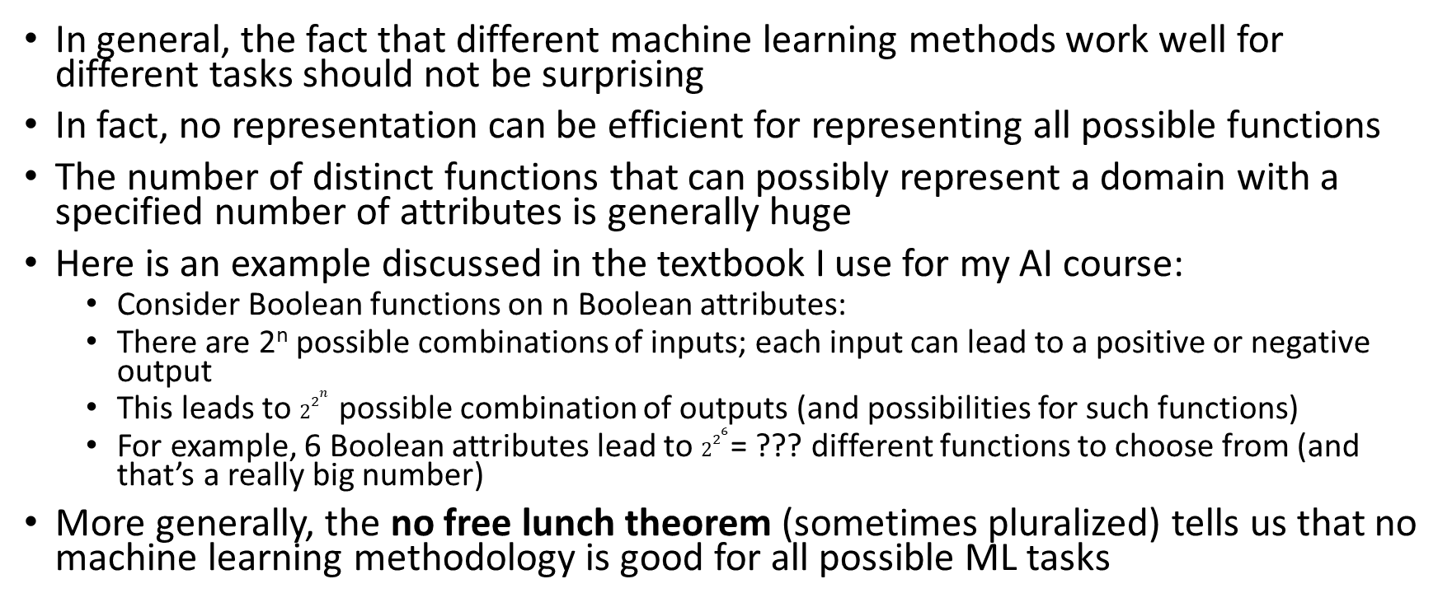
No Free Lunch
In general, the fact that different machine learning methods work well for different tasks should not be surprising
In fact, no representation can be efficient for representing all possible functions
The number of distinct functions that can possibly represent a domain with a specified number of attributes is generally huge
Here is an example discussed in the textbook I use for my AI course:
  Consider Boolean functions on n Boolean attributes:
  There are 2^{n} possible combinations of inputs; each input can lead to a positive or negative output
  This leads to $2^{2^{n}}$ possible combination of outputs (and possibilities for such functions)
  For example, 6 Boolean attributes lead to $2^{2^{6}}$= ??? different functions to choose from (and that’s a really big number)
More generally, the no free lunch theorem (sometimes pluralized) tells us that no machine learning methodology is good for all possible ML tasks

Slide 35
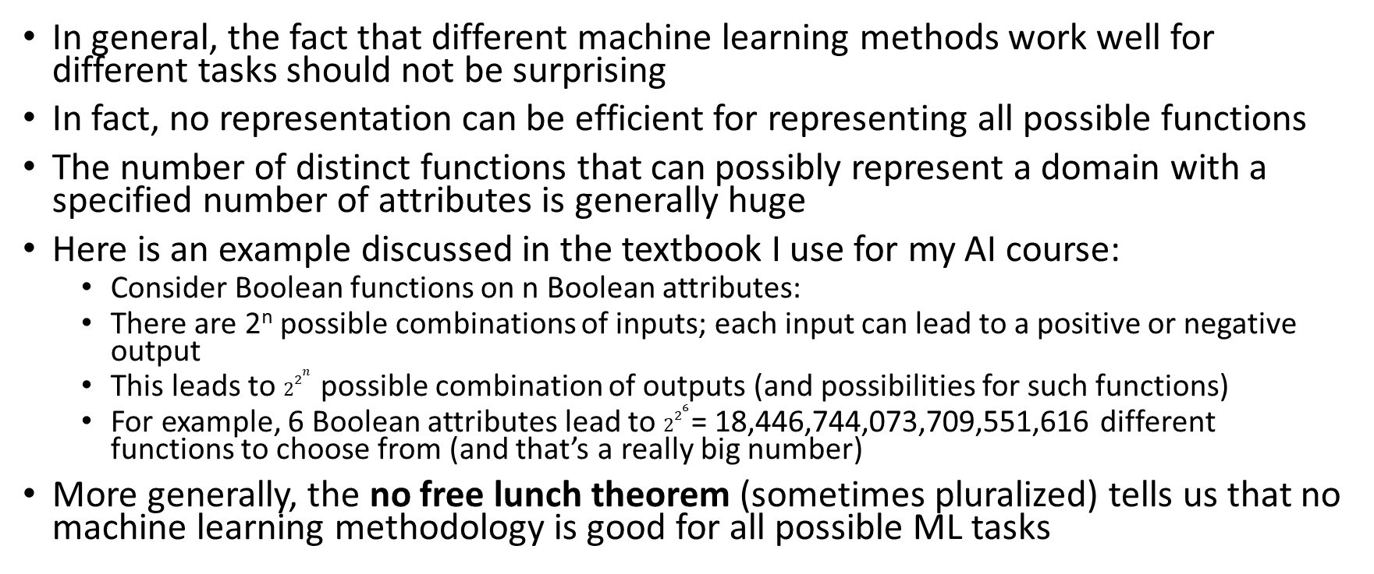
No Free Lunch
In general, the fact that different machine learning methods work well for different tasks should not be surprising
In fact, no representation can be efficient for representing all possible functions
The number of distinct functions that can possibly represent a domain with a specified number of attributes is generally huge
Here is an example discussed in the textbook I use for my AI course:
  Consider Boolean functions on n Boolean attributes:
  There are 2^{n} possible combinations of inputs; each input can lead to a positive or negative output
  This leads to $2^{2^{n}}$ possible combination of outputs (and possibilities for such functions)
  For example, 6 Boolean attributes lead to $2^{2^{6}}$= 18,446,744,073,709,551,616 different functions to choose from (and that’s a really big number)
More generally, the no free lunch theorem (sometimes pluralized) tells us that no machine learning methodology is good for all possible ML tasks

Slide 36
Properties of Categories
There are many factors to consider that can affect which methods perform the best for a particular text categorization task
First, we will consider some properties of the categories (most of these are not specific to TC):
  Are they mutually exclusive and exhaustive or independent, binary categories?
  Are there many categories or few?
  Are the categories general or specific?
  Related to the last question, do the documents within a category vary a lot, or do they tend to be very similar to each other?
  Are they topic-based categories? Are they action oriented? Do they involve sentiment? Are they abstract?
  Are some categories significantly more likely than others (i.e., do some categories contain a relatively high or low percentage of documents)?

Slide 37
Properties of Data
Next, we will consider some properties of the data (again, most of these are not specific to TC):
  Are the documents short or long?
  How big is the training set (i.e., how many documents are in it)?
  Is the training set likely to be very representative of the documents to which the system will be applied later?
  Are the training labels accurate or is there a high degree of error? (This could depend on how the training data is collected)
  Is there any missing data? (This is not generally an issue with TC, but it is an issue that some machine learning methods handle better than others)
  Is there additional metadata (text or otherwise) associated with documents?
Properties of the categories and data may very well affect which ML, or specifically TC, methods perform well for a given task
Especially considering the No Free Lunch theorem, we have no reason to assume that one method will perform the best for all tasks

