Slide 1
ECE264: Data Structures and Algorithms I (DSA 1)
Trees

Slide 2
Trees
Like a linked list, a tree is a collection of nodes
The collection can be empty; otherwise, a tree, T, consists of a root, r, and zero or more nonempty subtrees (T₁, T₂, ..., T_{k})
Each subtree of r has its own root connected by a directed edge (a.k.a. link) from r
Every directed edge in a tree connects a parent node to a child node
Every node has exactly one parent, except the root which has none
In a general tree, nodes can have any number of children
Nodes that share a parent are siblings
Nodes with no children are known as leaves (a.k.a. terminal nodes or external nodes)
Nodes with one or more children are called internal nodes (a.k.a. non-terminal nodes)
The figures on the next two slides (from the textbook) demonstrate two ways to think about trees; it is not clear in the figures, but the edges are directed

Slide 3
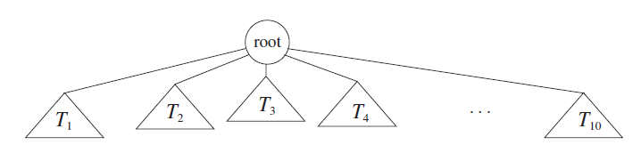
General Tree (depicted with subtrees)

Slide 4
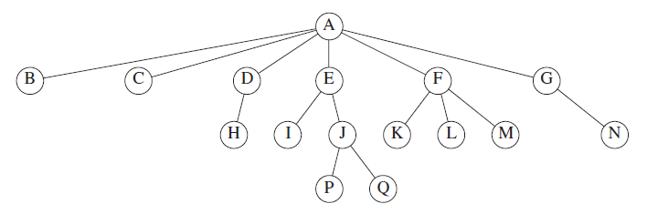
General Tree (depicted with nodes)

Slide 5
More Tree-related Terminology
A path from one node to another is defined as a sequence of nodes connected by directed edges; the length of the path is the number of edges
Technically, we allow a path from a node to itself with length 0
There is always exactly one path from the root to each node in the tree; there will be no undirected cycles
The depth of a node is the length of the unique path from the root to the node
The root is at depth 0
The depth of a tree is the depth of the deepest leaf
The height of a node is the length of the longest path from the node to a leaf
All leaves are at height 0
If there is a path from n₁ to n₂ then n₁ is an ancestor of n₂ and n₂ is a descendant of n₁
If n₁ ≠ n₂ than we can use the terms proper ancestor and proper descendant
A collection of trees is sometimes referred to as a forest

Slide 6
Implementing General Trees
So far, we have been discussing trees as an abstract data type (ADT)
When we implement a tree as a data structure, each node will also be represented as a data structure
In a language such as C++, we would likely implement trees and nodes as classes
One element of each node will generally be the value stored in the node; this might be of some specific type, or it might be kept general if templates are used
Each node will also contain at least one pointer to a child (which could be set to nullptr)
A node in a general tree might store a linked list of pointers to children, but this is not the usual way to implement a general tree
As mentioned earlier, in a general tree, each node is allowed to have any number of children
A common choice is to have each node store a pointer to its left child and its right sibling, so that each node has a fixed size
The figure on the next slide depicts this method of storing a general tree (the same tree we saw before depicted with nodes)
A node in a general tree might also store a pointer to its parent

Slide 7
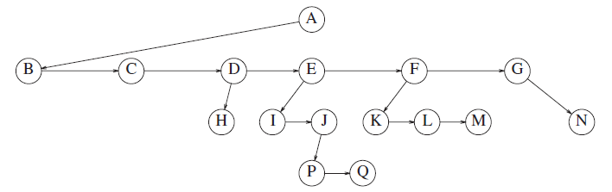
General Tree with Fixed-sized Nodes

Slide 8
Ordering Children
The implementation involving left child pointers and right sibling pointers seems to insinuate that children of a node are ordered in some linear fashion; e.g., from left to right
This is not necessarily intuitive for all trees; in general, a tree is a hierarchical data structure
For example, a tree can be used to represent a file system
  Nodes might represent directories and files
  Children might be ordered according to ASCII, file type, date, etc., but in general, the order of siblings may not matter
A document such as a book could be represented by a tree
  The root represents "book", whose children represent "parts" or "chapters", then "sections", etc.
  In this example, the order of siblings clearly matters
Trees can also be used to represent parsed sentences
  The root represents "sentence", which is broken into phrases, then sub-phrases, etc.
  The leaves would typically represent individual words (although there are other possibilities)
  In this example, once again, the order of siblings clearly matters
  If the rules of the grammar are worked into the tree, then this is an example of a parse tree, a.k.a. an abstract syntax tree
Computer programs can also be represented as parse trees, and some compilers might choose to do so
  The root represents "program", which is broken down into parts and subparts according to the syntax rules of the language
  Once again, the order of siblings clearly matters

Slide 9
Tree Traversal Strategies
Three important traversal strategies for trees are:
  A preorder traversal visits the current node first (e.g., the root) and then the subtrees from left to right (using preorder traversal)
  An inorder traversal visits the left subtree first (using inorder traversal), then the current node, then the remaining subtrees from left to right (using inorder traversal)
  A postorder traversal visits the subtrees first from left to right (using postorder traversal) and then the current node last
  The three traversal strategies mentioned above are typically implemented as recursive routines; recursive pseudo-code for preorder traversal is shown on the next slide
Another important traversal strategy is breadth-first search (BFS)
  This visits the root first, then every node at depth 1 from left to right, then every node at depth 2 from left to right, etc.
  BFS is typically implemented using a queue
Two slides from now, there is an example of each of the four traversal strategies mentioned on this slide, for the sample tree we have been looking at

Slide 10
Preorder Traversal Pseudo-code
PreorderTraversal(Tree T)
if T is empty
return
visit T.root
for each child of T.root from left to right:
PreorderTraversal(child)

Slide 11
Traversal Strategies: Example
Preorder: A, B, C, D, H, E, I, J, P, Q, F, K, L, M, G, N
Inorder: B, A, C, H, D, I, E, P, J, Q, K, F, L, M, N, G
Postorder: B, C, H, D, I, P, Q, J, E, K, L, M, F, N, G, A
Breadth-first search: A, B, C, D, E, F, G, H, I, J, K, L, M, N, P, Q

Slide 12
Applications of Tree Traversals
One use of a preorder traversal might be a program to display, for example, the contents of directories with subdirectories
  Every time you move down into a folder, you increase the number of tabs
  Every time you move back up, you decrease the number of tabs
One use of a postorder traversal might be a program to display the total size of each such directory (including all its subdirectories and files)
An inorder traversal is common for iterating through the nodes in a binary search trees, which we will discuss later in the topic
Other complex traversal strategies are possible, some relying on stacks, queues, and generalized lists
Some of these strategies are used by algorithms discussed in DSA II and AI

Slide 13
Binary Trees
A binary tree is a tree in which no node may have more than two children; i.e., it is possible for a node to have no children, one child, or two children
A proper binary tree, a.k.a. full binary tree, is a binary tree in which each internal node has exactly two children
A complete binary tree is one in which every level is filled, except possibly the bottom level, which gets filled from left to right
The depth of a binary tree with N nodes is often much smaller than N
  According to the book, an analysis shows that the average depth of a binary tree is O(N^{0.5})
  For a special type of binary tree, a binary search tree, the average depth is O(log N)
  In the worst case, the depth of a binary tree can be N-1
The number of nodes at depth d in a binary tree is at most 2^{d}

Slide 14
Implementing Binary Trees
To implement a binary tree, each node typically stores a pointer to the left child (or subtree) and a pointer to the right child (or subtree)
It is thus possible to have a right child but no left child; I consider this to be philosophically different from a general tree
Nodes will also typically store one or more additional values
Some implementations will also store a pointer to the node’s parent
As with linked lists, you generally need to allocate memory when a node is created and to free memory when a node is deleted
Note that in a binary tree, every node occupies a fixed amount of memory, and there is no need for a secondary data structure such as a linked list

Slide 15
Binary Tree Preorder Traversal Pseudo-code
Implementing traversals for binary trees is easier than for general trees; for example, pseudo-code for preorder traversal becomes:
  PreorderTraversal(BinaryTree T)
  if T is empty
  return
  visit T.root
  PreorderTraversal(T.left)
  PreorderTraversal(T.right)
By moving the visit one or two lines down, we can obtain pseudo-code for inorder or postorder traversal, respectively

Slide 16
Expression Trees
An expression tree can represent mathematical expressions
Leaves represent values (including variables), and internal nodes represent operators
Assuming that all operators are binary or unary, the expression tree will be a binary tree
An example of an expression tree is shown on the next slide

Slide 17
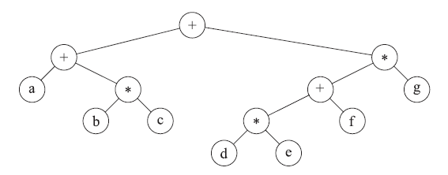
Expression Tree: Example
Consider the expression: (a + b * c) + ((d * e + f) * g)
The corresponding expression tree is:
There is a linear algorithm to convert a postfix expression to an expression tree using a stack (we will not cover this)

Slide 18
Binary Search Tree
One subcategory of binary tree is the binary search tree
One piece of information stored in each node is called a key
There will typically also be one or more other pieces of information stored in each node
Of course, each node will at least contain pointers to its left child and right child (because a binary search tree is a binary tree)
By definition, if X is a node in a binary search tree with key k, then:
  Every node in the left subtree of X has a key with value <= k
  Every node in the right subtree of X has a key with value >= k
The textbook assumes that there will be no duplicate values of keys; we will not make this assumption for regular binary search trees
Although you can place nodes with equal keys in the left or right subtree, it is important to be consistent; we will always move right on equality

Slide 19
Binary Search Tree Implementation
Assuming we are using C++:
  The binary search tree would be implemented as a class
  The possible operations that the data structure supports would be implemented as member functions
  Nodes would likely be implemented as a private nested class
  As with binary trees in general, each node will store a pointer to its left and a pointer to its right child, and often a pointer to its parent
  Each node will also typically contain additional information
The textbook shows code such that each node stores an element of some general type
  This relies on templates
  The type must have the "<" operator defined

Slide 20
Binary Search Tree Operations
Binary search trees at least support insertion and search
Both of those operations will have average-case logarithmic, but worst-case linear, time complexity
Most implementations would also support deletion
Other possible operations include findMin, findMax, getSuccessor, and getPredecessor
All the above operations can be implemented in average-case logarithmic time but worst-case linear time
A binary search tree also lets us iterate through all items in sorted order, based on their keys, in linear time (we will discuss this a bit later)

Slide 21
Binary Search Tree Insertion
To insert a new item in a binary search tree, you start at the root, and walk left or right as appropriate (based on a comparison of keys)
When you reach a nullptr (an empty tree), you insert the new item at the position of the nullptr
Implementations of the insertion operation will typically keep track of the parent of the current position as well as the current position
Recursive implementations are also possible (the textbook shows an example)
The next several slides help to explain how insertion works

Slide 22
Binary Search Tree: Example of Insertion
Inserting integers:
Tree so far:
50, 23, 41, 84, 90, 86, 7, 50, 72,
^
23, 50, 81
50

Slide 23
Binary Search Tree: Example of Insertion
Inserting integers:
Tree so far:
50, 23, 41, 84, 90, 86, 7, 50, 72,
^
23, 50, 81
50
/
23

Slide 24
Binary Search Tree: Example of Insertion
Inserting integers:
Tree so far:
50, 23, 41, 84, 90, 86, 7, 50, 72,
^
23, 50, 81
50
/
23
\
41

Slide 25
Binary Search Tree: Example of Insertion
Inserting integers:
Tree so far:
50, 23, 41, 84, 90, 86, 7, 50, 72,
^
23, 50, 81
50
/ \
23 84
\
41

Slide 26
Binary Search Tree: Example of Insertion
Inserting integers:
Tree so far:
50, 23, 41, 84, 90, 86, 7, 50, 72,
^
23, 50, 81
50
/ \
23 84
\ \
41 90

Slide 27
Binary Search Tree: Example of Insertion
Inserting integers:
Tree so far:
50, 23, 41, 84, 90, 86, 7, 50, 72,
^
23, 50, 81
50
/ \
23 84
\ \
41 90
/
86

Slide 28
Binary Search Tree: Example of Insertion
Inserting integers:
Tree so far:
50, 23, 41, 84, 90, 86, 7, 50, 72,
^
23, 50, 81
50
/ \
23 84
/ \ \
7 41 90
/
86

Slide 29
Binary Search Tree: Example of Insertion
Inserting integers:
Tree so far:
50, 23, 41, 84, 90, 86, 7, 50, 72,
^
23, 50, 81
50
/ \
23 84
/ \ / \
7 41 50 90
/
86

Slide 30
Binary Search Tree: Example of Insertion
Inserting integers:
Tree so far:
50, 23, 41, 84, 90, 86, 7, 50, 72,
^
23, 50, 81
50
/ \
23 84
/ \ / \
7 41 50 90
\ /
72 86

Slide 31
Binary Search Tree: Example of Insertion
Inserting integers:
Tree so far:
50, 23, 41, 84, 90, 86, 7, 50, 72,
23, 50, 81
^
50
/ \
23 84
/ \ / \
7 41 50 90
/ \ /
23 72 86

Slide 32
Binary Search Tree: Example of Insertion
Inserting integers:
Tree so far:
50, 23, 41, 84, 90, 86, 7, 50, 72,
23, 50, 81
^
50
/ \
23 84
/ \ / \
7 41 50 90
/ \ /
23 72 86
/
50

Slide 33
Binary Search Tree: Example of Insertion
Inserting integers:
Tree so far:
50, 23, 41, 84, 90, 86, 7, 50, 72,
23, 50, 81
^
50
/ \
23 84
/ \ / \
7 41 50 90
/ \ /
23 72 86
/ \
50 81

Slide 34
Binary Search Tree: Other Simple Routines
FindMin – Start at the root, and keep moving to the left child until you can’t anymore
FindMax – Start at the root, and keep moving to the right child until you can’t anymore
Search (a.k.a. contains) – To search for an item with a particular key:
  Start at the root
  While the current node’s key does not match the key you are looking for, and the current node is not nullptr:
    If the key you are searching for is less than the current node’s key, move left
    Otherwise, move right
  If the current node is nullptr, the key is not in the tree; otherwise, you found it

Slide 35
getSuccessor and getPredecessor
If you sorted all the nodes by key, the successor of a node is the one that would come right after it, and the predecessor is the one that would come right before it
To explain getSuccessor, consider that the successor of the current node was either inserted after it or before it
If the successor was inserted after the current node, it will be the node with the minimum key in the current node’s right subtree
Therefore, if the current node has a right child, apply findMin to the node’s right subtree
If the successor was inserted before the current node, then the current node will be the maximum node in the successor’s left subtree
Therefore, if the current node has no right subtree, walk up to parents until you take a step from a left-child to a parent
  If this happens, you found the successor
  If this never happens, there is no successor (i.e., the starting node was the max node)
The getPredecessor routine is analogous

Slide 36
Binary Search Tree Deletion
Deletion from a binary search tree is more complicated than insertion
Deleting a leaf is simple (just free the memory and set the appropriate parent’s pointer to nullptr)
Deleting a node with one child is also simple (free the memory and set the appropriate parent’s pointer to the deleted node’s child)
Deleting an internal node with two children has various solutions:
  Solution 1: Replace the node with the minimum node in the deleted node’s right subtree, and then delete the minimum node from the right subtree
  Solution 2: Make the parent node point to the node’s left child, and then insert the right child (keep all its children attached) starting at the left child

Slide 37
Iterating Through Nodes in Sorted Order
A significant benefit of binary search trees is that you can loop through all nodes in sorted order by key in linear time
The way to do this is simply by applying an inorder traversal
We have already seen pseudo-code for a preorder traversal of binary trees
We mentioned that moving the visit one line down would change this to an inorder traversal
One way to implement an average-case O(N log N) sort is by inserting all values into a binary search tree and applying an inorder traversal
  Each of the N insertions takes average-case logarithmic (but worst case linear) time
  The inorder traversal always takes linear time
  This is not a good sorting strategy (other strategies we discussed are empirically faster), but it is still interesting to note that it works

Slide 38
Proving Average-case Logarithmic Operations
Let’s assume insertion of items with distinct keys in random order
There are various ways to prove average-case logarithmic operations
We are going to sketch out a proof that involves the notion of internal path length, which is the sum of the depths of all the nodes in a tree
Some sources define this as the sum of depths of only internal nodes, but those sources define empty nullptr trees to be part of the tree

Slide 39
Internal Path Length Recurrence Relation
Let D(N) be the internal path length for some tree T with N nodes
We know that D(1) = 0 since a tree with one node only includes a root at depth zero
In general, an N-node tree consists of a root at depth 0, an i-node left subtree, and an (N - i - 1)-node right subtree, where 0 ≤ i < N
This leads to the recurrence D(N) = D(i) + D(N - i - 1) + N – 1
  The reason for the N-1 is that the depth of each node in the tree (other than the root) is one more than the depth of the node in the subtree
  That is, the creation of a root that points to two subtrees pushes down, in a sense, each node in both subtrees one additional layer

Slide 40
The (Incomplete) Proof
For a binary search tree (not a general binary tree), the number of nodes in each subtree depends only on the rank of the first inserted element
This means that the average of both D(i) and D(N - i - 1) is (1/N) ∑_{j=0..N-1} D(j)
This then leads to D(N) = (2/N) * ∑_{j=0..N-1} D(j) + N - 1
In chapter 7 of the textbook, a method is covered to solve recurrence relations like these
It can be shown that the solution to this recurrence is D(N) = O(N log N)
Since this is the sum of depth of all nodes in an N-node tree, the expected depth of any node is O(log N)
Other analyses can prove that the average depth of the tree as a whole (if distinct values are inserted in random order) is O(log N)

Slide 41
Balanced Binary Search Trees
Ordinary binary search trees have average-case logarithmic operations but worst-case linear operations
The worst case occurs when items arrive in sorted or reverse-sorted order (as well as various other orderings)
To ensure that all operations are worst-case logarithmic, we need to ensure that trees remain relatively balanced
A binary search tree that ensures balance is a balanced binary search tree

Slide 42
AVL Trees
One type of balanced binary search tree is an AVL tree (named after its inventors, Adelson-Velskii and Landis)
Like the textbook, we will assume that duplicate keys do not occur within an AVL tree
An AVL tree insists that for every node v of an AVL tree T, the heights of the two subtrees of v differ by at most 1
We will define the height of an empty tree to be -1
The figure on the next slide shown an example of an AVL tree, as well as an example of a tree that is not a valid AVL tree

Slide 43
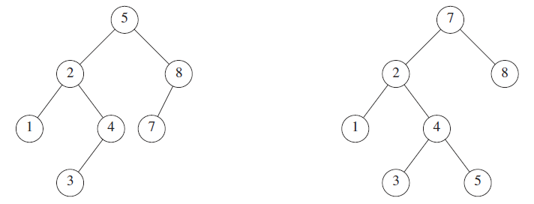
AVL Tree Example (one valid, one not)
X

Slide 44
AVL Trees: Proving Logarithmic Operations
For AVL trees to be useful, we must show two things:
  Operations on an AVL tree are logarithmic, given that the new constraint is maintained
  We can maintain the new constraint efficiently
We can show the first thing, for major operations other than insert, as follows:
  Let n(h) be the minimum number of nodes required to exist in an AVL tree of height h
  Clearly, n(0) = 1 and n(1) = 2
  For h ≥ 2, n(h) = n(h - 1) + n(h - 2) + 1; for example, the fewest nodes in an AVL tree with height 9 consists of one AVL subtree with height 7 and another with height 8
  This is related closely to the Fibonacci sequence, and it is clearly an exponential function
  It can be shown that n(h) ≥ 2^{(h/2 - 1)}; taking the log (assuming base 2) of each side leads to: log n(h) ≥ h/2 – 1; therefore: h ≤ 2 log n(h) + 2
  This implies than an AVL tree storing n keys has a height at most 2 log n + 2
  So, it should be clear that most of the operations applied to an AVL tree (e.g., search, findMin, getSuccessor, etc.) are worst-case logarithmic

Slide 45
AVL Trees: Overview of Insertion
Insertions into AVL trees are more complicated than for regular binary search trees
We must guarantee that the constraint (requiring the heights of subtrees of each node differ by at most one) is maintained and that the insertion is worst-case logarithmic
An insertion into an AVL tree starts off with a normal insertion into a binary search tree (which, of course, is logarithmic, since the tree is balanced before the insertion)
This, however, might upset the AVL balance condition of certain nodes, and therefore the tree as a whole
Only nodes on the path from the insertion point to the root might have their balance altered, because only these nodes have their subtrees altered
Therefore, walking from the new node up to the root, and checking for violations, can find the deepest violation of the constraint in logarithmic time
It turns out that by rebalancing the tree at the deepest such node, we can guarantee that the entire tree satisfies the AVL property

Slide 46
AVL Tree Insertions: Four Cases
Let x be the deepest node whose balance needs to be restored
Note that the parent of the inserted node will never have the constraint violated (I will discuss why this is not possible in class)
Therefore, there are four possible cases to consider:
  An insertion into the left subtree of the left child of x caused the imbalance
  An insertion into the right subtree of the left child of x caused the imbalance
  An insertion into the left subtree of the right child of x caused the imbalance
  An insertion into the right subtree of the right child of x caused the imbalance
Cases 1 and 4 are symmetrical, as are cases 2 and 3
It turns out that cases 1 and 4 can be solved with what is called a single rotation
Cases 2 and 3 can be solved with what is called a double rotation
The next six slides help to explain how single and double rotations work (I will discuss each of these in class)
The slide after that discusses a sequence of insertions, starting with an empty AVL tree (I will step through the example in class, but not necessarily all of it, depending on time)

Slide 47
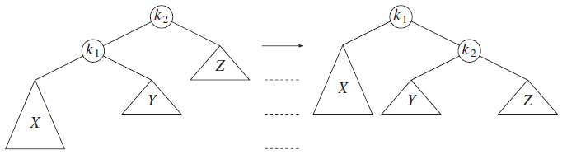
Case 1: Single Rotation

Slide 48
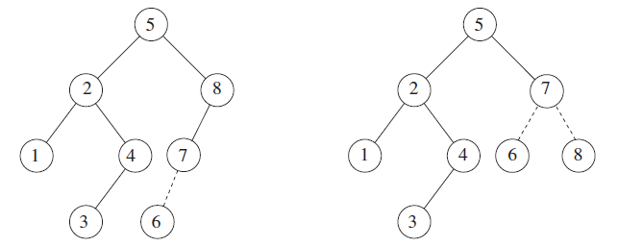
Case 1: Single Rotation Example

Slide 49
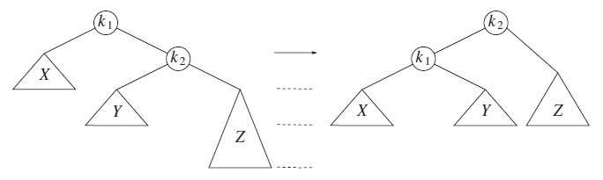
Case 4: Single Rotation

Slide 50
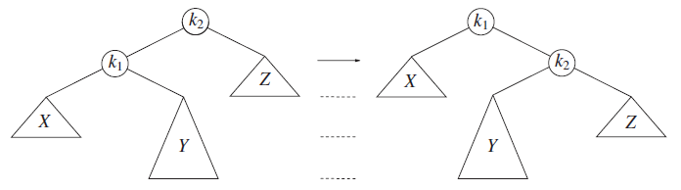
Case 2: Single Rotation Fails

Slide 51
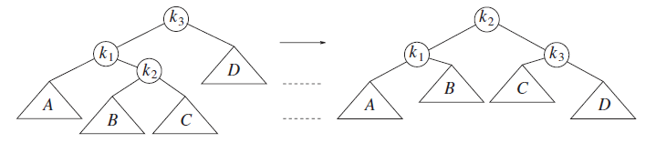
Case 2: Left-Right Double Rotation

Slide 52
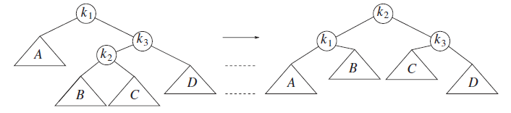
Case 3: Right-Left Double Rotation

Slide 53
AVL Tree Running Example of Insertions
The textbook steps through an example where the integers from 1 to 16 (but not in order) are inserted into an initially empty AVL tree
The order of insertions is: 3, 2, 1, 4, 5, 6, 7, 16, 15, 14, 13, 12, 11, 10, 8, 9
Through 16, each insertion either requires a single rotation, or does not require a rotation at all
For example, after the 7 is inserted, the tree is perfectly balanced, and the insertion of the 16 does not require a rotation
The insertion of the 15 is the first time a double rotation is required (a right-left double rotation, in this case) to fix the imbalance at the 7 node
Then, the insertion of the 14 also requires a right-left double rotation to fix the imbalance at the 6 node
Later, the insertion of the 9 requires a left-right double rotation to fix the imbalance at the 10 node
The insertions of the 6 and of the 13 require single rotations at the root
This example never requires a double rotation to fix an imbalance at the root, but of course, that is sometimes necessary in general
The final AVL tree after this sequence of insertions, starting with an empty AVL tree, is shown on the next slide

Slide 54
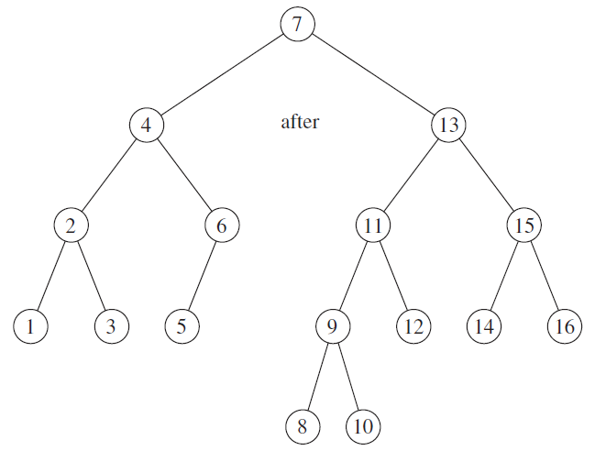
AVL Tree Running Example Final Tree

Slide 55
Deletions from AVL Trees
We will not discuss deletion from AVL trees in detail
A few worst-case logarithmic solutions exist
Another possibility is to use lazy deletion; I will briefly discuss this concept in class
In our next topic, we will also discuss lazy deletion in the context of hash tables

Slide 56
AVL Tree Implementations
Implementations of AVL trees can use either recursive or non-recursive functions
The non-recursive versions are arguably harder to get right, but they are faster (empirically, not in terms of big-O)
Height will generally be stored within each node
The book shows code including a recursive insertion routine and some rotation routines
A non-recursive implementation would probably store a pointer to each node’s parent in the node’s data structure

Slide 57
Other Types of Balanced Binary Search Trees
Other types of balanced binary search trees include splay trees and red-black trees; we will not cover the details of either, just some basic facts
Some facts about splay trees:
  A splay tree is a balanced binary search tree that guarantees that M consecutive basic operations, starting from an empty tree, take at most O(M log N) total time
  When a sequence of M operations has a total worst-case running time of O(M * F(N)), we say that the amortized running time is O(F(N))
  This can be thought of as a worst-case guarantee for a sequence of operations; I like to think of it as a guaranteed average (so it is better than the standard meaning of average case)
Some facts about red-black trees
  A red-black tree is a balanced binary search tree with the following coloring properties:
    Every node is colored either black or red
    The root is black
    If a node is red, its children must be black
    Every path from a node to a nullptr must contain the same number of black nodes
  Red-black trees are usually faster than AVL trees in practice (empirically, not in terms of big-O)

Slide 58
B+ Trees
A B+ tree of order M is a tree (not a binary tree) with the following properties:
  The root is either a leaf or has between 2 and M children (inclusively)
  All non-leaf nodes (except the root) have between M/2 (rounded up) and M children (inclusively)
  All leaves are at the same depth
  All data are stored at the leaves; there is a limit as to how many data items can be stored in each leaf (generally M, which is what we will assume, although this is not always the case)
  Each data item has a key
Note that the textbook calls this data structure a B-tree, but this is inconsistent with other sources; a B-tree is actually a different balanced tree data structure
The internal nodes of a B+ tree store M pointers p₁, p₂, ..., p_{M} to children (that might be nullptr) and values k₁, k₂, ..., k_{M-1} representing the smallest key found in each subtree T₂, T₃, ..., T_{M}
The values corresponding to nullptr pointers are undefined; otherwise, for every node, all the keys stored in T_{i} are less than all the keys in T_{i+1}
Most implementations link consecutive leaf nodes together, making range queries more efficient
The figure on the next slide shown an example of a B+ tree of order 5

Slide 59
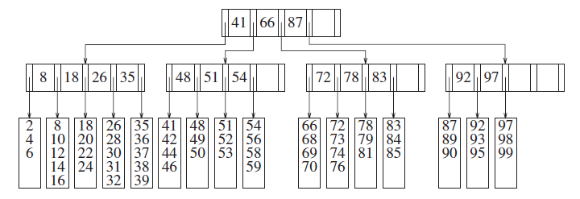
B+ Tree of Order 5 Example

Slide 60
Insertion into B+ Trees
The first thing insertion does is it uses the information in internal nodes (starting at the root) to find the appropriate leaf node
When possible, newly inserted data gets added to the appropriate leaf node
When newly inserted data cannot fit into a leaf node, the leaf node splits
Sometimes a split leaf nodes requires its parent node to also split
This can continue upwards, possibly splitting the root, which requires the creation of a new root; this is the only way that a B+ tree gains height
The next three slides show examples of insertions into a B+ tree
The textbook also discusses methods of deletion from B+ trees, but we will not discuss this

Slide 61
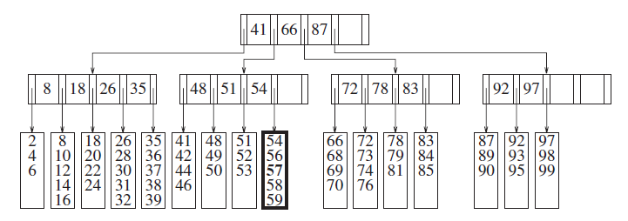
B+ Tree of Order 5 Example (insert 57)

Slide 62
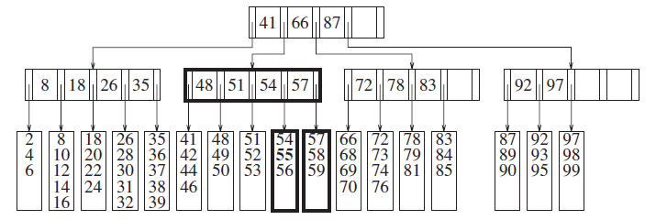
B+ Tree of Order 5 Example (insert 55)

Slide 63
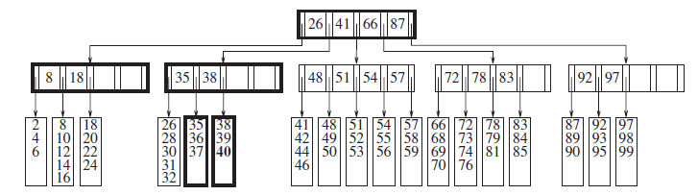
B+ Tree of Order 5 Example (insert 40)

Slide 64
B+ Trees in Practice
B+ trees are important data structures for database management systems (DBMSs)
Along with B-trees and hash tables, B+ trees are one of the common data structures for storing indexes in a DBMS
DBMSs are likely to be store data, including indexes, in external memory (e.g., hard drives or tapes) as opposed to main memory
The order of the B+ tree, M, is chosen so that each internal node can fit into one page of external memory
These days, M is often 100 or more
Accessing a disk is typically several orders of magnitude slower than any main memory operation
This is a real-world case in which big-O is not the most important concern
The O(log_{M}N) disk accesses to retrieve pages is more efficient than what a binary search tree would require
The O(M) computing time required at each node to determine the branch direction, and the O(M) computing time required for updates at a node, is not as significant

Slide 65
Provided C++ Classes
At the end of Chapter 4, the book describes two provided C++ classes, "set" and "map", which guarantee worst case logarithmic insertion, deletion, and searching
A C++ "set" or "map" is an ordered container that does not allow duplicates, whereas a C++ "unordered_set" or "unordered_map" (both added to C++11) is an unordered container that does not allow duplicates
The "set" and "map" classes support the ability to efficiently insert, remove, and search for items based on their keys
These classes also provides iterators, which iterate through items in sorted order based on their keys
We have already discussed the C++ "map" class during our C++ overview, which allows the mapping of an item of one type (the key) to an item of another type (the value)
In any map, the keys must all be distinct, but values can repeat
The C++ "set" and "map" classes are typically implemented with balanced binary search trees; this provides the required logarithmic insertion, deletion, and search capabilities, as well as supporting efficient iteration
The C++ "unordered_set" and "unordered_map" classes (added to C++11) use a hash table implementation
We will learn that hash tables provide faster average-case insertion, search, and (usually) deletion capabilities than balanced binary search trees, but they do not support efficient iteration
We will cover hash tables as our final topic of this course

