Slide 1
ECE264: Data Structures and Algorithms I (DSA 1)
Lists, Stacks, and Queues

Slide 2
Lists, Stacks, and Queues are Important
Lists, Stacks, and Queues are simple but extremely important data types (we will expand on the meaning of this term shortly)
A particular stack called "the stack" (a.k.a. the run-time stack or the call stack) is implicitly used every time a function or member function is called
This occurs in just about every program you will ever implement
We will discuss the call stack in detail near the end of the topic
More generally, many important algorithms rely on lists, stacks, and/or queues
It is also the case that more advanced data structures rely on lists, stacks, and/or queues for specific operations

Slide 3
Abstract Data Type
The book describes an abstract data type (ADT) as "a set of objects together with a set of operations", and says they are "mathematical abstractions"
The ADT specifies the domain of values that a data type can store, and the interface of a data type that must be implemented, but not how it should be implemented
To implement a data type using language-specific code, you create data structures
If a data type is implemented well, the data structure can be used for many different purposes by multiple programmers writing different programs
This is especially true in a language like C++, which allows object-oriented programming (involving classes) and generic programming (involving templates)
If information hiding is used appropriately, it should also be possible to modify the implementation without breaking code that uses it
We will often talk about data types (a more general term) as ADTs first, and then talk about one or more ways to implement them with data structures
Most modern computer languages provide implementations of some basic data types and rules that allow a programmer to create user-defined data types

Slide 4
The List ADT
The list ADT is used to represent a sequence of zero or more elements of a specified type
Often, we will represent a list as a sequence of elements separated by commas; using the textbook's convention, we label the elements: A₀, A₁, ..., A_{N-1}
The size of the list is N; if N is zero, we say we are dealing with an empty list
Otherwise, A₀ is the first element of the list and A_{N-1} is the last element of the list
We will say that each element A_{i} is at position i in the list
We will say that A_{i} precedes A_{i+1} (if both elements exist), and that A_{i+1} follows, or succeeds, A_{i} (if both elements exist)
The predecessor of A₀ and the successor of A_{N-1} are typically not defined
In some texts, you sometimes see something like END(L) which represents an abstract successor to the last element of a list L
The provided C++ list classes implements a similar concept (as we have seen when we briefly covered iterators)

Slide 5
List ADT Operations
Operations that might be part of a list ADT include:
  insert – insert a new element into the list
  delete – remove an element from the list
  findKth – provide access to the k^{th} element in the list
  find – find an element with a specified value
  next – move to the next element
  previous – move to the previous element
  printList – display the elements of the list
We will typically assume that insert and delete are provided access to the item before the one to be inserted or deleted
The implementer of the data type (i.e., the programmer) must decide what to do when special cases occur, e.g., if you call findKth with a k that is larger than the size of the list
Note that we have not specified the type of each element
At times, we’ll assume for simplicity that we are dealing with lists of integers, but the concepts we discuss apply to general lists

Slide 6
Array-based Lists
According to the textbook, the list ADT along with all its functions/operations mentioned so far "can be implemented just by using an array"
This is not exactly true; we need an array plus at least one additional component, e.g., a variable storing the current size of the list (which is different than its current capacity)
When implementing an array-based list using object-oriented programming, the array, the size, and the capacity would likely be combined into a single object
Historically, array-based implementations of lists were often fixed-sized, so they required an estimate of the maximum size of the list ahead of time
With the provided "vector" class in C++, this estimate is no longer necessary; the capacity of the array-based list can grow when necessary
Other modern programming languages provide similar classes
Note that resizing a vector (or other dynamically allocated array) is a relatively expensive operation, and the programmer should make sure that this does not happen often
For example, it may be a good idea to double the capacity whenever growth is necessary

Slide 7
Properties of Array-based Lists
An array-based implementation of a list allows printList and find to be carried out in linear time, and this is as good as can be expected
The findKth operation takes constant time, which is very good
Unfortunately, the insert and delete operations are expensive (linear)
  For example, inserting a new first element or deleting the first element requires shifting every other element
  The worst-case running time for these operations is Θ(N)
  On average, half of the list needs to be moved for either operation, still requiring linear time; i.e., the average-case running time for these operation is also Θ(N)
  Building a list by executing N successive inserts (not at the end) can require quadratic time
I add: Despite this, be aware that according to Stroustrup (the creator of C++), vectors are usually the appropriate data structure to store a list

Slide 8
Linked Lists
If we want to avoid linear costs for insertion and deletion, we need to avoid storing the elements of the list contiguously in memory
This brings us to linked lists; a linked list consists of a sequence of nodes (a.k.a. cells)
Each node contains one element and a link (often implemented as a pointer) to a node containing its successor; this link field is often called "next"
According to the textbook, "the last cell's next link points to nullptr"
I would personally say that the last cell's next link, or next pointer, "is null" or "is nullptr" (or "is set to the value of nullptr"), but I have seen sourced describe this both ways
Remember that a pointer is just a variable whose value is a memory address
Typically, drawings of linked lists represent each node as a rectangle and represent the links as arrows that point from one node to another (I will draw examples during class)
Really, the next links are just pointers that store the memory addresses of the start of the next node
The textbook uses a ground symbol for the nullptr pointer at the end of the linked list, but that is unusual
I just write "null", or something similar, or use a symbol such as empty set or an X, for the final link

Slide 9
Properties of Linked Lists
When a linked list is used to implement a list ADT, insertions and deletions can be constant-time routines
  This is more efficient than an array-based list, which requires linear insertions and deletions
  Recall that we are assuming the insert or deletion operation starts with access to the item before the one to be inserted or deleted; without this assumption, we cannot achieve constant-time insertion and deletion
  Inserting a new value requires the program to dynamically allocate a new node and to manipulate a couple of pointers
  Deleting a value requires the program to free the memory associated with the value’s node and to manipulate one pointer
  I will explain the insertion and deletion operations for linked lists with drawings during class
Unfortunately, the findKth routine is now a linear routine; findKth(i) now takes Θ(i) time
  This is less efficient than an array-based list, which allows constant-time findKth
  A program that would rely on a series of calls to this routine with increasing values of i could take quadratic time, although it is possible to traverse all nodes in linear time
Note that all nodes in a linked list are dynamically allocated; although dynamically allocated memory is a constant time operation, it is a relatively slow constant time operation
We will learn more about what happens when memory is dynamically allocated later in this topic

Slide 10
Variations of Linked Lists
A linked list as we have described it so far, where each node contains only one pointer, is sometimes referred to as a singly linked list
One possible extension is a doubly linked list
Every node contains two pointers; one points to the next node, and one points to the previous node (I'll show example drawings during class)
The final node’s next pointer is null (as with a singly linked list), and the first node’s previous pointer (sometimes called "prev") is also null
With a singly linked list, you need the pointer to the previous node to perform insertion or deletion
With a doubly linked list, you can insert a node to the left or right, and you can delete the node to which the provided pointer points
Other variations of linked lists include a circular linked list (the last node’s next pointer points to the first node) and a circular doubly linked list

Slide 11
The Textbook’s List Class and Vector Classes
Our textbook shows an implementation of a "List" class, which mimics the provided "list" class in C++ and implements a doubly linked list (not circular)
The book's implementation includes a header node and a tail node, also known as sentinel nodes or dummy nodes, which represent markers and do not contain real data
The inclusion of these two extra nodes simplifies the implementation of several member functions, especially those involving iterators
Three private fields of the book's "List" class store an integer to keep track of the current size of the list and two pointers that point to the header and tail nodes of the list
The book also shows code for a "Vector" class that mimics the provided "vector" class
The private fields of the book's "Vector" class include two integers to store the array list's current size and capacity, and a pointer to the dynamically allocated array of objects
Both the "Vector" class and the "List" class are implemented using templates for generic programming
I recommend that students examine our textbook's implementations of their "List" and "Vector" classes
There are some C++ concepts not covered in our overview that you need to be aware of to fully understand these, including nested classes (both public and private), implementations of iterators, destructors, etc.

Slide 12
Stacks and Queues
Both stacks and queues can be thought of as types of lists
For stacks, we can insert to, or delete from, one end of the list (called the top)
For queues, we insert to one end (the back, or rear) and delete from the other end (the front)
For stacks, the insertion operation is typically called push and the deletion operation is typically called pop
For queues, the insertion operation is typically called enqueue and the deletion operation is typically called dequeue
When I first learned about queues, however, I learned that inserts and deletions were called push and pop, respectively (the same as for a stack)
I will often use these terms for both stacks and queues
I like to think of a stack as a closed bucket and a queue as an open pipe (I'll explain this in class)

Slide 13
Stacks
Stacks are sometimes called last-in, first out (LIFO) lists
In addition to push and pop, other operations might include top, isEmpty, makeEmpty, size, etc.
The top operation returns the top element but does not remove it
Note: Our textbook defines the pop operation to remove the top element but not to return it; this is not standard
Our convention (and the common convention): pop both removes, and returns, the top element of the stack

Slide 14
Array-based stacks
Array-based stacks (including vector-based stacks) are very fast in practice
A standard array does not allow resizing
A vector-based stack allows the stack to be resized when full; this requires a linear push when that happens, but it should be very rare
Example of a line of code that might be part of a push routine:
  theArray[++topOfStack] = x;
With an object-oriented implementation, "theArray" and "topOfStack" would be private data members
The "topOfStack" data member would be -1 for an empty stack, and would otherwise represent the position of the top element

Slide 15
Linked-list-based stacks
With a linked-list-based stacks, a push can insert a node at the start of the linked list, and a pop can delete the first node of the linked list
Linked-list-based stacks are slower (in terms of actual time) on average than array-based stacks
Pushes require dynamic memory allocation (e.g., using "new")
Pops require freeing of memory (e.g., using "delete")
However, all pushes and pops will be constant-time operations, whereas an array-based stack will occasionally require a linear push

Slide 16
Options for Error Handling
When implementing a stack class (or really, any general data structure), you need to decide how you are going to handle errors
Errors for a stack class include, for example, popping form an empty stack, or failing to allocate additional memory when needed
Options for handling errors include:
  Returning error values; however, this can be tricky if you are implementing the class in a general way, especially if you are supporting multiple types with generics
  Displaying error messages; however, general classes should not typically do this
  Exiting the program; however, this seems a bit harsh
  Throwing exceptions; this is the most flexible option

Slide 17
Checking if Left/Right Symbols are Balanced
One example application of a stack is to check if left and right symbols are balanced, assuming typical nesting rules
For example, consider sequences containing parenthesis, brackets, and curly braces (any other symbols could be ignored)
An example of a valid sequence is: ({[]()}[])
An example of a non-valid sequence is: [(])
Counter-example: In HTML, this is valid:
  <b> Hello <i> World </b> Goodbye </i>
The pseudo-code that we will examine (on the next slide) is θ(N), where N is the number of characters in the input sequence
There is one linear loop and everything else is constant
I will step through examples of processing a valid and invalid sequence in class

Slide 18
Checking Balanced Expressions Pseudo-code
CheckExpression (String Exp)
s ← empty stack
for each character, c, in Exp
if c is not a left or right marker, ignore it
else if c is a left marker, push c onto s
else if c is a right marker
if s is empty, error
else
pop top symbol, x, from s
if x is not a left marker matching c, error
if s is empty, left and right markers are balanced
else error

Slide 19
Dealing with Postfix Notation
Three notations for representing mathematical expressions include:
  Infix notation places binary operators in between their operands (this is the notation we typically use for mathematical expressions)
  Prefix notation, a.k.a. Polish notation, places binary operators before their operands
  Postfix notation, a.k.a. reverse Polish notation, places binary operators after their operands
Example:
  Infix expression: a + b * c + (d * e + f) * g
  Equivalent postfix expression: a b c * + d e * f + g * +
One advantage of prefix and postfix notations over infix notation is that they don’t require parentheses
There is a simple linear algorithm involving a stack to evaluate postfix expressions
My pseudo-code for the algorithm is shown on the next slide; further slides step through an example
There is also a simple linear algorithm involving a stack to convert an infix expression to postfix; we won't cover it, but putting the two together, we can evaluate infix expressions in linear time

Slide 20
Evaluating Postfix Expressions Pseudo-code
EvaulatePostfix (Expression E)
s ← empty stack
for each symbol, x, in E
if x is a value
push x onto s
else if x is a binary operator
if s contains less than two elements, error
else
pop operand2 from s
pop operand1 from s
apply operator x to operand1 and operand2
push result onto s
if s has more than one item, error
pop and return value on s (this is the result)

Slide 21
Evaluating Postfix Example
a b c * + d e * f + g * +
operand1:
operand2:
result:
Stack:
EvaulatePostfix (Expression E)
=> s ← empty stack
for each symbol, x, in E
if x is a value
push x onto s
else if x is a binary operator
if s contains less than two elements, error
else
pop operand2 from s
pop operand1 from s
apply operator x to operand1 and operand2
push result onto s
if s has more than one item, error
pop and return value on s (this is the result)

Slide 22
Evaluating Postfix Example (cont.)
a b c * + d e * f + g * +
^
operand1:
operand2:
result:
Stack:
EvaulatePostfix (Expression E)
s ← empty stack
=> for each symbol, x, in E
if x is a value
push x onto s
else if x is a binary operator
if s contains less than two elements, error
else
pop operand2 from s
pop operand1 from s
apply operator x to operand1 and operand2
push result onto s
if s has more than one item, error
pop and return value on s (this is the result)

Slide 23
Evaluating Postfix Example (cont.)
a b c * + d e * f + g * +
^
operand1:
operand2:
result:
Stack:
EvaulatePostfix (Expression E)
s ← empty stack
for each symbol, x, in E
=> if x is a value
push x onto s
else if x is a binary operator
if s contains less than two elements, error
else
pop operand2 from s
pop operand1 from s
apply operator x to operand1 and operand2
push result onto s
if s has more than one item, error
pop and return value on s (this is the result)

Slide 24
Evaluating Postfix Example (cont.)
a b c * + d e * f + g * +
^
operand1:
operand2:
result:
Stack:
a
EvaulatePostfix (Expression E)
s ← empty stack
for each symbol, x, in E
if x is a value
=> push x onto s
else if x is a binary operator
if s contains less than two elements, error
else
pop operand2 from s
pop operand1 from s
apply operator x to operand1 and operand2
push result onto s
if s has more than one item, error
pop and return value on s (this is the result)

Slide 25
Evaluating Postfix Example (cont.)
a b c * + d e * f + g * +
^
operand1:
operand2:
result:
Stack:
a
EvaulatePostfix (Expression E)
s ← empty stack
=> for each symbol, x, in E
if x is a value
push x onto s
else if x is a binary operator
if s contains less than two elements, error
else
pop operand2 from s
pop operand1 from s
apply operator x to operand1 and operand2
push result onto s
if s has more than one item, error
pop and return value on s (this is the result)

Slide 26
Evaluating Postfix Example (cont.)
a b c * + d e * f + g * +
^
operand1:
operand2:
result:
Stack:
a
EvaulatePostfix (Expression E)
s ← empty stack
for each symbol, x, in E
=> if x is a value
push x onto s
else if x is a binary operator
if s contains less than two elements, error
else
pop operand2 from s
pop operand1 from s
apply operator x to operand1 and operand2
push result onto s
if s has more than one item, error
pop and return value on s (this is the result)

Slide 27
Evaluating Postfix Example (cont.)
a b c * + d e * f + g * +
^
operand1:
operand2:
result:
Stack:
b
a
EvaulatePostfix (Expression E)
s ← empty stack
for each symbol, x, in E
if x is a value
=> push x onto s
else if x is a binary operator
if s contains less than two elements, error
else
pop operand2 from s
pop operand1 from s
apply operator x to operand1 and operand2
push result onto s
if s has more than one item, error
pop and return value on s (this is the result)

Slide 28
Evaluating Postfix Example (cont.)
a b c * + d e * f + g * +
^
operand1:
operand2:
result:
Stack:
b
a
EvaulatePostfix (Expression E)
s ← empty stack
=> for each symbol, x, in E
if x is a value
push x onto s
else if x is a binary operator
if s contains less than two elements, error
else
pop operand2 from s
pop operand1 from s
apply operator x to operand1 and operand2
push result onto s
if s has more than one item, error
pop and return value on s (this is the result)

Slide 29
Evaluating Postfix Example (cont.)
a b c * + d e * f + g * +
^
operand1:
operand2:
result:
Stack:
b
a
EvaulatePostfix (Expression E)
s ← empty stack
for each symbol, x, in E
=> if x is a value
push x onto s
else if x is a binary operator
if s contains less than two elements, error
else
pop operand2 from s
pop operand1 from s
apply operator x to operand1 and operand2
push result onto s
if s has more than one item, error
pop and return value on s (this is the result)

Slide 30
Evaluating Postfix Example (cont.)
a b c * + d e * f + g * +
^
operand1:
operand2:
result:
Stack:
c
b
a
EvaulatePostfix (Expression E)
s ← empty stack
for each symbol, x, in E
if x is a value
=> push x onto s
else if x is a binary operator
if s contains less than two elements, error
else
pop operand2 from s
pop operand1 from s
apply operator x to operand1 and operand2
push result onto s
if s has more than one item, error
pop and return value on s (this is the result)

Slide 31
Evaluating Postfix Example (cont.)
a b c * + d e * f + g * +
^
operand1:
operand2:
result:
Stack:
c
b
a
EvaulatePostfix (Expression E)
s ← empty stack
=> for each symbol, x, in E
if x is a value
push x onto s
else if x is a binary operator
if s contains less than two elements, error
else
pop operand2 from s
pop operand1 from s
apply operator x to operand1 and operand2
push result onto s
if s has more than one item, error
pop and return value on s (this is the result)

Slide 32
Evaluating Postfix Example (cont.)
a b c * + d e * f + g * +
^
operand1:
operand2:
result:
Stack:
c
b
a
EvaulatePostfix (Expression E)
s ← empty stack
for each symbol, x, in E
=> if x is a value
push x onto s
else if x is a binary operator
if s contains less than two elements, error
else
pop operand2 from s
pop operand1 from s
apply operator x to operand1 and operand2
push result onto s
if s has more than one item, error
pop and return value on s (this is the result)

Slide 33
Evaluating Postfix Example (cont.)
a b c * + d e * f + g * +
^
operand1:
operand2:
result:
Stack:
c
b
a
EvaulatePostfix (Expression E)
s ← empty stack
for each symbol, x, in E
if x is a value
push x onto s
=> else if x is a binary operator
if s contains less than two elements, error
else
pop operand2 from s
pop operand1 from s
apply operator x to operand1 and operand2
push result onto s
if s has more than one item, error
pop and return value on s (this is the result)

Slide 34
Evaluating Postfix Example (cont.)
a b c * + d e * f + g * +
^
operand1:
operand2:
result:
Stack:
c
b
a
EvaulatePostfix (Expression E)
s ← empty stack
for each symbol, x, in E
if x is a value
push x onto s
else if x is a binary operator
=> if s contains less than two elements, error
else
pop operand2 from s
pop operand1 from s
apply operator x to operand1 and operand2
push result onto s
if s has more than one item, error
pop and return value on s (this is the result)

Slide 35
Evaluating Postfix Example (cont.)
a b c * + d e * f + g * +
^
operand1:
operand2: c
result:
Stack:
b
a
EvaulatePostfix (Expression E)
s ← empty stack
for each symbol, x, in E
if x is a value
push x onto s
else if x is a binary operator
if s contains less than two elements, error
else
=> pop operand2 from s
pop operand1 from s
apply operator x to operand1 and operand2
push result onto s
if s has more than one item, error
pop and return value on s (this is the result)

Slide 36
Evaluating Postfix Example (cont.)
a b c * + d e * f + g * +
^
operand1: b
operand2: c
result:
Stack:
a
EvaulatePostfix (Expression E)
s ← empty stack
for each symbol, x, in E
if x is a value
push x onto s
else if x is a binary operator
if s contains less than two elements, error
else
pop operand2 from s
=> pop operand1 from s
apply operator x to operand1 and operand2
push result onto s
if s has more than one item, error
pop and return value on s (this is the result)

Slide 37
Evaluating Postfix Example (cont.)
a b c * + d e * f + g * +
^
operand1: b
operand2: c
result: b*c
Stack:
a
EvaulatePostfix (Expression E)
s ← empty stack
for each symbol, x, in E
if x is a value
push x onto s
else if x is a binary operator
if s contains less than two elements, error
else
pop operand2 from s
pop operand1 from s
=> apply operator x to operand1 and operand2
push result onto s
if s has more than one item, error
pop and return value on s (this is the result)

Slide 38
Evaluating Postfix Example (cont.)
a b c * + d e * f + g * +
^
operand1: b
operand2: c
result: b*c
Stack:
b*c
a
EvaulatePostfix (Expression E)
s ← empty stack
for each symbol, x, in E
if x is a value
push x onto s
else if x is a binary operator
if s contains less than two elements, error
else
pop operand2 from s
pop operand1 from s
apply operator x to operand1 and operand2
=> push result onto s
if s has more than one item, error
pop and return value on s (this is the result)

Slide 39
Evaluating Postfix Example (cont.)
a b c * + d e * f + g * +
^
operand1:
operand2:
result:
Stack:
b*c
a
EvaulatePostfix (Expression E)
s ← empty stack
=> for each symbol, x, in E
if x is a value
push x onto s
else if x is a binary operator
if s contains less than two elements, error
else
pop operand2 from s
pop operand1 from s
apply operator x to operand1 and operand2
push result onto s
if s has more than one item, error
pop and return value on s (this is the result)

Slide 40
Evaluating Postfix Example (cont.)
a b c * + d e * f + g * +
^
operand1:
operand2:
result:
Stack:
b*c
a
EvaulatePostfix (Expression E)
s ← empty stack
for each symbol, x, in E
=> if x is a value
push x onto s
else if x is a binary operator
if s contains less than two elements, error
else
pop operand2 from s
pop operand1 from s
apply operator x to operand1 and operand2
push result onto s
if s has more than one item, error
pop and return value on s (this is the result)

Slide 41
Evaluating Postfix Example (cont.)
a b c * + d e * f + g * +
^
operand1:
operand2:
result:
Stack:
b*c
a
EvaulatePostfix (Expression E)
s ← empty stack
for each symbol, x, in E
if x is a value
push x onto s
=> else if x is a binary operator
if s contains less than two elements, error
else
pop operand2 from s
pop operand1 from s
apply operator x to operand1 and operand2
push result onto s
if s has more than one item, error
pop and return value on s (this is the result)

Slide 42
Evaluating Postfix Example (cont.)
a b c * + d e * f + g * +
^
operand1:
operand2:
result:
Stack:
b*c
a
EvaulatePostfix (Expression E)
s ← empty stack
for each symbol, x, in E
if x is a value
push x onto s
else if x is a binary operator
=> if s contains less than two elements, error
else
pop operand2 from s
pop operand1 from s
apply operator x to operand1 and operand2
push result onto s
if s has more than one item, error
pop and return value on s (this is the result)

Slide 43
Evaluating Postfix Example (cont.)
a b c * + d e * f + g * +
^
operand1:
operand2: b*c
result:
Stack:
a
EvaulatePostfix (Expression E)
s ← empty stack
for each symbol, x, in E
if x is a value
push x onto s
else if x is a binary operator
if s contains less than two elements, error
else
=> pop operand2 from s
pop operand1 from s
apply operator x to operand1 and operand2
push result onto s
if s has more than one item, error
pop and return value on s (this is the result)

Slide 44
Evaluating Postfix Example (cont.)
a b c * + d e * f + g * +
^
operand1: a
operand2: b*c
result:
Stack:
EvaulatePostfix (Expression E)
s ← empty stack
for each symbol, x, in E
if x is a value
push x onto s
else if x is a binary operator
if s contains less than two elements, error
else
pop operand2 from s
=> pop operand1 from s
apply operator x to operand1 and operand2
push result onto s
if s has more than one item, error
pop and return value on s (this is the result)

Slide 45
Evaluating Postfix Example (cont.)
a b c * + d e * f + g * +
^
operand1: a
operand2: b*c
result: a + b*c
Stack:
EvaulatePostfix (Expression E)
s ← empty stack
for each symbol, x, in E
if x is a value
push x onto s
else if x is a binary operator
if s contains less than two elements, error
else
pop operand2 from s
pop operand1 from s
=> apply operator x to operand1 and operand2
push result onto s
if s has more than one item, error
pop and return value on s (this is the result)

Slide 46
Evaluating Postfix Example (cont.)
a b c * + d e * f + g * +
^
operand1: a
operand2: b*c
result: a + b*c
Stack:
a + b*c
EvaulatePostfix (Expression E)
s ← empty stack
for each symbol, x, in E
if x is a value
push x onto s
else if x is a binary operator
if s contains less than two elements, error
else
pop operand2 from s
pop operand1 from s
apply operator x to operand1 and operand2
=> push result onto s
if s has more than one item, error
pop and return value on s (this is the result)

Slide 47
Evaluating Postfix Example (cont.)
a b c * + d e * f + g * +
^
operand1:
operand2:
result:
Stack:
a + b*c
EvaulatePostfix (Expression E)
s ← empty stack
=> for each symbol, x, in E
if x is a value
push x onto s
else if x is a binary operator
if s contains less than two elements, error
else
pop operand2 from s
pop operand1 from s
apply operator x to operand1 and operand2
push result onto s
if s has more than one item, error
pop and return value on s (this is the result)

Slide 48
Evaluating Postfix Example (cont.)
a b c * + d e * f + g * +
^
operand1:
operand2:
result:
Stack:
a + b*c
EvaulatePostfix (Expression E)
s ← empty stack
for each symbol, x, in E
=> if x is a value
push x onto s
else if x is a binary operator
if s contains less than two elements, error
else
pop operand2 from s
pop operand1 from s
apply operator x to operand1 and operand2
push result onto s
if s has more than one item, error
pop and return value on s (this is the result)

Slide 49
Evaluating Postfix Example (cont.)
a b c * + d e * f + g * +
^
operand1:
operand2:
result:
Stack:
d
a + b*c
EvaulatePostfix (Expression E)
s ← empty stack
for each symbol, x, in E
if x is a value
=> push x onto s
else if x is a binary operator
if s contains less than two elements, error
else
pop operand2 from s
pop operand1 from s
apply operator x to operand1 and operand2
push result onto s
if s has more than one item, error
pop and return value on s (this is the result)

Slide 50
Evaluating Postfix Example (cont.)
a b c * + d e * f + g * +
^
operand1:
operand2:
result:
Stack:
d
a + b*c
EvaulatePostfix (Expression E)
s ← empty stack
=> for each symbol, x, in E
if x is a value
push x onto s
else if x is a binary operator
if s contains less than two elements, error
else
pop operand2 from s
pop operand1 from s
apply operator x to operand1 and operand2
push result onto s
if s has more than one item, error
pop and return value on s (this is the result)

Slide 51
Evaluating Postfix Example (cont.)
a b c * + d e * f + g * +
^
operand1:
operand2:
result:
Stack:
d
a + b*c
EvaulatePostfix (Expression E)
s ← empty stack
for each symbol, x, in E
=> if x is a value
push x onto s
else if x is a binary operator
if s contains less than two elements, error
else
pop operand2 from s
pop operand1 from s
apply operator x to operand1 and operand2
push result onto s
if s has more than one item, error
pop and return value on s (this is the result)

Slide 52
Evaluating Postfix Example (cont.)
a b c * + d e * f + g * +
^
operand1:
operand2:
result:
Stack:
e
d
a + b*c
EvaulatePostfix (Expression E)
s ← empty stack
for each symbol, x, in E
if x is a value
=> push x onto s
else if x is a binary operator
if s contains less than two elements, error
else
pop operand2 from s
pop operand1 from s
apply operator x to operand1 and operand2
push result onto s
if s has more than one item, error
pop and return value on s (this is the result)

Slide 53
Evaluating Postfix Example (cont.)
a b c * + d e * f + g * +
^
operand1:
operand2:
result:
Stack:
e
d
a + b*c
EvaulatePostfix (Expression E)
s ← empty stack
=> for each symbol, x, in E
if x is a value
push x onto s
else if x is a binary operator
if s contains less than two elements, error
else
pop operand2 from s
pop operand1 from s
apply operator x to operand1 and operand2
push result onto s
if s has more than one item, error
pop and return value on s (this is the result)

Slide 54
Evaluating Postfix Example (cont.)
a b c * + d e * f + g * +
^
operand1:
operand2:
result:
Stack:
e
d
a + b*c
EvaulatePostfix (Expression E)
s ← empty stack
for each symbol, x, in E
=> if x is a value
push x onto s
else if x is a binary operator
if s contains less than two elements, error
else
pop operand2 from s
pop operand1 from s
apply operator x to operand1 and operand2
push result onto s
if s has more than one item, error
pop and return value on s (this is the result)

Slide 55
Evaluating Postfix Example (cont.)
a b c * + d e * f + g * +
^
operand1:
operand2:
result:
Stack:
e
d
a + b*c
EvaulatePostfix (Expression E)
s ← empty stack
for each symbol, x, in E
if x is a value
push x onto s
=> else if x is a binary operator
if s contains less than two elements, error
else
pop operand2 from s
pop operand1 from s
apply operator x to operand1 and operand2
push result onto s
if s has more than one item, error
pop and return value on s (this is the result)

Slide 56
Evaluating Postfix Example (cont.)
a b c * + d e * f + g * +
^
operand1:
operand2:
result:
Stack:
e
d
a + b*c
EvaulatePostfix (Expression E)
s ← empty stack
for each symbol, x, in E
if x is a value
push x onto s
else if x is a binary operator
=> if s contains less than two elements, error
else
pop operand2 from s
pop operand1 from s
apply operator x to operand1 and operand2
push result onto s
if s has more than one item, error
pop and return value on s (this is the result)

Slide 57
Evaluating Postfix Example (cont.)
a b c * + d e * f + g * +
^
operand1:
operand2: e
result:
Stack:
d
a + b*c
EvaulatePostfix (Expression E)
s ← empty stack
for each symbol, x, in E
if x is a value
push x onto s
else if x is a binary operator
if s contains less than two elements, error
else
=> pop operand2 from s
pop operand1 from s
apply operator x to operand1 and operand2
push result onto s
if s has more than one item, error
pop and return value on s (this is the result)

Slide 58
Evaluating Postfix Example (cont.)
a b c * + d e * f + g * +
^
operand1: d
operand2: e
result:
Stack:
a + b*c
EvaulatePostfix (Expression E)
s ← empty stack
for each symbol, x, in E
if x is a value
push x onto s
else if x is a binary operator
if s contains less than two elements, error
else
pop operand2 from s
=> pop operand1 from s
apply operator x to operand1 and operand2
push result onto s
if s has more than one item, error
pop and return value on s (this is the result)

Slide 59
Evaluating Postfix Example (cont.)
a b c * + d e * f + g * +
^
operand1: d
operand2: e
result: d*e
Stack:
a + b*c
EvaulatePostfix (Expression E)
s ← empty stack
for each symbol, x, in E
if x is a value
push x onto s
else if x is a binary operator
if s contains less than two elements, error
else
pop operand2 from s
pop operand1 from s
=> apply operator x to operand1 and operand2
push result onto s
if s has more than one item, error
pop and return value on s (this is the result)

Slide 60
Evaluating Postfix Example (cont.)
a b c * + d e * f + g * +
^
operand1: d
operand2: e
result: d*e
Stack:
d*e
a + b*c
EvaulatePostfix (Expression E)
s ← empty stack
for each symbol, x, in E
if x is a value
push x onto s
else if x is a binary operator
if s contains less than two elements, error
else
pop operand2 from s
pop operand1 from s
apply operator x to operand1 and operand2
=> push result onto s
if s has more than one item, error
pop and return value on s (this is the result)

Slide 61
Evaluating Postfix Example (cont.)
a b c * + d e * f + g * +
^
operand1:
operand2:
result:
Stack:
d*e
a + b*c
EvaulatePostfix (Expression E)
s ← empty stack
=> for each symbol, x, in E
if x is a value
push x onto s
else if x is a binary operator
if s contains less than two elements, error
else
pop operand2 from s
pop operand1 from s
apply operator x to operand1 and operand2
push result onto s
if s has more than one item, error
pop and return value on s (this is the result)

Slide 62
Evaluating Postfix Example (cont.)
a b c * + d e * f + g * +
^
operand1:
operand2:
result:
Stack:
d*e
a + b*c
EvaulatePostfix (Expression E)
s ← empty stack
for each symbol, x, in E
=> if x is a value
push x onto s
else if x is a binary operator
if s contains less than two elements, error
else
pop operand2 from s
pop operand1 from s
apply operator x to operand1 and operand2
push result onto s
if s has more than one item, error
pop and return value on s (this is the result)

Slide 63
Evaluating Postfix Example (cont.)
a b c * + d e * f + g * +
^
operand1:
operand2:
result:
Stack:
f
d*e
a + b*c
EvaulatePostfix (Expression E)
s ← empty stack
for each symbol, x, in E
if x is a value
=> push x onto s
else if x is a binary operator
if s contains less than two elements, error
else
pop operand2 from s
pop operand1 from s
apply operator x to operand1 and operand2
push result onto s
if s has more than one item, error
pop and return value on s (this is the result)

Slide 64
Evaluating Postfix Example (cont.)
a b c * + d e * f + g * +
^
operand1:
operand2:
result:
Stack:
f
d*e
a + b*c
EvaulatePostfix (Expression E)
s ← empty stack
=> for each symbol, x, in E
if x is a value
push x onto s
else if x is a binary operator
if s contains less than two elements, error
else
pop operand2 from s
pop operand1 from s
apply operator x to operand1 and operand2
push result onto s
if s has more than one item, error
pop and return value on s (this is the result)

Slide 65
Evaluating Postfix Example (cont.)
a b c * + d e * f + g * +
^
operand1:
operand2:
result:
Stack:
f
d*e
a + b*c
EvaulatePostfix (Expression E)
s ← empty stack
for each symbol, x, in E
=> if x is a value
push x onto s
else if x is a binary operator
if s contains less than two elements, error
else
pop operand2 from s
pop operand1 from s
apply operator x to operand1 and operand2
push result onto s
if s has more than one item, error
pop and return value on s (this is the result)

Slide 66
Evaluating Postfix Example (cont.)
a b c * + d e * f + g * +
^
operand1:
operand2:
result:
Stack:
f
d*e
a + b*c
EvaulatePostfix (Expression E)
s ← empty stack
for each symbol, x, in E
if x is a value
push x onto s
=> else if x is a binary operator
if s contains less than two elements, error
else
pop operand2 from s
pop operand1 from s
apply operator x to operand1 and operand2
push result onto s
if s has more than one item, error
pop and return value on s (this is the result)

Slide 67
Evaluating Postfix Example (cont.)
a b c * + d e * f + g * +
^
operand1:
operand2:
result:
Stack:
f
d*e
a + b*c
EvaulatePostfix (Expression E)
s ← empty stack
for each symbol, x, in E
if x is a value
push x onto s
else if x is a binary operator
=> if s contains less than two elements, error
else
pop operand2 from s
pop operand1 from s
apply operator x to operand1 and operand2
push result onto s
if s has more than one item, error
pop and return value on s (this is the result)

Slide 68
Evaluating Postfix Example (cont.)
a b c * + d e * f + g * +
^
operand1:
operand2: f
result:
Stack:
d*e
a + b*c
EvaulatePostfix (Expression E)
s ← empty stack
for each symbol, x, in E
if x is a value
push x onto s
else if x is a binary operator
if s contains less than two elements, error
else
=> pop operand2 from s
pop operand1 from s
apply operator x to operand1 and operand2
push result onto s
if s has more than one item, error
pop and return value on s (this is the result)

Slide 69
Evaluating Postfix Example (cont.)
a b c * + d e * f + g * +
^
operand1: d*e
operand2: f
result:
Stack:
a + b*c
EvaulatePostfix (Expression E)
s ← empty stack
for each symbol, x, in E
if x is a value
push x onto s
else if x is a binary operator
if s contains less than two elements, error
else
pop operand2 from s
=> pop operand1 from s
apply operator x to operand1 and operand2
push result onto s
if s has more than one item, error
pop and return value on s (this is the result)

Slide 70
Evaluating Postfix Example (cont.)
a b c * + d e * f + g * +
^
operand1: d*e
operand2: f
result: d*e + f
Stack:
a + b*c
EvaulatePostfix (Expression E)
s ← empty stack
for each symbol, x, in E
if x is a value
push x onto s
else if x is a binary operator
if s contains less than two elements, error
else
pop operand2 from s
pop operand1 from s
=> apply operator x to operand1 and operand2
push result onto s
if s has more than one item, error
pop and return value on s (this is the result)

Slide 71
Evaluating Postfix Example (cont.)
a b c * + d e * f + g * +
^
operand1: d*e
operand2: f
result: d*e + f
Stack:
d*e + f
a + b*c
EvaulatePostfix (Expression E)
s ← empty stack
for each symbol, x, in E
if x is a value
push x onto s
else if x is a binary operator
if s contains less than two elements, error
else
pop operand2 from s
pop operand1 from s
apply operator x to operand1 and operand2
=> push result onto s
if s has more than one item, error
pop and return value on s (this is the result)

Slide 72
Evaluating Postfix Example (cont.)
a b c * + d e * f + g * +
^
operand1:
operand2:
result:
Stack:
d*e + f
a + b*c
EvaulatePostfix (Expression E)
s ← empty stack
=> for each symbol, x, in E
if x is a value
push x onto s
else if x is a binary operator
if s contains less than two elements, error
else
pop operand2 from s
pop operand1 from s
apply operator x to operand1 and operand2
push result onto s
if s has more than one item, error
pop and return value on s (this is the result)

Slide 73
Evaluating Postfix Example (cont.)
a b c * + d e * f + g * +
^
operand1:
operand2:
result:
Stack:
d*e + f
a + b*c
EvaulatePostfix (Expression E)
s ← empty stack
for each symbol, x, in E
=> if x is a value
push x onto s
else if x is a binary operator
if s contains less than two elements, error
else
pop operand2 from s
pop operand1 from s
apply operator x to operand1 and operand2
push result onto s
if s has more than one item, error
pop and return value on s (this is the result)

Slide 74
Evaluating Postfix Example (cont.)
a b c * + d e * f + g * +
^
operand1:
operand2:
result:
Stack:
g
d*e + f
a + b*c
EvaulatePostfix (Expression E)
s ← empty stack
for each symbol, x, in E
if x is a value
=> push x onto s
else if x is a binary operator
if s contains less than two elements, error
else
pop operand2 from s
pop operand1 from s
apply operator x to operand1 and operand2
push result onto s
if s has more than one item, error
pop and return value on s (this is the result)

Slide 75
Evaluating Postfix Example (cont.)
a b c * + d e * f + g * +
^
operand1:
operand2:
result:
Stack:
g
d*e + f
a + b*c
EvaulatePostfix (Expression E)
s ← empty stack
=> for each symbol, x, in E
if x is a value
push x onto s
else if x is a binary operator
if s contains less than two elements, error
else
pop operand2 from s
pop operand1 from s
apply operator x to operand1 and operand2
push result onto s
if s has more than one item, error
pop and return value on s (this is the result)

Slide 76
Evaluating Postfix Example (cont.)
a b c * + d e * f + g * +
^
operand1:
operand2:
result:
Stack:
g
d*e + f
a + b*c
EvaulatePostfix (Expression E)
s ← empty stack
for each symbol, x, in E
=> if x is a value
push x onto s
else if x is a binary operator
if s contains less than two elements, error
else
pop operand2 from s
pop operand1 from s
apply operator x to operand1 and operand2
push result onto s
if s has more than one item, error
pop and return value on s (this is the result)

Slide 77
Evaluating Postfix Example (cont.)
a b c * + d e * f + g * +
^
operand1:
operand2:
result:
Stack:
g
d*e + f
a + b*c
EvaulatePostfix (Expression E)
s ← empty stack
for each symbol, x, in E
if x is a value
push x onto s
=> else if x is a binary operator
if s contains less than two elements, error
else
pop operand2 from s
pop operand1 from s
apply operator x to operand1 and operand2
push result onto s
if s has more than one item, error
pop and return value on s (this is the result)

Slide 78
Evaluating Postfix Example (cont.)
a b c * + d e * f + g * +
^
operand1:
operand2:
result:
Stack:
g
d*e + f
a + b*c
EvaulatePostfix (Expression E)
s ← empty stack
for each symbol, x, in E
if x is a value
push x onto s
else if x is a binary operator
=> if s contains less than two elements, error
else
pop operand2 from s
pop operand1 from s
apply operator x to operand1 and operand2
push result onto s
if s has more than one item, error
pop and return value on s (this is the result)

Slide 79
Evaluating Postfix Example (cont.)
a b c * + d e * f + g * +
^
operand1:
operand2: g
result:
Stack:
d*e + f
a + b*c
EvaulatePostfix (Expression E)
s ← empty stack
for each symbol, x, in E
if x is a value
push x onto s
else if x is a binary operator
if s contains less than two elements, error
else
=> pop operand2 from s
pop operand1 from s
apply operator x to operand1 and operand2
push result onto s
if s has more than one item, error
pop and return value on s (this is the result)

Slide 80
Evaluating Postfix Example (cont.)
a b c * + d e * f + g * +
^
operand1: d*e + f
operand2: g
result:
Stack:
a + b*c
EvaulatePostfix (Expression E)
s ← empty stack
for each symbol, x, in E
if x is a value
push x onto s
else if x is a binary operator
if s contains less than two elements, error
else
pop operand2 from s
=> pop operand1 from s
apply operator x to operand1 and operand2
push result onto s
if s has more than one item, error
pop and return value on s (this is the result)

Slide 81
Evaluating Postfix Example (cont.)
a b c * + d e * f + g * +
^
operand1: d*e + f
operand2: g
result: (d*e + f)*g
Stack:
a + b*c
EvaulatePostfix (Expression E)
s ← empty stack
for each symbol, x, in E
if x is a value
push x onto s
else if x is a binary operator
if s contains less than two elements, error
else
pop operand2 from s
pop operand1 from s
=> apply operator x to operand1 and operand2
push result onto s
if s has more than one item, error
pop and return value on s (this is the result)

Slide 82
Evaluating Postfix Example (cont.)
a b c * + d e * f + g * +
^
operand1: d*e + f
operand2: g
result: (d*e + f)*g
Stack:
(d*e + f)*g
a + b*c
EvaulatePostfix (Expression E)
s ← empty stack
for each symbol, x, in E
if x is a value
push x onto s
else if x is a binary operator
if s contains less than two elements, error
else
pop operand2 from s
pop operand1 from s
apply operator x to operand1 and operand2
=> push result onto s
if s has more than one item, error
pop and return value on s (this is the result)

Slide 83
Evaluating Postfix Example (cont.)
a b c * + d e * f + g * +
^
operand1:
operand2:
result:
Stack:
(d*e + f)*g
a + b*c
EvaulatePostfix (Expression E)
s ← empty stack
=> for each symbol, x, in E
if x is a value
push x onto s
else if x is a binary operator
if s contains less than two elements, error
else
pop operand2 from s
pop operand1 from s
apply operator x to operand1 and operand2
push result onto s
if s has more than one item, error
pop and return value on s (this is the result)

Slide 84
Evaluating Postfix Example (cont.)
a b c * + d e * f + g * +
^
operand1:
operand2:
result:
Stack:
(d*e + f)*g
a + b*c
EvaulatePostfix (Expression E)
s ← empty stack
for each symbol, x, in E
=> if x is a value
push x onto s
else if x is a binary operator
if s contains less than two elements, error
else
pop operand2 from s
pop operand1 from s
apply operator x to operand1 and operand2
push result onto s
if s has more than one item, error
pop and return value on s (this is the result)

Slide 85
Evaluating Postfix Example (cont.)
a b c * + d e * f + g * +
^
operand1:
operand2:
result:
Stack:
(d*e + f)*g
a + b*c
EvaulatePostfix (Expression E)
s ← empty stack
for each symbol, x, in E
if x is a value
push x onto s
=> else if x is a binary operator
if s contains less than two elements, error
else
pop operand2 from s
pop operand1 from s
apply operator x to operand1 and operand2
push result onto s
if s has more than one item, error
pop and return value on s (this is the result)

Slide 86
Evaluating Postfix Example (cont.)
a b c * + d e * f + g * +
^
operand1:
operand2:
result:
Stack:
(d*e + f)*g
a + b*c
EvaulatePostfix (Expression E)
s ← empty stack
for each symbol, x, in E
if x is a value
push x onto s
else if x is a binary operator
=> if s contains less than two elements, error
else
pop operand2 from s
pop operand1 from s
apply operator x to operand1 and operand2
push result onto s
if s has more than one item, error
pop and return value on s (this is the result)

Slide 87
Evaluating Postfix Example (cont.)
a b c * + d e * f + g * +
^
operand1:
operand2: (d*e + f)*g
result:
Stack:
a + b*c
EvaulatePostfix (Expression E)
s ← empty stack
for each symbol, x, in E
if x is a value
push x onto s
else if x is a binary operator
if s contains less than two elements, error
else
=> pop operand2 from s
pop operand1 from s
apply operator x to operand1 and operand2
push result onto s
if s has more than one item, error
pop and return value on s (this is the result)

Slide 88
Evaluating Postfix Example (cont.)
a b c * + d e * f + g * +
^
operand1: a + b*c
operand2: (d*e + f)*g
result:
Stack:
EvaulatePostfix (Expression E)
s ← empty stack
for each symbol, x, in E
if x is a value
push x onto s
else if x is a binary operator
if s contains less than two elements, error
else
pop operand2 from s
=> pop operand1 from s
apply operator x to operand1 and operand2
push result onto s
if s has more than one item, error
pop and return value on s (this is the result)

Slide 89
Evaluating Postfix Example (cont.)
a b c * + d e * f + g * +
^
operand1: a + b*c
operand2: (d*e + f)*g
result: a + b*c + (d*e + f)*g
Stack:
EvaulatePostfix (Expression E)
s ← empty stack
for each symbol, x, in E
if x is a value
push x onto s
else if x is a binary operator
if s contains less than two elements, error
else
pop operand2 from s
pop operand1 from s
=> apply operator x to operand1 and operand2
push result onto s
if s has more than one item, error
pop and return value on s (this is the result)

Slide 90
Evaluating Postfix Example (cont.)
a b c * + d e * f + g * +
^
operand1: a + b*c
operand2: (d*e + f)*g
result: a + b*c + (d*e + f)*g
Stack:
a + b*c + (d*e + f)*g
EvaulatePostfix (Expression E)
s ← empty stack
for each symbol, x, in E
if x is a value
push x onto s
else if x is a binary operator
if s contains less than two elements, error
else
pop operand2 from s
pop operand1 from s
apply operator x to operand1 and operand2
=> push result onto s
if s has more than one item, error
pop and return value on s (this is the result)

Slide 91
Evaluating Postfix Example (cont.)
a b c * + d e * f + g * +
operand1: a + b*c
operand2: (d*e + f)*g
result: a + b*c + (d*e + f)*g
Stack:
a + b*c + (d*e + f)*g
EvaulatePostfix (Expression E)
s ← empty stack
for each symbol, x, in E
if x is a value
push x onto s
else if x is a binary operator
if s contains less than two elements, error
else
pop operand2 from s
pop operand1 from s
apply operator x to operand1 and operand2
push result onto s
=> if s has more than one item, error
pop and return value on s (this is the result)

Slide 92
Evaluating Postfix Example (completed)
a b c * + d e * f + g * +
operand1: a + b*c
operand2: (d*e + f)*g
result: a + b*c + (d*e + f)*g
Stack:
EvaulatePostfix (Expression E)
s ← empty stack
for each symbol, x, in E
if x is a value
push x onto s
else if x is a binary operator
if s contains less than two elements, error
else
pop operand2 from s
pop operand1 from s
apply operator x to operand1 and operand2
push result onto s
if s has more than one item, error
=> pop and return value on s (this is the result)
RETURN VALUE: a + b*c + (d*e + f)*g

Slide 93
Analyzing the Postfix Evaluating Routine
There is a linear loop through all the symbols in the given expression
Everything else in the routine is a constant time operation
  Recall that the stack operations are average-case constant if using an array-based stack, worst-case constant if using a linked-list-based stack
  However, if the rare resize operation for an array-based stack is implemented appropriately, we can guarantee constant-average-time operations
  This is also known as constant amortized time operations (I'll discuss this concept a bit more in class)
Therefore, the algorithm is clearly Θ(N), where N is the number of symbols in the expression
Although we won’t cover it, as mentioned, there is also a linear algorithm involving a stack to convert an infix expression to postfix
Combining the two algorithms together, we could create a linear algorithm to evaluate infix expressions

Slide 94
The Call Stack
We’ll talk about the call stack (a.k.a. the run-time stack, or just the stack) later!

Slide 95
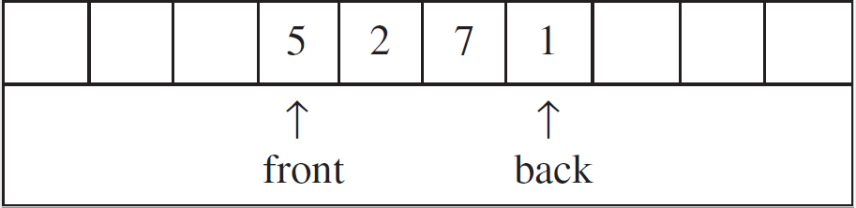
Queues
Queues are sometimes called first-in, first-out (FIFO) lists
Most modern sources use the terms enqueue and dequeue to refer to insertions (onto the back, or rear of a queue) and deletions (from the front of a queue), respectively
  Some sources use put and get
  I often use push and pop (because that’s how I learned it)
As with stacks, we can implement a queue with an array-based (or vector-based) list or with a linked list (we will only discuss the implementations very briefly)
Array-based queues rely on circular arrays; for example:
You need to be careful when the back of the array-based queue loops around to the start of the array
A linked-list-based queue would insert items at the end and remove items from the start (pointers can be maintained to the first and last nodes in a singly linked list)

Slide 96
Applications of Queues
A few straightforward example applications of queues include:
  Handling requests (e.g., a printer queue or a server responding to clients)
  Handling phone calls
  Handling triggered events (e.g., a GUI handling keyboard and mouse activity)
A branch of mathematics known as queueing theory deals with probabilistic approximations of various statistics concerning queues
Stacks, queues, and other forms of generalized lists are also used for:
  A variety of simple and complex search strategies
  A variety of AI algorithms
  A variety of graph-related algorithms and data structures
  Components of other more advanced data structures

Slide 97
How a Program Uses Memory
When running a computer program, RAM is divided into three segments:
  Static memory stores the program’s machine code, global variables, and static data members (some sources label sub-segments differently)
  The stack, a.k.a. the run-time stack or the call stack, stores activation records, a.k.a. stack frames (we will talk about this segment in significantly more detail)
  The heap, a.k.a. dynamic memory, stores all dynamically allocated memory
Other types of memory used by programs include registers, the cache, and sometimes virtual memory
My drawing on the next slide helps to explain this (I'll discuss the various parts of memory in class)
Note that not all sources show the segments in the same order, and some sources show the sub-segments of static memory as separate segments

Slide 98
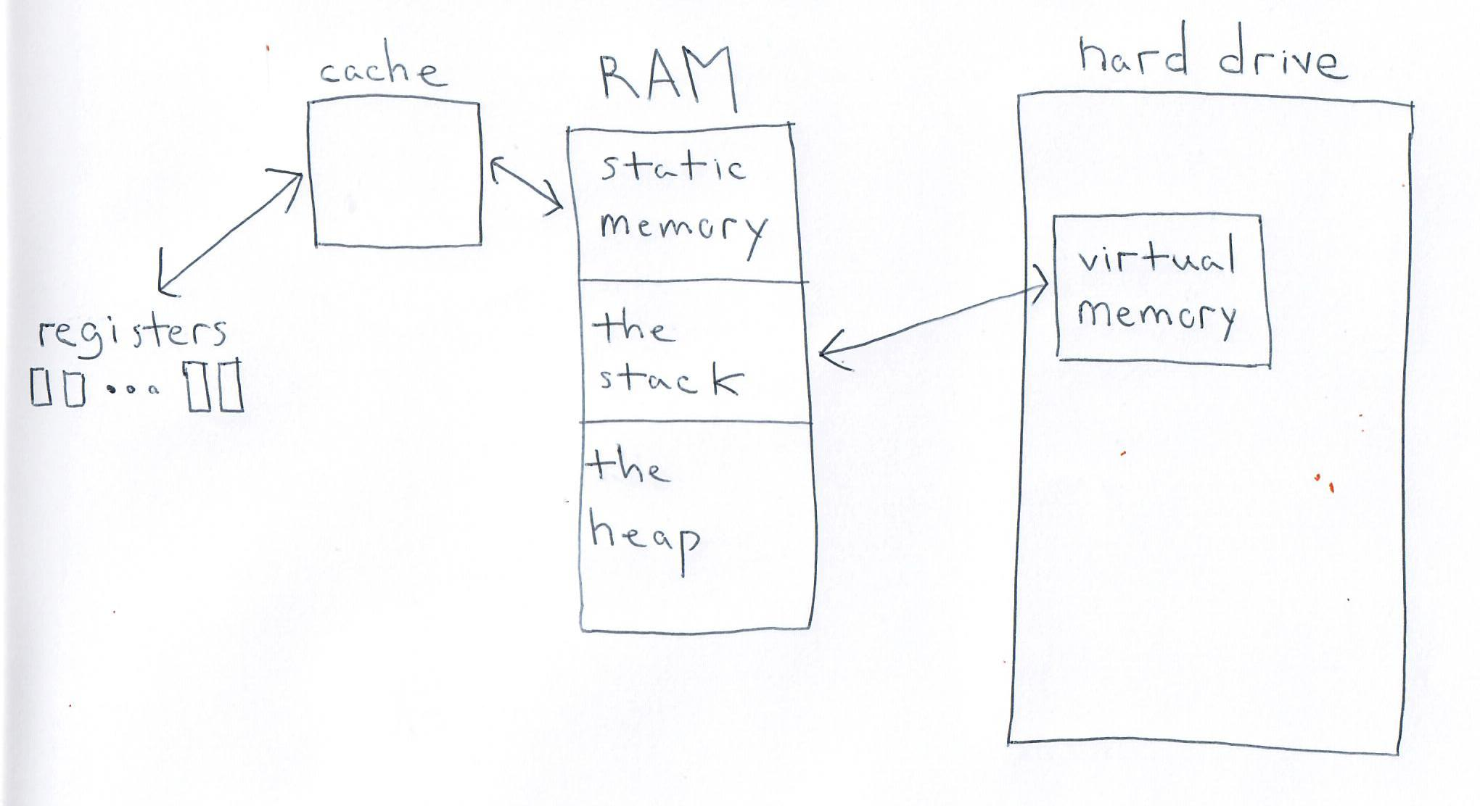
Memory Components used by Programs

Slide 99
The Stack
The stack (a.k.a. the call stack or the run-time stack) is, literally, a stack of activation records, a.k.a. stack frames
The stack contains an activation record for all functions (including member functions, a.k.a. methods) that have been called but have not yet returned
Each activation record corresponds to one such function or member function, and includes memory to store:
  Parameters – when the function is called, these are initialized to the values of arguments passed to the parameters
  Machine status info – this includes any information that needs to be backed up when the function is called and restored when the function returns
  Local variables and temporary variables (a.k.a. temp variables) – I'll explain temporary variables later
If there is a return value, this is also stored in the activation record
Not all sources depict activation records the same way (i.e., the parts may be labeled differently or drawn in different orders)
It is ultimately up to the compiler what gets stored where in an activation record
My drawing on the next slide shows one possible structure of an activation record

Slide 100
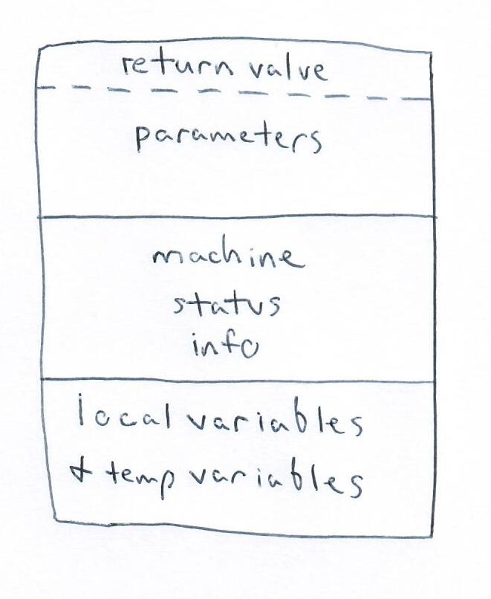
Activation Records (one possibility)

Slide 101
Function Calls and Returns
Whenever a function (or member function) is called:
  Arguments (sometimes called actual arguments or actual parameters) are copied to parameters (sometimes formal arguments or formal parameters)
  Certain registers (e.g., the program counter and registers containing pointers to each section of the current activation record) are backed up
  Many compilers back up all registers to keep things simple
  Space is set aside for all local variables and temp variables
Whenever a function (or member function) returns:
  If the function returns a value, the value is placed at the appropriate location in the activation record
  Machine status info is restored, which includes restoring the program counter, pointers to the various sections of the previous activation record, etc.
When a program is compiled, the compiler places all necessary machine code instructions for function calls and returns in the executable

Slide 102
More on Activation Records
Special registers typically contain pointers to the start of each section of the activation record
  These are updated when a function is called and a new activation record is created (i.e., when it gets pushed onto the stack)
  The old values of these registers are backed up in the section of the new activation record that stores machine status info (possibly along with all other registers)
  The old values are restored when the function returns (causing a pop from the stack), so they automatically point to the appropriate sections of the caller’s activation record
  In the machine code, parameters, local variables, and temp variables are just offsets from these pointers
  Therefore, it doesn’t matter where in the stack an activation record resides
Temp variables are needed because assembly code and machine code typically contain more variables than the corresponding source code
The next slide helps to explain the need for temp variables

Slide 103
Temp variables
Consider a C or C++ statement such as:
x = a * b + c * d;
Clearly, this can not be implemented by a single assembly code or machine code statement
Pseudo-assembly code may look more like this (introducing two additional temp variables):
t1 := a*b
t2 := c*d
x := t1+t2

Slide 104
Depicting a Call Stack
Unlike most stacks, call stacks are typically depicted as growing from top to bottom (i.e., the "top" of the stack is drawn at the bottom)
My understanding is that this is for historical reasons
Memory is typically depicted with the higher addresses on top, and the call stack typically grows from higher memory to lower memory
My drawing on the next slide depicts two hypothetical states of a call stack

Slide 105
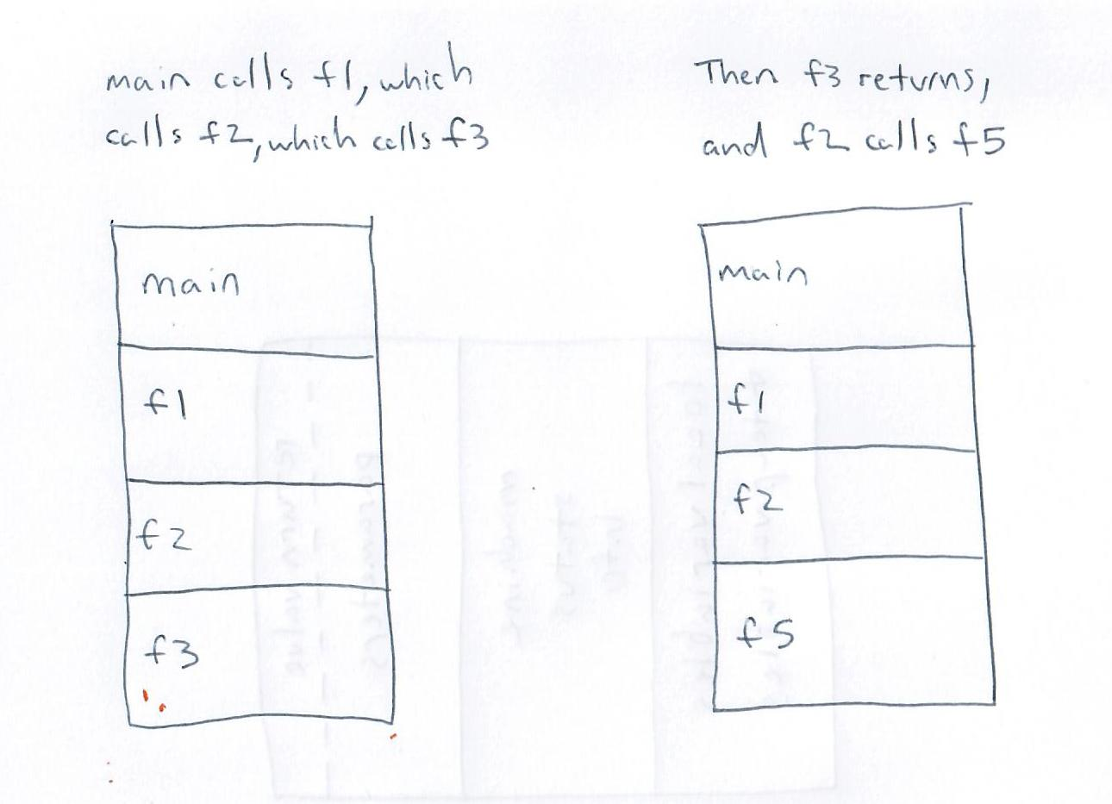
The Stack: Example

Slide 106
Benefits of the Call Stack
It is used for exception handling
Debuggers make use of it
This uses less memory relative to older programming languages that created an activation record for every function in the source code
Recursion just works!

Slide 107
Tail Recursion
This is a bit off topic, but it is a good idea to avoid unnecessary tail recursion
Tail recursion occurs when the last thing that a function (or member function) does is call itself
This can always be replaced by code that updates the function’s parameters and then jumps to the start of the function’s code
Some compilers might do this automatically in some cases
A recursive function that goes too deep can overflow the stack, and this is sometimes the case with tail recursion
Example: To display all the values in a singly linked list, it is better to use a loop than to display the value in the current node and make a recursive call
My pseudo-code on the next slide helps to explain this example
We’ll see additional examples of removing tail recursion during our topic on sorting
Note that all recursion can potentially be removed from a program by keeping track of your own stack, but this can get complicated

Slide 108
Tail Recursion Example
This is bad pseudo-code for displaying the nodes of a singly linked list:
  DisplayNodes(LinkedList L)
  if L is empty
  return
  L.displayCurVal()
  DisplayNodes(L.next())
Here is better pseudo-code:
  DisplayNodes(LinkedList L)
  while L is not empty
  L.displayCurVal()
  L ← L.next()

