Slide 1
CS 160: Introduction to
Procedural Programming and
ECE 160: Introduction to Programming for Electrical Engineers
Topic: Recursion

Slide 2
Recursive Functions
A recursive function is a function that calls itself; the act of the function calling itself is called recursion
Every task that can be done with recursion can also be done without it; however, recursion makes some tasks simpler to code
Recursion typically adds some overhead to a solution due to the extra function calls
  In some cases, the complexity of the recursive solution is the same as the non-recursive solution (i.e., the slowdown is just some constant factor)
  In other cases, a recursive solution may be significantly less efficient than a non-recursive one
In this topic, we will see one reasonable use of recursion and one bad use of recursion to compute mathematical functions
We'll also see one use of recursion to solve a famous puzzle
We'll see more useful examples of recursion in future topics

Slide 3
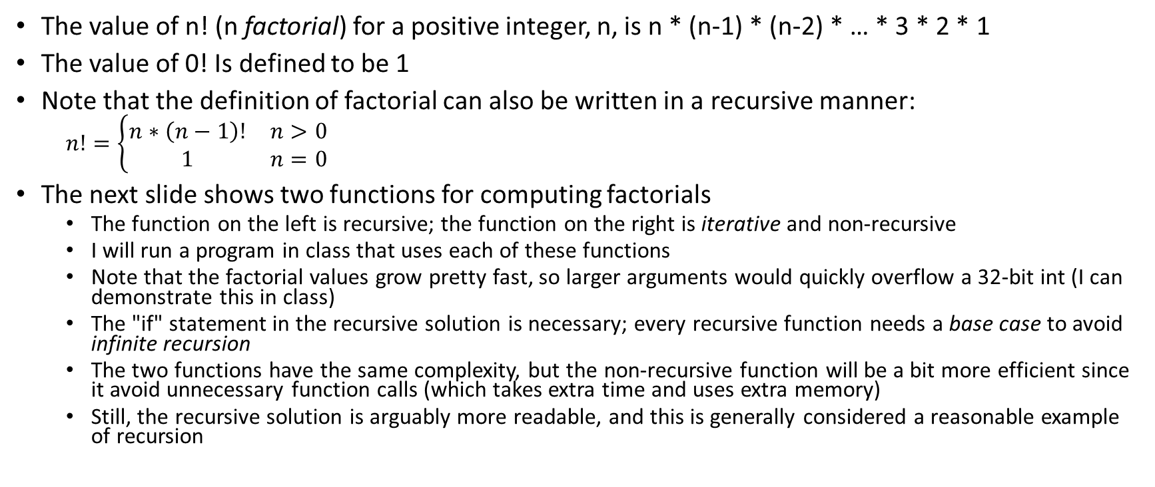
Factorial
The value of n! (n factorial) for a positive integer, n, is n * (n-1) * (n-2) * … * 3 * 2 * 1
The value of 0! Is defined to be 1
Note that the definition of factorial can also be written in a recursive manner:
  $$n!=\left\{\begin{matrix}n∗\left(n−1\right)! & n>0 \\ 1 & n=0\end{matrix}\right.$$
The next slide shows two functions for computing factorials
  The function on the left is recursive; the function on the right is iterative and non-recursive
  I will run a program in class that uses each of these functions
  Note that the factorial values grow pretty fast, so larger arguments would quickly overflow a 32-bit int (I can demonstrate this in class)
  The "if" statement in the recursive solution is necessary; every recursive function needs a base case to avoid infinite recursion
  The two functions have the same complexity, but the non-recursive function will be a bit more efficient since it avoid unnecessary function calls (which takes extra time and uses extra memory)
  Still, the recursive solution is arguably more readable, and this is generally considered a reasonable example of recursion

Slide 4
Recursive and Iterative Factorial Functions
Recursive solution:
  int factorial_1(int n)
  {
  if (n == 0)
  return 1;
  else
  return n*factorial(n-1);
  }
Non-recursive, iterative solution:
  int factorial_2(int n)
  {
  int result = 1;
  while (n > 0)
  {
  result = result * n;
  n = n - 1;
  }
  return result;
  }

Slide 5
Fibonacci
The Fibonacci sequence starts with two 1s, and each number after those is the sum of the two numbers before it
With this definition, the first several numbers of the Fibonacci sequence are: 1, 1, 2, 3, 5, 8, 13, 21, 34, 55, …
Some sources state that the first two numbers or 0 and 1; apart from the initial 0, the sequence is the same either way
The next slide shows two functions for computing Fibonacci the n^{th} Fibonacci value
  The function on the left is recursive; the function on the right is iterative and non-recursive
  I will run a program in class that uses each of these functions
  Note that the Fibonacci values also grow fast, so larger arguments would overflow a 32-bit int; the program I run in class will demonstrate this (really, we are computing the right-most 32-bits of the Fibonacci values)
  This time, the recursive solution is extremely less efficient than the iterative solution
  In fact, the iterative solution takes linear time with respect to n, whereas the recursive solution takes exponential time with respect to n
  Therefore, although the recursive solution might be easier to understand, this is a bad example of recursion (not all sources point this out)
  In fact, the program I run in class will not end, and I will have to stop it!

Slide 6
Recursive and Iterative Fibonacci Functions
Recursive solution:
  int Fibonacci_1(int n)
  {
  if (n <= 2)
  return 1;
  else
  return (Fibonacci_1(n-1) +
  Fibonacci_1(n-2));
  }
Non-recursive, iterative solution:
  int Fibonacci_2(int n)
  {
  int prev1 = 1, prev2 = 1;
  int x, cur;
  if (n <= 2)
  return 1;
  else
  {
  for (x = 3; x <= n; x++,
  prev2 = prev1, prev1 = cur)
  cur = prev2 + prev1;
  return cur;
  }
  }

Slide 7
The Tower of Hanoi
The Tower of Hanoi is a puzzle including three sticks and disks that can be placed on them
At the start, all disks are on one of the stick, arrange from the largest disk (at the bottom) to the smallest disk (at the top)
The goal is to move the pile of disks from the starting, or source, stick to a designated destination stick, subject to the following rules:
  Only one disk can be moved at a time
  You can only lift the top disk off a stick; this disk may then be placed on another stick, but you cannot violate the next constraint
  You can never place a larger disk on top of a smaller disk
The image on the next slide shows such a puzzle

Slide 8
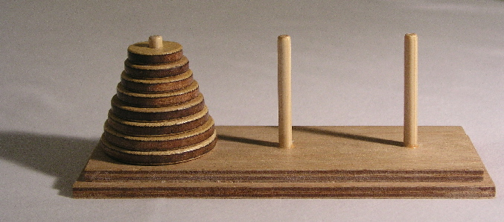
Tower of Hanoi Image (from Wikipedia)

Slide 9
Solving the Tower of Hanoi
Assume we have a Tower of Hanoi puzzle with N disks
At some point, we must move the largest disk from the source stick to the destination stick
Before that, we must move the other N-1 disks from the source stick to the third stick, which we'll call the auxiliary stick
The largest disk will not affect any of the moves required to achieve this intermediate goal
After the largest disk is moved to the destination stick, when then must move the other N-1 disks from the auxiliary stick to the destination stick
Again, the largest disk will not affect any of the moves required to achieve this follow-up task
In summary, we can move N disks from the source stick to the destination stick with the following procedure:
  Move N-1 disks from the source stick to the auxiliary stick (this is a recursive step)
  Move the largest disk from the source stick to the destination stick
  Move N-1 disks from the auxiliary stick to the destination stick (this is a recursive step)
Note that all three of the steps listed in this solution are necessary

Slide 10
Code for Solving the Tower of Hanoi
The next slide shows a function I wrote in C for solving the Tower of Hanoi puzzle
The function accepts the names of the three sticks (as strings), and the number of disks to be moved from the source disk to the destination disk
This function displays the moves to be made, in the order in which the moves should be made
This function also introduces the notion of a static variable; in C, a static variable is a local variable that retains its value between function calls
Suppose the three disks are labeled "source", "aux", and "dest", and there are 8 disks that must be moved from "source" to "dest"
Then we could call the function as follows: Tower(8, "source", "aux", "dest");
In class, I will run a program that calls the function as indicated above
The function lists a number of moves equal to 2^{N}-1
Although this is exponential with respect to N, it is easy to show that this number of moves is required to solve the Tower of Hanoi
In my Data Structures and Algorithms class, we analyze this solution in more detail

Slide 11
C Function for Solving the Tower of Hanoi
void Tower(int n, char *src, char *aux, char *dst)
{
static int move=0;
if (n == 1)
printf("Move #%d: Move disk from %s to %s.\n", ++move, src, dst);
else {
Tower(n-1, src, dst, aux);
printf("Move #%d: Move disk from %s to %s.\n", ++move, src, dst);
Tower(n-1, aux, src, dst);
}
return;
}

Slide 12
Other Examples of Recursion
In our next topic, we will examine a single recursive program for solving mazes
Other important examples if recursion include:
  Some prominent sorting algorithms, including mergesort and quicksort (we may discuss this later in the course)
  Important tree traversal algorithms, such as preorder traversal and postorder traversal (we discuss this in DSA)
  Some state-space search algorithms, such as depth-first search and iterative deepening search (we discuss this in AI)
  Minimax search, a popular algorithm for implementing two-player, turn-taking, zero-sum games (we discuss this in AI)
As mentioned earlier, every task that can be implemented with recursion can also be implemented without it
However, recursion makes some tasks simpler to code

