Slide 1
CS 160: Introduction to
Procedural Programming and
ECE 160: Introduction to Programming for Electrical Engineers
Topic: Course Overview and Introduction to the C Programming Language

Slide 2
The Basics
Lectures will be held:
  Tuesdays from 10 am – 10:50 pm
  Wednesdays from 12 pm – 1:50 pm
  Lectures will take place in Rm. 104
  If we are forced to do any lectures remotely, those lectures will take place via Teams
My Cooper webpage: http://faculty.cooper.edu/sable2
  From there, you can fine a link to the course webpage
  If you scroll down on the course webpage, you will find a (tentative) schedule
  Slides will be posted in the schedule before each lecture
  Under today's entry in the schedule, you can find the syllabus as a single document
  Programming projects will be posted on the course webpage when they are assigned
  Some general course policies can be found using the "policies" link on my Cooper webpage (not the course webpage)
My email address: carl.sable@cooper.edu

Slide 3
Optional Textbooks
"The C Programming Language, 2nd Edition" by Brian W. Kernighan and Dennis M. Ritchie
"Computer Science: A Structured Programming Approach Using C, 3rd Edition" by Behrouz A. Forouzan and Richard F. Gilberg
"Practical C Programming, 3rd Edition" by Steve Oualline
"C Programming: A Modern Approach, 2nd Edition" by K. N. King

Slide 4
Grading and Workload
The grading breakdown for the course is:
  Three quizzes (10% each)
  A final exam (20%)
  Five programming assignments (10% each)
All programs will be written in C
There are no problem sets in this course

Slide 5
Computer Hardware vs Software
Categories of computer hardware:
  Input devices (e.g. keyboard, mouse, webcam)
  Central processing unit (CPU), which at least includes a control unit, an arithmetic logic unit (ALU), and registers
  Graphical processing unit (GPU)
  Primary storage (e.g., RAM, ROM, cache, registers)
  Auxiliary storage (e.g., hard drive, flash drive)
  Output devices (e.g., monitor, printer, speaker)
Categories of computer software:
  System software (e.g., operating systems, disk formatting programs, compilers, drivers)
  Application software (e.g., word processors, spreadsheets, browsers, games)
  Software is created using a programming language

Slide 6
Chronology of Programming Languages
(Very) brief history of programming languages:
  40's and earlier – machine languages
  40's and 50's – symbolic languages (a.k.a. assembly languages)
  Late 1950's through present - high-level languages
See the next slide for the top 10 trending programming languages of 2025, according to IEEE
  Taken from https://spectrum.ieee.org/top-programming-languages-2025
  If we look at the Spectrum rankings, C falls to 8th place
  If we look at the Jobs rankings, C falls to 11th place

Slide 7
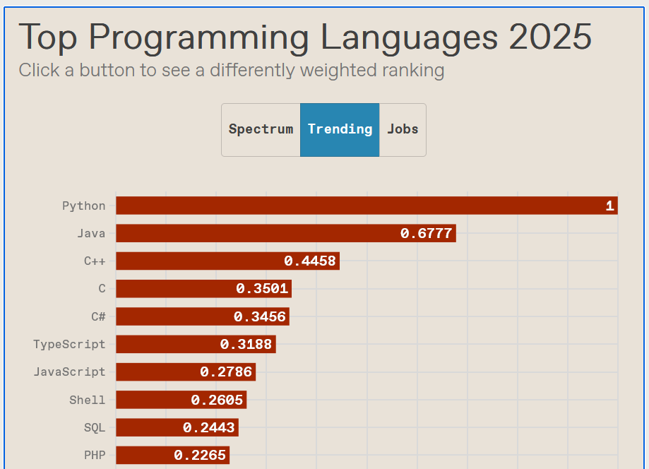

Slide 8
Types of Programming Languages
There are various categories of programming languages; for example:
  Interpreted vs compiled
  Procedural vs object-oriented vs functional
  Scripting languages
  High(er)-level vs low(er)-level
In modern terms, the lines between certain types of languages is often blurred

Slide 9
Machine Code
Machine code, a.k.a. machine language, is the lowest-level type of programming language; this is the type of language that actually runs on a computer
In machine code, each instruction is composed of bits; each bit is a 0 or a 1
Of course, internally, these bits are stored as electrical or magnetic states (e.g., very small capacitors that are either charged or discharged)
Eight bits make up one byte; we can represent bytes in binary or decimal
Instructions in a machine language might be variable length or constant length; some instructions also specify data
The currently executing machine code is stored in main memory; a special register keeps track of the current instruction
Normally code executes sequentially, but sometimes there are jumps
A couple of issues with machine code are that each machine is machine-dependent, and the code is extremely difficult to write, read, and debug
Note that when machine code was first used, computers were millions of times slower; they were huge; and they were often programming using punch cards

Slide 10
Assembly Language
Instruction in an assembly language, a.k.a. symbolic language, have (more-or-less) a one-to one mapping with instructions in a machine language
These languages are machine-dependent, like machine languages
On the positive side, they make it easier to write, read, and debug code (relative to machine code)
Example (this is old, but I'm sticking with it!):
  pushal 3(r2)
  calls #2,SCANF
  mull3 –8(fp),-12(fp)
  pushal 6(r2)
An assembler converts assembly code to machine code

Slide 11
C
C is a purely procedural programming language
C is a high-level programming language relative to machine code or assembly code, but today you may hear it referred to as a low-level or mid-level programming language
A brief history of C:
  1972: Dennis Ritchie creates first version of C
  1978: The first edition of "The C Programming Language" by Kernighan and Ritchie
  1983 – 1988: The American National Standards Institute (ANSI) establishes a more modern, comprehensive definition of C
  1988: The second edition of book is published
  1999: The C99 revision of the standard is generally considered a major revision
  2023: The C23 revision is the most recent revision of the standard
C is a still a popular programming language, especially for some embedded architectures
There are also various C-like languages used for various embedded platforms
C++ builds upon C, allowing both procedural and object-oriented programming

Slide 12
Programming in C
When you write a C program, you create source files and header files
  Every C program contains at least one source file
  Source files contains source code
  Each file can be created by any text editor
A C program consists of preprocessor directives, global declarations and functions (we'll look at the general format of a C program soon)
Some functions are provided in libraries, others you write yourself
Every C program contains at least one function called "main"
A compiler converts your program to machine code
  First, the compiler converts the code to assembly code
  Then it applies an assembler to convert the assembly code to machine code
  Finaly, a linker combines your machine code with pre-compiled libraries to create an executable

Slide 13
Hello World!
It has become traditional in computer science that when you learn a new programming language, you start with a "Hello World" program
When
  #include <stdio.h>
  int main(void)
  {
  printf("Hello World!\n");
  return 0;
  }

Slide 14
Hello World!
There is a tradition in CS that when you learn a new programming language, you start with a "Hello World" program.
Here is an example of a "Hello World" program in C:
  #include <stdio.h>
  int main(void)
  {
  printf("Hello World!\n");
  return 0;
  }
The keyword "void" inside the parentheses after "main", and the "return 0;" statement near the end; are optional
Some compilers may let you get away without the "int" return type

Slide 15
About the "Hello World" Program
Every program has a "main" function (optionally there can be others)
Curly braces begin and end function bodies
In between these curly braces, there are zero or more statements
Statements in C are separated by semicolons
Forgetting a semicolon is a common bug; the compiler will catch it
The statements of "main" are executed one at a time until the program is finished; some of statements are can be calls to other functions
One function in the C standard library is named "printf"; this function can be used to display a string (basically, a textual message) to standard output
The "#include" preprocessor directive at the top of the program enables us to call functions from the input/output component of the that C standard library
The "\n" in the string being passed to printf represents a newline character
C is flexible when it comes to whitespace, but formatting is important for readability

Slide 16
Compiling the "Hello World" Program
It is conventional in C to use the extension ".c" at the end of the name of a source file
Source files are just text files; they can be created with text editors such as emacs, vi, pico, Notepad++, etc.
Alternatively, you can use an IDE; this is probably the most common way to create modern programs
If you are using an IDE, you also use its interface to compile, run, and debug your programs
However, in this class, we will use text editors to create files and we will compile from the command line in a Linux environment
We will use "gcc" as the compiler; I will show how to compile the "Hello World" program in class
Note that the default output name is "a.out"; on a Windows system, it might be "a.exe"
We can use the "-o" command-line argument to name the executable something else
Suppose you wanted the program to display "Hello World!" three times, on separate lines
We haven't learned about loops yet, but without using loops, we will look at two ways to do this in class

Slide 17
General Format of a C Program
This is the general format of a C program
General format of C program:
  Preprocessor directives
  Global declarations
  int main(void)
  {
  Local declarations
  Statements
  }
  Optionally other functions with similar structure to "main"
Note that the "Hello World" program did not have optional functions in addition to "main" in the source file, but it did call the "printf" function which is part of the C standard library

Slide 18
Comments in C
There are two types of comments in C
Comments do not affect the behavior of a program, but they help a reader of the code understand the program
One type of comment starts with the token "/*" and ends with the token "*/"
This type of comment can occupy a part of a line, a single line, or multiple lines
The other type of comment starts with the token "//" and extends until the end of the current line
This type of comment was added to the C99 revision of the C standard
The code on the next slide shows the "Hello World" program with comments
Note that a simple program like this does not need so many comments; I am only showing them for pedagogical purposes!

Slide 19
"Hello World" Program with Comments
/*
* The following program prints the phrase "Hello World!"
* to the screen on its own line.
* Written by: Carl Sable
*/
/* Global declarations would go here */
int main(void)
{
/* Local declarations would go here */
printf("Hello World!\n"); // Display output
return 0; // Returns 0 to the operating system
}

