Slide 1
ECE461: Theoretical CS
Turing Machines and Algorithms

Slide 2
Brief Recap
In earlier topics, we learned about three equally powerful formalisms capable of recognizing the regular languages:
  Deterministic finite automata (DFAs)
  Nondeterministic finite automata (NFAs)
  Regular expressions (REs)
In other topics, we learned about two equally powerful formalisms capable of describing the context-free languages:
  Context-free grammars (CFGs)
  Pushdown automata (PDAs)
We have also learned about two forms of the pumping lemma; namely, the pumping lemma for regular languages and the pumping lemma for context-free languages
These lemmas can be used to prove that certain languages are not regular or are not context free
In this topic, we will discuss Turing machines, providing us with the most powerful known formalism for modeling computation
This topic is based on Chapter 3 of the textbook

Slide 3
Hilbert's Problems
In 1900, David Hilbert published 23 mathematical problems, whose solutions at the time were unknown
Our textbook, near the start of Section 3.3, discusses Hilbert's 10th problem
  This challenged mathematicians to devise an algorithm to determine if a polynomial with multiple variables and integer coefficients has an integral root
  Although the textbook doesn't mention the term, these are called Diophantine equations
  It is now known that this problem cannot be solved
Gödel's incompleteness theorems were produced given in response to other challenges by Hilbert
  In DSA 2, we discussed Gödel's first incompleteness theorem, which states that no appropriately expressive system of mathematics can be both consistent and complete
  This theorem will come up later in the textbook (in Section 6.2), and it was in a response to a challenge by Hilbert (not one of his 23 problems)
  Gödel's second incompleteness theorem states that no appropriately expressive system of mathematics can prove its own consistency (this was in response to Hilbert's 2nd problem)

Slide 4
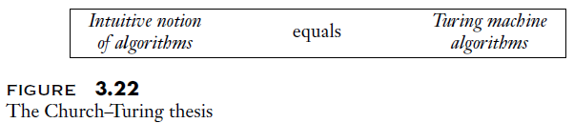
The Church-Turing Thesis
Another challenge by Hilbert (not one of the 23 problems) was known as the Entscheidungsproblem
Casually speaking, this challenged mathematicians to devise a method capable of answering any well-formed yes/no mathematical question
Turing's development of the Turing machine (TM) and Church's development of lambda calculus were both in response to this; they are given joint credit for demonstrating that Hilbert's challenge is impossible
The Turing machine, introduced by Turing in 1936, is widely believed by mathematicians and computer scientists to capture the full intuitive notion of what it means to be an algorithm
Many theoretical computer scientists accept this as the definition of an algorithm; that is, an algorithm is a computational process that can be reproduced by some Turing machine (or an equivalent device)
This is encapsulated by the Church-Turing thesis
  Interestingly, while the title of Chapter 3 in our textbook is titled "The Church-Turing Thesis", and Figure 3.22 (see above) is captioned "The Church-Turing Thesis", the textbook never actually states the thesis!
  According to Wikipedia, the Church-Turing thesis "states that a function on the natural numbers can be calculated by an effective method if and only if it is computable by a Turing machine"
  According to the Arora and Barak book, the thesis "states that every physically realizable computation device – whether it's based on silicon, DNA, neurons, or some other alien technology - can be simulated by a Turing machine"
  Also from Arora and Barak: "The CT thesis is not a theorem, merely a belief about the nature of the world as we currently understand it."

Slide 5
What's a Turing Machine?
Different textbooks, articles, websites, etc. define Turing machines differently
So long as the definitions are reasonable, the formalisms are all equivalent in power; all attempts to create more powerful (but still reasonable) computational formalisms have failed
The book briefly discusses what it means for a TM model to reasonable near the end of Section 3.2
They point out in a footnote: "For example, one requirement is the ability to perform only a finite amount of work in a single step"
According to our textbook, a Turing machine consists of:
  An infinitely long tape of squares (infinitely long in one direction); initially, a finite number of squares on the tape are marked with symbols from the machine's alphabet, and the other squares are blank
  A tape head (I call this a read-write head) that can "read and write symbols and move around on the tape"
  A finite set of states, including exactly one start state (I sometimes call this the initial state), exactly one accept state, and exactly one reject state
  A transition function (more details on this below)
At each step during machine a Turing machine's computation, depending on the current state and symbol under the read-write head, the transition function directs the machine to:
  Write some specified symbol at the location of the read-write head
  Move the read-write head either one space left or one space right
  Jump to some specified state

Slide 6
Formal Definition of a Turing Machine
Definition 3.3 in the textbook provides a formal definition of a Turing machine (I am keeping their exact wording but slightly modified the formatting):
A Turing machine is a 7-tuple (Q, Σ, Γ, δ, q₀, q_{accept}, q_{reject}), where Q, Σ, Γ are all finite sets and
  Q is the set of states,
  Σ is the input alphabet not containing the blank symbol ␣,
  Γ is the tape alphabet, where ␣ ∈ Γ and Σ ⊆ Γ,
  δ: Q x Γ → Q x Γ x {L, R} is the transition function,
  q₀ ∈ Q is the start state,
  q_{accept} ∈ Q is the accept state, and
  q_{reject} ∈ Q is the reject state, where q_{reject} ≠ q_{accept}.
Note that the textbook's formulation allows the tape alphabet to contain symbols in addition to the blank and the members of the input alphabet
This will come in handy for various purposes

Slide 7
Computation on a Turing Machine
Consider a Turing machine M = (Q, Σ, Γ, δ, q₀, q_{accept}, q_{reject})
The initial input is w = w₁w₂…w_{n} ∈ Σ*,with the symbols of the input string located on the leftmost n squares of the tape
The read-write head starts at the leftmost square, above w₁
The computation proceeds one step at a time, according to the transition function, δ
If at any time, the transition function attempts to move the read-write head left from the leftmost square, it stays still for that move
The computation continues until the state becomes q_{accept} or q_{reject}, at which point the Turing machine halts
If neither of those states is ever reached, the TM runs forever
Note that, unlike the previous automata we covered, a TM does not necessarily process its entire input from left to right; the input is the initial content of the tape

Slide 8
We Learned a Different Definition in DSA 2
An astute student may notice several differences between this definition of a Turing machine from what we learned in DSA 2; the main differences are:
  In DSA 2, we learned that the tape was infinitely long in both directions, and the read-write head is allowed to move left from its starting position
  In DSA 2, we learned that there can be multiple accept states
  In DSA 2, Turing machines did not have any reject states
Although these differences may seem significant, the two formalisms are equivalent in power; I will discuss how one sort of Turing machine can simulate the other in class
There is also another important conceptual difference between how we discussed Turing machines in DSA 2 and how we will mostly (but not always) be discussing them in this course
  In this course, we are often going to talk about Turing machines as recognizers or deciders for languages (we'll define these terms later); that is, the main thing that matters is whether the Turing machine accepts or rejects its current input
  In DSA 2, we paid more attention to the final string on the machine's tape at the end of the computation; we can think of the resulting string as the output of the algorithm
  Not all algorithms are intended to give a yes/no answer to a question, and even when they do, it is not always explicitly a question about inclusivity in a language (I'll discuss this more in class)
In DSA 2, we also learned that we could define Turing machines using only 0s and 1s instead of a full alphabet plus the blank symbol; only a finite number of squares would be marked with 1 at any time
Note that these and other variations do affect the efficiency of Turing machines, but not their power

Slide 9
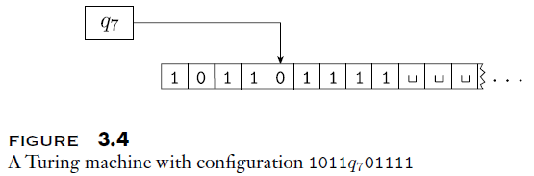
Configurations
The current configuration of a Turing machine is determined by the following three things:
  The current content of the tape
  The current location of the read-write head
  The current state
It is often useful to be able to represent the configuration of a TM as a string
We can specify the current configuration of a Turing machine, M, as uqv, where:
  uv is the contents of M's tape (all squares to the right of v contain blanks)
  q is the current state of M
  M's read-write head is over the leftmost symbol of v (if v is the empty string, M is positioned over the blank symbol just to the right of u)
For example, consider the configuration 1011q₇01111; the figure above graphically depicts a Turing machine in this configuration
The start configuration of M can be represented as q₀w, where w is the initial input

Slide 10
Computation in Terms of Configurations
We can reconsider how a Turing machine, M, computes in terms of its sequence of configurations
Suppose that the current configuration of M is uaq_{i}bv and δ(q_{i}, b) = (q_{j}, c, L)
  Then, the next configuration of M will be uq_{j}acv
  For this case, we can say that uaq_{i}bv yields uq_{j}acv
Now suppose that the current configuration of M is uaq_{i}bv and δ(q_{i}, b) = (q_{j}, c, R)
  Then, the next configuration of M will be uacq_{j}v
  For this case, we can say that uaq_{i}bv yields uacq_{j}v
A special case occurs if the current state is q_{i}bv and δ(q_{i}, b) = (q_{j}, c, L); then q_{i}bv yields q_{j}cv
If the read-write head is at the right-most location, uaq_{i} is equivalent to uaq_{i}␣, and we can handle this with the regular rules
A Turing machine computes in this manner, until the current state is q_{accept} (leading to an accepting configuration) or q_{reject} (leading to a rejecting configuration)
  Those are both halting configurations, which do not yield further configurations
  The book points out that we could have therefore defined the transition function to be δ: Q' x Γ → Q x Γ x {L, R}, where Q' is Q without q_{accept} or q_{reject}
If M never halts, it runs forever, continuously yielding new configurations

Slide 11
Turing Machines and Languages
The set of all strings accepted by a Turing machine, M, is the language of M, or the language recognized by M, denoted L(M)
M is said to be a recognizer of the language, and we can say it recognizes the language
A language is said to be Turing-recognizable (a.k.a. recursively enumerable) if some Turing machine recognizes it
For non-instances of L(M), the machine might reject the non-instances, or it might run forever (i.e., never halt, what the textbook calls loop)
If the Turing machine rejects all non-instances of L(M), it is said to be a decider for the language, and we can say it decides the language
Such a Turing machine ultimately halts for all inputs, either in the accept state or the reject state
A language is said to be Turing-decidable (a.k.a. recursive or decidable) if some Turing machine decides it
Clearly, all Turing-decidable languages are also Turing-recognizable
We will see that some languages are Turing-recognizable but not Turing-decidable, and that some languages are not Turing-recognizable

Slide 12
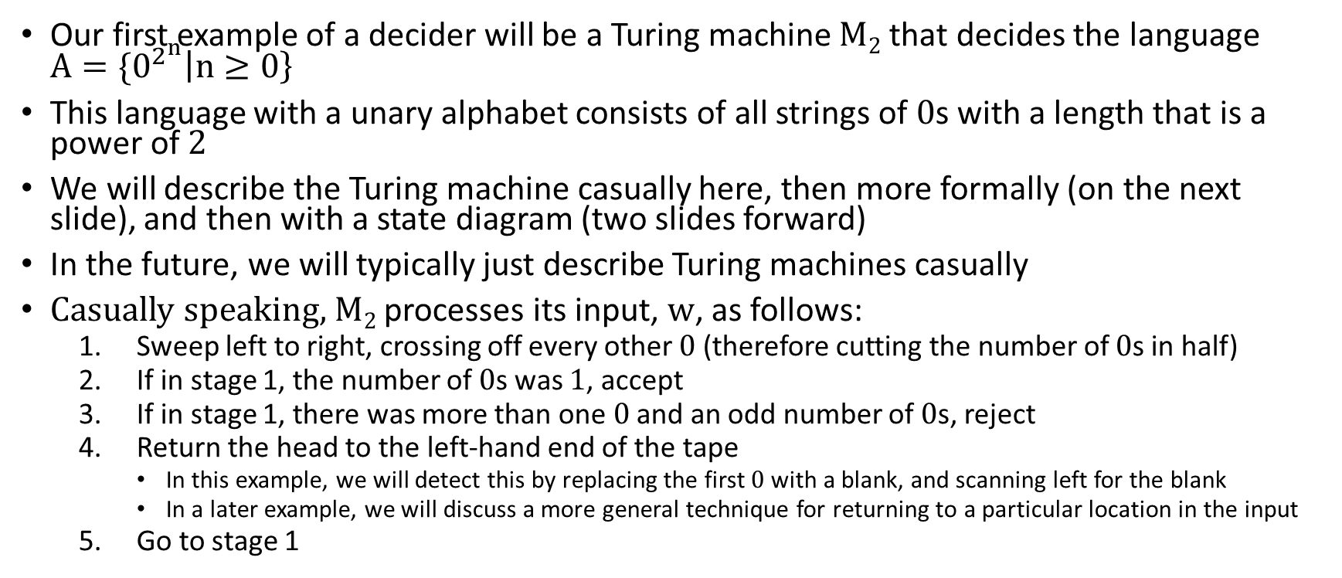
Turing-Decidable Language: Example 1
Our first example of a decider will be a Turing machine M₂ that decides the language ${A=\{0}^{2^{n}}\left|n≥0\right\}$
This language with a unary alphabet consists of all strings of 0s with a length that is a power of 2
We will describe the Turing machine casually here, then more formally (on the next slide), and then with a state diagram (two slides forward)
In the future, we will typically just describe Turing machines casually
Casually speaking, M₂ processes its input, w, as follows:
  Sweep left to right, crossing off every other 0 (therefore cutting the number of 0s in half)
  If in stage 1, the number of 0s was 1, accept
  If in stage 1, there was more than one 0 and an odd number of 0s, reject
  Return the head to the left-hand end of the tape
    In this example, we will detect this by replacing the first 0 with a blank, and scanning left for the blank
    In a later example, we will discuss a more general technique for returning to a particular location in the input
  Go to stage 1

Slide 13
Formal Description of M₂
We have learned that formally, every Turing machine is a 7-tuple
We can define M₂ = (Q, Σ, Γ, δ, q₁, q_{accept}, q_{reject}) as follows:
  Q = {q₁, q₂, q₃, q₄, q₅, q_{accept}, q_{reject}}
  Σ = {0}
  Γ = {0, x, ␣}
  δ is explained by the state diagram on the next slide
  q₁, q_{accept}, and q_{reject} are the start state, accept state, and reject state, respectively
Here are some general comments about the edge labels:
  In the state diagram, suppose an edge from q_{i} to q_{j} is labeled, for example, a → b,L
  This means that δ(q_{i}, a) = (q_{j}, b, L)
  If the output symbol is the same as the input symbol, it is left out of the label
I will explain the state diagram in class, and I encourage you to step through it carefully
  I would say the state diagram does not precisely match the casual description on the previous slide
  After all the 0s have been crossed out, except for the one that was changed to a blank, it will move all the way to the right to the next blank and then accept
In most future examples, we will discuss Turing machines more casually

Slide 14
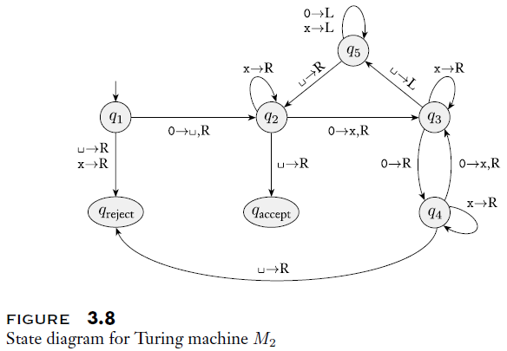
State Diagram for M₂

Slide 15
Turing-Decidable Language: Example 2
Our second example of a decider will be a Turing machine M₃ that decides the language C = {a^{i}b^{j}c^{k} | i*j=k and i, j, and k ≥ 1}
Casually speaking, M₃ processes its input, w, as follows (I'm wording this a bit differently than the textbook):
  Perform an initial pass to verify that the input is in the correct format (that is, make sure is of the form a⁺b⁺c⁺); otherwise, reject
  Return the read-write head to the left of the tape (we could detect in a similar manner to the previous example; we'll discuss a more general method soon)
  Cross out one a and scan for the first b; then:
    Zig-zag between the b's and c's, and cross off one c for every b (both the b's and c's get crossed out)
    If all the c's are gone when b's remain, reject
  Restore the crossed-out b's
  Check if there are additional a's
    If all a's have been crossed out, and there are additional c's, reject
    If all a's have been crossed out, and there are no additional c's, accept
    If there are remaining a's, return to stage 3

Slide 16
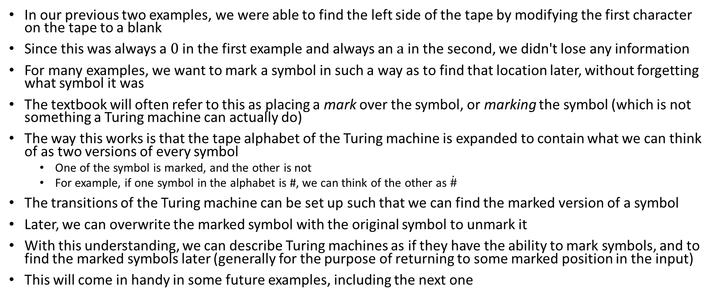
Marking Symbols
In our previous two examples, we were able to find the left side of the tape by modifying the first character on the tape to a blank
Since this was always a 0 in the first example and always an a in the second, we didn't lose any information
For many examples, we want to mark a symbol in such a way as to find that location later, without forgetting what symbol it was
The textbook will often refer to this as placing a mark over the symbol, or marking the symbol (which is not something a Turing machine can actually do)
The way this works is that the tape alphabet of the Turing machine is expanded to contain what we can think of as two versions of every symbol
  One of the symbol is marked, and the other is not
  For example, if one symbol in the alphabet is #, we can think of the other as $\dot{\#}$
The transitions of the Turing machine can be set up such that we can find the marked version of a symbol
Later, we can overwrite the marked symbol with the original symbol to unmark it
With this understanding, we can describe Turing machines as if they have the ability to mark symbols, and to find the marked symbols later (generally for the purpose of returning to some marked position in the input)
This will come in handy in some future examples, including the next one

Slide 17
Turing-Decidable Language: Example 3
Our second example of a decider will be a Turing machine M₄ that decides the language E = {#x₁#x₂#...#x_{l} | each x_{i} ∈ {0,1}* and x_{i} ≠ x_{j} for each i ≠ j}
The textbook refers to this as the "element distinctness problem"; M₄ accepts an input if and only iff all the substrings are different
I'll list the steps of M₄ (still casual) on the next slide
Here, I'll describe the high-level idea:
  First, compare x₁ to x₂, then to x₃, etc. until it is compared to x_{l}
  If any x_{i} with i > 1 matches x₁, reject
  Then, compare x₂ to x₃, then to x₄, etc. until it is compared to x_{l}
  If any x_{i} with i > 2 matches x₂, reject
  Continue in this manner until every x_{i} has been compared with each x_{j} to its right
  If not duplicate is found, accept

Slide 18
The Steps of M₄
Casually speaking, M₄ processes its input, w, as follows (I'm describing this a bit differently than the textbook):
  Place a mark on the top of the leftmost tape symbol (as explained on a previous slide)
    If this symbol was a blank, accept (assuming the empty string is a considered a valid member of E)
    Otherwise, if this symbol not a #, reject (it means the input has an improper format)
  Scan right to the next #
    If a second # is found, put a second mark on top of it
    If there is no second #, and a blank is encountered, accept
      In the textbook's solution, this always means that there is x₁ and no x₂, which is valid
      In my solution, this could mean that the leftmost mark has moved to x_{l} and no duplicate strings have been found
  Zig-zag back and forth between the two strings to the right of the two marked #'s
    If they are equal, reject
    The book doesn't explain the details of how to check this, but it also relies on marking, so we can compare the left-most unmarked bit (or more generally, symbol) of each substring, without losing any information
  Move the rightmost of the two marked # symbols to the next # to its right
    If there is no # to the right of the rightmost marked #, then move the leftmost of the two marked # symbols to the next # and return to stage 2 (the book describes this differently, but I'm confident my method is valid)
    If the rightmost mark is successfully moved right, then return to state 3

Slide 19
Variations of Turing Machines
We already discussed differences between our textbook's definition of Turing machines and how we described Turing machines in DSA 2
In general, different sources define Turing machines differently
This is OK, because all reasonable definitions of the formalism are equal in power
One simple variation, for example, is that some definitions allow transitions that keep the read-write head still
The transition function would then be defined as δ: Q x Γ → Q x Γ x {L, R, S}
A Turing machine without the ability to stay still can easily simulate one that has it
For each transition that stays still, the Turing machine without this ability could instead move right, followed by another transition that moves left
The textbook doesn't fully explain this; it potentially involves a lot of extra states and rules
  Suppose in the simulated Turing machine, δ(q_{i}, a) = (q_{j}, b, S)
  Then, in the simulating Turing machine, δ(q_{i}, a) = (q_{j'}, b, R)
  Also, in the simulating Turing machine, for every tape symbol s, we need δ(q_{j'}, s) = (q_{j}, s, L)

Slide 20
Multi-tape Turing Machines
One commonly discussed variation of a Turing machine is a multi-tape Turing machine (the book considers "multitape" to be a single word without a dash)
For example, the Arora and Barak book discuss a Turing machine where three tapes are used as a read-only input tape, a work tape, and an output tape
They also discuss a general k-tape Turing machine and how such a Turing machine can be simulated by a single-tape Turing machine (as does our textbook)
Their proof is a bit different than the version in our textbook; we'll discuss our textbook's version
We will consider Turing machines that have k tapes, each with its own read-write head that can move left or right or stay still
Then, the form of the transition function would be δ: Q x Γ^{k} → Q x Γ^{k} x {L, R, S}^{k}
The figure on the next slide helps to explain how a single-tape Turing machine can simulate this
  Each tape from the original Turing machine is copied to one segment of the single-tape machine simulating it
  The marked symbol in each segment represents the location of the corresponding read-write head
The slide after that explains how the simulation works; the description clearly assumes that the input starts off on the first tape, and the other tapes start blank

Slide 21
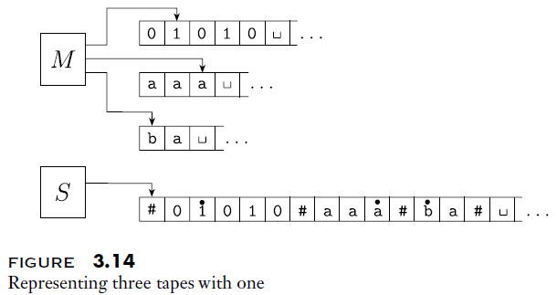
Simulating a 3-Tape Turing Machine Example

Slide 22
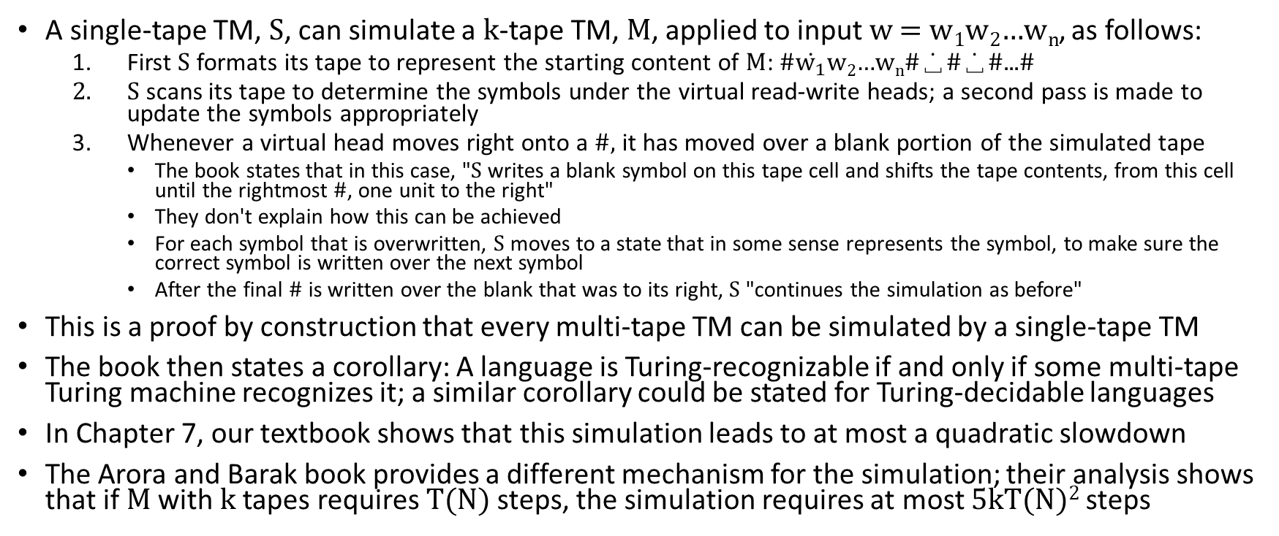
Simulating a k-Tape Turing Machine
A single-tape TM, S, can simulate a k-tape TM, M, applied to input w = w₁w₂…w_{n}, as follows:
  First S formats its tape to represent the starting content of M: #$\dot{w_{1}}$w₂…w_{n}#$\dot{\text{␣}}$#$\dot{\text{␣}}$#...#
  S scans its tape to determine the symbols under the virtual read-write heads; a second pass is made to update the symbols appropriately
  Whenever a virtual head moves right onto a #, it has moved over a blank portion of the simulated tape
    The book states that in this case, "S writes a blank symbol on this tape cell and shifts the tape contents, from this cell until the rightmost #, one unit to the right"
    They don't explain how this can be achieved
    For each symbol that is overwritten, S moves to a state that in some sense represents the symbol, to make sure the correct symbol is written over the next symbol
    After the final # is written over the blank that was to its right, S "continues the simulation as before"
This is a proof by construction that every multi-tape TM can be simulated by a single-tape TM
The book then states a corollary: A language is Turing-recognizable if and only if some multi-tape Turing machine recognizes it; a similar corollary could be stated for Turing-decidable languages
In Chapter 7, our textbook shows that this simulation leads to at most a quadratic slowdown
The Arora and Barak book provides a different mechanism for the simulation; their analysis shows that if M with k tapes requires T(N) steps, the simulation requires at most 5kT(N)² steps

Slide 23
Nondeterministic Turing Machines
Textbook: "A nondeterministic Turing machine is defined in the expected way"
  What the textbook clearly means by this is that a nondeterministic Turing machine (NTM) adds nondeterminism to Turing machines
  However, I am not entirely sure I agree with the statement (this will be discussed more on the next two slides)
The transition function for an NTM has the form δ: Q x Γ → P(Q x Γ x {L, R})
Recall that P represents a power set; so, given the current state and tape symbol, there can be 0, 1, or multiple transitions
The book states: "The computation of a nondeterministic Turing machine is a tree whose branches correspond to different possibilities for the machine"
  Recall that with NFAs, Sipser wrote that one way to think about nondeterminism is that the NFA explores branches of a tree; here, he is taking this point of view of an NTM
  We could also think of NFAs as exploring paths in parallel, or as taking guesses
  I am confident that we can also potentially think about NTMs in all three of these ways
The book correctly indicates that "if some branch of the computation leads to the accept state, the machine accepts its input"
What the book makes less clear is that a Turing machine only rejects its input if every path rejects

Slide 24
When is an NTM a Decider?
A decider for a language is a Turing machine that accepts all instances of a language and rejects all non-instances of a language
Note that DFAs never encounter infinite loops; this can also be true of implementations of NFAs under reasonable assumptions (I'll discuss this more in class)
However, Turing machines (both deterministic and nondeterministic) can encounter infinite loops; clearly, a deterministic TM that never encounters an infinite loop is a decider, since it must accept or reject all inputs
Book: "We call a nondeterministic Turing machine a decider if all branches halt on all inputs"
However, I have seen some sources claim that an NTM only has to halt on all branches for inputs that are rejected (i.e., non-instances of the language)
I believe that this relates to another difference between how various sources describe NTMs
  When I first learned about NTMs, I learned that branches are explored in parallel, and if any path accepts, the entire machine stops (this is how I describe NTMs in DSA II)
  For sources that described NTMs this way, for positive instances of the language that the machine decides, it does not matter if all branches halt
  Our textbook does not describe an NTM this way; all branches presumably run to the end
  With such a description, an NTM is only a decider if all branches halt on all inputs
  I have seen some online sources discuss this difference in formulations of an NTM, stating that languages that have deciders using either of these formulations also have deciders with the other

Slide 25
Further Thoughts about NTMs
I would like to add some of my own thoughts about how to think about nondeterminism in an NTM compared to other nondeterministic formalisms
  When considering an NFA, each path being explored only needs to keep track of its current state
  An implementation of an NFA can merge paths that are in the same state at a certain step in the execution
  When considering a PDA (we only discussed the nondeterministic version), each path needs to keep track of its current state and the contents of its stack
  Hence, we cannot merge paths that are in the same state
  When considering an NTM, each path needs a copy of the entire configuration of the machine
  Recall that a configuration of a Turing machine includes the current state, the position of the read-write head, and the entire contents of its tape
We are about to discuss the proof that NTMs and DTMs are equal in power
However, keep in mind that the efficiencies of the two formalisms may be vastly different for some problems
This will come up later in the course, when we discuss the P versus NP question (we discussed this in DSA 2, so you should be aware of its importance)

Slide 26
NTMs and DTMs are Equal in Power
Every DTM is a valid NTM; so clearly, the NTM formalism is at least as powerful as the DTM formalism
Therefore, to show that the two formalisms are equal in power, we need to show that every NTM can be simulated by a DTM
Textbook (Theorem 3.16): "Every nondeterministic Turing machine has an equivalent deterministic Turing machine"
In their "proof idea", they discuss a DTM, D, simulating an NTM, N
We can consider N's computation, applied to an input w, to be represented as a computation tree, with each branch of the tree representing one branch of N's nondeterminism
The root of the tree represents the start configuration of N
D has to search the tree for an accepting configuration
The book explains that a depth-first search wouldn't work, because some branches might be infinitely long
Instead, D will search the tree using a breadth-first search (BFS)
That's also what we said in DSA 2 to explain that the two formalisms have equal power, and we just left it at that; now, we'll flesh this out in more detail
Note that this simulation would tend to cause an exponential slowdown (the book explains this in Chapter 7)

Slide 27
Simulating an NTM with a DTM
Taking advantage of our previous proof, the textbook explains how a three-tape DTM, D, can simulate an NTM, N
  The first tape is considered an input-tape, and D will never modify it
  The second tape is considered a "simulation tape"; it is used to simulate a single branch of N's computation (it is used to execute the BFS)
  The third tape is an "address tape", which we will discuss in more detail
The third state stores an address, which is an indication of a path from the root of N's computation tree
  Suppose that the largest number of transitions from any state, symbol pair, according to N's transition function, is b
  Then the address stored on the third tape is a string of symbols, where each symbol represents a value from 1 to b, indicating a choice from a node in the computation tree
  Some of these choices will not be valid at certain nodes (since not all configurations have b valid transitions)
The figure on the next slide helps to explain the setup, and the slide after that provides more details about how simulation works
Since any multi-tape DTM can be simulated with a single-tape DTM, we know that any NTM can be simulated by a single-tape DTM

Slide 28
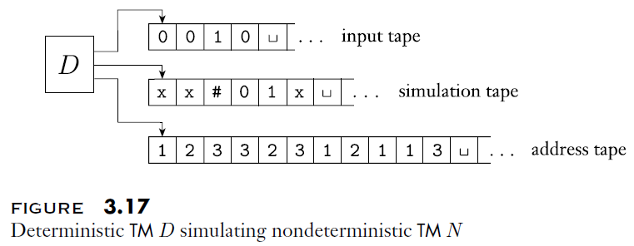
DTM Simulating NTM Example

Slide 29
The Steps of D, when Simulating N
The DTM, D, simulating an NTM, N, applied to an input, w, operates as follows:
  First, it copies the input, w, to tape 1 (the input tape); the other two blanks start off blank
  Tape 1 is copied to tape 2
  The address on tape 3 is to process tape 2
    Initially, tape 3 is empty, meaning that the BFS stays at the root of the computation tree (which means it will only accept at this point if the start configuration is an accepting configuration)
    Otherwise, the values on tape 3 tell D which choices to make at each node of the computation tree
    If any values in the address are not valid, this branch is aborted, and D continues with stage 4
    If a rejecting configuration is encountered at any time, this branch rejects, and D continues with stage 4
    If there are no more symbols in the address to process, this branch rejects, and D continues with stage 4
    If an accepting configuration is encountered at any time, D accepts (the simulation is complete)
  The address on tape 3 is incremented (I'll discuss this in class), and D returns to stage 2
As stated here so far, D will never halt if N does not accept, even if N is a decider
The algorithm can be updated to reject if every branch of N has rejected

Slide 30
Enumerators
Our textbook also describes what they refer to as "a type of Turing machine variant called an enumerator"; an enumerator prints strings from a language; the language is the set of strings that are eventually printed
Strings from the language may be listed in any order, possibly with repetition, possibly running forever
Theorem 3.21 of the textbook states "A language is Turing-recognizable if and only if some enumerator enumerates it"
To prove this, we need to prove two things
First, if an enumerator enumerates a language, we can create a TM that recognizes the language
  To decide if a string, w, should be accepted, the TM machine can run the enumerator, comparing every string to w
  If w ever appears, accept it
Second, if a TM, M, recognizes a language, we can construct an enumerator that enumerates it
  You might think that we can loop through every possible string, check if M accepts it, and if so, print it; however, this does not work, because M might never halt for some inputs
  Instead, we do the following (where s₁, s₂, … is a list of all possible strings, and we ignore the original input on the tape):
    Repeat for i = 1, 2, 3, …
    Run M for at most i steps for s₁, s₂, s₃, …, s_{i}
    Whenever a string is accepted, print it
  Note that every string in the language will get printed an infinite number of times (which is allowed)

Slide 31
Encodings
Turing machines always accept strings as input (recall that a string is any finite sequence of symbols from an alphabet)
Sometimes, we want to create Turing machines that perform computations related to objects of various types
Such objects might include graphs, polynomials, automata, etc.
This is fine, because all such objects can be encoded as strings.
The encoding, or representation, of an object, O, will be denoted as <O>
Several objects O₁, O₂, …, O_{k} can be encoded as a single string <O₁, O₂, …, O_{k}>
Although the textbook does not point this out until the next chapter, Turing machines can also be encoded as strings
  The encoding of a Turing machine, M, would be denoted <M>
  The encoding would have to specify every component of the formal definition of the TM; that is, the 7-tuple (Q, Σ, Γ, δ, q₀, q_{accept}, q_{reject})
  The exact format chosen to encode a TM doesn't matter in terms of it being valid, as long as it provides a complete, consistent, and unambiguous representation of the Turing machine

Slide 32
The Universal Turing Machine
The textbook doesn't discuss the universal Turing machine (UTM) until Section 4.2, when it comes up as a side note in the explanation of a theorem
I think this is a very important concept that deserves to be mentioned as part of this topic; the universal Turing machine is often considered to be the origin of the modern programmable computer
The concept of the universal Turing machine was first introduced by Alan Turing in 1936, as part of his original publication on Turing machines, in response to one of Hilbert's challenges
The universal Turing machine takes as input <M, w>, where <M> is the encoding of a TM, M, and w is the input that M should be applied to
The UTM simulates M applied to w, ultimately accepting its input <M, w> if and only if M accept w, and rejecting its input <M, w> if and only M rejects w
The UTM can also be constructed to ultimately output on its tape exactly what M would output when applied to w
It is also worth noting that the slowdown of the simulation is not extreme
  From the Arora and Barak book, if the simulated Turing machine, M, halts in T steps when applied to w, a well-designed UTM will halt within cT log T steps, where c is a constant on M's alphabet size, number of tapes, and number of states
  Their analysis also involves a UTM with multiple tapes; as previously mentioned, the Arora and Barak book also shows that the simulation of a multi-tape Turing machine with a single-tape Turing machine requires a quadratic slowdown

