Slide 1
ECE461: Theoretical CS
Time Complexity, Big-O Notation, the Class P

Slide 2
Brief Recap
In the first part of the course, based on the first part of the textbook, we learned about formalisms for describing regular languages and context-free languages, and discussed their limitations
In a topic that I consider to straddle the first two parts of the course, we learned about Turing machines
If we accept the Church-Turing thesis, all algorithms can be implemented by Turing machines
Then, in the second part of the course, based on the second part of the textbook, we learned about computability theory
Here, we learned that computation is inherently limited; in particular, some languages are undecidable, and some languages are not Turing-recognizable
Now we are moving on to the third part of the textbook and the third part of the course; the textbook calls this part "Complexity Theory", and all remaining topics will relate to this
For those problems that are decidable, we will learn that some are "easy" (meaning that they can be solved in polynomial time), and some are "hard" (meaning that they require exponential time)
In a later topic, we will learn about the NP-complete problems, which most computer scientists believe are hard in this sense, but that has not been proven
After that, we will cover various other topics, including space complexity, randomized algorithms, etc.
To start, however, we will initially focus on problems that do have polynomial time solutions

Slide 3
Time Complexity
Chapter 7 of the textbook is titled "Time Complexity"
This topic relates to Sections 7.1 and 7.2
Definition 7.1 of the textbook states (I am keeping the exact wording from the book):
  Let M be a deterministic Turing machine that halts on all inputs. The running time or time complexity of M is the function f: N → N, where f(n) is the maximum number of steps that M uses on any input of length n. If f(n) is the running time of M, we say that M runs in time f(n) and that M is an f(n) time Turing machine. Customarily we use n to represent the length of the input.
The book points out that its treatment of time complexity assumes that we are performing worst-case analysis
If we were performing average-case analysis, we would have to average the running times of all inputs of a particular length
There are a few basic things I want to point out:
  In DSA 1 and DSA 2, what we meant by the length of the input could vary from problem to problem
  For example, it might refer to the number of items being sorted, or the number of nodes and/or vertices in a graph; occasionally, we would even be measuring time complexity with respect to the value of the input
  In this course, we will very consistently be referring to the number of symbols that start off on a Turing machine's tape; it is literally the length of the input, measured in terms of TM cells

Slide 4
Big-O (and the rest)
The book defines big-O notation
  The definition matches what we learned in DSA 1 and used throughout DSA 1 and DSA 2
  They explain that when we use big-O notation, we are specifying an upper bound, or an asymptotic upper bound, of a function
  When we use this notation to analyze the running time of an algorithm, it is called asymptotic analysis, and "we seek to understand the running time of the algorithm when it is run on large inputs"
  They explain that when we express big-O notation, we ignore multiplicative constants and lower-order terms
A bit later, the book defines small-o notation (I call it little-o notation)
  The first part of the definition is not the same as what we learned in DSA 1
  However, they then state it another way that it is equivalent to the definition we learned in DSA 1
The textbook does not define, or use, big-Omega notation or big-Theta notation
  I don't think big-Omega is particularly relevant to the topics discussed in the textbook
  Big-Theta notation, on the other hand, is relevant at times
  In some locations, the book gets around the lack of big-Theta notation by specifying that some function is O(f(N)) but not o(f(N)), when they could be expressing that the function is Θ(f(N))
  In other locations, the book only uses big-O notation when they could be using big-Theta notation
I will feel free throughout the rest of the course to use any of the four notations that I see fit

Slide 5
Time Complexity Classes
Definition 7.7 of the textbook states (I am keeping the exact wording from the book):
  Let t: N → R⁺ be a function. Define the time complexity class, TIME(t(n)), to be the collection of all languages that are decidable by an O(t(n)) time Turing machine.
Note that the book defines R⁺ here to represent "the set of nonnegative real numbers"
Example: TIME(n²) contains all languages that can be decided in O(n²) time
Note that any language that can be decided in better than quadratic time (e.g., linear time) would also be a member of TIME(n²)
Some observations I would like to add:
  Two types of complexity classes are time complexity classes, which we are discussing in this topic, and space complexity classes, which we will discuss in a future topic
  We talked about the notion of a complexity class in DSA 2 as well (e.g., P and NP are complexity classes)
  In DSA 2, we casually defined a complexity class to be a set of computational problems with similar big-O time or memory bounds for deterministic or nondeterministic Turing machines
  The complexity classes we saw in DSA 2 were all defined in terms of decision problems (i.e., problems that ask yes/no questions); our textbook does not introduce the term "decision problem" until Chapter 10
  Our textbook defines complexity classes in terms of languages; it is easy to convert any decision problem into a language (i.e., the language consisting of all problem instances for which the answer is yes)
  In practice, most complexity classes are defined in terms of decision problems (or, alternatively, languages)

Slide 6
Example Language: {0^{k}1^{k} | k ≥ 0} (part 1)
Consider the following language: A = {0^{k}1^{k} | k ≥ 0}
In previous topics, we have seen that this is a non-regular language, but it is a context-free language; of course, it is also decidable
What we are concerned with here is how fast we can decide it; for now, we will consider how fast it can be decided using a single-tape Turing machine
One TM, M₁, for deciding A, can process an input, w, as follows:
  First, it checks if any 0 is found to the right of any 1; if so, reject
  Otherwise, as long as both 0s and 1s remain on the tape, M₁ repeatedly scans its input, crossing off a single 0 and a single 1 (like marking)
  If at any point, there are remaining 0s but not 1s, or remaining 1s and not 0s, reject
  If at any point, all 0s and 1s and crossed out, accept
The book discusses the analysis of the algorithm in a casual way, concluding that this is a O(n²) algorithm; I think this is obvious enough such that we don't need to go through all the details
Therefore, A ∈ TIME(n²)
Note: We could further conclude that this is a Θ(n²) algorithm, but as previously discussed, the book does not introduce this notation, and this fact is not relevant to us here

Slide 7
Example Language: {0^{k}1^{k} | k ≥ 0} (part 2)
Just because A ∈ TIME(n²), this does not preclude A from being in a smaller complexity class
That is, A may still be in TIME(t(n)) for some t(n) = o(n²)
In fact, there is a TM, M₂, that decides this language in O(n log n) time
M₂ processes its input, w, and proceeds as follows:
  First, it checks if any 0 is found to the right of any 1; if so, reject
  Otherwise, as long as both 0s and 1s remain on the tape, M₂ repeatedly does the following:
    If the total number of 0s and 1s is odd, reject
    Otherwise, scan the tape, cross off every other 0, starting with the first 0, and cross off every other 1, starting with the first 1
  Ultimately, if all 0s and 1s are crossed off, accept; otherwise, reject
An analysis shows that this algorithm performs a logarithmic number of linear passes; hence, it is a O(n log n) time algorithm
Therefore, A ∈ TIME(n log n)

Slide 8
Example Language: {0^{k}1^{k} | k ≥ 0} (part 3)
The book states without proof that the language, A, cannot be decided in o(n log n) time using a single-tape TM
They reference Problem 7.49, which asks you to prove that TIME(f(n)) where f(n) = o(n log n) can only contain regular languages!
However, the book goes on to show that a two-tape TM, M₃, can recognize A in linear time
M₃ processes its input, w, and proceeds as follows:
  First, it checks if any 0 is found to the right of any 1; if so, reject
  Otherwise, with a linear scan, M₃ copies all the 0s from the input tape to the other tape
  Next, M₃ scans the 1s on the input tape, and for each one, it crosses off a 0 from the other tape
  If there are remaining 1s when all the 0s are crossed off, reject
  When all the 1s are crossed off, if there are any 0s left, reject; otherwise, accept
I add: We can clearly recognize A in linear time using a modern computer (assuming the input fits in memory, with a bit of memory left over)

Slide 9
Important Point about Time Complexity
The textbook makes an important point:
  "This discussion highlights an important difference between complexity theory and computability theory. In computability theory, the Church–Turing thesis implies that all reasonable models of computation are equivalent—that is, they all decide the same class of languages. In complexity theory, the choice of model affects the time complexity of languages."
Some observations I would like to add:
  I don't particularly like the book's definitions of time complexity or time complexity classes, because the definitions do not make it clear that the model matters
  For example, one might ask whether A, the language we've been discussing, is a member of TIME(O(n)); we can't answer that without specifying our model of computation
  The book generally assumes the model of computation is a single-tape TM; in that case, the answer is no, but with a different model of a TM, the answer could be yes
  Additionally, the book's definition of a time complexity class does not allow us to define time complexity classes related to optimization problems
  Recall that we discussed optimization problems briefly at the end of DSA 2 in the context of approximation algorithms for optimization versions of complete problems
  The book discusses approximation algorithms in Section 10.1 (we will cover this near the end of the course)
  In theoretical computer science, it is less common to define complexity classes in terms of optimization problems, but it is still valid to do so

Slide 10
The Model Only Matters Somewhat
We have seen that the time complexity of a language depends on the model of computation we are using
However, "time requirements don't differ greatly for typical deterministic models"
Theorem 7.8 states: "Let t(n) be a function, where t(n) ≥ n. Then every t(n) time multitape Turing machine has an equivalent O(t²(n)) time single-tape Turing machine."
The proof is relatively simple
  They refer back to Theorem 3.13, which stated that every multi-tape TM has an equivalent single-tape TM
  To prove this, we showed that a single-tape TM can simulate a multi-tape TM
  Briefly, the single tape TM can concatenate all the tapes from the multi-tape TM, with a delimiter in between, and mark the position of each read-write head
  The simulation of each single step of the multi-tape TM requires at most O(t(n)) time, so the total time is O(t²(n)); the book provides some additional detail about this, but I think it is fairly obvious
When we discussed Theorem 3.13, I mentioned that the Arora and Barak book gives a more detailed analysis
  They show that if a TM with k tapes requires T(N) steps, the simulation requires at most 5kT(N)² steps
  However, their simulation was not exactly the same as the one described in our textbook, so it is unclear if this would hold precisely; either way, the simulation requires only a quadratic slowdown

Slide 11
Time Complexity of Nondeterministic TMs
In an earlier topic, we saw that deterministic Turing machines (DTMs) are equal in power to nondeterministic Turing machines (NTMs)
Now that we are interested in time complexity, we need to define what this means for NTMs
Definition 7.9 states (I am keeping the book's exact wording; the figure is on the next slide):
  Let N be a nondeterministic Turing machine that is a decider. The running time of N is the function f: N → N, where f(n) is the maximum number of steps that N uses on any branch of its computation on any input of length n, as shown in the following figure.
There are some important points to make here:
  As with DTMs, running time is synonymous with time complexity in this context
  Not all sources define the running time for NTMs this way (although the Arora and Barak book and the Papadimitriou book both define it this way)
  However, some other sources define the time complexity for NTMs when they accept the input as the smallest depth of any path leading to an accept state
  Recall from an earlier topic, our textbook states that a NTM is a decider iff every path halts on all inputs
  Other sources state that this is only necessary when the NTM rejects
  I think that both differences depend on whether we consider an NTM to stop as soon as any path accepts
  Either way, the power of the formalism is the same regardless of the definition of time complexity

Slide 12
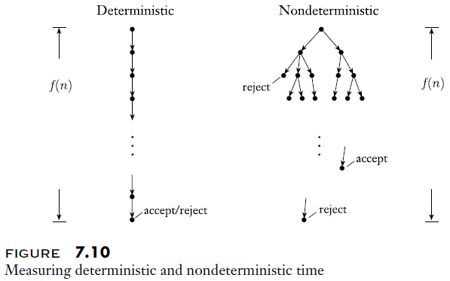
Deterministic versus Nondeterministic Time

Slide 13
Simulating an NTM
Theorem 7.11 states (I am keeping the exact wording from the book):
  Let t(n) be a function, where t(n) ≥ n. Then every t(n) time nondeterministic single-tape Turing machine has an equivalent 2^{O(t(n))} time deterministic single-tape Turing machine.
The proof is somewhat simple
  They refer back to Theorem 3.16, which states that every NTM, N, has an equivalent DTM, D
  To prove this, we showed that a multi-tape TM can simulate an NTM by performing a breadth-first search that travels to each node in the NTM's computation tree
  The current proof explains that the number of total leaves in the tree is at most b^{t(n)}, and the total number of nodes is less than twice that, so it is bound by O(b^{t(n)})
  The time it takes to simulate each path from the root to a particular node is O(t(n))
  Book: "Therefore, the running time of D is O(t(n)b^{t(n)}) = 2^{O(t(n))}
  The book does not explain the last simplification, but it is not too hard to show algebraically (I can discuss this during class)
  We previously showed that a single-tape TM can simulate a multi-tape TM in quadratic time; so, we can simulate the NTM in time (2^{O(t(n))})² = 2^{O(2t(n))} = 2^{O(t(n))}
Note that this does not prove that an exponential slowdown is necessary when we use a DTM to solve the same problem as an NTM; it is the slowdown for this method of simulation

Slide 14
Polynomial versus Exponential Running Time
Book: "For our purposes, polynomial differences in running time are considered to be small, whereas exponential differences are considered to be large."
A bit later: "Polynomial time algorithms are fast enough for many purposes, but exponential time algorithms are rarely useful"
Exponential algorithms sometimes arise when we are forced to execute a brute-force search over an exponentially big search space
Book: "All reasonable deterministic computational models are polynomially equivalent."
  This means that we can choose any reasonable TM model, and although the choice affects time complexity, it doesn't change what can or cannot be implemented in polynomial time
  This is important; it explains a pragmatic benefit of using polynomial versus exponential running time as the means of classifying a problem as easy or hard
The textbook points out that "real programmers certainly care about such differences"
However, just as we previously disregarded constants and lower order terms when using asymptotic notation, we are now disregarding "much greater polynomial differences"
This doesn't mean we don't care about such differences in general, but it will allow us to focus on some very important questions

Slide 15
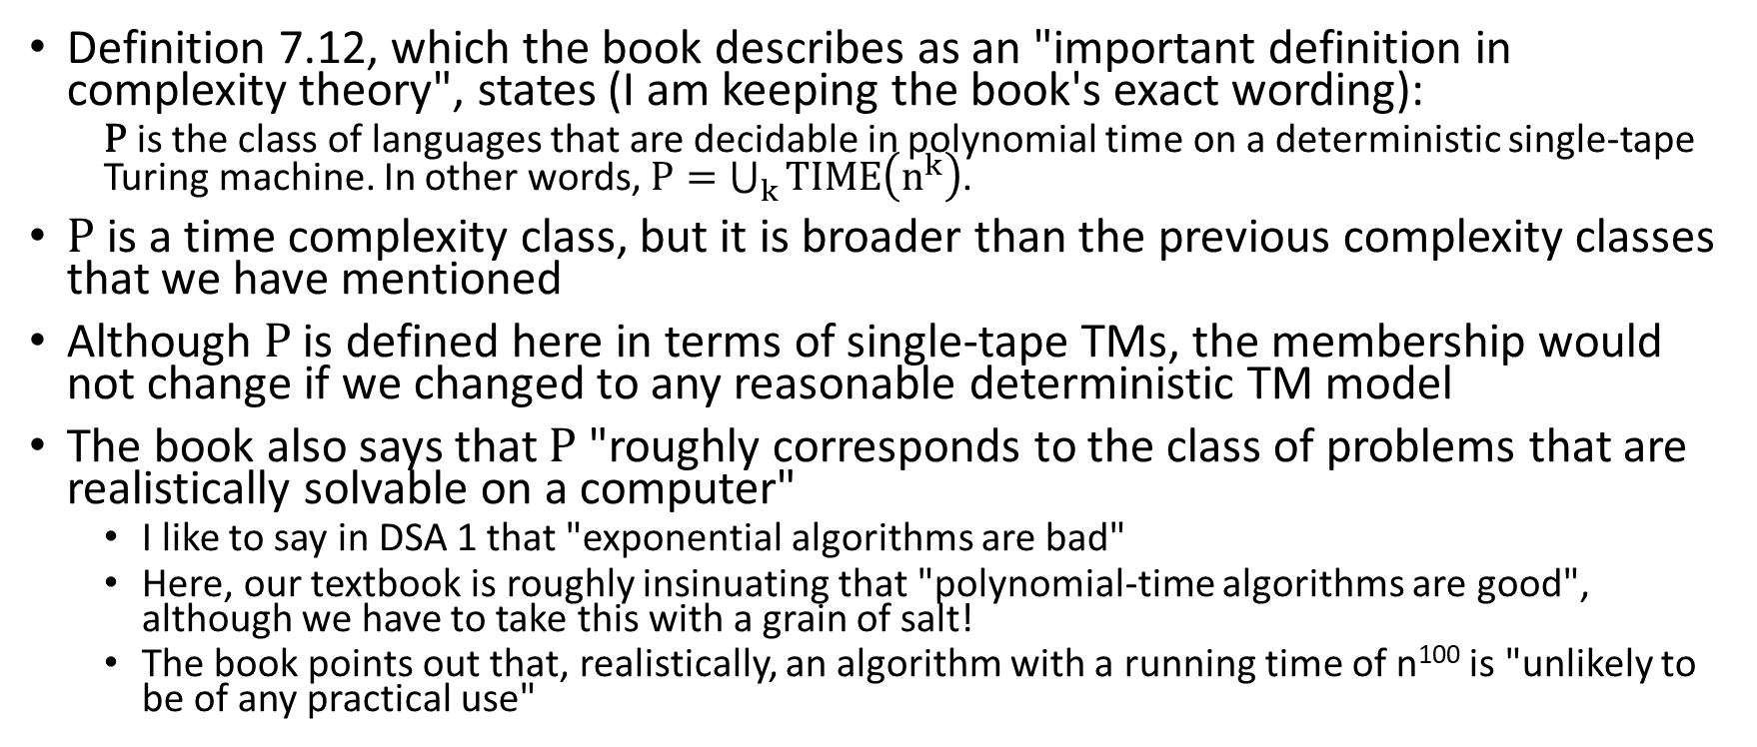
P
Definition 7.12, which the book describes as an "important definition in complexity theory", states (I am keeping the book's exact wording):
  P is the class of languages that are decidable in polynomial time on a deterministic single-tape Turing machine. In other words, $P=\bigcup_{k}{TIME\left(n^{k}\right)}$.
P is a time complexity class, but it is broader than the previous complexity classes that we have mentioned
Although P is defined here in terms of single-tape TMs, the membership would not change if we changed to any reasonable deterministic TM model
The book also says that P "roughly corresponds to the class of problems that are realistically solvable on a computer"
  I like to say in DSA 1 that "exponential algorithms are bad"
  Here, our textbook is roughly insinuating that "polynomial-time algorithms are good", although we have to take this with a grain of salt!
  The book points out that, realistically, an algorithm with a running time of n¹⁰⁰ is "unlikely to be of any practical use"

Slide 16
PATH
The book discusses graphs, and in particular, the PATH problem, which asks if there is a path from vertex s to vertex t in a directed graph, G
They define the notion of an adjacency matrix
Note that they don't mention adjacency lists; the purpose here is not to develop the most efficient algorithm possible, but just to show that the problem is solvable in polynomial time
Setting this up as a language, they define: PATH = {<G, s, t> | G is a directed graph that has a directed path from s to t}
Theorem 7.14 states, "PATH ∈ P"
The algorithm to decide this language works as follows:
  First, node s is marked
  Then the following procedure is repeated until no new node is marked:
    All edges are examined
    If any edge leads from a marked source to an unmarked destination, the destination is marked
  At the end, if t is marked, accept; otherwise, reject
This algorithm is clearly a polynomial-time algorithm, proving the theorem

Slide 17
RELPRIME
The RELPRIME problem asks us to determine if two positive integers are relatively prime (meaning that the largest integer that evenly divides both is 1)
This can be set up as a language as follows: RELPRIME = {<x, y> | x and y are relatively prime}
Theorem 7.15 states, "RELPRIME ∈ P"
Note that to solve this in polynomial time, we can not simply loop through all the values from 1 to min(x, y)
  This is because for any reasonable encoding of each integer value (e.g., binary), the magnitude of the value is exponential in the length of the encoding
  This might be different than such a problem would be analyzed in a class such as DSA 1 or 2 (I'll discuss this more in class), but it is consistent with our current definition of time complexity
Instead, the book describes the Euclidean algorithm (I learned it as Euclid's algorithm) for finding the greatest common divisor (GCD) of two integers
Clearly, two numbers are relatively prime iff the GCD is 1
They show that this algorithm can be implemented in polynomial time by a TM, thus proving the theorem

Slide 18
Context-Free Languages (revisited)
Earlier in the course, we proved Theorem 4.9, which states that "every context-free language is decidable"
That proof relied on Theorem 4.7, which sates that "A_{CFG} is a decidable language"
The proof of Theorem 4.7, however, involves an exponential algorithm to decide A_{CFG}
  That algorithm first converts the CFG to Chomsky normal form
    Recall that in Chomsky normal form, every rule is of the form A → BC (where A, B, and C are nonterminals), or A → b (where A is a nonterminal and b is a terminal)
    Optionally, there can be one more rule of the form S → ε, where S is the start symbol
  Then it explores all paths with length 2n-1; we proved that all paths leading to a string with n symbols would take this many steps if the grammar is in Chomsky normal form
  If any path is found that generates the given string w, the TM accepts
  If no path is found that generates the given string w, the TM rejects
This algorithm is clearly exponential, but when we covered it, we stated we would see a more efficient algorithm later in the course; now we will keep that promise

Slide 19
Dynamic Programming
Theorem 7.16 states: "Every context-free language is a member of P"
The book explains how dynamic programming can be used to solve the problem in polynomial time
As with the previous (exponential) algorithm, they assume the CFG is in Chomsky normal form
Given an input string w₁w₂…w_{n}, the algorithm fills in an n x n table, called "table"
  Only the main diagonal and slots above the main diagonal get filled
  The cell table[i][j], where i ≤ j, contains the collections of variables (nonterminals) that can generate w_{i}w_{i+1}…w_{j}
The two key insights to fill in the table are as follows:
  For all slots table[i][i] (the slots on the main diagonal), a nonterminal, A, can fill the slot iff there is a rule of the form A → b, where b matches the i^{th} input symbol
  For all slots table[i][j] where i < j (above the main diagonal), a nonterminal, A, can fill the slot iff there is a rule of the form A → BC, and there is a k with i ≤ k < j such that table[i][k] contains B and table[k+1][j] contains C
The pseudo-code shown on the next slide (a snapshot from the textbook) shows how the algorithm can be implemented
  This pseudo-code fills in the table one diagonal at a time (which is different than the order I had learned, but valid)
  When each slot is filled in, the slots it depends on have already been filled in; so, this is bottom-up dynamic programming
  The book mentions that the algorithm has a time complexity O(n³), where n is the number of input symbols
  I add: We can also say that the time complexity is O(n³m), where m is the number of rules in the CFG; however, we can treat m as a constant, so the book is not wrong; we could also say that the time complexity is θ(n³m)

Slide 20
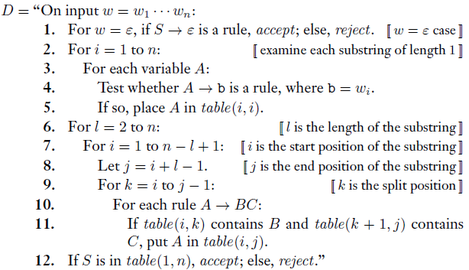
Dynamic Programming Example Pseudo-Code

Slide 21
The CKY Algorithm for NLP
Astute students who have taken the NLP course might recognize that the algorithm we just covered is identical to the CKY algorithm (not mentioned in our textbook)
  The algorithm is named after its inventors, Cocke, Kasami, and Younger; some sources refer to it as the CYK algorithm
  This is an example of a chart parsing algorithm; chart parsers, in general, use efficient, dynamic programming algorithms for parsing a string of terminal symbols, given a grammar expressed as a CFG
  In NLP, the CKY algorithm can be used to parse natural language text; here, we are using it more generally
For students who took the NLP course, some differences between the way we covered it in that class, compared to the way it is covered here, include:
  In NLP, we filled in the columns from left to right, and we filled each column from bottom to top; the pseudo-code from the textbook in our current course (on the previous slide) fills in one diagonal at a time
  Both orders are fine; either way, each cell depends only on cells that have previously been filled in
  In NLP, the indexes referred to spaces between terminals; here, the indexes refer to positions of terminals
  Both methods are equivalent; rows and columns are numbered so that cells represent spans of terminals
  In NLP, we first covered the algorithm as a recognizer, which is how it is covered here; that is, the algorithm determines whether a string is valid according to a grammar expressed as a CFG
  In NLP, we also expanded the algorithm to include backpointers so that we could retrieve all valid parses; if you took NLP during a recent semester, you implemented the expanded algorithm as a programming project

Slide 22
Thoughts about Dynamic Programming
When we learn about dynamic programming in DSA 2, it is one of several algorithm strategies that can be used to tackle certain problems
Other strategies included greedy algorithms, divide-and-conquer, randomized algorithms, exhaustive search, and backtracking search
While these strategies are all important, dynamic programming seems to me to have special significance for our current course, for the following reason:
  We will soon start investigating the P versus NP question, which was also discussed in DSA 2
  We will soon discuss the complexity class NP in this course, and we'll discuss the P versus NP question shortly after that
  Most computer scientists believe that P ≠ NP, and there is a lot of intuition behind this
  However, one might argue that dynamic programming algorithms provide evidence in the opposite direction
  That is, some problems which, at first, might seem to require exponential time using an exhaustive search, can be performed in polynomial time using dynamic programming
  For the record, however, I believe P ≠ NP, and I would be quite surprised if the opposite turns out to be true

