Slide 1
ECE461: Theoretical CS
Space Complexity,
Savitch's Theorem,
the Class PSPACE

Slide 2
Brief Recap
Earlier in the course, we explored computability theory
We discussed Turing machines (TMs), focusing mostly on deterministic Turing machines (DTMs), but also discussing nondeterministic Turing machines (NTMs)
If we accept the Church-Turing thesis, all algorithms can be implemented by Turing machines
Then, we started covering complexity theory
We discussed how to measure time complexity, using notations such as big-O
We learned the definition of a time complexity class, TIME(t(n)), containing all languages decidable by an O(t(n)) time Turing machine; membership in TIME(t(n)) depends on the specific TM model being used
We defined P, the time complexity class containing all languages that can be decided in polynomial time by a single-tape TM; using any reasonably defined model for DTMs, the membership of P would not change
We also defined another time complexity class, NP, and we saw two formulations of it
One formulation states that NP is the class of languages that have polynomial time verifiers; the other formulation states that NP is the class of languages that are decidable in polynomial time by some NTM
It is unknown whether P = NP; the textbook refers to this open question as the P versus NP question
In our previous topic, we learned about the hardest NP languages, known as NP-complete languages
In our current topic, we will shift our discussion to space complexity and space complexity classes
This topic is based on Sections 8.1 - 8.2 of the textbook (and the start of Chapter 8 before Section 8.1)

Slide 3
Space Complexity
Definition 8.1 of the textbook (at the start of Chapter 8, before Section 8.1 starts) defines space complexity for both DTMs and NTMs
First, they define space complexity for a DTM, M, that halts on all inputs as follows (I am keeping the book's exact wording):
  The space complexity of M is the function f: N→N, where f(n) is the maximum number of tape cells that M scans on any input of length n. If the space complexity of M is f(n), we also say that M runs in space f(n).
Then, they define space complexity for an NTM, M, where all branches halt on all inputs (I am truncating but keeping the book's exact wording):
  …we define its space complexity f(n) to be the maximum number of tape cells that M scans on any branch of its computation for any input of length n.
Note that both definitions assume we are performing worst-case analysis

Slide 4
Space Complexity Classes
For any function f: N → R⁺, Definition 8.2 defines the space complexity classes SPACE(f(N)) and NSPACE(f(N))
The definitions are as follows (I am keeping the book's exact wording):
  SPACE(f(n)) = {L | L is a language decided by an O(f(n)) space deterministic Turing machine}
  NSPACE(f(n)) = {L | L is a language decided by an O(f(n)) space nondeterministic Turing machine}
There are a few observations I would like to make here:
  As in previous topics, the book uses the notation R⁺ to represent the set of nonnegative real numbers
  These definitions are analogous to the definitions of TIME(t(n)) and NTIME(t(n)) that we saw in (two separate) previous topics
  Recall based on our definition of space complexity (on the previous slide) that:
    The languages in SPACE(f(n)) have DTM deciders that halt on every input
    The languages in NSPACE(f(n)) have NTM deciders that halt on every branch for every input

Slide 5
SAT (revisited)
Recall that SAT was the first-ever language (or decision problem) proven to be NP-complete
Thus, SAT is considered one of the hardest NP languages, and it is believed to not be in P (is SAT is in P, then P = NP)
Example 8.3 shows that SAT can be solved with linear space; i.e., it is a member of SPACE(N)
A DTM, M₁, processing input <Φ>, where Φ is a Boolean formula, can proceed as follows:
  One at a time, try every assignment to the variables x₁, …, x_{m} of Φ
  For each, evaluate Φ
  If the expression ever evaluates to 1 (true), accept
  If no assignment evaluates to 1, reject
Book: "Space appears to be more powerful than time because space can be reused, whereas time cannot."

Slide 6
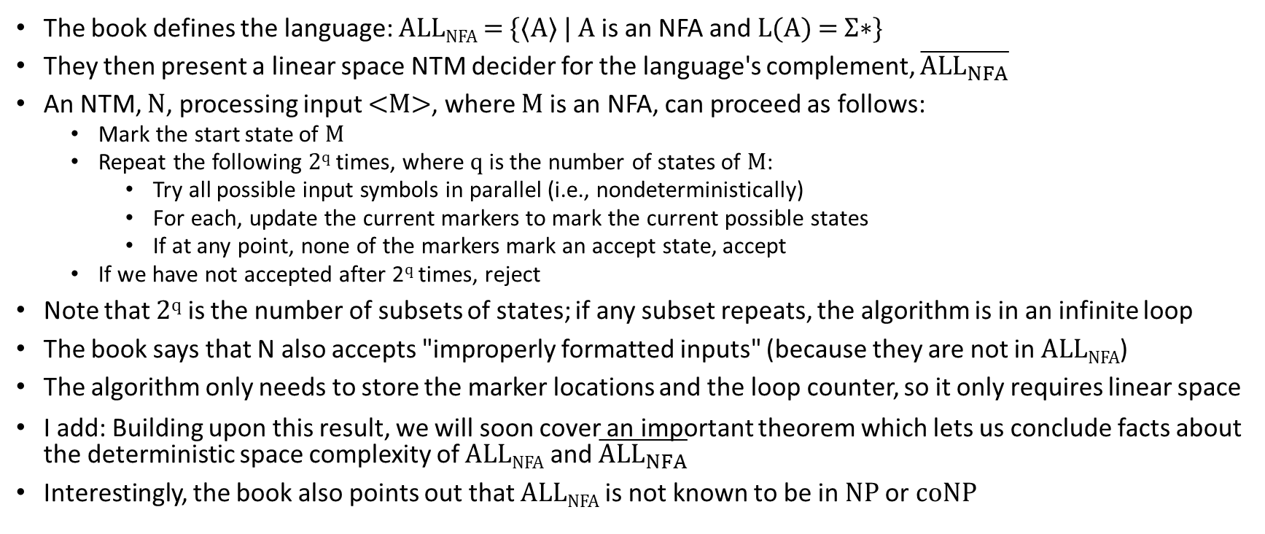
ALL_{NFA}
The book defines the language: ALL_{NFA} = {⟨A⟩ | A is an NFA and L(A) = Σ∗}
They then present a linear space NTM decider for the language's complement, $\overline{{ALL}_{NFA}}$
An NTM, N, processing input <M>, where M is an NFA, can proceed as follows:
  Mark the start state of M
  Repeat the following 2^{q} times, where q is the number of states of M:
    Try all possible input symbols in parallel (i.e., nondeterministically)
    For each, update the current markers to mark the current possible states
    If at any point, none of the markers mark an accept state, accept
  If we have not accepted after 2^{q} times, reject
Note that 2^{q} is the number of subsets of states; if any subset repeats, the algorithm is in an infinite loop
The book says that N also accepts "improperly formatted inputs" (because they are not in ALL_{NFA})
The algorithm only needs to store the marker locations and the loop counter, so it only requires linear space
I add: Building upon this result, we will soon cover an important theorem which lets us conclude facts about the deterministic space complexity of ALL_{NFA} and $\overline{{ALL}_{NFA}}$
Interestingly, the book also points out that ALL_{NFA} is not known to be in NP or coNP

Slide 7
Savitch's Theorem
Based on online sources, Savitch's theorem (Theorem 8.5 in the textbook) was proven by Walter Savitch in 1970
  This was just one year after receiving his Ph.D. from Berkeley in 1969, under the advisement of Steven Cook
  Interestingly, Cook apparently was forced to leave Berkely in 1970, after being denied tenure by the math department
  Recall that one year later, in 1971, Cook (in his new position at the University of Toronto) published his now famous paper proving the Cook-Levin theorem!
Savitch's theorem states: "For any function f: N→R⁺, where f(n) ≥ n, NSPACE(f(n)) ⊆ SPACE(f²(n))."
A footnote points out that this can be strengthened, such that it applies whenever f(n) ≥ log n (this is proven later in the chapter)

Slide 8
Proving Savitch's Theorem (part 1)
In the "proof idea", the textbook first discusses an approach that fails
  Consider the simulation of an NTM by a DTM, that tries out one branch at a time
  Note that this would not necessarily be a breadth-first search, like we've seen before
  Instead, it could be a depth-first search (although the textbook does not use that term), because we are dealing with NTMs where every branch halts for every input
  The space complexity of a depth-first search is related to the depth to which it searches
  However, a branch that uses f(n) space may run for up to 2^{O(f(n))} steps
  We have seen this term before, when discussing the straight-forward simulation of an NTM by a DTM during the topic of time complexity
  The simulation would need to keep track of the choices used in the current branch, so it can back up and try the next branch
  Clearly, this would require an exponential amount of space
Therefore, we need to take another approach

Slide 9
Proving Savitch's Theorem (part 2)
We will use a constructive proof that solves a more general problem; we will show that for any NTM, N, in NSPACE(f(n)), there is a SPACE(f²(n)) DTM, M, that solves the yieldability problem
The yieldability problem asks: Given an NTM, N, two configurations c₁ and c₂, and a number, t, can the N get from c₁ to c₂ within t steps
M (which is based on N) accepts input, w, intended for N
M then searches for "an intermediate configuration c_{m}", and it recursively checks two things:
  Can N get from c₁ to c_{m} within t/2 steps?
  Can N get from c_{m} to c₂ within t/2 steps?
Space is reused for the two recursive calls
The next slide shows pseudo-code for CANYIELD (I am using a snapshot from the textbook, to make sure the pseudo-code is exact)
N can also be modified such that before it accepts, it clears its tape and moves its head all the way to the left; then, there will only be a single accept state, c_{accept}
M can then use CANYIELD, passing it c_{start}, c_{accept}, and 2^{df(n)}, where this last term is the largest number of steps that N applied to w using O(f(n)) space might require (we'll tighten this up later)

Slide 10
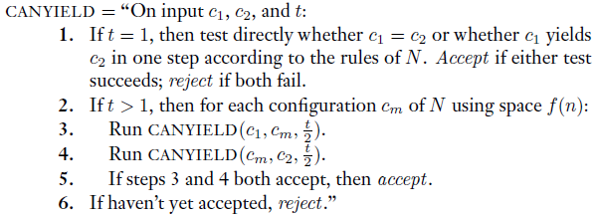
Proving Savitch's Theorem (part 3)

Slide 11
Proving Savitch's Theorem (part 4)
The book doesn't talk much about the ability to do recursion
We know from DSA 1 and 2 that any recursive algorithm can be implemented without recursion using a stack
We have also seen that the recursion theorem allows a TM to get access to its own description (but I don't think that is needed here)
When CANYIELD calls itself recursively, it "…stores the current stage number and the values of c₁, c₂, and t on a stack so that these values may be restored…"
Each level of recursion thus adds a O(f(n)) space to its tape (the size of a configuration is clearly linear with respect to the amount of space used so far)
Note that the second recursive call does not occur until the first recursive call returns, so only one path through the recursive calls is stored at a time
Book: "The depth of the recursion is log t, where t is the maximum time that the nondeterministic machine may use on any branch."; I add: this is because t is divided in half with each recursive call
As mentioned in the proof idea (already discussed), the largest number of steps that N applied to w using O(f(n)) space might require is 2^{df(n)}; thus, the depth of the recursion is O(log 2^{df(n)}) = O(f(n))
Therefore, the total space used is O(f²(n)), as claimed by Savitch's theorem

Slide 12
Proving Savitch's Theorem (part 5)
The book mentions that there is a "technical difficulty", which is that "M needs to know the value of f(n) when it calls CANYIELD"
I add: I think it really needs to "know the value of" d*f(n) so it can pass 2^{df(n)} to the original call to CANYIELD; the constant also matters
We can get around this by having M repeatedly call CANYIELD, continuously increasing the third parameter, trying 1, 2, 3, etc.
If any call to CANYIELD accepts, M accepts
We also need to know when to stop
After M uses CANYIELD to determine if N can reach c_{accept} in i steps, it then uses CANYIELD to determine if any configuration of length i+1 can be reached
Here are some of my thoughts about this:
  I was, at first, confused about the book's explanation about this, but after thinking it through, I realized it makes sense
  If the space complexity of N is O(f(n)), then no branch of N will use more space than this on any input
  So, M can loop through all possible configurations of length i+1, and use CANYIELD to see if any of them is reachable
  If no configuration of length i+1 is reachable (which eventually will happen if c_{accept} is not reachable), then M rejects
  If at least one configuration of length i+1 is reachable, M continues searching for a way to reach c_{accept}
  Obviously, this adds a lot to the time complexity, but it does not add to the space complexity

Slide 13
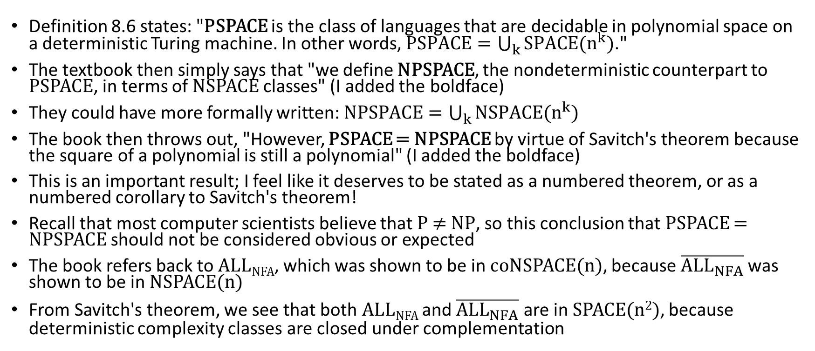
PSPACE and NPSPACE
Definition 8.6 states: "PSPACE is the class of languages that are decidable in polynomial space on a deterministic Turing machine. In other words, $PSPACE=\bigcup_{k}{SPACE(n^{k})}$."
The textbook then simply says that "we define NPSPACE, the nondeterministic counterpart to PSPACE, in terms of NSPACE classes" (I added the boldface)
They could have more formally written: $NPSPACE=\bigcup_{k}{NSPACE(n^{k})}$
The book then throws out, "However, PSPACE = NPSPACE by virtue of Savitch's theorem because the square of a polynomial is still a polynomial" (I added the boldface)
This is an important result; I feel like it deserves to be stated as a numbered theorem, or as a numbered corollary to Savitch's theorem!
Recall that most computer scientists believe that P ≠ NP, so this conclusion that PSPACE = NPSPACE should not be considered obvious or expected
The book refers back to ALL_{NFA}, which was shown to be in coNSPACE(n), because $\overline{{ALL}_{NFA}}$was shown to be in NSPACE(n)
From Savitch's theorem, we see that both ALL_{NFA} and $\overline{{ALL}_{NFA}}$ are in SPACE(n²), because deterministic complexity classes are closed under complementation

Slide 14
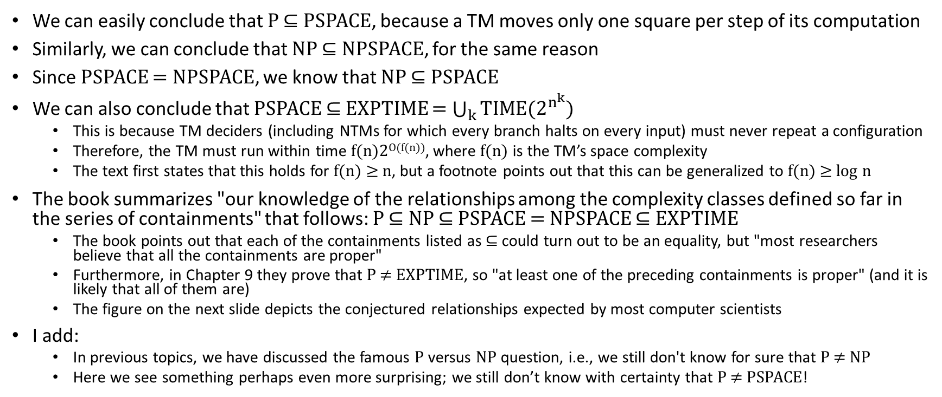
Relationships Among Complexity Classes
We can easily conclude that P ⊆ PSPACE, because a TM moves only one square per step of its computation
Similarly, we can conclude that NP ⊆ NPSPACE, for the same reason
Since PSPACE = NPSPACE, we know that NP ⊆ PSPACE
We can also conclude that PSPACE ⊆ EXPTIME = $\bigcup_{k}{TIME(2^{n^{k}})}$
  This is because TM deciders (including NTMs for which every branch halts on every input) must never repeat a configuration
  Therefore, the TM must run within time f(n)2^{O(f(n))}, where f(n) is the TM’s space complexity
  The text first states that this holds for f(n) ≥ n, but a footnote points out that this can be generalized to f(n) ≥ log n
The book summarizes "our knowledge of the relationships among the complexity classes defined so far in the series of containments" that follows: P ⊆ NP ⊆ PSPACE = NPSPACE ⊆ EXPTIME
  The book points out that each of the containments listed as ⊆ could turn out to be an equality, but "most researchers believe that all the containments are proper"
  Furthermore, in Chapter 9 they prove that P ≠ EXPTIME, so "at least one of the preceding containments is proper" (and it is likely that all of them are)
  The figure on the next slide depicts the conjectured relationships expected by most computer scientists
I add:
  In previous topics, we have discussed the famous P versus NP question, i.e., we still don't know for sure that P ≠ NP
  Here we see something perhaps even more surprising; we still don’t know with certainty that P ≠ PSPACE!

Slide 15
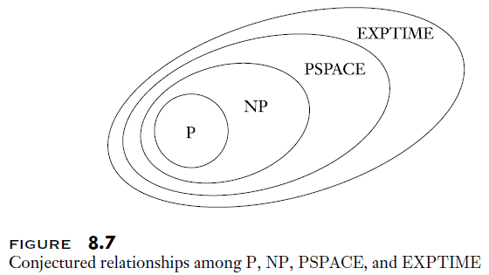
Conjectured Complexity Class Containments

