Slide 1
ECE461: Theoretical CS
Reductions and Computation Histories

Slide 2
Brief Recap
In our recent topics, we have been discussing Turing machines (TMs), providing us with the most powerful known formalism for modeling computation
If we accept the Church-Turing thesis, then all algorithms can be implemented by Turing machines
We discussed what it means for a language to be Turing-decidable (a.k.a. decidable) or Turing-recognizable; we also learned that some languages are undecidable (not decidable), and some are not Turing-recognizable
In one previous topic, we saw some examples of decidable languages that were related to other languages and the formalisms that describe them
These language were interesting in that deciding whether a string is a member of one of these languages is equivalent to answering a yes/now question about to the related formalism
In our previous topic, we proved that the language A_{TM} is an undecidable language
Determining if a string is a member of this language is equivalent to determining if a specified TM accepts a specified input; this is known as the acceptance problem for Turing machines
We proved that A_{TM} is undecidable using an indirect proof and diagonalization
In this topic, we will learn how to use reductions to prove that several additional languages are undecidable or not Turing-recognizable
This topic is based on Chapter 5 of the textbook

Slide 3
Reductions
Book: "A reduction is a way of converting one problem to another problem in such a way that a solution to the second problem can be used to solve the first problem."
The book doesn't formally define the concept of reductions until Section 5.3, and we will also discuss a formal definition toward the end of this topic
My wording (still not formal, but closer to the definition): A reduction is a function that maps instances of one language, L₁, to instances of another language, L₂, and maps non-instances of L₁ to non-instances of L₂
For now, we will less-strictly use the concept of reduction to prove that certain problems are undecidable
In this topic, we will, several times, reduce A_{TM} to some other language, L
Then, a Turing machine (or more generally, an algorithm) that decides L could be used to decide A_{TM}
This means that if L were decidable, then A_{TM} would also be decidable; since we already proved that A_{TM} is undecidable, then L is also undecidable
Once we prove that some language, L, is undecidable, we can reduce L to another language, L', to show that L' is also undecidable; logically speaking, we can say that reducibility obeys the transitive property
Note that in DSA 2, we used reductions to prove that certain problems are NP-complete, and we will also do that later in this course
In this topic, we will be using reductions to prove that certain languages are undecidable

Slide 4
HALT_{TM}
Our next language is: HALT_{TM} = {<M, w> | M is a TM and M halts on input w}
Of course, determining whether a string is part of this language is equivalent to determining whether a TM, M, halts on input w
This is known as the halting problem
Historically, the halting problem was the original problem that Turing showed was undecidable in 1936
This was also the problem that we proved was undecidable in DSA 2
In case anyone is reading along using the 2nd edition of the textbook, there is one point that needs explaining:
  Strangely, in the 2nd edition of the textbook, when the book first introduces A_{TM}, it refers to it as the halting problem, although I have not personally seen the term halting problem refer to A_{TM} in any other source
  Later, when the book introduces HALT_{TM}, it explains the following in a footnote:
    "In Section 4.2, we used the term halting problem for the language A_{TM} even though HALT_{TM} is the real halting problem. From here on we distinguish between the two by calling A_{TM} the acceptance problem."
  Thankfully, the 3rd edition of the textbook introduces A_{TM} as the acceptance problem to begin with!

Slide 5
The Halting Problem is Undecidable
Theorem 5.1 in the textbook states: "HALT_{TM} is undecidable"
It is easy to show that if the halting problem were decidable, then the acceptance problem would also be decidable
Assume a TM, R, exists that decides the halting problem
Then we could create a TM, S, that decides the acceptance problem, as follows:
  S processes input of the form <M, w> where M is a Turing machine and w is its input
  First, S uses R to decide if M halts on w
  If M does not halt on w, S rejects
  If M halts on w, then S simulates M on w (knowing it will halt)
  If M accepts w, S accepts <M, w>; if M rejects w, S rejects <M, w>
Casually (but not technically) speaking, we can think of this as a reduction from A_{TM} to HALT_{TM}

Slide 6
E_{TM}
Our next language is: E_{TM} = {<M> | M is a TM and L(M) = ∅}
Theorem 5.2 in the textbook states: "E_{TM} is undecidable"
We will prove this with using an indirect proof and a reduction (casually speaking) from A_{TM}
First, assume E_{TM} is decidable, and R is a TM that decides it; we will show that we we could then create a TM, S, that is a decider for A_{TM}, accepting input in the form <M, w> iff M accepts w
As part of S's processing, it will create the encoding <M₁> of another TM, M₁, that operates as follows:
  M₁ compares its input, x, to w (remember that w is available to S to hardcode into the encoding <M₁>)
  If x ≠ w, M₁ rejects; otherwise, if x = w, M₁ simulates M on input w; M₁ accepts if M accepts and rejects if M rejects
Now we can explain the behavior of S, processing input <M, w> as follows:
  First, S creates the encoding <M₁> as explained above
  Then, S runs R (a decider for E_{TM}) on input <M₁>
  If R accepts, S rejects; if R rejects, S accepts (so S does the opposite of R, unlike a typical reduction)
Note that TM M₁, encoded as <M₁>, recognizes the empty language, ∅, if and only if M does not accept w
Also note that M₁ is never actually applied, and it does not matter if M rejects w of runs forever on w
S as described would be a decider for A_{TM}, which is impossible; therefore, the assumption that E_{TM} is decidable, which lead to this contradiction, must be false

Slide 7
REGULAR_{TM}
Our next language is: REGULAR_{TM} = {<M> | M is a TM and L(M) is a regular language}
We will use another indirect proof and reduction from A_{TM}
First, assume REGULAR_{TM} is decidable, and R is a TM that decides it
Then we could create a TM, S, that is a decider for A_{TM}, accepting input in the form <M, w> iff M accepts w
As part of S's processing, it constructs another Turing machine, M₂, that works as follows:
  M₂ processes input x; if x is of the form 0^{n}1^{n} (which is a non-regular language), M₂ accepts
  Otherwise, M₂ simulates M on w; M₂ accepts if M accepts and rejects if M rejects
Note that if M accepts w, then M₂ will accept all strings, and hence recognize a regular language; if M does not accept w, then M₂ will only accept strings of the form 0^{n}1^{n}, which is a nonregular language
Note that M₂ will never actually be run on x, and it doesn't matter if M₂ would hang on w
Now, S can process its input <M, w> where M is a TM and w is a string as follows:
  First, S creates the encoding <M₂>, the encoding of M₂ described above as explained above
  Then, S runs R (a decider for REGULAR_{TM}) on input <M₂>
  If R accepts, S accepts; if R rejects, S rejects
S as described would be a decider for A_{TM}, which is impossible; so, the assumption that REGULAR_{TM} is decidable, which led to the contradiction, must be false

Slide 8
EQ_{TM}
Our next language is: EQ_{TM} = {<M₁, M₂> | M₁ and M₂ are TMs and L(M₁) = L(M₂)}
Theorem 5.4 in the textbook states: "EQ_{TM} is undecidable"
To prove this, we can now take advantage of the fact that reducibility is transitive
Assume that EQ_{TM} is decidable; then there must be a TM, R, that decides it
Given R, we could easily create a TM, S, that decides E_{TM}
S would process its input <M> as follows:
  Run R on <M, M'>, where M' is any TM that rejects all inputs
  If R accepts, S accepts; if R rejects, S rejects
Since we already proved that E_{TM} is undecidable, EQ_{TM} must also be undecidable

Slide 9
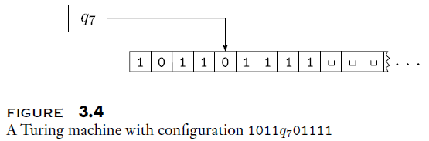
Configurations (revisited)
Recall that he current configuration of a TM is determined by the current content of the tape, the current location of the read-write head, and its current state
It is often useful to be able to represent the configuration of a TM as a string
We previously learned that we can denote the current configuration of a Turing machine, M, as uqv, where:
  uv is the contents of M's tape (all squares to the right of v contain blanks)
  q is the current state of M
  M's read-write head is over the leftmost symbol of v (if v is the empty string, M is positioned over the blank symbol just to the right of u)
The start configuration of M can be represented as q₀w, where w is the initial input
The figure below graphically depicts a TM in configuration 1011q₇01111

Slide 10
Computation Histories
The computation history for a TM is the sequence of configurations the machine goes through for a given input
  We can represent the computation history for a TM, M, on input w, as C₁, C₂, …, C_{l}
  C₁ is the start configuration, which can be represented as q₀w using the notation we previously covered
  Each c_{i}, with 1 < i ≤ l, must legally follow from c_{i-1}
  If c_{l} is an accepting configuration (meaning that the state is q_{accept}), then this is an accepting computation history
  If c_{l} is a rejecting configuration (meaning that the state is q_{reject}), then this is a rejecting computation history
For a deterministic Turing machine (DTM), there is a single computation history given the input
The notion of computation histories will be important to several reductions that we examine

Slide 11
Linear Bounded Automata
We will now introduce another computation formalism, known as a linear bounded automaton (LBA)
We can think of this as a Turing machine that is not allowed to move off the portion of the tape containing the input (if it tries to move left off the left-most square or right off the right-most square, it stays still)
Book: "Using a tape alphabet larger than the input alphabet allows the available memory to be increased up to a constant factor"
  This idea allows us to effectively increase the memory by a linear factor with respect to the size of the input, which is where the name of the formalism comes from (and some sources define LBAs to have this ability)
  The book doesn't flesh this out, but I'll talk about it during the lecture
Here is some history, based on other sources:
  The formalism was introduced in a 1960 paper by John Myhill
  A 1964 paper by S.-Y. Kuroda introduced the nondeterministic version and proved they recognize the class of context-sensitive languages
  This is part of the Chomsky hierarchy, above context-free languages but below Turing-recognizable languages
  As far as I can tell, it is still an open question whether deterministic LBAs are equally powerful to nondeterministic LBAs (e.g., that's what Wikipedia says, but I haven't seen definitive confirmation of this)
  Today, most sources use the term linear bounded automaton to refer to the nondeterministic version, and they refer to the deterministic version as a deterministic LBA explicitly
  However, our textbook uses the term linear bounded automaton to refer to the deterministic version
  I think that deterministic LBAs might be the best formalism to model what computers are capable of (I'll discuss this in class)

Slide 12
A_{LBA}
Our next language is: A_{LBA} = {<M, w> | M is an LBA that accepts string w}
Theorem 5.9 in the textbook states: "A_{LBA} is decidable"
  Here, we have an excursion from the general topic, and prove that A_{LBA} is a decidable language
  This may be surprising, since we have proven that A_{TM} is undecidable
We will be able to prove that A_{LBA} is decidable by showing that there are a finite number of configurations any LBA can be in
  Consider an LBA, M, with q states, g symbols in the tape alphabet, and a tape of length n (the read-write head will never stray from this)
  Lemma 5.8 of the textbook states that the number of distinct configurations of M is qng^{n} (I think the proof is obvious – I'll discuss the reasoning in class)
Given this fact, we can clearly construct a TM, L, that decides A_{LBA} as follows:
  L processes input <M, w>, where M is an LBA and w is M's input
  L simulates M on w until M halts or for at most qng^{n} steps
  Note that if M uses qng^{n} steps, it means it must repeat an exact configuration, and therefore must be in an infinite loop (i.e., it will never halt)
  If M accepts w, L accepts; otherwise, if M rejects w or uses qng^{n} steps without halting, L rejects

Slide 13
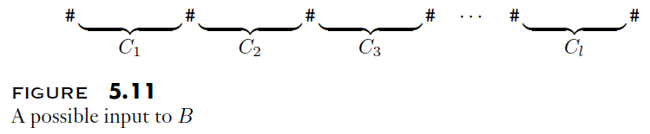
E_{LBA} (part 1)
Our next language is: E_{LBA} = {<M> | M is an LBA where L(M) = ∅}
Theorem 5.10 in the textbook states: "E_{LBA} is undecidable"
We will once again use an indirect proof and a reduction (casually speaking) from A_{TM}
First, assume E_{LBA} is decidable, and R is a TM that decides it; then we could create a TM, S, that is a decider for A_{TM}, accepting input in the form <M, w> iff M accepts w
As part of S's processing, S constructs an LBA, B, that accepts its input string x if and only if x is an accepting computation history for M on w
  The figure above shows a possible format of the input, x, processed by B, assuming that # is a special symbol used to separate configurations in the input sequence
  B must check three things to decide whether x is an accepting computation history for M on w:
    C₁ is M's start configuration
    Each C_{i+1} legally follows C_{i} for 1 ≤ i < l
    C_{l} is an accepting configuration for M
  The book explains some of the details, but I think it is pretty obvious that an LBA is capable of this
Note that if M accepts w, L(B) is non-empty; if M does not accept w, L(B) = ∅

Slide 14
E_{LBA} (part 2)
Now, S can process its input <M, w> where M is a TM and w is a string as follows:
  S constructs an encoding for the LBA, B, described on the previous slide
  Recall that the construction of <B> relies on S's knowledge of M and w
  Also recall that the language of B is empty if and only if M does not accept w
  If M does accept w, then the language of B is non-empty, because B would accept M's accepting computation history (which must exist)
  Then, S applies R, a decider for E_{LBA}, on input <B>
    Recall that we have assumed that E_{LBA} is decidable at the start of our indirect proof; thus, such an R must exist
    If R accepts, meaning L(B) = ∅, S rejects (since it means that M does not accept w)
    If R rejects, meaning L(B) is non-empty, S accepts (since it means that M accepts w)
S would be a decider for A_{TM}, which we know is impossible
Therefore, the assumption that E_{LBA} is decidable, which led to the contradiction, must be false; hence, E_{LBA} is undecidable

Slide 15
ALL_{CFG} (part 1)
Our next language is: ALL_{CFG} = {<G> | G is an CFG where L(G) = Σ*}
Determining whether a string is a member of this language is equivalent to determining if a CFG is capable of generating all strings that can be formed from its alphabet
Theorem 5.13 in the textbook states: "ALL_{CFG} is undecidable"
We will once again use an indirect proof and a reduction (casually speaking) from A_{TM}
This reduction, like the last one, will involve computation histories
Given the encoding of a TM, M, and its input, w
The book at first states that we will construct a CFG, G, that generates all strings that are not accepting computation histories for M on w (although we will soon make a couple of modifications to this plan)
Consider a computation history formatted as #C₁#C₂#...#C_{l}#
In order for this to not be an accepting computation history for M on w, at least one of the following three things must be true:
  C₁ is not the correct start configuration for M
  C_{i+1} does not legally follow C_{i} for some 1 ≤ i < l
  C_{l} is not an accepting configuration for M

Slide 16
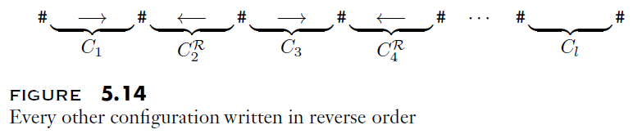
ALL_{CFG} (part 2)
Instead of constructing a CFG, we will construct a PDA that accepts all strings that are not accepting computation histories of M on w
We have previously learned that any PDA can be converted to a CFG describing the same language (and vice versa), so this is equivalent to our previously stated goal
The PDA will have to verify that at least one of the three criteria listed on the previous slide is violated
  Looking back at the criteria, determining if the first or third is violated should be simple, using separate branches of the PDA
  Determining if the second of the three criteria is violated would be more difficult using the PDA's stack
  We want to nondeterministically compare each C_{i} to C_{i+1}, where i is in the appropriate range
  In general, all symbols from the two configurations must match, except those right around the read-write head, where the differences must match one of the valid transitions
  To simplify this, we will change the format used to represent computation history, such that every other configuration is specified in reverse order; this is demonstrated in the following figure:
The book doesn't complete the proof, but at this point, you should be able to fill in the remaining details

Slide 17


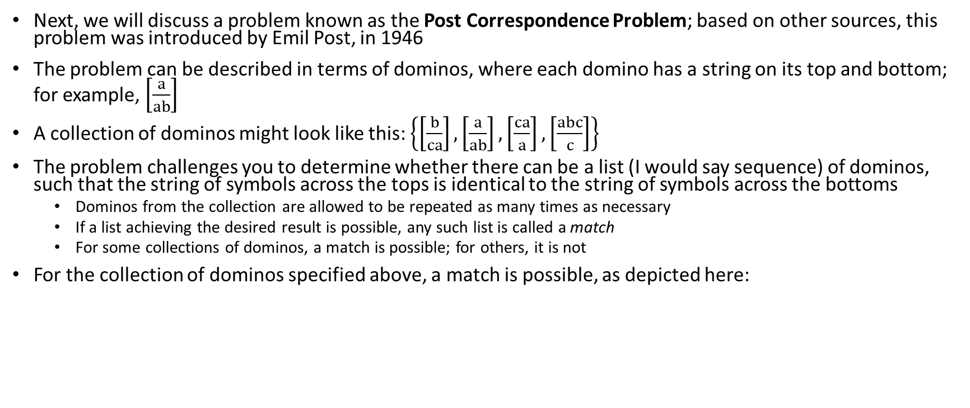
The Post Correspondence Problem
Next, we will discuss a problem known as the Post Correspondence Problem; based on other sources, this problem was introduced by Emil Post, in 1946
The problem can be described in terms of dominos, where each domino has a string on its top and bottom; for example, $\left[\frac{a}{ab}\right]$
A collection of dominos might look like this: $\left\{\left[\frac{b}{ca}\right], \left[\frac{a}{ab}\right],\left[\frac{ca}{a}\right],\left[\frac{abc}{c}\right]\right\}$
The problem challenges you to determine whether there can be a list (I would say sequence) of dominos, such that the string of symbols across the tops is identical to the string of symbols across the bottoms
  Dominos from the collection are allowed to be repeated as many times as necessary
  If a list achieving the desired result is possible, any such list is called a match
  For some collections of dominos, a match is possible; for others, it is not
For the collection of dominos specified above, a match is possible, as depicted here:

Slide 18
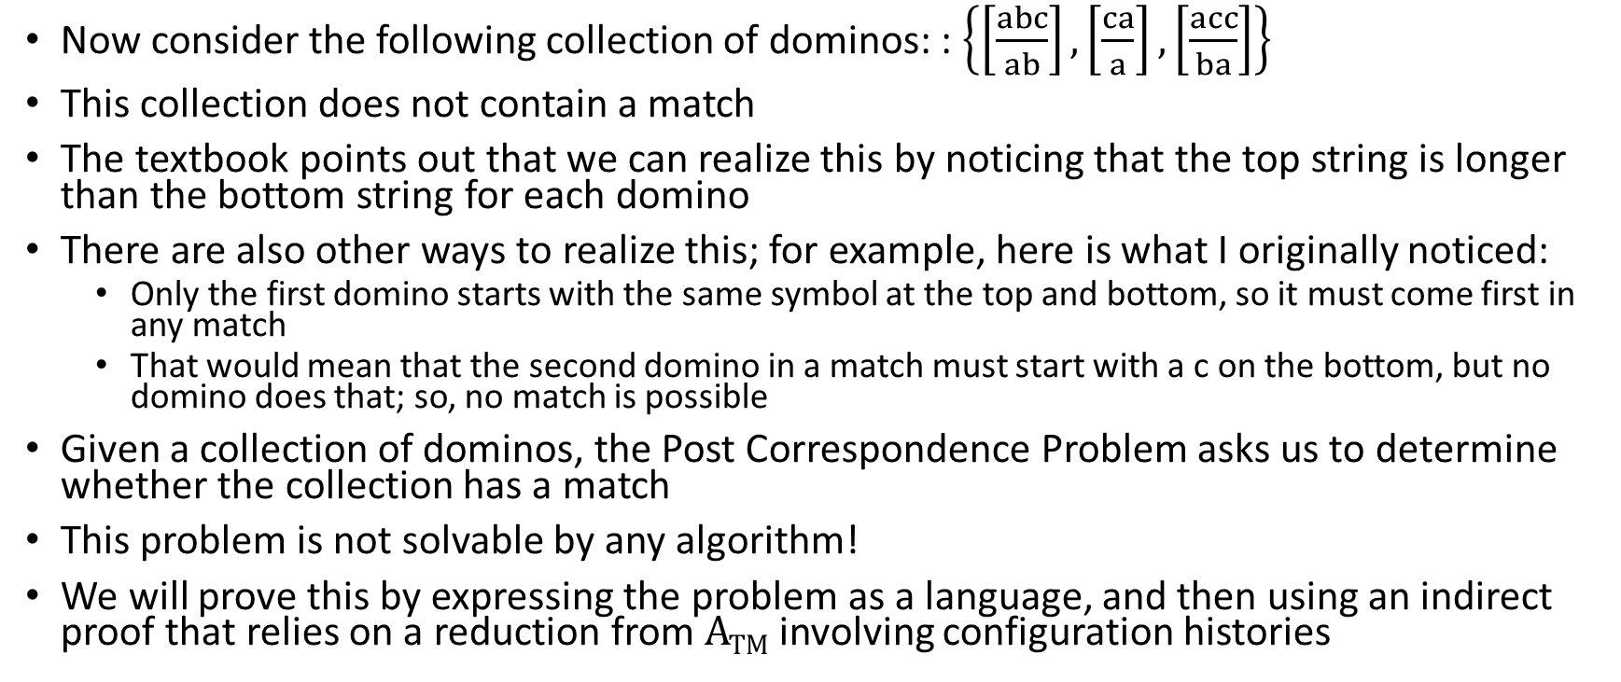
Not all Collections of Dominos have Matches
Now consider the following collection of dominos: : $\left\{\left[\frac{abc}{ab}\right], \left[\frac{ca}{a}\right],\left[\frac{acc}{ba}\right]\right\}$
This collection does not contain a match
The textbook points out that we can realize this by noticing that the top string is longer than the bottom string for each domino
There are also other ways to realize this; for example, here is what I originally noticed:
  Only the first domino starts with the same symbol at the top and bottom, so it must come first in any match
  That would mean that the second domino in a match must start with a c on the bottom, but no domino does that; so, no match is possible
Given a collection of dominos, the Post Correspondence Problem asks us to determine whether the collection has a match
This problem is not solvable by any algorithm!
We will prove this by expressing the problem as a language, and then using an indirect proof that relies on a reduction from A_{TM} involving configuration histories

Slide 19
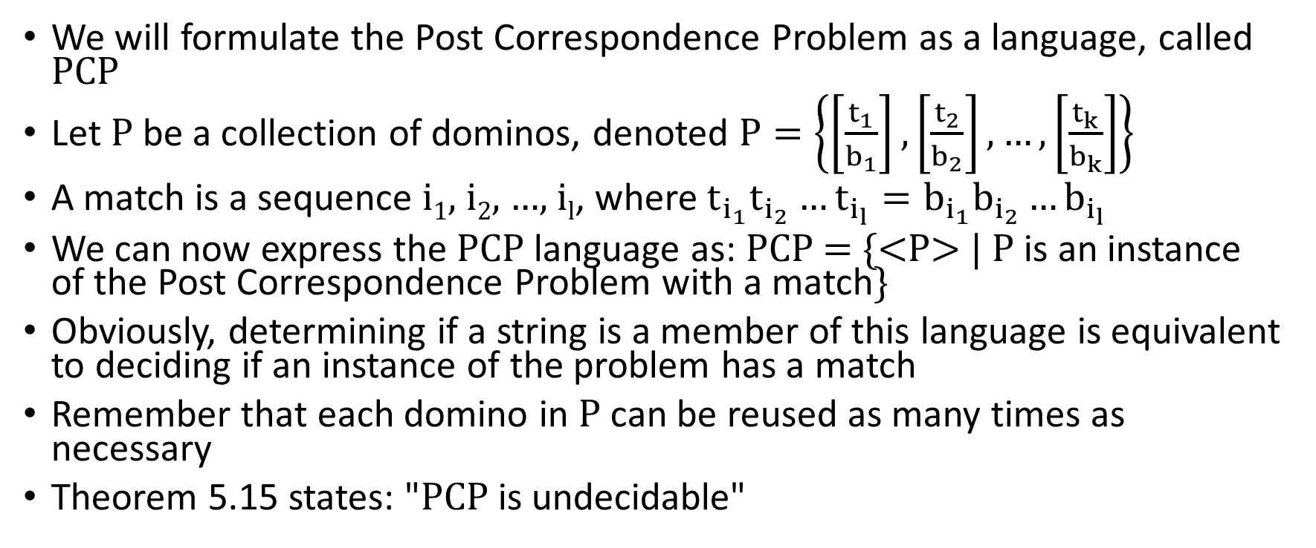
PCP
We will formulate the Post Correspondence Problem as a language, called PCP
Let P be a collection of dominos, denoted $P=\left\{\left[\frac{t_{1}}{b_{1}}\right], \left[\frac{t_{2}}{b_{2}}\right],…,\left[\frac{t_{k}}{b_{k}}\right]\right\}$
A match is a sequence i₁, i₂, …, i_{l}, where $t_{i_{1}}t_{i_{2}}…t_{i_{l}}=b_{i_{1}}b_{i_{2}}…b_{i_{l}}$
We can now express the PCP language as: PCP = {<P> | P is an instance of the Post Correspondence Problem with a match}
Obviously, determining if a string is a member of this language is equivalent to deciding if an instance of the problem has a match
Remember that each domino in P can be reused as many times as necessary
Theorem 5.15 states: "PCP is undecidable"

Slide 20
Proving that PCP is Undecidable (precursor)
We want to show that if we could solve PCP, then we could solve A_{TM}
Consider a string <M, w>; we will construct a collection of dominos, P, that has a match if and only if M accepts w
If there is a match, the string spelled out by both the top and bottom of the dominos will be an accepting computation history for M on w (with some extra symbols at the end)
First, we are going to handle what the textbook refers to as "three small technical points"
  We assume that M on w never attempts to move the read-write head off the left end of the tape, which requires "altering M to prevent this behavior"
    This, in my opinion, is the most complex of the three technical points
    I'll discuss how this can be achieved in class
    Exercise 5.8 (the answer is in the book) considers how to alter the proof so we can drop this assumption
  If w = ε, we use the string ␣ in place of w when we construct our instance of P (this is simple, and allows us to handle rules when the tape starts blank and there are transitions involving a blank tape symbol)
  We modify PCP such that the problem requires that the match starts with the first domino
    Thus, our reduction will be from A_{TM} to the language: MPCP = {<P> | P is an instance of the Post Correspondence Problem with a match that starts with the first domino}
    At the end of the proof, we will show how MPCP can be reduced to PCP

Slide 21
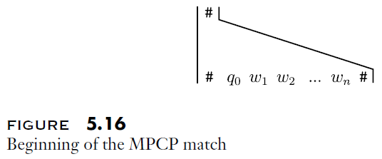
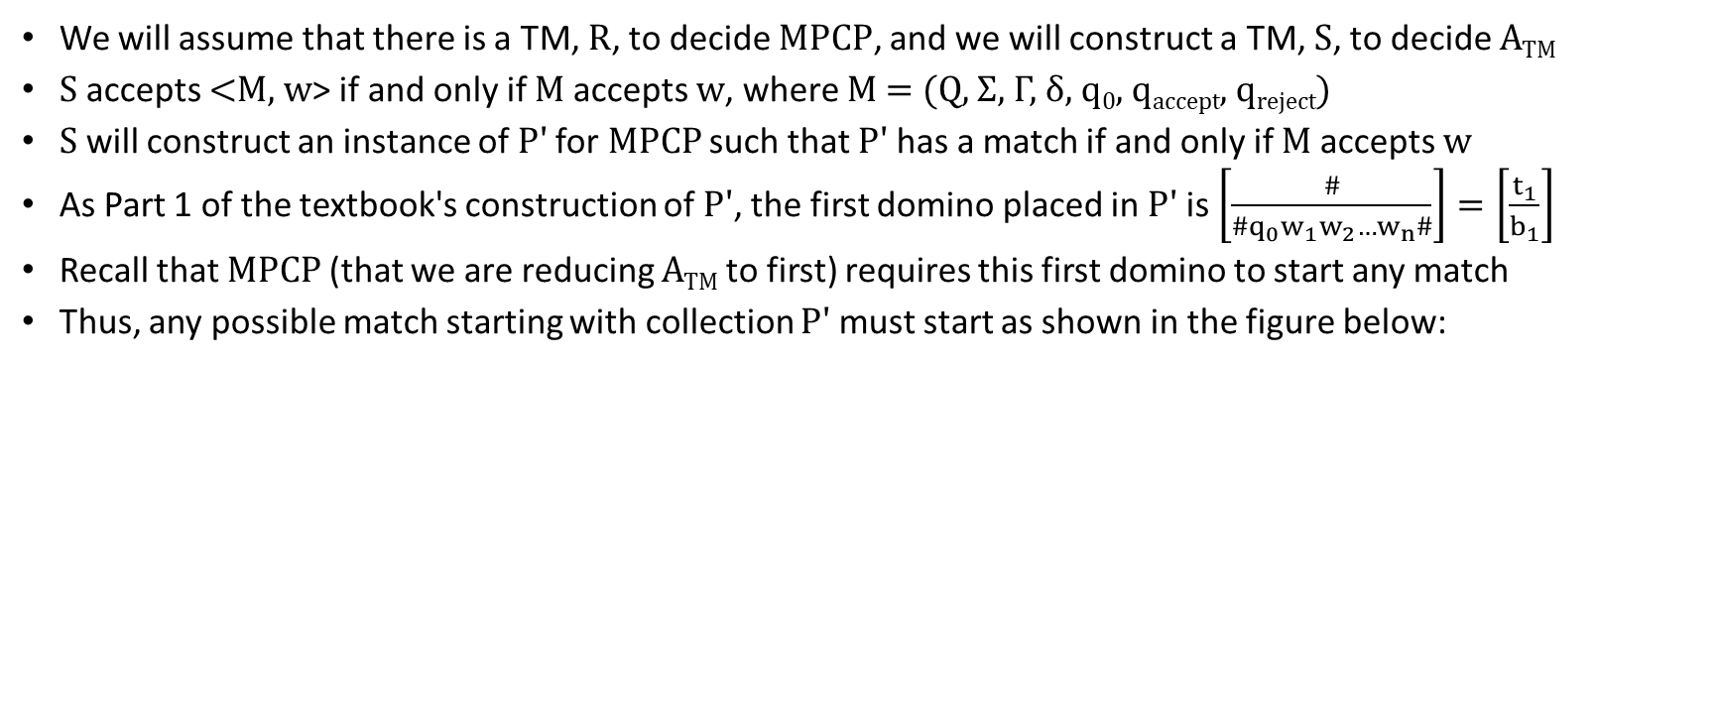
A_{TM} to MPCP, Part 1
We will assume that there is a TM, R, to decide MPCP, and we will construct a TM, S, to decide A_{TM}
S accepts <M, w> if and only if M accepts w, where M = (Q, Σ, Γ, δ, q₀, q_{accept}, q_{reject})
S will construct an instance of P' for MPCP such that P' has a match if and only if M accepts w
As Part 1 of the textbook's construction of P', the first domino placed in P' is $\left[\frac{\#}{\#q_{0}w_{1}w_{2}…w_{n}\#}\right]=\left[\frac{t_{1}}{b_{1}}\right]$
Recall that MPCP (that we are reducing A_{TM} to first) requires this first domino to start any match
Thus, any possible match starting with collection P' must start as shown in the figure below:

Slide 22
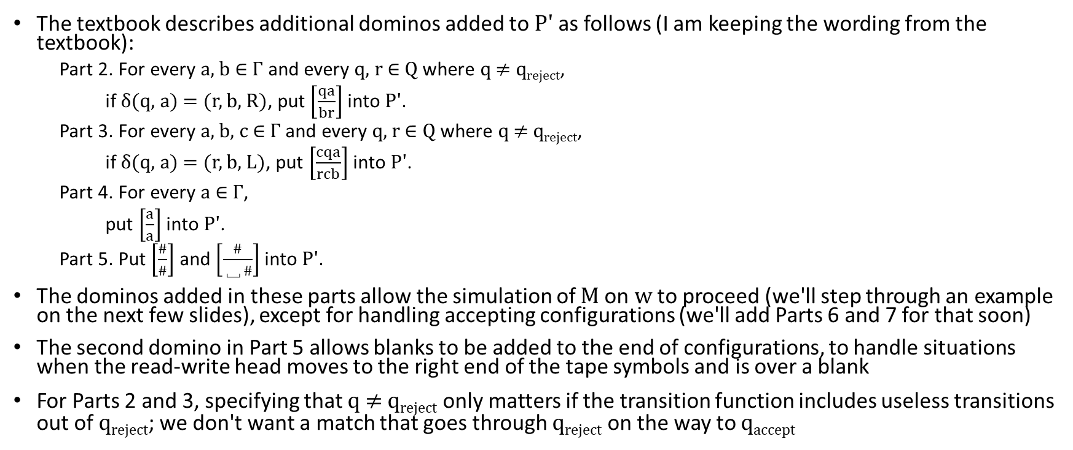
A_{TM} to MPCP, Parts 2 through 5
The textbook describes additional dominos added to P' as follows (I am keeping the wording from the textbook):
  Part 2. For every a, b ∈ Γ and every q, r ∈ Q where q ≠ q_{reject},
  if δ(q, a) = (r, b, R), put $\left[\frac{qa}{br}\right]$ into P'.
  Part 3. For every a, b, c ∈ Γ and every q, r ∈ Q where q ≠ q_{reject},
  if δ(q, a) = (r, b, L), put $\left[\frac{cqa}{rcb}\right]$ into P'.
  Part 4. For every a ∈ Γ,
  put $\left[\frac{a}{a}\right]$ into P'.
  Part 5. Put $\left[\frac{\#}{\#}\right]$ and $\left[\frac{\#}{\text{␣}\#}\right]$into P'.
The dominos added in these parts allow the simulation of M on w to proceed (we'll step through an example on the next few slides), except for handling accepting configurations (we'll add Parts 6 and 7 for that soon)
The second domino in Part 5 allows blanks to be added to the end of configurations, to handle situations when the read-write head moves to the right end of the tape symbols and is over a blank
For Parts 2 and 3, specifying that q ≠ q_{reject} only matters if the transition function includes useless transitions out of q_{reject}; we don't want a match that goes through q_{reject} on the way to q_{accept}

Slide 23
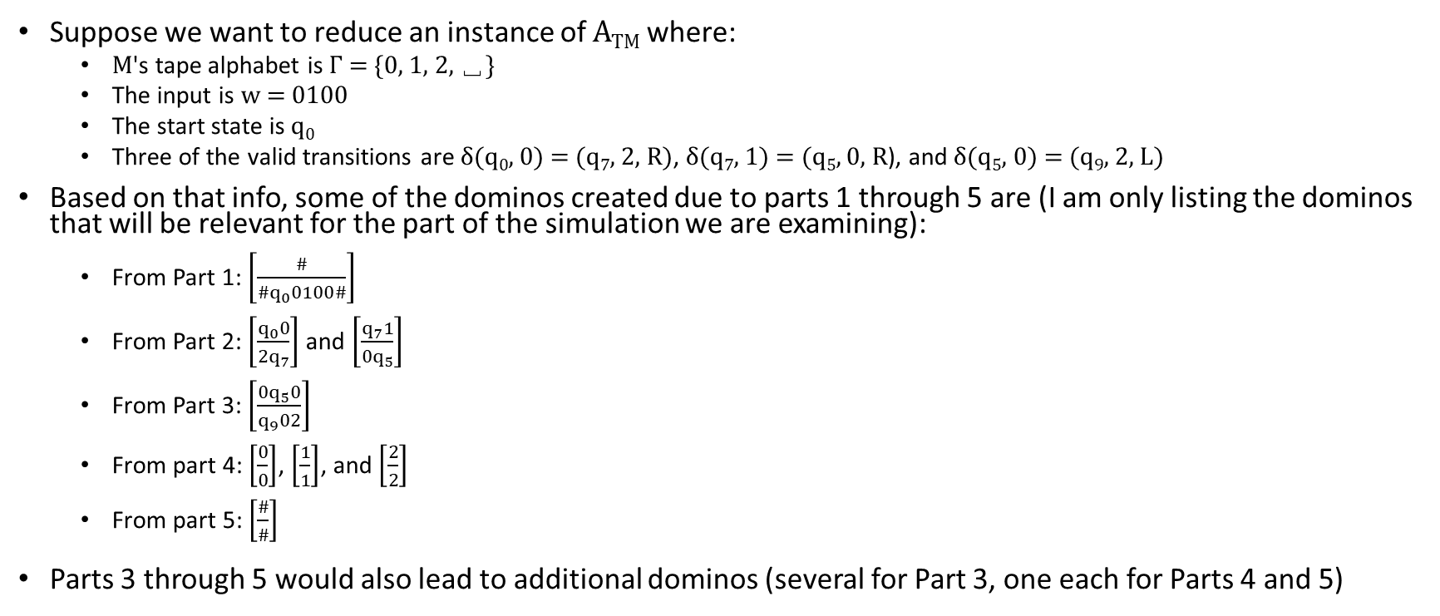
A_{TM} to MPCP, Parts 2 through 5 Example
Suppose we want to reduce an instance of A_{TM} where:
  M's tape alphabet is Γ = {0, 1, 2, $\text{␣}$}
  The input is w = 0100
  The start state is q₀
  Three of the valid transitions are δ(q₀, 0) = (q₇, 2, R), δ(q₇, 1) = (q₅, 0, R), and δ(q₅, 0) = (q₉, 2, L)
Based on that info, some of the dominos created due to parts 1 through 5 are (I am only listing the dominos that will be relevant for the part of the simulation we are examining):
  From Part 1: $\left[\frac{\#}{\#q_{0}0100\#}\right]$
  From Part 2: $\left[\frac{q_{0}0}{2q_{7}}\right]$ and $\left[\frac{q_{7}1}{0q_{5}}\right]$
  From Part 3: $\left[\frac{{0q}_{5}0}{q_{9}02}\right]$
  From part 4: $\left[\frac{0}{0}\right]$, $\left[\frac{1}{1}\right]$, and $\left[\frac{2}{2}\right]$
  From part 5: $\left[\frac{\#}{\#}\right]$
Parts 3 through 5 would also lead to additional dominos (several for Part 3, one each for Parts 4 and 5)

Slide 24

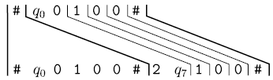
A_{TM} to MPCP, Simulating M on w, C₀ to C₁
The dominos specified so far allow the start of a match to simulate the start of M processing w
The string at the top and bottom of the match represent the start of a computation history
Since we are dealing with MPCP for now, the match must begin using the domino from Part 1
The dominos from Parts 2 and 4 allow the bottom part of the match to simulate the step from C₀ to C₁ (the first two configurations in the computation history) as follows:
Until we reach an accepting state, whenever the top string of a match completes the representation of a configuration, the bottom part of the match will be one valid configuration ahead
The dominos are set up such that all transitions from configuration to adjacent configuration are valid

Slide 25
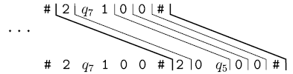

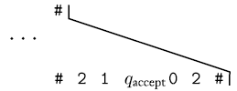
A_{TM} to MPCP, Simulating M on w, C₁ to C₂ to C₃
Then, the dominos from Parts 2 and 4 allow match to simulate the step from C₁ to C₂ as follows:
Then, the dominos from Parts 3 and 4 allow the match to simulate the step from C₂ to C₃ as follows:
The match proceeds to simulate a computation history until an accepting configuration is reached at the bottom of the match (assuming M accepts w)
An example of what the right part of the match might look like at that point is:

Slide 26
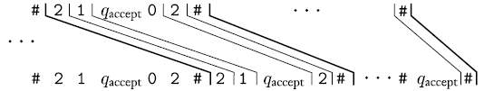

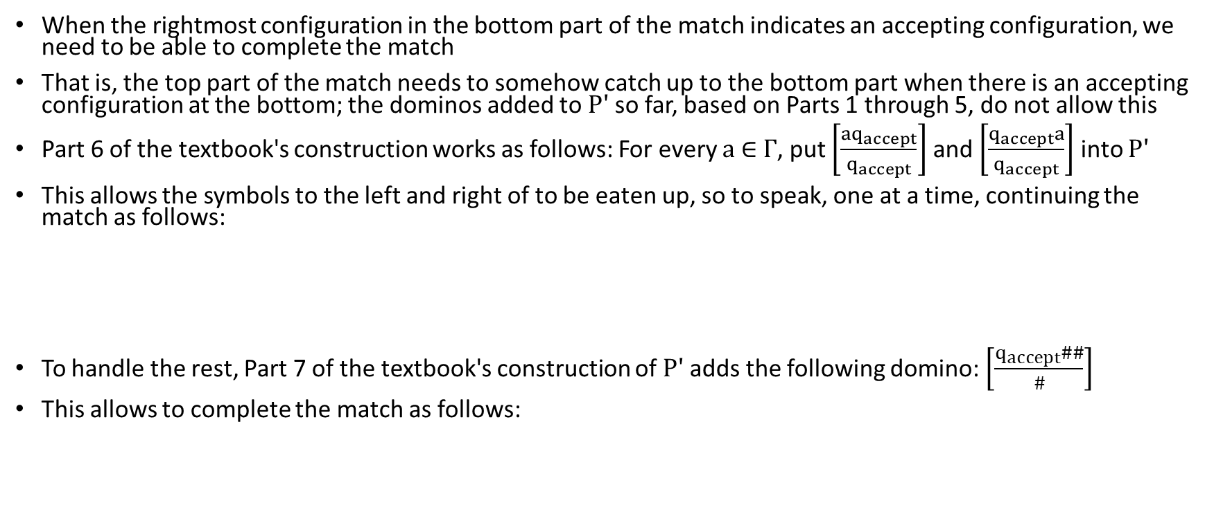
A_{TM} to MPCP, Handling the Accept State
When the rightmost configuration in the bottom part of the match indicates an accepting configuration, we need to be able to complete the match
That is, the top part of the match needs to somehow catch up to the bottom part when there is an accepting configuration at the bottom; the dominos added to P' so far, based on Parts 1 through 5, do not allow this
Part 6 of the textbook's construction works as follows: For every a ∈ Γ, put $\left[\frac{{aq}_{accept}}{q_{accept}}\right]$ and $\left[\frac{q_{accept}a}{q_{accept}}\right]$ into P'
This allows the symbols to the left and right of to be eaten up, so to speak, one at a time, continuing the match as follows:
To handle the rest, Part 7 of the textbook's construction of P' adds the following domino: $\left[\frac{q_{accept}\#\#}{\#}\right]$
This allows to complete the match as follows:

Slide 27
MPCP to PCP (part 1)
So far, we have reduced A_{TM} to MPCP
That is, we have taken an instance of A_{TM}, consisting of input <M, w>, and converted it to a collection of dominos P'
We have shown that P' is a member of MPCP if and only if M accept w
To achieve our original goal of reducing A_{TM} to PCP, we need to reduce MPCP to PCP (remember that reducibility is transitive)
Before explaining how to do this, the textbook introduces a new shorthand notation
For any string u = u₁u₂…u_{n} of length n, the book defines ★u, u★, and ★u★ as follows:
★u = *u₁*u₂*u₃*…*u_{n}
u★ = u₁*u₂*u₃*…*u_{n}*
★u★ = *u₁*u₂*u₃*…*u_{n}*
Note that there are asterisks before, after, or before and after each character of u

Slide 28
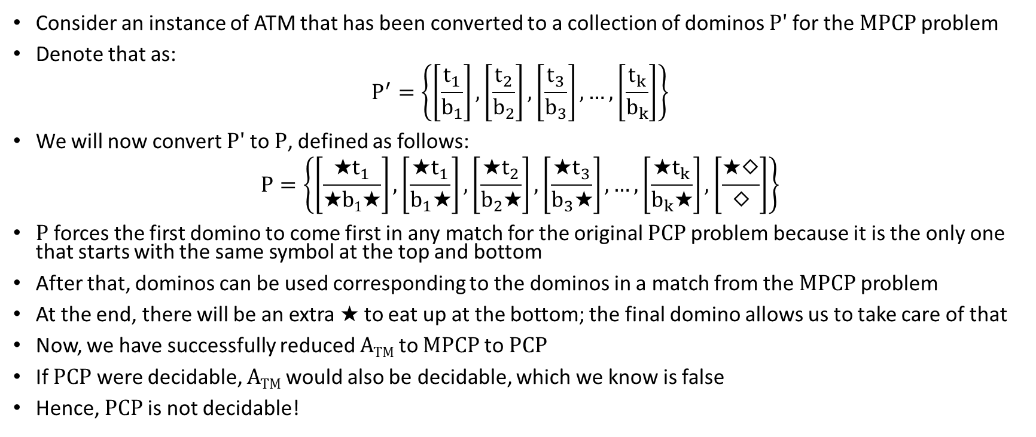
MPCP to PCP (part 2)
Consider an instance of ATM that has been converted to a collection of dominos P' for the MPCP problem
Denote that as:
$$P^{′}=\left\{\left[\frac{t_{1}}{b_{1}}\right],\left[\frac{t_{2}}{b_{2}}\right],\left[\frac{t_{3}}{b_{3}}\right],…,\left[\frac{t_{k}}{b_{k}}\right]\right\}$$
We will now convert P' to P, defined as follows:
$$P=\left\{\left[\frac{{\text{★}t}_{1}}{\text{★}\text{b}1\text{★}}\right],\left[\frac{\text{★}t_{1}}{b_{1}\text{★}}\right],\left[\frac{{\text{★}t}_{2}}{b_{2}\text{★}}\right],\left[\frac{{\text{★}t}_{3}}{b_{3}\text{★}}\right],…,\left[\frac{\text{★}t_{k}}{b_{k}\text{★}}\right],\left[\frac{\text{★}◇}{◇}\right]\right\}$$
P forces the first domino to come first in any match for the original PCP problem because it is the only one that starts with the same symbol at the top and bottom
After that, dominos can be used corresponding to the dominos in a match from the MPCP problem
At the end, there will be an extra $\text{★}$ to eat up at the bottom; the final domino allows us to take care of that
Now, we have successfully reduced A_{TM} to MPCP to PCP
If PCP were decidable, A_{TM} would also be decidable, which we know is false
Hence, PCP is not decidable!

Slide 29
Defining Reducibility
There are various ways that reducibility can be formally defined
The textbook covers one method (in Section 5.3) called mapping reducibility
Before we state the formal definition, we need to define the notion of a computable function
Definition 5.17 states: "A function f: Σ* → Σ* is a computable function if some Turing machine M, on every input w, halts with just f(w) on its tape"
There are a few points I want to make about this:
  I believe this is the first time that the textbook is considering the output of the tape of a Turing machine to be significant!
  We discussed this during an earlier topic, but an algorithm can obviously do more than just answers a yes/no question (or accepts or rejects an input)
  Algorithms can, for example, compute arithmetic expressions, solve algebraic equations, find optimal paths in graphs, transform Turing machines, etc.
  The output of the algorithm is what winds up on the tape
  According to the Church-Turing thesis, Turing machines are believed to be as powerful as all reasonable formalisms, matching our intuitive notion of what algorithms can do

Slide 30
Mapping Reducibility
Definition 5.20 states (I am keeping the book's wording exact):
  "Language A is mapping reducible to language B, written A ≤_{m} B, if there is a computable function f: Σ* → Σ*, where for every w,
  w ∈ A ⇔ f(w) ∈ B.
  The function f is called the reduction from A to B."
The book doesn’t specify how to read the double arrow, but it can be read as "if and only if"
This means that the reduction, f, maps instances of A to instances of B; it also maps non-instances of A to non-instances of B
The figure on the next slide helps to explain this
Note that this mapping is neither one-to-one or onto; more specifically:
  Every string from the alphabet is part of the domain, and will get mapped to something
  Different strings can get mapped to the same thing
  Not every string in the range will necessarily have something map to it

Slide 31
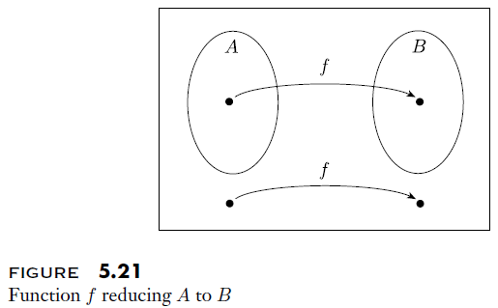
Mapping Reducibility Explained

Slide 32
Using Reductions to Prove (Un)Decidability
Theorem 5.22 states: "If A ≤_{m} B and B is decidable, then A is decidable"
  This should be fairly obvious
  Given a string that may or may not be a member of A, we can use the reduction, f, to calculate f(w)
  Then we can use a decider for B to determine if f(w) is a member of B
    If f(w) is a member of B, w is a member of A
    If f(w) is not a member of B, w is not a member of A
Corollary 5.23 states: " If A ≤_{m} B and A is undecidable, then B is undecidable"
  This should also be fairly obvious
  If B were decidable, then A would be decidable (according to Theorem 5.22)

Slide 33
HALT_{TM} (revisited)
Earlier, we showed that if we could decide HALT_{TM}, we would be able to decide A_{TM}, which we had previously proven is impossible; therefore, HALT_{TM} is undecidable
While we can casually think of the method used in that proof as a reduction, it is not a mapping reduction, as we have now defined it
A mapping reduction would be a function that maps the input to A_{TM}, <M, w>, to an input to HALT_{TM}, <M', w'>, such that: <M, w> ∈ A_{TM} if and only if <M', w'> ∈ HALT_{TM}
We can construct such a mapping reduction, implemented by a Turing machine F that performs as follows:
  F constructs a TM M' (but it does not run M') that does the following:
    M' runs M on x
    If M accepts, M' accepts
    If M rejects, M' purposely enters an infinite loop
  F outputs <M', w>; that is, it erases the original contents of the tape, and writes <M', w>
Note that <M', w> is a member of HALT_{TM} if and only if <M, w> is a member of A_{TM}
That means that F is a proper mapping reduction from A_{TM} to HALT_{TM}

Slide 34
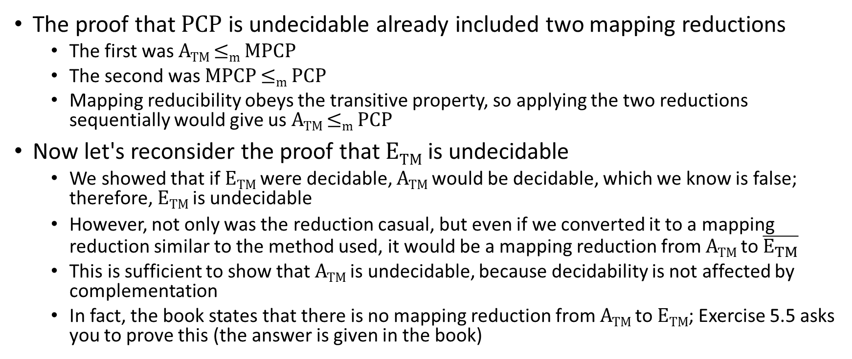
Revisiting Other Previous Examples
The proof that PCP is undecidable already included two mapping reductions
  The first was A_{TM} ≤_{m} MPCP
  The second was MPCP ≤_{m} PCP
  Mapping reducibility obeys the transitive property, so applying the two reductions sequentially would give us A_{TM} ≤_{m} PCP
Now let's reconsider the proof that E_{TM} is undecidable
  We showed that if E_{TM} were decidable, A_{TM} would be decidable, which we know is false; therefore, E_{TM} is undecidable
  However, not only was the reduction casual, but even if we converted it to a mapping reduction similar to the method used, it would be a mapping reduction from A_{TM} to $\overline{E_{TM}}$
  This is sufficient to show that A_{TM} is undecidable, because decidability is not affected by complementation
  In fact, the book states that there is no mapping reduction from A_{TM} to E_{TM}; Exercise 5.5 asks you to prove this (the answer is given in the book)

Slide 35
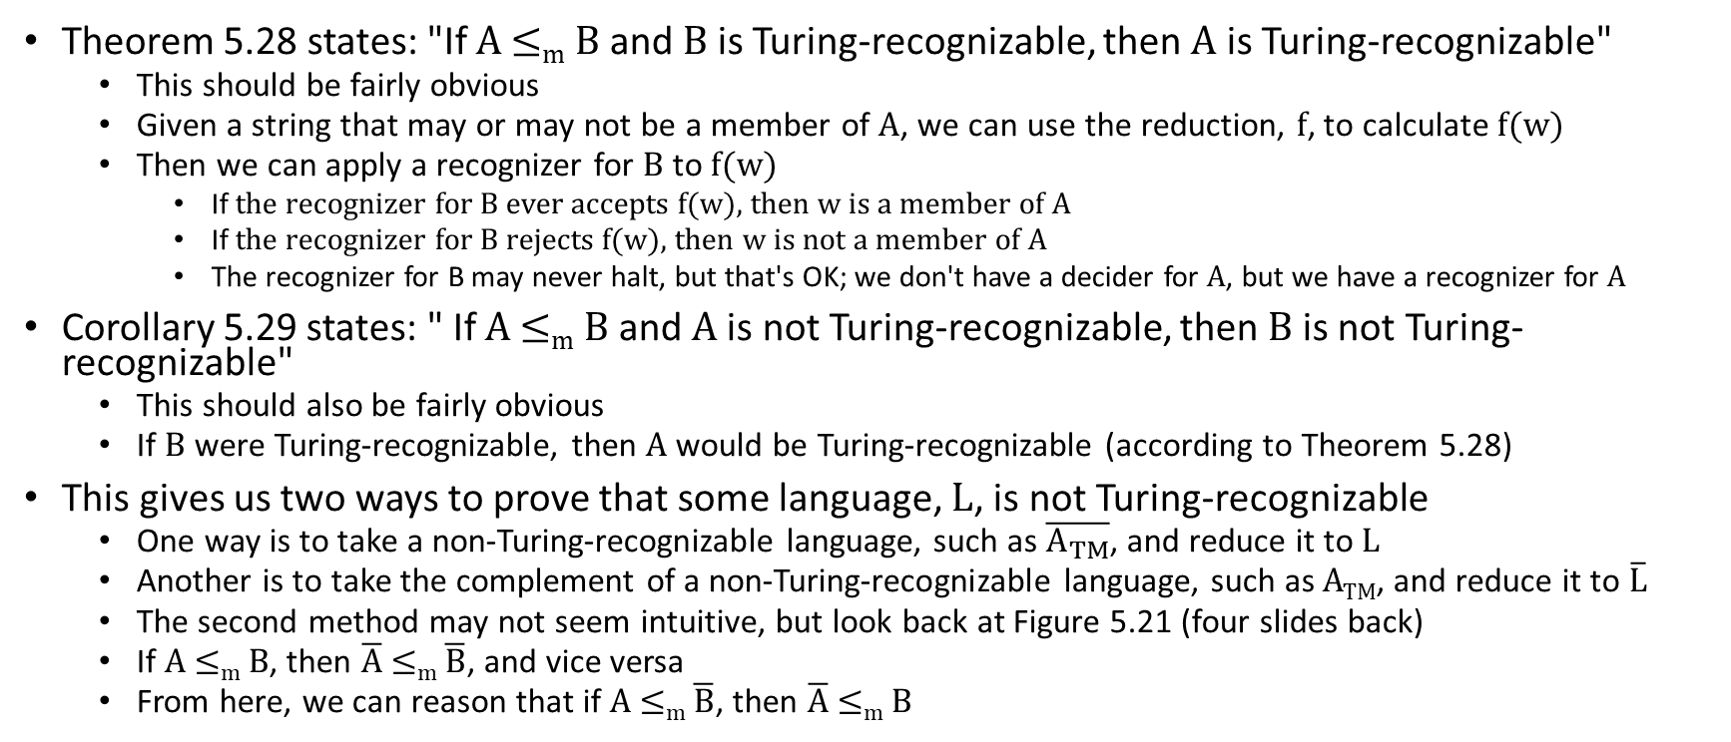
Using Reductions to Prove (Un)Recognizability
Theorem 5.28 states: "If A ≤_{m} B and B is Turing-recognizable, then A is Turing-recognizable"
  This should be fairly obvious
  Given a string that may or may not be a member of A, we can use the reduction, f, to calculate f(w)
  Then we can apply a recognizer for B to f(w)
    If the recognizer for B ever accepts f(w), then w is a member of A
    If the recognizer for B rejects f(w), then w is not a member of A
    The recognizer for B may never halt, but that's OK; we don't have a decider for A, but we have a recognizer for A
Corollary 5.29 states: " If A ≤_{m} B and A is not Turing-recognizable, then B is not Turing-recognizable"
  This should also be fairly obvious
  If B were Turing-recognizable, then A would be Turing-recognizable (according to Theorem 5.28)
This gives us two ways to prove that some language, L, is not Turing-recognizable
  One way is to take a non-Turing-recognizable language, such as $\overline{A_{TM}}$, and reduce it to L
  Another is to take the complement of a non-Turing-recognizable language, such as A_{TM}, and reduce it to $\overline{L}$
  The second method may not seem intuitive, but look back at Figure 5.21 (four slides back)
  If A ≤_{m} B, then $\overline{A}$ ≤_{m} $\overline{B}$, and vice versa
  From here, we can reason that if A ≤_{m} $\overline{B}$, then $\overline{A}$ ≤_{m} B

Slide 36
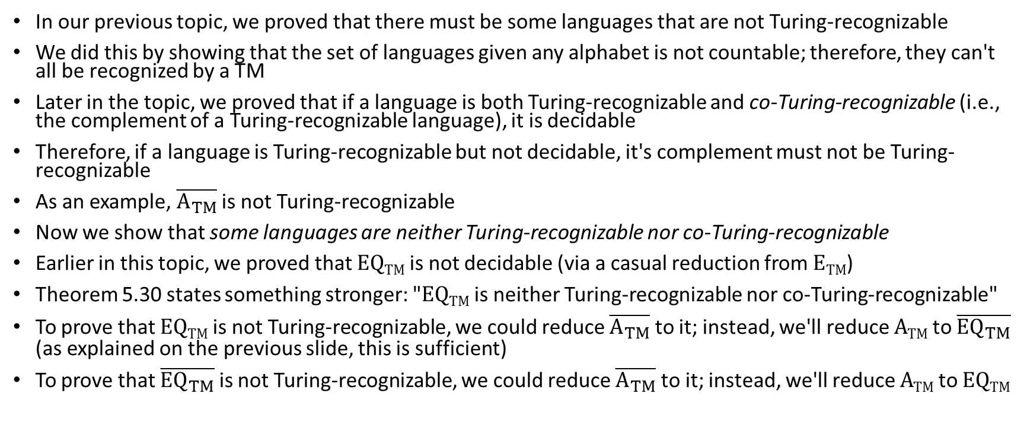
EQ_{TM} (revisited, part 1)
In our previous topic, we proved that there must be some languages that are not Turing-recognizable
We did this by showing that the set of languages given any alphabet is not countable; therefore, they can't all be recognized by a TM
Later in the topic, we proved that if a language is both Turing-recognizable and co-Turing-recognizable (i.e., the complement of a Turing-recognizable language), it is decidable
Therefore, if a language is Turing-recognizable but not decidable, it's complement must not be Turing-recognizable
As an example, $\overline{A_{TM}}$ is not Turing-recognizable
Now we show that some languages are neither Turing-recognizable nor co-Turing-recognizable
Earlier in this topic, we proved that EQ_{TM} is not decidable (via a casual reduction from E_{TM})
Theorem 5.30 states something stronger: "EQ_{TM} is neither Turing-recognizable nor co-Turing-recognizable"
To prove that EQ_{TM} is not Turing-recognizable, we could reduce $\overline{A_{TM}}$ to it; instead, we'll reduce A_{TM} to $\overline{{EQ}_{TM}}$ (as explained on the previous slide, this is sufficient)
To prove that $\overline{{EQ}_{TM}}$ is not Turing-recognizable, we could reduce $\overline{A_{TM}}$ to it; instead, we'll reduce A_{TM} to EQ_{TM}

Slide 37
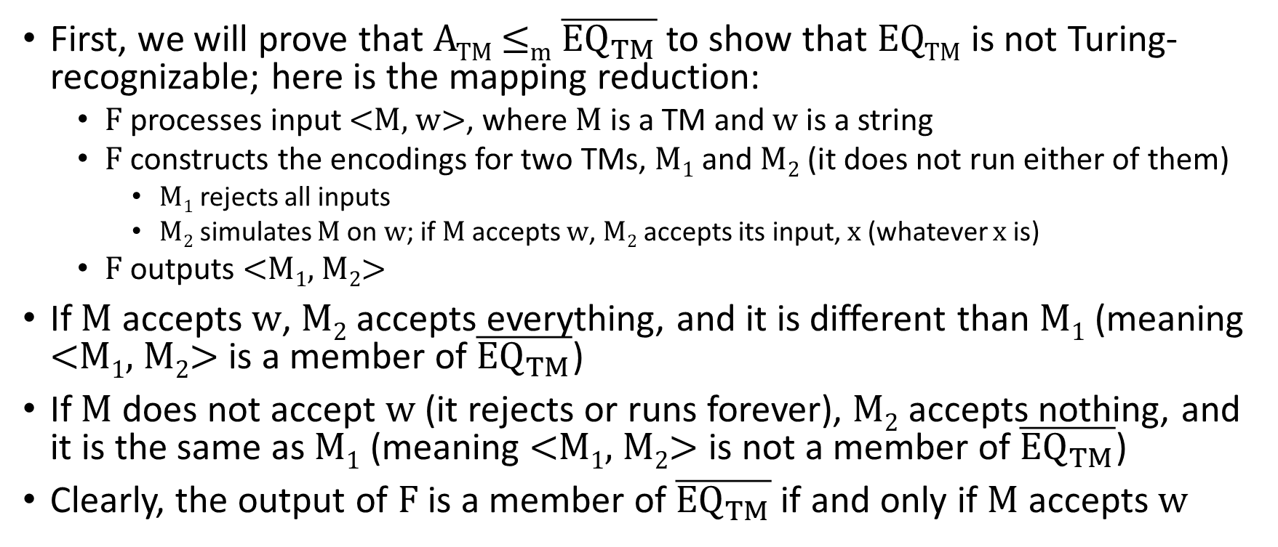
EQ_{TM} (revisited, part 2)
First, we will prove that A_{TM} ≤_{m} $\overline{{EQ}_{TM}}$ to show that EQ_{TM} is not Turing-recognizable; here is the mapping reduction:
  F processes input <M, w>, where M is a TM and w is a string
  F constructs the encodings for two TMs, M₁ and M₂ (it does not run either of them)
    M₁ rejects all inputs
    M₂ simulates M on w; if M accepts w, M₂ accepts its input, x (whatever x is)
  F outputs <M₁, M₂>
If M accepts w, M₂ accepts everything, and it is different than M₁ (meaning <M₁, M₂> is a member of $\overline{{EQ}_{TM}}$)
If M does not accept w (it rejects or runs forever), M₂ accepts nothing, and it is the same as M₁ (meaning <M₁, M₂> is not a member of $\overline{{EQ}_{TM}}$)
Clearly, the output of F is a member of $\overline{{EQ}_{TM}}$ if and only if M accepts w

Slide 38
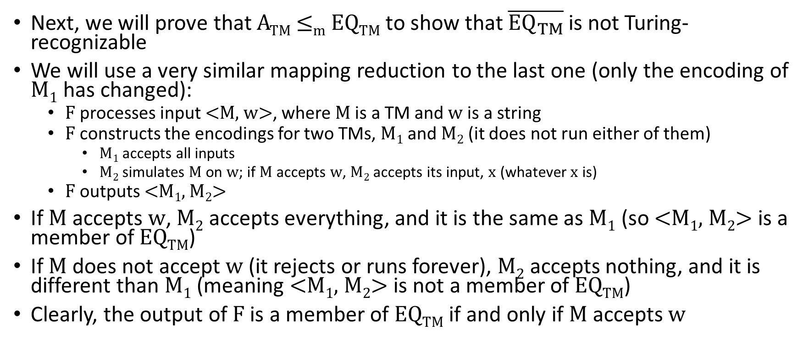
EQ_{TM} (revisited, part 3)
Next, we will prove that A_{TM} ≤_{m} EQ_{TM} to show that $\overline{{EQ}_{TM}}$ is not Turing-recognizable
We will use a very similar mapping reduction to the last one (only the encoding of M₁ has changed):
  F processes input <M, w>, where M is a TM and w is a string
  F constructs the encodings for two TMs, M₁ and M₂ (it does not run either of them)
    M₁ accepts all inputs
    M₂ simulates M on w; if M accepts w, M₂ accepts its input, x (whatever x is)
  F outputs <M₁, M₂>
If M accepts w, M₂ accepts everything, and it is the same as M₁ (so <M₁, M₂> is a member of EQ_{TM})
If M does not accept w (it rejects or runs forever), M₂ accepts nothing, and it is different than M₁ (meaning <M₁, M₂> is not a member of EQ_{TM})
Clearly, the output of F is a member of EQ_{TM} if and only if M accepts w

