Slide 1
ECE461: Theoretical CS
Regular Expressions

Slide 2
Brief Recap
In our previous two topics, we examined two formalisms for expressing regular languages
Those two formalisms were deterministic finite automata (DFAs) and nondeterministic finite automata (NFAs)
We have seen that any NFA can be converted to an equivalent DFA
The fact that both formalisms can be used to express the same class of languages means that they are equivalent in power
We also proved that class of regular languages is closed under the three regular operations (union, concatenation, and star)
In this topic, we will examine another equally powerful formalism; namely, regular expressions
This topic is based on Section 1.3 of the textbook

Slide 3
Regular Expressions
A regular expression (often shortened to regex or regexp, but I will use RE) is generally formed using symbols from an alphabet, parentheses, and the regular operations
The regular operations are union (∪), concatenation (∘), and star (*, a.k.a. Kleene star)
An example of a regular expression is: (0 ∪ 1)0*
Note that the concatenation symbol '∘' is typically left out of REs (i.e., it is implicit)
This expression represents the language consisting of all strings starting with a 0 or a 1 followed by any number of 0s
The alphabet of this language might be Σ = {0, 1} (but the alphabet might contain more symbols than that)
Recall that:
  A language is a set of strings (a language can be finite or infinite)
  A string a finite sequence of symbols from an alphabet
  An alphabet is a finite set of symbols

Slide 4
Formal Definition of a Regular Expression
An expression, R, is a regular expression if R is:
  a, were a ∈ Σ,
  ε (the empty string),
  ∅ (the empty set),
  (R₁ ∪ R₂), where R₁ and R₂ are regular expressions,
  (R₁ ∘ R₂), where R₁ and R₂ are regular expressions, or
  (R₁*), where R₁ is a regular expression.
As previously noted, we often leave out the concatenation symbol when writing a regular expression
Additionally, parentheses may be left out unless they are necessary to change the order that operations are applied
The order of precedence of operations is first star, followed by concatenation, followed by union
Note that the definition of a regular expression involves the three regular operations (I believe this is why they are called regular operations)

Slide 5
Regular Expressions in Practice
In practice, many programming languages include libraries that allow programmers to make use of regular expressions (this is not discussed in our textbook)
REs are often used in implementations of compilers for lexical analysis of a program
REs are often used in NLP applications for tokenization of natural language text
RE libraries typically allow many additional operations
Most are just shorthand for something that could be specified without these operations
  For example, the + operation (a.k.a. Kleene plus) represents one or more instances of the previous symbol or RE (this is also used in our textbook)
  A dash is often used to represent a range (e.g., "a-z" could represent all lowercase letters)
Many modern RE libraries also provide the use of registers to capture portions of matched expressions
  These matched sub-expressions can be used, for example, to find a repeated portion of a matching string
  It is important to note that registers increase the power of the formalism!
  That is, expressions using registers are not strictly regular expressions, and the languages that such expressions represent may not be regular languages
  This is not discussed in our textbook, and we will not discuss it further

Slide 6
ε and ∅ are different
The textbook points out:
  As an RE, ε denotes a language that has one member, the empty string (so it is not an empty language)
  As an RE, ∅ denotes the empty language, (i.e., it has no members and doesn't contain any strings)
  R ∪ ∅ = R, but R U ε "may not equal R" (I add: it depends on whether R allows ε to begin with)
  For example, if R = 0, then L(R) = L(R ∪ ∅) = {0}, but L(R ∪ ε) = {0, ε}
  R ∘ ε = R, but R ∘ ∅ "may not equal R" (I add: R ∘ ∅ will only equal R if R is the empty language to begin with)
  For example, if R = 0, then L(R) = L(R ∘ ε) = {0}, but L(R ∘ ∅) = ∅
The notation L(R), as used in two of the examples above, represents the language denoted by the regular expression R

Slide 7
Regular Languages (re-revisited)
Our original definition of regular languages was: A language is a regular language if and only if some DFA recognizes it
Later, we saw an alternative definition: A language is a regular language if and only if some NFA recognizes it
Here is another alternative definition: A language is a regular language if and only if some RE recognizes it
Theorem 1.54 states: "A language is regular if and only if some regular expression describes it" (they don't use this as a definition)
To prove the theorem, they prove two lemmas (we will discuss both proofs)
  Lemma 1.55 states: "If a language is described by a regular expression, it is regular"
  They prove this lemma by showing that any regular expression can be converted to an equivalent NFA
  Lemma 1.60 states: "If a language is regular, then it is described by a regular expression"
  They prove this lemma by showing that any DFA can be converted into an equivalent RE

Slide 8



Every RE has an Equivalent NFA
The book proves that every RE has an equivalent NFA by showing that it is true for each of the six pieces of the formal definition of REs
For the first three parts of the definition, the conversions from RE to NFA are trivial:
  The following NFA recognizes any RE of the form R=a:
  The following NFA recognizes R=ε:
  The following NFA recognizes R=∅:
For the remaining parts of the definition, we need to show NFAs that recognize R₁ ∪ R₂, R₁ ∘ R₂, and R₁*, where R₁ and R₂ are REs
  Assume already shown that R₁ and R₂ can be converted to NFAs
  Then, the proofs of closure for the regular operations using NFAs already showed that the expressions here can also be represented by NFAs (for union, we saw two versions of the proof, one with DFAs and one with NFAs)
  To show that R₁ and R₂ can be converted to NFAs, it is either a recursive case, or it is one of the three base cases mentioned above
  Ultimately, this serves as an inductive proof that any RE can be converted to an equivalent NFA

Slide 9
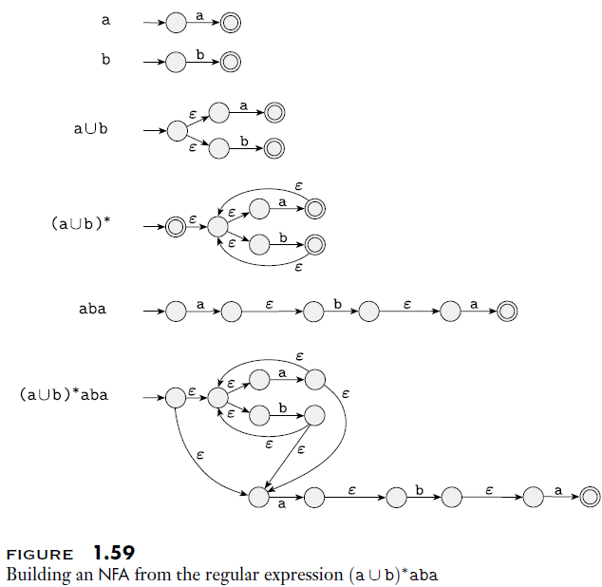
Converting an RE to an NFA Example
The book demonstrates how (a ∪ b)*aba can be converted to an NFA
The figure to the right explains this
The steps involving union, concatenation, and star come from proofs seen earlier

Slide 10
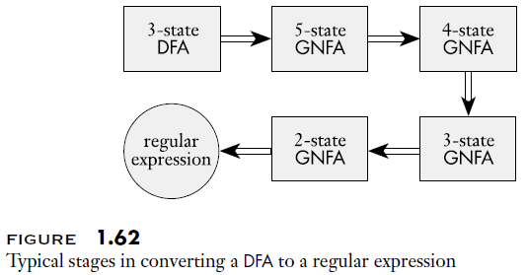
Every DFA has an Equivalent RE
The other half of the proof showing that REs are equivalent in power to NFAs and DFAs is more difficult
The book proves this by showing that every DFA has an equivalent RE
They do this in steps
  First, they introduce yet another formalism, called a generalized nondeterministic finite automaton (GNFA)
  Then, they show that every DFA with k states can be converted to a GNFA with k+2 states
  Then, they show that for n > 2, a GNFA with n states can be converted to a GNFA with n-1 states
  Finally, they show that a GNFA with exactly 2 states can be converted to an RE, thus completing the proof
The figure on this slide summarizes how a 3-state DFA could be converted to an RE

Slide 11
GNFAs
GNFAs are NFAs that allow regular expressions on their transition arrows (as opposed to individual symbols from the alphabet)
A GNFA can read any block of symbols form the input that satisfies an RE on a transition arrow and then take that transition
There are also several constraints that a GNFA must satisfy:
  There must be a single start state, q_{start}, and a single accept state, q_{accept}, that are different from each other
  The start state has outgoing transitions to every other state, but no incoming transitions
  The accept state has incoming transitions from every other state, but no outgoing transitions
  For every source state, destination state pair not including the start state or accept state, there is a single transition (including from each other state to itself)
A few things to point out:
  The way the textbook words its description, it is not clear if some of these constraints are part of the definition of GNFAs, or extra constraints they are adding (although they all match the book's formal definition)
  Based on other sources, these constraints are often part of the definition of GNFAs, but not always
  The links between states are allowed to be labeled with ∅, which is a valid regular expression, and this is basically the same as leaving out the transition altogether, since no input will ever satisfy that RE
  When drawing GNFAs, ∅-transitions are typically left out (although the example on the next slide includes it)

Slide 12
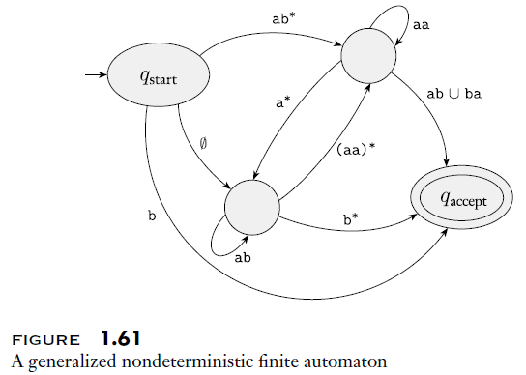
GNFA Example

Slide 13
Formal Description of a GNFA
A generalized nondeterministic finite automaton is a 5-tuple (Q, Σ, δ, q_{start}, q_{accept}), where:
  Q is a finite set called the states,
  Σ is a finite set called the alphabet,
  δ : (Q – {q_{accept}}) × (Q – {q_{start}}) → R is the transition function,
  q_{start} ∈ Q is the start state, and
  q_{accept} ∈ Q is the accept state
A few things to note about the transition function:
  It defines a transition for every pair of states, except that the source cannot be q_{accept} and the destination cannot be q_{start}
  The output of the transition function is a regular expression (recall again that ∅ is a valid regular expression)
  R, the range of δ, is the set of all regular expressions over the alphabet, Σ

Slide 14
Converting a DFA to a GNFA
Every k-state DFA can be converted into an equivalent (k+2)-state GNFA
A procedure to do so is as follows:
  Add a new start state, q_{start}
    Add an ε-transition from q_{start} to the original start state
    Add a ∅-transition from q_{start} to every other state
  Add a new accept state, q_{accept}
    Add an ε-transition from each original accept state to q_{accept}; also, the original accept states become regular states, i.e., no longer accept states
    Add a ∅-transition from every other state (including q_{start}) to q_{accept}
  For every other (i, j) pair, where i and j are original states (possible the same state), do the following:
    If there were multiple transitions from i to j in the original DFA, combine them into one transition with an RE representing the union of the symbols from the original transitions
    If there was no transition from i to j in the original DFA, add a ∅-transition

Slide 15
Condensing a GNFA
Every n-state GNFA where n > 2 can be converted into an equivalent (n-1)-state GNFA
A procedure to do so is as follows:
  Choose any state other than q_{start} or q_{accept} (there must be at least one other state, since n > 2); call this state q_{rip}
  Remove q_{rip} from the GNFA, along with all the incident transitions to and from q_{rip} (but remember them for the later steps)
  For every pair of states (q_{i}, q_{j}) in the GNFA, where q_{i} is not q_{accept} and q_{j} is not q_{start}, update the link from q_{i} to q_{j} as follows:
    Let R1 be the RE on the link from q_{i} to q_{rip}
    Let R2 be the RE on the link from q_{rip} to itself
    Let R3 be the RE on the link from q_{rip} to q_{j}
    Let R4 be the RE on the current link from q_{i} to q_{j}
    Replace the RE on the link from q_{i} to q_{j} with this RE: (R1)(R2)*(R3) ∪ R4
  The figure on the next slide helps to explain why removing q_{rip} like this makes sense
The textbook specifies the process a bit more formally, but I don't think it adds that much to the explanation

Slide 16
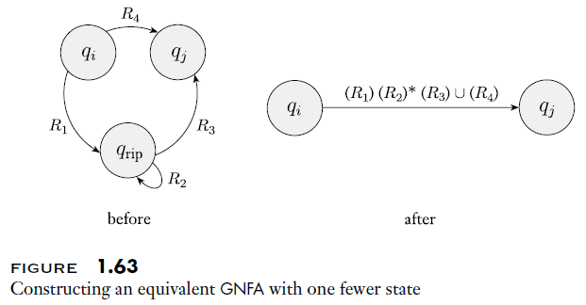
Removing q_{rip} Explained

Slide 17
Converting a DFA to an RE
We can now put the pieces together to convert any DFA to an equivalent RE
First, convert the DFA with k states to a GNFA with k+2 states, as previously explained
Assuming the original DFA was not empty, this GNFA will have more than two states
Repeatedly convert the GNFA with n states to a GNFA with n-1 states, as previously explained, until there are only 2 states left
These remaining two states must be q_{start} and q_{accept}
The regular expression on the link from q_{start} to q_{accept} is equivalent to the original DFA
The next slide shows an example of converting a specific DFA to an RE
Recall that we also previously explained how to convert any RE to an NFA (which in turn can be converted to a DFA)
Therefore, REs are equal in power to DFAs and NFAs
Any of the three formalisms can be used to define the regular languages

Slide 18
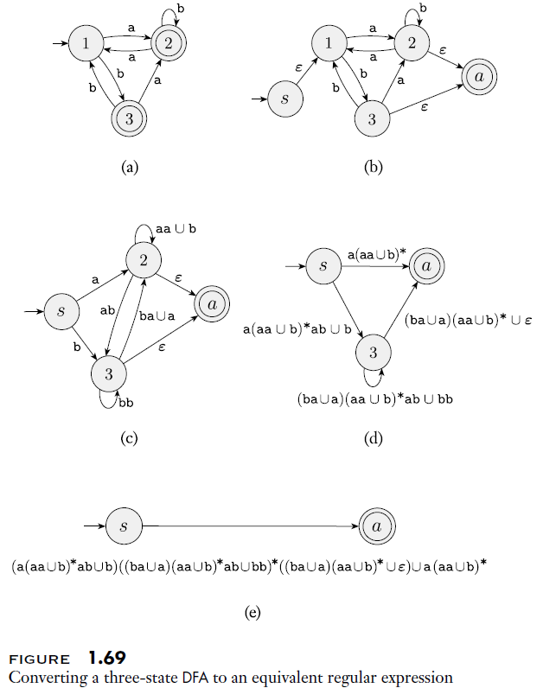
Converting a DFA to an RE Example
The book steps through two examples of converting a DFA to an RE
The figure to the right shows the more complex of the two examples
We first convert a 3-state DFA shown in part (a) to a 5-state GNFA shown in part (b)
Then, in 3 additional steps, we condense the 5-state GNFA to a 2-state GNFA
The final GNFA shown in part (e) contains only a start state, s, and accept state, a
The regular expression on the link from s to a is equivalent to the original DFA

