Slide 1
ECE461: Theoretical CS
Pushdown Automata

Slide 2
Brief Recap
In previous topics, we learned about three equally powerful formalisms capable of recognizing regular languages:
  Deterministic finite automata (DFAs)
  Nondeterministic finite automata (NFAs)
  Regular expressions (REs)
We also discussed the pumping lemma for regular languages, which can be used to prove that certain languages are nonregular
Then we learned about a more powerful formalism called context-free grammars (CFGs)
CFGs are capable of generating (or more generally, describing) the context-free languages (CFLs), which includes all regular languages but also some nonregular languages
In this topic, we will learn about another formalism called the pushdown automaton (PDA)
Pushdown automata are equal in power to CFGs
This topic is based on Section 2.2 of the textbook

Slide 3
Pushdown Automata
Pushdown automata "are like nondeterministic finite automata but have an extra component called a stack"
With each transition, a pushdown automaton can optionally pop one symbol from the top of the stack and/or push one symbol to the top of the stack
The transition function of a pushdown automaton is optionally conditioned on the symbol at the top of the stack, as well as the current state and current input symbol
If a stack symbol is specified as part of the input to the transition function, and that transition is applied, the symbol must be popped from the stack
The output of the transition function optionally specifies another stack symbol to push to the stack
The alphabet for the stack can be different than the input alphabet
PDAs are nondeterministic, meaning that zero, one, or multiple transitions can be specified for each (state, input symbol, stack symbol) 3-tuple
The output of a transition function is a (state, stack symbol) pair
The stack symbol for the input or output of the transition function can be ε
  If the input stack symbol is ε, this means that the transition only depends on the current state and current input symbol, and no stack symbol is popped from the stack when the transition is applied
  If the output stack symbol is ε, this means that no stack symbol is pushed onto the stack when the transition is applied

Slide 4
Formal Definition of a Pushdown Automaton
A pushdown automaton is a 6-tuple (Q, Σ, Γ, δ, q₀, F), where Q, Σ, Γ, and F are all finite sets, and:
  Q is the set of states,
  Σ is the input alphabet,
  Γ is the stack alphabet,
  δ : Q ⨉ Σ_{ε} ⨉ Γ_{ε} → P(Q ⨉ Γ_{ε}) is the transition function,
  q₀ ∈ Q is the start state, and
  F ⊆ Q is the set of accept states.
Recall that Σ_{ε} and Γ_{ε} represent Σ ∪ {ε} and Γ ∪ {ε}, respectively, and P(Q ⨉ Γ_{ε}) is the power set of the result of a Cartesian product

Slide 5
Computation with a PDA
Consider some pushdown automaton M = (Q, Σ, Γ, δ, q₀, F), as defined on the previous slide
We say that M accepts input w = w₁w₂…w_{m}, where each w_{i} ∈ Σ_{ε}, under the following circumstances:
  There exists a sequence of states r₀, r₁, …, r_{m}, where each r_{m} ∈ Q, and
  There exists a sequence of strings (representing the stack contents) s₀, s₁, …, s_{m}, where each s_{m} ∈ Γ*, and
  The following constraints are satisfied:
    r₀ = q₀ and s₀ = ε (i.e., M starts at the initial state with an empty stack)
    For each i = 0, 1, …, m-1, it is the case that (r_{i+1}, b) ∈ δ(r_{i}, w_{i+1}, a), where s_{i} = at and s_{i+1} = bt and a, b ∈ Γ_{ε} and t ∈ Γ* (i.e., every transition is a valid transition)
    r_{m} ∈ F (i.e., M reaches a final state at the end of the input)
Although this may seem straight-forward (once you carefully interpret all the symbols), there is one point that I was originally confused about
  According to the above notation, it is clear that M cannot stay at an accept state without processing all its input (the same is true for DFAs and NFAs, and I am confident that this is correct)
  However, if M reaches an accept state at the end of the input, and there are outgoing transitions that do not process input but pop a stack symbol, s, and s it at the top of the stack, can M ignore such transitions?
  According to this definition, the input would be accepted, meaning that such transitions can be ignored
  I believe this is correct; transitions (such as ε-transitions) are not forced, but all input must be processed

Slide 6
Deterministic Pushdown Automata
Earlier in the course, we saw (and proved) that DFAs and NFAs are equal in power
Later in the course, we will see that deterministic and nondeterministic Turing machines are equal in power
However, deterministic and nondeterministic pushdown automata are not equal in power
Deterministic pushdown automata (DPDAs) recognize a class of languages called deterministic context-free languages (DCFLs)
DCFLs fall in between regular languages and context-free languages
DPDAs and DCFLs are discussed in Section 2.4 of the 3rd edition of the textbook, but we will not cover this topic in the course

Slide 7
Pushdown Automaton Example 1
The next slide gives a description matching our formal definition for a pushdown automaton that recognizes the language {0^{n}1^{n} | n ≥ 0}
Recall that in previous topics, we proved this language to be nonregular, but we saw that it is context free, because a CFG can generate it
A PDA that recognizes this language can work as follows (this is a high-level description for now)
  It starts with an empty stack (all pushdown automata do), and it proceeds to read its input
  As each 0 is read, it is pushed onto the stack
  When each 1 is read, the top 0 from the stack is popped
  If the input ends at the same step that the last 0 is popped, the machine accepts
  If the stack becomes empty before the input ends, or if the input ends when the stack is nonempty, or if any 0s occur after the first 1, the machine rejects
  The next slide specifies such a PDA more formally

Slide 8
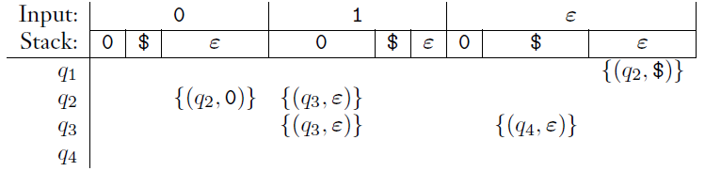
Formal Description of PDA Example 1
We will construct a pushdown automaton M₁ = (Q, Σ, Γ, δ, q₁, F) that recognizes the language {0^{n}1^{n} | n ≥ 0} as follows:
  Q = {q₁, q₂, q₃, q₄},
  Σ = {0, 1},
  Γ = {0, $},
  δ can described as follows, where blank entries represent ∅ (the chart was copied from the book):
  q₁ is the start state,
  F = {q₁, q₄} (q₁ is one of the final states so that the empty string is accepted)
Note that we need the $ as an additional stack symbol to give the machine a way to recognize when the stack becomes empty; this is a useful trick

Slide 9
State Diagrams for Pushdown Automata
As with DFAs and NFAs, PDAs can be represented graphically using state diagrams
IMO, this is much more readable than the formal description of a PDA
The next slide shows a state diagram for M₁, the PDA represented formally on the previous slide
Each transition arrow is labeled using the format "a, b → c"
Here, a represents the input symbol, b represents the symbol popped from the stack, and c represents the symbol pushed onto the stack
Of course, the source and destination states are labeled in the nodes at the source and destination of the transition arrow
Any of the three components of the label can be ε
  If a is ε, it means that no input is read when using this transition
  If b is ε, no symbol is read or popped from the top of the stack
  If c is ε, no symbol is pushed onto the stack

Slide 10
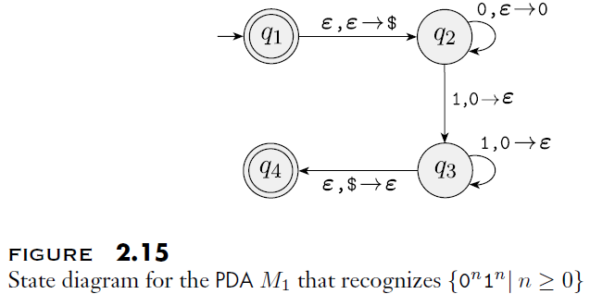
State Diagram for PDA Example 1

Slide 11
Pushdown Automaton Example 2
The next slide shows a state diagram for a pushdown automaton that recognizes the language {a^{i}b^{j}c^{k} | i, j, k ≥ 0 and i = j or i = k}
Informally, we can say that the PDA works as follows:
  First, it pushes all the a's to the stack
  Then, it relies on nondeterminism to try out two things in parallel
  In one branch, it checks if the number of b's matches the number of a's
  In another branch, it skips the b's and checks if the number of c's matches the number of a's
  Note that we once again use the trick with the extra $ symbol to recognize when the stack is empty
  Also, we don't have to explicitly check for symbols appearing out of order
  This is because paths being explored by the machine will end if there is no transition specified for the next input symbol (i.e., if the output of the transition function is ∅)

Slide 12
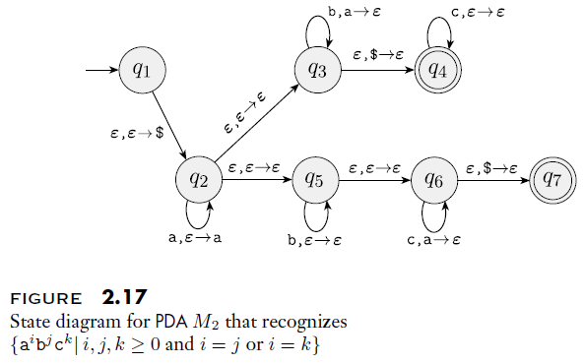
State Diagram for PDA Example 2

Slide 13
Pushdown Automaton Example 3
The next slide shows a state diagram for a pushdown automaton that recognizes the language {ww^{R} | w ∈ {0, 1}*}
Recall that w^{R} represents the reverse of string w (the string with the same symbols in the opposite order)
Informally, we can say that the PDA works as follows:
  It starts reading symbols from the input, and pushes the same symbols onto the stack
  Nondeterministically, at any point, it can "guess" that it is at the halfway point
  The way I like to think about it, each guess starts a parallel path of computation
  For each such path, it reads the remaining input symbols, continuing as long as the next input symbol matches the symbol at the top of the stack, which is popped
  If the input is fully processed at the point when the stack becomes empty, the input is accepted; otherwise, it is rejected
  Remember that if any path accepts the input, then the PDA accepts the input; if every path rejects the input, the PDA rejects the input

Slide 14
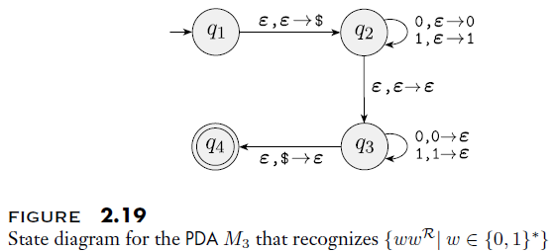
State Diagram for PDA Example 3

Slide 15
PDAs and CFGs are Equal in Power
As mentioned earlier, the two formalisms of CFGs and PDAs are equal in power
Theorem 2.20 in the textbook thus states: "A language is context free if and only if some pushdown automaton recognizes it"
To prove this, we need to show two things, neither of which is simple
One of these two things is stated in Lemma 2.21: "If a language is context free, then some pushdown automaton recognizes it"
To prove this, we will show that any CFG can be converted into an equivalent PDA
Later, Lemma 2.27 states: "If a pushdown automaton recognizes some language, then it is context free"
To prove this, we will show that any PDA can be converted into an equivalent CFG
Although I created slides for these two proofs, we will probably not cover these proofs in complete detail in class (to save time)
Both proofs are explained in the textbook, and I will at least try to provide some of the intuition behind them

Slide 16
Every CFG has an Equivalent PDA
We know that for every CFL, A, there is a CFG, G, that generates it
We will now discuss how to convert G into an equivalent PDA, P, that recognizes A
P therefore accepts an input string, w, if and only if w can be derived from G's start symbol
Each step of the derivation results in a sequence of nonterminals and terminals, which we will call an intermediate string
Book: "We design P to determine whether some series of substitutions using the rules of G can lead from the start variable to w"
Since there will often be multiple substitutions allowed, we will make use of nondeterminism
The PDA's stack contains the symbols of the intermediate string that have not yet matched input symbols
Symbols are pushed in an order such that the left-most remaining symbol in the intermediate string is at the top of the stack
The figure on the next slide helps to explain this; I add:
  In the figure, the start symbol has been used to derive the intermediate string 01A1A0
  The first two symbols of the input string, 01, have already been matched
  The machine will ultimately accept the input, 011001, if and only if the remainder of the intermediate string, A1A0, can derive the remainder of the input, 1001 (clearly this will not be possible in this case)

Slide 17
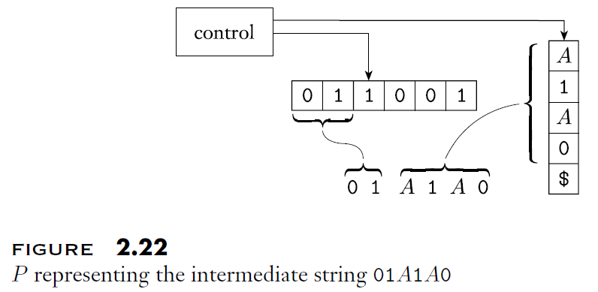
PDA Simulating a CFG Example

Slide 18
Pushing a String onto the Stack
The steps of the solution we will discuss assume that we can push an entire string to the stack
Since a PDA cannot do this in a single step (at least, not as PDAs are defined in our textbook – some other sources describing PDAs allow it), we need to do this using multiple steps
To do so will require creating additional states for every single transition rule
We can describe how to do this with an example (the figure on the next slide helps to explain it):
  Suppose we are in state q, the next input symbol is a, and the top of the stack contains s
  The desired transition would read the input a, pop s (transitions are always required to pop the matching stack symbol), jump to state r, and push the string xyz onto the stack (with z toward the bottom of the stack and x at the top of the stack)
  We can do this in three steps, one for each symbol of the string we want to push
  The first step will read the input symbol a, pop s, and push z; we will jump to a state called q₁, only for use with this particular, desired transition rule
  The next step will not read any input or pop anything; it will just push y and jump to state q₂
  The final step will also not read any input or pop anything; it will just push x and jump to state r
Now that this has been explained, we will present the steps of P (a PDA that simulates a CFG, G) as if a transition rule is allowed to push an entire string onto the stack
We do this with the understanding that a formal description of P would implement every such transition rule with multiple steps, and additional states, as described above

Slide 19
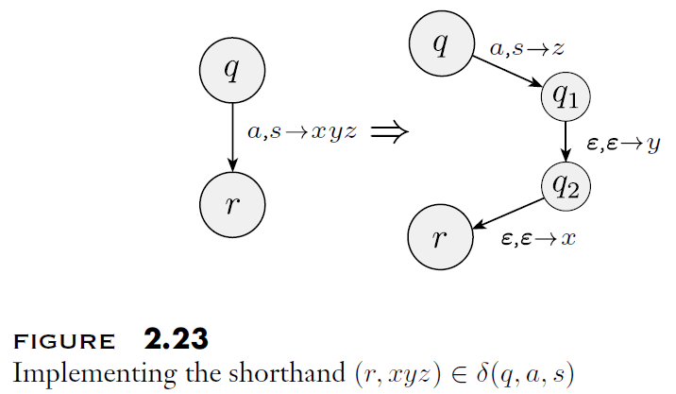
Pushing a String onto the Stack Example

Slide 20
The Description of P (somewhat informal)
The state diagram of P, the PDA simulating a CFG, G, is shown on the next slide
P starts in its initial state, q_{start} (with an empty stack, of course)
Without reading any input, P jumps to state q_{loop} and pushes the string S$ onto the stack
  This uses the process to push a string, as explained on the previous slide
  The $ is pushed first, so it will be at the bottom of the stack
  The symbol S (the start symbol of G) is pushed second, so it will be at the top of the stack
Then the following steps are repeated continuously, as long as we are at state q_{loop}
  If the top of the stack is a terminal symbol, and it matches the next input symbol, a, then pop a from the stack, and stay at the current state q_{loop}
  If the top of the stack is a nonterminal (a.k.a. a variable), A, without considering input, nondeterministically push every string w for which A → w is a rule of G, and stay at state q_{loop}
  If the top of the stack contains $ (meaning we have completed a derivation starting from S), then jump to state q_{accept}
A couple of additional things to point out are:
  It turns out that every transition that pushes a string does not depend on the input, so we are not even taking advantage of the full generality of the process explained on the previous two slides
  At state q_{loop}, if the top of the stack contains a terminal that does not match the next input symbol, this nondeterministic path rejects the input (which does not necessarily mean P rejects the input, if some other nondeterministic path accepts it)
  Similarly, if we jump to q_{accept} without exhausting the full input string, this nondeterministic path rejects the input

Slide 21
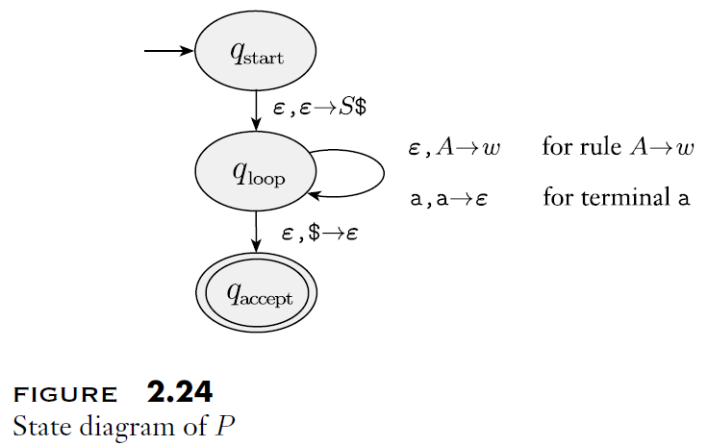
General State Diagram of PDA Simulating CFG

Slide 22
CFG to PDA Example
The next slide shows the resulting PDA when the process we have described is used to convert the following CFG:
  S → aTb | b
  T → Ta | ε
Some things to point out:
  The diagram is showing the complete PDA, including the extra states when pushing strings to the stack
  The multi-transition sequences leading from q_{loop} to q_{loop} relate to the rules S → aTb and T → Ta
  The curvy arrow really represents four separate transitions
    The top two labels relate to the rules S → b and T → ε
    The bottom two labels represent transitions that occur when the next symbol in the intermediate string matches the next input symbol

Slide 23
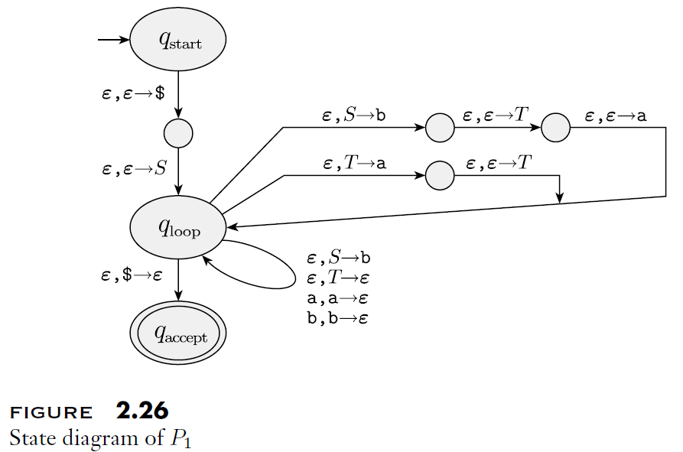
State Diagram for CFG to PDA Example

Slide 24
Every PDA has an Equivalent CFG
Consider a PDA, P, that recognizes some language, A
We will now discuss how to convert P into an equivalent CFG, G, that generates the same language, A, meaning that A is a CFL
We need to design a grammar that can generate a string, w, if and only if P accepts w, meaning that w takes P from its start state to one of its accept states
As the textbook explains, we will "design a grammar that does somewhat more"
We will design a grammar, G, such that for each pair of states p and q in P, G has a variable A_{pq} that generates all strings that take P from p with an empty stack to q with an empty stack
Of course, strings that take P from p with an empty stack to q with an empty stack would also take P from p to q, more generally, leaving the stack contents in the same state as it started
Before the conversion, we modify P to ensure the following properties:
  P has a single accept state, q_{accept}
  P empties its stack before accepting
  Every transition either pushes a symbol onto the stack or pops a symbol from the stack, but not both
The textbook doesn't even explain how to achieve the first two properties, claiming that they are "easy"; I might agree, but I think that the second property warrants discussion (I'll discuss it in class if we cover the proof in detail)
The next slide discusses how we can achieve the third property

Slide 25
Modifying P to Meet the Third Constraint
Assume we have a PDA, P, that already achieves the first two constraints (the so-called "easy" ones) listed on the previous slide
We can then achieve the third constraint as follows:
  For every transition that neither pushes or pops a symbol, convert it to two transitions
    The first transition processes its input symbol and pushes an arbitrary symbol to the stack
    The second transition does not process input and pops the symbol that the previous transition pushed
  For every transition that both pushes and pops a symbol, convert it to two transitions
    The first transition processes its input symbol and pushes the appropriate symbol
    The second transition does not process input and pops the appropriate symbol

Slide 26
How to Get from p to q with an Empty Stack?
Consider a nonterminal, A_{pq}, in a CFG, G, which generates all strings that bring PDA, P, from state p to state q with an empty stack
The path that P takes must start with a push and end with a pop (due to the constraints satisfied by P)
Either the symbol popped from the stack in the last step is the symbol pushed to the stack during the first step, or it is not; we will consider both possibilities
If the two symbols are the identical, this means that as the first input symbol is read, a stack symbol is pushed to the stack, and as the last input symbol is read, the same stack symbol is popped form the stack
  We simulate this possibility by adding the following rule to G: A_{pq} → aA_{rs}b
  Here, a is the input symbol read at the first step, and b is the input symbol read at the last step
  Also, r represents the state following p and s represents the state preceding q
If the two symbols are not identical, this means that the symbol pushed to the stack during the first step is popped from the stack at some point before the end of the sequence
  We simulate this possibility in G by adding the following rule: A_{pq} → A_{pr}A_{rq}
  Here, r represents a state where the stack becomes empty on the path from p to q
Note that there might be multiple rules (and rules of both types) generated for a pair of states (p, q), representing different paths from p to q that start and end with an empty stack
The figures on the next slide help to explain how these rules simulate computation performed by P

Slide 27
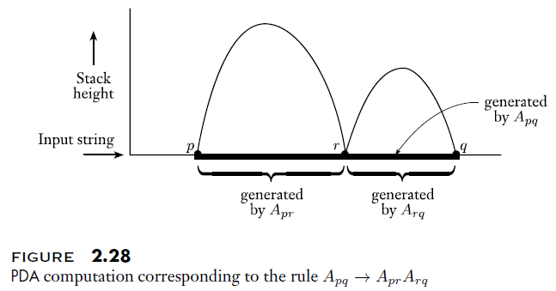
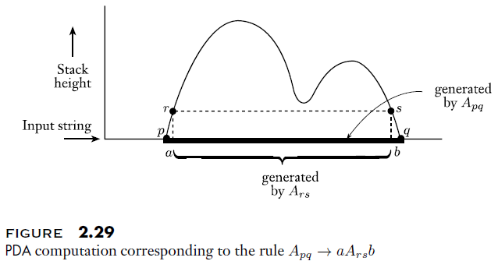
Rules Simulating PDA Computation Explained

Slide 28
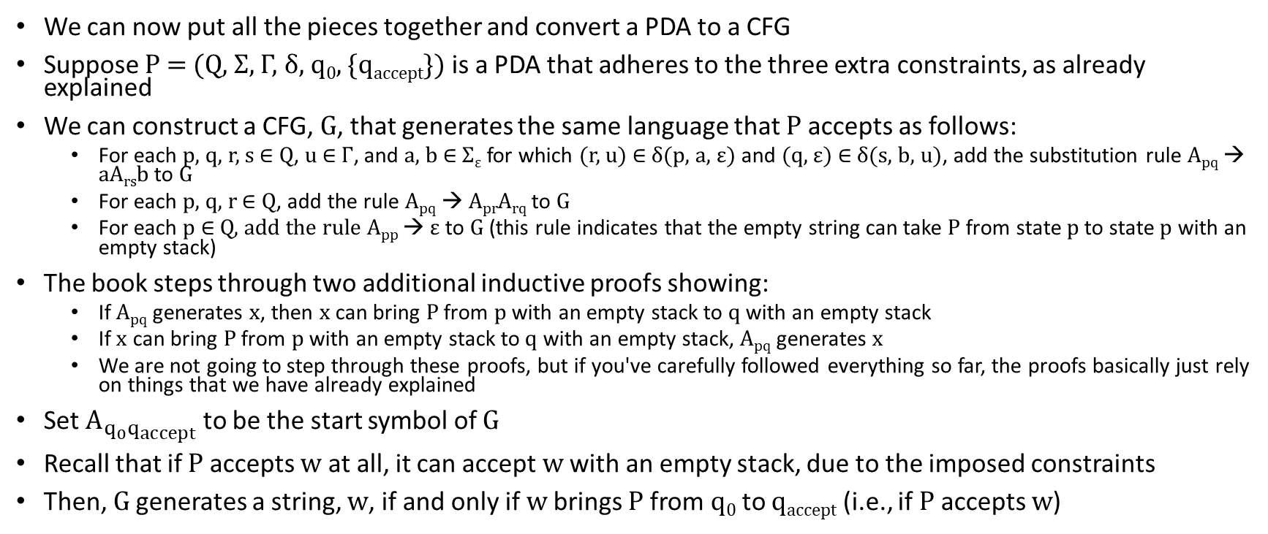
Converting a PDA to a CFG
We can now put all the pieces together and convert a PDA to a CFG
Suppose P = (Q, Σ, Γ, δ, q₀, {q_{accept}}) is a PDA that adheres to the three extra constraints, as already explained
We can construct a CFG, G, that generates the same language that P accepts as follows:
  For each p, q, r, s ∈ Q, u ∈ Γ, and a, b ∈ Σ_{ε} for which (r, u) ∈ δ(p, a, ε) and (q, ε) ∈ δ(s, b, u), add the substitution rule A_{pq} → aA_{rs}b to G
  For each p, q, r ∈ Q, add the rule A_{pq} → A_{pr}A_{rq} to G
  For each p ∈ Q, add the rule A_{pp} → ε to G (this rule indicates that the empty string can take P from state p to state p with an empty stack)
The book steps through two additional inductive proofs showing:
  If A_{pq} generates x, then x can bring P from p with an empty stack to q with an empty stack
  If x can bring P from p with an empty stack to q with an empty stack, A_{pq} generates x
  We are not going to step through these proofs, but if you've carefully followed everything so far, the proofs basically just rely on things that we have already explained
Set $A_{q_{0}q_{accept}}$ to be the start symbol of G
Recall that if P accepts w at all, it can accept w with an empty stack, due to the imposed constraints
Then, G generates a string, w, if and only if w brings P from q₀ to q_{accept} (i.e., if P accepts w)

Slide 29
Regular Languages (re-re-re-revisited)
In our previous topic (which covered CFGs), we casually discussed a proof that all regular languages are context free
Now, we have a much simpler way to prove this
All DFAs (and more generally, all NFAs) are also valid PDAs, because a PDA is allowed to ignore its stack
We now know that PDAs can be converted to CFGs
By definition, every regular language has a DFA that recognizes it
Therefore, every regular language has a PDA that recognizes it
Therefore, every regular language has a CFG that generates it
Hence, every regular language is context free
We have also seen that the context-free languages include some nonregular languages
Therefore, the regular languages are a proper subset of the context-free languages

