Slide 1
ECE461: Theoretical CS
PSPACE-complete Problems

Slide 2
Brief Recap
In our recent topics, we have been covering complexity theory
We discussed how to measure time complexity, using notations such as big-O
We learned about the time complexity classes TIME(t(n)) and NTIME(t(n)), which are related to deterministic Turing machines (DTMs) and nondeterministic Turing machines (NTMs); membership depends on the specific TM models being used
We defined P, the time complexity class containing all languages that can be decided in polynomial time by a single-tape TM; using any reasonably defined model for DTMs, the membership of P would not change
We also defined another time complexity class, NP, and we saw two formulations of it
One formulation states that NP is the class of languages that have polynomial time verifiers (which run on DTMs); the other formulation states that NP is the class of languages that are decidable in polynomial time by some NTM
It is unknown whether P = NP; the textbook refers to this open question as the P versus NP question
We also learned about the hardest NP languages, known as NP-complete languages
In our previous topic, we shifted our discussion to space complexity and space complexity classes
We learned about SPACE(f(n)) and NSPACE(f(N)), and the more general space complexity classes, PSPACE and NPSPACE
Savitch's theorem tells us that for any function f: N→R⁺, where f(n) ≥ n, NSPACE(f(n)) ⊆ SPACE(f²(n))
Savitch's theorem implies that PSPACE = NPSPACE
In this topic, we will learn about the hardest PSPACE languages, known as the PSPACE-complete languages; this topic is based on Section 8.3 of the textbook

Slide 3
PSPACE-Completeness
Definition 8.8 states (I am keeping the book's exact wording, but modifying the format a bit):
  A language B is PSPACE-complete if it satisfies two conditions:
    B is in PSPACE, and
    every A in PSPACE is polynomial time reducible to B.
  If B merely satisfies condition 2, we say that it is PSPACE-hard.
The book discusses why the definition of PSPACE-completeness uses the notion of polynomial time reducibility
  They mention: "The reduction must be easy, relative to the complexity of typical problems in the class, for this reasoning to apply."
  They also state: "Whenever we define complete problems for a complexity class, the reduction model must be more limited than the model used for defining the class itself."
  I feel like this can be explained better; we'll talk a bit more about this in class
  It's also worth noting that we don't know for sure that P is not the same as NP or PSPACE

Slide 4
Quantifiers (revisited)
Book: "Recall that a Boolean formula is an expression that contains Boolean variables, the constants 0 and 1, and the Boolean operations ∧, ∨, and ¬."
Next, the book (re-)introduces the concept of quantifiers; they explain the notions of for all (∀) and there exists (∃)
They mention that ∀ is also called the universal quantifier, and ∃ is also called the existential quantifier
Some thought I'd like to add:
  We are using the constants 0 and 1 to represent the notions of false and true, respectively
  We are also allowed to include parentheses (or equivalent symbols)
  We have seen quantifiers before when we covered Section 6.2, related to logic and logical theories (but the current topic does not refer back to that section)
  I mentioned that the formalism the book seemed to be using in that section was first-order logic, which also includes relations
  In this chapter, the book is less general; they freely use arithmetic operations in their expressions, but they do not mention the more general concept of relations

Slide 5
Quantified Boolean Formulas (part 1)
Boolean formulas with quantifiers are quantified Boolean formulas
The quantified variables within such formulas are said to be bound to quantifiers
In our topic on logic, we learned that variables that are not quantified are called free variables
The scope of each quantifier is until the end of the inner-most parentheses (or brackets, etc.) that the expression appears in
If all variables are quantified, we say that the formula is fully quantified; this type of quantified Boolean formula is called a statement, or a sentence
Every sentence is either true or false
If all quantifiers are placed at the left of a formula, it is said to be in prenex normal form
Book: "Any statement may be put into prenex normal form easily"

Slide 6
Quantified Boolean Formulas (part 2)
When interpreting a sentence, we need to consider the universe (a.k.a. domain) of possible values that variables can be assigned
For example, perhaps variables are constrained to natural numbers, the real numbers, etc.
The universe can also determine whether a sentence is true or false
For example, the sentence ∃y [y + y = 3] is false if the universe of variables is the natural numbers but true if the universe is the real numbers
The book points out that the order of the quantified variables matters
For example, ∀x ∃y [y > x] is clearly a true statement if the universe for both variables is the natural numbers, while ∃y ∀x [y > x] is clearly a false statement for the same universe
In this topic, we will consider only Boolean variables, so the universe of the variables will be {0, 1}
A few points I want to add:
  When we covered logic, we said that if specify the universe of variables and the meaning of each relation in a system, we call this a model, or an interpretation
  We also talked about the notion of the theory of a model, which is the collection of all true statements expressible within the model

Slide 7
TQBF (part 1)
Consider the language: TQBF = {⟨φ⟩| φ is a true fully quantified Boolean formula}
I add: Clearly, determining if a string is a member of this language is equivalent to the solving the decision problem asking if a given fully quantified Boolean formula is true
Theorem 8.9 of the textbook states: "TQBF is PSPACE-complete."
To prove that TQBF is PSPACE-complete, we need to show two things
First, we must show that TQBF is in PSPACE; the book presents an algorithm with three steps (the second and third are recursive):
  If there are no quantified variables (meaning there are no variables, just Boolean constants), simply evaluation the expression and accept if it is true; reject otherwise
  If the leftmost quantifier is ∃, for the corresponding variable, try both a 0 and a 1, and recursively apply the algorithm; accept if either recursive call accepts, reject otherwise
  If the leftmost quantifier is ∀, for the corresponding variable, try both a 0 and a 1, and recursively apply the algorithm; accept if both recursive calls accepts, reject otherwise
The depth of recursion is linear with respect to the number of Boolean variables, and each level of recursion just stores the value of one additional variable to the stack
Clearly, this is a PSPACE algorithm that decides the language

Slide 8
TQBF (part 2)
The harder part of the proof, of course, is showing that all PSPACE problems can be reduced, in polynomial time, to TQBF
The book first suggests considering an approach that ultimately does not work
  Consider constructing a quantified Boolean formula that is true if and only if there is an accepting tableau for some TM, M, applied to input w
  The problem is that the number of rows in a tableau is related to its time complexity, not its space complexity
  Furthermore, some PSPACE solutions to problems use exponential time, therefore leading to an exponentially large tableau
  Therefore, this approach doesn't work, and we need another method
The textbook points out that the approach we will use is related to the proof of Savitch's theorem
The formula constructed will basically reuse space to create a formula that represents both halves of the tableau, one at a time (we'll discuss the details)

Slide 9
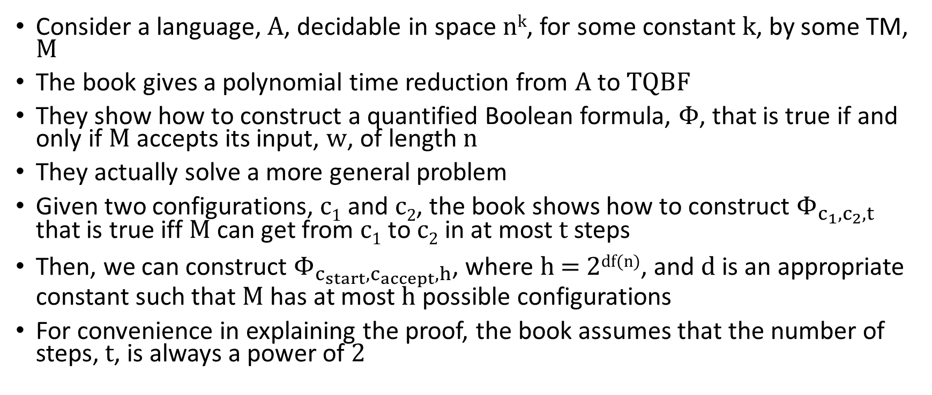
TQBF (part 3)
Consider a language, A, decidable in space n^{k}, for some constant k, by some TM, M
The book gives a polynomial time reduction from A to TQBF
They show how to construct a quantified Boolean formula, Φ, that is true if and only if M accepts its input, w, of length n
They actually solve a more general problem
Given two configurations, c₁ and c₂, the book shows how to construct $Φ_{c_{1},c_{2},t}$ that is true iff M can get from c₁ to c₂ in at most t steps
Then, we can construct $Φ_{c_{start},c_{accept},h}$, where h = 2^{df(n)}, and d is an appropriate constant such that M has at most h possible configurations
For convenience in explaining the proof, the book assumes that the number of steps, t, is always a power of 2

Slide 10
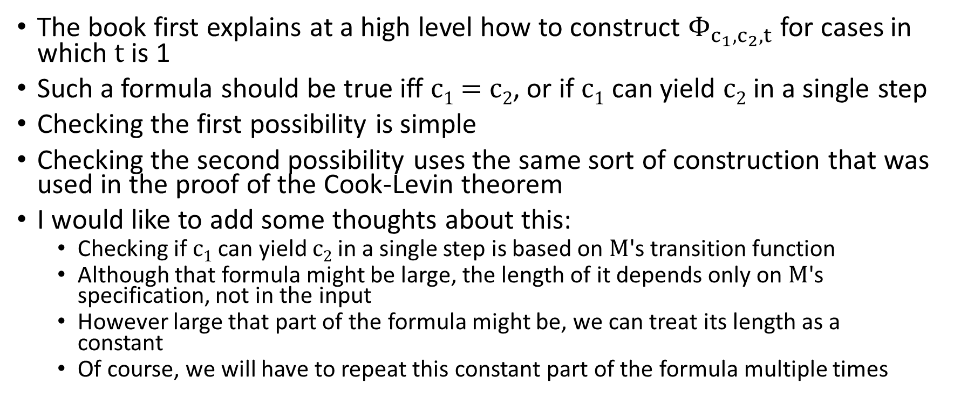
TQBF (part 4)
The book first explains at a high level how to construct $Φ_{c_{1},c_{2},t}$ for cases in which t is 1
Such a formula should be true iff c₁ = c₂, or if c₁ can yield c₂ in a single step
Checking the first possibility is simple
Checking the second possibility uses the same sort of construction that was used in the proof of the Cook-Levin theorem
I would like to add some thoughts about this:
  Checking if c₁ can yield c₂ in a single step is based on M's transition function
  Although that formula might be large, the length of it depends only on M's specification, not in the input
  However large that part of the formula might be, we can treat its length as a constant
  Of course, we will have to repeat this constant part of the formula multiple times

Slide 11
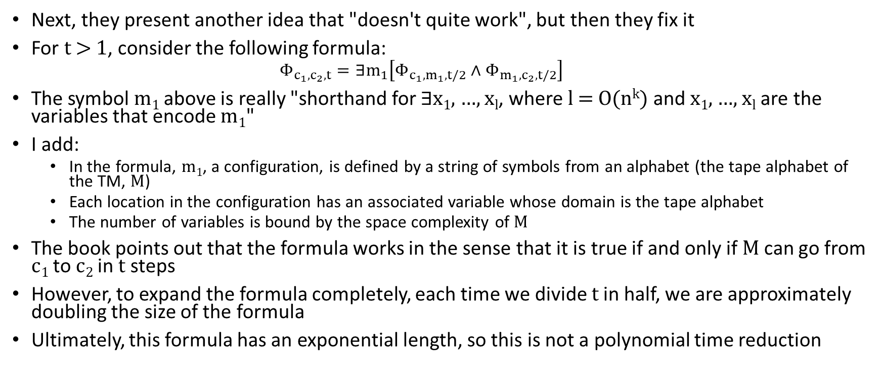
TQBF (part 5)
Next, they present another idea that "doesn't quite work", but then they fix it
For t > 1, consider the following formula:
  $$Φ_{c_{1},c_{2},t}=∃m_{1}\left[Φ_{c_{1},m_{1},t/2}∧Φ_{m_{1},c_{2},t/2}\right]$$
The symbol m₁ above is really "shorthand for $∃$x₁, …, x_{l}, where l = O(n^{k}) and x₁, …, x_{l} are the variables that encode m₁"
I add:
  In the formula, m₁, a configuration, is defined by a string of symbols from an alphabet (the tape alphabet of the TM, M)
  Each location in the configuration has an associated variable whose domain is the tape alphabet
  The number of variables is bound by the space complexity of M
The book points out that the formula works in the sense that it is true if and only if M can go from c₁ to c₂ in t steps
However, to expand the formula completely, each time we divide t in half, we are approximately doubling the size of the formula
Ultimately, this formula has an exponential length, so this is not a polynomial time reduction

Slide 12
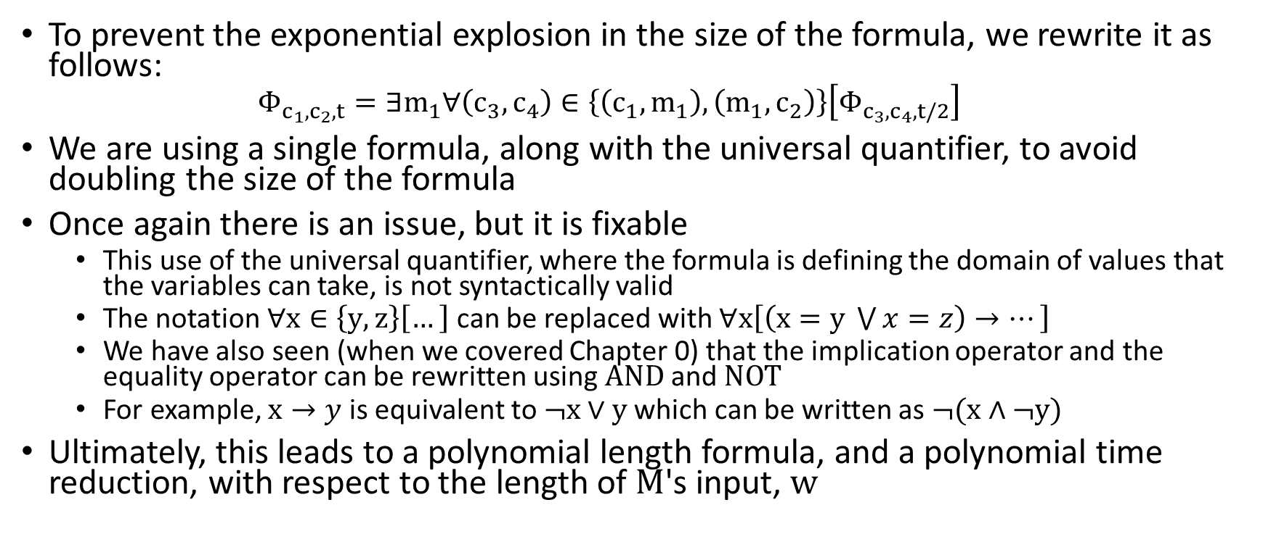
TQBF (part 6)
To prevent the exponential explosion in the size of the formula, we rewrite it as follows:
  $$Φ_{c_{1},c_{2},t}=∃m_{1}∀\left(c_{3},c_{4}\right)∈\left\{\left(c_{1},m_{1}\right),\left(m_{1},c_{2}\right)\right\}\left[Φ_{c_{3},c_{4},t/2}\right]$$
We are using a single formula, along with the universal quantifier, to avoid doubling the size of the formula
Once again there is an issue, but it is fixable
  This use of the universal quantifier, where the formula is defining the domain of values that the variables can take, is not syntactically valid
  The notation $∀x∈\left\{y,z\right\}\left[…\right]$ can be replaced with $∀x\left[\left(x=y \bigvee{x=z}\right)→…\right]$
  We have also seen (when we covered Chapter 0) that the implication operator and the equality operator can be rewritten using AND and NOT
  For example, $x→y$ is equivalent to ¬x ∨ y which can be written as ¬(x ∧ ¬y)
Ultimately, this leads to a polynomial length formula, and a polynomial time reduction, with respect to the length of M's input, w

Slide 13
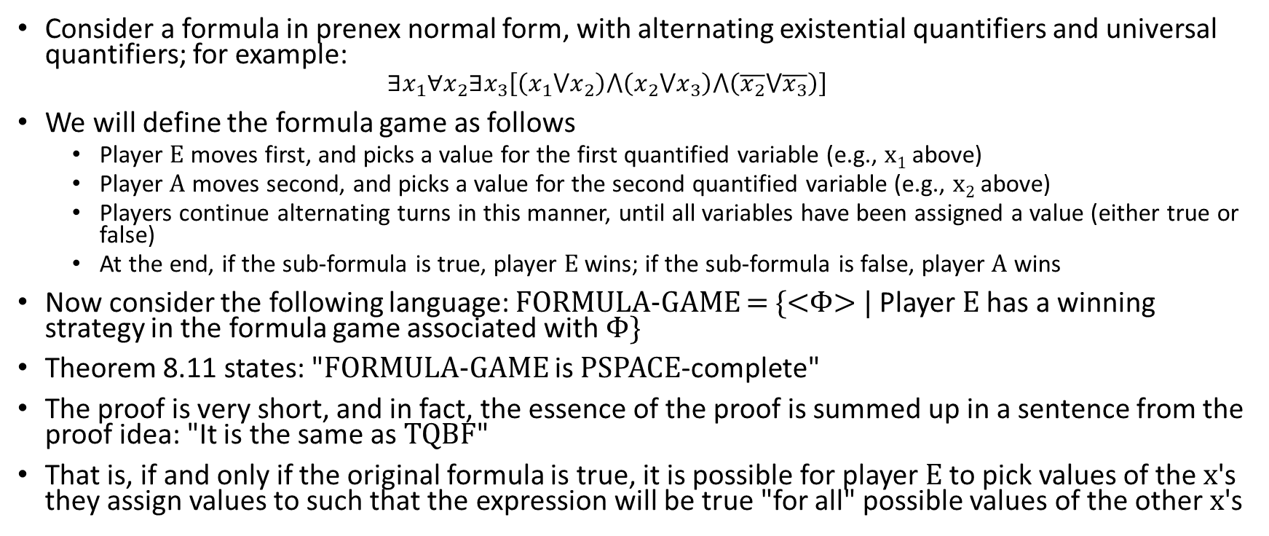
FORMULA-GAME (part 1)
Consider a formula in prenex normal form, with alternating existential quantifiers and universal quantifiers; for example:
  $$∃x_{1}∀x_{2}∃x_{3}\left[\left(x_{1}⋁x_{2}\right)⋀\left(x_{2}⋁x_{3}\right)⋀\left(\overline{x_{2}}⋁\overline{x_{3}}\right)\right]$$
We will define the formula game as follows
  Player E moves first, and picks a value for the first quantified variable (e.g., x₁ above)
  Player A moves second, and picks a value for the second quantified variable (e.g., x₂ above)
  Players continue alternating turns in this manner, until all variables have been assigned a value (either true or false)
  At the end, if the sub-formula is true, player E wins; if the sub-formula is false, player A wins
Now consider the following language: FORMULA-GAME = {<Φ> | Player E has a winning strategy in the formula game associated with Φ}
Theorem 8.11 states: "FORMULA-GAME is PSPACE-complete"
The proof is very short, and in fact, the essence of the proof is summed up in a sentence from the proof idea: "It is the same as TQBF"
That is, if and only if the original formula is true, it is possible for player E to pick values of the x's they assign values to such that the expression will be true "for all" possible values of the other x's

Slide 14
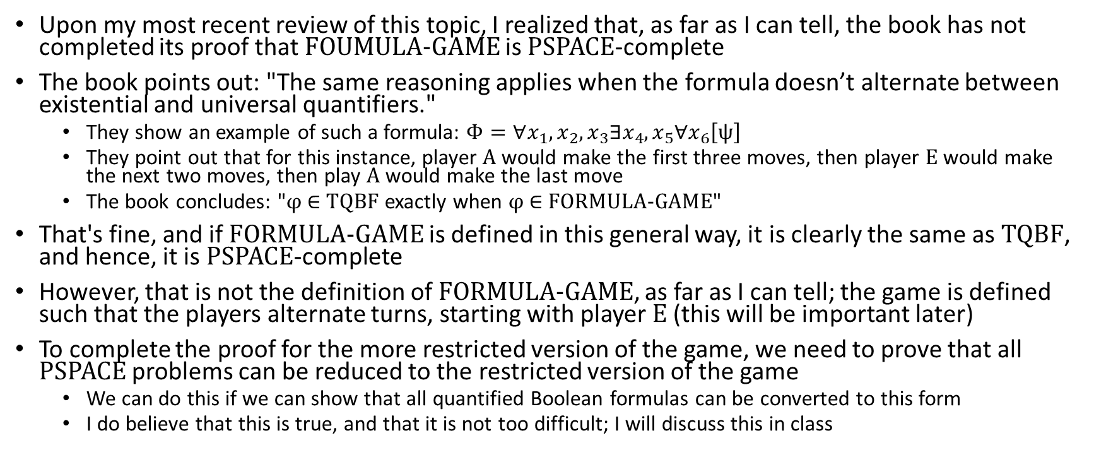
FORMULA-GAME (part 2)
Upon my most recent review of this topic, I realized that, as far as I can tell, the book has not completed its proof that FOUMULA-GAME is PSPACE-complete
The book points out: "The same reasoning applies when the formula doesn’t alternate between existential and universal quantifiers."
  They show an example of such a formula: $\text{Φ}=∀x_{1},x_{2},x_{3}∃x_{4},x_{5}∀x_{6}\left[ψ\right]$
  They point out that for this instance, player A would make the first three moves, then player E would make the next two moves, then play A would make the last move
  The book concludes: "φ ∈ TQBF exactly when φ ∈ FORMULA-GAME"
That's fine, and if FORMULA-GAME is defined in this general way, it is clearly the same as TQBF, and hence, it is PSPACE-complete
However, that is not the definition of FORMULA-GAME, as far as I can tell; the game is defined such that the players alternate turns, starting with player E (this will be important later)
To complete the proof for the more restricted version of the game, we need to prove that all PSPACE problems can be reduced to the restricted version of the game
  We can do this if we can show that all quantified Boolean formulas can be converted to this form
  I do believe that this is true, and that it is not too difficult; I will discuss this in class

Slide 15
The Geography Game
The book explains the geography game (I add: I played this as a kid)
  Two players alternate naming cities
  Each player is required to name a city that starts with the ending letter of the previous city, and no city names can be repeated
  If one player gets stuck (i.e., they cannot think of any new city starting with the ending letter of the previous city), they lose and the other player wins
This game can be modeled with a graph; an example is shown on the next slide (only a portion of the graph is shown)
  The starting player picks a starting node of the graph
  Then, starting with the second player, players alternate choosing edges out of the current node, and they are not allowed to repeat a node
  If a player gets stuck, they lose and the other player wins

Slide 16
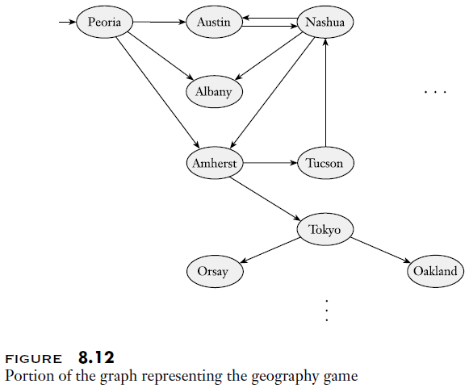
The Geography Game as a Graph

Slide 17
Generalized Geography (part 1)
In generalized geography, the graph used for the game can be an arbitrary directed graph (i.e., it does not need to be based on cities)
The figure on the next slide shows an example
  In this case, we are assuming that there is a specific starting node (node 1 in the example)
  The players alternate choosing edges, and they are not allowed to repeat a node
  The player that gets stuck loses; the other player wins
  In this particular graph, player 1 has a winning strategy; but if the graph is slightly modified, they might not
Now consider the following language: GG = {<G, b> | Player 1 has a winning strategy for the generalized geography game played on graph G starting at node b}
Theorem 8.14 states: "GG is PSPACE-complete"
To show that GG is in PSPACE, the book gives a PSPACE algorithm to solve it (we won't cover the details, but it is similar to the approach used for TQBF)
We can prove that GG is PSPACE-hard via a reduction from FORMULA-GAME
  Consider an appropriately structured, fully quantified formula, Φ (that alternates between players E and A)
  We can construct a graph, G, with a starting node, b, such that player 1 has a winning strategy if and only if player E has a winning strategy in the formula game

Slide 18
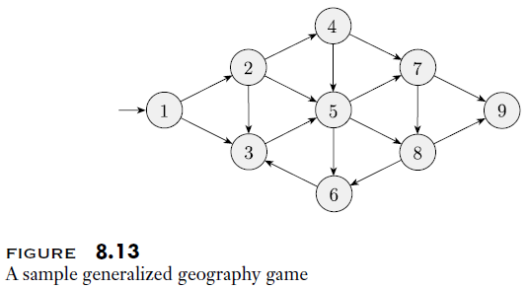
Generalized Geography (part 2)

Slide 19
Generalized Geography (part 3)
We will not cover this reduction in as much detail as some of the others (the book goes into more detail); we will explain it by example
The figure on the next slide helps to explain a polynomial time reduction from FORMULA-GAME to GG
  We are assuming the quantifiers alternate, and the first and last quantified variables are assigned by player E
  We are also assuming the formula is in conjunctive normal form (Problem 8.12 asks us to prove that TQBF is still PSPACE-complete for formulas in conjunctive normal form, and therefore so is FORMULA-GAME)
  On each player's turn, the player chooses if they want to traverse the next diamond going left (corresponding to a true variable) or right (corresponding to a false variable)
  After traversing all the diamonds, player 1 is forced to move to the c node
  Player 2 then gets to choose a clause node
  If the original formula was true, then player 1 can make appropriate choices ensuring that every clause has at least one true literal
  No matter what clause node player 2 chooses, player 1 is able to move from the current clause to a node corresponding to a true literal; this ensures that player 2 gets stuck
  If the original formula was not true, player 2 can pick a clause with no true literals
  Then, no matter which node player 1 picks (corresponding to a literal in the clause), player 2 will be able to make one more move, and player 1 will be stuck

Slide 20
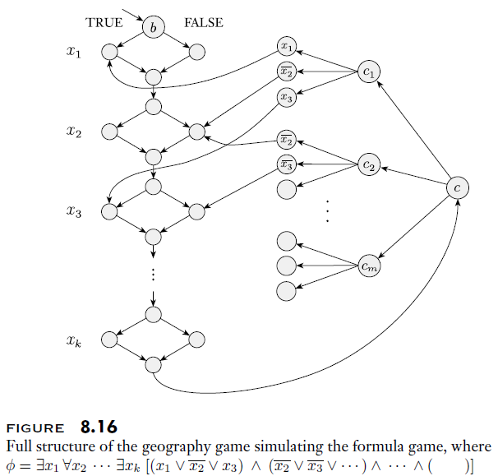
Generalized Geography (part 4)

