Slide 1
ECE461: Theoretical CS
NP-Complete Problems,
the Cook-Levin Theorem,
and (more) Reductions

Slide 2
Brief Recap
Earlier in the course, we explored computability theory
We discussed Turing machines (TMs), focusing mostly on deterministic Turing machines (DTMs); if we accept the Church-Turing thesis, all algorithms can be implemented by Turing machines
Then, we started covering complexity theory
We discussed how to measure time complexity, using notations such as big-O
We learned the definition of a time complexity class, TIME(t(n)), containing all languages decidable by an O(t(n)) time Turing machine; membership in TIME(t(n)) depends on the specific TM model being used
We defined P, the time complexity class containing all languages that can be decided in polynomial time by a single-tape TM; using any reasonably defined model for DTMs, the membership of P would not change
In our previous topic, we defined another time complexity class, NP, and we saw two formulations of it
  One formulation states that NP is the class of languages that have polynomial time verifiers
  The other formulation states that NP is the class of languages that are decidable in polynomial time by some nondeterministic Turing machine (NTM)
It is unknown whether P = NP; the textbook refers to this open question as the P versus NP question
In this topic, we will learn about the hardest NP languages, known as NP-complete languages
This topic is based on Sections 7.4 and 7.5 of the textbook

Slide 3
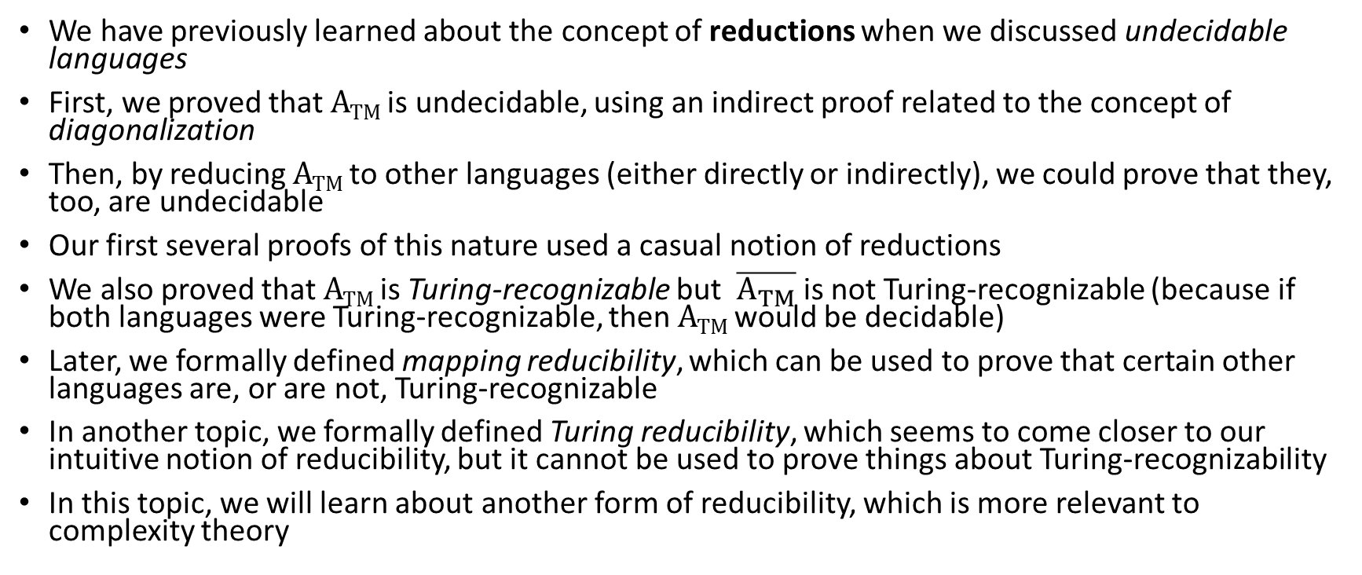
Reductions (revisited)
We have previously learned about the concept of reductions when we discussed undecidable languages
First, we proved that A_{TM} is undecidable, using an indirect proof related to the concept of diagonalization
Then, by reducing A_{TM} to other languages (either directly or indirectly), we could prove that they, too, are undecidable
Our first several proofs of this nature used a casual notion of reductions
We also proved that A_{TM} is Turing-recognizable but $\overline{A_{TM}}$is not Turing-recognizable (because if both languages were Turing-recognizable, then A_{TM} would be decidable)
Later, we formally defined mapping reducibility, which can be used to prove that certain other languages are, or are not, Turing-recognizable
In another topic, we formally defined Turing reducibility, which seems to come closer to our intuitive notion of reducibility, but it cannot be used to prove things about Turing-recognizability
In this topic, we will learn about another form of reducibility, which is more relevant to complexity theory

Slide 4
Polynomial Time Reducibility
Definition 7.28 states (I am keeping the book's exact wording):
  A function f : Σ∗ → Σ∗ is a polynomial time computable function if some polynomial time Turing machine M exists that halts with just f(w) on its tape, when started on any input w.
Definition 7.29 states (I am keeping the book's exact wording, but modifying the formatting a bit):
  Language A is polynomial time mapping reducible, or simply polynomial time reducible, to language B, written A ≤_{P} B, if a polynomial time computable function f : Σ∗ → Σ∗ exists, where for every w, w ∈ A ⇔ f(w) ∈ B. The function f is called the polynomial time reduction of A to B.
The figure on the next slide helps to explain this
  This should look familiar; it is virtually identical to the figure used to explain mapping reducibility and mapping reductions
  The only difference here is that the function computing the reduction is guaranteed to take polynomial time; we can say that the mapping is efficient (although in practice, polynomial does not always mean efficient)
Polynomial time reducibility is important when discussing complexity theory
Theorem 7.31 states: "If A ≤_{P} B and B ∈ P, then A ∈ P."
The proof is obvious; on an input w that might be a member of A, we can use the function f and then use the polynomial time decider for B (which must exist) to determine membership in A

Slide 5
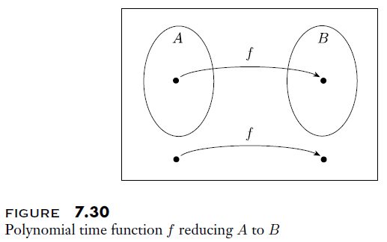
Polynomial Time Reducibility Explained

Slide 6
NP-Completeness (general overview)
In DSA 2, we described NP-complete and NP-hard as complexity classes; taken from DSA 2 slides:
  The class NP-hard includes every decision problem for which every problem in NP can be reduced to it in polynomial time
  A problem in the class NP-hard is called an NP-hard problem
  The class NP-complete includes every decision problem that is in NP and for which every problem that is in NP can be reduced to it in polynomial time
  A problem in the class NP-complete is called an NP-complete problem
We've seen several times throughout the course that definitions about decision problems can be recast as definitions about languages
However, our textbook does not define NP-complete as a complexity class; they define it as a property that an NP language might have (we will discuss the definition shortly)
  Looking at other sources, the Arora and Barak book and the Papadimitriou book discuss the term as our textbook does
  Looking at various online sources, many define NP-complete and NP-hard as complexity classes
  Ultimately, I think either definition is appropriate; in this course, we will discuss NP-completeness as a property that certain languages have, not as a complexity class

Slide 7
NP-Completeness (textbook's definition)
Definition 7.34 states (I am keeping the book's exact wording):
  A language B is NP-complete if it satisfies two conditions:
    1. B is in NP, and
    2. every A in NP is polynomial time reducible to B.
Our textbook only introduces the term NP-hard (which they also define in the expected way as a property) in Problem 7.34 at the end of the chapter; the term is used occasionally later in the book
There are a few additional points I want to make here:
  Whether we consider NP-complete to be a property or a complexity class, the definition is virtually identical
  This idea of "completeness" as a property is that such a language can be used to decide every member of its general class
  In this case, an NP-complete language is in NP, and it can be used to decide every other NP language efficiently
  If we were reasoning about decision problems instead of languages, an NP-complete problem can be used to solve every other NP problem efficiently
  The textbook starts to talk about reductions involving NP-complete languages before they even define NP-completeness (they continue to discuss more reductions afterward)
  I am covering things in a different order here; we are starting with the definition of NP-complete, then we'll cover the Cook-Levin theorem, then we'll discuss relevant reductions
Theorem 7.35 states: "If B is NP-complete and B ∈ P, then P = NP"
The proof simply states: "This theorem follows directly from the definition of polynomial time reducibility."

Slide 8
SAT
Here is the textbook's definition of SAT: SAT = {⟨φ⟩| φ is a satisfiable Boolean formula}
  A Boolean formula is "an expression involving Boolean variables and operations" (parentheses are allowed)
  The Boolean operations are AND (∧), OR (∨), and NOT (¬)
Deciding if a string, w, is a member of SAT is equivalent to solving the decision problem asking if w is a Boolean expression that is satisfiable
Our textbook refers to this as the satisfiability problem (a.k.a. the Boolean satisfiability problem)
Theorem 7.27, stated write after defining SAT early in Section 7.4, states: "SAT ∈ P iff P = NP"
Later in the section, Theorem 7.37 states: "SAT is NP-complete"
After Theorem 7.37, before the proof, the book states: "This theorem implies theorem 7.27" (i.e., because SAT is NP-complete, if it is decidable in polynomial time, then so are all NP problems)
Theorem 7.37 is known as the Cook-Levin theorem, a.k.a. Cook's theorem
  A publication by Cook in 1971 proved that SAT is NP-complete
  Leven independently proved that certain search problems are "complete" in the same sense; he didn’t publish his result until 1973, but according to Wikipedia, he had discussed his result a few years prior
  Before discussing the proof of the Cook-Levin theorem, we need to introduce one more relevant concept

Slide 9
Tableaus
Consider an NTM, N, that runs within n^{k} steps (the book actually assumes that it runs within n^{k}-3 steps, but says that "only those readers interested in details should worry about this minor point")
A tableau is a table representing a computation history of N applied to its input, w (although the book does not mention the term "computation history" in the description)
Recall that a computation history is a valid sequence of configurations of a TM on a given input
The figure on the next slide helps to explain the concept of a tableau
  Each row of the tableau stores a configuration "of a branch of the computation of N on w"
  The first row represents the start configuration of N
  Each other row must follow the previous row according to N's transition function
Book: "A tableau is accepting if any row of the tableau is an accepting configuration"; this would represent an accepting computation history (I add: this assumes there are no defined transitions out of a reject state)
Note that, unlike when we discussed computation histories of DTMs, an NTM may have many possible computation histories, and therefore many possible tableaus
The NTM accepts its input iff there is at least one accepting computation history (i.e., an accepting tableau)
Book: "The problem of determining whether N accepts w is equivalent to the problem of determining whether an accepting tableau for N on w exists" (which would represent an accepting computation history)

Slide 10
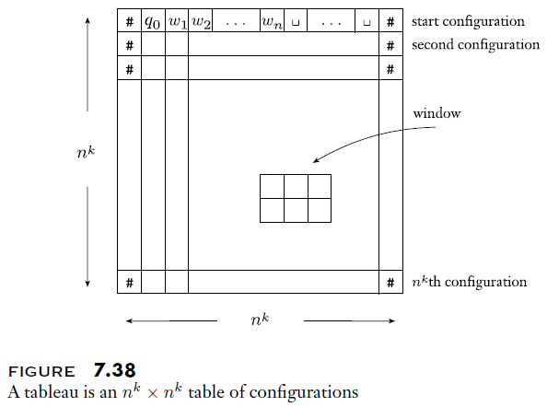
Graphical Depiction of a Tableau

Slide 11
Proving the Cook-Levin Theorem (part 1)
We already stated the Cook-Levin theorem a few slides back; this was Theorem 7.37, which states: "SAT is NP-complete"
To prove this, we must prove two things
First, we must prove that SAT is in NP
  This is obvious according to either formulation of NP
  Clearly, a satisfying assignment of a Boolean formula can serve as a certificate that the formula is satisfiable
  Also, an NTM can nondeterministically guess each possible assignment of Boolean values to its variables and check if any one of them satisfies the formula
Second, we must prove that all NP problems are reducible to SAT in polynomial time
  In DSA 2, we briefly looked at a proof that came from Wikipedia, but we did not go over it in detail
  While I do like that proof, I find the one in our current textbook significantly more elegant
  However, this proof relies on a few concepts that we didn't cover in DSA 2; namely, configurations, computation histories, and tableaus
  Given an NTM, N, and input w, we will show that we can construct a Boolean formula, Φ, that is satisfiable iff there is an accepting tableau for N on w
  The book's proof is also long; it occupies approximately five pages in the textbook
  Nonetheless, I think this proof is important, and I plan to cover it in detail

Slide 12
Proving the Cook-Levin Theorem (part 2)
To complete the proof of the Cook-Levin theorem, we must show that we can reduce any NP problem to SAT
We will do this with a constructive proof
Given an NTM, N, and input w, we will show that we can construct a Boolean formula, Φ, that is satisfiable iff there is an accepting tableau for N on w
We will start by defining the variables of Φ
  If Q is the set of N's states, and T is N's tape alphabet, then let C = Q ∪ T ∪ {#}; note that this includes the blank symbol, which is part of T
  In a tableau for N on w, every entry in row i and column j, where 1 ≤ i,j ≤ n^{k}, is referred to as a cell; each cell, cell[i, j], contains a symbol from C
  For each symbol, s, in C, and each i and j in the range from 1 to n^{k}, the variables of Φ will include a variable x_{i, j, s}
  Each variable x_{i, j, s} corresponds to the cell, cell[i, j]
  If the value of x_{i, j, s} is 1 (true) this means that cell[i, j] contains s; if the value of x_{i, j, s} is 0 (false), this means that cell[i, j] does not contain s (i.e., it contains some other symbol)

Slide 13
Proving the Cook-Levin Theorem (part 3)
Using the variables previously explained, we will construct a Boolean formula with four parts, ANDed together
At a high level, we can represent the formula (in terms of its four parts) as:
  Φ= Φ_{cell} ∧ Φ_{start} ∧ Φ_{move} ∧ Φ_{accept}
For the formula to be true, all four parts need to be true
We can think of the four parts, intuitively, as expressing the four facts:
  The contents of every cell is valid (i.e., each cell contains a single variable)
  The computation history starts off with the initial configuration (i.e., that is what is contained in the first row of the tableau)
  Each step in the computation represents a valid transition (i.e., each row of the tableau after the first row represents a valid transition from the previous row)
  The computation history is an accepting computation history (i.e., one row of the tableau contains an accepting configuration)

Slide 14
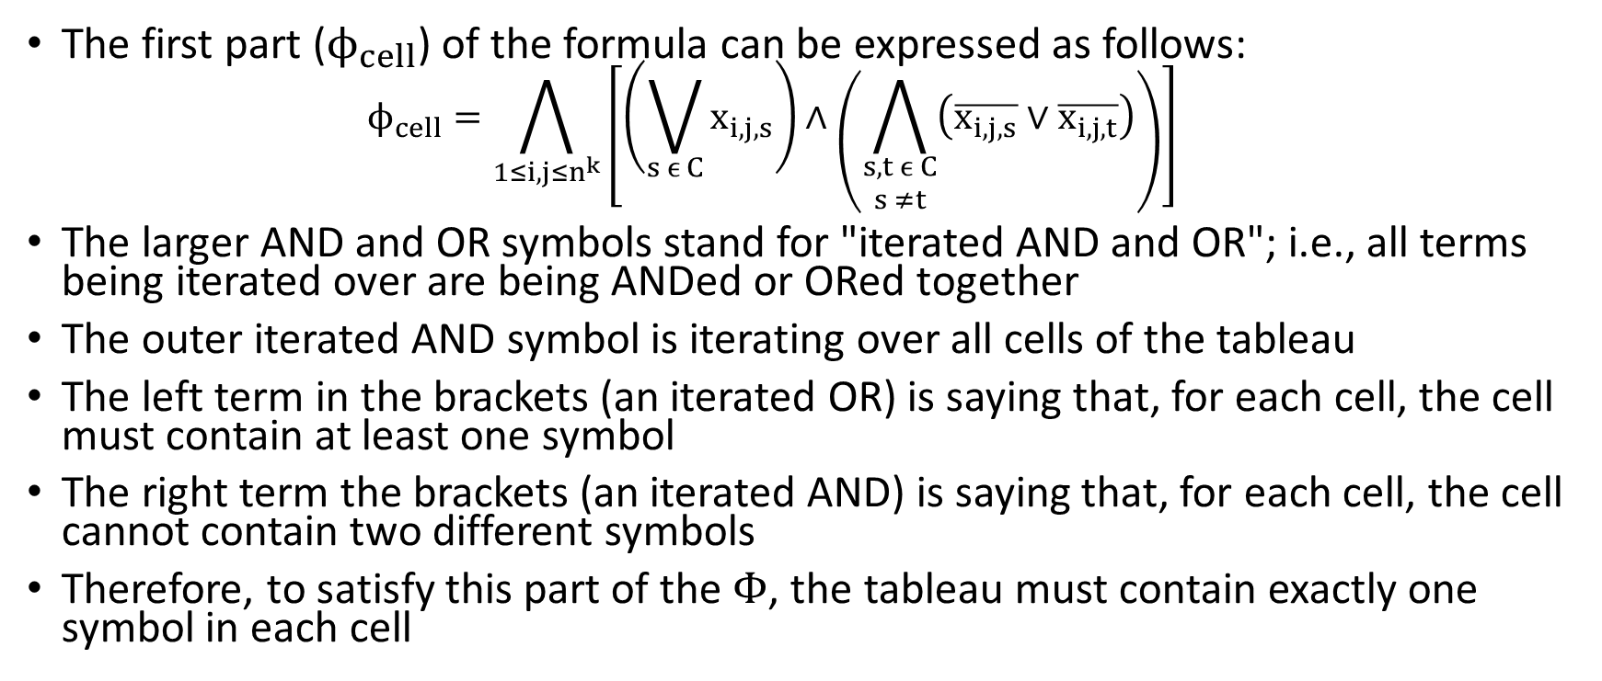
Proving the Cook-Levin Theorem (part 4)
The first part ($ϕ_{cell}$) of the formula can be expressed as follows:
  $$ϕ_{cell}=\bigwedge_{1≤i,j≤n^{k}}{\left[\left(\bigvee_{s ϵ C}{x_{i,j,s}}\right)∧\left(\bigwedge_{\begin{matrix}s,t ϵ C \\ s ≠t\end{matrix}}{\left(\overline{x_{i,j,s}} \text{∨} \overline{x_{i,j,t}}\right)}\right)\right]}$$
The larger AND and OR symbols stand for "iterated AND and OR"; i.e., all terms being iterated over are being ANDed or ORed together
The outer iterated AND symbol is iterating over all cells of the tableau
The left term in the brackets (an iterated OR) is saying that, for each cell, the cell must contain at least one symbol
The right term the brackets (an iterated AND) is saying that, for each cell, the cell cannot contain two different symbols
Therefore, to satisfy this part of the Φ, the tableau must contain exactly one symbol in each cell

Slide 15
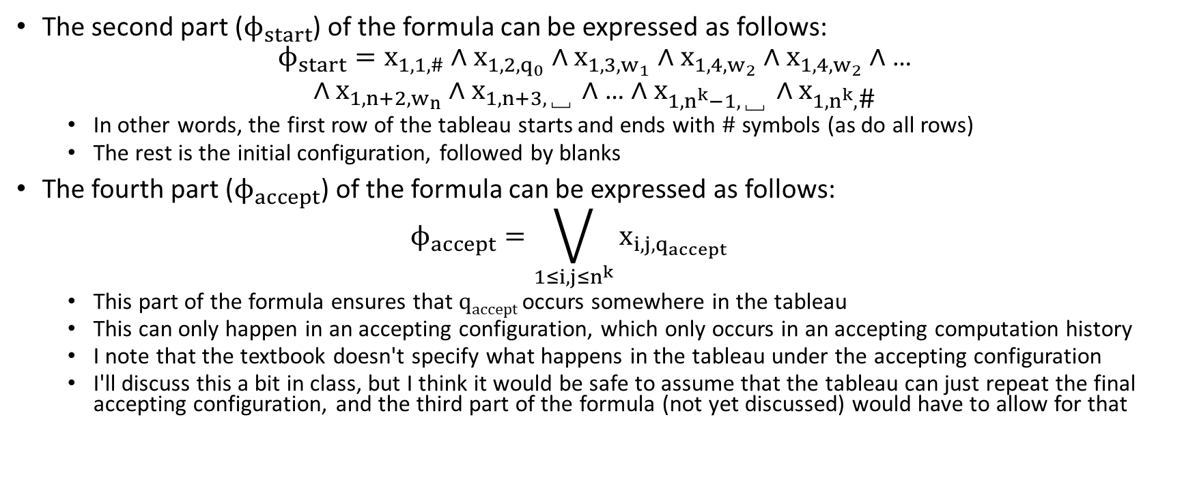
Proving the Cook-Levin Theorem (part 5)
The second part ($ϕ_{start}$) of the formula can be expressed as follows:
$$ϕ_{start}=x_{1,1,\#}∧x_{1,2,q_{0}}∧x_{1,3,w_{1}}∧x_{1,4,w_{2}}∧x_{1,4,w_{2}}∧\text{…}$$
$$∧x_{1,n+2,w_{n}}∧x_{1,n+3,\text{␣}}∧\text{…}∧x_{1,n^{k}−1,\text{␣}}∧x_{1,n^{k},\text{\#}}$$
  In other words, the first row of the tableau starts and ends with # symbols (as do all rows)
  The rest is the initial configuration, followed by blanks
The fourth part ($ϕ_{accept}$) of the formula can be expressed as follows:
  $$ϕ_{accept}=\bigvee_{1≤i,j≤n^{k}}{x_{i,j,q_{accept}}}$$
  This part of the formula ensures that q_{accept} occurs somewhere in the tableau
  This can only happen in an accepting configuration, which only occurs in an accepting computation history
  I note that the textbook doesn't specify what happens in the tableau under the accepting configuration
  I'll discuss this a bit in class, but I think it would be safe to assume that the tableau can just repeat the final accepting configuration, and the third part of the formula (not yet discussed) would have to allow for that

Slide 16
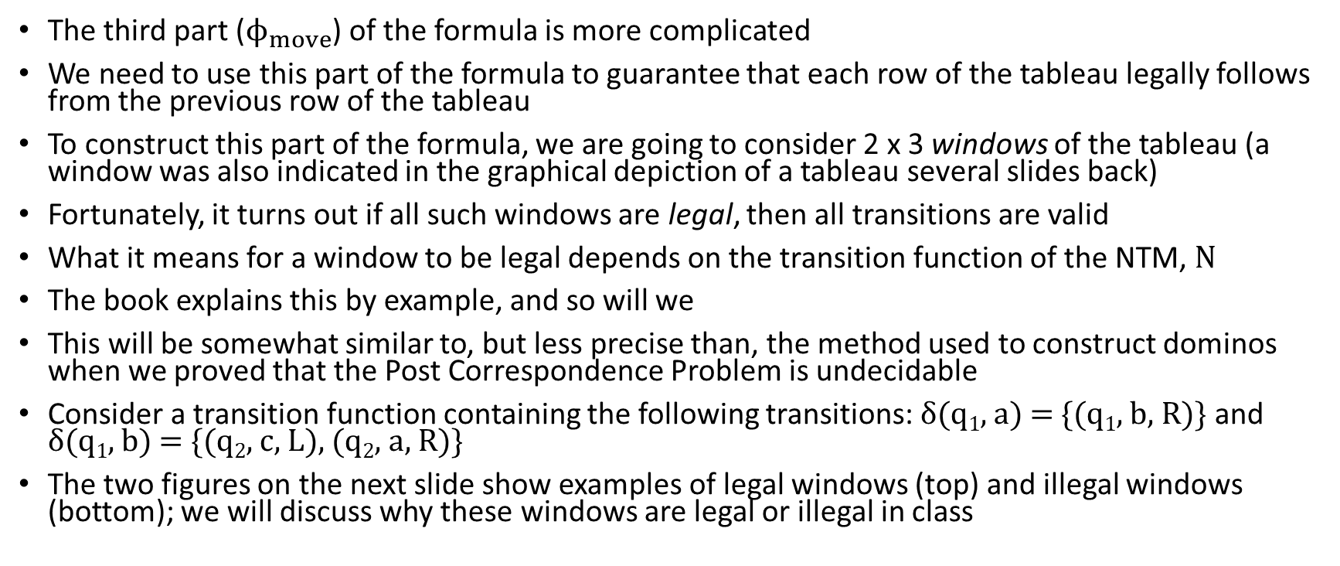
Proving the Cook-Levin Theorem (part 6)
The third part ($ϕ_{move}$) of the formula is more complicated
We need to use this part of the formula to guarantee that each row of the tableau legally follows from the previous row of the tableau
To construct this part of the formula, we are going to consider 2 x 3 windows of the tableau (a window was also indicated in the graphical depiction of a tableau several slides back)
Fortunately, it turns out if all such windows are legal, then all transitions are valid
What it means for a window to be legal depends on the transition function of the NTM, N
The book explains this by example, and so will we
This will be somewhat similar to, but less precise than, the method used to construct dominos when we proved that the Post Correspondence Problem is undecidable
Consider a transition function containing the following transitions: δ(q₁, a) = {(q₁, b, R)} and δ(q₁, b) = {(q₂, c, L), (q₂, a, R)}
The two figures on the next slide show examples of legal windows (top) and illegal windows (bottom); we will discuss why these windows are legal or illegal in class

Slide 17
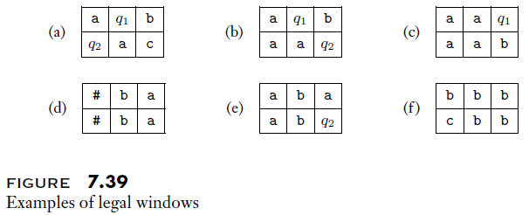
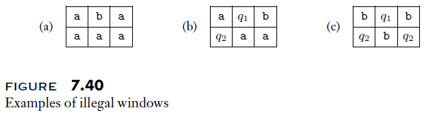
Proving the Cook-Levin Theorem (part 7)

Slide 18
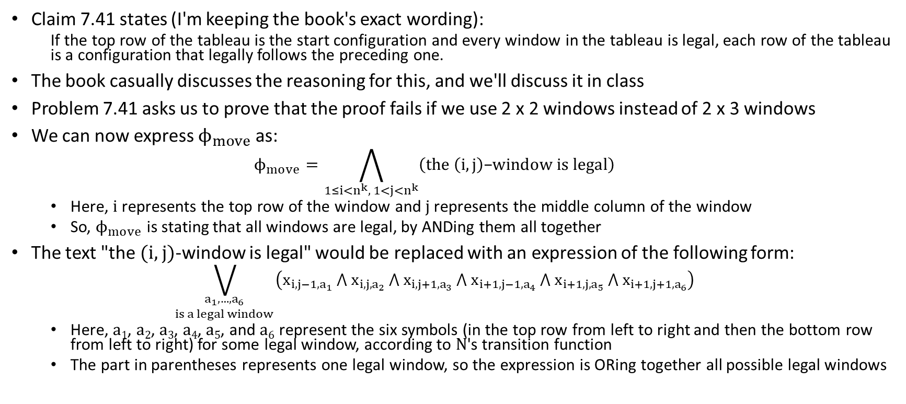
Proving the Cook-Levin Theorem (part 8)
Claim 7.41 states (I'm keeping the book's exact wording):
  If the top row of the tableau is the start configuration and every window in the tableau is legal, each row of the tableau is a configuration that legally follows the preceding one.
The book casually discusses the reasoning for this, and we'll discuss it in class
Problem 7.41 asks us to prove that the proof fails if we use 2 x 2 windows instead of 2 x 3 windows
We can now express $ϕ_{move}$ as:
  $$ϕ_{move}=\bigwedge_{1≤i<n^{k}, 1<j<n^{k}}{\left(the \left(i,j\right)\text{−}window is legal\right)}$$
  Here, i represents the top row of the window and j represents the middle column of the window
  So, $ϕ_{move}$ is stating that all windows are legal, by ANDing them all together
The text "the (i, j)-window is legal" would be replaced with an expression of the following form:
  $$\bigvee_{\begin{matrix}a_{1},…,a_{6} \\ is a legal window\end{matrix} }{\left(x_{i,j−1,a_{1}} ⋀{ x}_{i,j,a_{2}} ⋀{ x}_{i,j+1,a_{3}} ⋀{ x}_{i+1,j−1,a_{4}} ⋀{ x}_{i+1,j,a_{5}} ⋀{ x}_{i+1,j+1,a_{6}}\right)}$$
  Here, a₁, a₂, a₃, a₄, a₅, and a₆ represent the six symbols (in the top row from left to right and then the bottom row from left to right) for some legal window, according to N's transition function
  The part in parentheses represents one legal window, so the expression is ORing together all possible legal windows

Slide 19
Proving the Cook-Levin Theorem (part 9)
We have now described all four main parts of Φ= Φ_{cell} ∧ Φ_{start} ∧ Φ_{move} ∧ Φ_{accept}
If all four parts can be satisfied, then there must be some valid way for N to accept w
Thus, every NP language can be reduced to SAT
We still need to prove that this is a polynomial time reduction
The book first states (recall that n is the size of w, the input to N):
  The size of Φ_{cell} is O(n^{2k})
  The size of Φ_{start} is O(n^{k})
  The size of Φ_{move} is O(n^{2k})
  The size of Φ_{accept} is O(n^{2k})
I considered all of the above bounds intuitive, but the book then admits that its "estimates are low by a factor of O(log n)"
This is because "each variable has indices that can range up to n^{k}" and it can therefore "require O(log n) symbols" to express each variable
Either way, the length of the formula is polynomial with respect to the size of w
The book then casually reasons that the formula can also be generated in polynomial time, thus leading to a polynomial time reduction

Slide 20
Reductions (re-revisited)
Theorem 7.36 states: "If B is NP-complete and B ≤_{P} C for C in NP, then C is NP-complete."; the proof should seem obvious (I'll discuss this in class)
Thus, now that we have proved one problem is NP-complete, it is simpler to prove that other problems are NP-complete
In DSA 2, we discussed Karp's 1972 paper, "Reducibility Among Combinatorial Problems"
  Note that this extremely influential paper was published just one year after Cook's publication, which proved what is now often called the Cook-Levin theorem, a.k.a. Cook's theorem
  Our textbook lists this paper in its "Selected Bibliography" at the end of the book, although the paper does not appear to be referenced in Chapter 7, as far as I can tell
  Karp's paper shows that 21 problems are NP-complete
  These problems included SAT (Karp specifically considered formulas in conjunctive normal form), 3SAT, the clique problem, the Hamiltonian path problem, the subset sum problem, and several others.
  We will soon be discussing each of the problems mentioned in the previous bullet
  Several of the problems discussed in Karp's paper were problems that computer scientists were actively trying to find efficient solutions for at the time
  All of Karp's proofs involved polynomial time reductions from SAT, either directly or indirectly (recall that reducibility is transitive)
  Basically, Karp formed a tree of problems, with SAT at the root and each branch representing a reduction

Slide 21
Conjunctive Normal Form
Recall our textbook's definition of SAT: SAT = {⟨φ⟩| φ is a satisfiable Boolean formula}
  A Boolean formula is "an expression involving Boolean variables and operations" (parentheses are allowed)
  The Boolean operations are AND (∧), OR (∨), and NOT (¬)
A Boolean formula is in conjunctive normal form (CNF) if:
  The formula is expressed as a conjunction of clauses (i.e., clauses ANDed together)
  Each clause is a disjunction of literals (i.e., literals ORed together)
  Each literal is a Boolean variable or a Boolean variable negated
Some sources (including both the Arora and Barak book and the Papadimitriou book) define SAT such that the Boolean formula is in CNF; we will refer to this version of the problem as SAT in CNF
Our textbook defines SAT more generally (as do various other sources)
SAT can be reduced in polynomial time to SAT in CNF
  Every Boolean formula can be converted to a logically equivalent CNF formula; e.g., a straight-forward process for this can repeatedly apple De Morgan's laws and the distributed law
  However, this process can result in an expression that is exponentially longer than the original formula
  Fortunately, there are other polynomial time processes that can convert a Boolean formula to a polynomial-length Boolean formula in CNF that is equisatisfiable; i.e., that is satisfiable iff the original formula is satisfiable
  The new formula may not be logically equivalent to the original, because it may contain additional variables, but we do not care about that for the purposes of reducing SAT to SAT in CNF

Slide 22
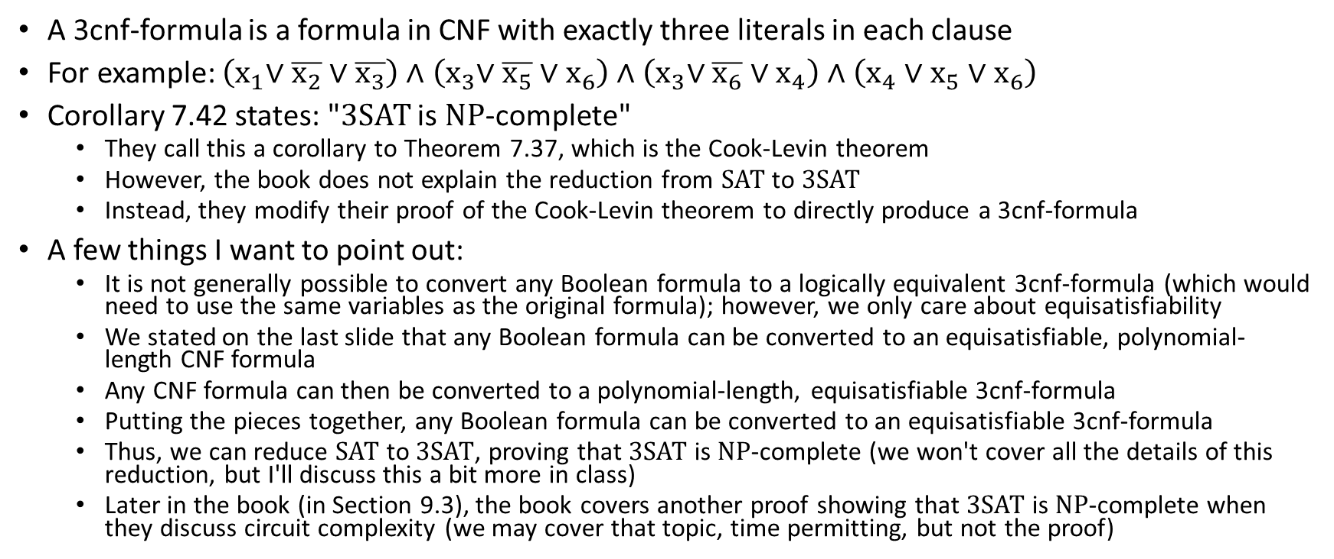
3SAT
A 3cnf-formula is a formula in CNF with exactly three literals in each clause
For example: $\left(x_{1}\text{∨} \overline{x_{2}} \text{∨} \overline{x_{3}}\right) \text{∧} \left(x_{3}\text{∨} \overline{x_{5}} \text{∨} x_{6}\right) \text{∧} \left(x_{3}\text{∨} \overline{x_{6}} \text{∨} x_{4}\right) \text{∧ }\left(x_{4} \text{∨} x_{5} \text{∨} x_{6}\right)$
Corollary 7.42 states: "3SAT is NP-complete"
  They call this a corollary to Theorem 7.37, which is the Cook-Levin theorem
  However, the book does not explain the reduction from SAT to 3SAT
  Instead, they modify their proof of the Cook-Levin theorem to directly produce a 3cnf-formula
A few things I want to point out:
  It is not generally possible to convert any Boolean formula to a logically equivalent 3cnf-formula (which would need to use the same variables as the original formula); however, we only care about equisatisfiability
  We stated on the last slide that any Boolean formula can be converted to an equisatisfiable, polynomial-length CNF formula
  Any CNF formula can then be converted to a polynomial-length, equisatisfiable 3cnf-formula
  Putting the pieces together, any Boolean formula can be converted to an equisatisfiable 3cnf-formula
  Thus, we can reduce SAT to 3SAT, proving that 3SAT is NP-complete (we won't cover all the details of this reduction, but I'll discuss this a bit more in class)
  Later in the book (in Section 9.3), the book covers another proof showing that 3SAT is NP-complete when they discuss circuit complexity (we may cover that topic, time permitting, but not the proof)

Slide 23
CLIQUE (part 1)
Recall from our previous topic that a clique is a subgraph of an undirected graph in which every pair of nodes is connected by an edge
A k-clique is a clique that has k nodes
We have seen the language: CLIQUE = {<G, k> | G is an undirected graph with a k-clique}
In our previous topic, we explained that CLIQUE is in NP (this is easy to see based on either formulation of NP)
Theorem 7.32 states: "3SAT is polynomial time reducible to CLIQUE"
This was before the book discussed the proof of the Cook-Levin theorem, or the proof that 3SAT is NP-complete
Later, Corollary 7.43 sates: "CLIQUE is NP-complete"
We will prove CLIQUE is NP-complete by demonstrating a polynomial time reduction from 3SAT (we already proved it is in NP)
An astute student might consider this reduction reminiscent of the reduction from 3SAT to the independent set problem that we discussed in DSA II

Slide 24
CLIQUE (part 2)
The reduction from 3SAT to CLIQUE works as follows (see the figure on the next slide for an example):
  For each clause in our 3cnf-formula, Φ, we create a triple of nodes in a graph, G
  The nodes within a triple correspond to the literals in the clause that the triple represents
  The nodes will be labeled with the literals they correspond to, for visual purposes
  No edge will be present between the nodes in any triple
  Nodes in different triples will be connected by an edge unless they represent negated literals
  Finally, k is set to the number of clauses in Φ
Claim: <G, k> ∈ CLIQUE iff Φ ∈ 3SAT; i.e., G has a clique with k nodes iff Φ is satisfiable
  To prove this, we need to show two things
  First, if there is a clique with k nodes in G, then Φ is satisfiable
  Second, if Φ is satisfiable, then G must have a clique with k nodes
  Both directions can clearly be seen by considering the example on the next slide, and realizing that this will generalize to any graph created the same way (we'll discuss this in class)
  It is also obvious that the creation of the graph can be performed in polynomial time
This is a proper reduction from 3SAT to CLIQUE, which we already proved is in NP; therefore, CLIQUE is NP-complete

Slide 25
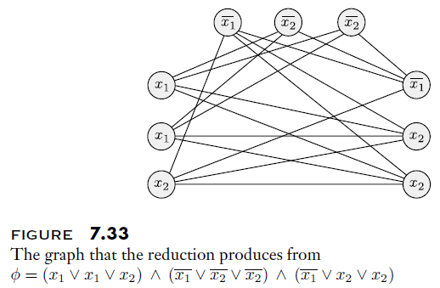
3SAT to CLIQUE Reduction Example

Slide 26
HAMPATH (part 1)
In our previous topic, we introduced the language: HAMPATH = {⟨G, s, t⟩ | G is a directed graph with a Hamiltonian path from s to t}
Recall that a Hamiltonian path is a path that visits every vertex exactly once
Theorem 7.46 states: "HAMPATH is NP-complete"
We will prove it via a polynomial time reduction from 3SAT (we already proved HAMPATH ∈ NP)
That is, given any 3cnf-formula, Φ, we can convert it in polynomial time to a graph, G, that has a Hamiltonian path from s to t iff Φ is satisfiable
  Consider a 3cnf-formula, Φ, with k clauses and l variables
  For every variable in Φ, we create a "diamond-shaped structure" in G, as depicted in the first figure on the next slide (left), so there are l such diamonds in all
  The number of nodes in the horizontal row contains 3k + 1 nodes (not including the two nodes that are part of the diamond); we will explain why later
  We also create k individual nodes, one for each clause; we will explain how they are connected to the rest of the graph later
  The second figure on the next slide (right) shows all the diamonds (representing variables) and all the clause nodes (not yet connected to the rest of the graph)
  Note that the top node in the graph is s, and the bottom node in the graph is t

Slide 27
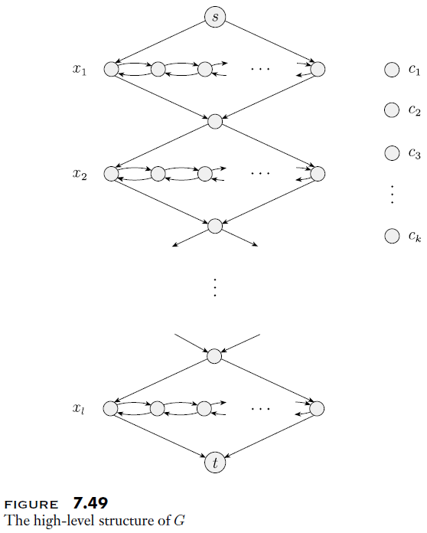
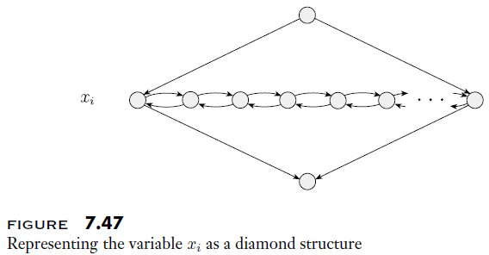
HAMPATH (part 2)

Slide 28
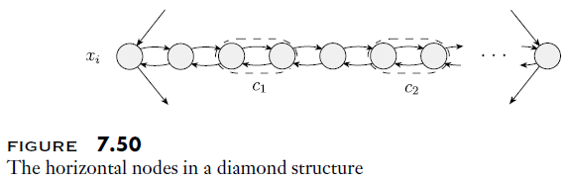
HAMPATH (part 3)
As mentioned previously, each horizontal row in each diamond contains 3k+1 nodes, where k is the number of clauses in Φ
The figure below helps to explain this:
Each clause has a corresponding pair of nodes, and there are separator nodes between them
Now we will describe how the other clause nodes, shown to the right of the graph in the rightmost figure on the previous slide, are connected to the rest of the graph
  If the literal x_{i} appears in clause c_{j} of Φ, then two edges from the j^{th} pair in the i^{th} diamond connect to the j^{th} clause node, as depicted in the left figure on the following slide
  If the literal $\overline{x_{i}}$ appears in clause c_{j} of Φ, then two edges from the j^{th} pair in the i^{th} diamond connect to the j^{th} clause node, as depicted in the right figure on the following slide

Slide 29
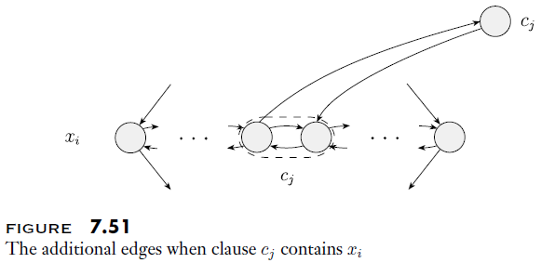
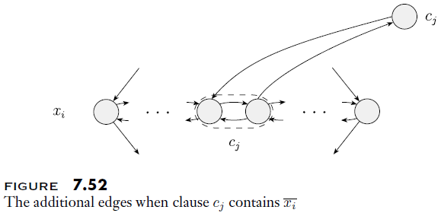
HAMPATH (part 4)

Slide 30
HAMPATH (part 5)
The construction of the graph, G, which was based on Φ, is now complete
To prove that this is a reduction from 3SAT to HAMPATH, we must show two things:
  If Φ is satisfiable, then G contains a Hamiltonian path from s to t
  If G contains a Hamiltonian path from s to t, then Φ is satisfiable
We will consider the first point first (it is the simpler of the two to see)
  Assuming Φ is satisfiable, consider some assignment to the variables that makes it true
  Starting at s, we walk down to t, and for every diamond, we either do what Sipser calls a "zig-zag" or a "zag-zig"; both are depicted in the figure on the next slide
  For the i^{th} diamond, which corresponds to x_{i}, we do a zig-zag if x_{i} is true, and we do a zag-zig if x_{i} is false
  For each clause, there is at least one true literal (either a variable or a variable negated)
  When you process such a literal, do a detour to the clause node and then return
  If there are multiple true literals, only do the detour once (it is arbitrary when you do it)
  This process will produce a valid Hamiltonian path in G from s to t

Slide 31
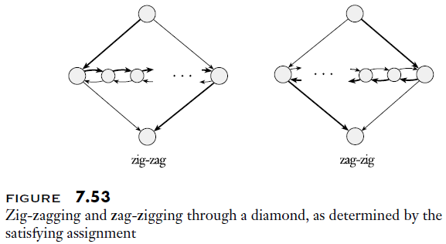
HAMPATH (part 6)

Slide 32
HAMPATH (part 7)
We still must show that the second point of the proof is true (i.e., that if there is a Hamiltonian path in G from s to t, then Φ is satisfiable
  Clearly, if there is a path from s to t that is standard (i.e., that gets from s to t with l sequences of zig-zags and zag-zigs), this is true
  That is because it means we can satisfy each clause with some settings of the Boolean variables
  The only thing that remains is to show that there is no other Hamiltonian path from s to t that involves entering a clause node from one diamond and returning to another
  Such a situation is depicted in the figure on the following slide
  We will explain why this is not possible by example, considering the figure
  In the figure, either a₂ or a₃ must be a separator node
    If a₂ is a separator node, the only ways to get there are from a₁ and a₃
    We've already visited a₁, so the only remaining way to get to a₂ is from a₃, and after that we would be stuck
    If a₃ is a separator node, the only edges entering a₂ are from a₁, a₃, and c
    We've already visited a₁ and c, so the only remaining way to get to a₂ is from a₃, and then we would be stuck
Thus, this graph is a proper reduction from 3SAT to HAMPATH
It is also clearly a polynomial-time reduction, so HAMPATH is NP-complete

Slide 33
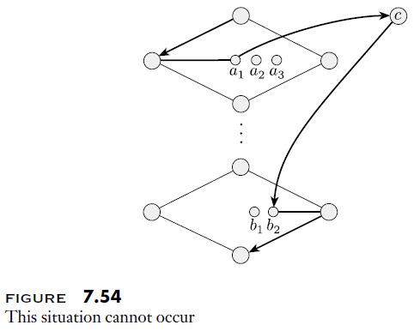
HAMPATH (part 8)

Slide 34
SUBSET-SUM (part 1)
Another NP language we saw in a previous topic is: SUBSET-SUM = {<S, t> | S = {x₁, …, x_{k}}, and for some {y₁, …, y_{l}} ⊆ {x₁, …, x_{k}}, we have Σy_{i} = t}
Theorem 7.56 states: "SUBSET-SUM is NP-complete"
We will prove it via another polynomial-time reduction from 3SAT (we already proved SUBSET-SUM is in NP)
Given any 3cnf-formula, Φ, we can convert it to a set of integers, S, and a number, t, such that S contains a subset that sums to t iff Φ is satisfiable
  The numbers we produce in S will contain only 0s and 1s, but they are decimal numbers
  The decimal number t will contain 1s and 3s
  I add: really, we could consider these numbers to be expressed in base 4 or above, but we'll consider them decimal numbers for simplicity
The next slide explains how the values are created, and the figure shown in two slides depicts the values in a table

Slide 35
SUBSET-SUM (part 2)
Assume that Φ contains l variables (x₁ through x_{l}) and k clauses (c₁ through c_{k})
The figure on the next slide helps to explain how the values in S and the value of t are generated
  The set S will contain 2l + 2k decimal integers
  There is a pair of integers, y_{i} and z_{i}, for each variable x_{i} in Φ
  There is also a pair of integers, g_{j} and h_{j}, for each clause c_{j} in Φ
  For each row labeled y_{i} or z_{i}, the digit in column i (1 ≤ i ≤ l) of the figure is 1, and the digits in the other first l columns are 0 (we are leaving out leading 0s)
  For the right k columns, the digit of y_{i} under c_{j} is 1 iff clause c_{j} contains the literal x_{i}; the digit is 0 otherwise
  For the right k columns, the digit of z_{i} under c_{j} is 1 iff clause c_{j} contains the literal $\overline{x_{i}}$; the digit is 0 otherwise
  For each row labeled g_{j} or h_{j}, the digit in column c_{j} is 1, and all other digits are 0
  The integer, t, contains l 1s followed by k 3s
Claim: S contains a subset if integers that add up to t iff Φ is satisfiable

Slide 36
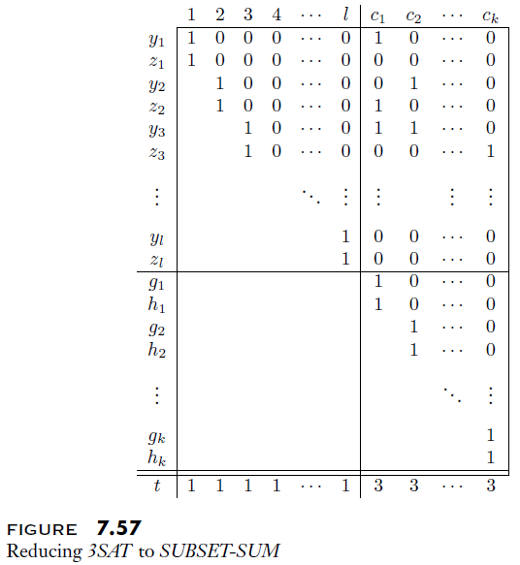
SUBSET-SUM (part 3)

Slide 37
SUBSET-SUM (part 4)
To prove this is a reduction from 3SAT to SUBSET-SUM, we must show two things
  If Φ is satisfiable, there is a subset of S that sums to t
    Consider an assignment of variables that makes Φ true
    For each variable, x_{i}, that is true, include the value from row y_{i} in S
    For each variable, x_{i}, that is false, include the value from row z_{i} in S
    At this point, the left l columns in the table will already add up correctly
    In each of the right k columns, there will be one, two, or three 1s so far (since there is at least one true literal in each clause)
    For each column, c_{j}, include two, one, or zero rows labeled g_{j} and h_{j}, as needed, to make the column sum to 3
  If there is a subset of S that sums to t, Φ is satisfiable
    In order to make each of the left l columns sum to 1, we must be using exactly one of y_{i} and z_{i}
    If we use y_{i}, set x_{i} to true; if we use z_{i}, set x_{i} to false
    We know that the right k columns all sum to 3, but the g and h rows sum to at most 2 in each column
    Therefore, at least one of the y and z rows is being used for each clause, meaning that each clause contains a true literal; hence, this assignment of variables satisfies Φ
Clearly, the size of the table is polynomial with respect to Φ, so this is a polynomial time reduction from 3SAT to SUBSET-SUM; hence, SUBSET-SUM is NP-complete

Slide 38
Other NP-complete Problems
Consider the language UHAMPATH, which the book simply defines as the "undirected version of the Hamiltonian path problem"
  The book proves that UHAMPATH is NP-complete with a reduction from HAMPATH
  This takes advantage of the fact that reducibility is transitive
  This is an interesting reduction, in my opinion, but to save time, we will not cover it in class
Consider the language: VERTEX-COVER = {<G, k> | G is an undirected graph has a k-node vertex cover}
  A vertex cover in a graph, G, is a subset of nodes such that every edge touches one of the nodes
  The book proves that VERTEX-COVER is NP-complete with a reduction from 3SAT
  There is also a reasonably simple reduction from CLIQUE to VERTEX-COVER
  We will not cover either of these reductions in class to save time
There are many additional languages (and corresponding decision problems) that are known to be NP-complete
You will probably have to prove a couple of them for your next problem set!

