Slide 1
ECE461: Theoretical CS
The Classes NP and coNP, The P versus NP Question

Slide 2
Brief Recap
At the start of the course, based on the first part of the textbook, we learned about formalisms for describing regular languages and context-free languages, and we discussed their limitations
Then, based on the second part of the textbook, we learned about computability theory
We discussed Turing machines (TMs), focusing on deterministic Turing machines (DTMs)
If we accept the Church-Turing thesis, all algorithms can be implemented by Turing machines
However, we also learned that computation is inherently limited; in particular, some languages are undecidable, and some languages are not Turing-recognizable
Then, we started covering the third part of the textbook; the textbook calls this part "Complexity Theory"
We discussed how to measure time complexity, using notations such as big-O
We learned the definition of a time complexity class, TIME(t(n)), containing all languages that are decidable by an O(t(n)) time Turing machine; membership in TIME(t(n)) depends on the specific TM model being used
We defined P, the time complexity class containing all languages that can be decided in polynomial time by a single-tape TM; using any reasonably defined model for DTMs, the membership of P would not change
In this topic, related to Section 7.3 of the textbook, we will define another time complexity class, NP, that is related to nondeterministic Turing machines (although we will discuss another way to define NP first)

Slide 3
NP (general overview)
Like P, NP is a time complexity class
When we discussed NP in DSA 2, we learned that there are two equivalent definitions for it
The first definition stated that NP contains all decision problems that can be solved by a nondeterministic Turing machine (NTM) in polynomial time
Recall that P, on the other hand, is defined in terms of deterministic Turing machines (DTMs); in DSA 2, I sometimes casually referred to these as regular Turing machines
When we discussed the second definition of NP in DSA 2, we did so more casually
  Taken from a DSA 2 slide: "It is equivalent to define NP (roughly speaking) as the set of decision problems for which a yes solution to the problem can be checked by a regular Turing machine in polynomial time"
  We will see a more formal definition in this course, and in fact, we will discuss this definition of NP before the other one (following our textbook's structure, although I personally prefer the other way around)
Of course, we can reformulate either definition of NP in terms of languages instead of decision problems (the textbook does not introduce the term "decision problem" until chapter 10)
Before we discuss our textbook's formulations of the complexity class NP, we need to introduce an additional concept (explained on the next slide)

Slide 4
Verifiers
Definition 7.18 states (I am keeping the book's exact wording, but changing the formatting a bit):
  A verifier for a language A is an algorithm V, where A = {w | V accepts ⟨w, c⟩ for some string c}. We measure the time of a verifier only in terms of the length of w, so a polynomial time verifier runs in polynomial time in the length of w. A language A is polynomially verifiable if it has a polynomial time verifier.
The book refers to c as "additional information" used by the verifier to verify that the string, w, is a member of the language, A
Book: "This information is called a certificate, or proof, of membership in A."; I will discuss this a bit more in class to try to make it more intuitive
Here are some example:
  Consider the language: HAMPATH = {⟨G, s, t⟩ | G is a directed graph with a Hamiltonian path from s to t}
    Recall from DSA II that a Hamiltonian path is a path that visits every vertex exactly once
    A certificate for HAMPATH could simply be a Hamiltonian path from s to t; clearly a TM can verify that this is correct in polynomial time
  Consider the language: COMPOSITES = {x | x = pq, for integers p, q > 1}
    A number is composite (and therefore a member of COMPOSITES) iff it is not prime
    A certificate for COMPOSITES could simply be an integer divisor of x between (non-inclusively) 1 and x
Typically, a certificate is a yes instance to the related decision problem, but it does not have to be

Slide 5
NP (first formulation)
Definition 7.19 states: "NP is the class of languages that have polynomial time verifiers."
By this definition, HAMPATH and COMPOSITES are both members of NP
Perhaps surprisingly COMPOSITES is also a member of P
  Since P is closed under complementation, this also means the analogous problem, PRIMES, is in P
  This was proven in 2002 by Agrawal, Kayal, and Saxena in 2002
  Their revised publication, dated 2004, is called "PRIMES is in P"
  However, the problem of factorization is believed to not be in P
  The factorization problem (or language) is also generally believed to not be NP-complete
HAMPATH is NP-complete, so it is generally believed to not be in P
We will start discussing NP-completeness as part of our next topic

Slide 6
NP (second formulation)
Theorem 7.20 states: "A language is in NP iff it is decided by some nondeterministic polynomial time Turing machine."
Although this is stated as a theorem (because the book sticks with the first formulation as the definition of NP), this could instead serve as a definition of the complexity class NP
We will soon prove that the two definitions are equivalent
We have already stated that HAMPATH is in NP
  An NTM can decide HAMPATH by trying every path of length m in parallel, where m is the number of nodes in a graph
  If any path is a Hamiltonian path, it accepts; if all paths reject, it rejects
We have already stated that COMPOSITES is in NP
  This is obvious, because it is also in P, and any DTM is a valid NTM
  Factorization, which is believe not to be in P, is clearly in NP, because an NTM can generate every possible divisor in parallel and try them all, or a verifier could be used to verify a specified factor
The book points out that NP stands for nondeterministic polynomial time
I have read that it is a common misconception to think that NP stands for "non-polynomial"; however, these problems can be solved in polynomial time, by a nondeterministic Turing machine

Slide 7
NP (the two formulations are equivalent)
Two prove that the two formulations of the complexity class NP are the same, we need to prove two things
First, we must prove that if a language has a polynomial time verifier, then it can be decided by an NTM in polynomial time
  Suppose any input of length w of length n has a verifier that runs in time at most n^{k}
  Then the certificate for w can have length at most n^{k}
  An NTM can generate all possible certificates of length up to n^{k} and check them with the verifier
Second, we must prove that if a language can be decided by an NTM in polynomial time, then it must have a polynomial time verifier
  The certificate for an input, w, can be an encoding of the path of the NTM decider that accepts w
  That is, a verifier can inspect a path through the NTM, deciding if it is a valid path that leads to an accept state
  This is an example where the certificate is not a yes instance to the related decision problem; it is possible, but not necessarily the case, that the path through the NTM has found such an instance

Slide 8
NTIME
The book defines the nondeterministic time complexity class NTIME(t(n)), which is analogous to TIME(t(n)) defined in our previous topic
  Recall that membership in TIME(t(n)) depends on the specific computational model we are using for Turing machines
  However, membership in P is the same with any reasonable model for deterministic TMs
Definition 7.21 states: "NTIME(t(n)) = {L | L is a language decided by an O(t(n)) time nondeterministic Turing machine}."
Given this definition and Theorem 7.20 (presented two slides back), Corollary 7.22 states: "NP = ∪_{k} NTIME(n^{k})."
  The class NTIME(t(n)) might depend on the specific model of computation for NTMs
  However, "the class NP is insensitive to the choice of a reasonable nondeterministic computational model because all such models are polynomially equivalent"

Slide 9
Other Examples of Languages in NP
Consider the language: CLIQUE = {<G, k> | G is an undirected graph with a k-clique}
  A clique is a subgraph of an undirected graph in which every pair of nodes is connected by an edge; a k-clique is a clique that has k nodes
  Theorem 7.24 states: "CLIQUE is in NP"
  This is somewhat obvious according to either formulation of NP
  A verifier can use a k-clique as a certificate
  An NTM can nondeterministically examine every set of k nodes and check if each is a k-clique
Consider the language: SUBSET-SUM = {<S, t> | S = {x₁, …, x_{k}}, and for some {y₁, …, y_{l}} ⊆ {x₁, …, x_{k}}, we have Σy_{i} = t}
  Theorem 7.25 states: "SUBSET-SUM is in NP"
  This is also somewhat obvious according to either formulation of NP
  A verifier can use a subset of the elements of S that add up to t as a certificate
  An NTM can nondeterministically examine every subset of S and check if they add up to t

Slide 10
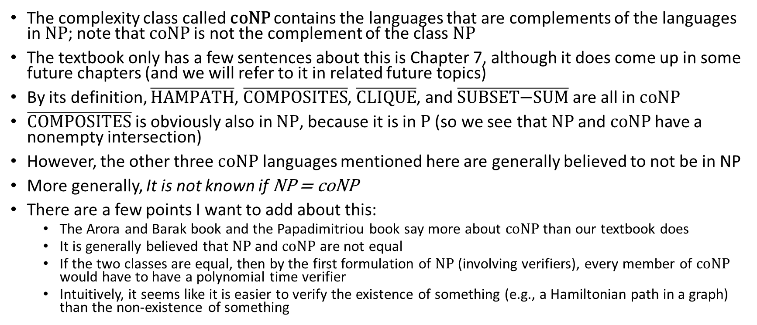
coNP
The complexity class called coNP contains the languages that are complements of the languages in NP; note that coNP is not the complement of the class NP
The textbook only has a few sentences about this is Chapter 7, although it does come up in some future chapters (and we will refer to it in related future topics)
By its definition, $\overline{HAMPATH}$, $\overline{COMPOSITES}$, $\overline{CLIQUE}$, and $\overline{\text{SUBSET}\text{−}\text{SUM}}$ are all in coNP
$\overline{COMPOSITES}$is obviously also in NP, because it is in P (so we see that NP and coNP have a nonempty intersection)
However, the other three coNP languages mentioned here are generally believed to not be in NP
More generally, It is not known if NP = coNP
There are a few points I want to add about this:
  The Arora and Barak book and the Papadimitriou book say more about coNP than our textbook does
  It is generally believed that NP and coNP are not equal
  If the two classes are equal, then by the first formulation of NP (involving verifiers), every member of coNP would have to have a polynomial time verifier
  Intuitively, it seems like it is easier to verify the existence of something (e.g., a Hamiltonian path in a graph) than the non-existence of something

Slide 11
The P versus NP Question
As we know from DSA II, and as was mentioned at the end of our last topic, it is unknown whether P = NP
The textbook refers to this open question as the P versus NP question
I have also seen this referred to as the P = NP? question, the P = NP problem, the P ≠ NP question, etc.
I believe that this is probably the most important open question in computer science
Most theoretical computer scientists believe that the two complexity classes are different, but to date, no one has been able to prove this
We can express some intuition behind this based on either of the formulations of NP we have discussed
  Based on the first formulation, it seems that it is simpler to verify an instance of something (e.g., a Hamiltonian path or a subset of integers that adds up to a given value) that to find an instance of that thing
  Based on the second formulation, it seems that an NTM should be more efficient than a DTM for certain problems by an exponential factor
The book summarizes the distinction between P and NP as follows (I am keeping the book's exact wording):
  "P = the class of languages for which membership can be decided quickly."
  "NP = the class of languages for which membership can be verified quickly."
During some of our future topics, we will refer back to this open question
The textbook also points out that NP ⊆ EXPTIME (a DTM can simulate an NTM in exponential time)

