Slide 1
ECE461: Theoretical CS
The Classes L, NL, and coNL

Slide 2
Brief Recap
In our recent topics, we have been covering complexity theory
We learned about the time complexity classes TIME(t(n)) and NTIME(t(n)), which are related to deterministic Turing machines (DTMs) and nondeterministic Turing machines (NTMs); membership depends on the specific TM models being used
We defined P, the time complexity class containing all languages that can be decided in polynomial time by a single-tape TM; using any reasonably defined model for DTMs, the membership of P would not change
We also defined another time complexity class, NP, and we saw two formulations of it
It is unknown whether P = NP; the textbook refers to this open question as the P versus NP question
We also learned about coNP, containing the complements of all languages in NP; it is unknown whether coNP = NP
We also learned about the hardest NP languages, known as NP-complete languages
Then, we shifted our discussion to space complexity and space complexity classes
We learned about SPACE(f(n)) and NSPACE(f(N)), and the more general space complexity classes, PSPACE and NPSPACE
Savitch's theorem implies that PSPACE = NPSPACE
We also learned about the hardest PSPACE languages, known as PSPACE-complete languages; TQBF is an example
In this topic, we will learn about complexity classes involving languages that require sublinear space bounds; however, such languages will require us to change our model of a Turing machine
This topic is based on Sections 8.4 – 8.6 of the textbook (we will not cover Section 8.6 in detail)

Slide 3
Turing Machines with Read-only Input Tape
To define space complexity classes with sublinear space bounds, we are going to consider a different model of Turing machine
Our new model will consider TMs with two tapes
  One will be a read-only input tape
  We assume that the machine can detect when the head is over the leftmost or rightmost cell
  The TM is allowed to move this head over the input tape and read symbols but not change them
  The other tape is a work tape
  This is like our typical TM tape; cells can be both read and written
In a dated reference, the textbook says we can think about the input tape like a CD-ROM
Book: "Sublinear space algorithms allow the computer to manipulate the data without storing all of it in main memory"

Slide 4
L and NL
Definition 8.17 defines the space complexity classes L and NL (I am keeping the books exact wording, but modifying the format a bit):
  L is the class of languages that are decidable in logarithmic space on a deterministic Turing machine. In other words, L = SPACE(log n).
  NL is the class of languages that are decidable in logarithmic space on a nondeterministic Turing machine. In other words, NL = NSPACE(log n).
The book mentions some reasons for concentrating on a logarithmic space bound:
  It is large enough to solve some interesting problems
  It has "attractive mathematical properties such as robustness even when the machine model and input encoding method change"
  It can be used to represent "pointers into the input"

Slide 5
Example Language: {0^{k}1^{k} | k ≥ 0} (revisited)
Recall the following language: A = {0^{k}1^{k} | k ≥ 0}
We have previously examined this language's time complexity, and looked at a few algorithms to decide it
  With a single-tape TM, we discussed a O(N²) algorithm and a O(N log N) algorithm
  With a two-tape TM, we saw that the language can be decided in linear time
The textbook mentions that those algorithms, directly modified to fit the new model, would require linear space
However, there is a log space algorithm
  First, the algorithm can count the number of 0s and, separately, the number of 1s, in binary, using the work tape
  Then, it can check if the two counts are equal
  Clearly, this algorithm uses O(log n) space
  Therefore, A ∈ L

Slide 6
PATH (revisited)
Recall the language: PATH = {<G, s, t> | G is a directed graph that has a directed path from s to t}
We have previously seen that PATH ∈ P
The book states that it is unknown if PATH can be decided in logarithmic space deterministically (i.e., it is unknown whether PATH ∈ L)
However, there is a known nondeterministic log space algorithm for deciding path
  Starting at s, nondeterministically guess the next node
  On each path, only record the position of the current node on the work tape
  Continue to nondeterministically guess the next node, and keep track of the count of nodes visited
  If the algorithm ever finds t, accept
  If the algorithm visits m nodes, where m is the number of nodes in the graph, without finding t, reject
Thus, PATH ∈ NL

Slide 7
Configurations (revisited)
We need to modify the notion of a configuration for our new TM model
The configuration of M on w, where w is the input of M must indicate:
  The current state
  The contents of the work tape
  The position of both read-write heads
Note that the input is not part of the configuration
The number of possible configurations of a TM, M, that runs in f(n) space on an input, w, of length n is n2^{O(f(n))}
The book derives this formula, but we'll skip the details (it is similar to things we've seen before)
The book points out that n2^{O(f(n))} = 2^{O(f(n))} when f(n) ≥ log n, so it is still true that "the time complexity of a machine is at most exponential in its space complexity"
The book also points out that Savitch's theorem holds for sublinear space bounds down to f(n) ≥ log n
  We previously proved Savitch's theorem for linear space complexity or higher
  The book says that the same proof holds with the new model of a TM and the new definition of configuration

Slide 8
NL-Completeness
Similar to the P versus NP question, it is unknown whether L = NL
We have previously seen that certain problems are NP-complete and certain problems are PSPACE-complete
It is also known that certain problems are NL-complete; these are considered the hardest NL problems
However, the type of reduction used to define NL-completeness is one we have not yet seen
Definition 8.22 states (I am keeping the book's exact wording, but changing the formatting a bit):
  A language B is NL-complete if
    B ∈ NL, and
    Every A in NL is log space reducible to B.

Slide 9
Log Space Reducibility (part 1)
To define log space reducibility, we need to introduce a new model of a Turing machine
A log space transducer is a Turing machine with the following properties:
  It has a read-only input tape
  It has a write-only output tape
  The head on the output tape cannot move left, so it cannot read what it has already written
  The work tape may contain O(log n) symbols, where n is the size of the input
A log space transducer, M, computes a function f: Σ∗→Σ∗, where f(w) is the string on the output tape when M halts after processing input w
Any function that can be calculated by a log space transducer is said to be a log space computable function
A language A is log space reducible to language B, written A ≤_{L} B, if A is mapping reducible to B by means of a log space computable function

Slide 10
Log Space Reducibility (part 2)
Theorem 8.23 states: "If A ≤_{L} B and B ∈ L, then A ∈ L"
  Unlike similar theorems we have seen, this is not obvious!
  Note that the definition of a log space transducer does not limit the length of the output
  The definition only limits the space used by the work tape, but the output can be arbitrarily long
  To prove Theorem 8.23, the textbook explains that a transducer can produce one symbol at a time, when needed
  Every time the machine that decide B needs another symbol from f(w), the transducer can start over, until the needed symbol is computed
  Of course, this may significantly affect the time complexity of the process, but it allows the entire process to use logarithmic space
Corollary 8.24 states: "If any NL-complete language is in L, then L = NL"

Slide 11
PATH (re-revisited)
Theorem 8.25 states: "PATH is NL-complete"
We already showed that PATH ∈ NL, so what remains is to show that all language in NL are log space reducible to PATH
Consider any NTM, M, that decides a language, A, in O(log n) space
Given M and its input, w, we can construct <G, s, t> with a log space transducer, where G is a directed graph, and there is a path from s to t in G iff M accepts w
  The nodes of G represent the possible configurations of M on w (each occupies at most logarithmic space)
  A directed edge connects the nodes representing configurations c₁ and c₂ iff c₁ can yield c₂ in a single step, according to M's transition function
  Node s represents the start configuration of M
  M is modified to have a unique accepting configuration, represented by node t (we have seen how to do this)
  The transducer can sequentially try out every possible configuration, each using space at most c log n, for an appropriate constant c, and output those that are legal
  Similarly, it can try out all pairs of configurations and output those that represent legal edges
Recall that G does not need to be stored at once; symbols can be computed one at a time, as needed

Slide 12
NL ⊆ P
Corollary 8.26 states: "NL ⊆ P"
Recall that we already showed that PATH is in P
Now, we have also showed that PATH is NL-complete
This means that all NL languages are log space reducible to PATH
The proof of the corollary explains that if a language, A, is log space reducible to a language B, it is also polynomial time reducible to B
This is because a TM that uses space f(n) runs in time n2^{O(f(N))}, as we have seen a few times

Slide 13
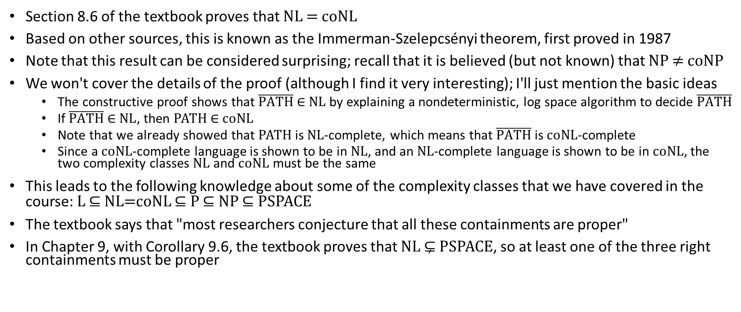
NL = coNL
Section 8.6 of the textbook proves that NL = coNL
Based on other sources, this is known as the Immerman-Szelepcsényi theorem, first proved in 1987
Note that this result can be considered surprising; recall that it is believed (but not known) that NP ≠ coNP
We won't cover the details of the proof (although I find it very interesting); I'll just mention the basic ideas
  The constructive proof shows that $\overline{PATH} \text{∈} \text{NL}$ by explaining a nondeterministic, log space algorithm to decide $\overline{PATH}$
  If $\overline{PATH} \text{∈} \text{NL}$, then PATH $\text{∈ }$coNL
  Note that we already showed that PATH is NL-complete, which means that $\overline{PATH}$ is coNL-complete
  Since a coNL-complete language is shown to be in NL, and an NL-complete language is shown to be in coNL, the two complexity classes NL and coNL must be the same
This leads to the following knowledge about some of the complexity classes that we have covered in the course: L ⊆ NL=coNL ⊆ P ⊆ NP ⊆ PSPACE
The textbook says that "most researchers conjecture that all these containments are proper"
In Chapter 9, with Corollary 9.6, the textbook proves that NL ⊊ PSPACE, so at least one of the three right containments must be proper

