Slide 1
ECE461: Theoretical CS
Intractable Problems and Hierarchy Theorems

Slide 2
Brief Recap
In our recent topics, we have been covering complexity theory
We learned about the time complexity classes TIME(t(n)) and NTIME(t(n)), which are related to deterministic Turing machines (DTMs) and nondeterministic Turing machines (NTMs)
Membership in these classes depends on the specific TM models being used
We defined P, the time complexity class containing all languages that can be decided in polynomial time by a single-tape TM; using any reasonably defined model for DTMs, the membership of P would not change
We also defined another time complexity class, NP, and we saw two formulations of it
It is unknown whether P = NP; the textbook refers to this open question as the P versus NP question
We also learned about the hardest NP languages, known as NP-complete languages
Then, we shifted our discussion to space complexity and space complexity classes
We learned about SPACE(f(n)) and NSPACE(f(N)), and the more general space complexity classes, PSPACE and NPSPACE; Savitch's theorem implies that PSPACE = NPSPACE
We also learned about the hardest PSPACE languages, the PSPACE-complete languages; TQBF is an example
We also learned about languages that require sublinear space bounds

Slide 3
Intractability
We have been defining complexity classes such as P, NP, and PSPACE = NPSPACE in terms of languages
However, as we have mentioned several times, they can just as easily be defined in terms of decision problems
Casually speaking, problems that can be solved in principle, given unlimited time and/or space, but that cannot be solved efficiently, are said to be intractable
Theoretical computer scientists roughly consider problems that can be solved in polynomial time to be tractable, or easy
Problems that require exponential time are considered to be intractable, or hard
It is believed that the NP-complete problems are intractable; they require exponential time algorithms to solve them, unless P = NP
In this topic, we will learn that some problems are known to require exponential time, and even exponential space; such problems are definitely intractable
Before we learn about such problems, we will learn about theorems known as hierarchy theorems
This topic is based on Section 9.1 of the textbook

Slide 4
Hierarchy Theorems
Book: "Common sense suggests that giving a Turing machine more time or more space should increase the class of problems that it can solve."
A bit later: "The hierarchy theorems prove that this intuition is correct…"
We will learn about two hierarchy theorems, one for space, and one for time
We will learn about the hierarchy theorem for space first, because it is a bit simpler
These theorems will explain that there are an infinite number of space complexity classes and an infinite number of time complexity classes
Roughly speaking, the more time or space that a TM is given, the more problems it can solve (or the more languages it can decide)

Slide 5
Space Constructibility
Before we explain the hierarchy theorem related to space, we need to define a notion known as space constructibility
Definition 9.1 states (I am keeping the book's exact wording):
  "A function f: N→N, where f(n) is at least O(log n), is called space constructible if the function that maps the string 1^{n} to the binary representation of f(n) is computable in space O(f(n))."
The textbook points out that for functions, f(n), that are o(n), we consider TMs with a read-only input tape, as when we considered sublinear space complexity
For functions that equate to fractions, they are "rounded down to the next lower integer"
Book (stated without proof): "All commonly occurring functions that are at least O(log n) are space constructible"
The explain two examples
  The book describes a O(n) space algorithm that processes n 1s (i.e., input 1^{n}) and produces the binary representation of n²
  Since O(n) is also O(n²), n² is space constructible
  They also describe a O(log n) space algorithm to process 1^{n} and produce the binary representation of log₂n
  Therefore, log₂n is space constructible

Slide 6
The Space Hierarchy Theorem (part 1)
Theorem 9.3, the space hierarchy theorem, states (I am keeping the book's exact wording):
  For any space constructible function f: N→N, a language A exists that is decidable in O(f(n)) space but not in o(f(n)) space.
The book uses a constructive proof to prove the space hierarchy theorem
They don't give any intuitive, verbal description of a language, A, that is decidable in O(f(n)) space but not o(f(n)) space
Rather, they explain a O(f(n)) space algorithm, D, that provably cannot be duplicated by any o(f(n)) space algorithm; A is the language it recognizes
Book: "Language A is different from languages we have discussed previously in that it lacks a nonalgorithmic definition. Therefore, we cannot offer a simple mental picture of A."
In the proof idea, the book first describes D at a high level, pointing out that there are technical details that need to be carefully considered; we will discuss this on the next slide
Then, in the main proof, they specify the algorithm D more formally; we will look at D in two slides

Slide 7
The Space Hierarchy Theorem (part 2)
At a high level, D acts as follows:
  D processes input representing some TM, <M>; it rejects if <M> is not properly formatted
  D simulates the TM, M, on input <M>, assuming <M> uses o(f(n)) space, and therefore at most 2^{o(f(n))} time
  D calculates f(n), where n is the size of <M>, and if D ever tries to use more than f(n) space, it rejects
  As D simulates M, it also counts the steps; if the number of steps reaches 2^{f(n)}, it rejects, because this means it is in an infinite loop
  If M processing <M> terminates on time, D does the opposite of M; that is, if M accepts <M>, D rejects <M>, and if M rejects <M>, D accepts <M>
It would be nice if we could now claim that D is different than every o(f(n)) space algorithm, because we would then have a proof of the space hierarchy theorem
However, there is a problem
  Even if M runs in o(f(n)) space, it may use more space when n is small
  When M processes <M>, it is possible that 'the asymptotic behavior hasn't "kicked in" yet'
  We can "fix this problem by modifying D to give it additional opportunities to avoid M’s language"
  Instead of taking only <M> as input, D will process any input of the form w = <M>10*, and it will simulate <M> on w (if this point seems confusing, the steps of the algorithm on the next slide might clarify it)
  For some input <M>10^{k}, with large enough k, the asymptotic behavior will "kick in"

Slide 8
The Space Hierarchy Theorem (part 3)
For any space constructable function, f(n), we can construct a O(f(n)) space algorithm, D, that is not decidable in o(f(n)) space
Let D processes its input, w, as follows (I am keeping the book's exact wording for the steps):
  Let n be the length of w.
  Compute f(n) using space constructibility and mark off this much tape. If later stages ever attempt to use more, reject.
  If w is not of the form ⟨M⟩10∗ for some TM M, reject.
  Simulate M on w while counting the number of steps used in the simulation. If the count ever exceeds 2^{f(n)}, reject.
  If M accepts, reject. If M rejects, accept.
Related to stage 4:
  The book points out that D has a fixed alphabet, and M's tape alphabet can be arbitrarily larger
  Therefore, each of M's tape cells might occupy multiple cells of D (but a constant number)
  Thus, "the simulation introduces a constant factor overhead in the space used", and "if M runs in g(n) space, then D uses d * g(n) space to simulate M for some constant d that depends on M"

Slide 9
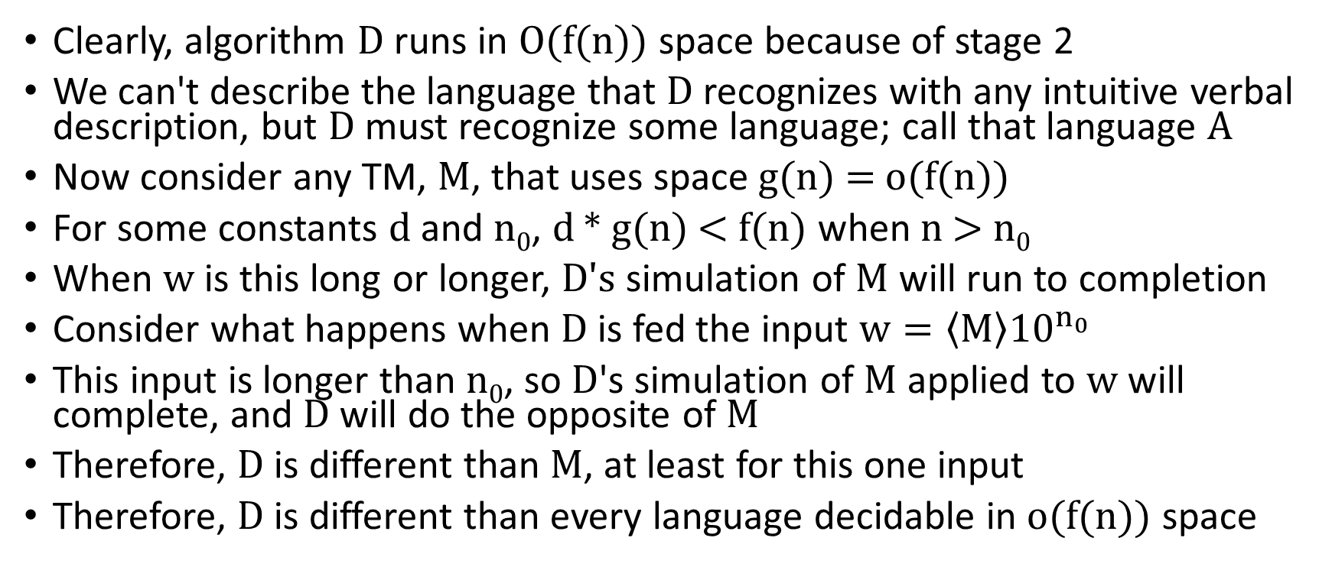
The Space Hierarchy Theorem (part 4)
Clearly, algorithm D runs in O(f(n)) space because of stage 2
We can't describe the language that D recognizes with any intuitive verbal description, but D must recognize some language; call that language A
Now consider any TM, M, that uses space g(n) = o(f(n))
For some constants d and n₀, d * g(n) < f(n) when n > n₀
When w is this long or longer, D's simulation of M will run to completion
Consider what happens when D is fed the input $w=\left\langle M\right\rangle {10}^{n_{0}}$
This input is longer than n₀, so D's simulation of M applied to w will complete, and D will do the opposite of M
Therefore, D is different than M, at least for this one input
Therefore, D is different than every language decidable in o(f(n)) space

Slide 10
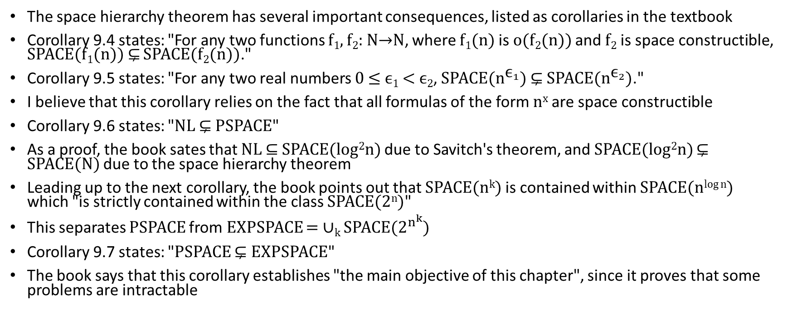
Corollaries of the Space Hierarchy Theorem
The space hierarchy theorem has several important consequences, listed as corollaries in the textbook
Corollary 9.4 states: "For any two functions f₁, f₂: N→N, where f₁(n) is o(f₂(n)) and f₂ is space constructible, SPACE(f₁(n)) ⊊ SPACE(f₂(n))."
Corollary 9.5 states: "For any two real numbers 0 ≤ ϵ₁ < ϵ₂, SPACE($n^{{\text{ϵ}}_{1}}$) ⊊ SPACE($n^{{\text{ϵ}}_{2}}$)."
I believe that this corollary relies on the fact that all formulas of the form n^{x} are space constructible
Corollary 9.6 states: "NL ⊊ PSPACE"
As a proof, the book sates that NL ⊆ SPACE(log²n) due to Savitch's theorem, and SPACE(log²n) ⊊ SPACE(N) due to the space hierarchy theorem
Leading up to the next corollary, the book points out that SPACE(n^{k}) is contained within SPACE(n^{log n}) which "is strictly contained within the class SPACE(2^{n})"
This separates PSPACE from EXPSPACE = ∪_{k} SPACE($2^{n^{k}}$)
Corollary 9.7 states: "PSPACE ⊊ EXPSPACE"
The book says that this corollary establishes "the main objective of this chapter", since it proves that some problems are intractable

Slide 11
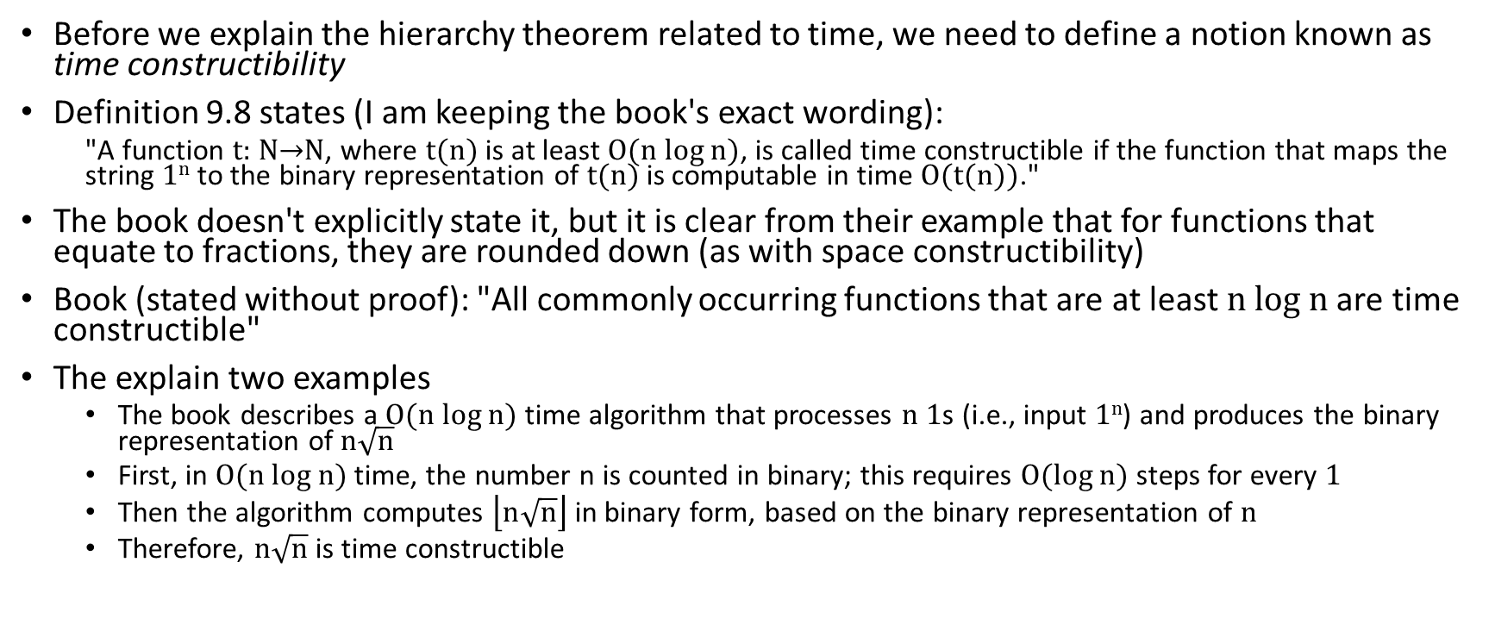
Time Constructibility
Before we explain the hierarchy theorem related to time, we need to define a notion known as time constructibility
Definition 9.8 states (I am keeping the book's exact wording):
  "A function t: N→N, where t(n) is at least O(n log n), is called time constructible if the function that maps the string 1^{n} to the binary representation of t(n) is computable in time O(t(n))."
The book doesn't explicitly state it, but it is clear from their example that for functions that equate to fractions, they are rounded down (as with space constructibility)
Book (stated without proof): "All commonly occurring functions that are at least n log n are time constructible"
The explain two examples
  The book describes a O(n log n) time algorithm that processes n 1s (i.e., input 1^{n}) and produces the binary representation of $n\sqrt{n}$
  First, in O(n log n) time, the number n is counted in binary; this requires O(log n) steps for every 1
  Then the algorithm computes $\left\lfloor n\sqrt{n}\right\rfloor$ in binary form, based on the binary representation of n
  Therefore, $n\sqrt{n}$ is time constructible

Slide 12
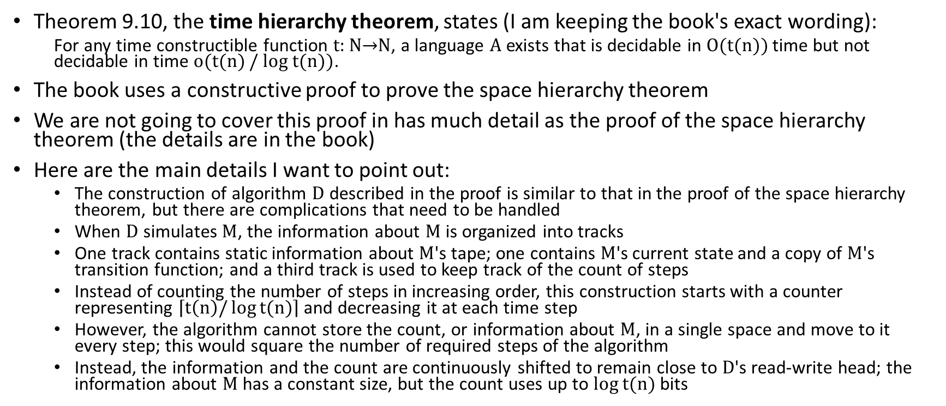
The Time Hierarchy Theorem (not detailed)
Theorem 9.10, the time hierarchy theorem, states (I am keeping the book's exact wording):
  For any time constructible function t: N→N, a language A exists that is decidable in O(t(n)) time but not decidable in time o(t(n) / log t(n)).
The book uses a constructive proof to prove the space hierarchy theorem
We are not going to cover this proof in has much detail as the proof of the space hierarchy theorem (the details are in the book)
Here are the main details I want to point out:
  The construction of algorithm D described in the proof is similar to that in the proof of the space hierarchy theorem, but there are complications that need to be handled
  When D simulates M, the information about M is organized into tracks
  One track contains static information about M's tape; one contains M's current state and a copy of M's transition function; and a third track is used to keep track of the count of steps
  Instead of counting the number of steps in increasing order, this construction starts with a counter representing $\left\lceil t\left(n\right)/\log{t(n)}\right\rceil$ and decreasing it at each time step
  However, the algorithm cannot store the count, or information about M, in a single space and move to it every step; this would square the number of required steps of the algorithm
  Instead, the information and the count are continuously shifted to remain close to D's read-write head; the information about M has a constant size, but the count uses up to log t(n) bits

Slide 13
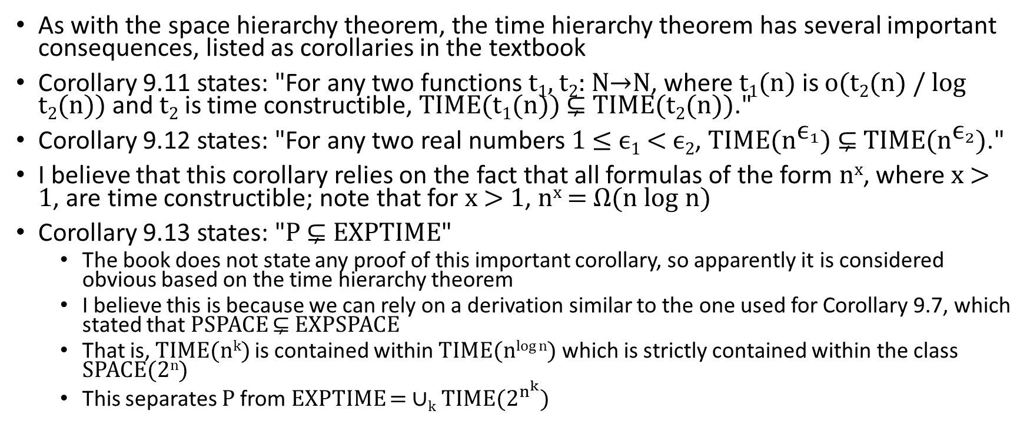
Corollaries of the Time Hierarchy Theorem
As with the space hierarchy theorem, the time hierarchy theorem has several important consequences, listed as corollaries in the textbook
Corollary 9.11 states: "For any two functions t₁, t₂: N→N, where t₁(n) is o(t₂(n) / log t₂(n)) and t₂ is time constructible, TIME(t₁(n)) ⊊ TIME(t₂(n))."
Corollary 9.12 states: "For any two real numbers 1 ≤ ϵ₁ < ϵ₂, TIME($n^{{\text{ϵ}}_{1}}$) ⊊ TIME($n^{{\text{ϵ}}_{2}}$)."
I believe that this corollary relies on the fact that all formulas of the form n^{x}, where x > 1, are time constructible; note that for x > 1, n^{x} = Ω(n log n)
Corollary 9.13 states: "P ⊊ EXPTIME"
  The book does not state any proof of this important corollary, so apparently it is considered obvious based on the time hierarchy theorem
  I believe this is because we can rely on a derivation similar to the one used for Corollary 9.7, which stated that PSPACE ⊊ EXPSPACE
  That is, TIME(n^{k}) is contained within TIME(n^{log n}) which is strictly contained within the class SPACE(2^{n})
  This separates P from EXPTIME = ∪_{k} TIME($2^{n^{k}}$)

Slide 14
Exponential Space Completeness
As with some of the other important, general complexity classes, we can define the notion of completeness for the class EXPSPACE
Definition 9.14 states (I am keeping the book's exact wording):
  A language B is EXPSPACE-complete if
    B ∈ EXPSPACE, and
    every A in EXPSPACE is polynomial time reducible to B.
Although the book doesn't explicitly define the term, they later use the term EXPSPACE-hard to define any language with the second property above
Note that any EXSPACE-complete problem must be intractable
  This is because we already know that PSPACE ⊊ EXPSPACE (i.e., it is a proper subset)
  We also know that P ⊆ PSPACE (it is not known if this containment is proper, but most computer scientists believe that it almost certainly is)

Slide 15
Regular Expressions (revisited)
As we have previously defined, an expression, R, is a regular expression (RE) if R is:
  a, were a ∈ Σ,
  ε (the empty string),
  ∅ (the empty set),
  (R₁ ∪ R₂), where R₁ and R₂ are regular expressions,
  (R₁ ∘ R₂), where R₁ and R₂ are regular expressions, or
  (R₁*), where R₁ is a regular expression.
We can generally leave out the concatenation symbol when writing a regular expression
Additionally, parentheses may be left out unless they are necessary to change the order that operations are applied
The order of precedence of operations is first star (a.k.a. Kleene star), followed by concatenation, followed by union
The three operations (union, concatenation, and star) are called the regular operations

Slide 16
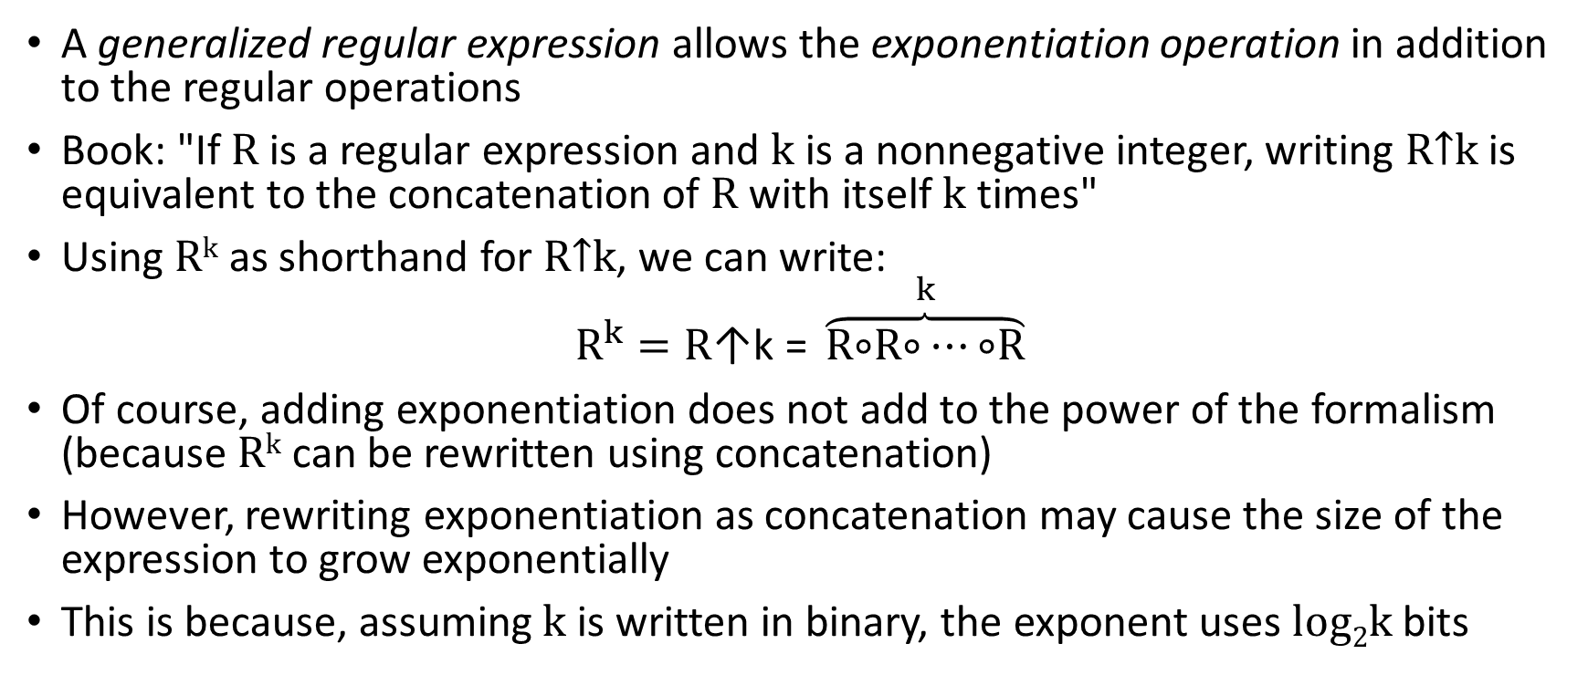
Generalized Regular Expressions
A generalized regular expression allows the exponentiation operation in addition to the regular operations
Book: "If R is a regular expression and k is a nonnegative integer, writing R↑k is equivalent to the concatenation of R with itself k times"
Using R^{k} as shorthand for R↑k, we can write:
$$R^{k}=R\text{↑}\text{k}\text{ = }\overset{k}{\overbrace{R\text{∘}R\text{∘}…\text{∘}R}}$$
Of course, adding exponentiation does not add to the power of the formalism (because R^{k} can be rewritten using concatenation)
However, rewriting exponentiation as concatenation may cause the size of the expression to grow exponentially
This is because, assuming k is written in binary, the exponent uses log₂k bits

Slide 17
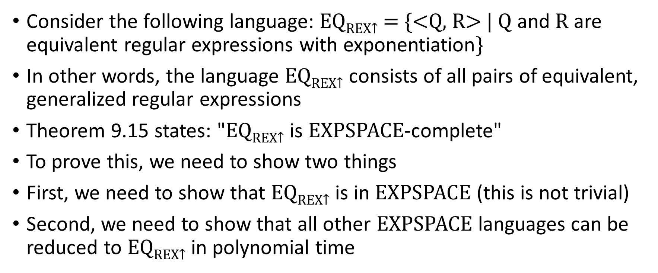
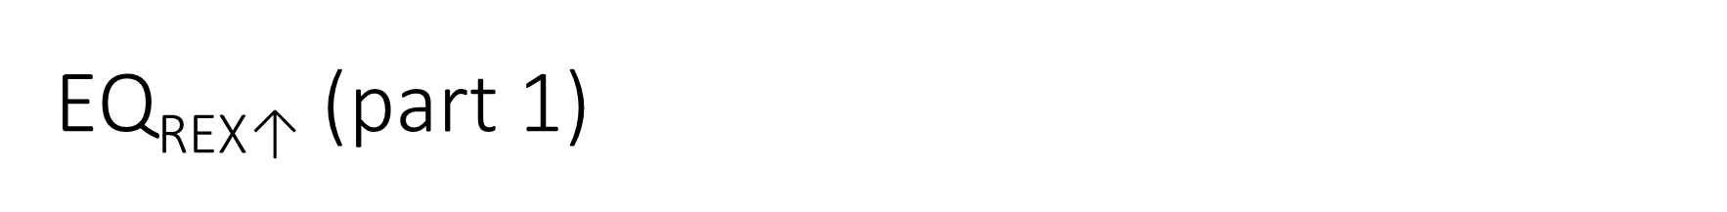
EQ_{REX}$\text{↑}$ (part 1)
Consider the following language: EQ_{REX}$\text{↑}$ = {<Q, R> | Q and R are equivalent regular expressions with exponentiation}
In other words, the language EQ_{REX}$\text{↑}$ consists of all pairs of equivalent, generalized regular expressions
Theorem 9.15 states: "EQ_{REX}$\text{↑}$ is EXPSPACE-complete"
To prove this, we need to show two things
First, we need to show that EQ_{REX}$\text{↑}$ is in EXPSPACE (this is not trivial)
Second, we need to show that all other EXPSPACE languages can be reduced to EQ_{REX}$\text{↑}$ in polynomial time

Slide 18
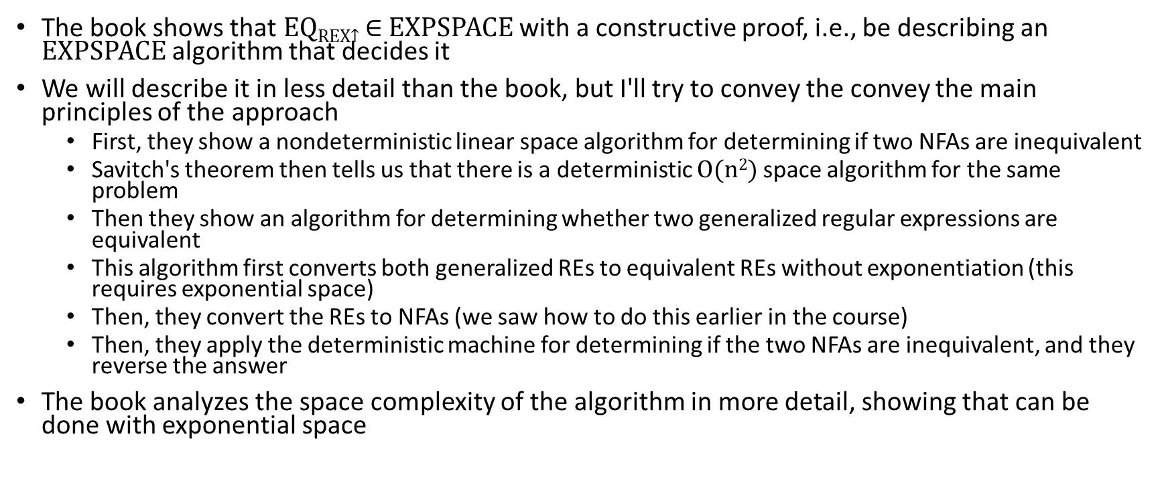
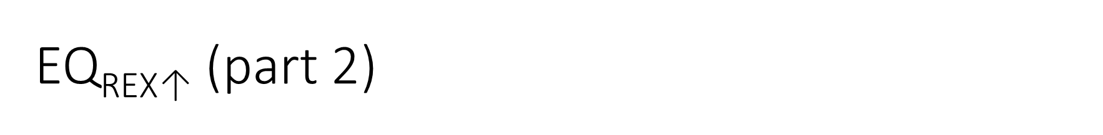
EQ_{REX}$\text{↑}$ (part 2)
The book shows that EQ_{REX}$\text{↑}$ ∈ EXPSPACE with a constructive proof, i.e., be describing an EXPSPACE algorithm that decides it
We will describe it in less detail than the book, but I'll try to convey the convey the main principles of the approach
  First, they show a nondeterministic linear space algorithm for determining if two NFAs are inequivalent
  Savitch's theorem then tells us that there is a deterministic O(n²) space algorithm for the same problem
  Then they show an algorithm for determining whether two generalized regular expressions are equivalent
  This algorithm first converts both generalized REs to equivalent REs without exponentiation (this requires exponential space)
  Then, they convert the REs to NFAs (we saw how to do this earlier in the course)
  Then, they apply the deterministic machine for determining if the two NFAs are inequivalent, and they reverse the answer
The book analyzes the space complexity of the algorithm in more detail, showing that can be done with exponential space

Slide 19
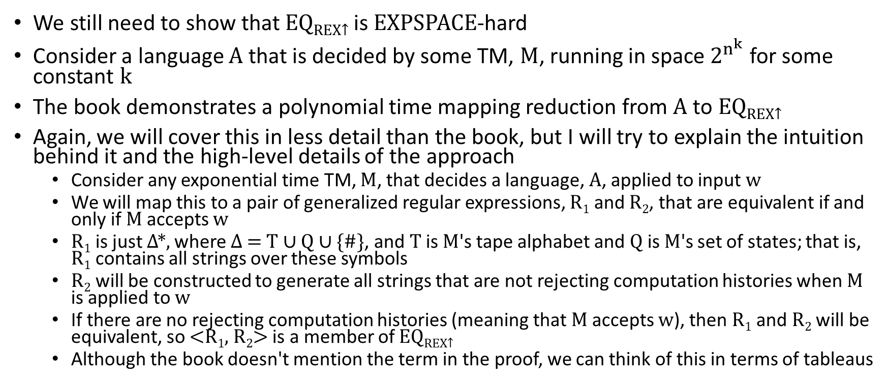
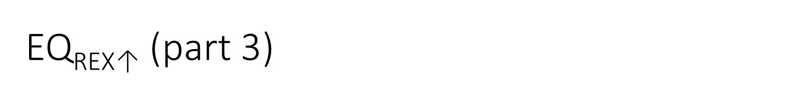
EQ_{REX}$\text{↑}$ (part 3)
We still need to show that EQ_{REX}$\text{↑}$ is EXPSPACE-hard
Consider a language A that is decided by some TM, M, running in space $2^{n^{k}}$ for some constant k
The book demonstrates a polynomial time mapping reduction from A to EQ_{REX}$\text{↑}$
Again, we will cover this in less detail than the book, but I will try to explain the intuition behind it and the high-level details of the approach
  Consider any exponential time TM, M, that decides a language, A, applied to input w
  We will map this to a pair of generalized regular expressions, R₁ and R₂, that are equivalent if and only if M accepts w
  R₁ is just Δ*, where Δ = T ∪ Q ∪ {#}, and T is M's tape alphabet and Q is M's set of states; that is, R₁ contains all strings over these symbols
  R₂ will be constructed to generate all strings that are not rejecting computation histories when M is applied to w
  If there are no rejecting computation histories (meaning that M accepts w), then R₁ and R₂ will be equivalent, so <R₁, R₂> is a member of EQ_{REX}$\text{↑}$
  Although the book doesn't mention the term in the proof, we can think of this in terms of tableaus

Slide 20
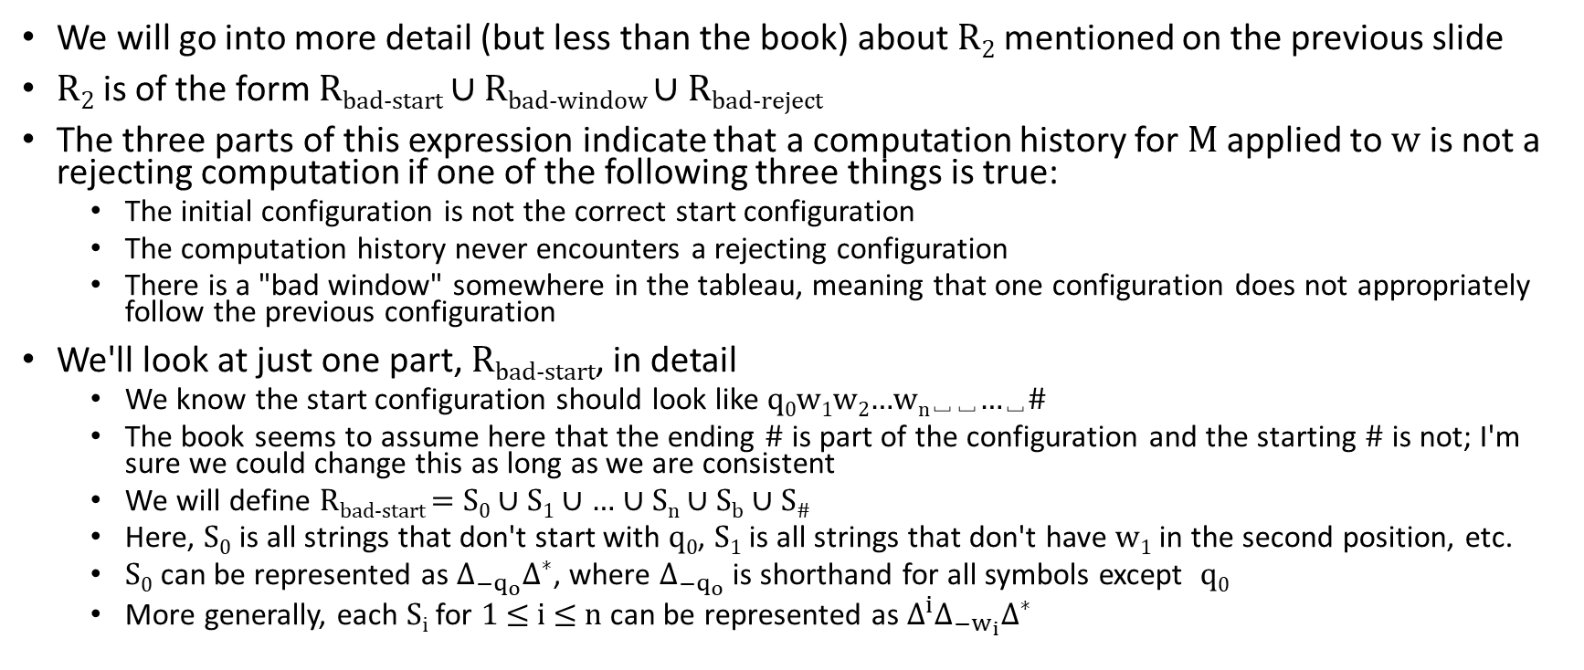
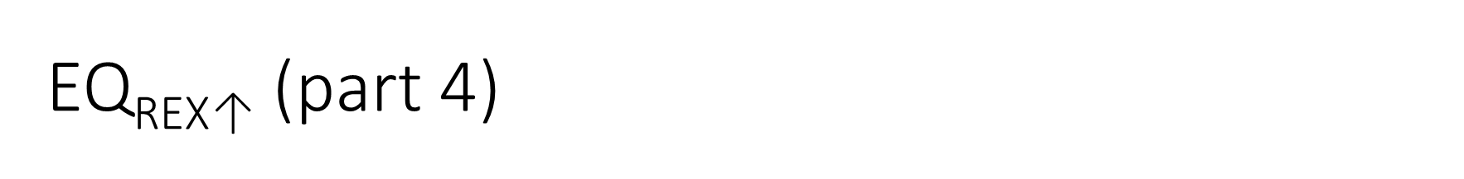
EQ_{REX}$\text{↑}$ (part 4)
We will go into more detail (but less than the book) about R₂ mentioned on the previous slide
R₂ is of the form R_{bad-start} ∪ R_{bad-window} ∪ R_{bad-reject}
The three parts of this expression indicate that a computation history for M applied to w is not a rejecting computation if one of the following three things is true:
  The initial configuration is not the correct start configuration
  The computation history never encounters a rejecting configuration
  There is a "bad window" somewhere in the tableau, meaning that one configuration does not appropriately follow the previous configuration
We'll look at just one part, R_{bad-start}, in detail
  We know the start configuration should look like q₀w₁w₂…w_{n}␣␣…␣#
  The book seems to assume here that the ending # is part of the configuration and the starting # is not; I'm sure we could change this as long as we are consistent
  We will define R_{bad-start} = S₀ ∪ S₁ ∪ … ∪ S_{n} ∪ S_{b} ∪ S#
  Here, S₀ is all strings that don't start with q₀, S₁ is all strings that don't have w₁ in the second position, etc.
  S₀ can be represented as ${\text{Δ}}_{{−q}_{o}}{\text{Δ}}^{∗}$, where ${\text{Δ}}_{{−q}_{o}}$ is shorthand for all symbols except q₀
  More generally, each S_{i} for 1 ≤ i ≤ n can be represented as ${\text{Δ}}^{i}{\text{Δ}}_{{−w}_{i}}{\text{Δ}}^{∗}$

Slide 21
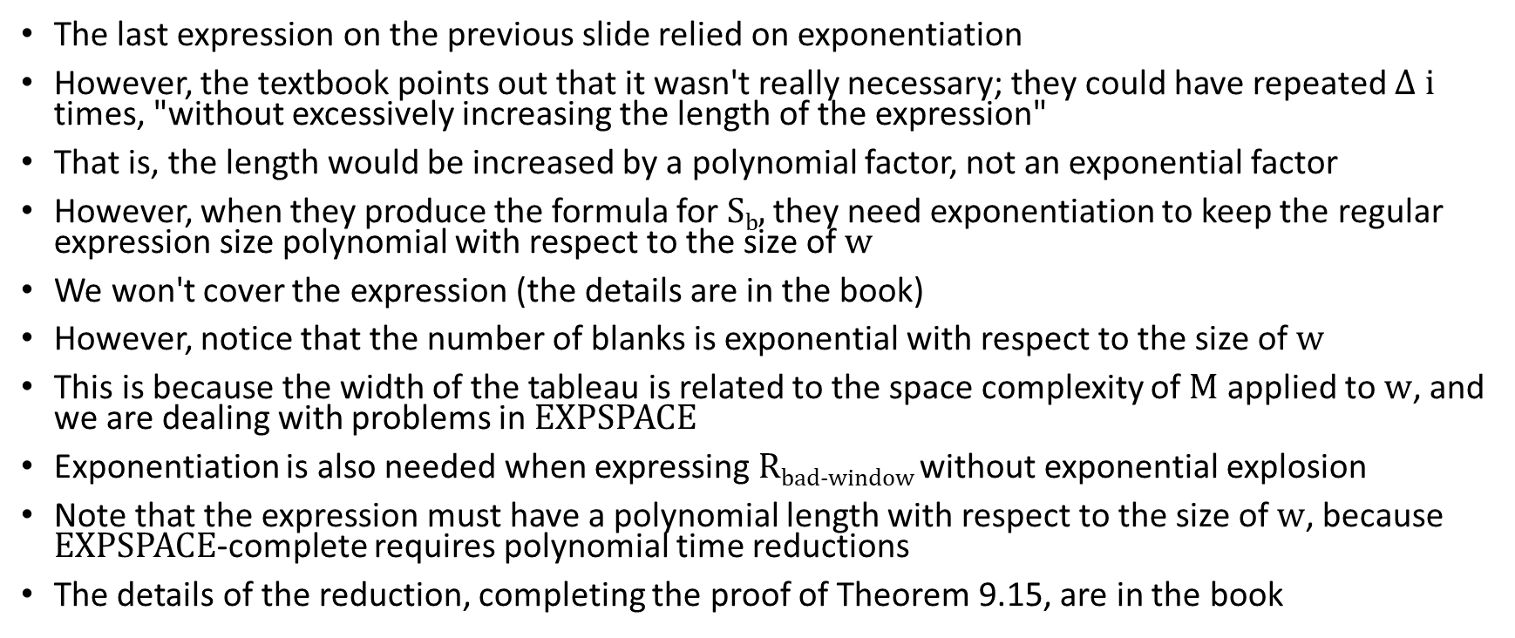
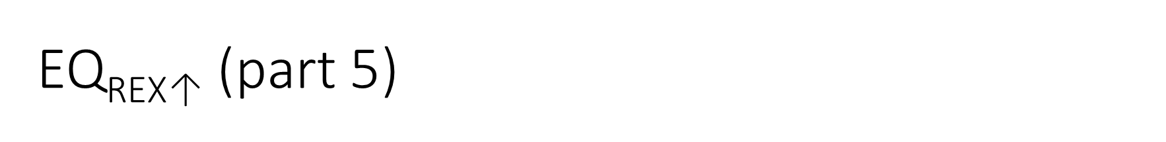
EQ_{REX}$\text{↑}$ (part 5)
The last expression on the previous slide relied on exponentiation
However, the textbook points out that it wasn't really necessary; they could have repeated $\text{Δ}$ i times, "without excessively increasing the length of the expression"
That is, the length would be increased by a polynomial factor, not an exponential factor
However, when they produce the formula for S_{b}, they need exponentiation to keep the regular expression size polynomial with respect to the size of w
We won't cover the expression (the details are in the book)
However, notice that the number of blanks is exponential with respect to the size of w
This is because the width of the tableau is related to the space complexity of M applied to w, and we are dealing with problems in EXPSPACE
Exponentiation is also needed when expressing R_{bad-window} without exponential explosion
Note that the expression must have a polynomial length with respect to the size of w, because EXPSPACE-complete requires polynomial time reductions
The details of the reduction, completing the proof of Theorem 9.15, are in the book

