Slide 1
ECE461: Theoretical CS
Decidable Languages

Slide 2
Brief Recap
In earlier topics, we explored formalisms that are sufficient for describing the regular languages and the context-free languages
Although they are useful for various purposes, those formalisms are quite limited in power; they cannot describe all languages that can be described by more powerful formalisms
In our previous topic, we discussed Turing machines (TMs), providing us with the most powerful known formalism for modeling computation
If we accept the Church-Turing thesis, then all algorithms can be implemented by Turing machines, and there cannot be a more powerful, reasonable formalism
In this topic, we will see some examples of decidable languages
  Of course, all previous examples of regular languages, context-free languages, and Turing-decidable languages we've seen so far fit this description (decidable, Turing-decidable, and recursive are synonymous)
  In this topic, we will examine decidable languages that are related to regular languages or context-free languages and the formalisms that describe them (that will make more sense after we see some example)
This topic is based on Section 4.1 of the textbook
In our next topic, we will start to explore undecidable languages, i.e., languages that cannot be decided by any Turing machine, and thus, cannot be decided by any algorithm

Slide 3
A_{DFA}
Our first decidable language about languages is: A_{DFA} = {<B, w> | B is a DFA that accepts input string w}
  This is the language of all encodings of (B, w) pairs such that B (the DFA encoded as <B>) accepts w
  Deciding whether a string is a member of this language is equivalent to deciding if the DFA encoded as <B> accepts the input string w
  This is known as the acceptance problem for DFAs
Theorem 4.1 states: "A_{DFA} is a decidable language"
The theorem is almost obvious; we can construct a Turing machine, M, that simulates B on w, and accepts if B accepts
  The book goes into a bit more detail; but not much
  I'm not claiming it would be simple to construct such a TM in a formal way, or to express the state diagram
  However, we should all be convinced at this point that it is possible
  Recall that if you can do it with a multi-tape TM, that's good enough, because we've already seen that any multi-tape TM can be simulated by a single-tape TM
  We have also discussed the fact that the universal Turing machine (not yet introduced in the textbook) can simulate any other Turing machine, and a DFA is simpler than a Turing machine

Slide 4
A_{NFA}
Our next decidable language about languages is: A_{NFA} = {<B, w> | B is an NFA that accepts input string w}
Theorem 4.2 in the book states: "A_{NFA} is a decidable language"
We could construct a Turing machine to simulate B directly, like what we proposed for A_{DFA}
However, there is also another approach
  We could construct a Turing machine, N, that first converts the NFA to a DFA (which we saw was possible in a previous topic)
  Then, it could simulate that DFA on input w, and accept if the DFA accepts
  The book describes this as having "N use M as a subroutine", where M is the TM discussed on the previous slide
  Of course, Turing machines don't actually have subroutines, i.e., they cannot make a calls to other TMs; but clearly, N can be constructed to do whatever it is that M does as part of its computation
  It helps me to think about this more like an inline function call
  For example, in this case, N would not actually be calling M; the actual situation would be more like a copy of M's states and rules being utilized at the point in N where the functionality of M would be useful
Again, regardless of whether constructing the actual Turing machine would be simple or hard, this is clearly possible with an algorithm, and therefore, with a Turing machine

Slide 5
A_{REX}
Our next decidable language about languages is: A_{REX} = {<R, w> | R is a regular expression that generates string w}
Theorem 4.3 in the book states: "A_{REX} is a decidable language"
We can construct a Turing machine, P, that decides this language as follows:
  First, P can convert the regular expression, R, to an NFA, A
  Then P can run the TM, N, that was described on the previous slide to see if N accepts w
  If N accepts w, accept; otherwise, reject

Slide 6
E_{DFA}
Our next decidable language about languages is: E_{DFA} = {<A> | A is a DFA and L(A) = ∅}
Checking if a string <A> is a member of this language is equivalent to checking if the DFA encoded as <A> does not accept any string; this is an example of emptiness testing
Theorem 4.4 in the book states: "E_{DFA} is a decidable language"
The book explains a proof by construction
Consider a TM, T, that takes <A> as input, where A is a DFA, and proceeds as follows:
  T starts by marking the start state of A (we have previously explained how a TM can simulate marking a symbol)
  T then repeatedly iterates through all transitions in A
  Whenever T finds a transition from a marked state to an unmarked state, it marks the destination state
  If a full iteration fails to mark any new state, T breaks out of its loop
  At the end, if no accept state is marked, T accepts; otherwise, T rejects

Slide 7
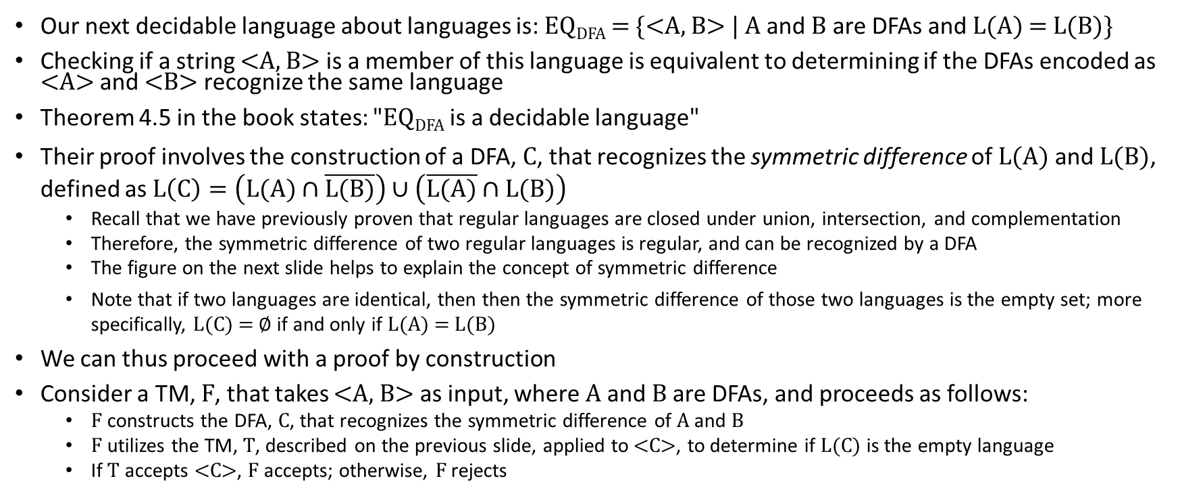
EQ_{DFA}
Our next decidable language about languages is: EQ_{DFA} = {<A, B> | A and B are DFAs and L(A) = L(B)}
Checking if a string <A, B> is a member of this language is equivalent to determining if the DFAs encoded as <A> and <B> recognize the same language
Theorem 4.5 in the book states: "EQ_{DFA} is a decidable language"
Their proof involves the construction of a DFA, C, that recognizes the symmetric difference of L(A) and L(B), defined as $L\left(C\right)=\left(L(A)∩\overline{L(B)}\right)∪\left(\overline{L(A)}∩L(B)\right)$
  Recall that we have previously proven that regular languages are closed under union, intersection, and complementation
  Therefore, the symmetric difference of two regular languages is regular, and can be recognized by a DFA
  The figure on the next slide helps to explain the concept of symmetric difference
  Note that if two languages are identical, then then the symmetric difference of those two languages is the empty set; more specifically, L(C) = ∅ if and only if L(A) = L(B)
We can thus proceed with a proof by construction
Consider a TM, F, that takes <A, B> as input, where A and B are DFAs, and proceeds as follows:
  F constructs the DFA, C, that recognizes the symmetric difference of A and B
  F utilizes the TM, T, described on the previous slide, applied to <C>, to determine if L(C) is the empty language
  If T accepts <C>, F accepts; otherwise, F rejects

Slide 8
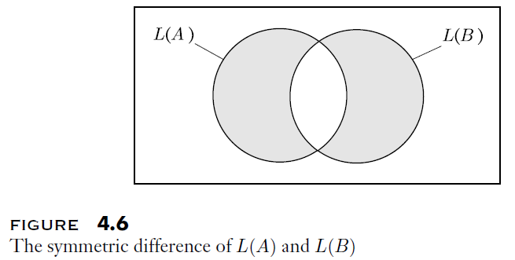
Symmetric Difference Example

Slide 9
A_{CFG}
So far, the decidable languages we have examined in this topic have been related to regular languages
Now, we will start to examine decidable languages related to context-free languages
Our next decidable language about languages is: A_{CFG} = {<G, w> | G is a CFG that generates string w}
Theorem 4.7 in the book states: "A_{CFG} is a decidable language"
One idea might be to search for a derivation starting at the start symbol of G that generates w
  This doesn't work, because infinite loops could occur, and a TM employing this strategy might never halt
  This would be a recognizer for A_{CFG}, but not a decider for A_{CFG}
  Therefore, another strategy is necessary (this is discussed on the next slide)

Slide 10
Proving that A_{CFG} is Decidable
Recall that any CFG can be converted to Chomsky normal form (we briefly discussed how to do this when we covered CFGs)
  In Chomsky normal form, all rules have the form A → BC or A → a, where A, B, and C are nonterminals (a.k.a. variables) and a is a terminal
  Optionally, one extra rule can be added of the form S → ε, where S is the start variable of the CFG
It is easy to show that if a CFG is in Chomsky normal form, then any derivation of a string, w, with length n ≥ 1 has exactly 2n-1 steps (see Problem 2.26 from the book)
We can thus proceed with a proof by construction
Consider a TM, X, that takes <G, w> as input, where G is a CFG and w is a string, and proceeds as follows:
  X converts G to Chomsky normal form
  If w is the empty string, check if S → ε is a rule of the converted grammar
  Otherwise, n ≥ 1, so X explores all derivations with exactly 2n-1 steps
  If any of these derivations generate w, X accepts; otherwise, X rejects
The textbook points out that determining if a string is valid according to a CFG is important for compiling computer programs
We will see a more efficient algorithm for doing this in a future topic (this is related to Theorem 7.16 in the textbook)

Slide 11
E_{CFG}
Our next decidable language about languages is: E_{CFG} = {<G> | G is a CFG and L(G) = ∅}
Theorem 4.8 in the book states: "E_{CFG} is a decidable language"
Determining if the language described by a CFG is empty is equivalent to determining if the start variable can generate at least one string (a sequence of terminal symbols)
The algorithm we will discuss achieves something more general; it determines if each variable (nonterminal) in the CFG is capably of generating at least string
Consider a TM, R, that takes <G> as input, where G is a CFG, and proceeds as follows:
  First, R marks all the terminal symbols in G
  R then repeatedly iterates through all the productions in G
  Whenever R finds a production (a.k.a. rule) such that all symbols on the right-hand side have been marked, R also marks the variable on the left-hand side
  If a full iteration fails to mark any new variable, R breaks out of its loop
  At the end, if the start variable is not marked, R accepts; otherwise, R rejects
I add:
  The books description does not specifically address the empty string (which is a valid string)
  Marking the empty string symbol, ε, along with terminals at the start of the algorithm should account for this

Slide 12
EQ_{CFG}
Now consider this language: EQ_{CFG} = {<G, H> | G and H are CFGs and L(G) = L(H)}
Based on the pattern we have been seeing, you may expect a proof that this language is decidable
However, the technique used to show that EQ_{DFA} is decidable does not work here, because the class of CFGs is not closed under intersection or complementation
In fact, this language is not decidable; it is an example of an undecidable language
No Turing machine, and thus no algorithm, is capable of deciding whether two CFGs describe the same language!
Of course, there will be algorithms that will be able to determine the answer for some cases, but not for all cases
We will learn about techniques for proving things like this in our next two topics; Exercise 5.1 in the textbook challenges you to prove that EQ_{CFG} is not decidable

Slide 13
Every Context-Free Language is Decidable
Theorem 4.9 of the textbook states: "Every context-free language is decidable"
To me, this sound extremely similar to Theorem 4.7, which states: "A_{CFG} is a decidable language"
  In fact, it is extremely similar
  To prove Theorem 4.7, we had to show that there is a Turing machine, S, that accepts input <G, w> if and only if the CFG G can generate the string w
  To prove Theorem 4.9, we have to show that for every CFG, G, we can construct a Turing machine, M_{G}, that accepts input w if and only if G can generate the string w
  Clearly, this is possible; we can simply have M_{G} pass the string <G, w> to S, the Turing machine constructed to prove Theorem 4.7
We now know that every context-free language is decidable, and we have seen some decidable languages that are not context-free
We have also previously shown that the class of regular languages is a proper subset of the class of context-free languages
Although we have not proven it yet, we have stated that some languages are Turing-recognizable but not Turing-decidable
Given this information, the figure on the next slide depicts the relationship among the four main classes of languages that we have studied so far

Slide 14
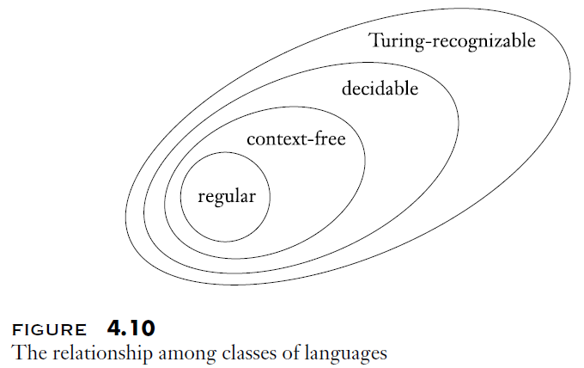
Four Important Classes of Languages

