Slide 1
ECE461: Theoretical CS
Course Introduction, Notations, and Terminology

Slide 2
The Basics
Lectures will be in Rm. 105
  Tuesdays from 5 pm – 6 pm
  Thursdays from 3 pm – 5 pm
My Cooper webpage: http://faculty.cooper.edu/sable2
  From there, you can fine a link to the course webpage
  I’ll post syllabus info, assignments, and the updated schedule on the course webpage
  Some general course policies can be found using the "policies" link on my Cooper webpage (not the course webpage)
E-mail: carl.sable@cooper.edu

Slide 3
Textbook
The main textbook is:
  "Introduction to the Theory of Computation, 3rd Edition" by Michael Sipser
  The 2nd edition is also fine (it lacks one section that we are skipping anyway)
  You can use either a physical digital version of either edition, obtained however you choose
  I expect students to keep up with the reading; I encourage you to read the textbook ahead of lectures, starting with week 2 of the course
Other references (I don't expect students to have these):
  "Computational Complexity: A Modern Approach" by Sanjeev Arora and Boaz Barak
  "Computational Complexity" by Christos Papadimitriou

Slide 4
Topics Covered
I expect to cover most of the Sipser textbook
The textbook has 11 chapters, including a Chapter 0 which I will summarize today (you don't have to read that one)
Not counting Chapter 0, the textbook is divided into three parts:
  Automata and Languages (Chapters 1 and 2, although I might include Chapter 3 here)
  Computability Theory (Chapters 3 through 6, although again, Chapter 3 really straddles the first two main ideas of the book)
  Complexity Theory (Chapters 7 through 10)
One might say that these three parts of the book roughly relate to three theoretical questions:
  What formalisms might we use to model computation (and what are their limitations)?
  What is it possible (and what is it not possible) to compute, in general?
  Of those things that can be computed, in general, what can be computed efficiently?
A tentative schedule is currently listed on the course webpage

Slide 5
Grading
The workload of this course will include 3 problem sets and 4 short quizzes
The problem sets will be difficult, in my opinion!
  Many of the problems will require a lot of thought
  Problems may involve, e.g., proving things true or false, determining interesting reductions, or solving difficult problems using a particular model of computation
The quizzes will (hopefully) be easier
  Quizzes will consist of a small number of conceptual, short answer questions
  The main purpose of these quizzes will be to make sure you are keeping up with the class (attending lectures, paying attention, and reading)
  The quizzes will probably be close book, closed notes
I'll weight problem sets and quizzes equally at the end of the semester (but problem sets will be graded in an unusual fashion – see the next slide)

Slide 6
Grading Problem Sets
When grading problem sets, I will grade each answer on a scale from 0 to 4, with meanings as follows:
  4 - The answer is entirely (or almost entirely) correct. All of the main points needed to answer the question have been addressed, and the correct solution has been determined. There can possibly be one or two minor points not mentioned or stated incorrectly, if they do not affect the overall gist of the solution.
  3 - The answer is mostly correct. Most of the main points are correctly addressed. However, either one main point is missing or incorrect, or multiple minor issues exist in the stated solution.
  2 - The answer is on the right track. One or more of the main points of the solution are correctly addressed, but other main points are missing. Further leaps were needed to complete the solution.
  1 - The answer is mostly wrong. Perhaps one main point out of several is stated correctly, but others are wrong. Or, maybe a few minor details related to the correct solution are stated correctly. However, the gist of the stated solution is wrong.
  0 - The answer is entirely (or almost entirely) incorrect, or the question was not answered at all. Note that it is still possible that effort was put into the problem. However, the stated solution does not work, perhaps because it makes incorrect leaps, or because it relies on incorrect assumptions, or because there was a misunderstanding of the question, etc.
At the end of the semester, I will computer a percentage, which is the sum of all scores for all problems, divided by the maximum possible score (4 times the number of total questions)

Slide 7
Today
The rest of today's lecture (and the corresponding slides) is based on parts of Chapter 0 of the textbook, titled "Introduction"
This chapter gives an overview of some of the background material necessary to understand later topics in the book
Some of this material involves topics that were covered in Data Structures or Algorithms I or II
Some of the material was likely covered in other courses that you probably already took (such as DLD), but it's OK if you haven't taken them
The chapter also introduces terminology and notations used throughout the book
Note: I like the textbook's discussion on page 2 about what makes some problems hard (a question to which the answer is not known)

Slide 8
Sets
Book: "A set is a group of objects represented as a unit."
Each object in a set (i.e., each member, or element, of the set) might be a number, a symbol, another set, etc.
A set can be described by listing all its elements within curly braces; for example, S = {7, 21, 57}
The symbols ∈ and ∉ represent membership and not non-membership, respectively
So, we can say, e.g., 7 ∈ {7, 21, 57} and 8 ∉ {7, 21, 57}
For two sets A and B, if every member of A is also a member of B, then A is a subset of B, which can be written as A ⊆ B
If A is a subset of B but A≠B then A is a proper subset of B, which can be written as A ⊊ B
The order of elements in a set, and the number of repetitions of its members, do not matter
If we want the number of repetitions (but not order) to matter, we can use a multiset

Slide 9
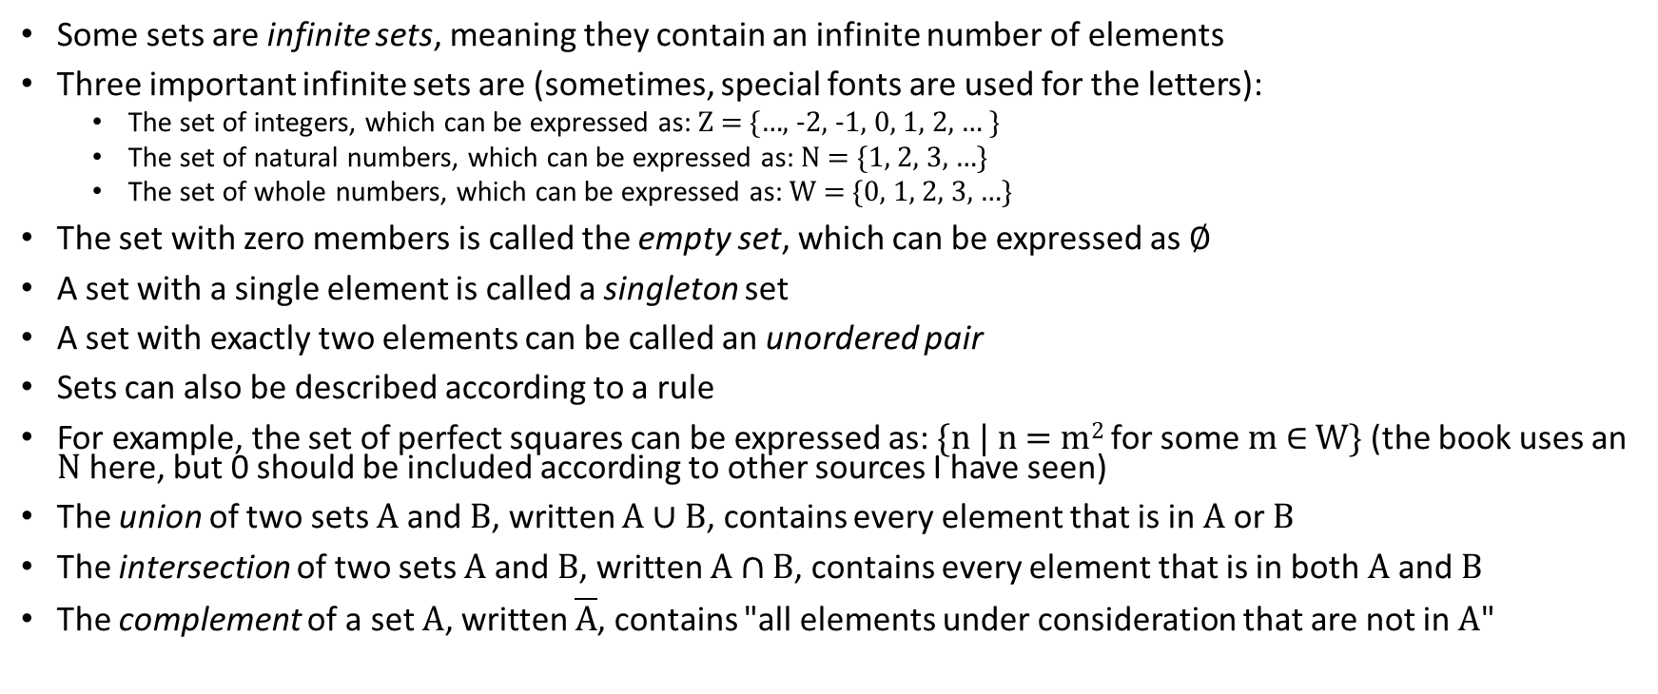
Working with Sets
Some sets are infinite sets, meaning they contain an infinite number of elements
Three important infinite sets are (sometimes, special fonts are used for the letters):
  The set of integers, which can be expressed as: Z = {…, -2, -1, 0, 1, 2, … }
  The set of natural numbers, which can be expressed as: N = {1, 2, 3, …}
  The set of whole numbers, which can be expressed as: W = {0, 1, 2, 3, …}
The set with zero members is called the empty set, which can be expressed as ∅
A set with a single element is called a singleton set
A set with exactly two elements can be called an unordered pair
Sets can also be described according to a rule
For example, the set of perfect squares can be expressed as: {n | n = m² for some m ∈ W} (the book uses an N here, but 0 should be included according to other sources I have seen)
The union of two sets A and B, written A ∪ B, contains every element that is in A or B
The intersection of two sets A and B, written A ∩ B, contains every element that is in both A and B
The complement of a set A, written $\overline{A}$, contains "all elements under consideration that are not in A"

Slide 10
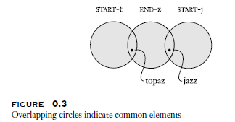
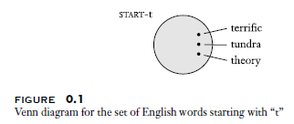
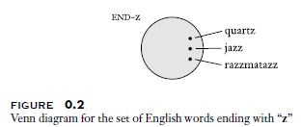
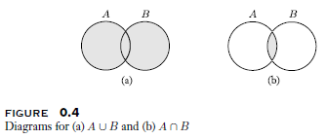
Venn Diagrams
Venn Diagrams can help represent sets as regions; for example:
These examples depict the union and intersection of sets A and B:

Slide 11
Sequences
Book: "A sequence of objects is a list of these objects in some order"
A sequence can be described by listing its objects within parentheses; e.g., (7, 21, 57)
Unlike a set, the order of the elements matters, and the repetition of elements matters
For example, the sequence (7, 21, 57) is different from (57, 7, 21) or (7, 21, 21, 57)
However, the sets {7, 21, 57}, {57, 7, 21}, and {7, 21, 21, 57} are all identical
Like sets, sequences can be finite or infinite
A finite sequence can be referred to as a tuple; if there are exactly k elements it can be referred to as a k-tuple
A 2-tuple can be referred to as an ordered pair
Sets and sequences can be members of other sets and sequences
The power set of set A is the set of all subsets of A; e.g., if A is {0, 1}, then the power set of A is {∅, {0}, {1}, {0, 1}}

Slide 12
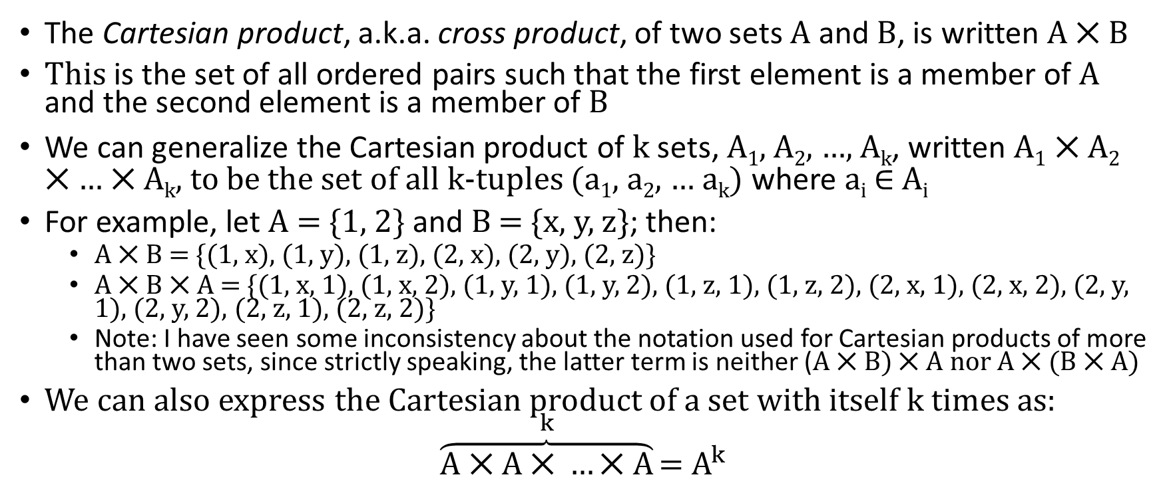
Cartesian Product
The Cartesian product, a.k.a. cross product, of two sets A and B, is written A ⨉ B
This is the set of all ordered pairs such that the first element is a member of A and the second element is a member of B
We can generalize the Cartesian product of k sets, A₁, A₂, …, A_{k}, written A₁ ⨉ A₂ ⨉ … ⨉ A_{k}, to be the set of all k-tuples (a₁, a₂, … a_{k}) where a_{i} ∈ A_{i}
For example, let A = {1, 2} and B = {x, y, z}; then:
  A ⨉ B = {(1, x), (1, y), (1, z), (2, x), (2, y), (2, z)}
  A ⨉ B ⨉ A = {(1, x, 1), (1, x, 2), (1, y, 1), (1, y, 2), (1, z, 1), (1, z, 2), (2, x, 1), (2, x, 2), (2, y, 1), (2, y, 2), (2, z, 1), (2, z, 2)}
  Note: I have seen some inconsistency about the notation used for Cartesian products of more than two sets, since strictly speaking, the latter term is neither (A ⨉ B) ⨉ A nor A ⨉ (B ⨉ A)
We can also express the Cartesian product of a set with itself k times as:
$$\overset{k}{\overbrace{\text{A}\text{ ⨉ }\text{A}\text{ ⨉} …\text{⨉} \text{A}}}\text{= }A^{k}$$

Slide 13
Functions
A function, also called a mapping, is an object that takes an input and produces an output
For a particular function, f, the same input will always product the same output
If the input a produces the output b, we can write f(a) = b
The set of possible inputs to a function is its domain, D, and the set of possible outputs is its range, R; we can write f: D → R
For a function such as absolute value (abs), the input, x, is a number, and the output is a number (x if x is positive, -x is x is negative), so abs: Z → Z
For a function such as addition (add), the input is an ordered pair, and the output is a number (the sum of the two elements of the input), so add: Z ⨉ Z → Z
Note that a function does not necessarily have to produce all elements of its specified range; if it does, it is said to be onto the range

Slide 14
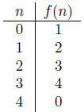
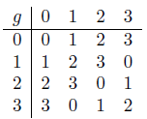
Expressing functions
One way to express a function is by specifying a procedure for computing an output, given an input
For functions with finite domains, another way it to specify a table listing the output for every possible input
For example, for a function f: {0, 1, 2, 3, 4} → {0, 1, 2, 3, 4} that adds 1 modulo four to the input, we can express it with the left of the two tables below (from Example 0.8 in the textbook)
Another way to express a subset of integers from 0 through m-1 is Z_{m}; so, the domain and range of function f above are both Z₅
For a function, g: Z₄ ⨉ Z₄ → Z₄ that performs addition modulo 4, we can express it with the right of the two tables below (from Example 0.9 in the textbook)

Slide 15
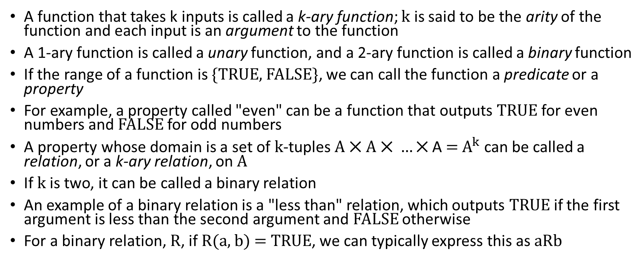
Types of Functions
A function that takes k inputs is called a k-ary function; k is said to be the arity of the function and each input is an argument to the function
A 1-ary function is called a unary function, and a 2-ary function is called a binary function
If the range of a function is {TRUE, FALSE}, we can call the function a predicate or a property
For example, a property called "even" can be a function that outputs TRUE for even numbers and FALSE for odd numbers
A property whose domain is a set of k-tuples $\text{A}\text{ ⨉ }\text{A}\text{ ⨉ }…\text{⨉}$ A $\text{= }A^{k}$ can be called a relation, or a k-ary relation, on A
If k is two, it can be called a binary relation
An example of a binary relation is a "less than" relation, which outputs TRUE if the first argument is less than the second argument and FALSE otherwise
For a binary relation, R, if R(a, b) = TRUE, we can typically express this as aRb

Slide 16
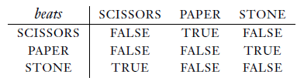
Binary Relation Example
An example of a binary relation is "beats" that relates to what the textbook calls the "Scissors-Paper-Stone" game (who calls it that?)
This can be expressed as a table as follows:
Alternatively, we can express the relation as (D, S), where D is the domain and S is the set of inputs for which the relation is true
This can be simplified to just S when the domain is obvious
For example, we can express the "beats" relation as {(SCISSORS, PAPER), (PAPER, STONE), (STONE, SCISSORS)}

Slide 17
Equivalence Relations
An equivalence relation is a binary relation that "captures the notion of two objects being equal in some feature"
A binary relation, R, is an equivalence relation if and only if it satisfies the following three conditions:
  R is reflexive, meaning that for every x, xRx
  R is symmetric, meaning that for every x and y, xRy implies yRx
  R is transitive, meaning that for every x, y, and z, xRy and yRz implies xRz
An example of an equivalence relation accepts, as input, a pair i, j ∈ N and outputs true if and only if i - j is a multiple of 7

Slide 18
Graphs
A graph, G, is a collection (set) of vertices (a.k.a. nodes), V, and edges, E; we can write G = (V, E)
Graphs and their edges can be undirected or directed
For an undirected graph, the degree of a vertex is the number of edges incident to it
For a directed graph, we can talk about its out-degree (the number of edges leaving it) and in-degree (the number of edges leading to it)
The textbook says that at most one edge can connect two nodes (I would claim that this is not always a constraint)
Nodes and edges can be labeled
A subgraph of a graph, G, is a graph containing a subset of the nodes of G and the edges from G connecting those particular nodes

Slide 19
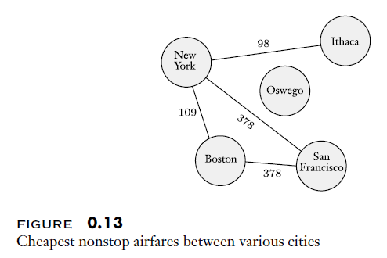
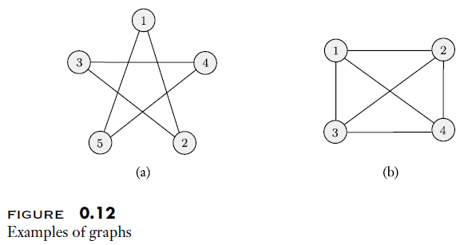
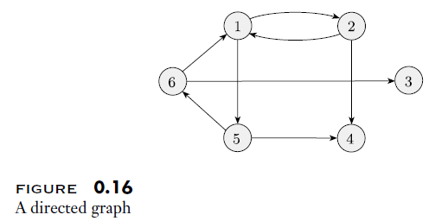
Examples of graphs
Graphs can be drawn with circles as nodes and lines or arrows as edges (depending on if the edges are directed); labels for nodes are edges can also be drawn; for example:
Alternatively, we can list the set of vertices and the set of edges
  For example, the graph in Figure 0.12 (a) shown above can be specified as follows: ({1, 2, 3, 4, 5}, {(1, 2), (2, 3), (3, 4), (4, 5), (5, 1)})
  Since this graph is undirected, the order in which the vertices are expressed for each edge does not matter; or we could represent undirected edges with set notation instead; e.g., {1, 2} instead of (1, 2)
  The directed graph in Figure 0.16 shown above can be specified as follows (this time, the order of vertices specified for each edge matters): ({1, 2, 3, 4, 5, 6}, {(1, 2), (1, 5), (2, 4), (5, 4), (5, 6), (6, 1), (6, 3)})

Slide 20
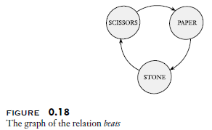
Scissors-Paper-Stone (revisited)
Directed graphs can be used to depict binary relations
For example, we can depict the "beats" relation for the "Scissors-Paper-Stone" game as follows:

Slide 21
Paths
A path is a sequence of nodes connected by edges
If the edges are directed, it is a directed path
The path is simple if none of the nodes repeat
A path is a cycle if it starts and ends at the same place
The cycle is simple if the first and last node are the only ones that repeat; in an undirected graph, we also must use at least three nodes
An undirected graph is connected if there is a path connecting any every pair of nodes
A directed graph is strongly connected if there is a directed path connecting every pair of nodes

Slide 22
Strings
A string is a finite sequence of symbols from an alphabet; the string is said to be over the alphabet
When programming, the alphabet typically consists of all ASCII characters or Unicode characters, for example
In theoretical CS, however, it can be any finite set of symbols
Typically, the Greek letters Σ (capital sigma) or Γ (capital gamma), often with subscripts, are used to represent alphabets; for example:
  Σ₁ = {0, 1}
  Σ₂ = {a, b, c, d, e, f, g, h, i, j, k, l, m, n, o, p, q, r, s, t, u, v, w, x, y, z}
  Γ = {0, 1, x, y, z}
A string over an alphabet is typically written with symbols next to each other, not separated by commas; e.g., one string over Σ₂ is abracadabra
The length of a string, w, written |w|, is the number of symbols it contains
The only string of length 0 is the empty string, often written as ε (lowercase epsilon)

Slide 23
Working with Strings
The reverse of a string, w = w₁w₂…w_{n}, can be expressed as w^{R} = w_{n}w_{n-1}…w₁
A string z is a substring of string w if and only if the symbols of z appear consecutively within w
If a string x, with length n, is concatenated with a string y, of length m, the concatenation can be written as xy, with length n+m
We can denote x concatenated with itself k times as x^{k}
A string x is a prefix of string y if there exists a string z such that xz = y; we can say that x is a proper prefix if x≠y
A language is a set of strings

Slide 24
Lexicographic Order
We can imagine iterating through all possible strings over an alphabet in lexicographic order, a.k.a. lexicographical order
In some contexts, this might be very similar to dictionary order
In other contexts, it is convenient to use what the book calls shortlex order, or string order, in which shorter strings precede longer strings
For the alphabet {0, 1}, the start of the sequence using shortlex order would be {ε, 0, 1, 00, 01, 10, 11, 000, 001, …}

Slide 25
Boolean Logic
Book: "Boolean logic is a mathematical system built around the two values TRUE and FALSE"
They call this "the foundation of digital electronics and computer design"
In practice, we often represent the Boolean values TRUE and FALSE as 1 and 0, respectively
We can generalize Boolean logic to apply to any situation in which all values have one of two possibilities
Examples might include electronic components that have high or low voltage, questions for which the answer is yes or no, etc.

Slide 26
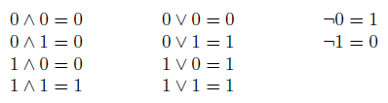
Working with Boolean Logic
Boolean operations can be applied to Boolean values
The negation, or NOT, operation can be denoted as ¬
The conjunction, or AND, operation can be denoted as ∧
The disjunction, or OR, operation, can be denoted as ∨
The book shows how these operations can be applied:

Slide 27

Additional Boolean Operations
The exclusive or, or XOR, operation can be denoted as ⊕
The equality operation can be denoted as ⟷
The implication operation can be denoted as →
The book shows how these operations can be applied:
Note that all the operations we covered (on this slide and the previous slide) also have alternative notations

Slide 28
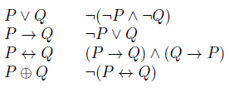
AND and NOT
Of course, we can combine various operations to make larger Boolean expressions
Interestingly, all Boolean operations, and therefore all Boolean expressions, can be represented with only AND and NOT operations
The book demonstrates this as follows:

Slide 29
The Distributive Law
In regular algebra, an example of the distributive law would be: a * (b + c) = (a * b) + (a * c)
The Boolean versions are as follows:
  P ∧ (Q ∨ R) = (P ∧ Q) ∨ (P ∧ R)
  P ∨ (Q ∧ R) = (P ∨ Q) ∧ (P ∨ R)

Slide 30
Mathematical Statements and Proofs
The book states that "definitions describe the objects and notions that we use", and a bit later that "precision is essential to any mathematical definition."
Once we have a set of agreed upon definitions, we can form mathematical statements about various objects, their properties, etc.
Some of these statements might be true, and others might be false; in many cases, we might not be sure
Book: "A proof is a convincing logical argument that a statement is true."
  They mention that the standard in a murder trial (e.g.) is proof "beyond any reasonable doubt"
  The standard for a mathematical proof is higher; this demands "proof beyond any doubt"
  I add: There can be formal proofs in mathematics; the proofs that we shall examine in this course (and those that are explained throughout the textbook) are not formal proofs
  I further add: The concept of what does / does not constitute a "convincing logical argument" is philosophically difficult
  For example, even an agreed upon formal proof might contain a mistake that nobody caught, and even a valid proof might not convince someone who is studying it
Once a mathematical statement has been proven to be true, we can refer to it as a theorem, although we usually use this term for significant mathematical statements
  Sometimes, we prove a statement for the main purpose of proving another statement, such as a theorem; such a statement is sometimes called a lemma
  At other times, a theorem allows us to easily prove another follow-up statement; such a statement is sometimes called a corollary

Slide 31
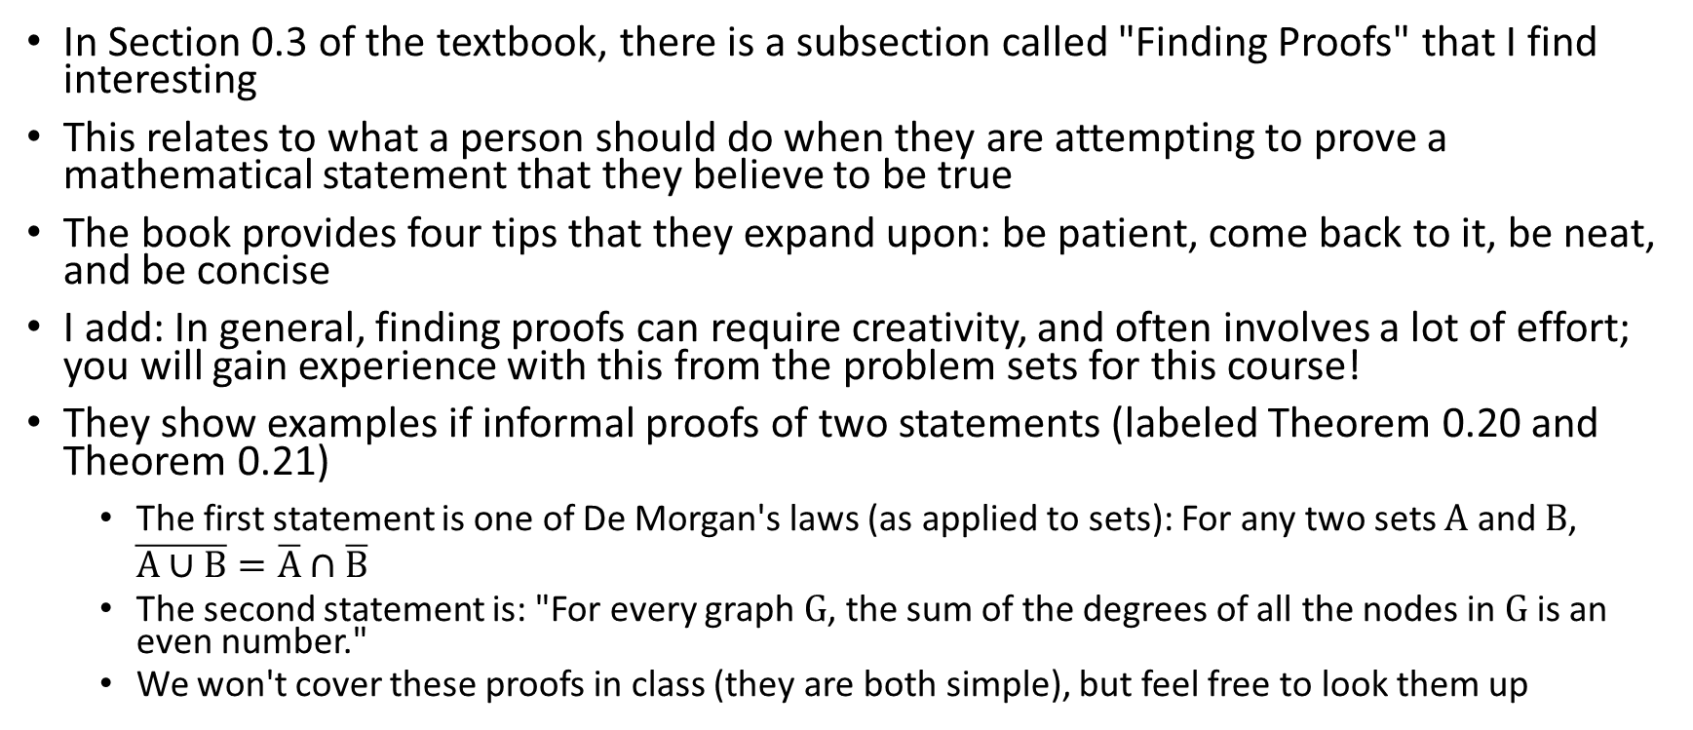
Finding Proofs
In Section 0.3 of the textbook, there is a subsection called "Finding Proofs" that I find interesting
This relates to what a person should do when they are attempting to prove a mathematical statement that they believe to be true
The book provides four tips that they expand upon: be patient, come back to it, be neat, and be concise
I add: In general, finding proofs can require creativity, and often involves a lot of effort; you will gain experience with this from the problem sets for this course!
They show examples if informal proofs of two statements (labeled Theorem 0.20 and Theorem 0.21)
  The first statement is one of De Morgan's laws (as applied to sets): For any two sets A and B, $\overline{A∪B}=\overline{A}∩\overline{B}$
  The second statement is: "For every graph G, the sum of the degrees of all the nodes in G is an even number."
  We won't cover these proofs in class (they are both simple), but feel free to look them up

Slide 32
Three Types of Proofs
Proof by construction
  For example, imagine that you are asked to prove that there exists an object of type <whatever> that has some property <blah> (my wording);
  One way to demonstrate this is to present a particular object of type <whatever> that has property <blah>
  The book uses this method to prove: "For each number n greater than 2, there exists a 3-regular graph with n nodes" (an k-regular graph is one in which every node has degree k)
Proof by contradiction (I call this an indirect proof)
  The idea here is to assume the opposite of what you are trying to prove, and then to demonstrate that this assumption leads to a clear contradiction of something that is known to be true
  The book uses this method to prove that the square root of 2 is irrational
Proof by induction (I call this an inductive proof)
  This involves two parts, called the basis and the induction step
  The basis proves a base case; i.e., you show that the statement is true for some particular, simple case
  The inductive step shows that if the statement is true for one case, it is also true for some other case, generally sequential from the previous case
  When used appropriately, these two things together can be combined to prove the statement for all cases
  The book uses this method to prove that a particular formula related to mortgage payments is correct

