Slide 1
ECE461: Theoretical CS
Context-Free Grammars

Slide 2
Brief Recap
In previous topics, we have learned about three formalisms capable of recognizing regular languages:
  Deterministic finite automata (DFAs)
  Nondeterministic finite automata (NFAs)
  Regular expressions (REs)
Regular languages could potentially be defined in terms of any one of these formalisms
Remember that, more generally, a language is a set of strings (possibly infinite), and a string a finite sequence of symbols from an alphabet
These three formalisms are equal in power; i.e., they are capable of representing exactly the same class of languages (the regular languages)
We have also learned that each of these formalisms is limited; that is, there are nonregular languages that cannot be represented by them
We discussed the pumping lemma for regular languages, which can be used to prove that certain languages are nonregular

Slide 3
Context-Free Grammars
In this topic, based on Section 2.1 of the textbook, we will learn about a more powerful formalism than the three previous discussed
This formalism is called a context-free grammar (CFG)
CFGs can describe all regular languages, and they can also describe certain nonregular languages
CFGs are often used to specify the syntax rules of programming languages, and to implement compilers
CFGs have historically been used by linguists to attempt to specify the grammar rules of natural languages, and in computational linguistics (a sub-field of NLP), they have been used to implement parsers
In our next topic, we will learn about another formalism, called a pushdown automaton, that is equally powerful to CFGs
The class of languages that can be described by CFGs or pushdown automata are known as context-free languages (CFLs)
Although more powerful than the formalisms we previously learned about, CFGs and pushdown automata still cannot describe all languages; that is, some languages are not context free
Two topics from now, will learn about another form of the pumping lemma that can be used to prove that certain languages are not context free

Slide 4
Brief History of Context-Free Grammars
As our textbook states, "context-free grammars were first used in the study of human languages" (although the book provides no details about the history)
Chomsky was hugely influential in the study of context-free grammars and related formalisms
  In a 1956 paper, Chomsky first described phrase-structure grammars, and he discussed (in an earlier form) what is now known as the Chomsky hierarchy, which includes, from most powerful to least powerful:
    Recursively enumerable languages (which can be recognized by Turing machines)
    Context-sensitive languages (we won't be learning about these, but they can be recognized by nondeterministic linear bounded Turing machines)
    Context-free languages (we will learn about these over the next few topics)
    Regular languages (we already learned about these)
  Chomsky continued to formalize and describe properties of CFGs and CFLs over the next few years
  Chomsky may also be the person who first formalized the pushdown automaton, although that is less clear
  Chomsky's theories dominated linguistics for decades, although some have always been controversial
The pumping lemmas for both context-free languages and regular languages were proven in a 1961 paper by Bar-Hillel, Perles, and Shamir
  Some sources refer to the pumping lemma for context-free languages as the Bar-Hillel lemma
  Some sources claim that the pumping lemma for regular languages was previously proven by Rabin and Scott, although others cite the Bar-Hillel, Perles, and Shamir paper as the source of the original proof

Slide 5
CFG Terminology
The textbook shows a simple example of a CFG; we will call this G₁:
  A → 0A1
  A → B
  B → #
Each line is a substitution rule, a.k.a. a production; these are often referred to simply as rules
The book says that each rule consists of "a symbol and a string separated by an arrow"
The book refers to the symbols to the left of the arrows as variables; I have typically seen these referred to as nonterminal symbols (or nonterminals), and I will often call them that
The strings on the RHS of the arrows consist of nonterminal symbols and terminal symbols (or terminals)
One variable is designated as a start variable (I have often seen this called the start symbol); it conventionally appears to the left of the first arrow in a CFG
There are a few things I want to point out:
  I don’t generally think of the RHS of each rule as a "string", although it is a sequence of symbols; but the symbols in a string come from an alphabet, and here, the RHS of each rule consists of symbols from two sets (nonterminals and terminals)
  The textbook doesn't mention how to read such a rule; I have learned to read the arrow as "can have the form of" or "can consist of"
  I think the book should also make it clearer that there must be exactly one nonterminal symbol to the left of the arrow

Slide 6
Formal Definition of a CFG
A context-free grammar is a 4-type (V, Σ, R, S), where:
  V is a finite set called the variables,
  Σ is a finite set, disjoint from V, called the terminals
  R is a finite set of rules, with each rule being a variable and a string of variables and terminals, and
  S ∈ V is the start variable.
A few things to point out:
  I kept the textbook's wording of this exactly as they state it (except for adding a colon), but I feel like this is less precise than most of their definitions
  As with DFAs, NFAs, and REs, we can think of Σ as the alphabet of the CFG, although the textbook does not seem to use the term alphabet when discussing CFGs
  The definition states what a rule consists of, but nothing about its form or meaning
  Contrasting this to their definitions of automata, it is clear, in those cases, that the transition function is a function, and therefore that it provides a mapping

Slide 7
Derivations
Consider a rule A → w, where A is a single variable and w is a string of variables and terminals (the required form for a production in a CFG)
Also let u and v be other strings of variables and terminals
We can write: uAv ⇒ uwv
Referring to the above substitution, we can saw that uAv yields uwv (referring to a single substitution)
We can say that u derives v, written u ⇒* v, if u=v or if there is a sequence u₁, u₂, …, u_{k} with k≥0 such that u⇒ u₁ ⇒ u₂ ⇒ … ⇒ u_{k} ⇒ v
Note that for the derivation symbol, the book places the asterisk centered above the arrow ( ); I could not figure out how to do that without pasting an image!
For a CFG, G, with start symbol S, we can say that the language of the grammar is L(G) = {w ∈ Σ* | S ⇒* w}

Slide 8
Context-Free Languages
With DFAs and NFAs, it is common to say that each recognizes, or accepts, a language
I also often state this about REs (as do some other sources), but it seems to be more common to say that a regular expression describes a language
We can also say that a DFA, NFA, or RE accepts a string (a member of the language that it recognizes)
With CFGs, it is common to say that each generates a language (the language of the CFG, as defined on the previous slide)
A language generated by some CFG is called a context-free language (CFL)
It is also common to say that a CFG generates a string that is a member of its language
A few things I want to point out:
  Due to my background in NLP, I don't personally like this distinction between recognizing or accepting a language or string as opposed to generating a language or string
  This is because CFGs are often used as the basis for writing parsers, that can decide whether a sentence is grammatically correct according to a grammar
  Similarly, designers of programming languages use CFGs to specify the syntax rules of the languages, and implementations of compilers rely on CFGs when parsing programs
  However, I will try to generally follow the convention of referring to CFGs as generating strings and languages

Slide 9
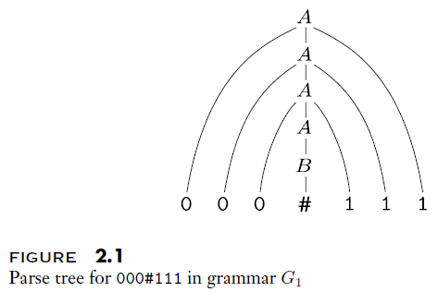
Parse Trees
I am re-pasting the simple CFG called G₁:
  A → 0A1
  A → B
  B → #
A parse tree is a graphical way of showing how a string can be generated by a CFG
The figure to the right shows how the string 000#111 can be generated by G₁
The book displays all terminals at the bottom to make it easier to read the string
However, note that the symbols of the string occur at different depths of the parse tree
This parse tree relates to the following derivation of the string:
  A ⇒ 0A1 ⇒ 00A11 ⇒ 000A111 ⇒ 000B111 ⇒ 000#111

Slide 10
CFG: Interesting Example
Consider the CFG: G₃ = ({S}, {a, b}, R, S) with R containing only one rule:
  S → aSb | SS | ε
Note that the | symbol is not officially part of the definition of CFGs
  This is used as a shorthand when there are multiple rules with the same LHS
  You can think of it as meaning "or"
Also note that the empty string symbol, ε, can appear as the RHS of a rule in a CFG, but it is not considered one of the terminal symbols of the grammar
G₃ can generate strings including: abab, aaabbb, aababb
It cannot generate strings such as: aabbba, baba, aaabb
I find it interesting that we can intuitively understand this language by considering another language we are already familiar with
Instead of the alphabet {a, b}, consider the alphabet {(, )}
Then, this language would consist of all properly nested parentheses

Slide 11
CFG: Arithmetic Example
Consider the CFG: G₄ = (V, Σ, R, <EXPR>), where:
  V = {<EXPR>, <TERM>, <FACTOR>}
  Σ = {a, +, x, (, )}
  R includes the following rules:
    <EXPR> → <EXPR> + <TERM> | <TERM>
    <TERM> → <TERM> x <FACTOR> | <FACTOR>
    <FACTOR> → ( <EXPR> ) | a
  <EXPR> is the start symbol
This allows the generation (or parsing) of strings of a's, added and multiplied together, grouped using the standard precedence rules
The figure on the next slide shows the parse trees for a+axa and (a+a)xa

Slide 12
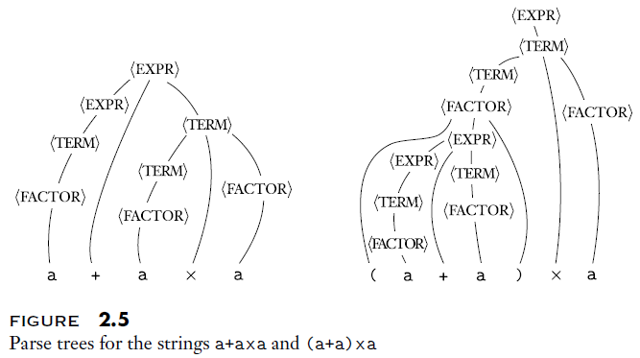
CFG: Arithmetic Parse Trees Example

Slide 13
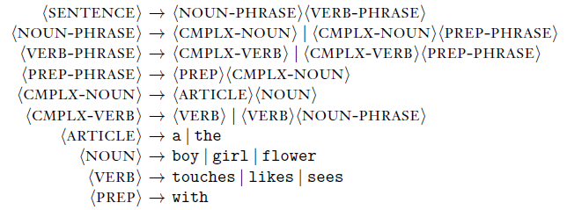

CFG: Natural Language Example
The book defines a CFG, G₂, that they claim "describes a fraction of the English Language"
This is seen at the right, on top
Examples of sentences that G₂ can generate are seen at the right, at the bottom
Some things I want to point out:
  I consider this example somewhat sloppy, which is unusual for the textbook
  They claim that the alphabet consists of lowercase letters and spaces (they call it "the blank symbol")
  They further claim that a space is "placed invisibly after each word"
  However, there is nothing in the grammar that does this!
  Also, in linguistics and NLP, it is common to consider terminals to be words as opposed to characters

Slide 14
CFG: Example with Union
Consider the language: L = {0^{n}1^{n} | n≥0} ∪ {1^{n}0^{n} | n≥0}
Note that the language to the left of the union was one that we proved to be nonregular in our previous topic
The previous CFGs that we just covered are also nonregular (although we won't prove that)
In any case, we can easily represent this with a CFG as follows:
  S₁ → 0S₁1 | ε
Similarly, we can represent the language to the right of the union as follows:
  S₂ → 1S₂0 | ε
Adding one more rule, we can create a CFG to generate L as follows:
  S → S₁ | S₂
  S₁ → 0S₁1 | ε
  S₂ → 1S₂0 | ε

Slide 15
Regular Languages (re-re-revisited)
We have just seen that some nonregular languages can be represented by CFGs
Additionally, all regular languages can be represented by CFGs; the textbook explains this as follows:
  If a language is regular, there is a DFA, M, that recognizes it
  For every state, q_{i}, of M, make a variable (nonterminal) called R_{i} in the CFG
  For the variable, R₀, that corresponds to the start sate, q₀, of M, make R₀ the start variable of the CFG
  For every transition δ(q_{i}, a) = q_{j} in M, add the rule R_{i} → aR_{j} to the CFG
  If q_{i} is an accept state of M, add R_{i} → ε to the CFG
  The book does not step through the proof more formally, but this constructed CFG is guaranteed to generate the same strings that M recognizes
The textbook's explanation is in a subsection called "Designing Context-Free Grammars" giving advice that might help when constructing a CFG for language
Of course, this means that the regular languages form a subset of the context-free languages
I feel like the book should give this proof more emphasis; it is an important fact
In our next topic, we will see another proof that all regular languages are context free

Slide 16
Ambiguity
For some CFGs, there are multiple ways to derive the same strings, leading to different parse trees
Such a CFG is said to be an ambiguous grammar
As an example of an ambiguous CFG, consider this alternative grammar for generating arithmetic expressions, which we will call G₅:
  <EXPR> → <EXPR> + <EXPR> | <EXPR> * <EXPR> | ( <EXPR > ) | a
This CFG generates exactly the same language as one of the previous grammars that we saw, G₄
Although we will not prove it, G₄ is not ambiguous; that is, every valid string has exactly one parse tree
However, with G₅, some strings have ambiguous derivations, leading to different parse trees
The next slide shows two parse trees for the string a+axa using this ambiguous grammar, G₅
  Note that evaluating the expression using the two parse trees leads to two different results
  One of the two parse trees follows the standard precedence rules, but the other does not
In NLP and linguistics, ambiguous parse trees represent different ways to syntactically parse valid sentences, in turn leading to different semantic interpretations of sentences

Slide 17
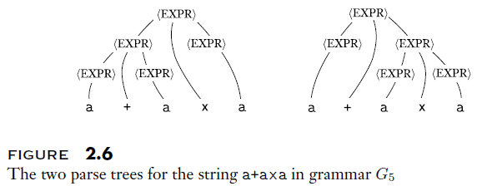
Ambiguity Example

Slide 18
Formal Definition of an Ambiguous CFG
Note that many parse trees can lead to different derivations, because we can place nonterminals in any order that we choose
This does not mean that a grammar is ambiguous
To avoid this confusion, we can replace nonterminals in a fixed order, from left to right
A leftmost derivation is one in which the leftmost remaining variable is the one replaced at every step
With this understanding, we can define ambiguity as follows (Definition 2.7 from the textbook):
  A string w is derived ambiguously in context-free grammar G if it has two or more different leftmost derivations. Grammar G is ambiguous if it generates some string ambiguously.
If there are two or more leftmost derivations of a string, those will lead to different parse trees
Although we will not prove it, some context-free languages are inherently ambiguous, meaning that any CFG generating such languages will be ambiguous

Slide 19
Chomsky Normal Form
Definition 2.8 defines Chomsky normal form as follows (I am using the book's wording exactly here):
  A context-free grammar is in Chomsky normal form if every rule is of the form
    A → BC
    A → a
  Where a is any terminal and A, B, and C are any variables – except that B and C may not be the start variable. In addition, we permit the rule S → ε, where S is the start variable.
Coming from an NLP background, I am used to seeing Chomsky normal form without the extra clauses at the end
  Disallowing the start symbol on the RHS is helpful for certain proofs, and it does not decrease the power of the formalism if the rule S → ε is allowed
  The rule S → ε is only needed in contexts for which the language might contain the empty string (typically not true in NLP and linguistics)
  Of course, this rule should only be added to the grammar if the empty string is a member of the language
Every CFG can be converted to Chomsky normal form
The book proves this fact, which will be useful for a couple of proofs later in the course, by explaining how to do the conversion (explained on the next slide)

Slide 20
Converting a CFG to Chomsky Normal Form
First, add a new start variable, S₀, and a new rule S₀ → S, ensuring that the start variable does not occur on the RHS
Next, all rules of the form A → ε are removed from the grammar, unless A is the new start variable (which might occur during the construction)
Then, for each rule that includes A on the RHS, a new rule is created with A removed
For example, R → uAv would lead to the addition R → uv
Note that we do not remove the rule R → uAv from the grammar, because A can also be on the LHS of other rules
This must take into account various all combinations of A on the RHS; For example, if there is a rule R → uAvAw, we must add the rules R → uvAw, R → uAvw, and R → uvw
Next, all rules of the form A → B are removed
Then, for all rules of the form B → u (where u is a string of terminals and nonterminal), we add a rule of the form A → u (unless such a rule was previously removed)
Next, all rules with 3 or more symbols on the RHS are handled
Consider a rule of the form A → u₁u₂…u_{k}, where k ≥ 3
This would be replaced with rules of the form A → u₁A₁, A₁ → u₂A₂, A₂ → u₃A₃, …, A_{k-2} → u_{k-1}u_{k}
Finally, any terminal u_{i} on the RHS of a rule with multiple symbols is replaced with a new variable, U_{i}, and we add the rule U_{i} → u_{i}
The book steps through a complete example explaining the steps (we'll skip this in class, but I encourage you to step through it)

