Slide 1
ECE467: Natural Language Processing
Semantics

Slide 2
Definition of Semantics
Two definitions of semantics (from dictionary.reference.com):
  "the study of meaning"
  "the meaning, or an interpretation of the meaning, of a word, sign, sentence, etc."
When the meaning of a sentence is captured using formal structures, the result is called a meaning representation
This first part of this topic is largely based on Chapter 19 from the current draft of the textbook, titled "Logical Representations of Sentence Meaning"
Semantics, more generally, also applies to individual words, as well as text sequences involving multiple sentences
The next two slides list some topics related to semantics, a couple of which will be covered later in the topic

Slide 3
Other Topics Related to Semantics (slide 1)
Sematic analysis (a.k.a. semantic parsing)
  This relates to the process of analyzing a sentence (or other unit of text) and assigning its meaning representation
  Chapter 20 of the current draft of the textbook is titled "Computational Semantics and Semantic Parsing", but the chapter has not been filled in yet
  We will not cover this topic
Lexical semantics
  This relates to the meanings of individual words
  The book has a section on this, Section 6.1 titled "Lexical Semantics"
  Chapter 6 in general is titled "Vector Semantics and Embeddings" (we will cover word embeddings as part of the third unit of the course)
  Chapter 23, titled "Word Senses and WordNet", is also relevant
  Also briefly mentioned in a previous topic, WordNet was a very important resource for conventional computational linguistics; WordNet stores all senses of nouns and verbs, as well as relationships between senses of words
  I used to cover lexical semantics as a separate topic, but I no longer cover it in the course
Word sense disambiguation (WSD)
  This relates to computational approaches for determining the correct meaning of a word that can have multiple senses
  The book covers WSD in section 23.4, titled "Word Sense Disambiguation"
  We will not cover this topic

Slide 4
Other Topics Related to Semantics (slide 2)
Semantic roles
  This relates to the thematic roles that words play in a sentence
  Examples of thematic roles include agent, which is the volitional causer of an event; experiencer, the experiencer of an event; force, a non-volitional causer of an event; etc.
  These are different than syntactic roles (e.g., consider sentences written in the active voice vs. passive voice)
  The book covers this in Chapter 24, titled "Semantic role labeling"
  I used to cover this as part of lexical semantics, but I no longer cover it
Coreference resolution
  This refers to the automatic determination of which words or phrases in a sentence refer to the same entities
  The book covers this in Chapter 26, titled "Coreference Resolution"
  We won't cover this in detail, but we will briefly discuss it near the end of our current topic
Discourse
  This relates to the labeling and determination of coherence relations between sentences in a discourse (i.e., a sequence of related sentences)
  The textbook covers this in Chapter 27, titled "Discourse Coherence"
  We won't cover this in detail, but we will briefly discuss it later in our current topic

Slide 5
Meaning Representations
The next slide demonstrates three meaning representations (based on three formalisms) for the sentence "I have a car"
The types of formalisms shown in the figure are:
  First-order logic (FOL), shown at the top of the figure
  Abstract meaning representation (AMR), shown in both graph format (bottom left) and text format (bottom middle)
  Frame-based representations, a.k.a. slot-filler representation (bottom right)
I add: There are several other formalisms for meaning representation that have been attempted in NLP literature; e.g., semantic networks were somewhat popular for a while
Note that each of these representations can be viewed from two perspectives:
  As a representation of the meaning of a particular linguistic input (in this case, "I have a car")
  As a representation of the state of affairs in the world (or some world)
We will focus in first-order logic, as does the book; of the formalisms that have been used for meaning representations, this is the one I am personally the most familiar with

Slide 6
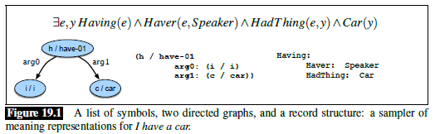
Three Meaning Representations

Slide 7
Intro Example
The book uses examples related to a hypothetical system intended to provide advice to tourists about restaurants
I add: Dealing with restaurant scenarios was common throughout the history of NLP
The first example concerns the question: "Does Maharani serve vegetarian food?"
This involves the proposition: "Maharani serves vegetarian food"
Although we have not yet discussed FOL, we can represent the meaning as: Serves(Maharani, VegetarianFood)
The notion known as verifiability would then concern the system's ability to compare this representation to the known state of affairs in its world
This brings up the notion of a knowledge base in which information about the world is stored
I add: I would refer to this type of knowledge as real-world knowledge; the techniques and formalisms used to store such knowledge constitute the tools for knowledge representation
Storing such real-world knowledge in an efficient and accurate manor is not a solved task

Slide 8
Multiple Ways to Phrase the Question
One reason that semantic analysis (which we will not cover) is complicated is that there are often many possible ways to phrase a sentence that communicates a single meaning
For example:
  "Does Maharani serve vegetarian food?" (the same phrasing as earlier)
  "Does Maharani have vegetarian dishes?"
  "Do they have vegetarian food at Maharini?"
  "Are vegetarian dishes served at Maharini?"
  "Does Maharini serve vegetarian fare?"
I add: It is not always the case that any single word would be present in all ways to express a thought, although "vegetarian" happens to be in all the examples above
Let's assume that the fact that Maharini does (or does not) sever vegetarian food is stored in a knowledge base in only one way (storing every fact in many possible forms is not feasible)
All the questions above must be interpreted in such a way as to match this fact; this is simpler if all of them lead to the same meaning representation
The notion that inputs with the same meaning should have the same meaning representation is known as the doctrine of canonical form

Slide 9
Inference and Variables
Now consider the question, "Can vegetarians eat at Maharini?"
This question does not have the same meaning as the previous questions, even if it is bound to have the same answer; it is a related question
The term inference refers to a system's ability to draw valid conclusions based on the meaning representation of its input and its background knowledge
We'll talk a bit more about inference later in the topic
Now consider: "I'd like to find a restaurant where I can get vegetarian food"
This example brings up the notion of variables; here, the system must find a restaurant, x, such that: Serves(x, VegetarianFood)
We also need to more generally consider the expressiveness of a meaning representation
Ideally, a meaning representation should be "expressive enough to handle a wide range of subject matter, ideally any sensible natural language utterance"
While FOL falls short of this goal, the textbook claims that it "is expressive enough to handle quite a lot of what needs to be represented"
I add: FOL also has several shortcomings, which we will also discuss later in the topic

Slide 10
Models
The non-logical vocabulary of a meaning representation is an "open-ended set of names for the objects, properties, and vocabulary relations that make up the world we’re trying to represent"
The logical vocabulary of a meaning representation is a "closed set of symbols, operators, quantifiers, links, etc., that provide the formal means for composing expressions" in the meaning representation language
A model is "a formal construct that stands for the particular state of affairs in the world" we are trying to represent (the next slide shows an example)
The domain of the model is the set of existing objects in this state of affairs
Objects denote elements from the domain (e.g., people, restaurants, styles of food, etc.)
Properties of objects are denoted by sets of elements of the domain that have the property
  e.g., "red" is the set of all things we think of as red
  e.g., "noisy" is the set of all things that are noisy
Relations among objects are denoted by sets of ordered lists, or tuples, of domain elements that take part the relation
  e.g., "Married" is the set of pairs of domain elements that are married
  e.g., if a tuple <a, b> is a member of the relation "Likes", it means that a likes b
An interpretation maps expressions in the meaning representation language to elements of the model

Slide 11
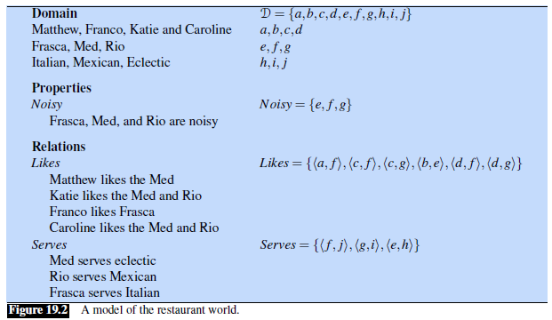
Model Example

Slide 12
Evaluating Sentences
Sentences can be evaluated with respect to a model
For example, evaluating "Matthew Likes Frasca" adds the tuple <a, e> to the set of tuples representing the Likes relation
Some sentences are harder to evaluate; for example:
  "Katie likes the Rio and Matthew likes the Med."
  "Katie and Caroline like the same restaurants."
  "Franco likes noisy, expensive restaurants."
  "Not everybody likes Frasca."
The book discusses the first example, which adds two tuples to the set denoted by the Likes relation "if we assume the simplest possible semantics for the English word and"
I add: Clearly, this is the simplest of these four examples
I further add: What if "and" is changed to "or" in that example? What about the other examples? It is not clear how to handle such cases

Slide 13
Constructs within First-Order Logic
The next slide shows a CFG specification of the syntax of FOL representations
Some things to point out are:
  The book does not make it clear, but the start symbol of this CFG specification is "Formula"; you can roughly think of a formula as a sentence expressed using FOL
  A term is the FOL device for representing objects; terms include constants (e.g., Maharani), variables, and functions
  Variables, typically depicted as single lower-case letters, allow us to draw inferences about objects without having to make reference to any particular named object
  Example of a variable (unquantified): Serves(x, VegetarianFood)
  Functions provide a way to refer to specific objects that don't have an associated named constant
  Example of a function: LocationOf(Frasca)
  Predicates can refer to relations that hold among some fixed number of objects in a given domain, or they can be used to express properties of objects
  A predicate expressing a relation: Serves(Maharani, VegetarianFood)
  A predicate expressing a property: Restaurant(Maharini)
  Note that functions share the same syntax as predicates, but functions are used to express a term
  Composite representations can be expressed with logical connectives; e.g., "I have five dollars and I don't have a lot of time" can be represented as: Have(Speaker, FiveDollars) ^ ¬Have(Speaker, LotOfTime)

Slide 14
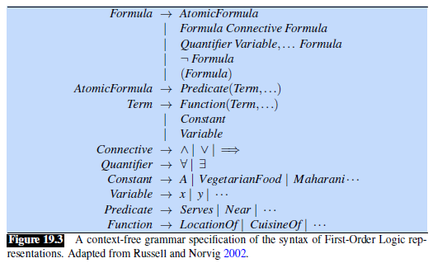
Syntax Rules for FOL

Slide 15
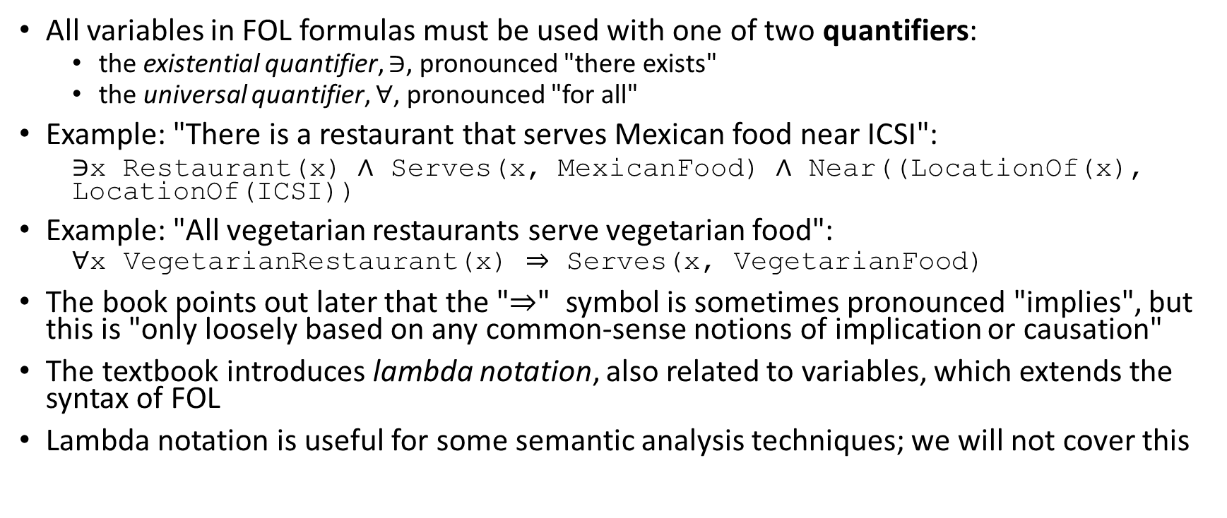
Quantifiers
All variables in FOL formulas must be used with one of two quantifiers:
  the existential quantifier, $∋$, pronounced "there exists"
  the universal quantifier, $∀$, pronounced "for all"
Example: "There is a restaurant that serves Mexican food near ICSI":
  ∋x Restaurant(x) ∧ Serves(x, MexicanFood) ∧ Near((LocationOf(x), LocationOf(ICSI))
Example: "All vegetarian restaurants serve vegetarian food":
  $$\text{∀}\text{x} \text{VegetarianRestaurant}\text{(}\text{x}\text{) ⇒ }\text{Serves}\text{(}\text{x}\text{, }\text{VegetarianFood}\text{)}$$
The book points out later that the "⇒" symbol is sometimes pronounced "implies", but this is "only loosely based on any common-sense notions of implication or causation"
The textbook introduces lambda notation, also related to variables, which extends the syntax of FOL
Lambda notation is useful for some semantic analysis techniques; we will not cover this

Slide 16
Modus Ponens
One of the most important criteria for a meaning representation language is that it should support inference
The most widely implemented inference method provided by FOL is known as modus ponens, which supports deduction; informally, we can think of this as if-then reasoning
We can abstractly define modus ponens as follows, where α and β are FOL formulas:
  α
  α ⇒ β
  ______
  β
This indicates that the formula below the line can be inferred from the formulas above the line by some form of inference
One possible application of this rule would be:
  VegetarianRestaurant(Leaf)
  ∀x VegetarianRestaurant(x) ⇒ Serves(x, VegetarianFood)
  _____________________________________________________
  Serves(Leaf, VegetarianFood)

Slide 17
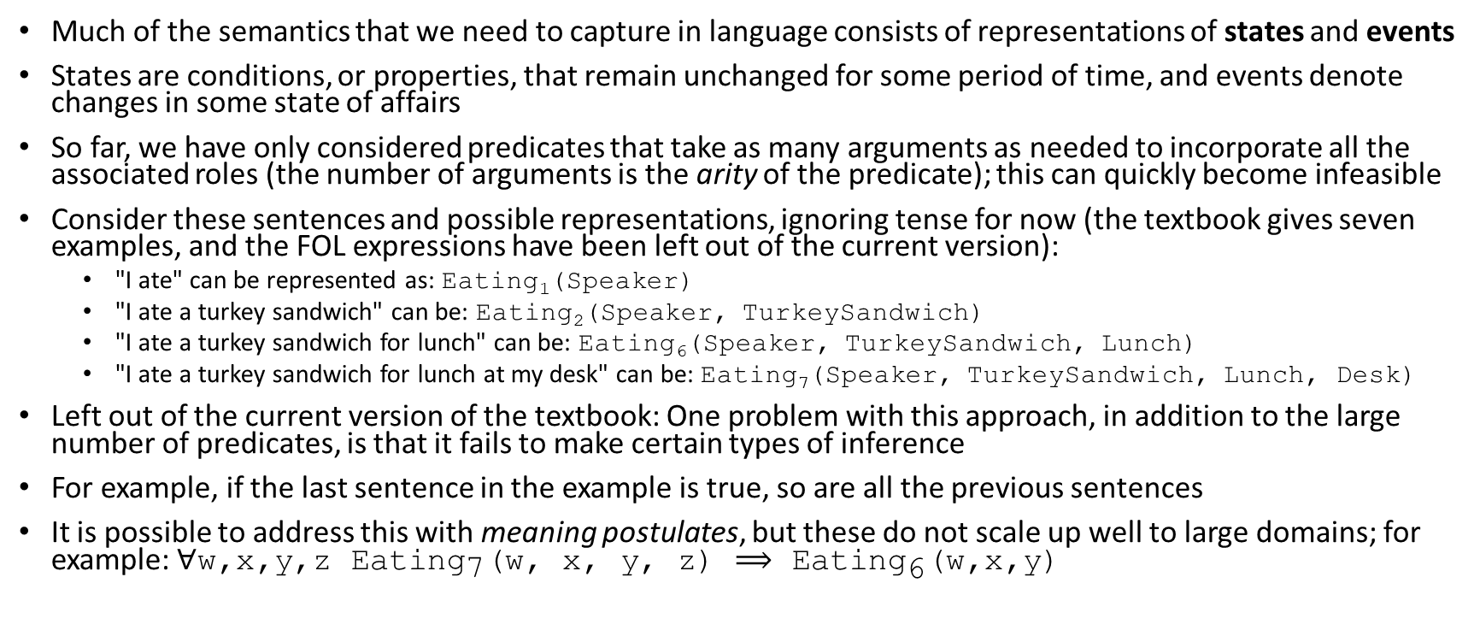
States and Events
Much of the semantics that we need to capture in language consists of representations of states and events
States are conditions, or properties, that remain unchanged for some period of time, and events denote changes in some state of affairs
So far, we have only considered predicates that take as many arguments as needed to incorporate all the associated roles (the number of arguments is the arity of the predicate); this can quickly become infeasible
Consider these sentences and possible representations, ignoring tense for now (the textbook gives seven examples, and the FOL expressions have been left out of the current version):
  "I ate" can be represented as: Eating₁(Speaker)
  "I ate a turkey sandwich" can be: Eating₂(Speaker, TurkeySandwich)
  "I ate a turkey sandwich for lunch" can be: Eating₆(Speaker, TurkeySandwich, Lunch)
  "I ate a turkey sandwich for lunch at my desk" can be: Eating₇(Speaker, TurkeySandwich, Lunch, Desk)
Left out of the current version of the textbook: One problem with this approach, in addition to the large number of predicates, is that it fails to make certain types of inference
For example, if the last sentence in the example is true, so are all the previous sentences
It is possible to address this with meaning postulates, but these do not scale up well to large domains; for example: $\text{∀}\text{w}\text{,}\text{x}\text{,}\text{y}\text{,}\text{z} {\text{Eating}}_{\text{7}}\text{(}\text{w}\text{, }\text{x}\text{, }\text{y}\text{, }\text{z}\text{) ⟹}{ \text{Eating}}_{\text{6}}\text{(}\text{w}\text{,}\text{x}\text{,}\text{y}\text{)}$

Slide 18
Event Variables
A more general problem with having multiple predicates for the same concept with different arities is that it is not scalable
This can be solved with event variables
We will briefly consider neo-Davidsonian event representations
This type of event representation was named after the philosopher Donald Davidson, who introduced the notion of event variables
Example:
  ∋e Eating (e) ⋀ Eater(e, Speaker) ⋀ Eaten(e, TurkeySandwich) ⋀ Meal(e, Lunch) ⋀ Location(e, Desk) ⋀ Day(e, Tuesday)
Note that a single event variable is shared by all the predicates, each of which adds a piece of information about the event
Instead of fixing the number of arguments for a predicate, "as many roles and fillers can be glued on as are provided in the input"

Slide 19
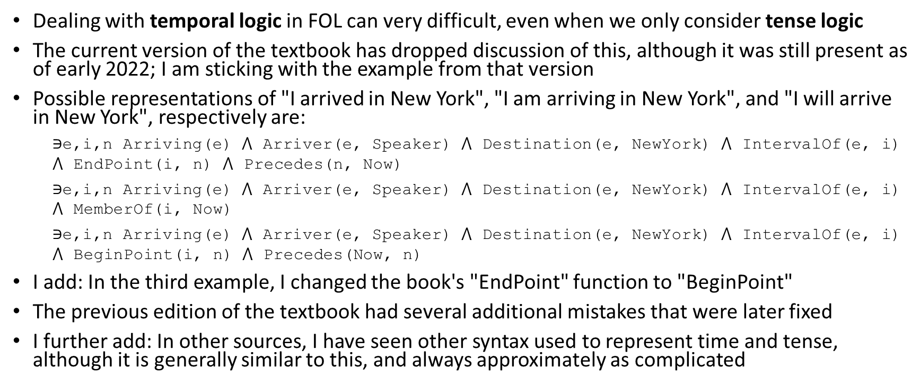
Tense Logic
Dealing with temporal logic in FOL can very difficult, even when we only consider tense logic
The current version of the textbook has dropped discussion of this, although it was still present as of early 2022; I am sticking with the example from that version
Possible representations of "I arrived in New York", "I am arriving in New York", and "I will arrive in New York", respectively are:
  $\text{∋}\text{e}\text{,}\text{i}\text{,}\text{n} \text{Arriving}\text{(}\text{e}\text{)}$ $\text{⋀}$ Arriver(e, Speaker) $\text{⋀}$ Destination(e, NewYork) $\text{⋀}$ IntervalOf(e, i) $\text{⋀}$ EndPoint(i, n) $\text{⋀ }\text{Precedes}\text{(}\text{n}\text{, }\text{Now}\text{)}$
  $\text{∋}\text{e}\text{,}\text{i}\text{,}\text{n} \text{Arriving}\text{(}\text{e}\text{)}$ $\text{⋀}$ Arriver(e, Speaker) $\text{⋀}$ Destination(e, NewYork) $\text{⋀}$ IntervalOf(e, i) $\text{⋀}$ MemberOf(i, Now)
  $\text{∋}\text{e}\text{,}\text{i}\text{,}\text{n} \text{Arriving}\text{(}\text{e}\text{)}$ $\text{⋀}$ Arriver(e, Speaker) $\text{⋀}$ Destination(e, NewYork) $\text{⋀}$ IntervalOf(e, i) $\text{⋀}$ BeginPoint(i, n) $\text{⋀ }\text{Precedes}\text{(}\text{Now}\text{, }\text{n}\text{)}$
I add: In the third example, I changed the book's "EndPoint" function to "BeginPoint"
The previous edition of the textbook had several additional mistakes that were later fixed
I further add: In other sources, I have seen other syntax used to represent time and tense, although it is generally similar to this, and always approximately as complicated

Slide 20
More General Temporal Logic
Earlier versions of the textbook pointed out that more general reference points are needed to handle sentences that specify orderings of events other than just tense
Difficult examples from the ATIS corpus include:
  "Ok, we fly from San Francisco to Boston at 10."
  "Flight 1390 will be at the gate an hour now."
  "Flight 1902 arrived late."
  "Flight 1902 had arrived late."
  "When Mary's flight departed, I ate lunch."
  "When Mary's flight departed, I had eaten lunch."
  "I'd like to go at 6:45, in the morning."
  "Somewhere around noon, please."
The book did not show FOL expressions to handle any of these examples; they claimed that a more complex meaning representation language might be needed for some of them
The textbook mentioned that handling temporal expressions like these is important for information extraction; I used to cover information extraction as a separate topic, but I no longer cover it
The textbook used to discuss aspect, which distinguishes events that occur in a moment from events that span an interval of time (there are also other factors); I used to briefly discuss aspect, but I no longer cover it

Slide 21
Problems with FOL
The previous edition of the textbook summarized some alternative approaches to FOL (the current edition discusses description logics, which was are skipping), starting with the following quote:
  "The notion that the translation of linguistic expressions into formal representations made up of discrete symbols adequately captures the notion of meaning is subject to considerable debate."
Neither the previous edition, nor the current edition, of the textbook addresses the shortcomings of FOL
I am going to list here what I consider to be a few of the most significant problems:
  The notation can get very unwieldy
  Semantic parsing is very difficult
  There is no way to handle uncertainty
  I am skeptical that humans processing sentences create an underlying representation similar to FOL
  Symbols are being defined only in terms of other symbols
Related to the last point, let's look back at one of the FOL formulas from earlier:
  ∋e Eating (e) ⋀ Eater(e, Speaker) ⋀ Eaten(e, TurkeySandwich) ⋀ Meal(e, Lunch) ⋀ Location(e, Desk) ⋀ Day(e, Tuesday)
This makes sense to us because we know, based on experience, what it means to be eating, and we understand the concepts of location and time, and even the concept of a turkey sandwich
We can picture a turkey sandwich, and imagine what the it tastes like; we can imagine the qualia

Slide 22
Discourse, Coreference, and Coherence
Discourse refers to text sequences involving multiple sentences
Processing a discourse involves pragmatics, which is the study of meaning given context
One issue that makes interpreting discourse difficult is coreference, meaning that an entity can be referred to in different ways at different locations in a text
Coreference resolution is the automatic determination of which words or phrases in a sentence refer to the same entities
Coreference also occurs within sentences, but it is generally more difficult across sentences
Another issue that makes interpreting discourse difficult is coherence, which refers to how various sentences in a discourse relate to one another
The current version of the textbook covers discourse, in general, including coherence, in Chapter 27, titled "Discourse Coherence"
Coreference resolution is covered in Chapter 26, titled, "Coreference Resolution"
In our discussion of discourse, we will consider coherence first, and then consider coreference resolution (we will cover both topics somewhat briefly)

Slide 23
Coherence
As mentioned, coherence refers to how various sentences (or more generally, clauses) in a discourse relate to one another
This is more difficult when dealing with dialogues, involving multiple speakers, because there are more types of speech acts
Types of speech acts include statements of fact, questions, answers, requests, promises, commands, declarations, etc.
The current version of the textbook discusses speech acts in Chapter 15, titled "Chatbots & Dialogue Systems", but we will not discuss this further in this topic
We will consider only monologues, involving a single speaker
Processing monologues can be useful for applications including information extraction, essay grading, summarization, etc.
The first step in interpreting discourse (and in particular, monologues) is called discourse segmentation, which involves separating a document into a linear sequence of subtopics
There were various conventional approaches for this; the current edition of the textbook seems to have dropped discussion of this, and we will not cover it

Slide 24
Coherence Examples
All examples of coherence and coherence relations (not just on this slide) come from the previous edition of the textbook
I add: Some of the examples also appear in the current edition, but in general, I found the previous edition to be clearer on this topic
Consider the following short discourses:
  "John hid Bill's car keys. He was drunk."
  "John hid Bill's car keys. He likes spinach."
In the first example, the second sentence provides an Explanation, Cause, or Reason for the first sentence
Explanation is an example of a coherence relation
In the second example, there is no clear link (but I would claim you can contrive a context in which there would be one)

Slide 25
Coherence Relations
We have already seen an example of a coherence relation called Explanation
Here are examples of other types of coherence relations:
  Result: "The Tin Woodman was caught in the rain. His joints rusted."
  Parallel: "The Scarecrow wanted some brains. The Tin Woodman wanted a heart."
  Elaboration: "Dorothy was from Kansas. She lived in the midst of the great Kansas Prairies."
  Occasion: "Dorothy picked up the oil-can. She oiled the Tin Woodman's joints."
The Occasion relation occurs when the first sentence implies a change of state that is a necessary precondition of the second sentence
Sources will generally differ on the types and exact definitions of coherence relations
Coherence relations do not always simply relate sequential sentences to each other
The next slide shows an example of a discourse from the previous edition of the textbook
The slide after that graphically indicates the discourse structure of the same passage of text; each node in the tree represents a group of locally coherent sentences or clauses

Slide 26
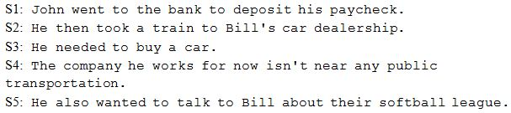
More Complex Example (multiple sentences)

Slide 27
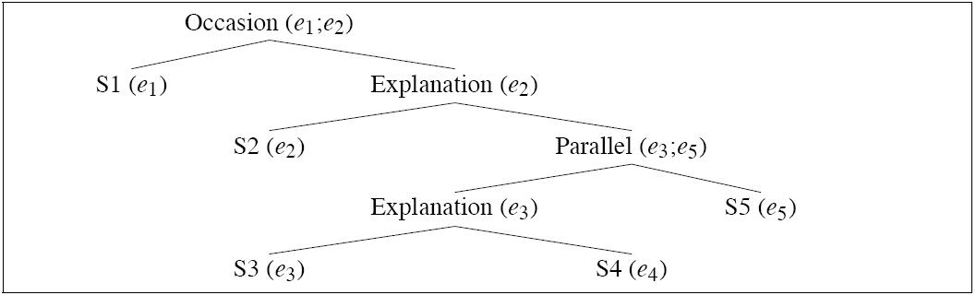
More Complex Example (discourse structure)

Slide 28
Rhetorical Structure Theory
Rhetorical structure theory (RST) is a theory that defines 23 coherence relations
RST classifies each clause as either:
  A nucleus (a central unit to the discourse that is interpretable independently)
  A satellite (a less central unit, only interpretable with respect to a nucleus)
Many of the RST rhetorical relations relate a satellite to a nucleus (e.g., Elaboration, Attribution, Background)
Some relate two nuclei (e.g., List, Contrast)
Automatically determining coherence relations is difficult; we are not going to cover this

Slide 29
Coreference Resolution
Reference resolution is the task of determining what entities (referents) are referred to by which expressions (referring expressions, or mentions)
Coreference resolution is the task of finding all referring expressions in a text that refer to the same entity
Reference to an entity that has been previously introduced into the discourse is called anaphora
The referring expression is called an anaphor, and the earlier term is called an antecedent
Pronominal anaphora resolution is the task of finding the antecedent for a single pronoun
Sometimes, pronouns refer to a term that is introduced after the pronoun
  In that case, the later term that the pronoun refers to is called a postcedent
  Some sources still refer to this as anaphora, others refer to it as cataphora

Slide 30
Coreference Examples
Here is an example from the previous edition of the textbook (there is a similar example in the current edition) in which all the underlined words or phrases corefer to the same person:
  "Victoria Chen, Chief Financial Officer of Megabucks Banking Corp since 2004, saw her pay jump 20%, to $1.3 million, as the 37-year-old also became the Denver-based financial-service company's president. It has been ten years since she came to Megabucks from rival Lotsabucks."
Here is another example from the previous edition of the textbook with three sets of coreferring expressions:
  "The Tin Woodman went to the Emerald City to see the Wizard of Oz and ask for a heart. After he asked for it, the Woodman waited for the Wizard's response."
Note that in the first example, the word "it" was used in a context in which there was no antecedent, and that instance of "it" did not really refer to anything
Also note that sometimes words can refer to things that are not entities; for example, in "But that turned out to be a lie" (given a proper context), the referent of "that" is a speech act
The current version of the textbook mentions some conventional methods for coreference resolution, and it also discusses a deep learning approach; we will not cover this

Slide 31
Pronominal Anaphora Resolution
Reference resolution applied specifically to pronouns is called pronominal anaphora resolution
Consider this example from the textbook (discussed in both the current and previous editions):
  (26.40) "John telephoned Bill. He lost the laptop."
  (26.41) "John criticized Bill. He lost the laptop."
Discussing this example, the textbook argues:
  "These examples differ only in the verb used in the first sentence, yet “he” in (26.40) is typically resolved to John, whereas “he” in (26.41) is resolved to Bill. This may be partly due to the link between implicit causality and saliency: the implicit cause of a “criticizing” event is its object, whereas the implicit cause of a “telephoning” event is its subject. In such verbs, the entity which is the implicit cause may be more salient."
I do not completely buy this argument; consider my sentences:
  "John telephoned Bill. He answered the phone."
  "John criticized Bill. He was quite angry."
I believe that truly solving reference resolution would require reliance on real-world knowledge, a.k.a. commonsense knowledge
Although most of the NLP community ignores this, we will see this is sometimes acknowledged specifically when it comes to this task of pronominal anaphora resolution

Slide 32
Winograd Schemas
Terry Winograd is a famous figure from the history of AI and NLP
Winograd has noted the importance of real-world knowledge and commonsense reasoning for pronominal anaphora resolution
Winograd schemas involve examples of anaphora resolution that are simple for humans but difficult for computers
Winograd schemas include two sentences with an ambiguous pronoun and two possible antecedents; the two sentences differ by one word (or sometimes a short phrase)
The differing word changes what antecedent is referred to by the pronoun in question
The textbook discusses this famous example attributed to Winograd from 1972:
  "The city council denied the demonstrators a permit because they feared violence."
  "The city council denied the demonstrators a permit because they advocated violence."
A human can easily figure out who "they" refers to easily in both cases, but it is generally recognized that doing so requires real-world knowledge or sophisticated reasoning

Slide 33
Real-World Knowledge
Here is an example of a Winograd schema created by me:
  "One customer called the waiter to the table. He asked for their check."
  "One customer called the waiter to the table. He asked for their order."
The example, obviously related to restaurants, brings to mind Roger Schank's notions of scripts, introduced in 1977
Each script represents a typical scenario for a common type of event
The most famous is the restaurant script; every trip to a restaurant includes entering the restaurant, being seated, reading menus, ordering food, eating, paying, leaving the restaurant, etc.
Of course, obtaining a representation of all commonly known real-world knowledge would be a daunting task
You would need to collect, store, and be able to efficiently retrieve the information
Cyc, in development since 1984 and currently maintained by Cycorp, is an attempt to represent all commonsense knowledge in a single database
According to their website, Cyc currently contains "more than 40,000 predicates, millions of collections and concepts, and more than 25 million axioms"
Although interesting and ambitious, I don't think that Cyc has been particularly influential in NLP

