Slide 1
ECE467: Natural Language Processing
Recurrent Neural Networks and LSTMs

Slide 2
Simple RNN
This topic is partly based on Sections 9.1 – 9.6 of the current draft of the textbook
Some of the content in this topic come from an earlier draft of the current edition of the textbook
In a previous topic, we discussed feedforward neural networks, which are neural networks (NNs) that do not contain any cycles; they are usually organized into layers
A recurrent neural network (RNN) "is any network that contains a cycle within its network connections"
We will start by covering simple recurrent networks, a.k.a. Elman networks or vanilla RNNs
A simple RNN has a single hidden layer, with outputs that lead back to its own inputs; the book calls this a recurrent link
The next slide shows a diagram of a simple RNN
As with feedforward neural networks, layers can be implemented as vectors, and weights between layers can be implemented as matrices
The recurrent link can also be implemented as a matrix

Slide 3
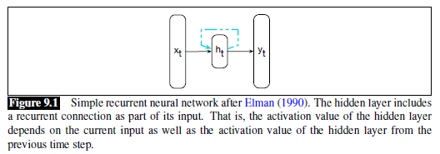
Simple RNN: Diagram

Slide 4
Simple RNN: Single Time Step
The figure on the next slide shows what happens at a single time, or step, of the RNN as it is processing input sequentially
The caption says that the recurrent neural network is being "illustrated as a feedforward network", but I don't think of it that way
Note that h_{t-1} and h_{t} refer to the same layer, but at different times or steps
Not all RNNs include an output node for every time step
Those that do can be used for sequence labeling
An example of sequence labelling in NLP is part-of-speech (POS) tagging
We covered conventional methods for this in an earlier topic
We'll discuss how a simple RNN can be for POS tagging later in this topic

Slide 5
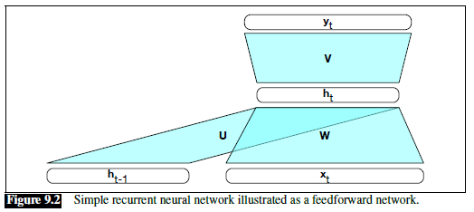
Simple RNN: Single Time Step Diagram

Slide 6
Simple RNN: Equations
The equations describing what happens at each time step are:
  h_{t} = g(Uh_{t-1} + Wx_{t})
  y_{t} = f(Vh_{t})
We can initialize h₀ to be a vector of 0s, and start the indexing of actual steps at 1
The activation function at the hidden layer is g; this might be a sigmoid function or a tanh function, for example
If the output layer is assumed to be a softmax layer, we can write:
  y_{t} = softmax(Vh_{t})
In some sources, you will see additional terms in the parentheses, representing bias weights; for example:
  h_{t} = g(Uh_{t-1} + Wx_{t} + b_{h})
  y_{t} = f(Vh_{t} + b_{y})

Slide 7
Simple RNN: Unrolling an RNN
It is common to depict an RNN as unrolled
Basically, each time step (for some fixed number of time steps) is drawn separately
Each instance of the hidden layer and output layer for each of the depicted time steps is drawn separately
The next slide shows a diagram of an unrolled RNN; some things to point out are:
  Depicting the unrolled RNN on a slant like this is not something I've seen in other sources
  The number of depicted time steps shown in the unrolled network is arbitrary; when a simple RNN is applied to input, it keeps taking inputs until there are no more
  The values at the hidden layers and output nodes are changing, but the U, W, and V matrices are not (they change during training, but not during forward propagation)
Such a diagram helps intuit how forward inference in an RNN proceeds

Slide 8
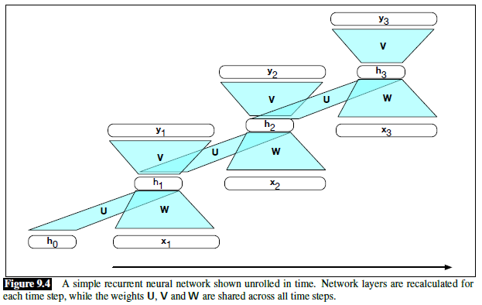
Simple RNN: Unrolled

Slide 9
Simple RNN: Forward Inference
Forward inference, also called forward propagation, in an RNN proceeds much like with a feedforward neural network
The values of hidden nodes and the output nodes change at each time step
The values of the weights (often implemented as matrices) do not
That is, the same weights are reused at each time step
Of course, when we train an RNN, the weights will change (but we haven’t talked about how to do that yet)
The figure on the next slide shows pseudo-code for forward inference with a simple RNN

Slide 10
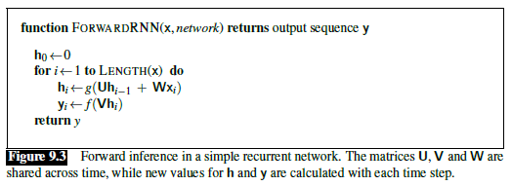
Simple RNN: Forward Inference Pseudo-code

Slide 11
Simple RNN: Training
As with feedforward neural networks, we can train a simple RNN using stochastic gradient descent (SGD) and backpropagation
Also, as with feedforward neural networks, we need a training set, and we need to define a loss function
We now have three sets of weights to update:
  W represents the weights between the input layer and the hidden layer
  V represents the weights between the hidden layer and the output layer
  U represents the weights from the output of the hidden layer (at one time step) to the input of the hidden layer (at the next time step)
  Some formulations will also include bias weights, which also need to be updated
The current draft of the textbook drops most of the discussion of training RNNs, but we will still discuss it in some detail
The figure on the next slide, from an earlier draft of the textbook (from October 16, 2019), helps to visualize this
More generally, much of the information we discuss related to training RNNs over the next several slides has based on that earlier draft

Slide 12
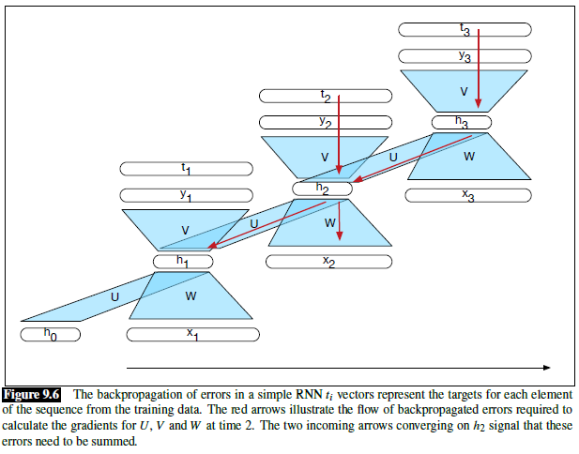
Simple RNN: Backprop (from earlier draft)

Slide 13
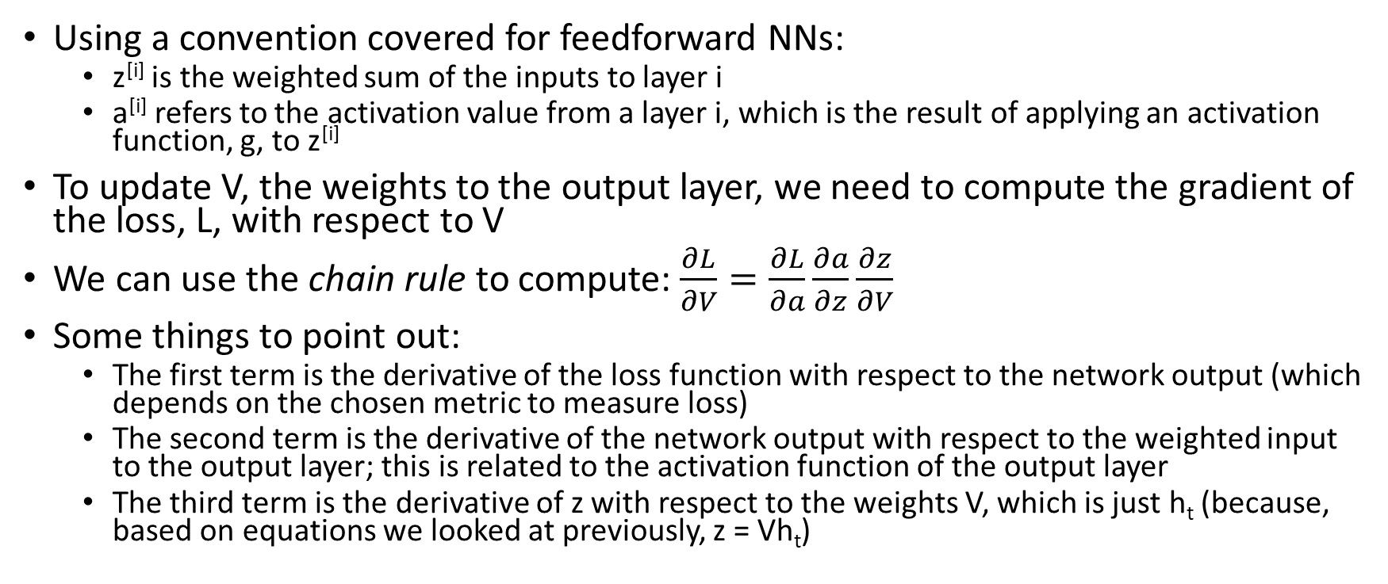
Simple RNN: Updating V
Using a convention covered for feedforward NNs:
  z^{[i]} is the weighted sum of the inputs to layer i
  a^{[i]} refers to the activation value from a layer i, which is the result of applying an activation function, g, to z^{[i]}
To update V, the weights to the output layer, we need to compute the gradient of the loss, L, with respect to V
We can use the chain rule to compute: $\frac{∂L}{∂V}=\frac{∂L}{∂a}\frac{∂a}{∂z}\frac{∂z}{∂V}$
Some things to point out:
  The first term is the derivative of the loss function with respect to the network output (which depends on the chosen metric to measure loss)
  The second term is the derivative of the network output with respect to the weighted input to the output layer; this is related to the activation function of the output layer
  The third term is the derivative of z with respect to the weights V, which is just h_{t} (because, based on equations we looked at previously, z = Vh_{t})

Slide 14
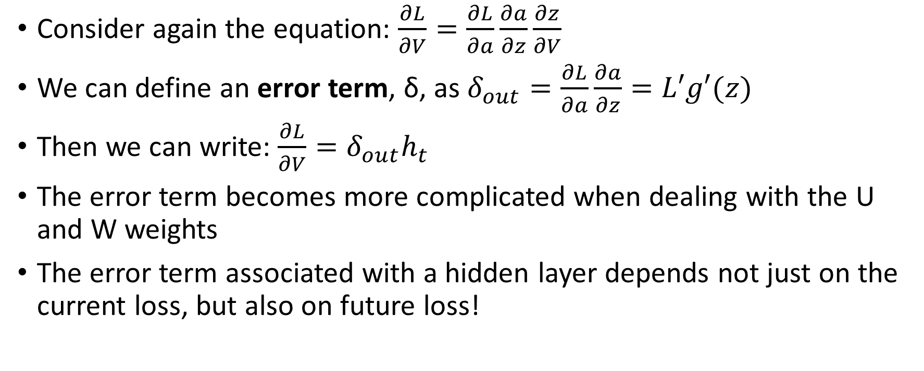
Simple RNN: Error terms
Consider again the equation: $\frac{∂L}{∂V}=\frac{∂L}{∂a}\frac{∂a}{∂z}\frac{∂z}{∂V}$
We can define an error term, δ, as $δ_{out}=\frac{∂L}{∂a}\frac{∂a}{∂z}=L′g′(z)$
Then we can write: $\frac{∂L}{∂V}=δ_{out}h_{t}$
The error term becomes more complicated when dealing with the U and W weights
The error term associated with a hidden layer depends not just on the current loss, but also on future loss!

Slide 15
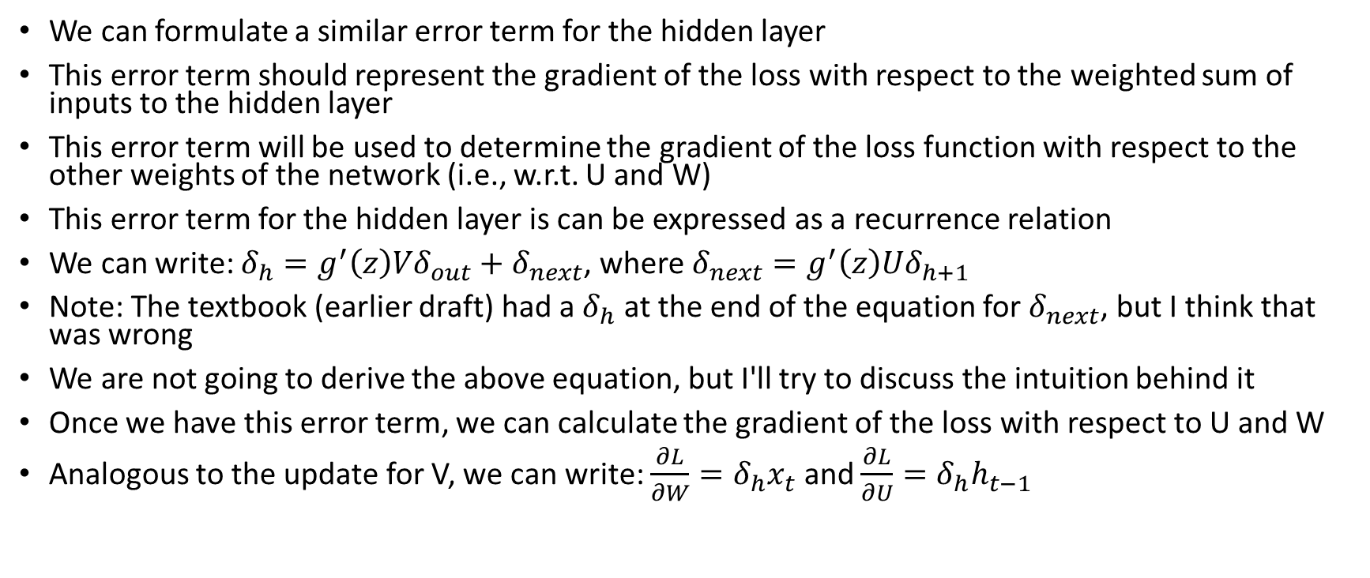
Simple RNN: Gradient of L w.r.t. W and U
We can formulate a similar error term for the hidden layer
This error term should represent the gradient of the loss with respect to the weighted sum of inputs to the hidden layer
This error term will be used to determine the gradient of the loss function with respect to the other weights of the network (i.e., w.r.t. U and W)
This error term for the hidden layer is can be expressed as a recurrence relation
We can write: $δ_{h}=g^{′}\left(z\right)Vδ_{out}+δ_{next}$, where $δ_{next}=g^{′}\left(z\right)Uδ_{h+1}$
Note: The textbook (earlier draft) had a $δ_{h}$ at the end of the equation for $δ_{next}$, but I think that was wrong
We are not going to derive the above equation, but I'll try to discuss the intuition behind it
Once we have this error term, we can calculate the gradient of the loss with respect to U and W
Analogous to the update for V, we can write: $\frac{∂L}{∂W}=δ_{h}x_{t}$ and $\frac{∂L}{∂U}=δ_{h}h_{t−1}$

Slide 16
Simple RNN: Two-pass Weight Training
The book talks about a "two-pass algorithm for training weights in RNNs"
  First, we perform forward inference, computing all the h and y values at every time step
  Second, we "process the sequence in reverse", computing the required error terms and gradients
The book does not specify when weights are actually updated
My understanding is that the gradients during the backward pass are accumulated, and the sum is used to adjust the weights
This type of training process is sometimes called backpropagation through time

Slide 17
Simple RNN: Language Model
Simple RNNs can be used as recurrent neural language models
The previous hidden state and the current word are used to calculate the current hidden state
The current hidden state is fed to a softmax layer, which creates a probability distribution used to predict the next word
As with other language models (e.g., N-grams or feedforward NNs), we combine probabilities to evaluate the model
In practice, log probabilities or perplexity are used
Unlike the previous language models we considered, RNNs are not limited to a fixed number of prior words when predicting the next word
That is, all the words in the sequence so far can affect the prediction of the next word, in theory
The diagram on the next slide helps to explain how to train a simple RNN to behave as a language model, assuming that we are using a cross-entropy loss function

Slide 18
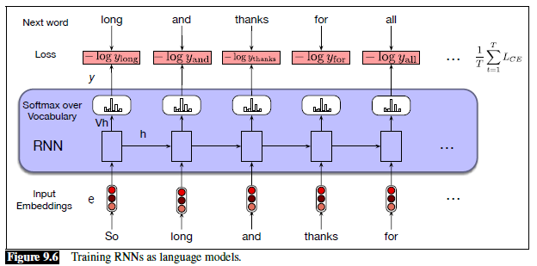
Simple RNN: Training a Language Model

Slide 19
Simple RNN: Autoregressive Generation
A related task is autoregressive generation, which automatically generates random text
In a previous topic, we saw the results of using N-grams for this type of natural language generation, when trained on Shakespeare or the Wall Street Journal
Once a simple RNN is trained as a language model, we can apply the RNN to generate random text; the probabilities of each possible next word are used to randomly choose a word
The diagram on the next slide shows how to apply the simple RNN for autoregressive generation; some things to point out are:
  The inputs are pre-trained word embeddings
  The <s> is a beginning of sentence marker, which has its own embedding
  The hidden state can be interpreted as being a semantic representation of all content that has been processed so far
  The output of the softmax is not used to predict the most likely word, but rather as a probability distribution from which to sample the next word
  The processing ends either after a fixed number of tokens, or when an end of sentence marker, </s>, is produced
Earlier drafts of the book referred autoregressive generation as an "entertaining exercise"
However, as recognized in the current draft, this sort of generation is crucial to applications, such as machine translation, summarization, question answering, and modern chat engines
We will cover some of these applications later in the course

Slide 20
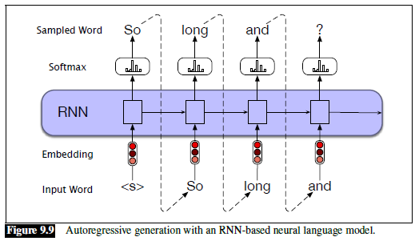
Simple RNN: Autoregressive Generation

Slide 21
Simple RNN: Sequence labelling
Sequence labeling refers to any task that involves categorizing every item in a sequence
One example is part-of-speech (POS) tagging
Conventional approaches for POS tagging include hidden Markov models (HMMs) and maximum entropy Markov models
We covered the use of HMMs for POS tagging during our unit on conventional statistical NLP
The figure on the next slide shows how a simple RNN could be applied to POS tagging
The textbook does not address how well a simple RNN would perform for POS tagging
State-of-the-art POS tagging uses more complex variations of RNNs (we will cover those later in the topic) or transformers (we will cover that during a future topic)

Slide 22
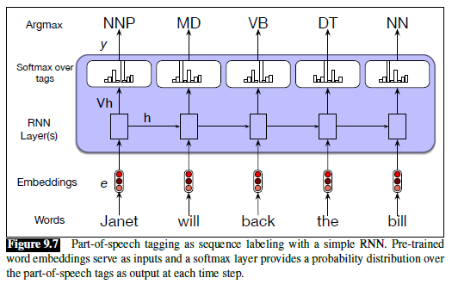
Simple RNN: POS tagging

Slide 23

Simple RNN: Named Entity Recognition
Another important sequence labelling task in NLP is named entity recognition (NER)
NER involves detecting spans of text representing names of people, places, organization, etc.
It can also include additional concepts such as times and dates, or domain-specific entities such as diseases, symptoms, medications, etc.
NER is often the first phase of an information extraction (IE) system
NER system are typically trained using supervised machine learning
Words in the training set are labeled with IOB tags (a.k.a. BIO tags)
  The B stands for "begin", and tokens labeled B begin the name of a named entity
  I stands for "inside", and tokens labeled I continue the named of a named entity
  O stands for "outside", and tokens labeled O are not part of a named entity
Here is an example of labeled text that may be part of the training data (from an earlier draft):

Slide 24
Simple RNN: Conditional Random Fields
An RNN used for POS tagging or NER (the architectures are basically identical) make each prediction independently
Recall that when an HMM is used for POS tagging, the Viterbi algorithm is used to predict the optimal sequence
When a simple RNN, as discussed so far, is used for NER, it is not even guaranteed to output a logically valid sequence of IOB tags
This can be improved using conditional random fields (CRFs); we are not going to cover this in detail
Basically, instead of predicting a single tag (POS or IOB) for each token, the RNN predicts tag transition probabilities
This can be followed by a separate algorithm, such as Viterbi, to determine the most likely sequence of tags
CRFs can also be used separately from RNNs, and the current draft of the textbook covers CRFs for POS or NER in a different chapter (in Section 8.5)
We will not cover CRFs further in this course

Slide 25
Simple RNN: Text Categorization
Simple RNNs can be applied for text categorization; the textbook calls this sequence classification
  As with previous tasks, state-of-the-art results involve variations of RNNs that we haven’t discussed yet
  RNNs, in general, have mostly been successful for the categorization of short sequences of text, such as tweets or individual sentences, but they can also be applied to longer documents
  Of course, we covered conventional methods of text categorization during our first unit of the course
When an RNN is applied for text categorization, a common approach is to have the final hidden state become the input to a feedforward neural network
The figure on the next slide demonstrates how a simple RNN can be applied to text categorization
  The inputs are presumably word embeddings, probably pre-trained
  Within the purple box, N hidden states are being computed, one for each word in the sequence
  It is common to think of the final hidden state, which is the input to the feedforward neural network, as representing the meaning of the text
Earlier drafts of textbook referred to this example as "our first example of a deep neural network"
Most sources refer to RNNs as deep, in general, since the error is backpropagated through all the time steps
This is still the first place where the book uses the phrase end-to-end training, which means that all parts of the system are trained at once, based on training examples

Slide 26
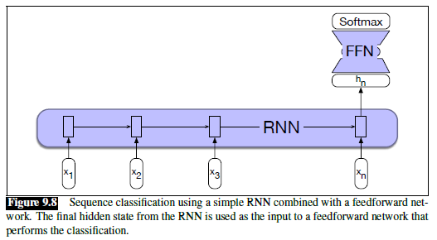
Simple RNN: TC Example Network

Slide 27
Stacked RNNs
A stacked RNN uses the hidden states produced by one RNN as the inputs to the next
We can then refer to each RNN as a layer
The final RNN in the stack produces the final outputs for the stack
That is, the hidden states of the top layer can be used as outputs of the stack, perhaps sent as input to another type of layer, such as a softmax layer
The next slide shows a diagram of a stacked RNN
The slide after that shows basically the same diagram from an earlier draft; note that it is common to leave out the internal structure of a common type of layer in such diagrams
Stacks RNNs have outperformed single-layer RNNs for many tasks
The optimal number of RNN layers varies according to the task and the training set
Adding additional layers of RNNs can significantly increase the training time
The entire stack is trained at once using end-to-end training

Slide 28
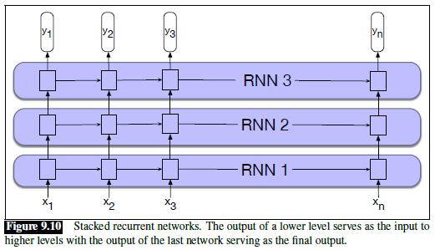
Stacked RNN

Slide 29
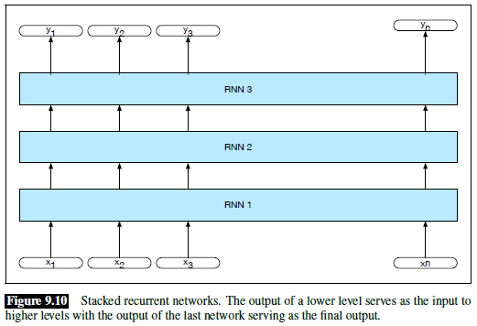
Stacked RNN (from earlier draft)

Slide 30
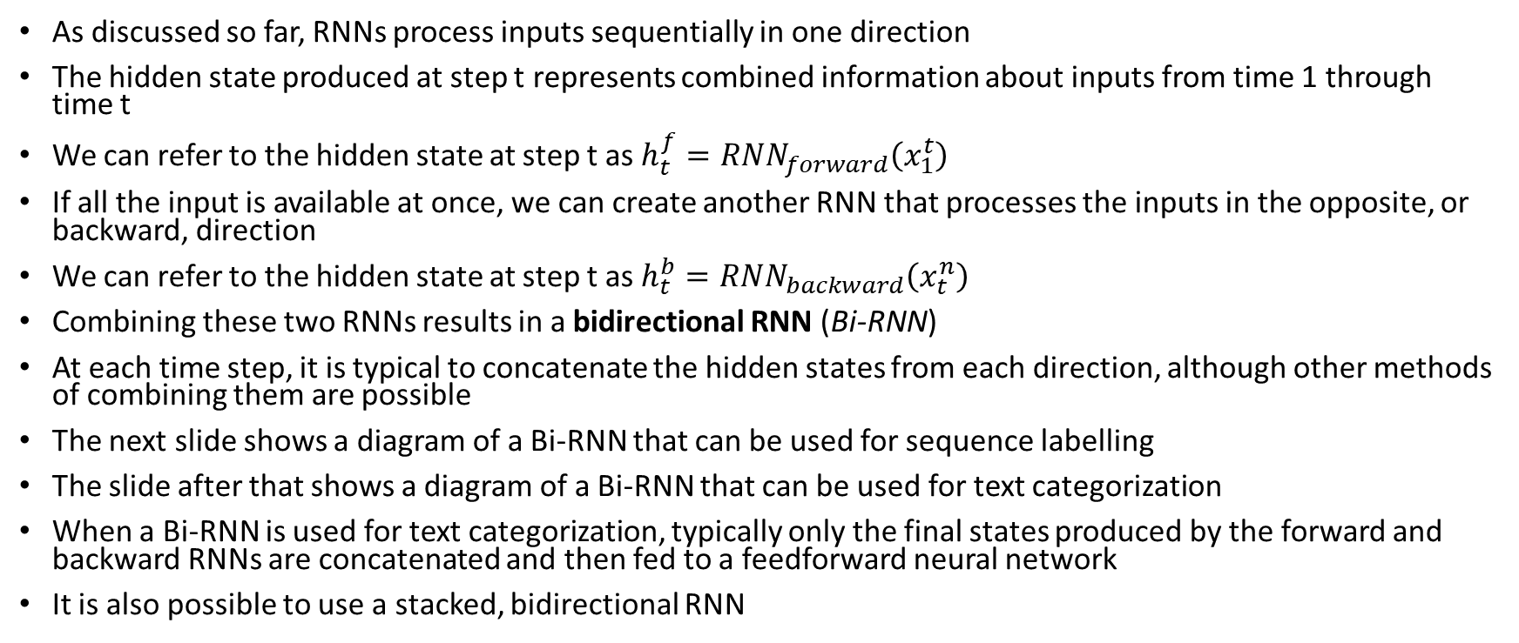
Bidirectional RNNs
As discussed so far, RNNs process inputs sequentially in one direction
The hidden state produced at step t represents combined information about inputs from time 1 through time t
We can refer to the hidden state at step t as $h_{t}^{f}={RNN}_{forward}\left(x_{1}^{t}\right)$
If all the input is available at once, we can create another RNN that processes the inputs in the opposite, or backward, direction
We can refer to the hidden state at step t as $h_{t}^{b}={RNN}_{backward}\left(x_{t}^{n}\right)$
Combining these two RNNs results in a bidirectional RNN (Bi-RNN)
At each time step, it is typical to concatenate the hidden states from each direction, although other methods of combining them are possible
The next slide shows a diagram of a Bi-RNN that can be used for sequence labelling
The slide after that shows a diagram of a Bi-RNN that can be used for text categorization
When a Bi-RNN is used for text categorization, typically only the final states produced by the forward and backward RNNs are concatenated and then fed to a feedforward neural network
It is also possible to use a stacked, bidirectional RNN

Slide 31
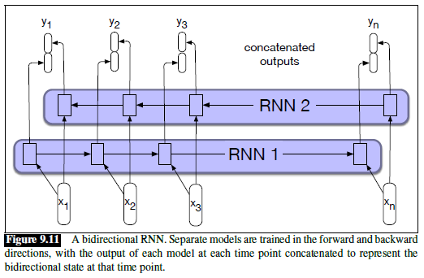
Bi-RNN for Sequence Labelling

Slide 32
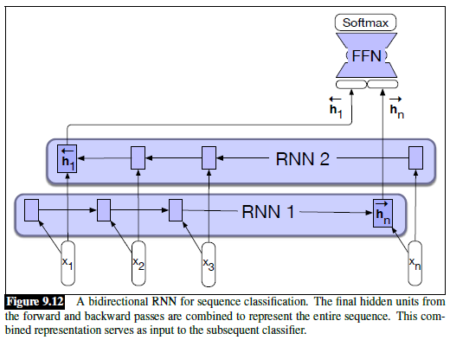
Bi-RNN for Text Categorization

Slide 33
The Vanishing Gradient Problem
All variations of RNNs discussed so far still have problems that hinder their performance for most NLP tasks
During backpropagation, for each layer or time step that error is backpropagated, there is a multiplication taking place
Typically, these multiplications reduce the gradients
That is, the further back we go, the less significant layers or states seem to be, in terms of how they affect the measured loss during training
This leads to the vanishing gradient problem; it affects all deep neural network architectures, not only RNNs
For other sorts of architectures (e.g., CNNs and feedforward NNs), rectified linear units (ReLUs) mitigate the problem to some extent
ReLUs are not typically used for RNNs (I have read various speculation about why they don't work well for RNNs, but I have not found any particularly convincing)
I add: Sometimes, multiplications increase the gradients, leading to what is then called the exploding gradient problem (not mentioned in our textbook)
It turns out that simply capping the gradient to some fixed maximum provides an adequate solution to the exploding gradient problem
Unfortunately, there is no such simple solution for the vanishing gradient problem

Slide 34
Non-local Context
Without any solution to mitigate the vanishing gradient problem, only very local context winds up being significant
I have read that, for NLP tasks, hidden states in a simple RNN are only significantly influenced by the previous two or three words
Sometimes that is not enough
Consider: "The flights the airline was cancelling were full."
In order to know that "were" is the appropriate word, we need to recognize that the subject of the sentence, "flights", is plural
Note that the only other noun in between, "airline", is singular

Slide 35
Long Short-Term Memory Units
Long short-term memory (LSTM) networks provide one solution for mitigating the vanishing gradient problem
In addition to the on-line draft of the textbook, I have also relied on this blog post for my slides on LSTMs:
  https://colah.github.io/posts/2015-08-Understanding-LSTMs
Often, the network as a whole, or each layer of a stacked network, is referred to as an LSTM
It is common to depict LSTMs graphically in terms of cells
Such depictions show the LSTM unrolled; the cell is the component of the architecture that repeats
We can also depict simple RNNs as cells, for a quick comparison
The next slide shows a diagram of an unrolled RNN in terms of cells, assuming a tanh activation function (from the LSTM blog)
The slide after that shows a diagram of an LSTM in terms of cells (from the LSTM blog); note that the cells are more complex

Slide 36
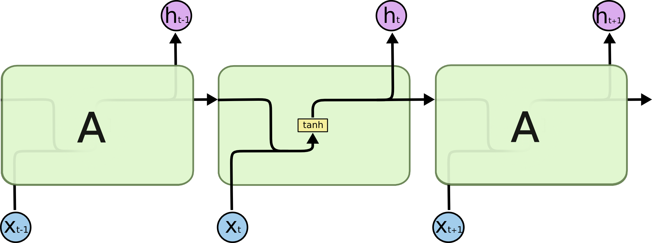
LSTM: Cells of Simple RNNs
https://colah.github.io/posts/2015-08-Understanding-LSTMs

Slide 37
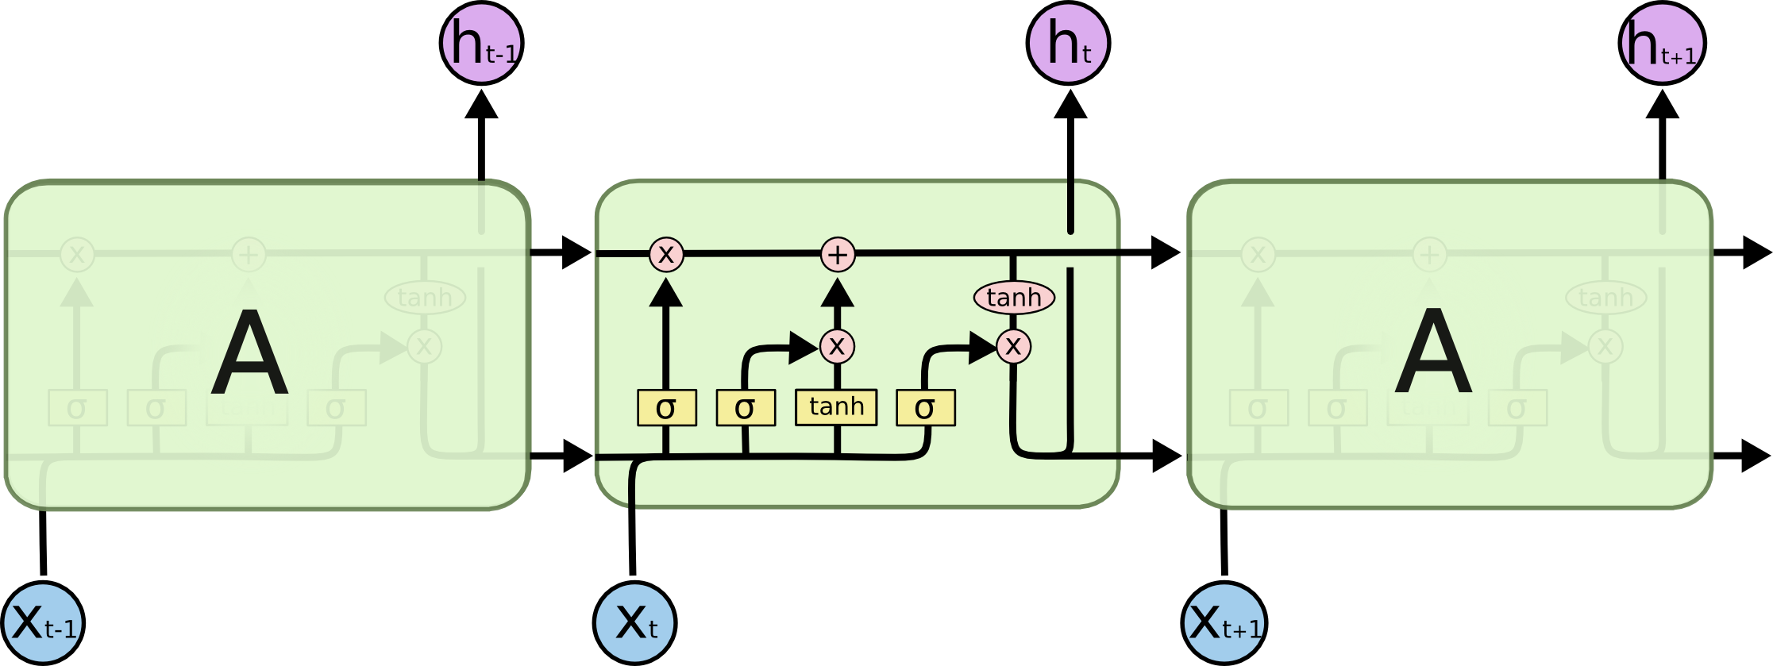
LSTM: Cells
https://colah.github.io/posts/2015-08-Understanding-LSTMs

Slide 38
LSTM: Input and Output of Cells
LSTM cells have two sets of values that are passed between cells (really being passed as feedback between one time step and the next)
One set of values (the one on top in the figure) is typically referred to as the cell state (our textbook refers to it as the cell's context)
The other set of values is the cell's hidden state
Our textbook refers to these two sets of values as separate layers of an LSTM network, but this does not seem to be common usage

Slide 39
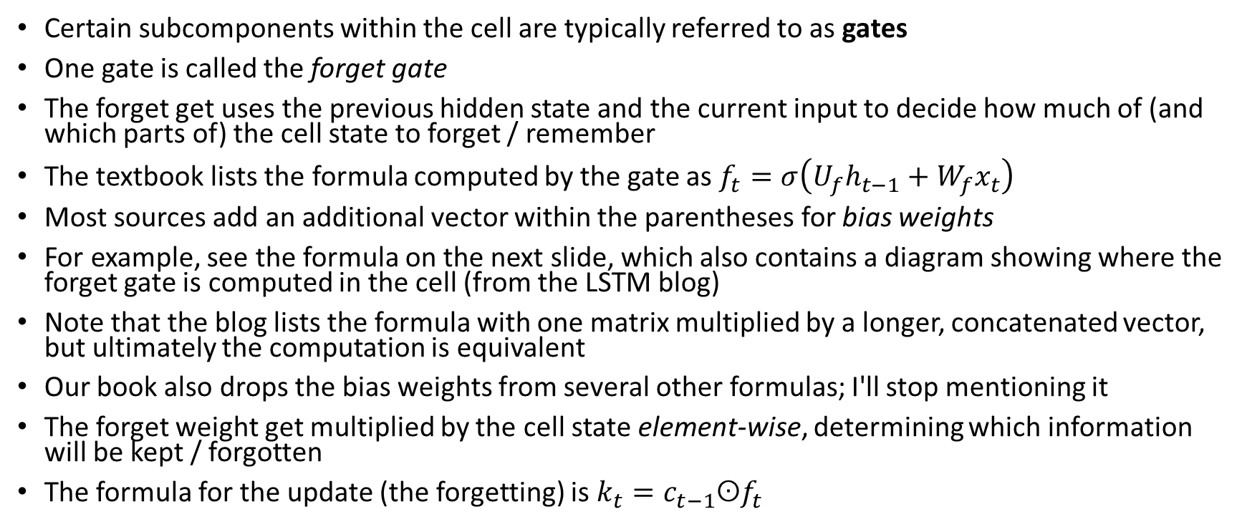
LSTM: The Forget Gate
Certain subcomponents within the cell are typically referred to as gates
One gate is called the forget gate
The forget get uses the previous hidden state and the current input to decide how much of (and which parts of) the cell state to forget / remember
The textbook lists the formula computed by the gate as $f_{t}=σ\left(U_{f}h_{t−1}+W_{f}x_{t}\right)$
Most sources add an additional vector within the parentheses for bias weights
For example, see the formula on the next slide, which also contains a diagram showing where the forget gate is computed in the cell (from the LSTM blog)
Note that the blog lists the formula with one matrix multiplied by a longer, concatenated vector, but ultimately the computation is equivalent
Our book also drops the bias weights from several other formulas; I'll stop mentioning it
The forget weight get multiplied by the cell state element-wise, determining which information will be kept / forgotten
The formula for the update (the forgetting) is $k_{t}=c_{t−1}ʘf_{t}$

Slide 40
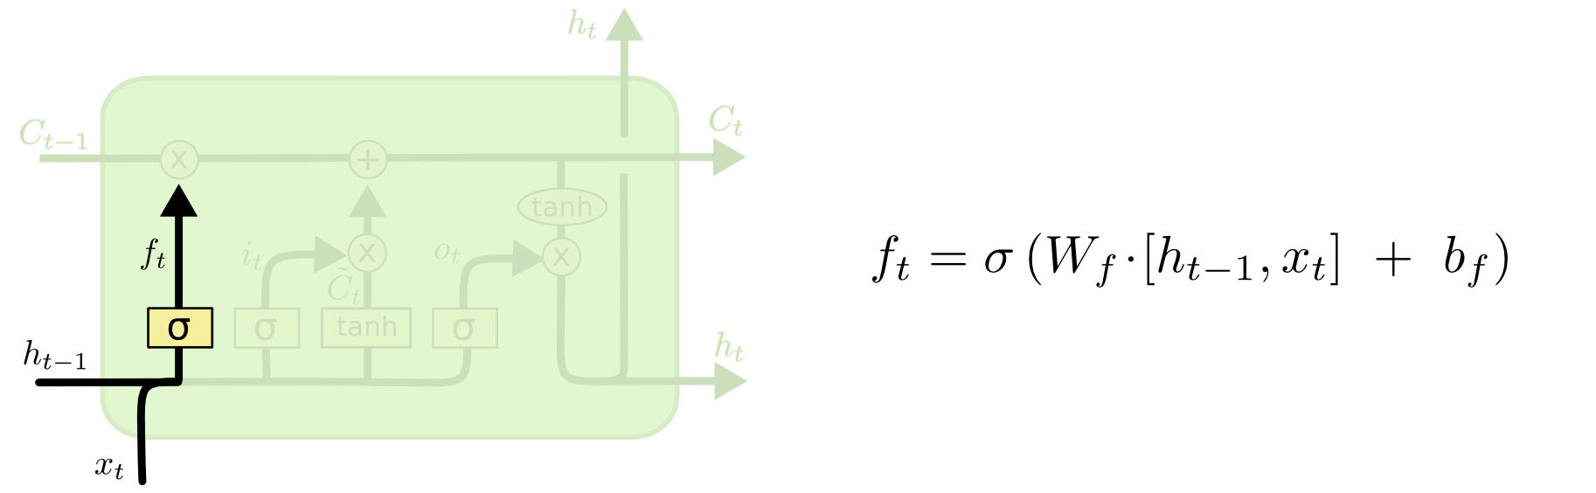
LSTM: The Forget Gate in a Cell
https://colah.github.io/posts/2015-08-Understanding-LSTMs

Slide 41
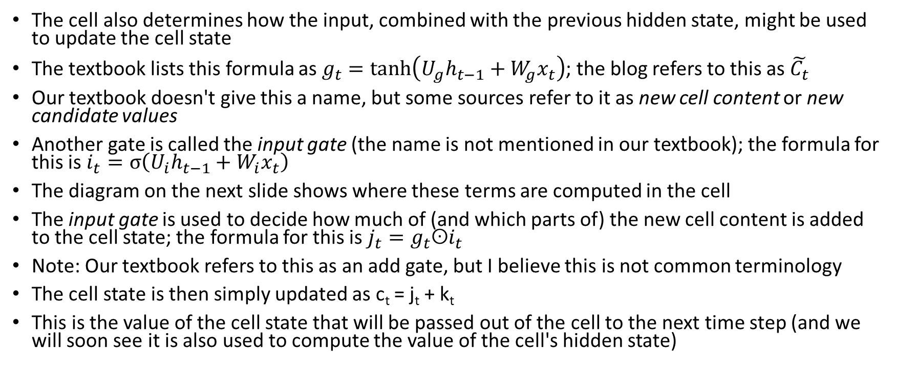
LSTM: New Cell Content and the Input Gate
The cell also determines how the input, combined with the previous hidden state, might be used to update the cell state
The textbook lists this formula as $g_{t}=\tanh\left(U_{g}h_{t−1}+W_{g}x_{t}\right)$; the blog refers to this as $\tilde{C_{t}}$
Our textbook doesn't give this a name, but some sources refer to it as new cell content or new candidate values
Another gate is called the input gate (the name is not mentioned in our textbook); the formula for this is $i_{t}=σ\left(U_{i}h_{t−1}+W_{i}x_{t}\right)$
The diagram on the next slide shows where these terms are computed in the cell
The input gate is used to decide how much of (and which parts of) the new cell content is added to the cell state; the formula for this is $j_{t}=g_{t}ʘi_{t}$
Note: Our textbook refers to this as an add gate, but I believe this is not common terminology
The cell state is then simply updated as c_{t} = j_{t} + k_{t}
This is the value of the cell state that will be passed out of the cell to the next time step (and we will soon see it is also used to compute the value of the cell's hidden state)

Slide 42
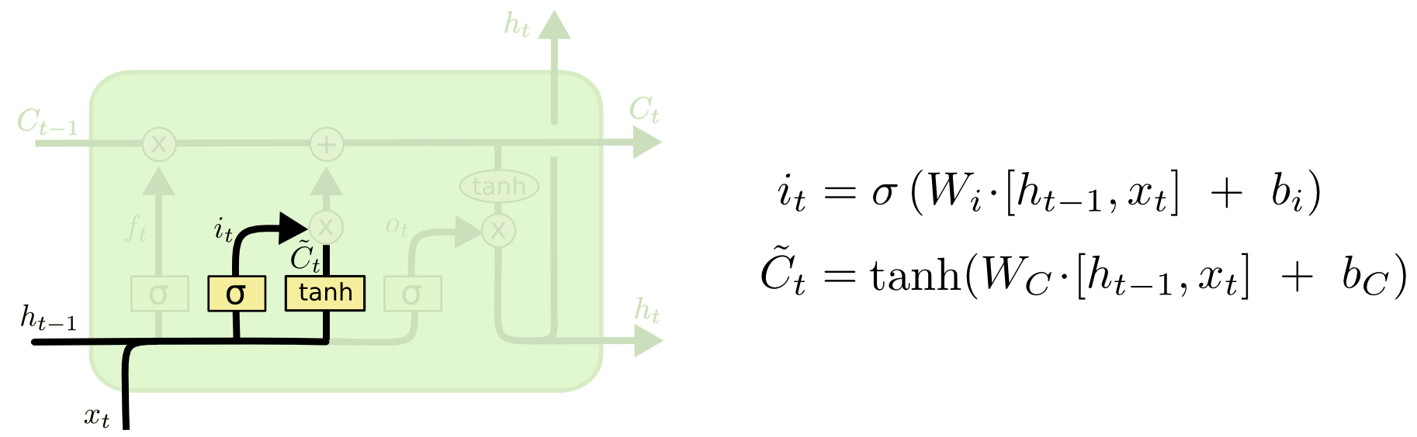
LSTM: New Cell Content & Input Gate in a Cell
https://colah.github.io/posts/2015-08-Understanding-LSTMs

Slide 43
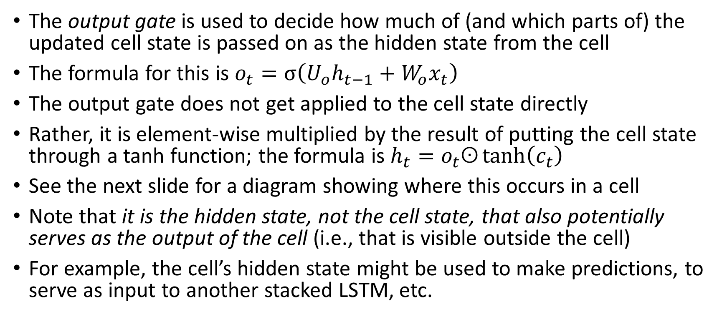
LSTM: The Output Gate
The output gate is used to decide how much of (and which parts of) the updated cell state is passed on as the hidden state from the cell
The formula for this is $o_{t}=σ\left(U_{o}h_{t−1}+W_{o}x_{t}\right)$
The output gate does not get applied to the cell state directly
Rather, it is element-wise multiplied by the result of putting the cell state through a tanh function; the formula is $h_{t}=o_{t}ʘ\tanh\left(c_{t}\right)$
See the next slide for a diagram showing where this occurs in a cell
Note that it is the hidden state, not the cell state, that also potentially serves as the output of the cell (i.e., that is visible outside the cell)
For example, the cell’s hidden state might be used to make predictions, to serve as input to another stacked LSTM, etc.

Slide 44
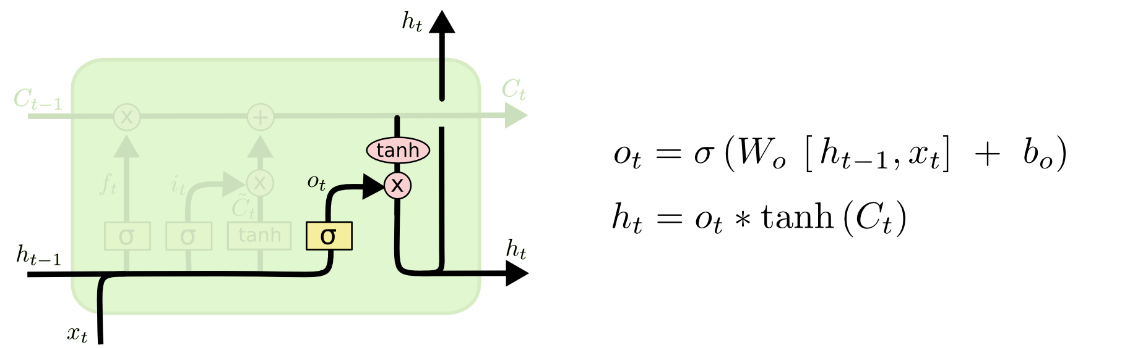
LSTM: The Output Gate in a Cell
https://colah.github.io/posts/2015-08-Understanding-LSTMs

Slide 45
LSTM: Summary
A single LSTM cell/unit accepts as input the previous cell's state (a.k.a. context), the previous cell's hidden state, and the current input (which is also a vector)
The cell generates an updated cell state and an updated hidden state, which are passed to the next cell (really the same unit at the next time step)
The hidden state can also serve as the cell's output (i.e., it is visible outside the cell and can be used for classification, as input to another stacked LSTM layer, etc.)
Note that the gates, and the process of calculating the new candidate values, all ultimately involve ordinary nodes and weights in a neural network
It is also worth noting that there are subtle variations of LSTMs
If you look up formulas in other sources, they may not be identical (but they will be close, and may turn out to be equivalent even if they look different)
As with other NN architectures that we have covered, we can learn the weights (i.e., train the LSTM) using stochastic gradient descent and backpropagation

Slide 46
Gated Recurrent Units
Gated recurrent units (GRUs) are an alternative to LSTMs
The current draft of the textbook dropped its discussion of GRUs altogether
We are not going to cover the details of GRUs, but we will briefly point out that:
  GRUs were developed much more recently than LSTMs
  There is just a hidden state passed from cell to cell (i.e., there is no separate cell state)
  They are conceptually simpler to understand
  They are significantly faster to train
  They perform as well as LSTMs for some, but not all, NLP tasks
The figure on the next slide (from an earlier draft) summarizes the four types of neural network architectures we have covered so far in the course
The current draft of the textbook has a similar figure that leaves out GRU units

Slide 47
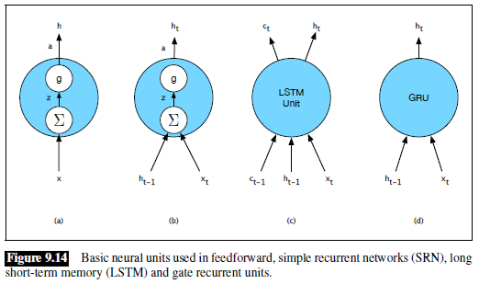
Four Basic Types of Neural Network Units

Slide 48
Building Complex Neural Networks
Any of the three recurrent structures can be bi-directional and/or stacked
Any of the recurrent structures can be applied to any of the tasks we previously discussed in the context of simple RNNs
The outputs from recurrent structures (at each time step or just at the ends) can be fed as input to feedforward networks for categorization
Modern deep learning libraries (e.g., TensorFlow or PyTorch) make it relatively easy to build complex networks out of standard layers
The libraries allow more advanced programmers to design their own units
Regardless of the architecture, neural networks can be trained end-to-end using stochastic gradient descent and backpropagation

