Slide 1
ECE467: Natural Language Processing
Feedforward Neural Networks

Slide 2
Machine Learning Approaches
Throughout the history of artificial intelligence (AI) and natural language processing (NLP), there have been many popular machine learning (ML) approaches
We covered some ML methods during our unit on conventional statistical NLP
For text categorization, we covered the naïve Bayes, KNN, and Rocchio/TF*IDF approaches
For part-of-speech tagging, we covered hidden Markov models
Other common approaches for conventional NLP tasks include decision trees, support vector machines, maximum entropy models, expectation maximization, etc.
Until semi-recently, no single approach dominated; generally speaking, different methods seemed to perform the best for different tasks
That has changed in more recent years, as neural networks have come to dominate machine learning

Slide 3
Origins of Neural Networks
Neural networks (NNs), a.k.a. artificial neural networks (ANNs) were loosely inspired by the structure of the human brain and its neurons
From the current draft of the textbook:
  "Neural networks are a fundamental computational tool for language processing, and a very old one. They are called neural because their origins lie in the McCulloch-Pitts neuron (McCulloch and Pitts, 1943), a simplified model of the human neuron as a kind of computing element that could be described in terms of propositional logic. But the modern use in language processing no longer draws on these early biological inspirations."
Conventionally, much of the work with NNs focused on feedforward neural networks (we will define what that means later in the topic)
Our coverage of feedforward neural networks is partially based on Sections 7.1 – 7.4 and Section 7.6 of the current draft of the textbook
Chapter 7 in general is titled "Neural Networks and Neural Language Models"; we will cover neural language models as part of our next topic
I have also relied on material from the textbook that I use for my AI course: "Artificial Intelligence: A Modern Approach" by Russell and Norvig (R&N), both the 3rd and 4th editions
The next slide shows a rough diagram of a neuron, taken from the R&N textbook

Slide 4
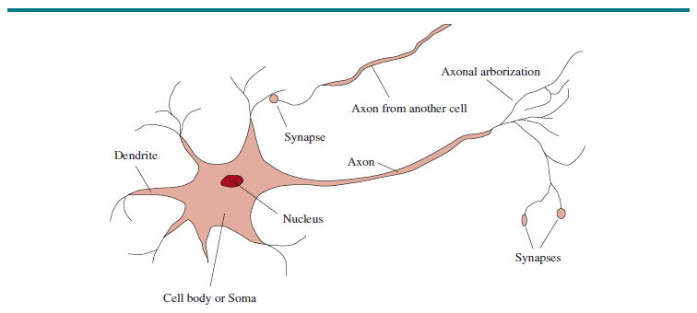
Diagram of a Neuron (Figure 1.1, R&N, Ed. 4)

Slide 5
Computer vs. Brain
There are roughly 10¹¹ neurons in the human brain
There are roughly 10¹⁴ synapses
Both of those estimates vary somewhat from source to source
The CPU or GPU in a typical, modern, personal computer has roughly 10¹⁰ transistors
RAM uses one transistor per bit for DRAM or six transistors per bit for SRAM; therefore, 32 GB of SRAM uses over 10¹² transistors
With modern NNs, we also care about the number of weights, or parameters (to be explained soon)
  The number of parameters in some of the largest language models is over 100 billion, so on the order of 10¹¹
  GPT-4 is rumored to have about 100 trillion parameters, so in the order of 10¹⁴
The number of transistors in computers had been increasing exponentially for decades roughly according to Moore's law; however, this pace has significantly slowed down in recent years
The brain has a much higher degree of parallelism compared to computers, although with GPUs, computers rely on more parallelism than they used to
Obviously, signals in a computer are traveling faster than signals in a brain
Relative to modern NNs, the human brain relies more heavily on feedback loops

Slide 6
Neural Network Units
Neural networks are composed of units (some sources refer to these as nodes)
  Each unit accepts inputs and computes a weighted sum of the inputs; the weights are adjustable parameters of the unit
  A bias weight is also added (or subtracted, according to some sources)
  An activation function is applied to the weighted sum, including the bias weight
  The result of the activation function is the output, or activation, of the unit
In the original model by McCulloch and Pitts, inspired by neurons of the brain, they used a threshold instead of a bias weight
  If the sum of the weighted inputs exceeded the threshold, the node would fire
  This can easily be shown to be equivalent to using a (subtracted) bias weight and a simple threshold activation function (we will discuss activation functions soon)
  Some descriptions of neural networks still describe neural network units as using thresholds instead of bias weights
The figure on the next slide shows a diagram of a unit
The equations on the following slide define how the unit behaves
Activation functions will be discussed on later slides

Slide 7
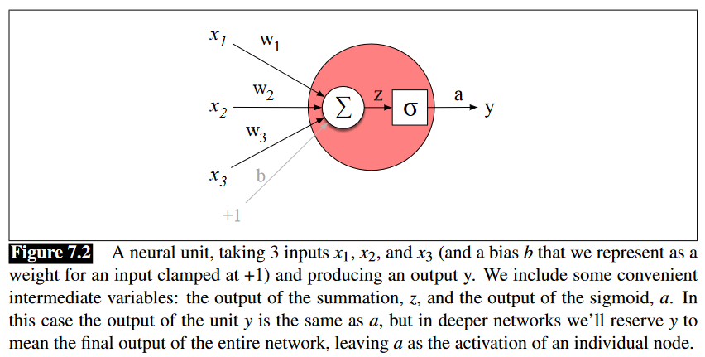
Diagram of a Neural Network Unit

Slide 8
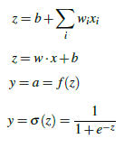
Formulas (using a sigmoid activation function)

Slide 9
Activation Functions
The activation function introduces a non-linearity, which is necessary for a neural network to represent functions that are not linearly separable
In conventional neural networks, two popular activation functions were the threshold function and the sigmoid function
The sigmoid function is also known as the logistic function, and another common use of it is related to logistic regression
The figure on the next slide, taken from the 3rd edition of the R&N textbook, shows graphs explaining these conventional activation functions
Threshold activation functions are not common in deep neural networks (which we will discuss later in this topic as well as future topics)
Sigmoid activation functions are still somewhat common; another graph of a sigmoid function is shown two slides from now

Slide 10
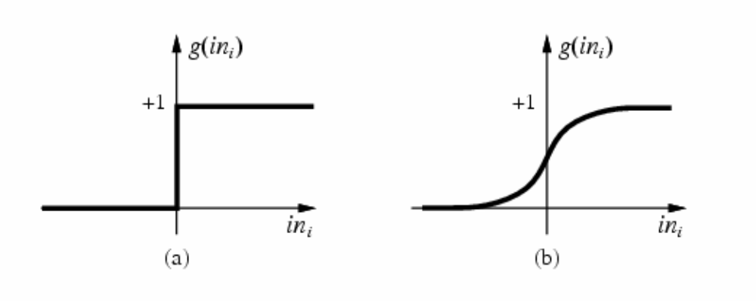
Conventional Activation Functions (R&N, Ed. 3)
Threshold Function
Sigmoid Function

Slide 11
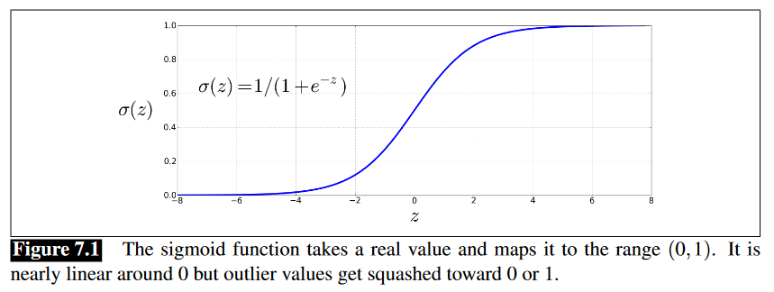
Sigmoid Function

Slide 12

Other Modern Activation Functions
Other common activation functions in deep neural networks include the tanh function and rectified linear units (ReLUs)
Formulas for these activation functions are:
Graphs of these activation functions are shown on the next slide
As mentioned earlier, sigmoid activation functions are also still somewhat common in deep neural networks
Textbook: "These activation functions have different properties that make them useful for different language applications or network architectures"

Slide 13
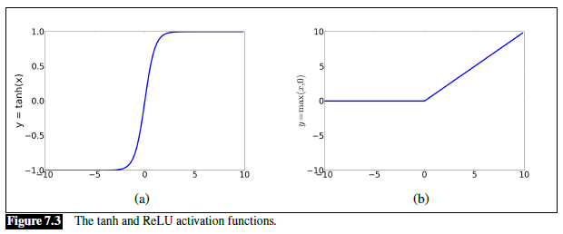
Tanh function and ReLU

Slide 14
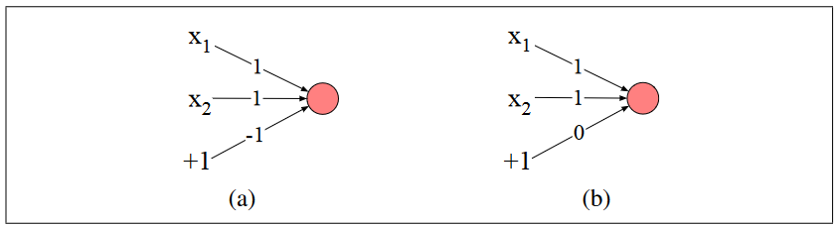

AND, OR, and NOT
Part (a) of the figure above shows an AND node; part (b) shows an OR node
This assumes a threshold activation function; the book doesn’t call it that, but it shows the formula (note the node does not fire at exactly 0):
Some points I would like to add:
  If we modify the bias weights in (a) and (b) to -1.5 and -0.5, respectively, then it is not relevant what happens when the weighted sum is exactly 0
  It is also easy to create a node that functions as a NOT gate; e.g., we can create a node with a single input weighted by -1 and a bias weight of 0.5
  Since we can compute AND, OR, and NOT with individual nodes, then with a network of nodes, we can compute any Boolean function

Slide 15
Perceptrons
The nodes we have seen so far are examples of perceptrons, a.k.a. single-layer perceptrons
Perceptrons can be defined as NNs which do not contain any hidden layers (to be discussed soon), although the exact definition differs from source to source
Perceptrons are generally allowed to contain multiple nodes that share the same input, but each node functions completely independently of the other
So, perceptrons are only capable of representing functions that can be represented by individual nodes
Although individual nodes (and more generally, perceptrons) can represent AND, OR, NOT, and many other functions, they are severely limited
In a very influential 1969 publication, Minsky and Papert proved that single units cannot compute XOR
More generally, perceptrons can only represent linearly separable functions
It can easily be shown that a perceptron with a threshold activation function will fire if and only if w∙x > 0 (this is a dot product of the inputs and the weights)
Positive and negative examples of linearly separable functions can be separated by hyperplanes in the input space
The next slide demonstrates that hyperplanes can separate true and false instances of the AND and OR functions, but no hyperplane can separate true and false instances of the XOR function

Slide 16
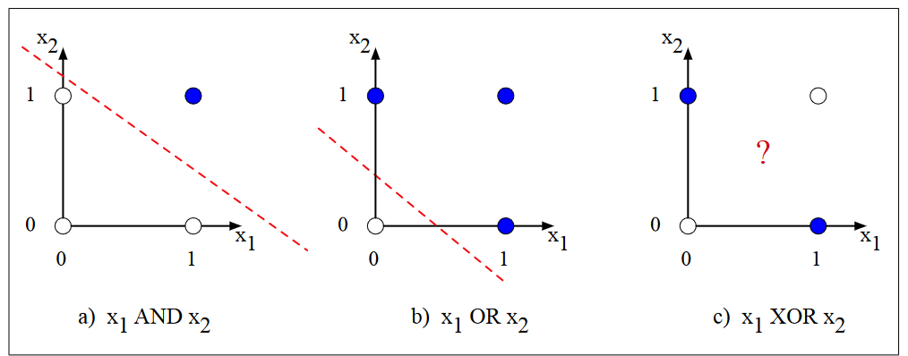
Hyperplane Examples (none for XOR)

Slide 17
Feedforward Neural Networks
One way to represent functions that are not linearly separable is by using feedforward neural networks; a.k.a. feedforward networks or sometimes multi-layer perceptrons
Some sources hyphenate feed-forward or write it as two separate words
A feedforward neural network is typically organized into layers
The output nodes (the only type that existed in perceptrons) constitute an output layer
Sources differ as to whether the inputs themselves constitute a layer
Our textbook does refer to the inputs as an input layer, but they don’t include it when counting layers
In addition to the inputs and the output layer, there are one or more hidden layers, consisting of hidden units (a.k.a. hidden nodes)
When the nodes in a layer connect with every node from the previous layer, the layer is said to be fully-connected
Typically, the inputs to a feedforward neural network do not have an activation function applied to them directly; the inputs are fed as scalars to the nodes in the first hidden layer
The next slide shows an example of a feedforward neural network with one hidden layer
Our textbook calls this a two-layer network, but some sources would consider it to be a three-layer network

Slide 18
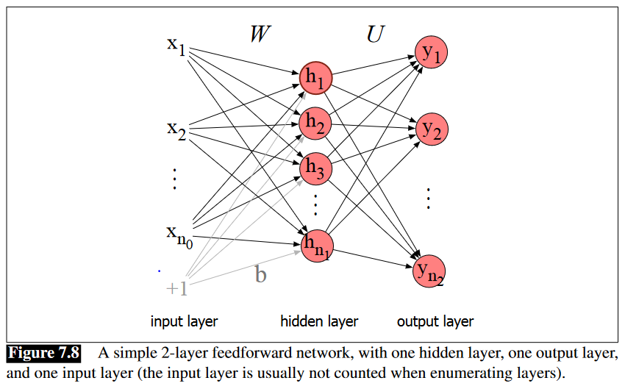
Feedforward Network with One Hidden Layer

Slide 19
Computing Values for the Hidden Layer
Note that the fixed input (in this case, +1) is connected to every node in the hidden layer, and each has its own bias weight
You could apply the equations we looked at before separately to each hidden node; alternatively, you can handle them all at once
We can think of the inputs as a vector, x, and the bias weights as a bias vector, b
We can think of the other weights between inputs and hidden nodes as a matrix, W
If the hidden nodes use a sigmoid activation function, their outputs can be computed as: h = σ(Wx+b)
Note that Wx+b is a vector, and the activation is being applied element-wise
Note: You need to be careful with how you treat rows and columns of the matrix if you are implementing a neural network using vectors and matrices
Some sources treat the vectors as column vectors, some as row vectors; some use transposes for vectors or matrices
Conventionally, nodes were often handled one at a time, but there is a significant computational advantage of representing layers as vectors and representing weights between layers as matrices
Modern deep learning libraries, such as TensorFlow and PyTorch, take advantage of this by parallelizing computation with GPUs

Slide 20


Computing Values for the Output Layer
In many neural network architectures, the output nodes will also include bias weights connected to fixed inputs; in our first sample neural network (shown two slides ago), they do not
We can represent the intermediate output as z = Uh, where h = σ(Wx+b) as explained on the previous slide
We could apply a sigmoid function to z, as we did for the hidden layer, and for some tasks, this might make sense
Another common type of output layer for modern neural networks is the softmax layer
The softmax layer converts a vector of real numbers into a vector of floating-point values between 0 and 1 that add up to 1; the formula is:
The output of the softmax function is often interpreted as a probability distribution
In summary, the formulas used to calculate the values produced by the sample feedforward neural network would then be:

Slide 21

Deep Feedforward Neural Networks
If a feedforward neural network has more than one hidden layer, it would generally be considered a deep neural network
Consider a neural network with n layers, not including the inputs, numbered from 1 to n
Let the i^{th} layer have incoming weight matrix W^{[i]}, bias vector b^{[i]}, and activation function g^{[i]}, and let a^{[0]} be the input vector
Then we can implement forward propagation (the textbook calls this the forward step) as follows:
This pseudo-code allows a different activation function, g^{[i]}, to be used at each layer; 'g' is commonly used to represent a general activation function

Slide 22
Creating a Neural Network
The textbook never really discusses how you might go about creating a neural network for a task you are working on
Creating a neural network for a particular task involves:
  Choosing an architecture (e.g., the number, types, and sizes of layers); we will learn about various types of neural networks in future topics
  Setting hyperparameters (we haven’t talked about these yet)
  Obtaining a training set (including examples with known inputs and outputs)
  Training the neural network to learn the other parameters of the network (i.e., the weights, including the bias weights); we will talk more about training shortly
  The architecture and hyperparameters are set manually, before training; optionally, they can be tuned based on a validation set, a.k.a. development set or tuning set
After the neural network has been finalized (including tuning and training it), you can evaluate it using a test set

Slide 23


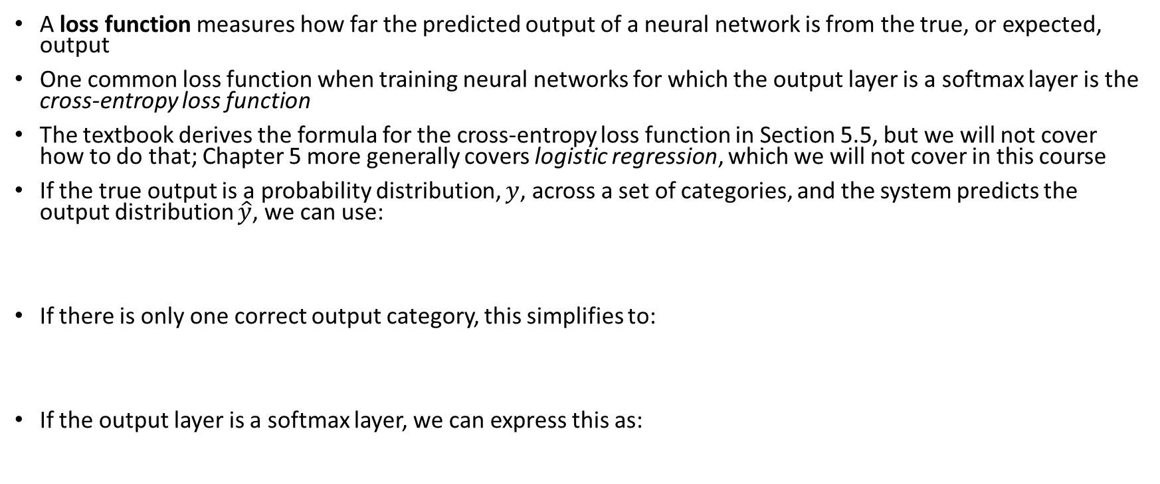
Loss Functions
A loss function measures how far the predicted output of a neural network is from the true, or expected, output
One common loss function when training neural networks for which the output layer is a softmax layer is the cross-entropy loss function
The textbook derives the formula for the cross-entropy loss function in Section 5.5, but we will not cover how to do that; Chapter 5 more generally covers logistic regression, which we will not cover in this course
If the true output is a probability distribution, $y$, across a set of categories, and the system predicts the output distribution $\hat{y}$, we can use:
If there is only one correct output category, this simplifies to:
If the output layer is a softmax layer, we can express this as:

Slide 24
Stochastic Gradient Descent
In principle, gradient descent could be used to train the weights of a neural network
  First, we compute the partial derivative of the loss function w.r.t. each weight
  Then, we push the weights in a direction to reduce the loss
In practice, stochastic gradient descent (SGD) is used instead
  One mini-batch is used at a time to estimate the gradient
  The size of the mini-batch is a hyperparameter of the neural network
It is common to loop through the entire training set multiple times (one mini-batch at a time); each pass is called an epoch
Modern implementations use vectors and matrix calculations to implement the procedure, making SGD more efficient due to parallelization

Slide 25
Adjusting Weights
Deriving the formulas to update weights going into the output nodes is relatively simple, since each weight affects one output node
Deriving the formulas to update weights into hidden layers is more complicated
The procedure to do this involves backpropagation, a.k.a. error backpropagation or backprop, to compute the partial derivative of the loss function w.r.t. each weight
We are not going to cover the details of backpropagation for feedforward neural networks in this course
However, we will examine backpropagation in more detail for recurrent neural networks when we cover that topic
Once the gradients for all weights are calculated, they are multiplied by a learning rate that controls the size of the adjustments
Modern neural networks have adaptive learning rates
There are also methods of regularization to minimize overfitting; for example:
  An extra term is often added to the loss function to penalize large weights
  Dropout randomly drops units or weights during training

Slide 26
Computation Graphs
Neural networks can be described using computation graphs
  These are graphical representations of processes for computing mathematical expressions
  A graph representing a forward pass shows how to compute values; an example for a specific formula (not a neural network) is shown on the next slide
  A graph representing a backward pass shows how to compute partial derivatives of the output with respect to each node; an example is shown two slides from now
The computation of the gradients during the backward pass is called backward differentiation
We will also see that neural networks can be represented as computation graphs; those tend to look more complex
Viewing neural networks as computation graphs has become more common in recent years

Slide 27
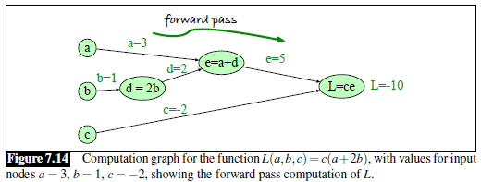
Computation Graph: Forward Pass

Slide 28
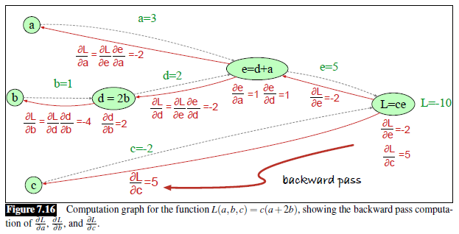
Computation Graph: Backward Pass

Slide 29
Representing NNs as Computation Graphs
The next slide shows a simple feedforward neural network represented as a computation graph
The neural network has two input nodes, one hidden layer with two ReLU nodes, and one output sigmoid node
The nodes shown in light blue represent the regular weights and bias weights
These are the parameters of the neural network that are updated during training
When a computation graph represents a neural network, backpropagation is equivalent to backward differentiation
Some modern deep learning libraries allow you to express neural networks as computation graphs
When you build a neural network out of standard types of layers, and you use a standard loss function, backward differentiation can be applied automatically

Slide 30
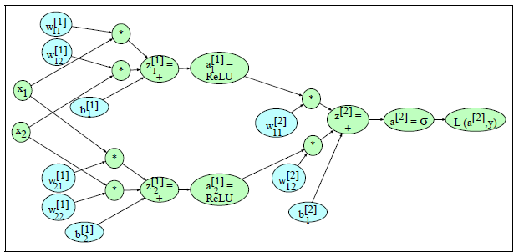
Computation Graph: Neural Network

