Slide 1
ECE467: Natural Language Processing
Encoder-Decoder Models, Attention,
and Machine Translation

Slide 2
Review of RNNs
In our last topic, we saw how recurrent neural networks (RNNs) could be applied to sequence labelling or text categorization
For sequence labelling, every word or token gets a label; examples include POS tagging and named entity recognition (NER)
For text categorization, a sequence of text receives one label; our textbook refers to this as sequence classification when RNNs are used
In practice, variations or RNNs such as long short-term memory (LSTM) networks or gated recurrent unit (GRU) networks are used
Such variations of RNNs help to mitigate (although not completely eliminate) the vanishing gradient problem
Any of these variations can be bidirectional and/or stacked

Slide 3
Mapping Sequences to Sequences
The first part of this topic is partly based on Section 9.7, titled "The Encoder-Decoder Model with RNNs"
The middle part of this topic is partly based on Sections 13.1-13.3 and Section 13.5; Chapter 13 in general is titled "Machine Translation"
The last part of this topic is partly based on Section 9.8, titled "Attention"
Some of the content (including some figures) comes from an earlier draft of the book
Many NLP tasks involve mapping a sequence of text to another sequence of text
Examples include machine translation (MT), summarization, and (in some sense) question-answering (QA)
We will cover encoder-decoder networks, also known as sequence-to-sequence (seq2seq) models, that are capable of this

Slide 4
Recall: RNN Equations
The equations describing what happens at each time step in a simple RNN used for sequence labelling are:
  h_{t} = g(Uh_{t-1} + Wx_{t})
  y_{t} = f(Vh_{t})
The function, g, is an activation function used at the hidden layer (e.g., tanh, sigmoid, or ReLU, although ReLU is not common in RNNs)
Often, the output layer will be a softmax layer
Generalizing for variations of RNNs (some of which use more complex structures within gated cells), we can instead write:
  h_{t} = g(h_{t-1}, x_{t})
  y_{t} = f(h_{t})
Technically speaking, for an LSTM, there should be two outputs and an extra input for each cell

Slide 5
Recall: Autoregressive Generation
To apply an RNN to the task of autoregressive generation, we first train the RNN as a language model
  Language models, in general, can be evaluated by computing their predicted probabilities for actual text corpora
  When evaluating neural language models, we consider the probabilities assigned to each word in a test set
  In theory, we can multiply the probabilities, but in practice, we add log probabilities and sometimes express the result using perplexity
When using an RNN trained as a language model for autoregressive generation:
  Instead of using the outputs from the softmax layer to evaluate the probability of a word in a test set, we use the probability distribution to sample words
  We start the sequence with a beginning-of-sentence marker (<s>)
  We keep generating words until an end-of-sentence marker (</s>) is generated, or until some fixed, maximum number of words have been generated
The figure on the next slide helps to explain how RNNs can be applied to autoregressive generation (any variation of RNN could be used)
Here, I am using a version of this figure from an earlier draft of the textbook, because it matches our next figure, which has been dropped from the current draft of the textbook

Slide 6
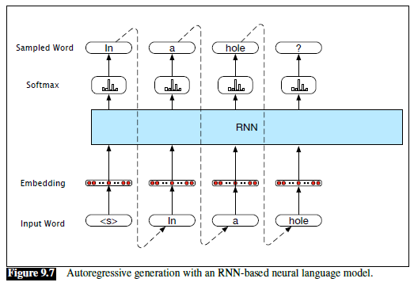
Recall: Autoregressive Generation Example

Slide 7
Autoregressive Generation with Prefix
An earlier draft of the textbook asked us to consider a variation of the autoregressive generation task before discussing encoder-decoder models
Instead of seeding the network with just a start-of-sentence marker, we allow it to be seeded with a more general prefix
In other words, given a prefix (which can be supplied by a user), the task of the RNN is to predict the completion of a sentence starting with the prefix
The figure on the next slide (from an earlier draft of the textbook) demonstrates how an RNN can be used for this purpose
Note that the prefix is processed first, without leading to any outputs or predictions; this is just forward inference
The final hidden state after processing the prefix is used as the starting point for the autoregressive generation

Slide 8
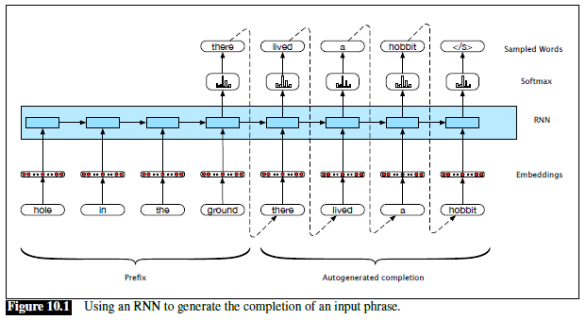
Autoregressive Generation with Prefix Example

Slide 9
Machine Translation
The textbook defines machine translation (MT) as "the use of computers to translate from one language to another"
An earlier draft defined MT as "the task of automatically translating sentences from one language into another"
Sometimes, MT by a computer is called automatic machine translation
Of course, we are talking about natural languages here, not formal languages
Even before the success of deep learning in NLP, most efforts in automatic MT involved statistical machine translation
When neural networks are used for machine learning, this is often referred to in other sources as neural machine translation (NMT)
Later in the topic, we'll take a brief excursion to talk about pre-neural MT (that content is partially based in the previous edition of the textbook)

Slide 10
Training Data for MT
Statistical machine translation (neural or pre-neural) relies on a training set in the form of a parallel corpus
A parallel corpus is also known as a multilingual corpus, parallel text, or a bitext
Such a corpus contains text in (at least) two different languages
Additionally, sentences have been aligned (either manually or in some automated fashion)
The original language for an MT task is typically referred to as the source language
The desired language (that the original text is translated to) is typically referred to as the target language
To use a parallel corpus to train an NMT model, the source and target sentences are concatenated
The book specifies that an end-of-sentence marker is appended to the end of the source sentence (in the current draft, they call it a sentence separation marker)
Really, end-of-sentence markers are generally added to both sentences
The target sentence end-of-sentence is never fed as input to the NMT model, but it is known to be the desired prediction after the last word

Slide 11
Using an RNN for MT
An earlier draft of the textbook explained that machine translation with an RNN can be viewed as being similar to autoregressive generation with a prefix
Instead of a prefix, the source sentence of a pair is fed to the RNN first
Instead of generating a continuation of a prefix, the RNN predicts the target sentence
The figure on the next slide (from an earlier draft of the textbook) demonstrates how a simple RNN can be used for MT; a similar figure appears in the current draft
Really, the end-of-sentence marker (</s>) should be considered part of the source sentence, and would be processed by the encoder
As with all RNN variations we have looked at, this network can be trained end-to-end using stochastic gradient descent (SGD) and backpropagation
We will talk about training a more general encoder-decoder network for MT in more detail later
After training, we can apply the network as follows:
  First, apply a source sentence into the network
  Second, use the final hidden state from the source sentence as the initial hidden state for the rest of the network, which predicts the target sentence

Slide 12
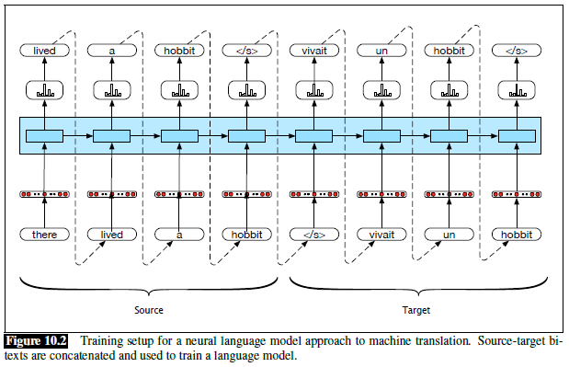
NMT: Similar to Autoregressive Generation

Slide 13
Simple Encoder-Decoder Model
We can view the previous architecture as an encoder-decoder model
The figure on the next slide (from an earlier draft of the textbook) generalizes the architecture from the previous slide; a similar figure appears in the current draft
Note that this network is no longer specific to machine translation, but we can apply it to MT
The encoder is the portion of the network that processes an input sequence (e.g., the source sentence for MT)
The decoder is the portion of the network that generates an output sequence (e.g., the target sentence for MT)
This simple encoder-decoder model has at least three flaws:
  The encoder and the decoder are assumed to have the same internal structure
  The final state of the encoder is the only context available to the decoder
  The final state of the encoder is only available to the decoder as its initial state

Slide 14
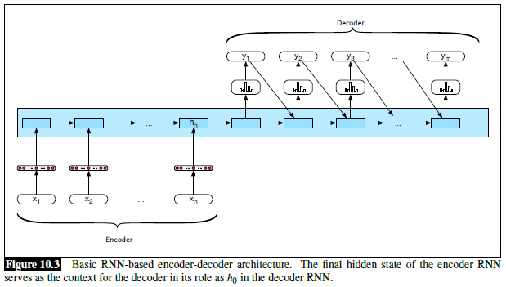
Simple Encoder-Decoder Network

Slide 15
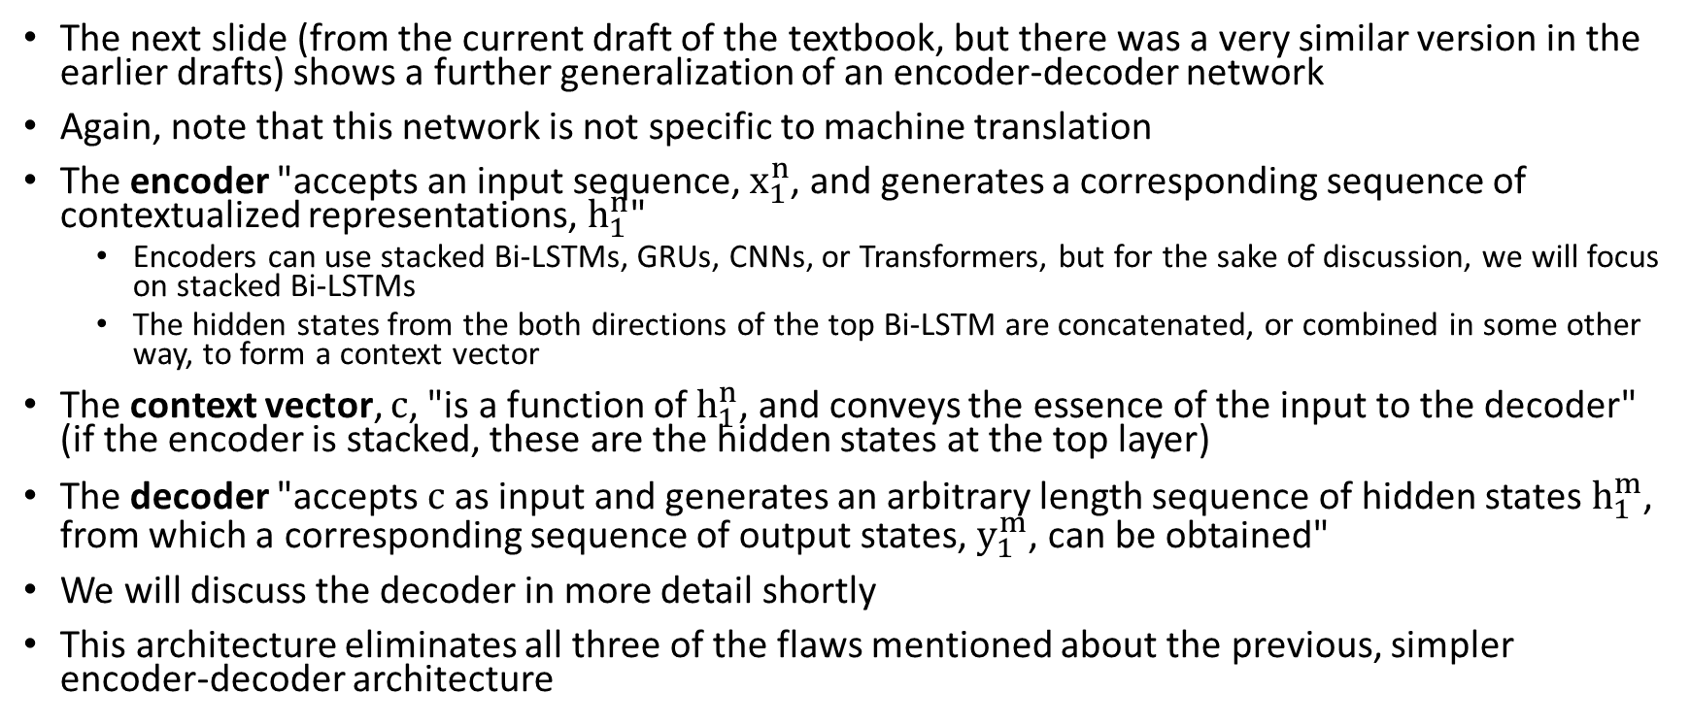
Generalized Encoder-Decoder Network
The next slide (from the current draft of the textbook, but there was a very similar version in the earlier drafts) shows a further generalization of an encoder-decoder network
Again, note that this network is not specific to machine translation
The encoder "accepts an input sequence, $x_{1}^{n}$, and generates a corresponding sequence of contextualized representations, $h_{1}^{n}$"
  Encoders can use stacked Bi-LSTMs, GRUs, CNNs, or Transformers, but for the sake of discussion, we will focus on stacked Bi-LSTMs
  The hidden states from the both directions of the top Bi-LSTM are concatenated, or combined in some other way, to form a context vector
The context vector, c, "is a function of $h_{1}^{n}$, and conveys the essence of the input to the decoder" (if the encoder is stacked, these are the hidden states at the top layer)
The decoder "accepts c as input and generates an arbitrary length sequence of hidden states $h_{1}^{m}$, from which a corresponding sequence of output states, $y_{1}^{m}$, can be obtained"
We will discuss the decoder in more detail shortly
This architecture eliminates all three of the flaws mentioned about the previous, simpler encoder-decoder architecture

Slide 16
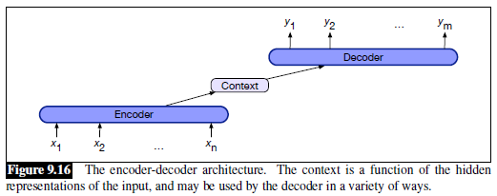
Basic Encoder-Decoder Network

Slide 17
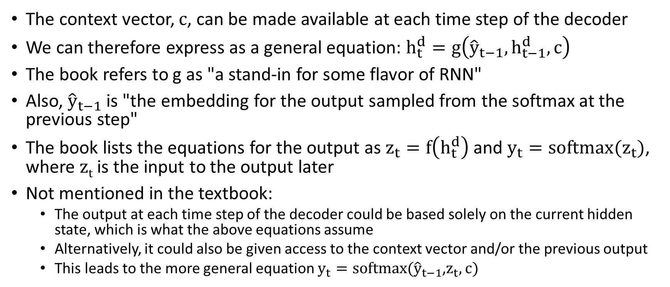
Decoder Functionality
The context vector, c, can be made available at each time step of the decoder
We can therefore express as a general equation: $h_{t}^{d}=g\left({\hat{y}}_{t−1},h_{t−1}^{d},c\right)$
The book refers to g as "a stand-in for some flavor of RNN"
Also, ${\hat{y}}_{t−1}$ is "the embedding for the output sampled from the softmax at the previous step"
The book lists the equations for the output as $z_{t}=f\left(h_{t}^{d}\right)$ and $y_{t}=softmax(z_{t})$, where z_{t} is the input to the output later
Not mentioned in the textbook:
  The output at each time step of the decoder could be based solely on the current hidden state, which is what the above equations assume
  Alternatively, it could also be given access to the context vector and/or the previous output
  This leads to the more general equation $y_{t}=softmax({\hat{y}}_{t−1}$,$z_{t},c)$

Slide 18
Excursion: Pre-neural MT
The current draft of the textbook hardly discusses the rich history of machine translation
Pre-neural MT is only briefly described in the "Bibliographical and Historical Notes" section at the end of Chapter 13
I think that to appreciate NMT, we need to be at least partially aware of what came before it
I am partially basing this excursion on material from the previous edition of the textbook; after the excursion, we will return to the discuss of NMT
The figure on the next slide (from the previous edition of the textbook) shows the translation of a passage from an 18th century Chinese novel
The C1 through C4 lines show the direct translations of words (and phrases) from Chinese to English
The E1 through E4 lines show the actual words (and phrases) and sentences produced by a human translator
Note that in Chinese, this was a single sentence, but it led to four sentences in English
Book (previous edition): "Translation of this sort requires a deep and rich understanding of the source language and the input text and a poetic and creative command of the target language"

Slide 19
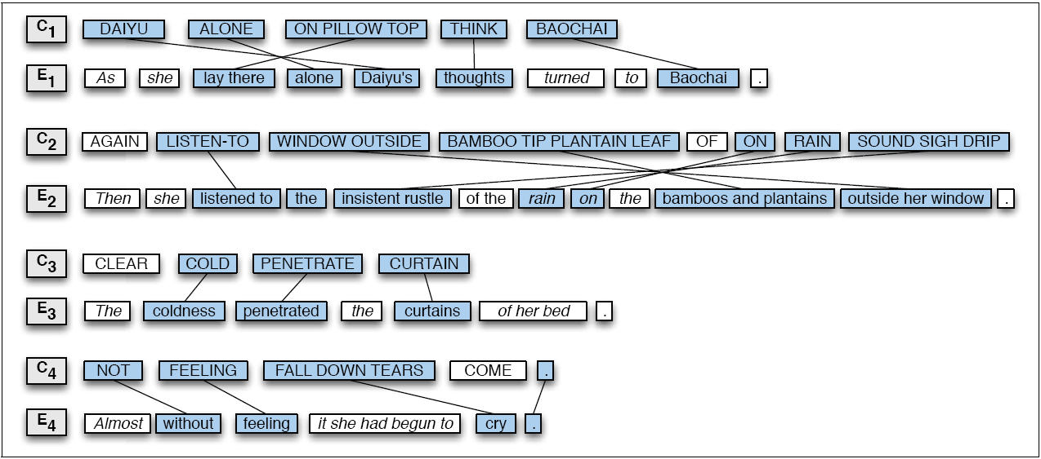
Example of a Translated Passage

Slide 20
Some Reasons that Automatic MT is Difficult
A single word in the source language can have many possible translations in the target language, and sometimes the differences are subtle
Different words in the source language can have the same translation in the target language
Morphological rules differ between languages
In general, good translations do not always involve one-to-one mappings of words; sometimes one-to-many, many-to-one, or many-to-many mappings are necessary
The rules of grammar differ from one language to the next, and word order will likely need to change
Some syntactic notions (e.g., forms of agreement, politeness levels, etc.) exist in some languages but not others
Figures of speech differ from one language to another
Pronoun resolution (and reference resolution in general), as well as other types of disambiguation, often comes into play; some languages leave out pronouns altogether
Some languages may lack words or short phrases for certain concepts that exist as single words in other languages; this is called lexical gap
Some languages have particular oddities (e.g., the existential "there" in English)

Slide 21
Pre-Statistical Machine Translation
The figure on the next page (from the previous edition of the textbook) shows the Vauquois triangle, which helps explain the various pre-statistical approaches to MT
A simpler version is shown in the "Bibliographical and Historical Notes" section at the end of Chapter 13
The approaches not only pre-dated NMT, but also predated conventional, statistical NLP approaches
Direct translation approaches:
  These translate word-by-word, or possibly phrase-by-phrase
  Some simple word reordering might be possible in post-processing
Transfer approaches:
  These approaches start by parsing the input text
  Then, they apply rules to transform the source-language parse to a target-language parse
  Then, they generate words in the target language
  Some transfer approaches would, in theory, apply some semantic parsing, but in practice this generally was not attempted
Interlingua approaches:
  These analyze the input text to produce a meaning representation called an interlingua
  Then they then generate the target text from the interlingua
  This was considered an ideal; such approaches did not exist in practice
  However, some NLP practitioners consider modern encoder-decoder approaches to be interlingua approaches

Slide 22
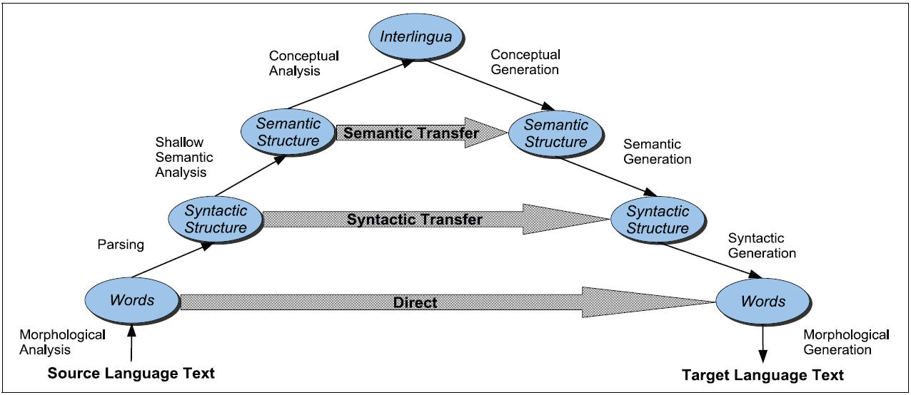
The Vauquois Triangle

Slide 23
Fluency vs. Faithfulness
The previous edition of the textbook introduced statistical MT (which was pre-neural) with an example
Suppose we were translating the Hebrew phrase "adonai roi"
The textbook pointed out that this would typically be translated into English as "The Lord is my shepherd"
They then pose the following question: What if we are translating this phrase into the language of a culture with no notion of sheep or shepherds?
We could attempt to translate the phrase to something fluent, that captures the spirit of the meaning, such as "The Lord will look after me"
Alternatively, we could try to be faithful to the explicit meaning
This might produce something like "the Lord is for me like somebody who looks after animals with cotton-like hair"

Slide 24
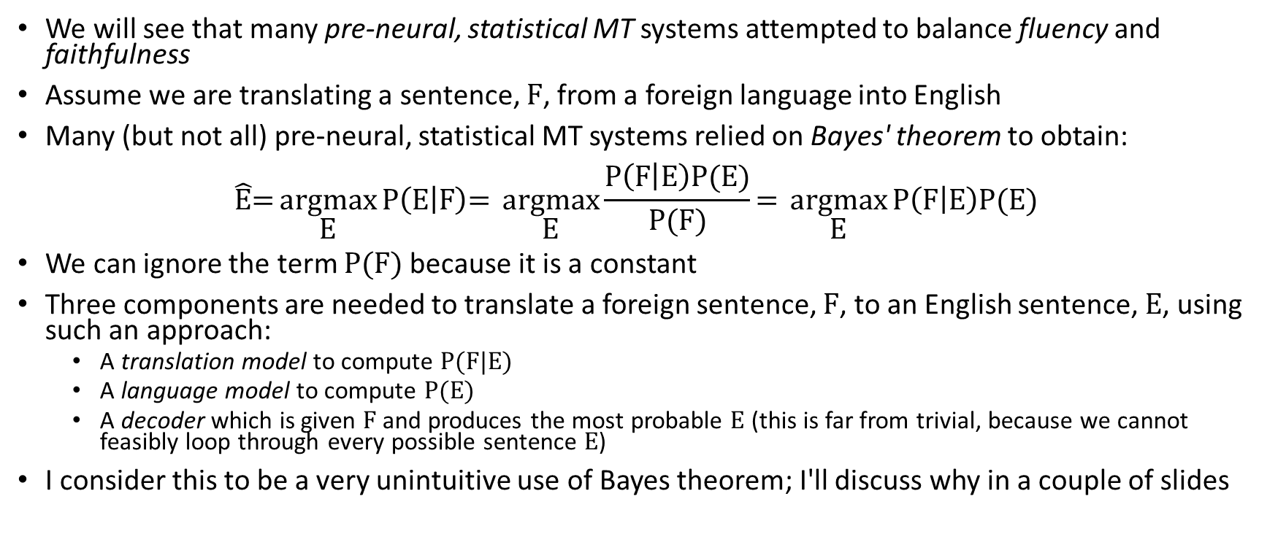
Bayes’ Rule for Pre-neural Statistical MT
We will see that many pre-neural, statistical MT systems attempted to balance fluency and faithfulness
Assume we are translating a sentence, F, from a foreign language into English
Many (but not all) pre-neural, statistical MT systems relied on Bayes' theorem to obtain:
$$\hat{\text{E}}\text{=}\underset{\text{E}}{\text{argmax}}{\text{P}\left(\text{E} | \text{F}\right)\text{=} }\underset{\text{E}}{\text{argmax}}{\frac{\text{P}\left(\text{F} | \text{E}\right)\text{P}\text{(}\text{E}\text{)}}{\text{P}\text{(}\text{F}\text{)}}\text{=} \underset{\text{E}}{\text{argmax}}{\text{P}\left(\text{F} | \text{E}\right)\text{P}\text{(}\text{E}\text{)}}}$$
We can ignore the term P(F) because it is a constant
Three components are needed to translate a foreign sentence, F, to an English sentence, E, using such an approach:
  A translation model to compute P(F|E)
  A language model to compute P(E)
  A decoder which is given F and produces the most probable E (this is far from trivial, because we cannot feasibly loop through every possible sentence E)
I consider this to be a very unintuitive use of Bayes theorem; I'll discuss why in a couple of slides

Slide 25
Pre-neural Statistical MT Translation Model
The translation model component of a pre-neural, statistical MT system would typically rely on phrase-to-phrase probability estimates
These estimates would be learned from a parallel corpus, the same sort of corpus used to train NMT systems
However, while these datasets generally indicate sentence alignments, they typically do not indicate word or phrase alignments
These would have to be estimated using other algorithms
Ultimately, to estimate P(F | E) in the formula, a system would:
  Multiply the probabilities of each English word or phrase being translated to each foreign word or phrase
  Also account for distortion probabilities, which account for how far each phrase has moved in the translation
This component helps to account for the faithfulness of the predicted translation
We are not discussing the translation model in detail

Slide 26
Pre-neural Statistical MT Language Model
As mentioned earlier, I consider the use of Bayes theorem for statistical MT to be very unintuitive
There is no reason to think that estimating P(F | E), discussed on the last slide, is simpler or more accurate than estimate P(E | F) directly
The reason that many pre-neural statistical MT systems used Bayes' law is specifically to introduce the language model for the target language
The language model component of a pre-neural, statistical MT system would typically be the simplest part of such a system
As we learned during the first unit of our course, conventional language models typically relied on N-grams
Adding this component to the system helped to account for fluency of the predicted translation

Slide 27
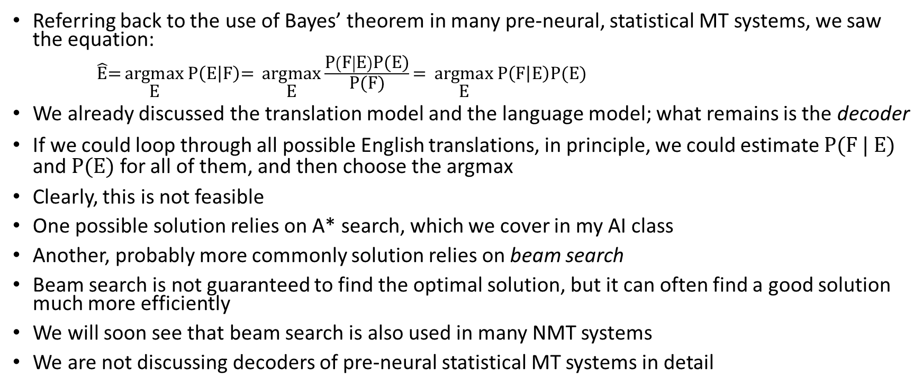
Pre-neural Statistical MT Decoder
Referring back to the use of Bayes’ theorem in many pre-neural, statistical MT systems, we saw the equation:
$\hat{\text{E}}\text{=}\underset{\text{E}}{\text{argmax}}{\text{P}\left(\text{E} | \text{F}\right)\text{=} }\underset{\text{E}}{\text{argmax}}{\frac{\text{P}\left(\text{F} | \text{E}\right)\text{P}\text{(}\text{E}\text{)}}{\text{P}\text{(}\text{F}\text{)}}\text{=} \underset{\text{E}}{\text{argmax}}{\text{P}\left(\text{F} | \text{E}\right)\text{P}\text{(}\text{E}\text{)}}}$
We already discussed the translation model and the language model; what remains is the decoder
If we could loop through all possible English translations, in principle, we could estimate P(F | E) and P(E) for all of them, and then choose the argmax
Clearly, this is not feasible
One possible solution relies on A* search, which we cover in my AI class
Another, probably more commonly solution relies on beam search
Beam search is not guaranteed to find the optimal solution, but it can often find a good solution much more efficiently
We will soon see that beam search is also used in many NMT systems
We are not discussing decoders of pre-neural statistical MT systems in detail

Slide 28
Neural Machine Translation
As mentioned earlier, when neural networks are used for MT, this is often referred to as neural machine translation (NMT)
The figure on the next slide, repeated from earlier in the topic, shows a general encoder-decoder network (not specific to MT)
Over the next few slides, we will discuss how such an architecture can be applied to MT

Slide 29
Basic Encoder-Decoder Network Revisited

Slide 30
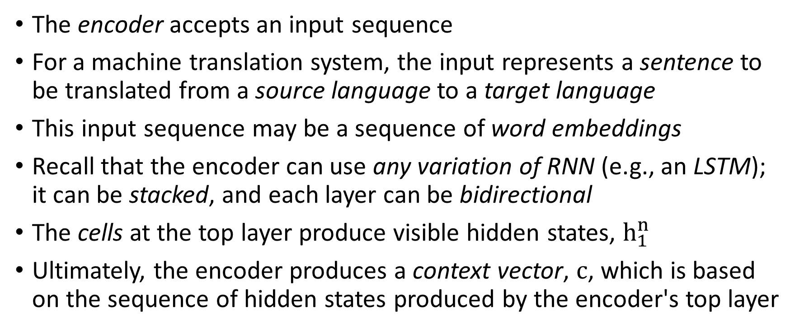
Encoder Applied to MT
The encoder accepts an input sequence
For a machine translation system, the input represents a sentence to be translated from a source language to a target language
This input sequence may be a sequence of word embeddings
Recall that the encoder can use any variation of RNN (e.g., an LSTM); it can be stacked, and each layer can be bidirectional
The cells at the top layer produce visible hidden states, $h_{1}^{n}$
Ultimately, the encoder produces a context vector, c, which is based on the sequence of hidden states produced by the encoder's top layer

Slide 31
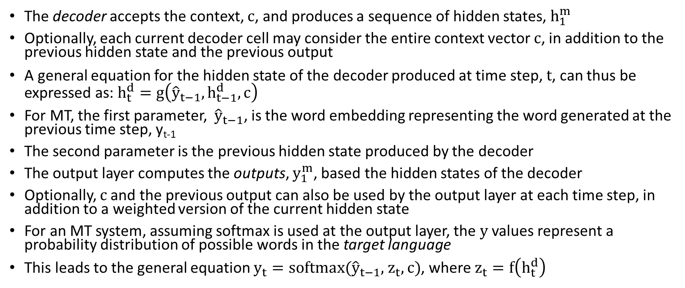
Decoder Applied to MT
The decoder accepts the context, c, and produces a sequence of hidden states, $h_{1}^{m}$
Optionally, each current decoder cell may consider the entire context vector c, in addition to the previous hidden state and the previous output
A general equation for the hidden state of the decoder produced at time step, t, can thus be expressed as: $h_{t}^{d}=g\left({\hat{y}}_{t−1},h_{t−1}^{d},c\right)$
For MT, the first parameter, ${\hat{y}}_{t−1}$, is the word embedding representing the word generated at the previous time step, y_{t-1}
The second parameter is the previous hidden state produced by the decoder
The output layer computes the outputs, $y_{1}^{m}$, based the hidden states of the decoder
Optionally, c and the previous output can also be used by the output layer at each time step, in addition to a weighted version of the current hidden state
For an MT system, assuming softmax is used at the output layer, the y values represent a probability distribution of possible words in the target language
This leads to the general equation $y_{t}=softmax({\hat{y}}_{t−1}$, $z_{t},c)$, where $z_{t}=f\left(h_{t}^{d}\right)$

Slide 32
Training an Encoder-Decoder for MT
As previously mentioned, to train an NMT system, we use sentence-pairs from a parallel corpus, a.k.a. a parallel text or a bitext
The source sentence, ending in an end-of-sentence marker is applied to the encoder
When the decoder is applied, the error is based on the probability assigned to the true next word (if we are using the cross-entropy loss function)
Regardless of what word the decoder predicts, the actual next word from the target sentence is fed to the decoder at the next time step for training
The end-of-sentence marker is never fed to the decoder as input, but it is the expected token after the last word in the target sentence
The entire encoder-decoder network can be trained end-to-end using stochastic gradient descent and backpropagation

Slide 33
Problem with Choosing Words As We Go
We have been assuming that the decoder applies an argmax to the output of softmax to determine the most likely word at each time step
This would be an example of greedy decoding
This is not optimal to produce the best overall sentence
Book: "The problem is that the token that looks good to the decoder now might turn out later to have been the wrong choice"
For sequence labelling tasks, we can use algorithms such as the Viterbi algorithm to optimize tags for the entire sentence
The current draft of the book explains that this doesn't work for generation tasks involving long-distance dependencies
Related to this, I would add that the Markov assumption doesn't hold

Slide 34
Beam Search
One common method to improve translations (or other encoder-decoder tasks) is to use beam search
We also mentioned beam search as a technique used by decoders for pre-neural statistical MT
My slides on beam search for NMT are partially based on an earlier draft of the textbook; the current draft covers beam search in Section 10.4 (Chapter 10, in general, relates to Transformers)
Beam search views the task of the decoder as a search through the state space of possible output sequences (translations, in the case of MT), but we must avoid an exponential search
At the first step of decoding, beam search keeps track of the B best choices; B is the beam size
For MT, after the first step, it keeps track of the B most likely first words of the predicted translation
Using general search terminology, the B states currently comprising the beam represent the frontier of the search; the partial paths leading to these B states can be called hypotheses
Each of the B hypotheses leading to states on the frontier is fed to a distinct decoder; that is, for each of the B hypotheses, we are keeping track of separate updated states of the entire neural network
Looking at the outputs of all B softmax functions, we choose the B best updated hypotheses to store for the next time step (along with their updated full neural networks)
For MT, after T time steps, the current hypotheses represent the B best output sequences so far, representing predictions for the first T words of the translated sentence

Slide 35
Terminating Beam Search
When an end-of-sentence marker is generated, the hypothesis leading to it is recorded, and the size of the beam is reduced by one
The process continues until the beam size is 0
At that point, we have remembered B complete hypotheses, each representing a fully translated sentence
Based on their overall probabilities (determined by the softmax functions that predicted the target words), we can choose the best sentence
The figure on the next slide (from an earlier draft of the textbook) helps to explain how beam search works
One issue with beam search is that longer sequences tend to have lower probabilities associated with them than shorter sequences
This is because more probabilities have been multiplied together
This can be mitigated with some sort of length normalization

Slide 36
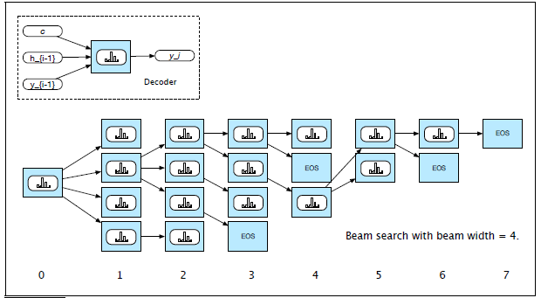
Beam Search Example

Slide 37
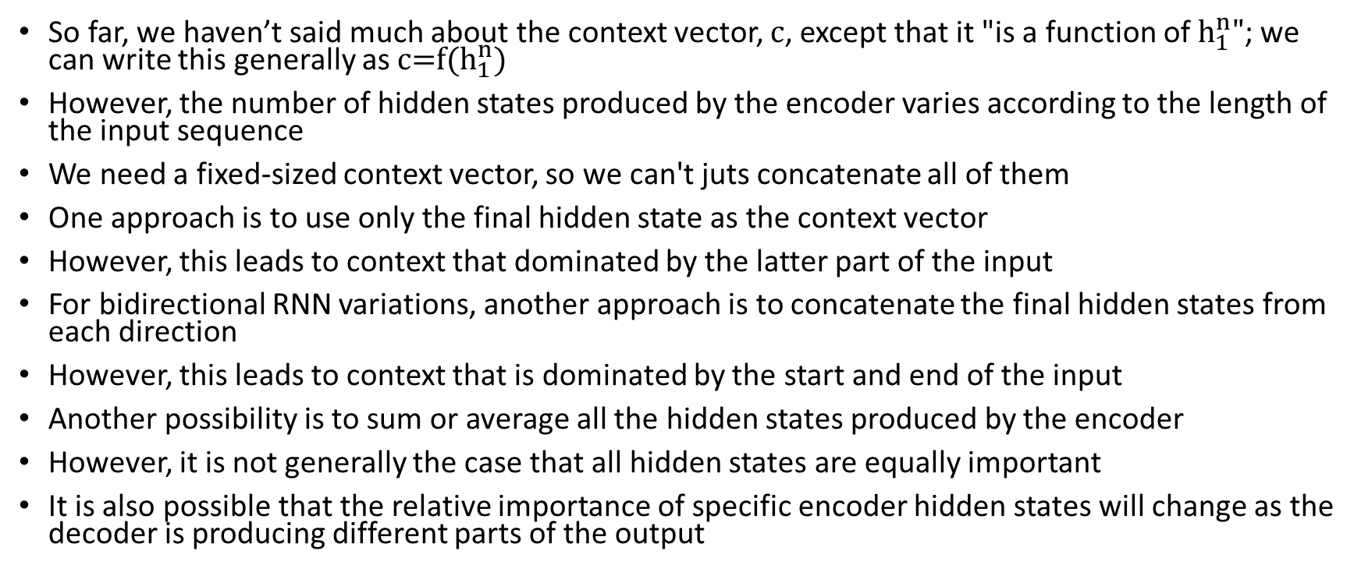
The Context Vector Revisited
So far, we haven’t said much about the context vector, c, except that it "is a function of $h_{1}^{n}"$; we can write this generally as c=f($h_{1}^{n}$)
However, the number of hidden states produced by the encoder varies according to the length of the input sequence
We need a fixed-sized context vector, so we can't juts concatenate all of them
One approach is to use only the final hidden state as the context vector
However, this leads to context that dominated by the latter part of the input
For bidirectional RNN variations, another approach is to concatenate the final hidden states from each direction
However, this leads to context that is dominated by the start and end of the input
Another possibility is to sum or average all the hidden states produced by the encoder
However, it is not generally the case that all hidden states are equally important
It is also possible that the relative importance of specific encoder hidden states will change as the decoder is producing different parts of the output

Slide 38
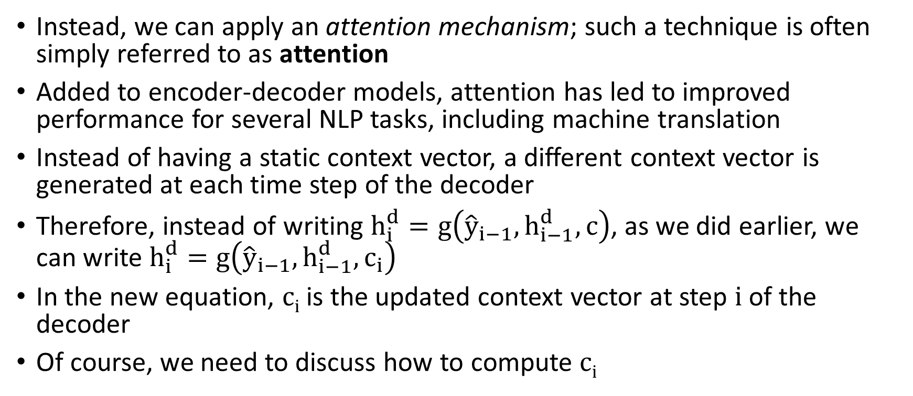
Attention
Instead, we can apply an attention mechanism; such a technique is often simply referred to as attention
Added to encoder-decoder models, attention has led to improved performance for several NLP tasks, including machine translation
Instead of having a static context vector, a different context vector is generated at each time step of the decoder
Therefore, instead of writing $h_{i}^{d}=g\left({\hat{y}}_{i−1},h_{i−1}^{d},c\right)$, as we did earlier, we can write $h_{i}^{d}=g\left({\hat{y}}_{i−1},h_{i−1}^{d},c_{i}\right)$
In the new equation, c_{i} is the updated context vector at step i of the decoder
Of course, we need to discuss how to compute c_{i}

Slide 39
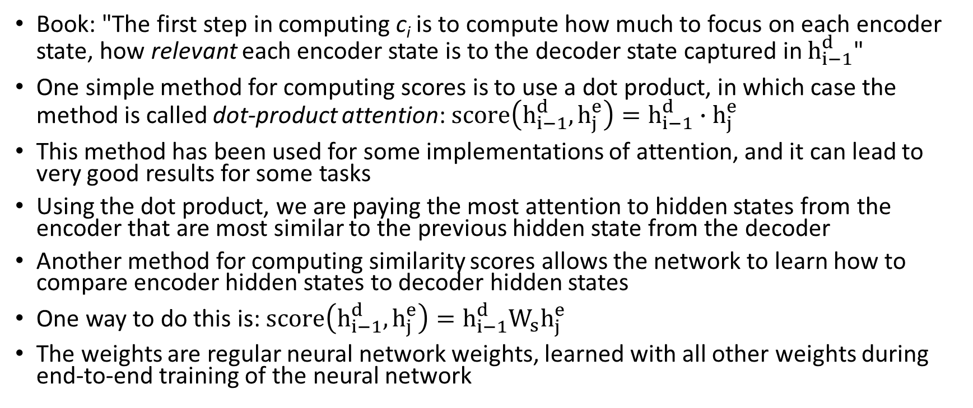
Attention: Computing Scores
Book: "The first step in computing c_{i} is to compute how much to focus on each encoder state, how relevant each encoder state is to the decoder state captured in $h_{i−1}^{d}$"
One simple method for computing scores is to use a dot product, in which case the method is called dot-product attention:$score\left(h_{i−1}^{d},h_{j}^{e}\right)=h_{i−1}^{d}∙h_{j}^{e}$
This method has been used for some implementations of attention, and it can lead to very good results for some tasks
Using the dot product, we are paying the most attention to hidden states from the encoder that are most similar to the previous hidden state from the decoder
Another method for computing similarity scores allows the network to learn how to compare encoder hidden states to decoder hidden states
One way to do this is: $score\left(h_{i−1}^{d},h_{j}^{e}\right)=h_{i−1}^{d}W_{s}h_{j}^{e}$
The weights are regular neural network weights, learned with all other weights during end-to-end training of the neural network

Slide 40
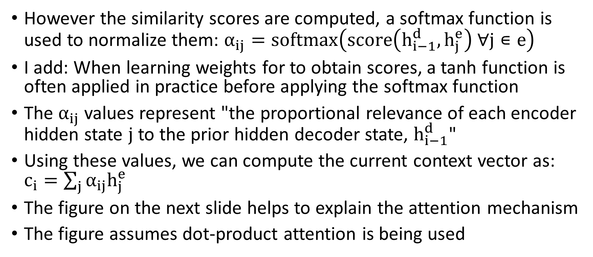
Attention: Computing the Context Vector
However the similarity scores are computed, a softmax function is used to normalize them: $α_{ij}=softmax\left(score\left(h_{i−1}^{d},h_{j}^{e}\right) ∀j∊e\right)$
I add: When learning weights for to obtain scores, a tanh function is often applied in practice before applying the softmax function
The $α_{ij}$ values represent "the proportional relevance of each encoder hidden state j to the prior hidden decoder state, $h_{i−1}^{d}$"
Using these values, we can compute the current context vector as: $c_{i}=\sum_{j}{α_{ij}h_{j}^{e}}$
The figure on the next slide helps to explain the attention mechanism
The figure assumes dot-product attention is being used

Slide 41
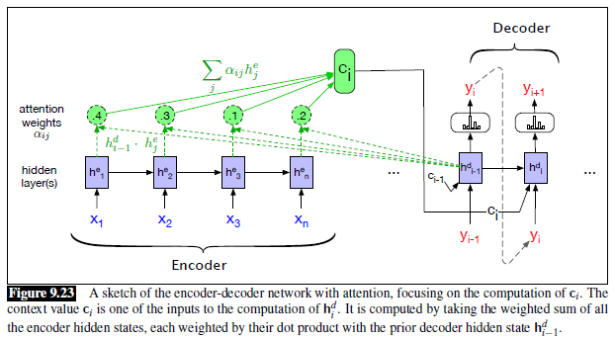
Attention: Graphical Depiction

Slide 42
Evaluating MT systems
One way to evaluate MT systems is to rely on human judgements, but that is expensive and not always feasible
Another way is to use a metric
The metric that has dominated the automatic MT literature is called BLEU, which stands for Bilingual Evaluation Understudy
  BLEU compares an automatically generated translation to one or more human translations of the same source sentence to the same target language
  BLUE measures the frequencies of all N-grams, up to some specified N, that overlap with at least one of the human sentences
  These measures are combined, and there is also a penalty for brevity, without which the metric would favor short translations
When BLEU was first created, it seemed to correlate very well with human judgements of quality
However, after researchers started to optimize their systems specifically to maximize BLEU scores, that correlation often fails to hold
Nonetheless, BLEU has been the dominant metric to evaluate MT systems
The textbook also explains a similar, newer metric called chrF

Slide 43
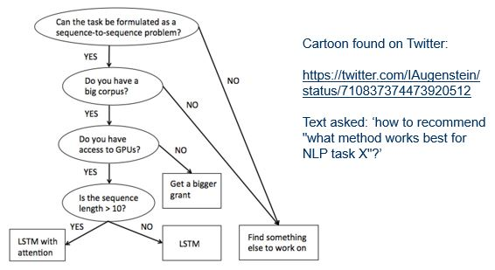
Cartoon Found on Twitter, Posted in 2016

