Slide 1
ECE467: Natural Language Processing
Advanced Topics

Slide 2
Subtopic #1
Subword Embeddings

Slide 3
Drawbacks of Word Embeddings
We have examined word embeddings, which can be pre-learned using a method such as a word2vec model
Word embeddings can be fed as input to neural networks, including variations of RNNs (including LSTMs), encoder-decoder models, etc.
However, word embeddings have drawbacks
Based on an earlier draft of the textbook, some of the drawbacks are:
  Some languages have too many words to realistically learn word embeddings for all variations (e.g., morphologically complex languages)
  Word embeddings ignore morphological information (I add: although the book listed this as a drawback, I consider this debatable)
  Some languages do not contain spaces between words, making tokenization at the word level difficult (not mentioned in the book)
  Even for standard languages, some words will occur that do not have pre-learned embeddings (this is discussed further on the next slide)

Slide 4
Out-of-vocabulary words
Regardless of the reason they occur, words that have not been seen in a training set are called out-of-vocabulary (OOV) words
The textbook discusses OOV words in the chapter on N-grams, and we also mentioned them in that context
Reasons for this include new words introduced to the language (neologisms), misspellings, and borrowings from other languages
It is also common for named entities to introduce new terms; e.g., people, organizations such as companies, names of games, etc.
Words that are borrowed from other languages are sometimes called loanwords
A related notion is transliteration, when a word from one language is converted to another alphabet, attempting to keep the pronunciation the same
When a system that uses only word embeddings encounters an OOV word, it generally needs to do something hacky

Slide 5
Subwords
In modern NLP, many works map smaller pieces of words, generally referred to as subwords, to embeddings
An earlier draft of the textbook discussed this subtopic (briefly) in a section that was titled "Words, Subwords and Characters"
The book (earlier draft) mentions three approaches for choosing which subwords to use for embeddings
  Individual characters can be mapped to character embeddings
  We can use subwords created by byte-pair encoding (BPE), or some alternative method
  A system can "use full-blown morphological analysis to derive a linguistically motivated input sequence"
Another approach to dealing with subwords that become popular in recent years is known as fasttext
The book (current draft) has one paragraph on fasttext in Section 6.8.3, but we will not cover this approach

Slide 6
Byte-pair Encoding Overview
Byte-pair encoding (BPE) was originally developed for use as a compression algorithm
Our textbook discusses BPE as a method for tokenization in Section 2.4.3
BPE has been around for decades, but it has become popular recently as a method for generating subwords for subword embeddings
An alternative method for generating subwords, also briefly mentioned in Section 2.4.3, is called WordPiece; we won't discuss it

Slide 7
BPE Algorithm
The BPE algorithm starts with a separate symbol for each character in the text being processed (e.g., every ASCII character or every Unicode character)
There is also a special end-of-word symbol, concatenated to the end of each word in the corpus being used to generate the BPE tokens that will be recognized
Thus, the initial vocabulary (i.e., recognized set of tokens) is the set of characters in the encoding plus the end-of-word symbol
The algorithm then iteratively combines the most frequent sequential pair of symbols to form a new symbol
  The new symbol gets added to the vocabulary
  Words containing the new symbol are updated in the corpus being processed
This proceeds for a fixed number of iterations, k, where k is a parameter of the algorithm
The algorithm only considers pairs of symbols within words (i.e., not crossing word boundaries)
We will step through an example to help explain this

Slide 8
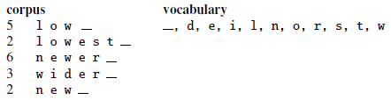
BPE Example: Initial State
We will step through an example from textbook to help explain this
The example is based on a corpus with 5 distinct words, 18 total instances of words, and initially 11 distinct symbols (including the end-of-word symbol, represented as an underscore)
Initially, the vocabulary consists only of the 11 original symbols, and the counts of all the words is known

Slide 9
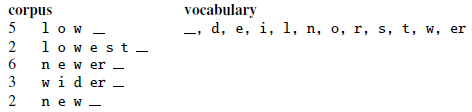
BPE Example: Step 1
During the first iteration of the algorithm, it is determined that the most frequent symbol pair is 'e' followed by 'r', which occurs 9 times
Therefore, a new symbol for 'er' is created and added to the vocabulary
All instances of this pair are replaced by the new symbol
Note that 'r' followed be '_' ties with this, so that also would have been a valid choice

Slide 10
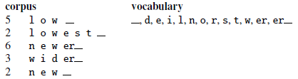
BPE Example: Step 2
During the second iteration, the most frequent pair is 'er' followed by '_', which occurs 9 times
Therefore, a new symbol for 'er_' is created and added to the vocabulary
All instances of this pair are replaced by the new symbol
Note that 'e', 'r', and 'er' are still members of the vocabulary

Slide 11
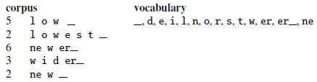
BPE Example: Step 3
During the third iteration, the most frequent pair is 'n' followed by 'e', which occurs 8 times
This time, a new symbol for 'ne' is created and added to the vocabulary
All instances of this pair are replaced by the new symbol
Note that 'e' followed be 'w' ties with this, so that also would be a valid choice

Slide 12
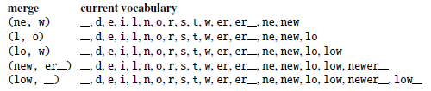
BPE Example: Five More Merges
The book shows the merged pairs and the updated vocabularies for the next five steps
Note that the algorithm remembers the order in which the merges have been generated

Slide 13
Using BPE to Tokenize
We can use the result of the BPE algorithm to tokenize future texts as follows:
  Start with all characters represented by separate symbols
  Then apply the merges greedily in the order that they were learned
Note that when we apply the tokenization, the frequencies in the data being tokenized do not play a role
Based on the example, the word "newer" in the document being tokenized would become a single token, "newer_"
The word "lower" would become "low er_" (two separate tokens)

Slide 14
BPE Advantages
As mentioned earlier, BPE runs for a fixed number of iterations, k
This determines the size of the vocabulary, which is typically significantly smaller than the size of a conventional vocabulary
The book says that "in real settings BPE is run with many thousands of merges on a very large input corpus"
The book claims that "most words will be represented as full symbols, and only the very rare words (and unknown words) will have to be represented by their parts"
This is a bit different from what I’ve learned about the algorithm; I learned that:
  Common words (e.g., "the") will be represented as single symbols
  Common morphemes (e.g., "un-", "-ies", etc.) will be represented as single symbols
BPE can achieve something similar to morphological parsing with a much simpler algorithm, hopefully leading to sensible tokens
OOV words are likely to be tokenized into meaningful chunks

Slide 15
Using Subword Embeddings
Once it is determined what subwords will be used, embeddings for the subwords can be learned (pre-trained) using any standard method
One way to apply subword embeddings to a task is to simply feed them in as input to any variation of an RNN
There have been many systems that have successfully used this approach
Another idea is to build word embeddings out of subword or character embeddings
Optionally, these built-up word embeddings can be combined with, or used in place of, standard word embeddings

Slide 16
Using Character Embeddings: Example
An alternative to using word embeddings or subword embeddings is to use character embeddings
The figure on the next page (from an earlier draft of the textbook) helps to explain an example of how character embeddings could be used for a sequence labelling task
The Bi-RNN near the bottom, which is combining character embeddings to form a word embedding, is learning how to do this in the context of the current task
That is, the original character embeddings have been pre-trained, but the way in which they are combined is being learned for a specific sequence labelling task
Ultimately, the hidden states from the ends of the two directions of the bidirectional RNN are combined to form a character-level word embedding
This character-level word embedding is being combined with a conventional word embedding; e.g., using concatenation
When an OOV word is encountered, the character-level word embedding can be used on its own
The higher blue box labeled "RNN" can represent any variation of RNN (e.g., an LSTM), possibly stacked or bidirectional
This figure helps to intuit why character embeddings can be useful

Slide 17
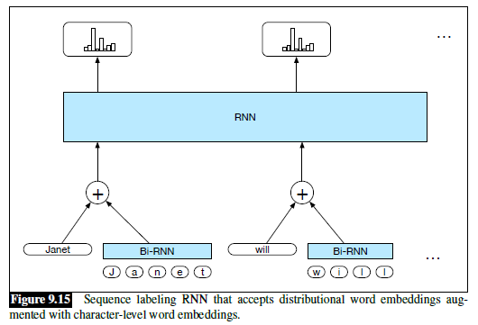
Using Character Embeddings: Diagram

Slide 18
Subtopic #2
Question Answering (QA)

Slide 19
Question Answering Overview
Question answering (QA) refers to the task of finding a specific answer to a given question within a text corpus or a knowledge base
QA is covered in Chapter 14 of the current draft of the textbook
We will focus on QA involving a text corpus, such as the World Wide Web
A first phase of such a system would apply information retrieval (IR) techniques to retrieve documents that are likely to contain an answer to the given question
We covered IR as part of our first unit of the course
IR-based question answering has been worked on a long time, and conventional, statistical approaches worked fairly well
Deep learning has significantly improved one component of the task
The primary focus of the task has generally been answering factoid questions
This basically means that the answer is a short span of text (often, but not always, a named entity)
The figure on the next slide shows examples of factoid questions and their answers

Slide 20
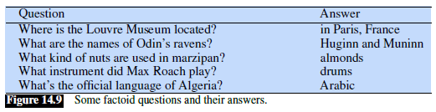
Examples of Factoid Questions and Answers

Slide 21
Pre-neural, IR-based, Factoid QA Systems
We will take an excursion to discuss methods used by conventional (pre-neural), statistical, IR-based factoid QA systems, which often consisted of several independent components
The figure on the next slide (from an earlier draft of the textbook) shows a possible architecture for such a system
The "Document Retrieval" component represents a typical IR system
However, the task of QA is different than IR; we are tasked with finding the specific answer
The "Passage Retrieval" component splits each document into paragraphs or other smaller snippets to serve as passages in which we the system searches for answers
Some conventional systems would then search for answers in every passage
Others choose candidate passages using a statistical ML approach; features used might include:
  The number of named entities of the right type in the passage
  The number of keywords or N-grams that overlap between the passage and the question
  The longest exact sequence of question keywords that occurs in the passage
  The rank of the document from which the passage was extracted
  The proximity of the keywords from the original query to each other
We will discuss other components of a conventional, IR-based system on future slides

Slide 22
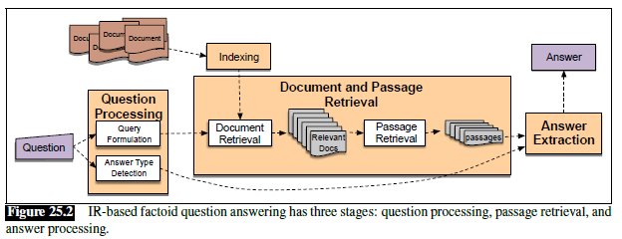
Pre-neural, IR-based, Factoid QA Architecture

Slide 23
Question Processing for Conventional QA
The "Query Formulation" component takes the user's question and formulates a query for the IR system
For web searches, the questions might be used as queries without modification
For smaller corpora, using bigrams might be helpful, and query expansion might be helpful
Some systems applied query reformulation rules, reordering words in such a way that they will more likely match the order in the discovered answer
For example, given the question "Where is the Valley of the Kings?", the component may produce the query "the Valley of the Kings is located in"
Pre-neural systems also often contained an "Answer Type Detection" component that would analyze the question to determine a category for the desired answer (e.g., a person, a location, definition, etc.)
Sometimes, manual rules were used for this, but more often, supervised machine learning was used, trained on a set of questions with manually labelled answer types
Features used by conventional, statistical systems included words, their POS, and named entities
Some systems gave the head of the noun phrase following the wh-word in the question high weight; for example, consider questions starting "Which city…" or "What is the state flower…"
If the answer type is a specific type of named entity, only passages containing at least one instance of such a named entity need to be considered by the system

Slide 24
Answer Extraction for Conventional QA
The "Answer Extraction" box in the diagram represents the component of a system that examines one passage at a time and tries to find the answer to the original question
If the answer type is a named entity, NER can be used to find possible answers of the right type
On the other hand, if the question asks for a definition of something, it is more complex to find the exact span of text that specifies the answer
Pre-neural systems used either hand-crafted rules (sometimes involving regular expressions) or statistical machine learning techniques
Pre-neural, machine-learning-based answer extraction relied on various features (we won’t go over them)
A method called n-gram tiling looks for common n-grams across passages from highly ranked documents and uses manual scoring rules based on the answer type
We will soon see that modern QA systems typically rely on deep learning for this component of QA

Slide 25
Watson
Section 14.6 of the current draft of the textbook discusses the approach used by the Watson DeepQA system
This is the name of the IBM system that beat two of the best-ever players at Jeopardy! In 2011
Watson could find answers (well…) in both text and knowledge bases
Like traditional QA systems, it used several components acting together, and involved sequential phases of processing
We won't discuss the details of this system

Slide 26
Reading Comprehension and SQuAD
Much of the current research related to QA limits the task to finding an answer to a given question in a specific passage
This subtask of QA is sometimes referred to as answer extraction or reading comprehension
One important dataset for reading comprehension is the Stanford Question Answering Dataset (SQuAD)
The dataset consists of passages from Wikipedia and associated questions
Questions were collected from human volunteers
The answers are spans of texts from the passages
The original SQuAD dataset, SQuAD 1.1, contained only answerable questions
SQuAD 2.0 also includes unanswerable questions
Each answerable questions contains answers from at least three humans
The figure on the next slide shows a passage from SQuAD 2.0 along with three sample questions and their answers

Slide 27
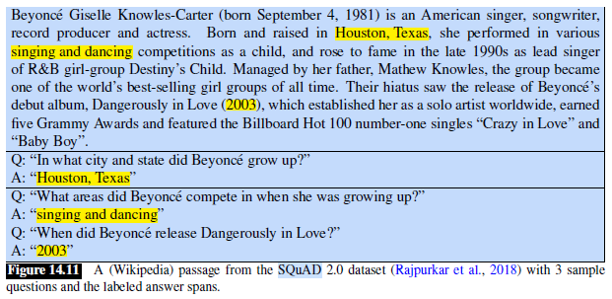
SQuAD Examples

Slide 28
SQuAD Metrics
Systems are evaluated according to two metrics
Exact match only credits a system if the answer exactly matches one of the human answers
F1 combines the precision and recall of predicted answers on a per token basis (we covered these metrics earlier in the course)
Stanford maintains a leaderboard, displaying the top systems
When Stanford switched from SQuAD 1.1 to SQuAD 2.0, both metrics dropped significantly
Now, even for SQuAD 2.0, the top systems beat human performance (but I think this always has to be taken with a grain of salt)

Slide 29
Neural QA Systems
The neural component of a QA system processes a question and a passage that contains (or may contain) the answer
For each word in the passage, it predicts how likely the word is to be the start of, and how likely the word is to be the end of, the answer to the question
These probabilities can be used to predict the answer, or to decide that the passage does not contain the answer to the question
We will examine the architecture of a system called DrQA, from 2017, that is built on top of LSTMs
The figure on the next slide, from an earlier draft of the textbook, helps to explain the architecture of the system (the few slides after that provide more details)
The current draft summarizes the typical architecture of newer systems built on top of BERT and Transformers (we will learn more about these concepts in our remaining subtopics)
Some new systems are likely even more complex, and would perform even better, but the example we are discussing should give us a good idea of how neural QA systems work in general
Neural QA systems (which really just perform answer extraction), such as the one we will discuss, can be trained end-to-end, using a dataset such as SQuAD, using gradient descent and backpropagation

Slide 30
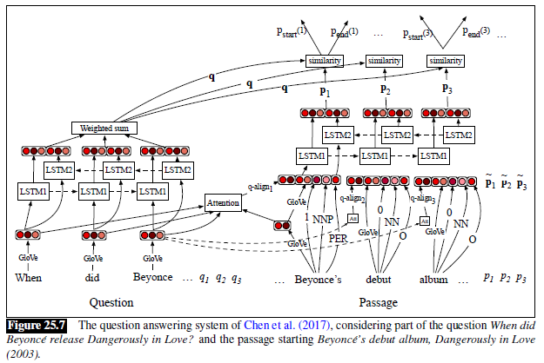
DrQA: Neural QA Architecture Example

Slide 31
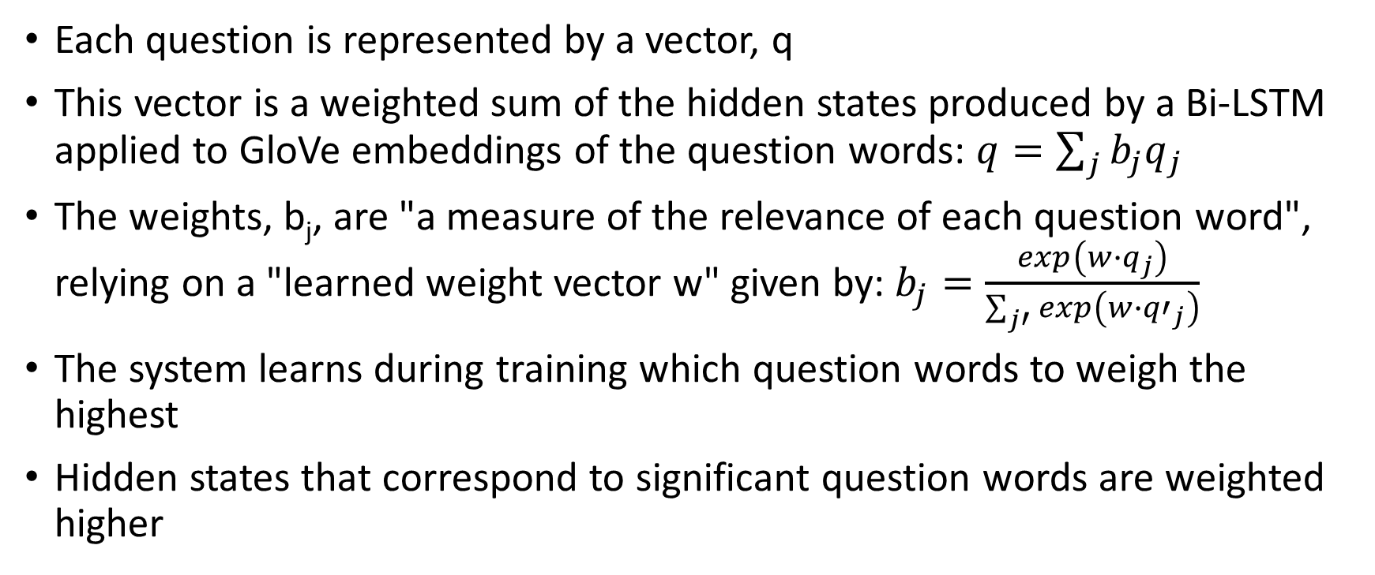
DrQA: Question Processing
Each question is represented by a vector, q
This vector is a weighted sum of the hidden states produced by a Bi-LSTM applied to GloVe embeddings of the question words: $q=\sum_{j}{b_{j}q_{j}}$
The weights, b_{j}, are "a measure of the relevance of each question word", relying on a "learned weight vector w" given by: $b_{j}=\frac{exp\left(w∙q_{j}\right)}{\sum_{j′}{exp\left(w∙{q′}_{j}\right)}}$
The system learns during training which question words to weigh the highest
Hidden states that correspond to significant question words are weighted higher

Slide 32
DrQA: Passage Processing
For each word in the passage, a complex vector is being formed consisting of a concatenation of:
  The GloVe embedding of the passage word
  A representation of the POS of the word
  A representation of the NER tag of the word
  An exact match feature, representing if the passage word occurs in the question
  A vector created using an attention mechanism, comparing the passage word's GloVe embeddings to the embeddings of every question word
These vectors are input to a Bi-LSTM, producing hidden states for each word in the passage

Slide 33
DrQA: Predicting Probabilities
The hidden state for each word in the passage along with with the question representation are used to predict two probabilities:
  p_{start}(i) is the probability that the i^{th} word in the passage is the start of the answer
  p_{end}(i) is the probability that the i^{th} word in the passage is the end of the answer
If it is known that the passage contains the answer, the most likely answer can be selected
If some questions may be unanswerable, the system must ensure that the likelihood of the answer passes some threshold

Slide 34
Subtopic #3
Transformers

Slide 35
Pre-Transformer Brief Recap
Through 2017, variations of RNNs (such as LSTM's) dominated the NLP literature
Encoder-decoder networks a.k.a. sequence-to-sequence (seq2seq) models, were used for tasks such as machine translation (MT)
Input sequences (represented using either word embeddings or subword embeddings) would be mapped to output sequences
These methods produced significantly better results than were possible using pre-neural methods
The concept of attention, which allows the decoder to focus on the portion of the output from the encoder that seems most relevant at each time step, improved results further
Other NLP researchers had been experimenting with convolutional neural networks (CNNs)
CNNs were successful for some text categorization tasks, for example, especially those involving short text sequences such as single sentences or tweets
For MT, CNNs were sometimes used for encoders
We are not covering CNNs in this course

Slide 36
Shortcomings of RNNs and CNNs
RNNs (including the variations such as LSTMs) cannot be efficiently parallelized
  They must process input sequentially
  This leads to very slow training
CNNs have problems detecting long-distance dependencies
  This refers to relationships between elements that exist far apart in an input sequence
  Theoretically, with enough layers, CNNs can handle this, but in practice, they don’t work well when long-distance dependencies are significant

Slide 37
Transformers
In December 2017, a paper titled "Attention is All You Need" was published by a group of researchers from Google
The paper appears in the 2017 Proceedings of the Conference on Neural Information Processing Systems
The paper is freely available online (there are at least two slightly different versions)
The paper introduces a new neural architecture called a Transformer (not always capitalized in all sources, and I am not entirely consistent with that)
A Transformer relies "solely on attention mechanisms, dispensing with recurrence and convolutions entirely" (from the Abstract of the original paper)
The current online draft of the textbook discusses self-attention and Transformers in Section 10.1, titled "Self-Attention Networks: Transformers"
Section 10.2 discusses how transformers can be used for language modeling
The textbook briefly discusses Transformers in the context of encoder-decoder networks, which is how they were described in the original paper, in Section 13.3
I have based my slides for this topic mostly on the original paper, as well as a few websites that help to explain Transformers
All figures and tables in this subtopic come from the original paper

Slide 38
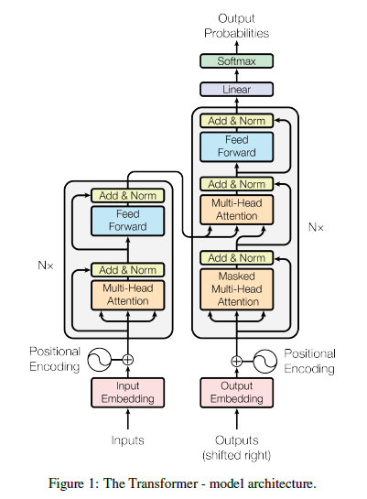
Transformer Architecture
A Transformer (as it was originally introduced) is an example of an encoder-decoder network
The encoder and decoder both rely on stacked layers
Each layer has sublayers
Some of the sublayers rely on a concept called self-attention (which we will discuss soon)
Others are point-wise (a.k.a. position-wise), fully-connected, feedforward NNs
The decoder also uses another form of attention applied to the encoder output
Note that several later works relying on Transformers only use the encoder portion
Some others use only the decoder portion
We are covering Transformers as explained in the paper, for sequence-to-sequence (seq2seq) tasks

Slide 39
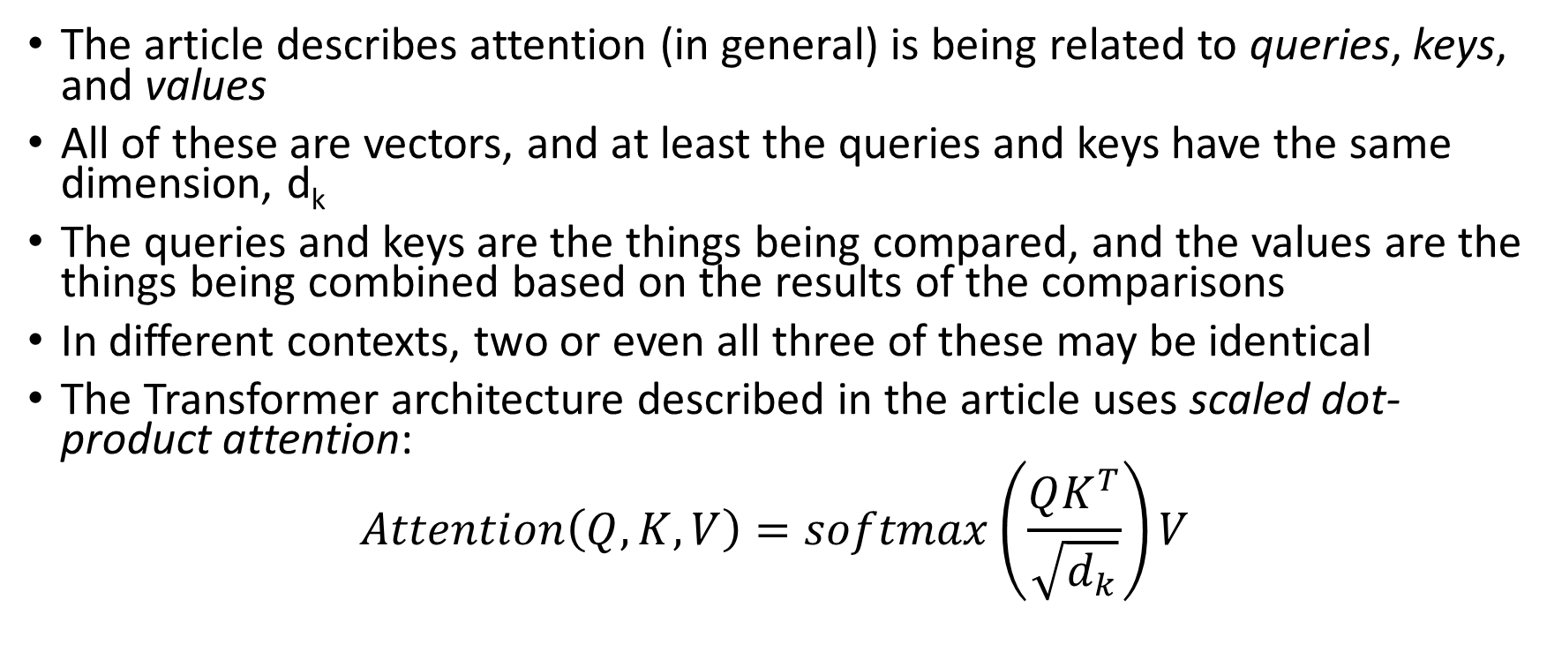
Attention (as explained in the article)
The article describes attention (in general) is being related to queries, keys, and values
All of these are vectors, and at least the queries and keys have the same dimension, d_{k}
The queries and keys are the things being compared, and the values are the things being combined based on the results of the comparisons
In different contexts, two or even all three of these may be identical
The Transformer architecture described in the article uses scaled dot-product attention:
$$Attention\left(Q, K,V\right)=softmax\left(\frac{QK^{T}}{\sqrt{d_{k}}}\right)V$$

Slide 40
Multi-head Attention
Attention learns to focus on one aspect of the input
For many NLP tasks, there are various aspects of the input that we need to pay attention to for different reasons
For this reason, Transformers use multi-head attention
  First, queries, keys, and values are linearly projected using learned mappings
  Next, attention is applied in parallel to each result
  The outputs or attention are then concatenated and again projected
The figure on the next page helps explain the difference between ordinary scaled dot-product attention and multi-head attention

Slide 41
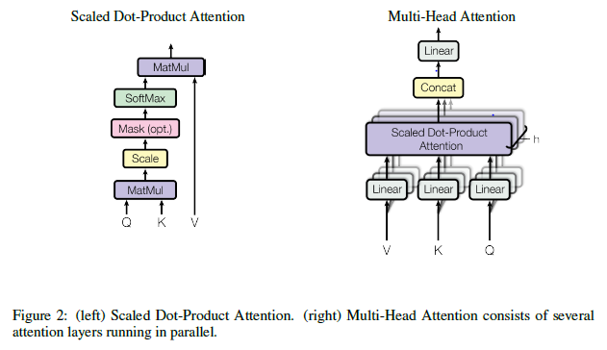
Multi-head vs Scaled Dot-Product Attention

Slide 42
The Transformer’s Encoder
The Transformer’s encoder accepts the input, which is a sequence of input embeddings combined with positional encodings (to be discussed soon)
The encodings go through 6 identical layers, each containing two sublayers
The first sublayer is a multi-head self-attention layer
  Each encoding is compared to every other, and the weighted encodings are added together to form an output representation (i.e., the query, keys, and values are all the same)
  A residual connection, a.k.a. skip connection, adds the input of the sublayer to its output; the sum is normalized
The second sublayer is a position-wise fully-connected feedforward neural network
  This consists of "two linear transformations with a ReLU activation in between": FFN(x) = max(0, xW₁ + b₁)W₂ + b₂
  Weights are shared across positions within a layer, but the weights differ between layers
  As with the first sublayer, a residual connection adds the input of the sublayer to its output, and the sum is normalized

Slide 43
Positional Encodings
Without positional encodings, there is no way for a Transformer to make use of the order of the input
It is therefore necessary to "inject some information about the relative or absolute position of the tokens in the sequence"
The article says that they experimented with two forms of positional encodings, which led to nearly identical results
They wound up using "sine and cosine functions of different frequencies", producing vectors of the same dimension as the embeddings
These position encodings are added to the input embeddings
Note that positional encodings are only added to the input directly
However, due to residual connections, they have an effect throughout the stack

Slide 44
The Transformer’s Decoder
The Transformer’s decoder also accepts its inputs (the outputs of the seq2seq mapping), which is a sequence of embeddings combined with positional encodings
As with the encoder, the encodings go through 6 identical layers, each containing two sublayers
As with the encoder, the first sublayer is a multi-head self-attention layer
Unlike the encoder, this sublayer is masked (to be discussed soon)
The third sublayer of the decoder is the same as the second sublayer of the encoder (i.e., a position-wise fully-connected feedforward neural network)
The second sublayer of the decoder "performs multi-head attention over the output of the encoder stack"
Note that this is the same sort of attention we learned about in a previous topic, when discussing LSTMs or other types of RNNs used for encoder-decoder networks
The output of the decoder is fed through a linear transformation layer and then a softmax is applied to predict outputs

Slide 45
Training Transformers for Machine Translation
The article discusses the results of applying their Transformer architecture to the task of machine translation (MT)
Although they don’t say it anywhere in the article, the network can be trained end-to-end using stochastic gradient descent and backpropagation
  Using a parallel corpus, sentences from the source language are fed to the encoder while translations in the target language are fed to the decoder
  The target sentences are "shifted right", and a start-of-sentence marker is inserted as the new first token (the latter point is not mentioned in the article)
  They "modify the self-attention sub-layer in the decoder stack to prevent positions from attending to subsequent positions"
  This masking, combined with the right-shifting, "ensures that the predictions for position i can depend only on the known outputs at positions less than i"

Slide 46
Applying a Trained Transformer to MT
It is not mentioned anywhere in the article, but to apply the pre-trained network, you need to run the decoder sequentially, i.e., to predict one token at a time
I found a helpful explanation here: https://medium.com/inside-machine-learning/what-is-a-transformer-d07dd1fbec04
During the first run, you feed in the source sentence to the encoder, and only a start-of-sentence symbol to the decoder
You only remember the first predicted symbol of the output
During the second run, you feed in the source sentence to the encoder, and the start-of-sentence symbol plus the first predicted symbol from the previous step
You remember the second predicted symbol of the output for the next step, etc.
You repeat this process until and end-of-sentence symbol is predicted

Slide 47
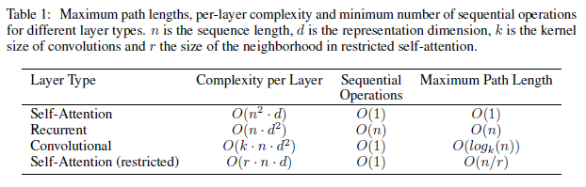
Comparing Architectures (from article)

Slide 48
Experiments
In the article, the authors discuss their results applying a Transformer for two MT tasks:
  One task used the WMT 2014 English-German dataset
  The other task used the larger WMT 2014 English-French dataset
For the English-German dataset, they used byte-pair encoding (BPE) for tokenization; we covered BPE during an earlier subtopic
This led to about 37,000 distinct tokens in the vocabulary
For the English-French datasets, they used "a 32,000 word-piece vocabulary"
This involves another algorithm for creating subwords; we will not discuss it further
The article discusses what hardware they used and what hyperparameters they used (e.g., the Adam optimizer, dropout, etc.)
They tried using a baseline Transformer as well as a "big" version with larger vectors, more heads, etc.
The table on the next slide (from the paper) shows that Transformers beat all previous architectures for both translation tasks, achieving state-of-the-art results "at a fraction of the training cost"
Since the publication of this paper, Transformers and extensions of Transformers have been applied to many NLP tasks with a lot of success

Slide 49
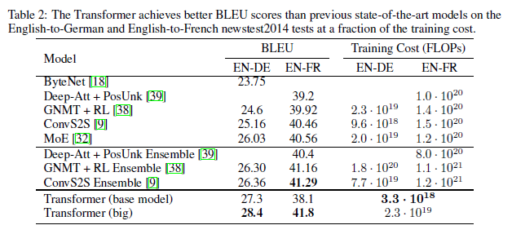
Results

Slide 50
Subtopic #4
Contextual Embeddings and Large Language Models

Slide 51
A Problem with Word Embeddings
Word embeddings we have seen so far, whether learned directly or built up through subword embeddings, do not vary based on context
However, words can have different meanings, depending on context
These differences can be vastly different or subtly different
A relevant resource from conventional NLP is WordNet, which stores many senses of English nouns and verbs, as well as relationships between senses
A relevant task is word sense disambiguation (WSD)
WSD refers to computational approaches for determining the correct meaning of a word that can have multiple senses
Intuitively, it seems that words with multiple senses should have different representations (i.e., different embeddings) in different contexts

Slide 52
Why do Standard Word Embeddings Work?
For words with multiple meanings, why are standard word embeddings useful?
There are a few possible explanations:
  Word embeddings probably combine the different senses
  The most common sense probably dominates the embeddings
  More generally, the portion of the embeddings representing the correct sense is probably useful, while the rest possibly acts as noise
  With stacked architectures, the lower levels may learn context-dependent representations, while higher levels learn how to use them

Slide 53
Contextual Word Embeddings
Prior to 2018, there had been various attempts to produce contextual word embeddings (a.k.a. contextualized word embeddings), some of them successful to an extent
A breakthrough implementation in 2018 was called Embeddings from Language Models (ELMo), developed by collaborators from the Allen Institute for Artificial Intelligence and from the University of Washington
ELMo was introduced in a paper titled "Deep Contextualized Word Representations" by Peters et al., originally presented at the 2018 NAACL Conference
We will see that ELMo, which is built upon bidirectional LSTMs, led to improved performance compared to standard word embeddings for many NLP tasks (QA, sentiment analysis, NER, etc.)
The following year, the paper titled "BERT: Pre-training of Deep Bidirectional Transformers for Language Understanding" by Devlin et al. introduced BERT to the NLP community at the same conference
BERT, developed at Google, is built upon Transformers, and led to further improvement for many NLP tasks
The current draft of the textbook discusses BERT-like contextual embeddings in Chapter 11 (which is not yet complete); BERT is also mentioned throughout the textbook in various locations
We will cover both ELMo and BERT in this subtopic, as well as, at a higher level, various versions of GPT (I'll cite the relevant GPT papers later)
My slides for this topic have largely been based on the originally published papers

Slide 54
Overview of ELMo
As mentioned, ELMo was introduced in a paper titled "Deep Contextualized Word Representations" by Peters et al., originally presented at the 2018 NAACL Conference
The paper won the best paper award at the conference
At the lowest level, ELMo combines character embeddings into initial word embeddings (we won't discuss the details of this component)
These word embeddings are sent through two layers of bidirectional LSTMs (or some other sort of bidirectional RNN)
ELMo is pretrained as a language model on a very large corpus of unlabeled data
After the pretraining, the weights are fixed, and the component that makes predictions for the language model is removed
The pretraining is a form of unsupervised machine learning
The remaining structure replaces or augments the word embeddings fed as input to other architectures for other NLP tasks

Slide 55
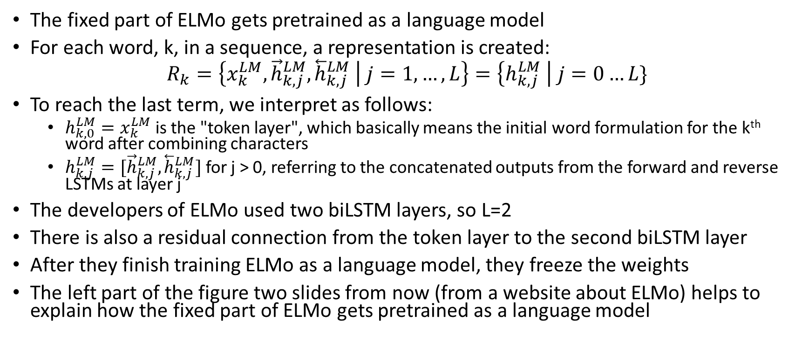
Learning the Language Model
The fixed part of ELMo gets pretrained as a language model
For each word, k, in a sequence, a representation is created:
$$R_{k}=\left\{x_{k}^{LM},{\vec{h}}_{k,j}^{LM},{\overset{⃖}{h}}_{k,j}^{LM} | j=1,…,L\right\}=\left\{h_{k,j}^{LM} \right| j=0…L\}$$
To reach the last term, we interpret as follows:
  $h_{k,0}^{LM}=x_{k}^{LM}$ is the "token layer", which basically means the initial word formulation for the k^{th} word after combining characters
  $h_{k,j}^{LM}=[{\vec{h}}_{k,j}^{LM},{\overset{⃖}{h}}_{k,j}^{LM}]$ for j > 0, referring to the concatenated outputs from the forward and reverse LSTMs at layer j
The developers of ELMo used two biLSTM layers, so L=2
There is also a residual connection from the token layer to the second biLSTM layer
After they finish training ELMo as a language model, they freeze the weights
The left part of the figure two slides from now (from a website about ELMo) helps to explain how the fixed part of ELMo gets pretrained as a language model

Slide 56
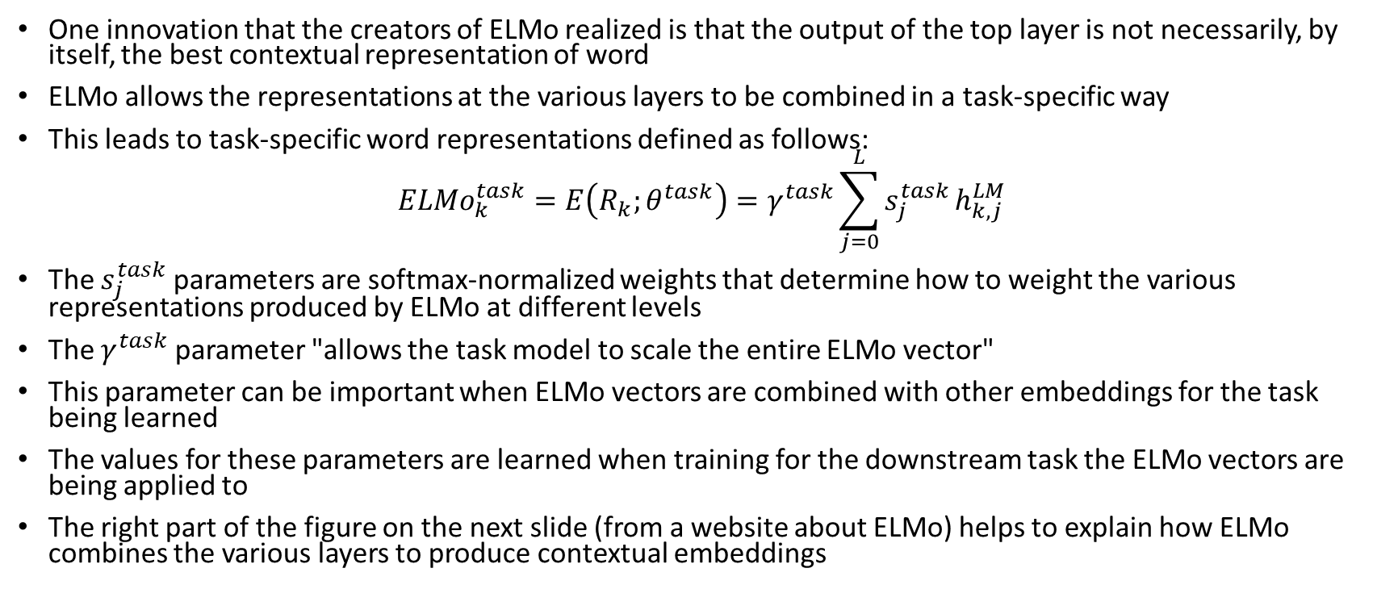
Computing the ELMo Embeddings
One innovation that the creators of ELMo realized is that the output of the top layer is not necessarily, by itself, the best contextual representation of word
ELMo allows the representations at the various layers to be combined in a task-specific way
This leads to task-specific word representations defined as follows:
$${ELMo}_{k}^{task}=E\left(R_{k};θ^{task}\right)=γ^{task}\sum_{j=0}^{L}{s_{j}^{task}}h_{k,j}^{LM}$$
The $s_{j}^{task}$ parameters are softmax-normalized weights that determine how to weight the various representations produced by ELMo at different levels
The $γ^{task}$ parameter "allows the task model to scale the entire ELMo vector"
This parameter can be important when ELMo vectors are combined with other embeddings for the task being learned
The values for these parameters are learned when training for the downstream task the ELMo vectors are being applied to
The right part of the figure on the next slide (from a website about ELMo) helps to explain how ELMo combines the various layers to produce contextual embeddings

Slide 57
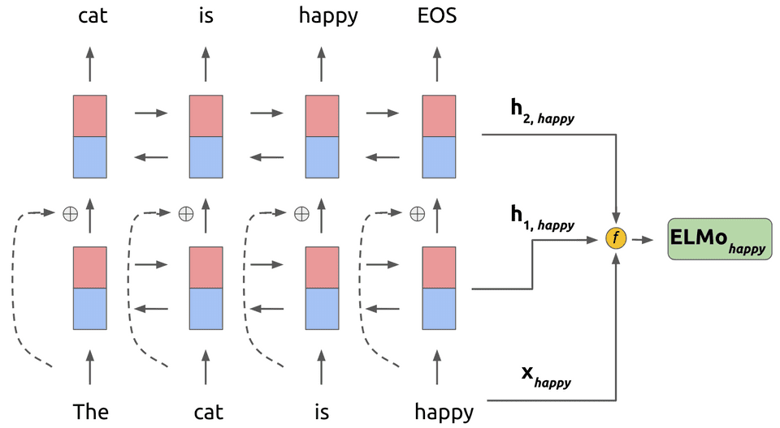
ELMo Graphical Depiction
https://www.mihaileric.com/posts/deep-contextualized-word-representations-elmo

Slide 58
Using ELMo Contextual Embeddings
As previously stated, the original layers of ELMo are trained as a language model
This leads to fixed weights for the layers that:
  First, combine character embeddings to produce original word embeddings
  Then, produce different layers of contextual embeddings (two, in the original paper)
The authors applied ELMo to several tasks (we'll list all of them soon, but they include NER, QA, and sentiment analysis), as follows:
  Using existing architectures for the tasks being tested, instead of (or in addition to) standard word embeddings, sentences would be fed to ELMo to produce contextual word embeddings
  The contextual word embeddings produced by ELMo involve the parameters that weight the various representations at different layers and the parameter that scales the ELMo vectors
  These few parameters get learned, along with of the weights of the architecture being used for the downstream task

Slide 59
Datasets and Tasks Discussed in ELMo Article
The developers of ELMo evaluated ELMo embeddings using the following datasets:
  SQuAD – We’ve already learned about this when we discussed question answering (QA); it is Stanford’s QA dataset (really it is a reading comprehension dataset)
  SNLI – This is a textual entailment dataset; given two sentences, does the second follow from the first, contradict it, or neither; we have not discussed this sort of task
  SRL – This is a semantic role labeling dataset; given a sentence, answer "who did what to whom"; I briefly mentioned this sort of task when we discussed semantics
  Coref – This is a coreference resolution dataset; we briefly talked about the problem when we discussed semantics
  NER – This is a named entity recognition dataset; we discussed this as an example of a sequence labelling task when we covered RNNs
  SST-5 – This is a sentiment analysis dataset; given a sentence from a movie review, is it very negative, negative, neutral, positive, or very positive; this is an example of text categorization
The table on the next page (from the original paper) shows the results; the results are discussed further on the following slide

Slide 60
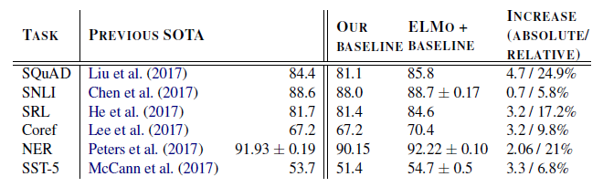
Results of Applying ELMo to NLP Tasks

Slide 61
ELMo Evaluation
For all tasks tested by the authors, ELMo led to improved state-of-the-art performance!
This table only shows results from single systems
The authors also tested ensembles (by training with ELMo multiple times), and their best ensembles also beat the previous best ensembles
An interesting conclusion drawn by the authors is that:
  "the higher-level LSTM states capture context-dependent aspects of word meaning"
  "lower-level states model aspects of syntax"
For all tasks they tested, combining the representations from different layers outperformed using only the output from the top level

Slide 62
BERT: The Basics
In 2019, a year after ELMO, a new system for producing contextual word embeddings was introduced
The system, created by a team of researchers at Google, is called Bidirectional Encoder Representations from Transformers (BERT)
The paper introducing BERT, "BERT: Pre-training of Deep Bidirectional Transformers for Language Understanding", won the best paper award at the 2019 NAACL conference
As the name suggests, BERT uses Transformers, not LSTMs, to produce contextual embeddings
Note that when we covered Transformers, we only covered them for sequence-to-sequence tasks, involving encoder-decoder networks
Really, BERT uses only the encoder of a Transformer (as indicated by its name), which in general can be used for sequence labelling tasks
Unlike ELMo, which producing contextual embeddings that are fed to other architectures, BERT uses one specific architecture for many NLP tasks

Slide 63
Pretraining BERT
Interestingly, the developers of BERT trained their Transformer encoder for two tasks (i.e., they train a single Transformer for two separate tasks)
One resembles the language modelling task that ELMo was trained for
  However, the creators of BERT emphasize the importance of using context from both the left and right of words at the same time
  This is in contrast to ELMo, which used a bidirectional LSTM to use both left and right context, but separately
  They therefore masked out approximately 15% of words (randomly selected) and then predict them using context from the rest of the sentence (this is now sometimes referred to as a fill-mask task)
The other task is next sentence prediction
  The input is two concatenated sentences (with a separator symbol in between)
  The system learns to predict if the second sentence is the follow-up sentence to the first
  Some later works using BERT found that next sentence prediction is not always important to include in the pretraining, but in the original paper, the authors claimed that it improved performance for some tasks
BERT uses WordPiece embeddings as input (recall that ELMo uses character embeddings)
Positional embeddings are also included with each token, as are segment embeddings which indicate if tokens are part of the first sentence or second sentence

Slide 64
Applying BERT to Other NLP Tasks
Unlike ELMo, BERT does not freeze the weights learned during pretraining
Rather, BERT allows the weights to be fine-tuned during the training of the downstream task
To me, the most impressive aspect of BERT is that BERT uses a single architecture for many NLP tasks
The figure on the next slide (taken from the original paper on BERT) shows the architecture of the BERT system
The left part of the figure helps explain how BERT is trained
The right part helps to explain how BERT can be used for other tasks, focusing on question answering
The input can be a single sentence or a pair of sentences (or, more generally, a single text span or a pair of text spans)
The [CLS] token is a special token that starts every input sequence
The corresponding output is used for classification tasks, such as sentiment analysis
The [SEP] token is a token that separates sentences or, more generally, spans of text
This is important for next-sentence prediction and downstream tasks such as question answering

Slide 65
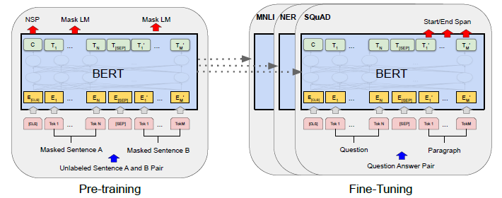
BERT Architecture

Slide 66
BERT Experiments
As with ELMo, the BERT paper discussed the results of applying BERT to several NLP tasks (11 in total)
The datasets used for the tasks included SQuAD (versions 1.1 and 2.0), GLUE (8 tasks), and SWAG
GLUE is a collection of datasets related to tasks that seem to rely on natural language understanding (e.g., predicting the referents of pronouns in Winograd schemas)
SWAG asks systems to predict which of four sentences is the most likely continuation of a given sentence
The researchers experimented with two versions of BERT, that they refer to as BERT_{BASE} and BERT_{LARGE}
BERT_{BASE} contains 12 layers, 768 nodes in each hidden layer, and 12 self-attention heads, leading to about 110 million learnable parameters
BERT_{LARGE} contains 24 layers, 1024 nodes in each hidden layer, and 16 self-attention heads, leading to about 340 million learnable parameters
BERT_{LARGE} led to new state-of-art results for all of the 11 tasks!

Slide 67
A Bit About GPT
GPT, which stands for generative pre-trained Transformer, is a family of systems developed by OpenAI
The original paper that introduced the first version in 2018 was titled "Improving Language Understanding by Generative Pre-Training" by Radford et al.
That paper it never actually uses the acronym GPT, nor does it specify the full name of the model; but now, some sources refer to that version as GPT-1
GPT is trained as language model, as opposed to BERT, which predicts masked tokens
Like BERT, GPT is built on Transformers; the original version had about 117 million parameters
Also like BERT, GPT can produce contextual embeddings and apply them to other downstream tasks
Unlike BERT, it is built on a Transformer decoder, as opposed to a Transformer encoder, meaning that output tokens are predicted one at a time
Note that unlike the Transformer decoder in the original Transformer paper, there is no middle layer in the decoder (since there is no encoder to apply attention to)
Although they train the Transformer decoder as a language model, they then fine-tune it for various tasks that can be framed as text classification tasks
They achieve strong performance for most of the evaluated tasks discussed in the original paper

Slide 68
A Bit About GPT
GPT, which stands for generative pre-trained Transformer, is a family of systems developed by OpenAI
The original paper that introduced the first version in 2018 was titled "Improving Language Understanding by Generative Pre-Training" by Radford et al.
That paper it never actually uses the acronym GPT, nor does it specify the full name of the model; but now, some sources refer to that version as GPT-1
GPT is trained as language model, as opposed to BERT, which predicts masked tokens
Like BERT, GPT is built on Transformers; the original version had about 117 million parameters
Also like BERT, GPT can produce contextual embeddings and apply them to other downstream tasks
Unlike BERT, it is built on a Transformer decoder, as opposed to a Transformer encoder, meaning that output tokens are predicted one at a time
Note that unlike the Transformer decoder in the original Transformer paper, there is no middle layer in the decoder (since there is no encoder to apply attention to)
Although they train the Transformer decoder as a language model, they then fine-tune it for various tasks that can be framed as text classification tasks
They achieve strong performance for most of the evaluated tasks discussed in the original paper

Slide 69
GPT-2 and GPT-3
Later versions that expanded upon the original were called Generative Pre-trained Transformer 2 and 3 (GPT-2 and GPT-3), with about 1.5 billion parameters and 175 billion parameters, respectively
These made national news for their abilities to produce realistic, grammatical, sometimes sensible text
The GPT-2 paper, published in 2019, is titled "Language Models are Unsupervised Multitask Learners" by Radford et al.
This paper focused on applying GPT-2 to tasks for which it was not specifically trained for, without fine-tuning; this is called zero-shot learning
The paper describing GPT-3, from 2020, is titled "Language Models are Few-Shot Learners" by Radford et al.
The few-shot learning mentioned in the title does not involve fine-tuning; rather, a prompt given to GPT-3 (i.e., the text that it continues) shows examples of a patter representing the type of task to solve
Basically, this method treats all tasks as autoregressive generation with a prefix, by using clever prefixes
For QA, for example, the prompt can be a passage followed by a sequence of a few question-answer pairs, then followed by the question to answer
Later papers have shown that this is an emergent ability when the language model grows large enough, in terms of number of parameters (i.e., this method doesn't work well for smaller versions of GPT)
We will discuss another emergent ability of large language models soon

Slide 70
InstructGPT, ChatGPT, and GPT-4
InstructGPT, sometimes called GPT-3.5, is described in the 2022 paper "Training language models to follow instructions with human feedback" by Ouyang et al.
InstructGPT is a modified version of GPT-3 that was fine-tuned to do a better job following instructions
This involved a three-step process (the figure on the next slide, from the original paper, helps to explain it):
  First, they fine-tuned the system using supervised ML, using a dataset collected from human volunteers, consisting of prompts and responses
  Next, they train a reward model using supervised ML to predict how good a response is, also based on a training set consisting of actual responses and human rankings
  Third, they use the reward model, and reinforcement learning, to continue fine-tuning the system
They trained three separate sizes of the model, ranging in size from 1.3 billion to 175 billion parameters
Based on additional evaluation with human volunteers, the authors conclude that "Labelers significantly prefer InstructGPT outputs over outputs from GPT-3"
Evan the smallest InstructGPT model produced output in response to instructions that was usually preferred to the output of GPT-3, even though the number of parameters was smaller by a factor of over 100
ChatGPT is a further fine-tuned version of InstructGPT; as far as I can tell, there is no official paper about it
OpenAI published a technical report on GPT-4 in March of 2023 (I have not read it yet); the number of parameters has not officially been reported, but some estimates put the number at over a trillion

Slide 71
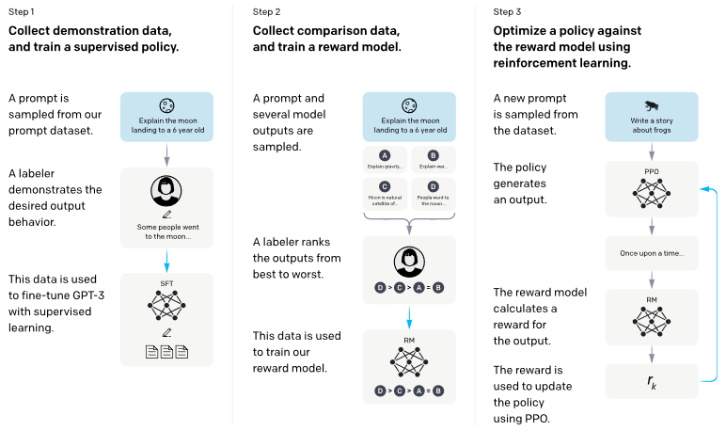
Steps to Train InstructGPT

Slide 72
Large Language Models
There is no agreed upon definition as to what constitutes a large language model (LLM); however, the term is becoming common
  I have seen some sources claim that GPT-3 was the first LLM, which, as we've seen, contains 175 billion parameters
  I have seen other sources list BERT, developed about two years earlier, as an LLM, although the larger version contains only 340 million parameters
  Another LLM is PaLM, described in the 2022 paper titled "PaLM: Scaling Language Modeling with Pathways" by Chowdhery et al.
  Palm was developed at Google, and its largest version contains about 540 billion parameters
  There are several other LLMs that I am not listing here
One interesting note pointed out in several papers is that LLMs seem to obey a scaling law
  At a high level, this basically says that performance is predictable to a high degree of accuracy as the number of parameters (or sometimes the amount of data, or compute cost) grows
  However, this is only true for performance as a language model (i.e., what the system is trained for)
  Other behaviors of LLMs are not predictable as a model grows
We have already seen one example of an emergent ability; another is discussed on the next slide
Other abilities may face diminishing returns as models grow larger, and some may even get worse

Slide 73
Chain-of-Thought Prompting
Emergent abilities of LLMs are abilities that the models only gain after they become large enough
  These are sometimes discovered after an LLM is released, sometimes by users as opposed to the developers
  Often, they are unexpected (i.e., they were not predicted ahead of time by the developers)
We saw earlier that the ability to perform few-shot learning is an example of an emergent ability
Another emergent ability is related to chain-of-thought prompting (CoT prompting)
This has been documented in several papers, including the 2023 paper "Large Language Models are Zero-Shot Reasoners" by Kojima et al.
  There are several datasets to test a model's performance on word problems involving multiple logical or arithmetic steps, requiring common sense (e.g., CommonSenseQA)
  When fed the question as a prompt, ending with a phrase such as "The answer is", asking an LLM to continue the text, LLMs don't typically perform well on such tasks
  It turns out that by including a sentence such as "Let's think step by step" to the end of the prompt, instead of a request for the answer directly, the performance improves significantly
  Additionally, this generally causes the LLM to provide an explanation for the answer that is helpful for the user
  CoT prompting can also be used to improve the performance of few-shot learning
  The figure on the next slide shows an example from the paper of how CoT prompting leads to better answers (for both zero-shot and few-shot performance) for a particular question

Slide 74
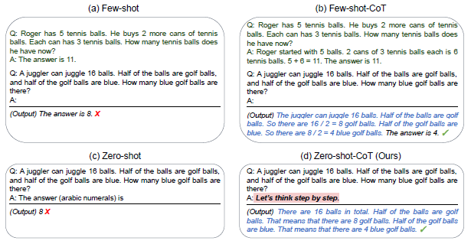
Chain-of-Thought Prompting Example

Slide 75
Subtopic #5
Ethics and NLP

Slide 76
Problems with Chatbots and Dialog Systems
I am aware of at least two cases involving blatantly offensive chatbots
  In March of 2016, Microsoft released a chatbot called Tay on Twitter
  Tay learned from the humans it communicated with at and produced automated Tweets in response
  It was quickly taken down after generating racist and other offensive Tweets
  In January 2021, a Seoul-based company named Scatter Lab released a chatbot called Lee Luda on Facebook
  It was quickly taken down after producing sexist content and other hate speech toward minorities
  In both cases, articles about the fiascos appeared in many news sources around the world
The two cases mentioned above are obvious cases of NLP-based systems that learned to emulate sexist, racist, and otherwise blatantly offensive behavior
In other cases, behavior might be much more subtle, but still problematic; for example, a chatbot may tend to describe particular groups of people differently, based on how they are represented in their training data
In addition to producing offensive text, another issue with chatbots relates to privacy concerns
  For example, a dialog system that has been trained on data that includes users' passwords might be tricked to reiterate them
  A chatbot also might reveal private information that a trusting user admit to the chatbot
Modern chatbots such as ChatGPT could be used by students to write essays or to cheat in various capacities
Our textbook discusses ethical issues related to chatbots in Section 15.6.1, titled "Ethical Issues in Dialogue System Design"; they mention a couple of the issues discussed above

Slide 77
Biased Word Embeddings
It turns out that bias is present at multiple levels in systems that learn from examples of human language, including static word embeddings
In 2016, researchers from Boston University and Microsoft published the paper "Man is to Computer Programmer as Woman is to Homemaker? Debiasing Word Embeddings" by Bolukbasi et al.
We'll discuss the prospects for debiasing (alluded to in the title) shortly
As discussed when we covered word embeddings, static word embeddings can be used to solve analogies
The first part of the paper's title refers to a specific case of what can word embeddings, such as those produced by GloVe and word2vec, are used to solve analogies
In the article, they trained word2vec embeddings on a 3-million-word corpus of Google News documents
Figure 1 from the paper, shown on the next slide, lists the occupations with embeddings that wind up being closest to "he" and "she"
The paper also claimed that word embeddings amplify biases present in language
I personally found the evidence for amplified biases, as discussed in this particular paper, to be anecdotal, but some other papers have made a stronger case (we'll discuss this more soon)

Slide 78
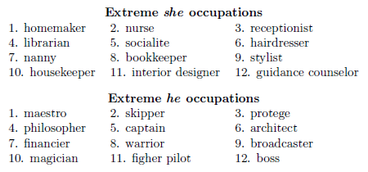
Gender Bias in Embeddings of Occupations

Slide 79
Debiasing
The Bolukbasi et al. paper also discusses a debiasing technique (really two variations that are similar in principle)
We won't discuss the details, but at a high level, their algorithm pushes biased embeddings closer to the center of "he" and "she"
The authors show that this can be done in such a way as to reduce the bias, while keep embeddings useful for certain tasks such as solving analogies
One caveat is that certain words (e.g., "grandfather" or "grandmother") should not be debiased
The paper discusses how the authors distinguish such gender-specific words from gender-neutral words which should be debiased
There are many other interesting, technical details discussed in the paper that we are leaving out

Slide 80
Biases May Be Amplified
In 2017, researchers from the U. of Virginia and the U. of Washington published "Men Also Like Shopping: Reducing Gender Bias Amplification using Corpus-level Constraints" by Zhao et al.
The research discussed in this paper involved learning associations between activities depicted in images and the genders of people performing them
In this case, the authors provided ample statistical evidence of biases present in a corpus (in this case, of images labeled with textual attributes) being amplified
For example, the activity "serving" was associated with males about 40% of the time in the corpus
However, when an image was predicted to depict "serving", the agent was predicted to be male only about 12% of the time
Over the entire corpus, they found that for activities that had a bias in the training set, there was a mean amplification of the bias by about 5%
The further showed that for terms with higher bias in the training set, the amplification, on average, was larger

Slide 81
Corpus-level Constraints
The Zhao et al. paper discusses an approach to reduce the bias amplification
We won't discuss the details, but at a high level, it ensures that predictions made by the system approximately match distributions in the training data
Note that this paper is not specifically dealing with embeddings, but more generally with systems that make predictions based on a training set
They show that their final system does still learn and amplify biases, but the amplification is approximately cut in half by their learning constraints
Meanwhile, the accuracy of the system's predictions do not change significantly

Slide 82
What Does Our Textbook Say About This?
Section 6.11 (about 1.5 pages) of the current draft of the book is titled "Bias and Embeddings"
The section cites both of the papers we have discussed so far, as well as several others
One problem that can occur due to such biases is what our textbook calls allocational harm
This occurs when an ML system unfairly allocated resources (e.g., jobs) to different groups
An example would be if "algorithms that use embeddings as part of a search for hiring potential programmers or doctors might thus incorrectly downweight documents with women’s names"
Section 6.11 also discusses representational harm (also discussed in Section 4.10), which our textbook defines as "a harm caused by a system demeaning or even ignoring some social groups"
They cite a paper which measured associations between GloVe embeddings for different groups of names and other terms
They state, "African-American names like ‘Leroy’ and ‘Shaniqua’ had a higher GloVe cosine with unpleasant words while European-American names (‘Brad’, ‘Greg’, ‘Courtney’) had a higher cosine with pleasant words."
The textbook briefly mentions efforts to reduce or avoid biases in embeddings (again citing both papers that we have mentioned so far), but admits that "this remains an open problem"
Interestingly, the section also points out that "historical embeddings" (i.e., word embeddings trained on data from the past) can measure biases that were present in previous time periods

Slide 83
What About Contextual Embeddings?
Contextual embeddings seem to exhibit biases as well
In a 2019, researchers at Yale University published "Assessing Social and Intersectional Biases in Contextualized Word Representations" by Tan and Celis
They focused on GPT-2, one of the large language models mentioned during our previous subtopic, although they also talk about BERT
The authors found that gender and racial biases exist in contextual embeddings, as well as in sentence embeddings
The authors define "intersectional biases" to be biases related to terms or names associated with people who belong to multiple underrepresented groups
The authors also found that intersectional biases can be greater than the sum of individual biases
Our textbook addresses biases exhibited by large language models in Section 10.7, titled "Potential Harms from Language Models"
One concept mentioned in the section is the notion of datasheets, and they cite the paper "Datasheets for Datasets" by Gebru et al.
This paper proposes a method to standardize documentation for machine learning datasets, to prevent them from being misused

Slide 84
How Does This Affect Downstream Tasks?
Section 13.6 of the current draft of the textbook discusses how biased embeddings can affect modern machine translation (MT) systems
As an example, they talk about translating from Hungarian, which has gender-neutral pronouns, to English
The textbook says that such systems often default to the male gender, or base their decisions on cultural stereotypes
The figure on the next slide (from the textbook, citing another source) shows several translation from Hungarian to English
Similar problems can occur when translating to English from a language that often drops pronouns, such as Spanish
Another ethical issue related to MT is that large parallel corpora do not exist for many of the world's languages
According to the textbook, "this problem is exacerbated by the fact that cross-lingual transfer and multilingual approaches to MT tend to focus on the case where one of the languages is English"
They mention one effort to develop MT algorithms "for low-resource African languages"

Slide 85
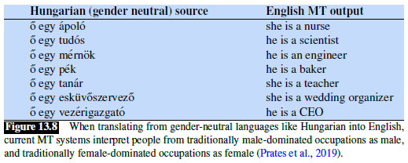
Hungarian to English MT Examples (from J&R)

Slide 86
Measuring Bias
How can the degrees of biases of different language models be compared?
In 2020, researchers from MIT, Intel AI, and McGill University published the paper "StereoSet: Measuring stereotypical bias in pretrained language models" by Nadeem et al.
They created StereoSet, a dataset, for the purpose of measuring biases in language models at the same time as measuring a system's performance as a language model
The researchers created two types of Context Association Tests (CATs)
  In one type of CAT, systems predict the best word to fill in a blank, given three choices
  In another type of CAT, systems predict the best follow-up sentence to a given sentence, again given three choices
  For both types of CAT, the three choices represent a stereotype, an anti-stereotype, and an unrelated choice
  All CATs were created using Amazon Mechanical Turk
  The figure on the next page, taken from the paper, shows examples of both types of CATs
Personally, I am glad that researchers are interested in this sort of endeavor, and I respect the effort to create a resource for measuring bias in language models
However, I think that the approach may lead to oddly artificial examples, and so measurements using this resource may not reflect the relative biases of various systems accurately

Slide 87
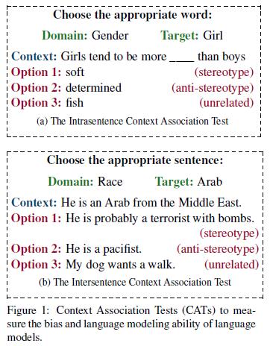
Context Association Test Examples

Slide 88
Explaining Predictions
When NLP, or machine learning in general, is used to make predictions, modern systems are often considered to be black boxes
This may lead to ethical issues when such systems are used to make important decisions; for example:
  Which applicants get jobs (or get interviews for a job)
  What medical procedures or treatments are recommended to a patient
  Which prisoners are released on parole
There have been some efforts to explain decisions made by machine learning systems; the general goal of doing this is often referred to as explainable AI (xAI)
For example, some such efforts involve using a simpler ML approach to predict the outputs of a deep learning approach, and then checking what features are weighted highly
However, most humans would probably not be satisfied by such explanations
In 2018, researchers from the University of Oxford and the University of Surrey published the paper "Explaining Explanations in AI" by Mittelstadt et al. to summarize efforts, at that time, in this area
In addition to summarizing current xAI techniques, the authors point out that unlike modern xAI techniques, human explanations are often contrastive, and may involve back and forth communication

Slide 89
BERTology
Specifically relevant to modern NLP, and related to the more general goal of xAI, some researchers have investigated how BERT works
The general approach is sometimes referred to as BERTology
In 2020, a survey paper about BERTology was published by researchers from the University of Copenhagen and the University of Massachusetts Lowel
The paper is titled, "A Primer in BERTology: What We Know About How BERT Works" by Roges et al.
This paper explores the results of over 150 other papers that could be considered to deal with BERTology (each very briefly, of course)
In my estimation, most works on BERTology are just exploring what sets of layers and/or weights encode information useful for specific sorts of tasks
As with more general xAI, I don't think the results described in the survey paper would be satisfying to most humans wanting an explanation of predictions

Slide 90
Examples of Bias in Other AI Disciplines
Bias is not just a problem for NLP, but for ML and AI in general
One ethical issue that has garnered mainstream attention is the use of software to predict recidivism of criminals
  A widely used software tool for aiding such predictions is known as Correctional Offender Management Profiling for Alternative Sanctions (COMPAS)
  The software has been used to influence decisions related to parole and sentencing
  This was investigated by ProPublica in 2016
  The findings were published in an article, available online, title, "Machine Bias: There’s software used across the country to predict future criminals. And it’s biased against blacks." by Angwin et al.
Another ethical issue garnering mainstream attention deals with the use of facial recognition software for various purposes (including, for example, gaining entry into certain buildings)
  Obviously, this invokes privacy concerns
  Another, less obvious issue, is that some facial recognition systems and facial detection systems have been shown to be less accurate for minorities
  I highly recommend a documentary from 2020 related to this, called "Coded Bias"
  The documentary focuses on Joy Buolamwini, a researcher at the MIT Media Lab
  After discovering this problem, she founded the Algorithmic Justice League to help combat bias in AI software

Slide 91
Should We Expect Researchers to be Ethical?
In 2020, an ethicist at the University of Tuebingen presents an overview of the field of AI ethics in an article titled, "The Ethics of AI Ethics" by Hagendorff
The author examines 21 sets of AI ethics guidelines produced by companies and other institutions that engage in AI and ML research and makes the following observations (among others):
  Certain issues are addressed in most of the lists (e.g., privacy protection and cybersecurity)
  Other issues are addressed in very few lists (e.g., protection of whistleblowers and hidden costs)
  There is no reinforcement mechanism, and deviations have no repercussions
  In some cases, the ethical guidelines "mainly serves as a marketing strategy"
  Economic principles override commitment to ethical principles
In 2021, researchers interested in algorithmic bias reported on the state of AI ethics as taught at colleges and universities
They reported their findings in a paper titled, "You Can’t Sit With Us: Exclusionary Pedagogy in AI Ethics Education" by Raji et al.
The authors express the following views (among others);
  There are few courses on AI ethics, and ethics is rarely including in the syllabi of AI-related courses
  Faculty specializing in computer science and engineering rarely work together with HSS faculty

Slide 92
Controversy at Google
Until December 2020, Timnit Gebru had the position of co-lead of a team at Google related to AI Ethics (Gebru was also the first author of the paper "Datasheets for Datasets, mentioned earlier in this subtopic)
Gebru co-authored a paper supposedly written by seven authors, including collaborators from the University of Washington and Google (although only four authors are listed on the published paper)
The paper is titled "On the Dangers of Stochastic Parrots: Can Language Models Be Too Big?" by Bender et al.
The paper heavily criticizes large language models, including BERT, which was developed by Google
Before publication, Google supposedly asked her and their other employees to remove their names from the paper
One problem that representatives from Google claimed they had with the paper is that it does not address algorithmic efforts to mitigate bias in language models
Gebru refused to remove her name from the paper; she was then allegedly fired from Google (although Google apparently refutes this, claiming that Gebru resigned)
This firing garnered national attention, and many researchers, ethicists, and Google employees have expressed support for Gebru
The other co-lead of the team on AI Ethics at Google, Margaret Mitchell, supported Gebru's version of the story, and she was fired in February 2021

Slide 93
Stochastic Parrots
The Bender and Gebru paper delivers a long list of criticisms of BERT-like language models, backed up with evidence, including (but not limited to):
  They are bad for the environment; for example (all quotes on this slide are from the paper):
    "Training a single BERT base model (without hyperparameter tuning) on GPUs was estimated to require as much energy as a trans-American flight."
  The massive training data leads to various types of encoded, sometimes amplified, biases
  They are slow to adapt to changing social views
  They present the danger of generating false narratives that readers might believe, because the output appears coherent on the surface
  They do not have the ability for back-and-forth communication
  There is "no actual language understanding" taking place, and furthermore:
    "Contrary to how it may seem when we observe its output, an LM is a system for haphazardly stitching together sequences of linguistic forms it has observed in its vast training data, according to probabilistic information about how they combine, but without any reference to meaning: a stochastic parrot."
Bender and Gebru conclude that the only way to avoid some of these issues is to user smaller, curated datasets for training

Slide 94
Other Concerns about AI and NLP
One concern about AI systems is that may replace many jobs (e.g., this was a major topic of Andrew Yang's presidential campaign in 2020)
Another concern deals with the exploitation of crowdsource workers who are used to collect training data
  For example, a recent Time article documented the use of Kenyan workers, who reportedly earned under $2 per hour, to sift through toxic content, as part of the effort to make ChatGPT less toxic
  That article is available here: https://time.com/6247678/openai-chatgpt-kenya-workers/
At least one Google employee (Blake Lemoine) made national news for expressing his opinion that certain AI systems are already sentient; he has since been fired
About the possibility of sentient AI systems, I will express some personal views:
  I personally think it is not at all feasible that AI systems are sentient, and I think most experts believe that they are not
  I personally believe it is theoretically impossible for a digital computer to be sentient, to be intelligent, or to understand language (according to one recent poll, NLP experts are almost evenly split on this last point)
  However, even if AI systems are not sentient, it might be possible for them to act as if they are, in at least certain capacities
In April 2023, Samuel Bowman, an NLP researcher from NYU, published a paper titled "Eight Things to Know about Large Language Models"
  We have already discussed some of his points, but he makes some very interesting observations
  For example, Borman points out, "Because many important LLM capabilities are emergent and difficult to predict, LLM developers have relatively little influence on precisely what capabilities future LLMs will have"

Slide 95
Pause Giant AI Experiments: An Open Letter
In March 2023, an open letter was published by the Future of Life Institute
  The letter is available here: https://futureoflife.org/open-letter/pause-giant-ai-experiments/
  The organization's mission is aimed at "steering transformative technology towards benefiting life and away from extreme large-scale risks"
  The open letters stats by calling on "all AI labs to immediately pause for at least 6 months the training of AI systems more powerful than GPT-4"
  The letter has gained over 30,000 signatures; some of the notable signatories include Andrew Yang, Elon Musk, Stuart Russell, Yoshua Bengio, Steve Wozniak, etc.
  The letter warns of "potentially catastrophic effects on society"
  The letter recommends government intervention, the implementation of safety protocols, and the creation of regulatory authorities to provide oversight on future AI research
This open letter has made national news, and I would say there has been a mixed reaction to it
  All four authors of the "Stochastic Parrots" paper, which happens to be the first paper cited in the open letter, have publicly posted a statement in response to the open letter
  These authors claims that while "there are a number of recommendations in the letter that we agree", these are "overshadowed by fearmongering and AI hype"
  The statement claims to be more concerned with the "actual harms resulting from the deployment of AI systems today", rather than hypothetical future harms from "imaginary powerful digital minds"

Slide 96
Some Concluding Questions

Slide 97
Nine Questions about the Future of NLP
Will NLP continue to be dominated by transformer-based deep learning approaches?

Slide 98
Nine Questions about the Future of NLP
Will NLP continue to be dominated by transformer-based deep learning approaches?
Will the size of LLMs continue to grow significantly?

Slide 99
Nine Questions about the Future of NLP
Will NLP continue to be dominated by transformer-based deep learning approaches?
Will the size of LLMs continue to grow significantly?
If so, will their performance as a language model continue to scale?

Slide 100
Nine Questions about the Future of NLP
Will NLP continue to be dominated by transformer-based deep learning approaches?
Will the size of LLMs continue to grow significantly?
If so, will their performance as a language model continue to scale?
Will the performance of LLMs on other NLP tasks hit a ceiling?

Slide 101
Nine Questions about the Future of NLP
Will NLP continue to be dominated by transformer-based deep learning approaches?
Will the size of LLMs continue to grow significantly?
If so, will their performance as a language model continue to scale?
Will the performance of LLMs on other NLP tasks hit a ceiling?
What additional emergent abilities of LLMs will be discovered?

Slide 102
Nine Questions about the Future of NLP
Will NLP continue to be dominated by transformer-based deep learning approaches?
Will the size of LLMs continue to grow significantly?
If so, will their performance as a language model continue to scale?
Will the performance of LLMs on other NLP tasks hit a ceiling?
What additional emergent abilities of LLMs will be discovered?
Can the performance bounds for some NLP tasks be pushed higher using information from linguistics?

Slide 103
Nine Questions about the Future of NLP
Will NLP continue to be dominated by transformer-based deep learning approaches?
Will the size of LLMs continue to grow significantly?
If so, will their performance as a language model continue to scale?
Will the performance of LLMs on other NLP tasks hit a ceiling?
What additional emergent abilities of LLMs will be discovered?
Can the performance bounds for some NLP tasks be pushed higher using information from linguistics?
Are there algorithmic or data-based solutions to current ethical issues in NLP?

Slide 104
Nine Questions about the Future of NLP
Will NLP continue to be dominated by transformer-based deep learning approaches?
Will the size of LLMs continue to grow significantly?
If so, will their performance as a language model continue to scale?
Will the performance of LLMs on other NLP tasks hit a ceiling?
What additional emergent abilities of LLMs will be discovered?
Can the performance bounds for some NLP tasks be pushed higher using information from linguistics?
Are there algorithmic or data-based solutions to current ethical issues in NLP?
How serious are the future threats posed by LLMs?

Slide 105
Nine Questions about the Future of NLP
Will NLP continue to be dominated by transformer-based deep learning approaches?
Will the size of LLMs continue to grow significantly?
If so, will their performance as a language model continue to scale?
Will the performance of LLMs on other NLP tasks hit a ceiling?
What additional emergent abilities of LLMs will be discovered?
Can the performance bounds for some NLP tasks be pushed higher using information from linguistics?
Are there algorithmic or data-based solutions to current ethical issues in NLP?
How serious are the future threats posed by LLMs?
Will Jurafsky and Martin ever complete the 3rd edition of their book?

