Slide 1
ECE467: Natural Language Processing
Part-of-Speech Tagging

Slide 2
Parts of Speech
This topic is largely based on Chapter 8 of the textbook, titled "Sequence Labeling for Parts of Speech and Named Entities"
Parts of speech (POS) are categories for words that indicate their syntactic functions
Parts of speech are also known as word classes, lexical tags, or syntactic categories
The chapter starts by mentioning a few facts related to the history of parts of speech
Dionysius Thrax of Alexandra (c. 100 B.C.) is generally credited for creating a work summarizing the linguistic knowledge of his day
Our textbook says it is possible that it was really someone else
Included was the description of eight parts-of-speech: noun, verb, pronoun, preposition, adverb, conjunction, participle, and article
Earlier lists include those from Aristotle and the Stoics, but Thrax's became the basis for POS descriptions for the next 2000 years

Slide 3
POS Tagsets
Most modern lists of parts of speech (or tagsets) for English have many more word classes
  The Brown corpus tagset includes 87 tags
  The Penn Treebank tagset includes 45 tags
  The C7 tagset includes 146 tags
The Universal Dependencies tagset, which is newer, includes only 17 tags (features can be added to make find-grained distinctions)
We'll look at the Universal Dependencies tagset briefly (see the figure on the next slide)
Later, we'll look at (and mostly rely on) the Penn Treebank tagset

Slide 4
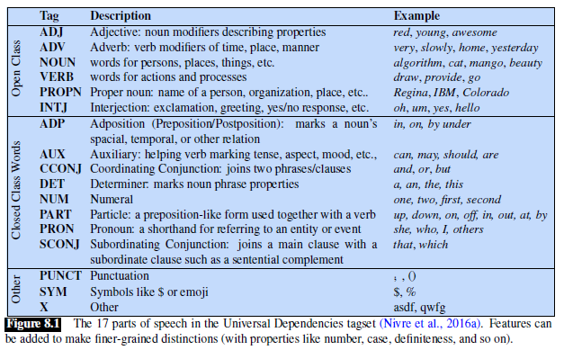
POS in the Universal Dependencies Tagset

Slide 5
Uses of POS
Knowing the POS of a word gives you information about its neighbors
Examples: possessive pronouns (e.g., "my", "her", "its") are likely to be followed by nouns, while personal pronouns (e.g., "I", "you", "he") are likely to be followed by verbs
POS can tell us about how a word is pronounced (e.g., "content" as a noun or an adjective)
POS can also be useful for applications such as parsing, named entity recognition, and coreference resolution
Corpora that have been marked with parts of speech are useful for linguistic research
Part-of-speech tagging (a.k.a. POS tagging or sometimes just tagging) is the automatic assignment of POS to words
POS tagging is often an important first step before several other NLP applications can be applied
We will discuss the use of hidden Markov models (HMMs) for POS tagging later in the topic
There are also deep learning approaches for POS tagging, which tend to perform a bit better (we'll learn about such methods later in the course)

Slide 6
Defining Parts of Speech
Traditionally, linguist's definitions of POS are based on syntactic and morphological function
That is, words in a class function similarly with respect to what can occur nearby and/or what affixes they can take
Word classes have tendencies toward semantic coherence, but not always
For example, nouns often describe people, places, or things, and adjectives often describe properties, but there are other possibilities
In general, linguists do not agree about what all the POS categories should be, or about how each part of speech should be defined

Slide 7
Open and Closed Classes of POS
POS can be divided into two broad categories: open classes and closed classes
Four major open classes occur in languages of the world: nouns (including proper nouns), verbs, adjectives, and adverbs
Not every language has all four open classes (of course, English does)
New nouns and verbs are continually added to languages (sometimes borrowed from other languages)
The current draft of the new edition also considers interjections a smaller open class
Recall hat the Universal Dependencies tagset included interjections as an open class, and it also included proper nouns as a separate category from nouns
Many modern tagsets include separate tags for things such as plural nouns, various tenses of verbs, etc.
Closed classes (e.g., prepositions) have relatively fixed membership
Closed classes generally include function words (e.g., "of", "it", "and", "you", etc.), which tend to be very short and occur frequently

Slide 8
English Nouns
Noun is the name given to the syntactic class in which the words for most people, places, or things occur
However, this is not how the class is defined by linguists, and there are exceptions in both directions
Nouns include concrete terms (e.g., "cat", "chair"), abstractions (e.g., "algorithm", "beauty"), verb-like terms (e.g., "pacing"), etc.
What defines a noun in English are things like:
  Its ability to occur with determiners (e.g., "a goat", "its bandwidth", "Plato's Republic")
  Its ability to take possessives (e.g., "IBM's annual revenue")
  For most (but not all) nouns, its ability to occur in the plural form (e.g., "goats", "abaci")

Slide 9
Types of Nouns
Nouns include proper nouns and common nouns
Another subclass of nouns called pronouns will be discussed later (along with other closed classes)
Proper nouns are names of specific persons or entities
  In English, they are not usually preceded by articles (e.g., "Regina is upstairs")
  In written English, they are usually capitalized
In many languages, including English, common nouns are further divided into two categories:
  Count nouns allow grammatical enumeration
  They can occur in both singular and plural form (e.g., "goat/goats", "relationship/
  relationships"), and they can be counted (e.g., "one goat", "two goats")
  Mass nouns are used for things conceptualized as a homogeneous group (e.g., "snow", "salt", "communism")
  They are not counted and can appear without articles (e.g., "snow is white")

Slide 10
English Verbs
The verb class includes most words referring to actions and processes
In English, verbs have a number of morphological forms (e.g., "eat", "eats", "eating", "eaten")
Recall from our previous topic that irregular verbs can have fewer or more forms than regular forms
Nouns in English can be singular or plural, but they generally have fewer morphological forms than verbs
A subclass of verbs called auxiliary verbs will be discussed later (along with other closed classes)
Many researchers believe that all human languages include nouns and verbs
However, some linguists have argued that certain languages (e.g., Riau Indonesian and Tongan) don't even have this distinction

Slide 11
English Adjectives
Semantically, the class of adjectives includes many words that describe properties or qualities (e.g., color, age, value, etc.)
The textbook claims that some languages do not contain adjectives
The textbook states: "In Korean, for example, the words corresponding to English adjectives act as a subclass of verbs"
As an example, they say that the English adjective "beautiful" acts in Korean like a verb meaning "to be beautiful"
I add: This is not correct; my wife has convinced me that Korean does include adjectives, and other sources have backed her up!
I have not found a clear answer as to whether there are any languages that clearly do not contain adjectives

Slide 12
English Adverbs
According to the textbook, the class of adverbs "is rather a hodge-podge in both form and meaning" (shortened in the current draft to "adverbs are a hodge-podge")
In this example from the book, every italicized word is an adverb: "Actually, I ran home extremely quickly yesterday."
Book (earlier draft and previous edition): "What coherence the class has semantically may be solely that each of these words can be viewed as modifying something"
I add: I would consider this syntactic coherence, not semantic coherence
Types of adverbs include:
  Directional adverbs or locative adverbs specify the direction or location of some action (e.g., "home", "here", "downhill")
  Degree adverbs specify the extent of some action, process, or property (e.g., "extremely", "very", "somewhat")
  Manner adverbs describe the manner of some action or process (e.g., "slowly", "slinkily", "delicately")
  Temporal adverbs describe the time that some action or event took place (e.g., "yesterday", "Monday"); some tagging schemes tag words like "Monday" as a noun

Slide 13
English Closed Classes
The closed classes differ more from language to language than do the open classes
Some of the more important closed classes in English include (we will discuss most of these in more detail):
  Prepositions (e.g., "on", "under", "over", "near", "by", "at", "from", "to", "with")
  Particles (e.g., "up", "down", "on", "off", "in", "out", "at", "by")
  Determiners (e.g., "a", "an", "the", "this", "that")
  Conjunctions (e.g., "and", "but", "or", "as", "if", "when")
  Pronouns (e.g., "she", "who", "I", "others")
  Auxiliary verbs (e.g., "can", "may", "should", "are")
  Numerals (e.g., "one", "two", "three", "first", "second", "third")

Slide 14
English Prepositions and Particles
Prepositions occur before noun phrases; semantically, they are relational, often indicating spatial or temporal relations
They can be literal (e.g., "on it", "before then", "by the house") or metaphorical ("on time", "with gusto", "beside herself")
Sometimes they indicate other types of relations (e.g., "Hamlet was written by Shakespeare")
A particle is a word that resembles a preposition and is used in combination with a verb
They often have meanings that are not the same as the prepositions they resemble; e.g., "…she had turned the paper over."
When a verb and particle behave as a single unit, the combination is called a phrasal verb
A phrasal verb has a meaning separate and not predictable from those of the verb and particle; e.g., "turn down", "rule out", "find out", "go on"
The previous edition of the textbook pointed out that it is very hard to distinguish particles from prepositions, and some tagsets do not distinguish them

Slide 15
English Determiners
A closed class that occurs with nouns, often marking the beginning of a noun phrase, is determiners
One subtype of determiners is the articles; English has three ("a", "an", and "the")
The articles "a" and "an" mark a noun phrase as indefinite, while "the" marks it as definite
Articles are frequent in English; in fact, "the" is the most common word in most corpora of written English (often by far)
I add: It is less clear what is the most common word in spoken English
I've seen sources claim it is "the", "OK", "a", "I", etc. (but I haven't seen anything convincing)
Other determiners include "this" and "that" (e.g., "this chapter", "that page")
Some sources consider a word ending in a possessive 's, used before a noun, to be a determiner (e.g., "Plato's Republic"); our textbook also does in some places

Slide 16
English Conjunctions
Conjunctions join two phrases, clauses, or sentences
Coordinating conjunctions (e.g., "and", "or", "but") join two elements of equal status
Subordinating conjunctions are used when one element has an embedded status; e.g., "I thought that you might like some milk."
Such subordinating conjunctions that link a verb to its argument are also called complementizers

Slide 17
English Pronouns
Pronouns are a subclass of nouns that often act as a kind of shorthand for referring to some noun phrase, entity, or event
Types of pronouns include:
  Personal pronouns refer to persons or entities (e.g., "you", "she", "I", "it", "me")
  Possessive pronouns are personal pronouns that indicate actual possession or an abstract relationship (e.g., "my", "your", "his", "her", "its", "our", "their")
  Some sources consider possessive pronouns to be possessive determiners when they are used before nouns
  Wh-pronouns (e.g., "what", "who", "whom") are used in certain question forms or may act as complementizers (e.g., "Frida, who married Diego…")

Slide 18
English Auxiliary Verbs
A close-class subtype of verbs is auxiliary verbs, a.k.a. auxiliaries
Auxiliaries in English include:
  The copula verb (a.k.a. linking verb) "be", which connects a subject with certain kinds of predicate nominals and adjectives (e.g., "he is a duck")
  Forms of "be" can also be used as part of the passive (e.g., "we were robbed") or progressive (e.g., "we are leaving") constructions
  The verb "have", when it is used to mark the perfect tenses (e.g., "I have gone", "I had gone")
  The modal verbs indicate what is called mood, i.e., if an action is necessary, desired, etc. (e.g., "can", "may", "must", "have" as in "I have to go")

Slide 19
Other Possible English Classes
The previous edition of the textbook indicated some other English classes for words of "more or less unique function", including:
  Interjections (e.g., "oh", "hey", "alas", "uh", "um"); as was previously mentioned, some sources consider this to be an open class
  Negatives (e.g., "no", "not")
  Politeness markers (e.g., "please", "thank you")
  Greetings (e.g., "hello", "goodbye")
  The existential there (e.g., "There are two books on the table.")
The book notes that some of these classes may be lumped together with interjections or, in some cases, adverbs
In general, sources listing English parts of speech, including tagsets, differ significantly on what POS are included, and on their definitions

Slide 20
The Brown Corpus Tagset
Recall from our previous topic (N-grams) that the Brown Corpus consists of 1 million words taken from 500 texts of various genres
The Brown Corpus tagset consists of 87 tags
The corpus was first tagged by TAGGIT, an early rule-based tagger
According to our textbook, this tagger accurately tagged approximately 77% of words (that is very low by modern standards)
Then the tags were manually corrected
Later, several other popular tagsets for English evolved from the Brown Corpus tagset

Slide 21
The Penn Treebank Tagset
One popular tagset is the 45-tag Penn Treebank tagset (36 tags w/o punctuation, shown on the next slide)
This tagset has been applied to the Brown corpus, the Wallstreet Journal corpus, and the Switchboard corpus
Here is an example of a sentence tagged using the Penn Treebank tagset: "The/DT grand/JJ jury/NN commented/VBD on/IN a/DT number/NN of/IN other/JJ topics/NNS ./."
The Penn Treebank tagset was culled from the original 87-tagset of the Brown corpus
The reduced set leaves out information that can be recovered; e.g., the original tagset included a separate tag for each form of the verb "do", "be", and "have"
The Penn Treebank sentences were not only tagged, but also parsed, so additional syntactic information is represented in the phrase structure; this can also help to disambiguate tags
For example, the tag "IN" is used for both subordinating conjunctions (e.g., "after/IN spending/VBG a/DT day/NN at/IN the/DT beach/NN") and prepositions (e.g., "after/IN sunrise/NN")
Since many tagging situations do not involve parsed corpora, the Penn Treebank tagset is not specific enough for many uses
Despite the limitations, the Penn Treebank tagset has been a widely used tagset for evaluating POS tagging algorithms, and our textbook mostly uses this tagset

Slide 22
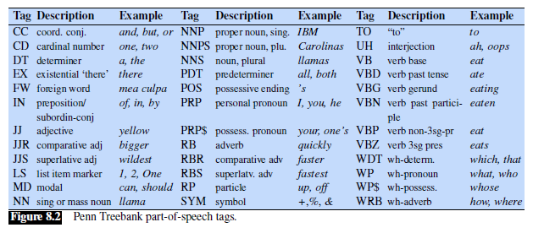
Penn Treebank Tagset POS (w/o punctuation)

Slide 23
Part-of-Speech Tagging
As mentioned earlier, part-of-speech tagging (a.k.a. POS tagging or tagging) is the process of assigning a POS to each word or token in an input text
Tags are often also applied to certain types of punctuation, so POS tagging may require that appropriate punctuation marks are separated from words
This involves consistent tokenization, discussed in a previous topic
Note that other text normalization steps, such as stemming or lemmatization, would not be applied before POS tagging
Some tagging decisions are difficult to make even for humans (although experts usually agree)
Even in situations that are simple for humans, automatically assigning POS tags is not trivial, since many words are ambiguous (as we will soon see)
POS tagging involves resolving the ambiguities; thus, POS tagging is a disambiguation task

Slide 24
Ambiguous POS in English
It turns out that most distinct words in the English language are unambiguous, meaning that they have only a single possible tag; however, many of the most common words of English are ambiguous
The next slide shows the percent of word types (i.e., distinct words), and percent of total tokens, with ambiguous tags, in both the Brown corpus and the WSJ Corpus
An earlier draft of the textbook pointed out that the WSJ has significantly fewer ambiguous tokens than the Brown corpus, probably because it is focused on financial news, whereas the Brown corpus is more diverse
Some words can have several possible tags; the slide after the next shows examples of six possible tags for the word "back"
The book points out that many of the ambiguous tokens are easy to disambiguate; this is partly because not all tags associated with a word are equally likely
This can lead to a baseline tagger that selects the highest frequency tag for every token; the textbook states that for the WSJ corpus, such a tagger can achieve about a 92% accuracy
Comparatively, the book claims that rule-based taggers, HMM taggers, maximum-entropy Markov model (MEMM) taggers, and modern neural network taggers can all achieve around 97% accuracy
I add: Based on other sources, it seems that the modern neural network taggers (e.g., using bi-LSTMS or Transformers) perform a bit better than MEMM taggers which perform a bit better than HMM taggers

Slide 25
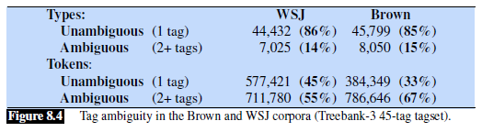
Tag Ambiguity in the Brown and WSJ Corpora

Slide 26
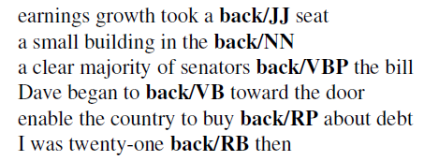
Example: Six Tags for "back"

Slide 27
Hidden Markov Models
We are going to cover the use of hidden Markov Models (HMMs) for POS tagging
HMMs used to be a very important tool for several NLP applications
I am still covering this method because it was historically very important for NLP, it is intuitive, and it provides strong insight into how conventional taggers worked
An HMM is a probabilistic sequence model that provides a label to each unit in a sequence
The task of predicting a label for each item in a sequence is called sequence labeling
An HMM allows us to reason about observed events (or observations) and about hidden events (represented by hidden states) that we consider to be the causal factors of the observations
For POS tagging, an HMM accepts a sequence of observed words or tokens; these are the values of the observed events
Typically, one sentence is processed at a time in practice
The HMM assigns a sequence of POS tags, one to each word or token; these are the predicted values of the hidden events

Slide 28
Hidden Markov Models Defined
An HMM can be specified by :
  A set of states, representing the possible values for each hidden event
  A transition probability matrix specifying the transition probabilities of moving between states
  A sequence of observations, each one drawn from a vocabulary of possible observations
  Observation likelihoods (a.k.a. emission probabilities) specifying the probability of each possible observation being generated from each state
  An initial probability distribution, specifying the probability of each possible initial state
The next slide shows an example of an HMM for POS tagging (but we will then discuss a different, equivalent representation of HMMs)

Slide 29
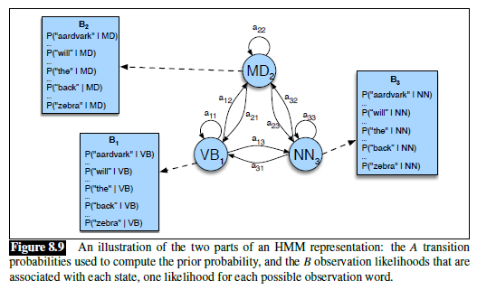
Simple Example of HMM for POS tagging

Slide 30
Alternative Description of HMMs
I am used to seeing HMMs represented as a dynamic Bayesian network
We are not going to cover Bayesian networks in this course, but I will explain the related HMM representation:
  An HMM can be represented as a sequence, or chain, of nodes representing random variables for the hidden states
  Each of these nodes also includes a downward link to another node; these lower nodes represent random variables for the observations
  Each pair of nodes represents a hidden state and an observation at some particular time or position in the sequence
  For POS tagging, the hidden states relate to the parts of speech, and the observations relate to the observed words or tokens (usually in a single sentence)
  The links between consecutive hidden nodes represent transition probabilities, and the links between hidden nodes and observation nodes represent emission probabilities
This representation is mathematically equivalent to the one used in our textbook

Slide 31
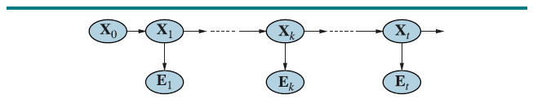
Alternative Description of HMMs Depicted
Here is an HMM depicted as a dynamic Bayesian network (from the book I use for my AI course):
In this figure, the Xs are the random variables representing hidden states, and the Es are the random variables representing observed values
The links between the Xs represent the transition probabilities
The links from the Xs to the Es represent the emission probabilities
Not all sources include an initial hidden state without a matching observation
The initial hidden state by itself (i.e., without a matching observation) could make sense for POS tagging if we include start-of-sentence markers that don't get tagged
This formulation of HMMs is mathematically equivalent to the one used by our textbook

Slide 32
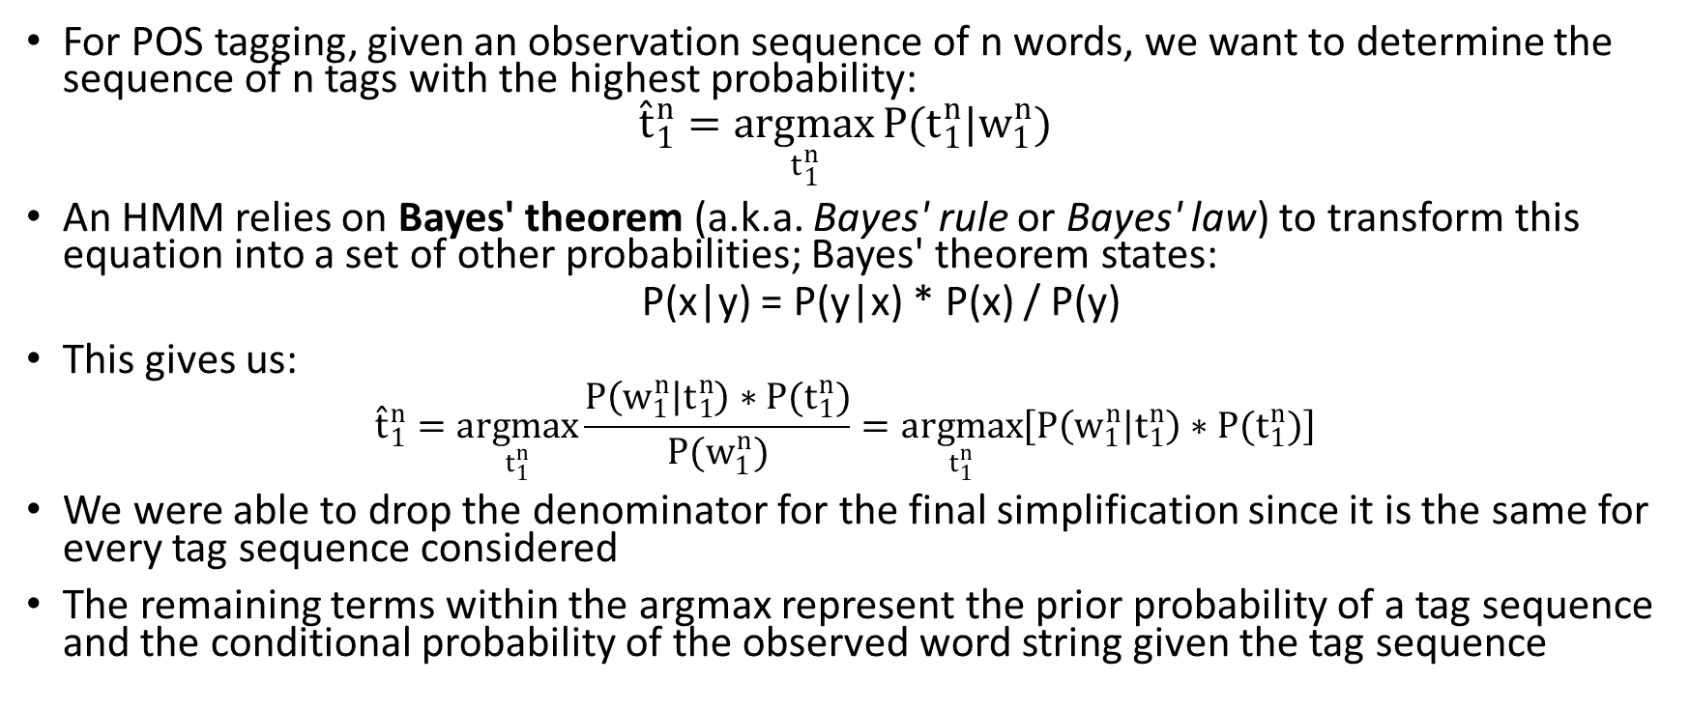
Predicting POS Tags
For POS tagging, given an observation sequence of n words, we want to determine the sequence of n tags with the highest probability:
$${\hat{t}}_{1}^{n}=\underset{t_{1}^{n}}{argmax}{P(t_{1}^{n}|w_{1}^{n})}$$
An HMM relies on Bayes' theorem (a.k.a. Bayes' rule or Bayes' law) to transform this equation into a set of other probabilities; Bayes' theorem states:
  P(x|y) = P(y|x) * P(x) / P(y)
This gives us:
$${\hat{t}}_{1}^{n}=\underset{t_{1}^{n}}{argmax}{\frac{P\left(w_{1}^{n} | t_{1}^{n}\right)∗P(t_{1}^{n})}{P(w_{1}^{n})}}=\underset{t_{1}^{n}}{argmax}\left[P\left(w_{1}^{n} | t_{1}^{n}\right)∗P(t_{1}^{n})\right]$$
We were able to drop the denominator for the final simplification since it is the same for every tag sequence considered
The remaining terms within the argmax represent the prior probability of a tag sequence and the conditional probability of the observed word string given the tag sequence

Slide 33
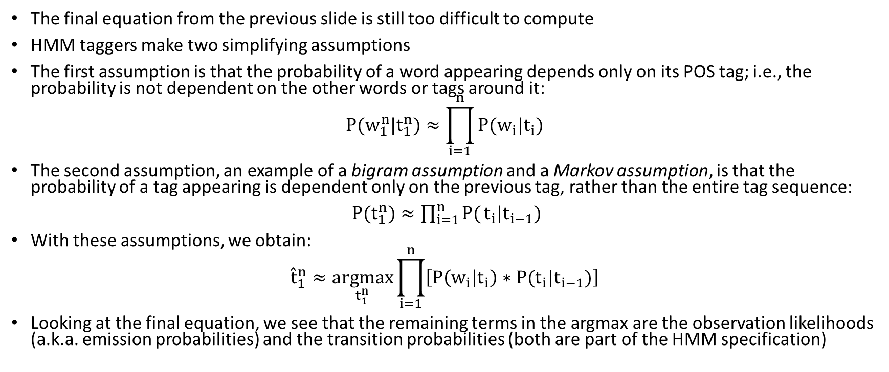
Simplifying Assumptions Used by HMMs
The final equation from the previous slide is still too difficult to compute
HMM taggers make two simplifying assumptions
The first assumption is that the probability of a word appearing depends only on its POS tag; i.e., the probability is not dependent on the other words or tags around it:
$$P(w_{1}^{n}|t_{1}^{n})≈\prod_{i=1}^{n}{P(w_{i}|t_{i})}$$
The second assumption, an example of a bigram assumption and a Markov assumption, is that the probability of a tag appearing is dependent only on the previous tag, rather than the entire tag sequence:
$P(t_{1}^{n})≈\prod_{i=1}^{n}{P(}t_{i}|t_{i−1})$
With these assumptions, we obtain:
$${\hat{t}}_{1}^{n}≈\underset{t_{1}^{n}}{argmax}{\prod_{i=1}^{n}{\left[P\left(w_{i} | t_{i}\right)∗P(t_{i}|t_{i−1})\right]}}$$
Looking at the final equation, we see that the remaining terms in the argmax are the observation likelihoods (a.k.a. emission probabilities) and the transition probabilities (both are part of the HMM specification)

Slide 34
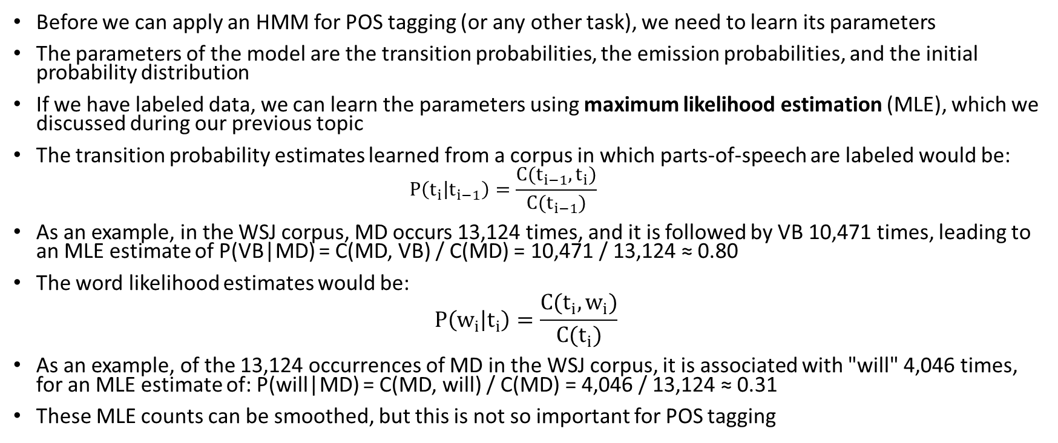
Learning the Parameters of an HMM
Before we can apply an HMM for POS tagging (or any other task), we need to learn its parameters
The parameters of the model are the transition probabilities, the emission probabilities, and the initial probability distribution
If we have labeled data, we can learn the parameters using maximum likelihood estimation (MLE), which we discussed during our previous topic
The transition probability estimates learned from a corpus in which parts-of-speech are labeled would be:
  $$P\left(t_{i} | t_{i−1}\right)=\frac{C(t_{i−1},t_{i})}{C(t_{i−1})}$$
As an example, in the WSJ corpus, MD occurs 13,124 times, and it is followed by VB 10,471 times, leading to an MLE estimate of P(VB|MD) = C(MD, VB) / C(MD) = 10,471 / 13,124 ≈ 0.80
The word likelihood estimates would be:
$$P\left(w_{i} | t_{i}\right)=\frac{C(t_{i},w_{i})}{C(t_{i})}$$
As an example, of the 13,124 occurrences of MD in the WSJ corpus, it is associated with "will" 4,046 times, for an MLE estimate of: P(will|MD) = C(MD, will) / C(MD) = 4,046 / 13,124 ≈ 0.31
These MLE counts can be smoothed, but this is not so important for POS tagging

Slide 35
Advanced Features of HMM POS Taggers
The best HMM POS taggers rely on a trigram model of tag history along with interpolation to combine bigram and unigram probabilities
It is difficult for HMM taggers to deal with unknown words; for unknown words, we cannot allow all the estimated word emission probabilities to be 0
The methods of replacing these 0 probabilities generally make use of morphological information and orthographic information; the previous edition of the textbook gave some examples:
  Words that end in "-s" are likely to be plural nouns (NNS)
  Words that end in "-ed" are likely to be past tense verbs (VBD)
  Words that end in "-able" are likely to be adjectives (JJ)
  Words starting with capital letters are likely to be proper nouns (NP)
Using Bayes' theorem, the probabilities of seeing various features given a tag can be combined to find the overall probability of the features (and therefore, the observed word) given a tag
The previous edition of the textbook also discussed how MEMMs can be used for POS tagging, and the current draft discusses how conditional random fields (CRFs) can be used for POS tagging
It is also possible to learn the parameters of an HMM from an (often much larger) unlabeled dataset using the expectation maximization (EM) algorithm; this is discussed in the appendix on HMMs
However, EM does not work as well as MLE for learning parameters of an HMM for POS tagging

Slide 36
The Viterbi Algorithm
Once the parameters of an HMM POS tagger have been learned, we can use the HMM to find sequences of POS tags that maximize the likelihood of observed sequences of words
The Viterbi algorithm, a dynamic programming algorithm, accepts a sequence of observed words o₁, o₂, …, o_{T} and determines the most probable sequence of hidden states (in this case, POS tags)
The next slide shows pseudo-code for the Viterbi algorithm; some things to point out are:
  The viterbi and backpointer matrices are both N x T; the indexes start at 1
  T is the number of words (really tokens) in the sequence (typically a single sentence) and N is the number of distinct tags
  a_{s',s} is the transition probability from tag s' to tag s; I would label this: P(s_{t} = s | s_{t-1} = s')
  π_{s} is the probability that tag s is the first tag in a sequence; I would label this: P(s₁ = s)
  b_{s}(o_{t}) is the probability of seeing the t^{th} word of the observed sequence given that the corresponding tag is s; I would label this: P(o_{t} | s_{t} = s)
  viterbi[s, t] is the maximum probability of any sequence of POS tags ending at state s (a particular tag) after step t (i.e., after the first t observed words)
  backpointer[s, t] is the previous tag in the sequence that led to the maximum probability stored in viterbi[s, t]

Slide 37
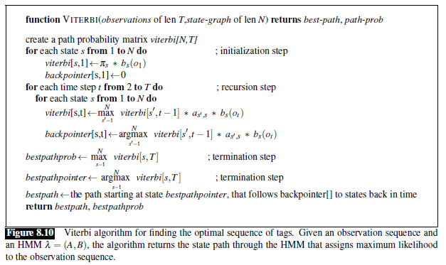
The Viterbi Algorithm Pseudo-code

Slide 38
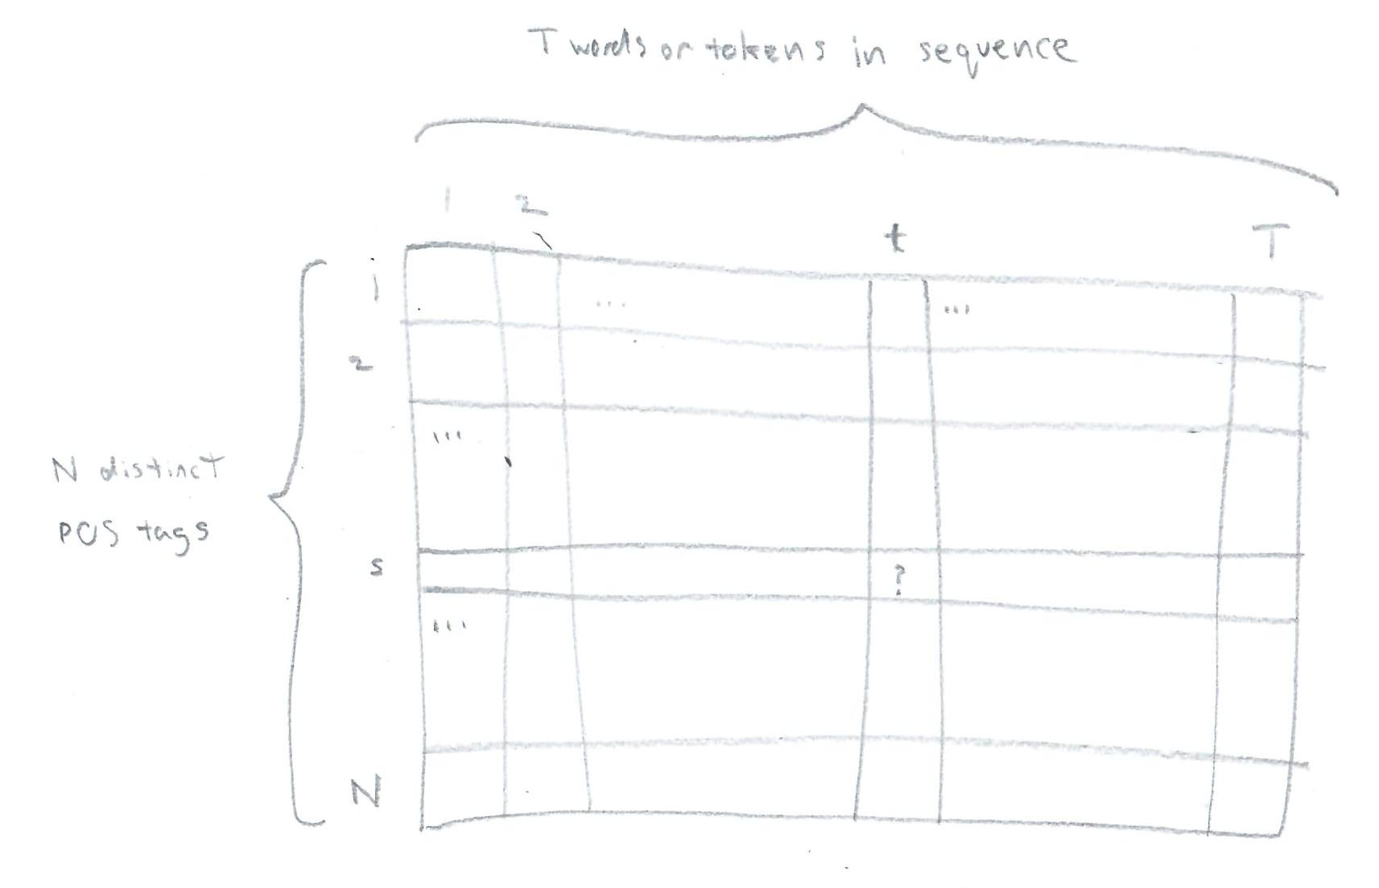
Either Viterbi Matrix Sketched

Slide 39
The Viterbi Algorithm Pseudo-code Explained
The various parts of the algorithm do the following:
  The first loop determines the probability associated with each possible initial tag, taking into account the first word in the observed sequence
  The nested loop fills in one column of the viterbi and backpointer matrices at a time; note that the max and argmax also involve loops (through the previous column)
  The two lines after the nested loops are complete determine the probability of the best path (bestpathprob) and the final tag in the sequence (bestpathpointer)
  The final line involves a loop starting at index bestpathpointer in the final column, moving back one column at a time following the appropriate entries of backpointer
The running time of the algorithm is O(T * N²)

Slide 40
Evaluating POS Taggers
As mentioned earlier, HMM taggers, MEMM taggers, and modern neural network taggers all achieve about 97% accuracy on POS tagging
POS taggers are evaluated by comparing their predicted POS tags for a test set to a "gold standard" involving expert human labels
Our textbook states that human performance is also about 97%, but I think claiming that taggers do as well as human experts would be misleading
In order to improve a model, it is helpful to understand where it goes wrong; the current edition of the textbook dropped this discussion, but it was discussed in the previous edition
They defined a confusion matrix (a type of contingency table); rows indicate predicted tags and columns indicate actual tags; each cell specifies a count or a percentage
Confusion matrices from POS experiments have shown the following difficulties for taggers:
  Distinguishing singular nouns, singular proper nouns, and (surprisingly to me) adjectives
  Distinguishing particles, prepositions, and adverbs (they all often appear after verbs)
  Distinguishing past tense verbs, past participle verbs, and (surprisingly to me) adjectives

Slide 41
Tag Indeterminacy
The previous textbook edition pointed out that some words are very nearly impossible to disambiguate, and even experts may disagree
This is called tag indeterminacy
Searching for an example online, I found a reference to a witticism from Katherine Hepburn (I presume about Cary Grant):
  "Grant can be outspoken – but not by anyone I know"
The latter phrase indicates that "outspoken" must be a past participle (VBN), not an adjective (JJ)

Slide 42
Tagging Morphologically Complex Languages
The previous edition of the textbook discussed the POS tagging for morphologically complex languages, such as Czech, Hungarian, and Turkish
For some languages (the book gave German as an example), the same algorithms already discussed work about equally well as with English
The book mentions that one particular tagger which achieves 96.7% accuracy for both English and German achieves only 92.88% accuracy for Hungarian
The performance was about the same on known words (98.32%), but for unknown words, the performance drops down from 84% or 85% for English or German to only 67.07% for Hungarian
The morphologically complex languages have many more possible distinct words, also making unknown words more likely
One chart in the previous edition shows that a one million English word corpus has 33,398 different words while a same-sized Turkish corpus has 106,547 different words
The chart also shows that a 10-million English word corpus has 97,734 different words while a same-sized Turkish corpus has 417,775 different words
In some cases, it may be important for a tagger to tag not just single tokens, but also some of the morphemes, which adds greater complexity

