Slide 1
ECE467: Natural Language Processing
Phrase Structure Grammars and Dependency Grammars

Slide 2
If you are following along in the book…
The majority of this topic is related to Chapter 12, titled "Constituency Grammars"
The textbook covers dependency grammars in Chapter 14, titled "Dependency Parsing"
We will discuss dependency grammars briefly toward the end of the topic
This topic will focus on English
Our next topic will consider grammars of human languages more generally
That topic will be based on excerpts from Pinker’s and Baker's books (not the textbook)

Slide 3
Syntax
According to our textbook, syntax "refers to the way that words are arranged together" (e.g., to form sentences)
Some previous notions we have seen that can be relevant to syntax include:
  Regular expressions can be used to represent orderings of strings of words (but we did not use them that way; we used them to discuss morphology)
  N-grams represent probabilities of short word sequences
  Part-of-speech (POS) categories represent classes of words that are important for syntax

Slide 4
Phrase Structure Grammars
The fundamental idea of phrase structure grammars is that a group of words may behave as a single unit called a phrase or constituent
Examples of categories of phrases include noun phrases, verb phrases, prepositional phrases, sentences, etc.
Phrase structure grammars are also known as constituency grammars; this is the term used by our textbook
We will use context-free grammars (CFGs) as a formalism for modeling constituency structure
Recall that it was mentioned during a previous topic that CFGs are part of the Chomsky hierarchy (as were regular grammars, which can be described by regular expressions)
Note that the textbook and some other sources use the term phrase structure grammar to refer to the formalism
I am using it more generally, the way that the textbook uses constituency grammar
In general, I have not seen consistency in the way these terms are used

Slide 5
Phrases
Examples of noun phrases: "Harry the Horse", "the Broadway coppers", "they", "a high-class spot such as Mindy's", "the reason he comes into the Hot Box", "three parties from Brooklyn"
One piece of evidence that these words group together (i.e., form constituents or phrases) is that they appear in similar syntactic environments (for example, before a verb)
Another piece of evidence is that each phrase can be moved around together in some sentences
However, you can't generally break a phrase into parts and put the parts in different places
The book discusses an example involving the prepositional phrase "on September seventeenth" (see the next slide)
Many examples in this topic come from the Air Traffic Information System (ATIS) domain; this involves examples of spoken language by users booking airline reservations
Book: "ATIS systems were an early example of spoken language systems for helping book airline reservations"; users would interact with the system to book flights

Slide 6


Phrase Example
Consider the preposition phrase "on September 17th"
Note that it can be placed at several locations in a sentence:
However, it is not generally the case that the words in the place can be split and placed in different locations:

Slide 7
Context-free Grammars
Context-free grammars (CFGs) are the most common grammatical formalism used by linguists for modeling constituent structure in English and other natural languages
A CFG consists of a set of rules, a.k.a. productions, each of which expresses a way that symbols of the language can be grouped and ordered
Examples of possible rules include:
  NP → Det Nominal
  NP → ProperNoun
  Nominal → Noun | Nominal Noun
The book does not state how to read these rules, but I have learned that the arrow is often read, "can have the form of" or "can consist of"
The vertical bar is the "or" symbol; it's not technically part of the CFG specification, but it can be used as a shorthand to represent multiple rules
A CFG can also includes a lexical rules, defining a lexicon
Here are some additional possible rules expressing facts about the lexicon:
  Det → a
  Det → the
  Noun → flight

Slide 8
CFG Terminology
The symbols that correspond to words in a language are called terminal symbols (or terminals)
Symbols that express abstractions of these (basically, types of phrases) are called non-terminal symbols (or non-terminals)
In each rule:
  To the left of the arrow, there is a single non-terminal
  To the right of the arrow, there is an ordered list, or sequence, of one or more terminals and non-terminals
Lexical rules include a POS to the left of the arrow and a word (terminal) to the right of the arrow
Every grammar must contain a designated start symbol, often called S, which in linguistics and NLP, is usually interpreted as a sentence node
This rule shows that a sentence can consist of a noun phrase followed by a verb phrase:
  S → NP VP
The next two slides show some additional grammar rules and lexical rules; the textbook refers to this simple grammar as L₀

Slide 9
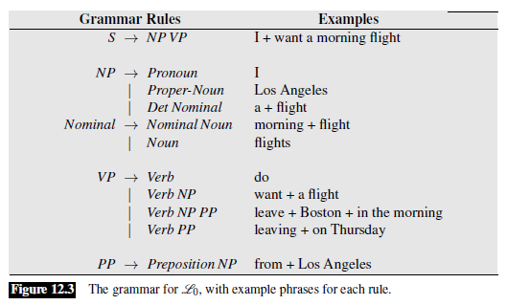
Sample Grammar Rules

Slide 10
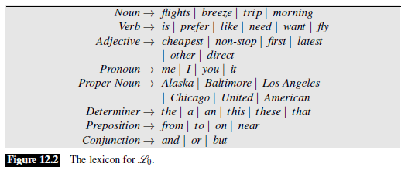
Sample Lexical Rules

Slide 11
Parse Trees
We can view a CFG as a device for generating sentences or for assigning structure to a sentence
A sequence of expansions is called a derivation of a string of words, and it is common to represent a derivation as a parse tree
An example of a parse tree is shown on the next slide
Book: "The problem of mapping from a string of words to its parse tree is called syntactic parsing"
We will cover parsing in a future topic

Slide 12
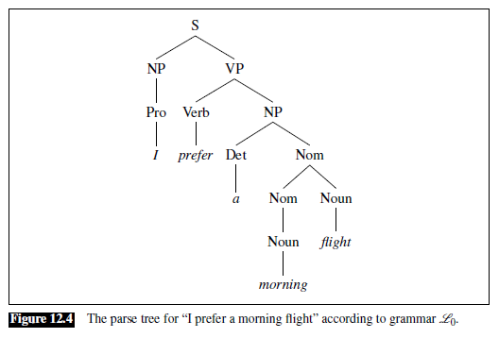
Parse Tree Example

Slide 13
Formal Languages
A CFG defines a formal language
When discussing regular expressions, we learned that a formal language is a set of strings, typically adhering to some set of rules
Sentences (strings of words) that can be derived by a grammar are in the formal language defined by the grammar and are called grammatical sentences
Strings of words that cannot be derived by a grammar are not in the language defined by the grammar and are referred to as ungrammatical
This is a simplification of how natural languages really work
In reality, determining whether a given sentence is part of a natural language often depends on context
In linguistics, the use of formal languages to model natural languages is called generative grammar
This is because the language is defined by the set of possible sentences that can be generated by the grammar

Slide 14
Formal Description of CFGs
A CFG is defined by four parameters:
  N is a set of non-terminal symbols (a.k.a. variables)
  ∑ is a set of terminal symbols (disjoint from N)
  R is a set of rules, or productions, each of the form A → B, where A is a non-terminal and B is a string of symbols from the infinite set of strings (∑ U N)*
  S is the designated start symbol
Our textbook uses the following conventions:
  Capital letters represent non-terminals
  S specifically represents the start symbol
  Lower-case Greek letters represent strings drawn from (∑ U N)*
  Lower-case English letters represent strings of terminals

Slide 15
English Grammar Rules
The next portion of our lecture is related to Section 12.3 of the textbook, titled "Some Grammar Rules for English"
The textbook emphasizes that the discussion is far from complete
In fact, when you look at different sources, the rules, and even the types of phrases and POS categories, will differ
I would add that, in general, linguists try to develop grammar rules that are descriptive, rather than prescriptive
We will discuss this distinction more at the end of our next topic

Slide 16
Sample Rules for English Sentences
There are several possible structures of English sentences
Some (by no means all) are indicated by the following rules:
  S → NP VP (declarative structure)
  S → VP (imperative structure)
  S → Aux NP VP (yes-no question structure)
  S → Wh-NP VP (wh-subject-question structure)
  S → Wh-NP Aux NP VP (wh-non-subject-question structure)
  S → S CC S (compound sentence with a coordinating conjunction)
The different types of sentences will be discussed over the next several slides

Slide 17
Declarative Structure
Sentences with declarative structure have a subject noun phrase followed by a verb phrase
This is the only type of sentence recognized by a rule in the simple grammar introduced earlier
Sentences of this structure have many different uses (e.g., stating a fact, a preference, an opinion, etc.)
Examples include:
  "I prefer a morning flight"
  "The return flight should leave at around seven p.m."

Slide 18
Imperative Structure
Sentences with imperative structure often begin with a verb phrase and have no subject
They are called imperative because they are often used for commands or suggestions
Examples include:
  "Show me the cheapest fare that has lunch"
  "Give me Sunday's flights arriving in Las Vegas from New York City"
I would add that this is the only type of English sentence in which the subject is not explicitly stated!

Slide 19
Yes-No Question Structure
Sentences with yes-no question structure are often (though not always) used to ask a question
Sometimes they are used for making requests or suggestions
Examples include:
  "Do any of these flights have stops?" (question)
  "Can you give me the same information for United?" (request)
These sentences begin with an auxiliary verb, followed by a subject NP, followed by a VP

Slide 20
Wh-Subject-Question Structure
There are at least two types of wh-question structures
One of their constituents is a Wh-NP including a wh-word (e.g., "who", "whose", "when", "where", "what", "which", "how", "why")
One type, wh-subject-question structure, is nearly identical to declarative structure, except that the first noun phrase contains some wh-word
Examples include:
  "What airlines fly from Burbank to Denver?"
  "Which of these flights have the longest layover in Nashville?"
Additional rules would be necessary for the words that make up the Wh-NP constituent

Slide 21
Wh-Non-Subject-Question Structure
For another type, wh-non-subject-question structure, the wh-phrase is not the subject, and so the sentence contains another subject
Structures like these include long-distance dependencies
for example, in the question "What flights do you have from Burbank to Tacoma Washington?", "flights" is an argument of "have"
In some models of parsing, this is considered to be a semantic relationship, and it is determined during semantic interpretation (which takes place after syntactic parsing)
In other models, it is considered a syntactic relation, and the grammar is modified to insert a marker called a trace, a type of empty category, after the verb
One argument I have heard in favor of the existence of traces is that speakers usually pause where the trace would be
The previous edition of the textbook also mentioned topicalization, another sentence level structure that they did not give a rule for, but it also involves a long-distance dependency
With topicalization, a phrase is placed at the beginning of the sentence for discourse purposes; for example, "On Tuesday, I'd like to fly from Detroit to Saint Petersburg"

Slide 22
Embedded Sentences
The book also points out that S can also occur on the right-hand side of grammar rules
A sentence within a larger sentence can be called an embedded sentence
The embedded S then corresponds "to the notion of a clause, which traditional grammars often describe as forming a complete thought" [book]
Although the book does not give any rules for this, one obvious rule (I included it on a previous slide) combines two S phrases with a coordinating conjunction
My made-up example: "I like sitting in an aisle seat, but I do not like stopovers."
Another type of embedded sentence occurs in dependent clauses after certain verbs (we will not look at a rule for this)
My made-up example: "I think that the meal contains a flight."

Slide 23
English Noun Phrases
The L₀ grammar accounts for only three types of noun phrases: pronouns, proper nouns, and a determiner followed by a nominal (nominals are discussed more on the next few slides)
We will now focus more on the determiners that can modify nominals
Determiners include articles (i.e., "a", "an", "the") and words such as "this", "those", "any", and "some"
The role of the determiner in English noun phrase can also be filled by more complex expressions; for example, "United's flight" or "Denver's mayor's mother's canceled flight"
In these examples, the role of the determiner is filled by a possessive expression consisting of a noun phrase followed by an 's as a possessive marker; the rule is: Det → NP 's
Note that this rule is recursive, since an NP can start with a Det (allowing the previous example)
In some cases, determiners are optional (but the book does not discuss modifying the rule)
For example, if the noun is plural: "Show me flights from San Francisco to Denver on weekdays"
Mass nouns, including substances and certain abstract nouns, also don't require a determiner; for example, "Does this flight serve dinner?"
Some noun phrases also include a predeterminer before the determiner; e.g., "all" in the phrase "all the morning flights" (we would need a new rule for this)

Slide 24
English Nominals
A nominal consists of a head noun along with various modifiers that can occur before or after the head
I add: Although our textbook uses the phrase "head noun" several times in the context of noun phrases, they don't fully define the notion of a "head"
The head of a phrase is the word that is syntactically the most significant to the phrase; they often, but don't always, match my intuition
We will discuss the concept of heads of phrases in more detail in our next topic
The book shows several examples of pre- and post-head noun modifiers, which they consider part of the nominal (as is typical); we will look at some of these over the next two slides
Some linguistic theories would call the full phrase, including the determiner, a determiner phrase, with the determiner as the head, as opposed to a noun phrase
Some other linguistic theories don't distinguish between noun phrases and nominals at all
Earlier additions of the textbook considered the pre-head modifiers to be prenominal modifiers; that is, it considered them to be part of the noun phrase, but not part of the nominal (although this is not common)
In the simplest case, the nominal consists only of a single noun
The rule we have seen in L₀ recursively allows multiple nouns to combine to form a nominal (e.g., to allow nominals such as "dinner flight")

Slide 25
Pre-head Noun Modifiers
Pre-head noun modifiers can appear before the head noun in a nominal; these include cardinal numbers (e.g., "one", "ten"), ordinal numbers, quantifiers (e.g., "many", "few"), and adjectives
Ordinal numbers include "first", "second", etc. but also words like "next", "past", and "another"
Adjectives can be grouped into an adjective phrase (AP) and placed before the head noun
APs can include an adverb before an adjective; for example, "the least expensive fare"
The textbook does not provide rules for this, but we could include something such as:
  Nominal → (Card) (Ord) (Quant) (AP) Nominal
The parentheses here are used to mark optional constituents of the NP; it is really a shorthand for multiple rules (with and without the optional constituent)
Of course, each of the optional constituents would require their own rules
Cardinal numbers, ordinal numbers, and quantifiers may be considered parts of speech, but the adjective phrase is a type of phrase consisting of one or more adjectives
Also note that this rule implies that there is a particular order to prenominal modifiers; other orders would not sound right

Slide 26
Postmodifiers
A head noun can also be followed by post-head noun modifiers, or postmodifiers, which are part of the nominal
Examples include prepositional phrases ("all flights from Cleveland"), non-finite clauses ("any flights arriving after eleven a.m."), and relative clauses ("a flight that serves breakfast")
Prepositional phrases (PPs) can be strung together; for example, "all flights from Cleveland to Newark" or "a reservation on flight six oh six from Tampa to Montreal"
A possible rule to handle such PPs is: Nominal → Nominal PP
Three kinds of non-finite (meaning they do not indicate tense) postmodifiers are the gerundive (-ing), -ed ("the aircraft used by this flight"), and infinitive forms ("the last flight to arrive in Boston")
Gerundive postmodifiers consist of a verb phrase that begins with the gerundive (-ing) form of a verb, optionally followed by other types of phrases; e.g., "any flights arriving after eleven a.m."
Possible new rules for gerundive non-finite postmodifiers are:
  Nominal → Nominal GerundVP
  GerundVP → GerundV NP | GerundV PP | GerundV | GerundV NP PP
  GerundV → being | arriving | leaving | …
The book does not show rules for the infinitive or -ed forms of non-finite postmodifiers

Slide 27
Postnominal Relative Clauses
A postnominal relative clause often begins with a relative pronoun (e.g., "who" or "that") which serves as the subject of the embedded verb
Examples include "a flight that serves breakfast", "the one that leaves at ten thirty five", and "the pilot who showed up late"
Rules that can help deal with these cases might include:
  Nominal → Nominal RelClause
  RelClause → (who | that) VP
Without showing rules, the book points out that the relative pronoun may also function as the object of the embedded verb
For example, consider the phrase "the earliest American Airlines flight that I can get"
Various postnominal modifiers can be combined
For example, consider "a friend living in Denver that would like to visit me in DC"

Slide 28
Verb Phrases
Verb phrases can take many different forms; here are some possible rules with examples:
  VP → Verb (e.g., "disappear")
  VP → Verb NP (e.g., "prefer a morning flight")
  VP → Verb NP PP (e.g., "leave Boston in the morning")
  VP → Verb PP (e.g., "leaving on Thursday")
  VP → Verb S (e.g., "said there were two flights that were the cheapest")
Recall that verbs can also be followed by particles, resembling prepositions; together, the verb and particle form a phrasal verb
We won't look at rules handling phrasal verbs (neither does the book)

Slide 29
Subcategorization Frames
Traditional grammars distinguish between transitive verbs and intransitive verbs
Transitive verbs (e.g., "find") take a direct object NP (e.g., "I found a flight") while intransitive verbs (e.g., "disappear") do not
Modern grammars distinguish as many as 100 subcategories
We say that a verb like "find" subcategorizes for an NP, while a verb like "want" subcategorizes for either an NP or a non-finite VP
We can call these constituents complements of the verb
The possible complements for a verb are called subcategorization frames
The next slide shows subcategorization frames for some example verbs

Slide 30
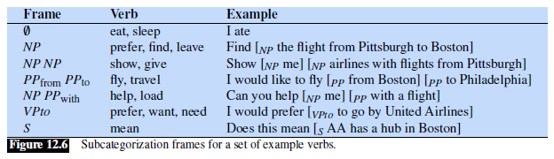
Subcategorization Frame Examples

Slide 31
Rules for Subcategorization
To handle this with a CFG, using only techniques discussed so far requires rules such as these:
  Verb-with-no-complement → disappear | …
  Verb-with-NP-complement → find | leave | repeat | want | …
  Verb-with-S-complement → think | believe | say | …
  Verb-with-Inf-VP-complement → want | try | need | …
  VP → Verb-with-no-complement
  VP → Verb-with-NP-complement NP
  VP → Verb-with-S-complement S
Note that some verbs can fall into multiple categories if they take different types of complements in different contexts
We will see a more reasonable way to handle subcategorization later in the topic

Slide 32
Auxiliary Verbs
Discussion of handling auxiliary verbs has been dropped in the current edition of the textbook
Auxiliary verbs include:
  Modals ("can", "may", etc.)
  The perfect "have" (e.g., "have booked")
  The progressive "be" (e.g., "am going")
  The passive "be" (e.g., "was delayed")
A verb phrase can include multiple auxiliary verbs, but they must appear in a certain order: modal < perfect < progressive < passive
For example, consider the phrase "might have been prevented"
Each type of auxiliary verb expects a certain type of complement
For example, the perfect verb "have" subcategorizes for a VP whose head verb is a past participle, as in "have booked three flights"

Slide 33
Conjunctions
Major phrase types can be combined with conjunctions to form larger constructions of the same type
Possible rules look like this:
  NP → NP and NP (e.g., "I need to know the aircraft and the flight number")
  Nominal → Nominal and Nominal (e.g., "I need to know the aircraft and flight number")
  VP → VP and VP (e.g., "What flights do you have leaving Denver and arriving in San Francisco?")
  S → S and S (e.g., "I'm interested in a flight from Dallas to Washington and I'm also interested in going to Baltimore")
We can replace "and" with "CC" for more generality
The way the rules are listed above provides examples of rules with both terminals and nonterminals on the right-hand side
The ability to form coordinate phrases though conjunctions is often used as a test for constituency
In fact, this provides evidence for the Nominal constituent

Slide 34
Agreement
We have seen when discussing morphology that nouns and verbs have different forms; in some cases, the form used for one word depends on the context of the surrounding words
Example: Most present tense verbs have a separate form for third-person singular subjects (e.g., "The flight leaves in the morning", "The flights leave in the morning", "I leave…", etc.)
One way to handle this requirement for subject-verb agreement is to expand the grammar with multiple sets of rules; e.g., the rule S → NP VP might be replaced with these two rules:
  S → 3sgNP 3sgVP
  S → Non3sgNP Non3pVP
However, handling agreement like this can possibly double the size of the grammar for every type of agreement (thus increasing the size of the grammar exponentially)
Other types of agreement include:
  Case agreement; for example, English pronouns have nominative (e.g., "I", "she", "he", "they") and accusative (e.g., "me", "her", "him", "them") versions
  Some determiners require determiner-noun agreement, meaning that they must agree in number with the nouns they modify (for example, "this flight" versus "these flights")
  In some languages, there is also a requirement for gender agreement

Slide 35
Augmented Grammars
There are various ways to augment grammars to handle various agreement rules that must be enforced, without exponentially increasing the size of the grammar
For example, our textbook discusses lexicalized grammars in Section 12.6, but we will skip this
Instead, we are going to briefly discuss a notation used in "Artificial Intelligence: A Modern Approach" by Stuart Russell and Peter Norvig (I use this textbook for my AI course)
Consider the following rules representing part of an augmented grammar:
  S(head) → NP(Sbj, pn, h) VP(pn, head) | …
  NP(c, pn, head) → Pronoun(c, pn, head) | Noun(c, pn, head) | …
  VP(pn, head) → VP(pn, head) NP(Obj, pn, h) | …
  PP(head) → Prep(head) NP(Obj, pn, h)
  Pronoun(Sbj, 1S, I) → I
  Pronoun(Sbj, 1P, we) → we
  Pronoun(Obj, 1S, me) → me
  Pronoun(Obj, 3P, them) → them
Here, "c" and "pn" represent parameters, or features, for case (subject or object) and person/number, respectively; "head" and "h" are parameters representing heads of phrases

Slide 36
Interpreting Augmented Grammars
Certain facts indicated in the snippet of an augmented grammar on the previous slide are are:
  "I" is a first-person singular subject, "them" is a third person plural object, etc.
  A sentence can have the form of a subject noun phrase followed by a verb phrase, but only if the person and number of the noun phrase and the verb phrase match
  When a sentence is formed this way, the head of the sentence is the head of the verb phrase
  A noun phrase can have the form of a single pronoun or single noun, and the noun phrase takes the case, person, and number of the pronoun or noun
  The head of each type of phrase comes from one of its words or sub-phrases
Augmentations like these can also be used for determiner-noun agreement, gender agreement, and verb subcategorization (discussed earlier)
All of this can be done without greatly increasing the size of the grammar
Theoretically, this type of augmentation does not add to the expressive power of the formalism
That is, for every augmented grammar of this type, there is an equivalent CFG (although it would possibly be much larger)

Slide 37
Why CFGs?
Recall again that CFGs are one type of grammar that is part of the Chomsky hierarchy
We have previously learned that regular expressions can be useful to express morphology rules
It is typically wise to use the least powerful formalism that can be used to solve a task, because it generally makes it easier compared to using a more powerful formalism
It has been well established that natural languages cannot be defined by regular grammars
It has long been debated whether CFGs are capable of defining natural languages
It has been shown that a few constructs in some languages (but not English) are not context free
Nonetheless, CFGs have been the most common formalism used by linguists to represent grammar
More generally, the previous edition of the textbook discussed some evidence from psychology experiments supporting the notion that constituents (phrases) may be mentally depicted when humans process language
For example, one study started by asking subjects to read sentences that contain a constituent (e.g., a verb phrase) with a particular structure (e.g., V NP PP)
If the subjects were then asked to describe a picture, they were more likely to use the same structure
One possible explanation for this is that the particular form of the constituent has been primed, suggesting that the constituent is mentally represented

Slide 38
Treebanks
A treebank is a corpus in which every sentence is syntactically annotated with a parse
The Penn Treebank project has produced treebanks from the Brown, switchboard, ATIS and Wall Street Journal corpora of English (as well as treebanks in Arabic and Chinese)
We have previously heard about the Penn Treebank when we discussed parts-of-speech (which are also manually annotated in the treebank); one tagset we looked at came from this treebank
The Penn Treebank is currently maintained and distributed by the Linguistic Data Consortium (LDC)
Unfortunately, it is not freely available, but Cooper Union does have access to it (we recently obtained it!)
Treebanks are often created by first having parsers automatically parse each sentence in a corpus, and then having human linguists hand-correct the parses
The book discusses formats used by treebanks (note that tagsets, formats, and grammars can differ between treebanks)
The next slide shows examples from the Brown and ATIS portions of the Penn Treebank (using different formats)
Some treebanks, including the Penn Treebank, include traces in their parses to mark certain long-distance dependencies (mentioned earlier)

Slide 39
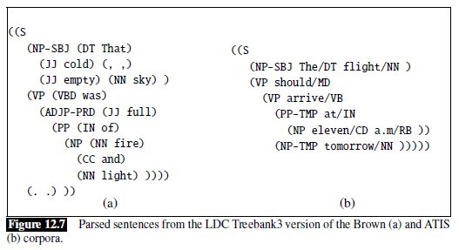
Sample Parses from the Penn Treebank

Slide 40
Treebanks and Grammars
Every treebank implicitly constitutes a grammar of the language that can be expressed as a CFG
Grammars represented by treebanks often include very many and very long rules
For example, one rule represented by the Penn Treebank is: VP → VBP PP PP PP PP PP ADVP PP
The sentence that would indicate this rule is, "This mostly happens because we go from football in the fall to lifting in the winter to football again in the spring."
The Penn Treebank III Wall Street Journal corpus, which contains about 1 million words, consists of about 17,500 distinct rule types
Linguists and NLP practitioners typically don't use grammars learned from treebanks directly
However, it can still be useful for linguistic research to search a treebank for examples of a particular grammatical phenomenon

Slide 41
Dependency Grammars
Dependency grammars offer an alternative to phrase structure grammars (a.k.a. constituency grammars)
We are only going to discuss this topic briefly, but it has become very important in modern NLP
Dependency grammars are not based on constituents
Instead, individual words are related to each other through binary grammatical relations, each between a head word and one of its dependents
The meaning of "head" here is similar to the meaning used with constituency grammars, but the notion of a phrase, a.k.a. constituent, is not as important
  I add: I don't think that proponents of dependency grammars deny that phrases exist
  However, they are not labeled as whole units, and there are no explicit rules for how they can be formed
As with constituency grammars, text is typically analyzed one sentence at a time

Slide 42
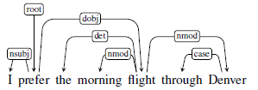
Depicting Dependency Parses
Two common conventions for graphically representing dependency parses are:
  Draw arrows from each head to its dependents (there may be 0, 1, or many arrows leaving each word, including a special "root" symbol)
  Draw arrows from each dependent to its head (every dependent is associated with a single head, including one that points to "root")
The textbook takes the first approach; here is an example of such a dependency tree:
The arrow from "root" to "prefer" implies that "prefer" is the head of the entire sentence
Two slides from now, we will discuss the labels along the arrows
Dependency parses can also be depicted as parse trees; the next slide shows an example

Slide 43
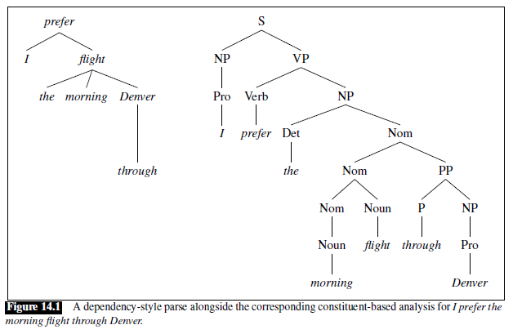
Parse Trees

Slide 44
Dependency Relations
The arrows in a graphical depiction of a dependency parse can include labels indicating the types of dependencies
Different researchers have come up with different sets of categories with which dependencies can be labeled
The example from the book uses labels from the Universal Dependencies project
The goal of this project is to come up with a set of labels that can be used for all the world's languages
The next slide shows a selected subset of relations form the Universal Dependencies set (including all of those used in the previous example)
As with constituency grammars, dependency treebanks have been annotated with dependency relations
Sometimes an algorithm applies labels first, and then experts correct mistakes
Such treebanks can be used to study dependency grammars or to evaluate dependency parsers

Slide 45
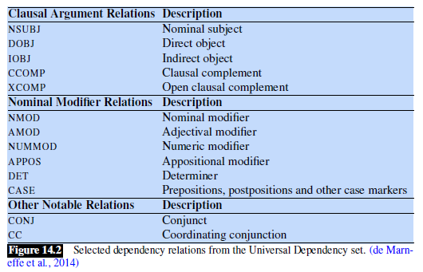
Examples of Dependency Relations

Slide 46
Constraints on Dependency Parses
Unlike with constituency grammars, there are no specific rules for how words or phrases can combine to form other phrases; however, there are constraints imposed on the dependency parses
We can consider the constraints to be imposed on the dependency tree, consisting of a set of vertices V (representing words) and the arcs connecting them (representing dependency relations)
Here are three constraints, copied from the textbook:
  There is a single designated root node that has no incoming arcs.
  With the exception of the root node, each vertex has exactly one incoming arc.
  There is a unique path from the root node to each vertex in V.
Additionally, some dependency grammar formalisms require projectivity
Book: "An arc from a head to a dependent is said to be projective if there is a path from the head to every word that lies between the head and the dependent in the sentence"
It turns out that an equivalent constraint is to impose that arrows cannot cross each other (i.e., a sentence is projective if it is possible to draw the dependencies with no crossing arrows)
It is well-known that some sentences (including in English) violate this constraint (projectivity)
However, it was a useful constraint to impose for some traditional dependency parsing algorithms
We will cover constituency parsing in a future topic, but we will not cover dependency parsing

Slide 47
Spoken English
The previous edition of our textbook discussed the grammar of spoken English, which differs in several aspects from the grammar of written English
In the context of linguistics and NLP, the main unit for spoken English is sometimes referred to as an utterance as opposed to a sentence
Differences between spoken utterances and written sentences include:
  Utterances contain a much higher frequency of pronouns
  Utterances often consist of short fragments or phrases
  There are phonological, prosodic, and acoustic characteristics
  There are various kinds of disfluencies (e.g., hesitations, fillers such as "uh" and "um", restarts, word repetitions, and repairs)
Pinker emphasizes how complex and non-grammatical spoken English can be relative to written English in one chapter of "The Language Instinct"
To back this up, he discusses an excerpt from the Watergate transcripts (we'll talk about it during our lecture)

