Slide 1
ECE461: Theoretical CS
Undecidability and Diagonalization

Slide 2
Brief Recap
In earlier topics, we explored formalisms that are sufficient for describing the regular languages and the context-free languages
Although they are useful for various purposes, those formalisms are quite limited in power
Then, we discussed Turing machines (TMs), providing us with the most powerful known formalism for modeling computation
If we accept the Church-Turing thesis, then all algorithms can be implemented by Turing machines
In our previous topic, we saw some examples of decidable languages
These language were interesting in that they were related to regular languages or context-free languages and the formalisms that describe them
Toward the end of the topic, we mentioned that one language, EQ_{CFG}, is an undecidable language; no Turing machine, and thus no algorithm, is capable of deciding whether two CFGs describe the same language
In this topic, we will learn about another undecidable language, and we will use a technique called diagonalization to prove that it is undecidable
This topic is based on Section 4.2 of the textbook
In our next topic, we will learn how to use reductions to prove that several other languages are also undecidable

Slide 3
A_{TM}
The first language we will prove is undecidable is: A_{TM} = {<M, w> | M is a TM and M accepts w}
  This is the language of all (<M>, w) pairs such that M (the TM encoded as <M>) accepts w
  Deciding whether a string is a member of this language is equivalent to deciding if the TM encoded as <M> accepts the input w
  This is known as the acceptance problem for Turing machines
Recall that we have previously seen that A_{DFA}, A_{NFA}, A_{REX}, and A_{CFG} are all decidable languages; however, we will soon prove that A_{TM} is not
In our next topic, we will see that this problem is related to the famous halting problem, which we will prove is also undecidable
Although A_{TM} is not Turing-decidable (a.k.a. decidable), it is clearly Turing-recognizable
  Consider a Turing machine, U, that accepts input <M, w>, where M is a TM and w is a string
  U can simulate M on w
  If M accepts w, U accepts <M, w>; if M rejects w, U rejects <M, w>
  However, if M never halts, then U never halts; hence, U is a recognizer for A_{TM}, but not a decider for A_{TM}
  In fact, in this example, U is a universal Turing machine, which we discussed in a previous topic (this is where the textbook introduces the concept)

Slide 4
Diagonalization
The technique called diagonalization was originally used by Cantor, who "was concerned with the problem of measuring the sizes of infinite sets"
  In particular, Cantor proved that the set of real numbers is not countable (we will soon explain what this means)
  Our textbook specifies the year of this achievement as 1873
  Based on online sources, Cantor's original proof was published in 1874 and did not use diagonalization
  However, a later proof by Cantor, published in 1891, used diagonalization
We will first explain how diagonalization can be used to show that the set of real number is not countable
Soon, we will see that diagonalization can also be used to show that certain languages are undecidable

Slide 5
One-to-One Correspondences
Cantor observed that finite sets have the same size if the elements of each set can be paired with each other
He reasoned that we should could consider infinite sets to have the same size under the same circumstances
Some terminology (taken from Definition 4.12 of the textbook):
  Suppose we have two sets (finite or infinite) A and B, and a function f that maps from A to B
  We say that f is one-to-one (a.k.a. injective) if it never maps two different elements to the same value; i.e., if a ≠ b, then f(a) ≠ f(b)
  We say that f is onto (a.k.a. surjective) if every element of B has something that maps to it
  A function that is both one-to-one and onto is a correspondence (other sources call this a one-to-one correspondence, and that's the term that I use; some sources use the term bijection)
  We will say that two sets are the same size if and only if there is a one-to-one correspondence f: A → B
  A one-to-one correspondence maps every element of A to a unique element of B, and it maps every element of B to a unique element of A
  This provides a way of pairing the elements of A and the elements of B
We wills say that two sets (finite or infinite) have the same size if and only if there is a one-to-one correspondence that pairs the elements of the two sets

Slide 6
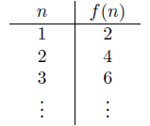
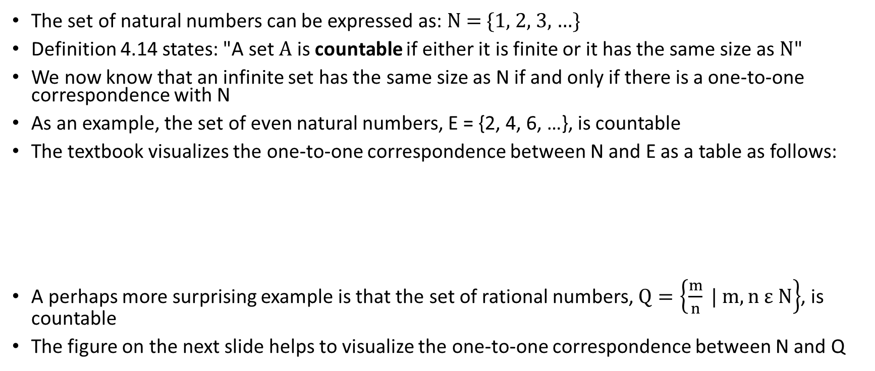
Countable Sets
The set of natural numbers can be expressed as: N = {1, 2, 3, …}
Definition 4.14 states: "A set A is countable if either it is finite or it has the same size as N"
We now know that an infinite set has the same size as N if and only if there is a one-to-one correspondence with N
As an example, the set of even natural numbers, E = {2, 4, 6, …}, is countable
The textbook visualizes the one-to-one correspondence between N and E as a table as follows:
A perhaps more surprising example is that the set of rational numbers, $Q=\left\{\frac{m}{n} | m, n ε N\right\}$, is countable
The figure on the next slide helps to visualize the one-to-one correspondence between N and Q

Slide 7
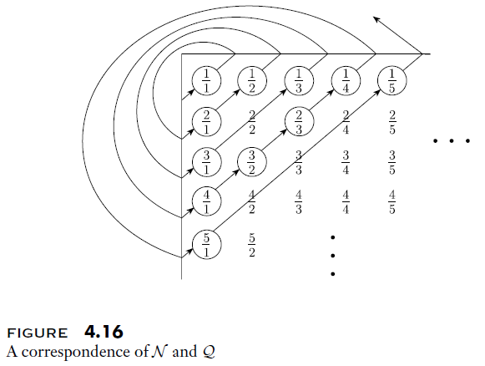
One-to-One Correspondence between N & Q

Slide 8
Uncountable Sets
An infinite set is uncountable if there does not exist any one-to-one correspondence with N
Consider the set of real numbers, R, which contain all numbers that have a decimal representation; e.g., π = 3.14159…
Theorem 4.17 in the textbook states: "R is uncountable"
We will prove this with an indirect proof (a.k.a. proof by contradiction)
  Assume that R is countable
  Then there must be a one-to-one correspondence between N and R
  We would be able to represent such a one-to-one correspondence as a table, as shown in the left figure on the next slide
  Now consider the following decimal number, x:
    The whole number portion is 0
    To create the i^{th} digit after the decimal point, look at the i^{th} digit after the decimal point of the real number paired with natural number i, and choose any other digit (but don't choose 0 or 9 to avoid a "slight problem" – I'll discuss this in class)
    This process is demonstrated by the right figure on the next slide
  Clearly, x is different than every entry in the table by at least one digit
  Therefore, this is not a proper one-to-one correspondence between N and R, contradicting our assumption
  Therefore, the assumption must be false; R is uncountable

Slide 9
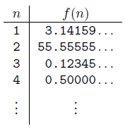
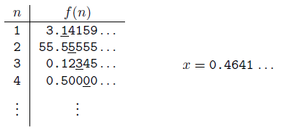
One-to-One Correspondence between N & R?
Hypothetical one-to-one correspondence between N & R
Creation of a real number leading to a contradiction to our assumption

Slide 10
Some Languages are Not Turing-Recognizable
The book proves that some languages are not Turing-recognizable; there are three main steps:
  Showing that the set of all Turing machines is countable
    We have explained that a Turing machine can be encoded as a string
    We can loop through all possible strings using any given alphabet (e.g., all strings of length 1, then all strings of length 2, etc.); this is related to the concept of a lexicographical order that we discussed in DSA 2
  Showing that B, the set of all infinite binary strings (i.e., sequences of 0s and 1s), is not countable
    We can prove this using diagonalization and an indirect proof
    Assume there is a one-to-one correlation between N and B
    Consider a matrix, where each row represents an element of B, and each column stores one bit
    Now consider the binary string formed by taking the elements of the diagonal and flipping all the bits; this is an infinite sequence of 0s and 1s that is different than all the elements of B
  Showing that the size of B is equal to the size of L, the set of all languages over some alphabet
    Consider any language over a specified alphabet
    Some strings that can be formed using the alphabet are members of the language, and some are not
    We can represent any such language as a string of 0s and 1s, where the i^{th} bit indicates whether the i^{th} string (using the same sort of ordering specified above) is part of the language
    This gives us a one-to-one correspondence between B and the L, so they must have the same size
Since the number of languages over an alphabet is larger than the number of TMs, and each TM recognizes one language, some languages must not be Turing-recognizable

Slide 11
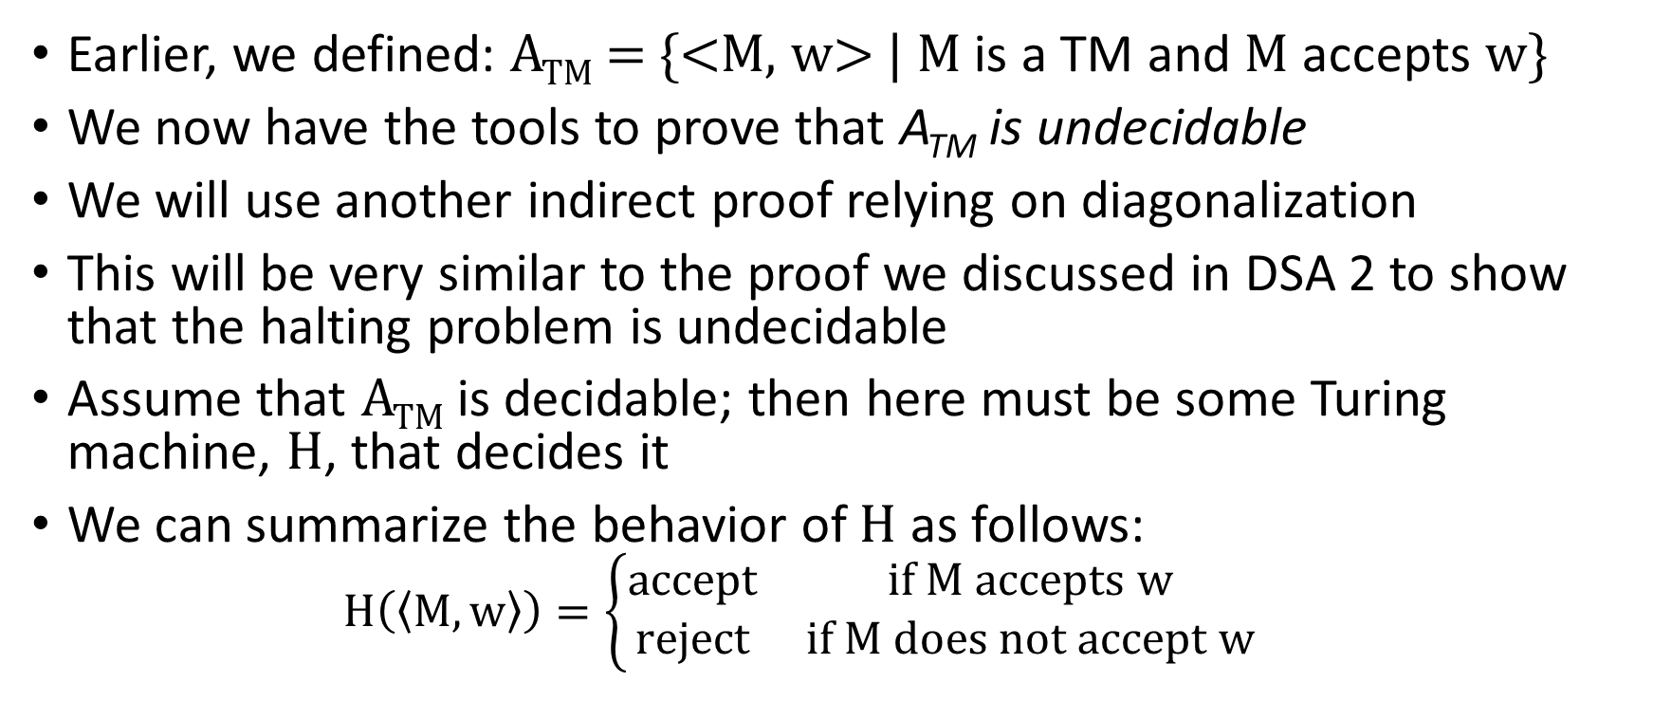
Proving that A_{TM} is Undecidable (the start)
Earlier, we defined: A_{TM} = {<M, w> | M is a TM and M accepts w}
We now have the tools to prove that A_{TM} is undecidable
We will use another indirect proof relying on diagonalization
This will be very similar to the proof we discussed in DSA 2 to show that the halting problem is undecidable
Assume that A_{TM} is decidable; then here must be some Turing machine, H, that decides it
We can summarize the behavior of H as follows:
  $$H\left(\left\langle M,w\right\rangle \right)=\left\{\begin{matrix}accept & if M accepts w \\ reject & if M does not accept w\end{matrix}\right.$$

Slide 12
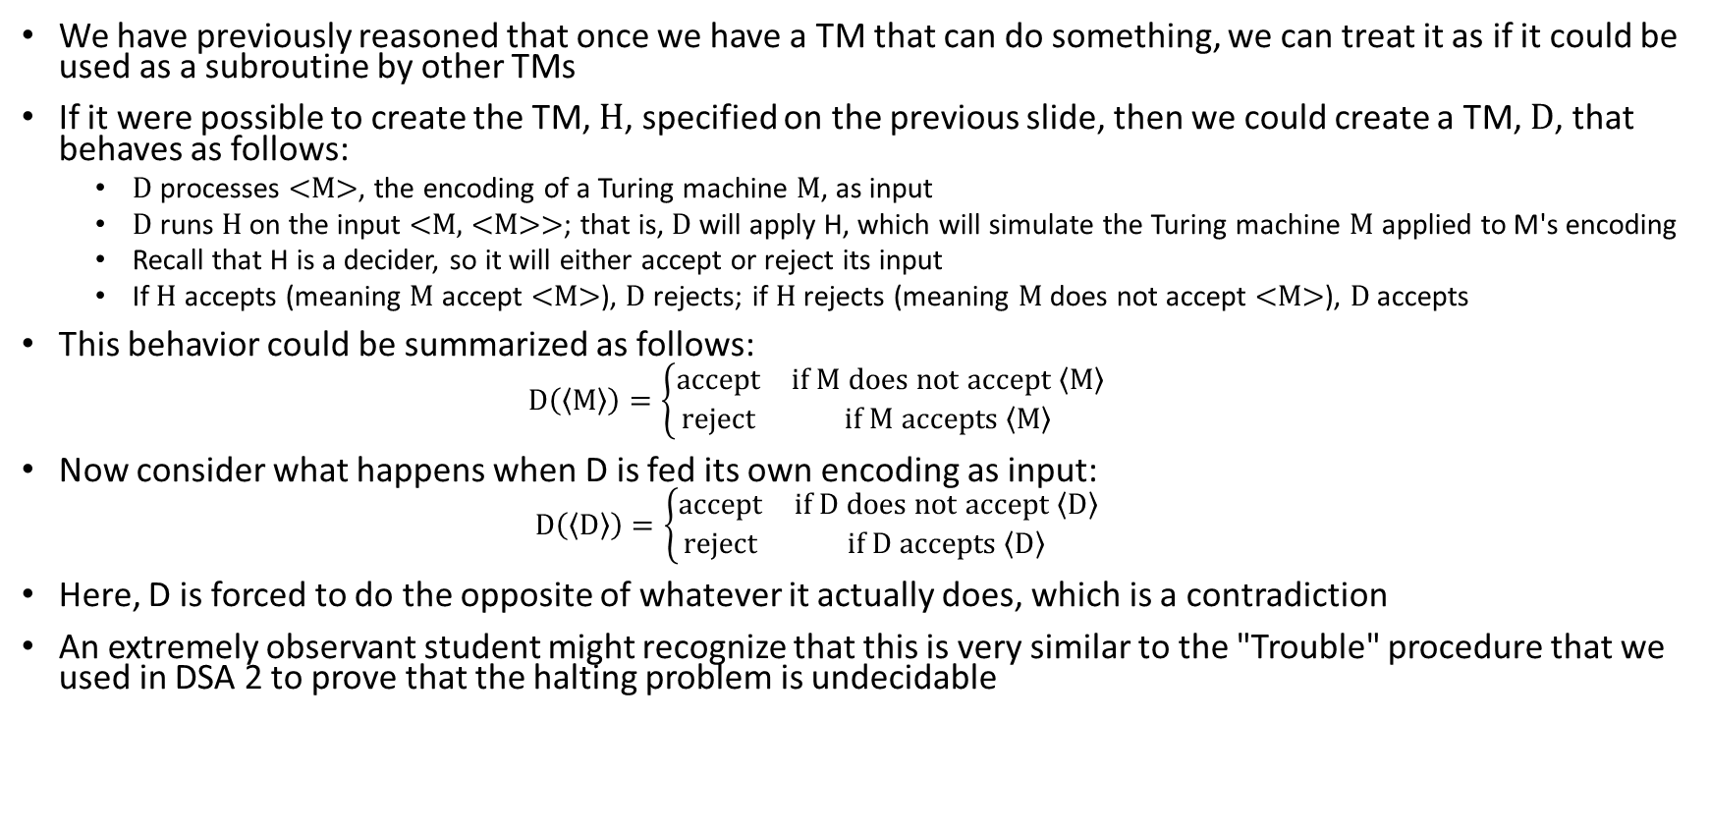
Trouble
We have previously reasoned that once we have a TM that can do something, we can treat it as if it could be used as a subroutine by other TMs
If it were possible to create the TM, H, specified on the previous slide, then we could create a TM, D, that behaves as follows:
  D processes <M>, the encoding of a Turing machine M, as input
  D runs H on the input <M, <M>>; that is, D will apply H, which will simulate the Turing machine M applied to M's encoding
  Recall that H is a decider, so it will either accept or reject its input
  If H accepts (meaning M accept <M>), D rejects; if H rejects (meaning M does not accept <M>), D accepts
This behavior could be summarized as follows:
  $$D\left(\left\langle M\right\rangle \right)=\left\{\begin{matrix}accept & if M does not accept \left\langle M\right\rangle \\ reject & if M accepts \left\langle M\right\rangle \end{matrix}\right.$$
Now consider what happens when D is fed its own encoding as input:
  $$D\left(\left\langle D\right\rangle \right)=\left\{\begin{matrix}accept & if D does not accept \left\langle D\right\rangle \\ reject & if D accepts \left\langle D\right\rangle \end{matrix}\right.$$
Here, D is forced to do the opposite of whatever it actually does, which is a contradiction
An extremely observant student might recognize that this is very similar to the "Trouble" procedure that we used in DSA 2 to prove that the halting problem is undecidable

Slide 13
How is this related to diagonalization?
The top-left figure on the next slide displays what hypothetically happen when a Turing machine M_{i} is run on input <M_{j}>
  If M_{i} accepts <M_{j}>, the slot (i, j) in the table is filled in with accept
  Otherwise, the slot (i, j) is left blank; in some of these cases, M_{i} might reject <M_{j}>, and in other places, it may run forever (i.e., never halt)
The bottom-left figure on the next slide displays the values of H when fed <M_{i}, <M_{j}>> as input
  This is basically the same as the previous figure, but all blanks have been replaced with reject
  This is because H (which is a decider) accepts its input if M_{i} accepts <M_{j}>, and rejects otherwise
  Clearly, such a TM is possible if the acceptance problem for TMs is solvable (because H is a TM that solves the acceptance problem)
The right figure on the next slide is the same as the previous figure, but we are pondering whether any row in the table represents the Turing machine D
  We can logically reason that this is not possible, because D will differ from every row in the table in at least one position, which is on the diagonal
  On the other hand, if H is a TM, then we would be able to implement D as a TM, so this is a contradiction
The assumption that led us to this contradiction was the assumption made two slides back that A_{TM} is decidable; hence, A_{TM} is undecidable

Slide 14
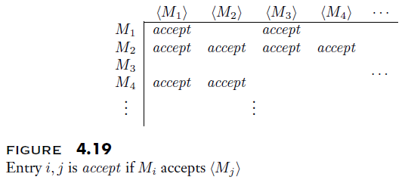
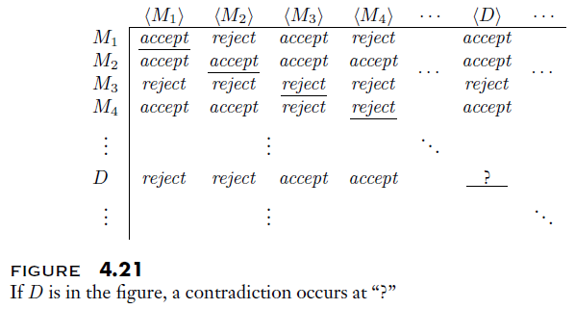
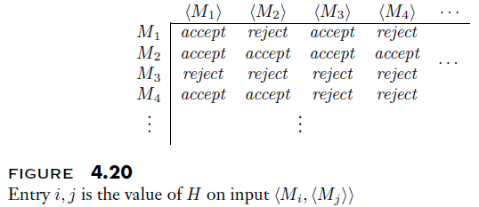
The Contradiction Explained

Slide 15
Co-Turing-Recognizable Languages
A co-Turing-recognizable language is any language that is the complement of a Turing recognizable language
Theorem 4.22 states: "A language is decidable iff it is Turing-recognizable and co-Turing-recognizable"
To prove this, we have to show two things
First, if a language is decidable, it is Turing-recognizable and co-Turing-recognizable
  We already know that all decidable languages are Turing-recognizable
  It is also obvious that such a language is co-Turing-recognizable, since the complement of a decidable language is clearly also decidable
Second, if a language is Turing-recognizable and co-Turing-recognizable, it is decidable
  The book describes this as if a Turing machine can run the recognizers for the language and its complement "in parallel"
  Of course, a Turing machine can't really do that, but it can simulate it
  The textbook discusses using a multi-tape TM, where different tapes are used for each simulation, but of course, anything that can be done with a multi-tape TM can be done with a single-tape TM
  Once one of the two simulated TMs accepts (one of them eventually will), the TM performing the simulation would either accept or reject

Slide 16
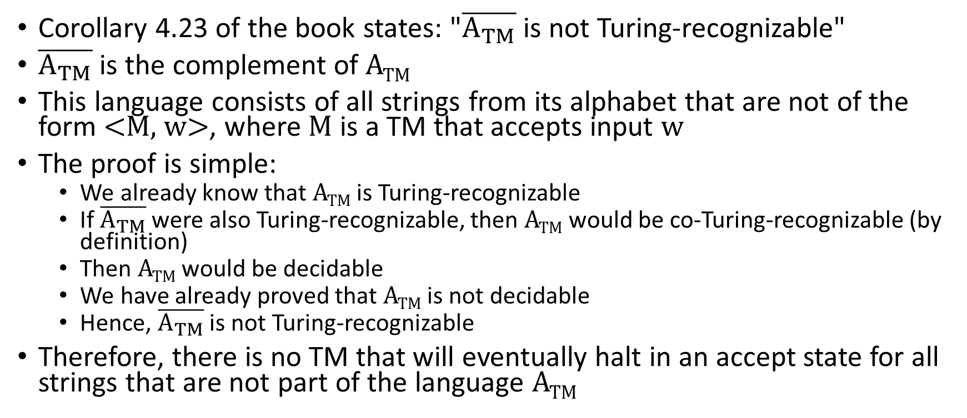
A Non-Turing-Recognizable Language
Corollary 4.23 of the book states: "$\overline{A_{TM}}$ is not Turing-recognizable"
$\overline{A_{TM}}$ is the complement of A_{TM}
This language consists of all strings from its alphabet that are not of the form <M, w>, where M is a TM that accepts input w
The proof is simple:
  We already know that A_{TM} is Turing-recognizable
  If $\overline{A_{TM}}$ were also Turing-recognizable, then A_{TM} would be co-Turing-recognizable (by definition)
  Then A_{TM} would be decidable
  We have already proved that A_{TM} is not decidable
  Hence, $\overline{A_{TM}}$ is not Turing-recognizable
Therefore, there is no TM that will eventually halt in an accept state for all strings that are not part of the language A_{TM}

