Slide 1
ECE461: Theoretical CS
Relativization and
(more about) Oracles

Slide 2
Brief Recap
Earlier in the course, we discussed topics related to computability theory, which relates to the question of which languages or decision problems are decidable
Our primary models of computation have been deterministic Turing machines (DTMs) and nondeterministic Turing machines (NTMs)
If we accept the Church-Turing thesis, all algorithms can be implemented by Turing machines
We have learned that computation is inherently limited, and that some languages are undecidable; an important tool in proving this has been diagonalization
Then we started to cover complexity theory, which explores which languages can be decided efficiently
We introduces time and space complexity classes
Two important time complexity classes are P and NP, which are believed to be different, but the P versus NP question has never been solved
The existence of NP-complete languages give us some insight into the question; the definition of NP-completeness relies on the concept of polynomial time mapping reducibility
At some point, we were introduced to the concept of oracles, which were used to define Turing reducibility
In this topic, based on Section 9.2 of the textbook, we will use oracles to gain further insights about the P versus NP question

Slide 3
Oracles (revisited)
We previously discussed the concept of oracles when we covered Section 6.3, related to Turing reducibility
Recall that Turing reducibility is probably a more intuitive notion of reducibility compared to mapping reducibility, but it is generally less useful
Section 9.2 discusses oracles for a different reason that we will discuss later in the topic
The definition of an oracle given in this section is consistent with, but more detailed than, the definition provided in Section 6.3
Definition 9.17 states (I am keeping the book's exact wording, but modifying the formatting a bit):
  An oracle for a language A is a device that is capable of reporting whether any string w is a member of A. An oracle Turing machine M^{A} is a modified Turing machine that has the additional capability of querying an oracle for A. Whenever M^{A} writes a string on a special oracle tape, it is informed whether that string is a member of A in a single computation step. Let P^{A} be the class of languages decidable with a polynomial time oracle Turing machine that uses oracle A. Define the class NP^{A} similarly.
Our textbook doesn't specify how an oracle Turing machine is "informed" whether an oracle accepts a string
Based on other sources, the answer could be written on a tape, or the oracle TM can jump to one of two special sates
An oracle can be thought of as a "black box" that "doesn't necessarily correspond to any physical device"; we have previously seen that we can even consider oracles for undecidable languages such as A_{TM}
An oracle TM is said to be computing relative to the oracle, leading to the term "relativization"

Slide 4
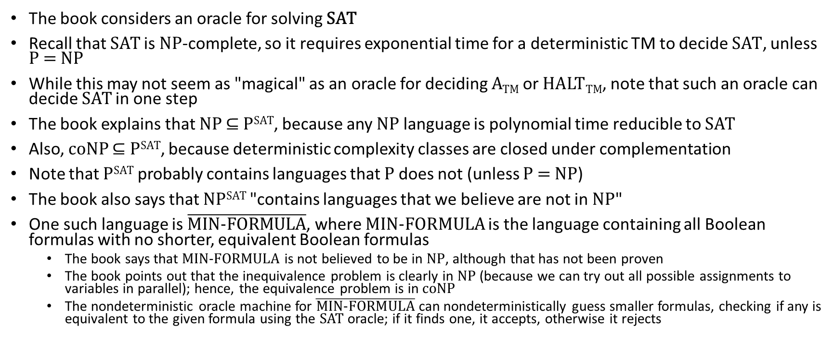
SAT Oracle
The book considers an oracle for solving SAT
Recall that SAT is NP-complete, so it requires exponential time for a deterministic TM to decide SAT, unless P = NP
While this may not seem as "magical" as an oracle for deciding A_{TM} or HALT_{TM}, note that such an oracle can decide SAT in one step
The book explains that NP ⊆ P^{SAT}, because any NP language is polynomial time reducible to SAT
Also, coNP ⊆ P^{SAT}, because deterministic complexity classes are closed under complementation
Note that P^{SAT} probably contains languages that P does not (unless P = NP)
The book also says that NP^{SAT} "contains languages that we believe are not in NP"
One such language is $\overline{\text{MIN}\text{−}\text{FORMULA}}$, where MIN-FORMULA is the language containing all Boolean formulas with no shorter, equivalent Boolean formulas
  The book says that MIN-FORMULA is not believed to be in NP, although that has not been proven
  The book points out that the inequivalence problem is clearly in NP (because we can try out all possible assignments to variables in parallel); hence, the equivalence problem is in coNP
  The nondeterministic oracle machine for $\overline{\text{MIN}\text{−}\text{FORMULA}}$can nondeterministically guess smaller formulas, checking if any is equivalent to the given formula using the SAT oracle; if it finds one, it accepts, otherwise it rejects

Slide 5
P^{A} versus NP^{A} for Different Oracles (part 1)
Theorem 9.20 states (I am keeping the book's exact wording):
  An oracle A exists whereby P^{A} ≠ NP^{A}.
  An oracle B exists whereby P^{B} = NP^{B}.
We will prove the second part first, since it is simpler
Any PSPACE-complete problem would suffice for oracle B; the book chooses TQBF
  The book explains that the following sequence of containments must hold of a TQBF oracle: NP^{TQBF} ⊆ NPSPACE ⊆ PSPACE ⊆ P^{TQBF}
    The first containment holds because any NTM with a TQBF oracle can be converted to a nondeterministic polynomial space TM that solves TQBF as needed instead of using the oracle
    The second containment holds because of Savitch's theorem
    The third containment holds because TQBF is PSPACE-complete (so any PSPACE problem can be converted to TQBF in polynomial time and then solved with the oracle)
  Clearly, P^{TQBF} cannot be larger than NP^{TQBF}, so PT^{QBF} = NP^{TQBF}

Slide 6
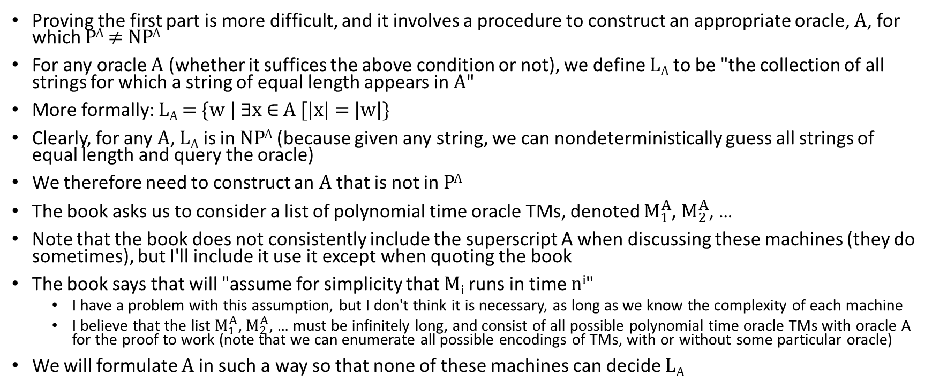
P^{A} versus NP^{A} for Different Oracles (part 2)
Proving the first part is more difficult, and it involves a procedure to construct an appropriate oracle, A, for which P^{A} ≠ NP^{A}
For any oracle A (whether it suffices the above condition or not), we define L_{A} to be "the collection of all strings for which a string of equal length appears in A"
More formally: L_{A} = {w | ∃x ∈ A [|x| = |w|}
Clearly, for any A, L_{A} is in NP^{A} (because given any string, we can nondeterministically guess all strings of equal length and query the oracle)
We therefore need to construct an A that is not in P^{A}
The book asks us to consider a list of polynomial time oracle TMs, denoted $M_{1}^{A}$, $M_{2}^{A}$, …
Note that the book does not consistently include the superscript A when discussing these machines (they do sometimes), but I'll include it use it except when quoting the book
The book says that will "assume for simplicity that M_{i} runs in time n^{i}"
  I have a problem with this assumption, but I don't think it is necessary, as long as we know the complexity of each machine
  I believe that the list $M_{1}^{A}$, $M_{2}^{A}$, … must be infinitely long, and consist of all possible polynomial time oracle TMs with oracle A for the proof to work (note that we can enumerate all possible encodings of TMs, with or without some particular oracle)
We will formulate A in such a way so that none of these machines can decide L_{A}

Slide 7
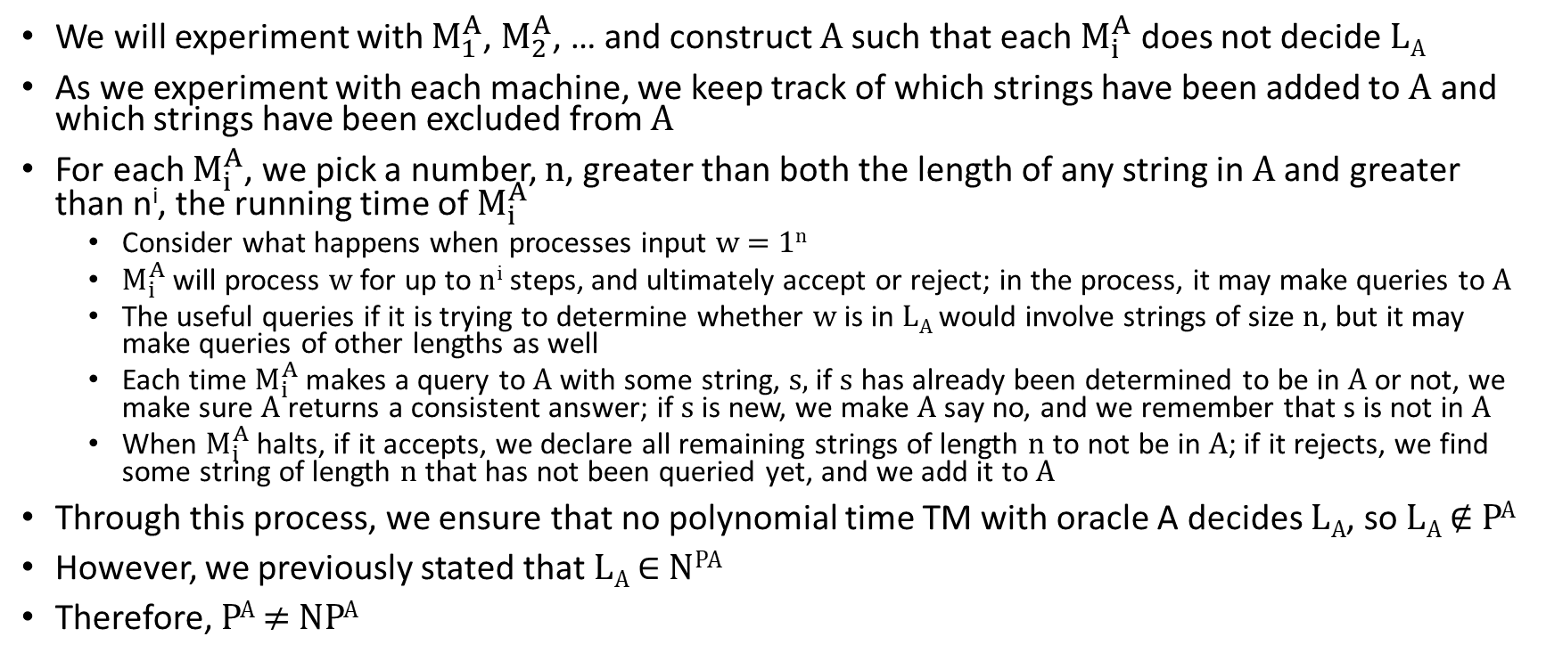
P^{A} versus NP^{A} for Different Oracles (part 3)
We will experiment with $M_{1}^{A}$, $M_{2}^{A}$, … and construct A such that each $M_{i}^{A}$ does not decide L_{A}
As we experiment with each machine, we keep track of which strings have been added to A and which strings have been excluded from A
For each $M_{i}^{A}$, we pick a number, n, greater than both the length of any string in A and greater than n^{i}, the running time of $M_{i}^{A}$
  Consider what happens when processes input w = 1^{n}
  $M_{i}^{A}$will process w for up to n^{i} steps, and ultimately accept or reject; in the process, it may make queries to A
  The useful queries if it is trying to determine whether w is in L_{A} would involve strings of size n, but it may make queries of other lengths as well
  Each time $M_{i}^{A}$makes a query to A with some string, s, if s has already been determined to be in A or not, we make sure A returns a consistent answer; if s is new, we make A say no, and we remember that s is not in A
  When $M_{i}^{A}$halts, if it accepts, we declare all remaining strings of length n to not be in A; if it rejects, we find some string of length n that has not been queried yet, and we add it to A
Through this process, we ensure that no polynomial time TM with oracle A decides L_{A}, so L_{A} ∉ P^{A}
However, we previously stated that L_{A} ∈ N^{PA}
Therefore, P^{A} ≠ NP^{A}

Slide 8
The Limits of Diagonalization
The textbook argues that Theorem 9.20 has important implications about the limits of diagonalization
They argue that it is highly unlikely that diagonalization alone can be used to prove that P ≠ NP or P = NP
The argument goes something like this:
  When a diagonalization argument is used to prove that one complexity class does not equal another, it relates to simulation
  Basically, one type of machine can simulate all possible machines of another type, and make sure to do something different
  The book claims that when this approach can be used effectively, it should not be affected by any particular oracle, because the simulator would have access to the same oracle
  Similarly, when a proof based purely on simulation shows that two complexity classes are equal, it involves showing that one type of machine can simulate any instance of another type of machine
  Once again, this should not be affected by any particular oracle, because the simulator would have access to the same oracle
  Since P^{A} ≠ NP^{A} for some oracles but P^{B} = NP^{B} for other oracles, neither type of proof is likely to settle the P versus NP question
  Therefore, if the P versus NP question is ever solved, the proof will have to use some other type of approach
I admit that I have difficulty fully grasping this, but the same sort of argument is made in both the Arora and Barak book and the Papadimitriou book, and it seems to be understood as a solid argument

