Slide 1
ECE461: Theoretical CS
Nonregular Languages and the Pumping Lemma

Slide 2
Brief Recap
We have studied three mathematical models, and proved that they are equal in power; those are:
  Deterministic finite automata (DFAs)
  Nondeterministic finite automata (NFAs)
  Regular expressions (REs)
Any one of the three formalisms could be used to define the class of regular languages
Many languages are regular, and can be described by any of the three formalisms
However, many other languages are not regular, and cannot be described by any of the three formalisms
In this topic, we will see examples of nonregular languages, and learn how to prove that certain languages are nonregular
This topic is based on Section 1.4 of the textbook

Slide 3
Nonregular Languages
Here is our first example of a nonregular language: B = {0^{n}1^{n} | n ≥ 0}
DFAs and the other equally powerful formalisms have no memory, so to speak
Consider DFAs, for example
  At any point, they are in a certain state, and have processed some of their input
  There is no memory of how they got to the state, or what the input was that got them there
  They cannot rewind the input
Consider the language B above
  There is no way for a DFA to count the number of 0s
  You might try to imagine a different state for each possible count; however, the number of 0s is unbounded, and DFAs have a finite set of states
  This intuitively makes it seem like B is irregular, and in this case, the intuition would be correct; however, we still need to prove it!
Now consider two other languages:
  C = {w | w has an equal number of 0s and 1s}
  D = {w | w has an equal number occurrences of 01 and 10 as substrings}

Slide 4
Nonregular Languages
Here is our first example of a nonregular language: B = {0^{n}1^{n} | n ≥ 0}
DFAs and the other equally powerful formalisms have no memory, so to speak
Consider DFAs, for example
  At any point, they are in a certain state, and have processed some of their input
  There is no memory of how they got to the state, or what the input was that got them there
  They cannot rewind the input
Consider the language B above
  There is no way for a DFA to count the number of 0s
  You might try to imagine a different state for each possible count; however, the number of 0s is unbounded, and DFAs have a finite set of states
  This intuitively makes it seem like B is irregular, and in this case, the intuition would be correct; however, we still need to prove it!
Now consider two other languages:
  C = {w | w has an equal number of 0s and 1s}
  D = {w | w has an equal number of occurrences of 01 and 10 as substrings}
  You may be surprised to find out that C is not regular, but D is regular!

Slide 5
The Pumping Lemma
There are different versions of the pumping lemma, that apply to different classes of languages
The pumping lemma for regular languages (Theorem 1.70 in the textbook) states:
  If A is a regular language, then there is a number p (the pumping length) where if s is any string in A of length at least p, then s may be divided into three pieces, s = xyz, satisfying the following conditions:
    for each i ≥ 0, xy^{i}z ∈ A,
    |y| > 0, and
    |xy| ≤ p.
So, given any string, s, of length p or more, that is a member of a regular language, A, the string can be divided into three consecutive parts x, y, and z, such that:
  Substrings x and z may be ε, but y cannot (because of condition 2 above)
  The lengths of x and y together can be at most p (because of condition 3 above)
  Substring y can be repeated any number of times, including 0 times, and the resulting string will still be a member of A (because of condition 1 above)
We can say that such strings (members of A with length ≥ p) can be pumped

Slide 6
Why is there a Pumping Length?
For any regular language, A, we know that there must be a DFA that recognizes the language; call such a machine M
Set p, the pumping length, to be the number of states in M
Consider what happens as M processes any string, s, belonging to A, with p or more symbols
  Before any symbols are processed, M starts in its start state (it has visited 1 state so far)
  After the first symbol is processed, it moves to a second state (it has visited 2 states so far, possibly the same state twice)
  After the second symbol is processed, it moves to a third state (it has visited 3 states so far, possibly repeating one of the first two states)
  By the time that M processes the first p symbols of s, it will visit p+1 states altogether
  However, M only contains p states (since we set p to the number of states of M), so at least one state will have to have been repeated at least twice
  This is an example of the pigeonhole principle
One thing that the textbook does not explain:
  What happens if no string, s, that is part of the language, A, contains p or more characters?
  Then, the pumping lemma is trivially true for language A; i.e., it is true that every string in A of length p or more can be pumped, if there are no such strings

Slide 7
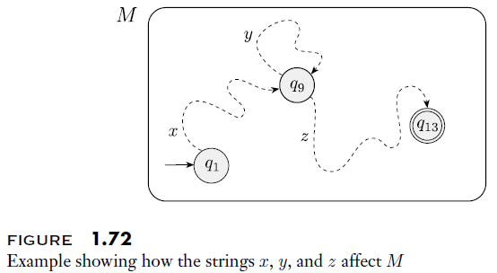
The Pigeonhole Principle in Action

Slide 8
Proving the Pumping Lemma
Consider the figure on the previous slide, which helps to explain the pumping lemma and the pigeonhole principle
The state q₉ represents the first repeated state when a machine, M, recognizing some regular language, A, processes a string, s ∈ A, with length p or more
The reasoning two slides back proves that there must be such a state, and that the state must repeat within the first p characters of s, proving condition 3 of the pumping lemma
In order to make the state repeat, y must have length > 0, proving condition 2 of the pumping lemma
So, we can split s into three portions, xyz, where y is non-empty (x and z may be empty)
Looking at the figure, we also see that string xz (with y removed) is also a member of A, because processing it will lead to the same accepting state as xyz
Furthermore, if y is repeated more than once, e.g., xyyyyz, this would also be a member of A, because processing it would lead to the same accepting sate as xyz
The previous two points prove condition 1 of the pumping lemma
We have proved all three conditions of the pumping lemma, so the pumping lemma is true
The textbook steps through this more formally (I encourage you to read the book's proof, if you have not already done so, and make sure you understand it)

Slide 9
Why is this important?
We can use the pumping lemma to prove that certain languages are nonregular
These proofs generally take the form of proof by contradiction, a.k.a. by using an indirect proof
Given some language, A, that we suspect is nonregular, we can prove that A is nonregular as follows:
  Assume A is regular
  Reason that if A is regular, it must adhere to the pumping lemma
  Therefore, there must be some pumping length, p, and any string in A of length p or greater can be pumped
  Construct some specific string, s, with a length of at least p, that is a member of A
  Prove that s cannot be pumped (i.e., prove that there is no way to split s into the form s = xyz that satisfies the three conditions of the pumping lemma)
  This contradiction shows that the assumption that A is regular must be wrong; hence, A is nonregular

Slide 10
Nonregular Language: Example 1
The first nonregular language we saw earlier was: B = {0^{n}1^{n} | n ≥ 0}
To prove this:
  Assume B is regular; then there must be some pumping length, p
  Now consider the following string: s = 0^{p}1^{p} (i.e., p 0s followed by p 1s)
  According to the pumping lemma, there must be some way to split s into three parts, s = xyz, such that for any i ≥ 0, s = xy^{i}z is also a member of B
  Furthermore, |xy| ≤ p and |y| > 0
  Putting the pieces together, y must consist only of 0s and at least one 0
  If you either remove y, or repeat y, you will not have the same number of 0s as 1s in the string; therefore, the new string will not be a member of B
  Therefore, s cannot be pumped, which defies the pumping lemma
  Therefore, the assumption that B is regular is wrong; B is nonregular

Slide 11
Nonregular Language: Example 2
A similar proof can be used to show that this language (also mentioned earlier) is nonregular: C = {w | w has an equal number of 0s and 1s}
The book steps through the similar proof (also involving the string s = 0^{p}1^{p}), but we will skip that
The book also discusses an alternate way of proving that C is nonregular, which we will discuss
Recall that when we first proved that regular languages are closed under union, we noted that the proof could be modified to prove that regular languages are also closed under intersection
With that information, we can prove that C is nonregular as follows:
  Assume C is regular, and consider the language C' = C ∩ 0*1*
  Clearly, 0*1* is regular, so if C is regular (as we are assuming), then C' is regular
  Given the definition of C, it is easy to see that C' equals B, the language we considered on the previous slide
  We already proved that B is irregular using the pumping lemma!
  Therefore, C must not be regular; C is nonregular

Slide 12
Nonregular Language: Example 3
Consider the language: F = {ww | w ∈ {0, 1}*}
F is the language of all binary strings such that the first half is identical to the second half
To prove that F is nonregular:
  Assume F is regular, and p is the pumping length
  Consider the string s = 0^{p}10^{p}1; clearly, s ∈ F
  Once again, condition 3 of the pumping lemma is important; any s = xyz satisfying the conditions would make y contain only 0s and at least one 0
  Repeating or removing y would result in a string that is not a member of F
  Therefore, F is nonregular

Slide 13
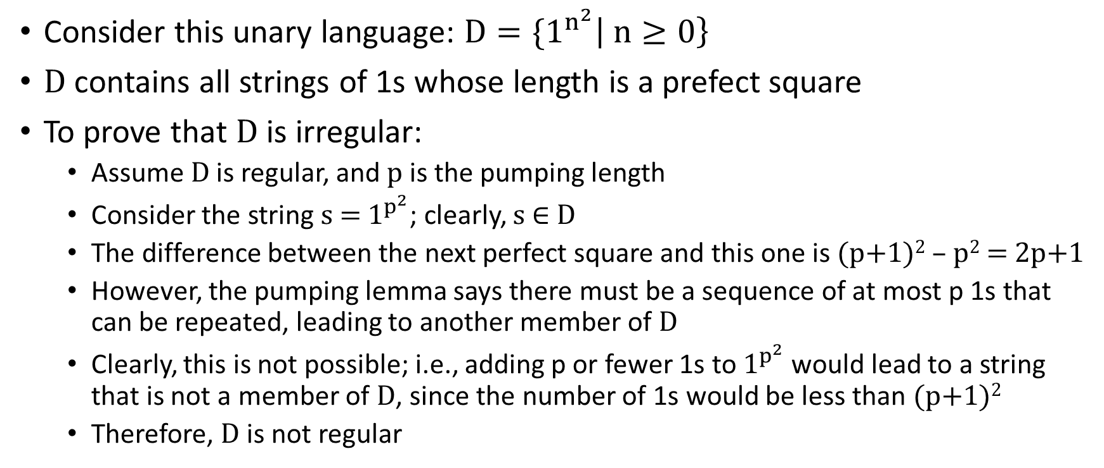
Nonregular Language: Example 4
Consider this unary language: ${D=\{1}^{n^{2}}\left| n≥0\right\}$
D contains all strings of 1s whose length is a prefect square
To prove that D is irregular:
  Assume D is regular, and p is the pumping length
  Consider the string s = $1^{p^{2}}$; clearly, s ∈ D
  The difference between the next perfect square and this one is (p+1)² – p² = 2p+1
  However, the pumping lemma says there must be a sequence of at most p 1s that can be repeated, leading to another member of D
  Clearly, this is not possible; i.e., adding p or fewer 1s to $1^{p^{2}}$would lead to a string that is not a member of D, since the number of 1s would be less than (p+1)²
  Therefore, D is not regular

Slide 14
Nonregular Language: Example 5
Consider the language: E = {0^{i}1^{j} | i > j}
To prove that E is nonregular:
  Assume E is regular, and p is the pumping length
  Consider the string s = 0^{p+1}1^{p}
  For any breakdown of s=xyz, where |xy| ≤ p and |y| > 0, y will contain at least one 0 and only 0s
  In this case, repeating y more than one time is fine; it would lead to other members of E
  However, the pumping lemma also says we could remove y, leading to s=xz, and that this also needs to be a member of E
  In this case, that doesn't work, since we started with one more 0 than 1s; removing y would lead to fewer 0s, and the resulting string would not be a member of E
  Therefore, E is nonregular

