Slide 1
ECE461: Theoretical CS
Non-Context-Free Languages and the Pumping Lemma

Slide 2
Brief Recap
In earlier topics, we learned about three equally powerful formalisms capable of recognizing the regular languages:
  Deterministic finite automata (DFAs)
  Nondeterministic finite automata (NFAs)
  Regular expressions (REs)
We also discussed a form of the pumping lemma, the pumping lemma for regular languages, which can be used to prove that certain languages are nonregular
Then, in other topics, we learned about two equally powerful formalisms capable of describing the context-free languages (CFLs):
  Context-free grammars (CFGs)
  Pushdown automata (PDAs)
We have seen that the context-free languages include all the regular languages, as well as some languages that are nonregular
In this topic we will discuss another form of the pumping lemma, the pumping lemma for context-free languages, which can be used to prove that certain languages are not context free
This topic is based on Section 2.3 of the textbook

Slide 3
The Pumping Lemma
We have previously learned that there are different forms of the pumping lemma
We already discussed the pumping lemma for regular languages
The pumping lemma for context-free languages (Theorem 2.34 in the textbook) states:
  If A is a context-free language, then there is a number p (the pumping length) where, if s is any string in A of length at least p, then s may be divided into five pieces s=uvxyz satisfying the conditions
    for each i ≥ 0, uv^{i}xy^{i}z ∈ A,
    |vy| > 0, and
    |vxy| ≤ p.
As with regular languages, we can say that such strings (members of A with length ≥ p) can be pumped
Unlike with regular languages, strings with length ≥ p can be split into five parts (not three), and two of the parts can be removed or repeated
Note that both parts (v and y) must be repeated the same number of times
Also note that either v or y can be ε, but they cannot both be ε

Slide 4
Why is there a Pumping Length for CFLs?
For any context-free language (CFL), A, we know that there must be a CFG that generates the language; call such a CFG G
For any string, w, that is a member of A, it must be the case that S, the start symbol of G, derives w
This can be represented as a parse tree, where the leaves of the parse tree are the symbols of w
The greater the length of w is (i.e., the more symbols it contains), the taller the parse tree needs to be
If w is long enough (we will get more specific about this a bit later), this will force the parse tree to grow to a size such that at least one path from the root to a leaf needs to repeat at least one nonterminal
This is another example of the pigeonhole principle
The top part of the figure on the next slide represents this situation
If we expand the lower repetition of the nonterminal as we expanded the upper repetition of the nonterminal, this leads to the situation depicted at the bottom-left of the figure
This sort of substitution could be repeated as many times as desired
On the other hand, if we expand the upper repetition of the nonterminal as we expanded the lower repetition of the nonterminal, this leads to the situation depicted at the bottom-right of the figure
This figure helps to explain the first condition required by the pumping lemma

Slide 5
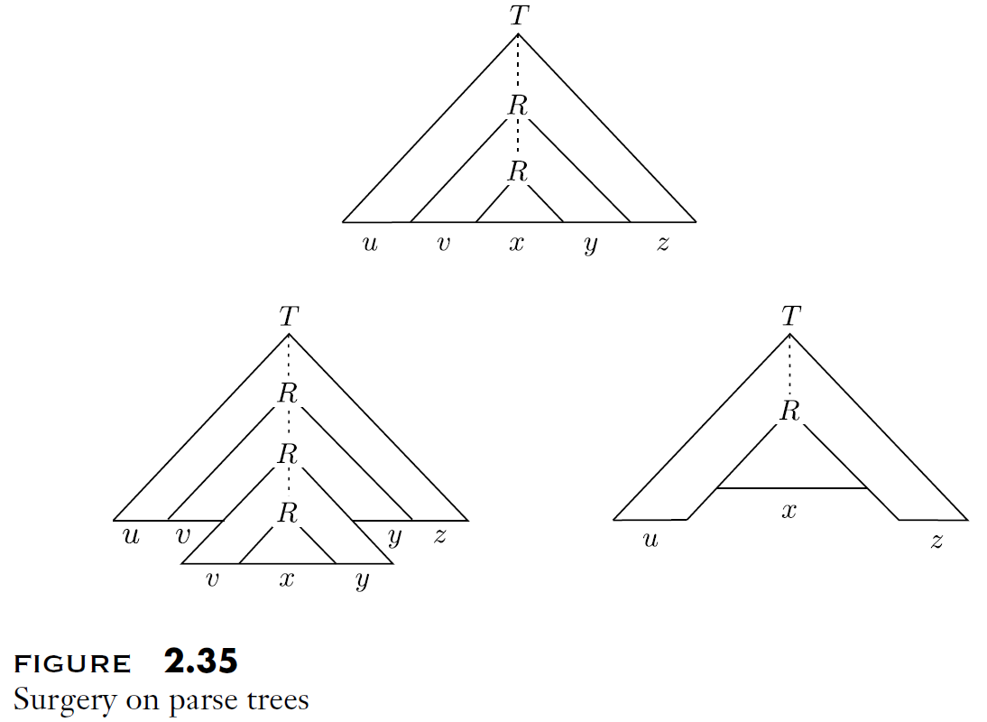
The Pigeonhole Principle Applied to CFGs

Slide 6
What is the Pumping Length for CFGs?
Consider some CFL, A
Let G be a CFG that generates A (we know that such a CFG must exist)
Let b be the maximum number of symbols on the right-hand side of any production in G
Then, the number of leaves in a parse tree with height h is at most b^{h}
So, if any string that G can generate has at least b^{h}+1 symbols, the parse tree must have height at least h+1
Let V be the set of nonterminals in G, so |V| is the number of nonterminals in G
If we set p to be b^{|V|}+1 or greater, then the parse tree for any string in A with at least p symbols must have height at least |V|+1
The longest path in this path tree must contain at least |V|+2 nodes, and at least |V|+1 of those nodes must represent nonterminals, thus forcing a repetition
We will set p to be b^{|V|+1}, which is ≥ b^{|V|}+1 (and therefore long enough to force a repetition)
The reason we are making p greater than needed to prove condition 1 is that it will make it a bit simpler to prove one of the other conditions of the pumping lemma

Slide 7
Proving Conditions 2 and 3
Consider a string w ∈ A, where A is a CFL, and |w|≥ p, where p is the pumping length as specified on the previous slide
It is possible that w is ambiguous, meaning that there are multiple possible parse trees; if so, consider the parse tree with the fewest nodes
Consider the longest path from a root to a leaf in this parse tree
There may be multiple repeated variables in this path
Let R be the repeated variable such that the upper instance of R is as low in the parse tree as possible
If both v and y were ε, we could replace the upper R with the lower R and obtain a parse tree with fewer nodes (a violation of what is known, since we are considering the parse tree with the fewest nodes)
Therefore, at least one of v and y cannot be empty, proving condition 2 of the pumping lemma
Because we chose the upper R to be as low as possible, there can be at most |V|+1 variables on the path from the upper R to any leaf
Therefore, the height of the subtree rooted at the upper R has height at most |V|+1, which can generate at most b^{|V+1|} symbols, as explained on the previous slide
We set p to b^{|V+1|}, so the length of the substring vxy is at most p, proving condition 3 of the pumping lemma

Slide 8
Why is this important?
We can use the pumping lemma for context-free languages to prove that certain languages are not context free
These proofs generally take the form of proof by contradiction, a.k.a. by using an indirect proof
Given some language, A, that we suspect is not context free, we can prove that A is not context free as follows:
  Assume A is a CFL
  Reason that if A is context free, it must adhere to the pumping lemma
  Therefore, there must be some pumping length, p, and any string in A of length p or greater can be pumped
  Construct some specific string, s, with a length of at least p, that is a member of A
  Prove that s cannot be pumped (i.e., prove that there is no way to split s into the form s = uvxyz that satisfies the three conditions of the pumping lemma)
  This contradiction shows that the assumption that A is context free must be wrong; hence, A is not context free

Slide 9
Non-Context-Free Language: Example 1
Consider the language: B = {a^{n}b^{n}c^{n} | n ≥ 0}
We can prove that B is not context free as follows (this is a bit different than the book's argument, but I'm confident it is valid):
  Assume that B is a CFL; then there exists a pumping length, p
  There must be some way to split any string, s ∈ B, with length ≥ p, into five parts, s = uvxyz, satisfying the three conditions specified by the pumping lemma
  Consider this string: s = a^{p}b^{p}c^{p}
  The third condition of the pumping lemma states that |vxy| ≤ p, so there is no way that v and y contain all three letters a, b, and c
  Also, at least one of v and y cannot be empty
  So, repeating v and y more than once will lead to a string that does not have the equal counts for all three letters
  Therefore, s cannot be pumped, which defies the pumping lemma
  Therefore, s is not context free

Slide 10
Non-Context-Free Language: Example 2
Consider the language: C = {a^{i}b^{j}c^{k} | i ≤j ≤k}
We can prove that C is not context free as follows:
  Assume that C is context free, with pumping length p
  Consider the string s = a^{p}b^{p}c^{p}, the same string as the previous example
  There must be some way to split s into five parts, s = uvxyz, satisfying the three conditions specified by the pumping lemma
  Once again, v and y cannot contain all three letters
  If there are no c's in v and y, then we cannot repeat v and y additional times (because i and/or j would become greater than k)
  If there are no a's, we cannot remove v and y (because j and/or k would be come less than i)
  If there are no b's, then v and y (together) contain at least one a or at least one c
    If there is at least one a, then v and y cannot be repeated (because i would become greater than j)
    If there is at least one c, then v and y cannot be removed (because k would become less than j)
    The book doesn't mention it, but v and y cannot contain both a and c, due to condition 3 of the pumping lemma, but this does not affect the proof
  We see s cannot be pumped, so C is not context free

Slide 11

Non-Context-Free Language: Example 3
Consider the language: D = {ww | w ∈ {0,1}*}
We can prove that D is not context free as follows:
  Assume that D is context free, with pumping length p
  The textbook first considers the string 0^{p}10^{p}1, but this string can be pumped, as demonstrated here:
  Instead, we will thus consider another string, s = 0^{p}1^{p}0^{p}1^{p}
  First, let's consider what happens when the substring vxy does not cross the midpoint of s
    If vxy is entirely in the left half, then repeating v and y once more (i.e., forming uv²xy²z) would mean that the second half of s starts with a 1, but the first half of s starts with a 0
    If vxy is entirely in the second half, repeating v and y once more would mean that the first half of s ends in a 0, but the second half of s ends in a 1
  Next, consider what happens when vxy crosses the middle, and we remove v and y
    This would lead to a string of the form 0^{p}1^{i}0^{j}1^{p}, with at least one of i and j being less than p
    Either the number of 0's or 1's in the two halves would not match, so this would not be a member of D
  We see that s cannot be pumped, so D is not context free

