Slide 1
ECE461: Theoretical CS
Nondeterministic
Finite Automata

Slide 2
Brief Recap
In our previous topic, we were introduced to the deterministic finite automaton (DFA)
We learned that we can formally define a DFA as a 5-tuple (Q, Σ, δ, q₀, F), where:
  Q is a finite set called the states,
  Σ is a finite set called the alphabet,
  δ : Q × Σ → Q is the transition function,
  q₀ ∈ Q is the start state, and
  F ⊆ Q is the set of accept states
We learned that every DFA, M, recognizes, or accepts, a language, A (recall that a language is a set of string)
When M processes any input string w ∈ A, it ends at an accept state and accepts the input; when M processes any other string w ∉ A, it does not end at an accept state and it rejects the input
We learned that a language is a regular language if and only if some DFA recognizes it (and this can serve as a definition of regular languages)
Three so-called regular operations are union, concatenation, and star (a.k.a. Kleene star)
Regular languages are closed under all three regular operations, but we only proved this so far for union
  We proved this for union by showing that if a DFA M₁ accepts language A₁ and a DFA M₂ accepts language A₂, we can construct a DFA M that accepts A₁ ∪ A₂
  However, using a similar approach to prove that regular languages are closed under concatenation or star would be difficult

Slide 3
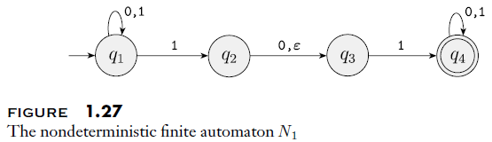
Nondeterminism
A DFA is deterministic because from for each (state, symbol), there is exactly one transition
With a nondeterministic finite automaton (NFA), there can be no choice, one choice, or multiple choices
Additionally, an NFA can have transitions labeled with ε, sometimes called ε-transitions
This topic is based on Section 1.2 of the textbook
To the right is a state diagram of an NFA:
Note that the types of components of an NFA are the same as that for a DFA:
  The circles represent the set of states that the machine might be in
  Double circles represent accept states (a.k.a. final states); the accept states are a subset of the states
  The arrow without a source points to the start state (a.k.a. initial state), which is a member of the set of states
  The arrows represent transitions, labeled with symbols from the machines alphabet
Unlike a DFA, an NFA accepts its input if there is any path for the given input that leads to an accepting state!

Slide 4
How Does an NFA Process Its Input?
There are various ways that we can think about an NFA processing its input
  I like to think of the NFA as exploring all possible paths in parallel; if any concurrent process/thread ends in an accept state, the machine accepts the input
  Alternatively, we can think of an NFA as exploring branches of a tree; if any branch ends in an accept state, the machine accepts the input
  Sipser often writes about an NFA as if it guesses which link to take when there are multiple choices; if any path leads to an accept state, it always guesses correctly
As with DFAs, if an NFA does not accept its input, we can say that it rejects the input
An NFA only rejects its input if there is no path for that input leading to an accept state
The book walks through an example where 010110 is fed to the NFA on the previous slide (this input is ultimately accepted by the machine)
Sipser recommends that you "keep track of the possibilities by placing a finger on each state where a machine could be"
The figure on the next slide shows how this example could be viewed as a tree

Slide 5
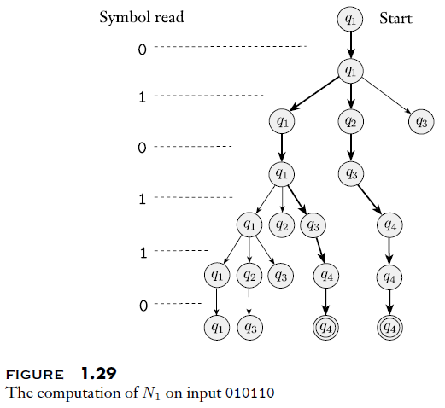
NFA Computation Views as a Tree Example

Slide 6
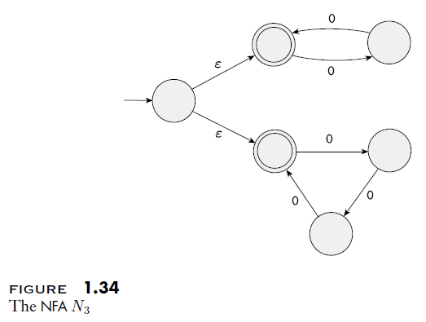
Example of an NFA
This NFA with a unary alphabet recognizes all strings of the form 0^{k}, where k is a multiple of 2 or 3

Slide 7
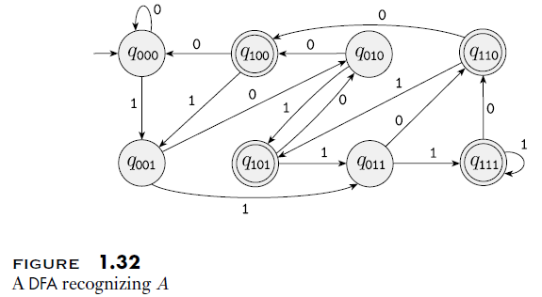
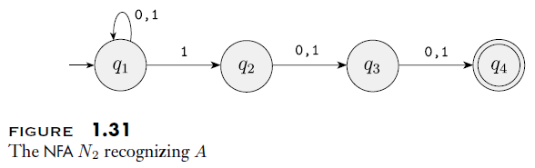
Example of an NFA and Equivalent DFA
Although this may seem surprising, every NFA has an equivalent DFA (we will prove this later)
Here is an NFA and equivalent DFA that recognize all strings over the alphabet {0, 1} with at least three symbols and a 1 in the third to last position
Note that the NFA is simpler to understand

Slide 8
Formal Description of an NFA
We will now consider a formal definition of a nondeterministic finite automaton (Definition 1.37 from the textbook)
Below, Σ_{ε} represents the set defined by Σ ∪ ε, and P(Q) represents the power set of Q (i.e., the set of all subsets of Q)
A nondeterministic finite automaton is a 5-tuple (Q, Σ, δ, q₀, F), where:
  Q is a finite set called the states,
  Σ is a finite set called the alphabet,
  δ : Q × Σ_{ε} → P(Q) is the transition function,
  q₀ ∈ Q is the start state, and
  F ⊆ Q is the set of accept states
Note: According to this definition, looking at the domain of δ, we see that for every state and either every alphabet symbol or ε, the transition function must provide a mapping to something
However, the range of δ includes the empty set; when that is the output of the function δ, this means that there are no transitions that lead to any other state
Such mappings would not be indicated in a state diagram

Slide 9
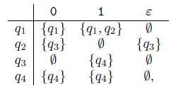
Formal Description of an NFA Example
We can now describe N₁, seen earlier as a state diagram, formally
N₁ = (Q, Σ, δ, q₁, F), where:
  Q = {q₁, q₂, q₃, q₄},
  Σ = {0, 1},
  δ can described as:
  q₁ is the start state, and
  F = {q₄}

Slide 10
Regular Languages (revisited)
Earlier, we defined regular languages as follows: A language is a regular language if and only if some DFA recognizes it
Here is an alternative definition: A language is a regular language if and only if some NFA recognizes it
This is because the two models defined by DFAs and NFAs are equivalent in power (sometimes called expressive power or computational power)
To prove this, we would typically have to show two things:
  One, that every DFA can be converted to an equivalent NFA
  Two, that every NFA can be converted to an equivalent DFA
In this case, the first sub-bullet above is trivial, because every DFA is already a valid NFA!
The second sub-bullet above is not obvious
Theorem 1.39 in the textbook states: "Every nondeterministic finite automaton has an equivalent deterministic finite automaton" (we will discuss a proof of this shortly)
This leads to Corollary 1.40, which matches our alternative definition of regular languages above

Slide 11
Every NFA has an Equivalent DFA
As is common in the book, to prove this, Sipser first discusses a "proof idea", and then a more technical (but not formal) "proof"
In discussing the proof idea, Sipser states, "The idea is to covert the NFA into an equivalent DFA that simulates the NFA"
He asks you to imagine yourself simulating an NFA in a deterministic way
As you process each symbol of the input string, you could place fingers on all locations in the NFA that might be active at each step
Note that you only need to place at most one finger on each state, since it doesn't matter how you got there
Of course, this wouldn't work in practice if there are more than ten potentially active states at the same time, but in theory, you could follow such a procedure
If k is the number of states in the NFA, with states Q, we are simulating, there are 2^{k} possible sets of states that may be active at any point (the subsets of Q)
Recall again that the set of all subsets of Q is the power set of Q

Slide 12
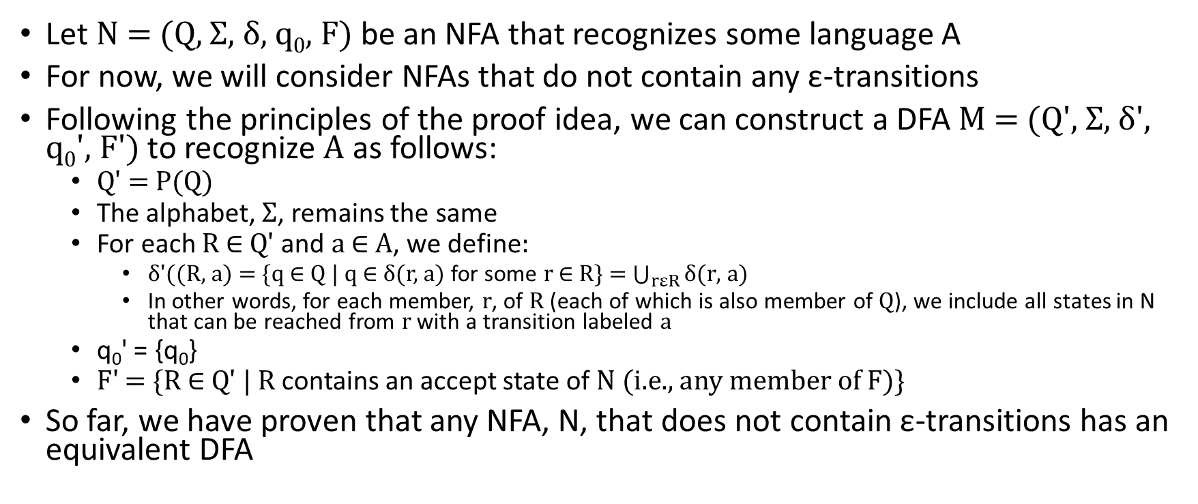
Proof that Every NFA has an Equivalent DFA
Let N = (Q, Σ, δ, q₀, F) be an NFA that recognizes some language A
For now, we will consider NFAs that do not contain any ε-transitions
Following the principles of the proof idea, we can construct a DFA M = (Q', Σ, δ', q₀', F') to recognize A as follows:
  Q' = P(Q)
  The alphabet, Σ, remains the same
  For each R ∈ Q' and a ∈ A, we define:
    δ'((R, a) = {q ∈ Q | q ∈ δ(r, a) for some r ∈ R} = $\bigcup_{rεR}{\text{δ}\text{(}\text{r}\text{, }\text{a}\text{)}}$
    In other words, for each member, r, of R (each of which is also member of Q), we include all states in N that can be reached from r with a transition labeled a
  q₀' = {q₀}
  F' = {R ∈ Q' | R contains an accept state of N (i.e., any member of F)}
So far, we have proven that any NFA, N, that does not contain ε-transitions has an equivalent DFA

Slide 13
Expanding the Proof to Consider ε-transitions
To allow for ε-transitions in N, we will introduce an additional notation
Book's wording: E(R) = {q | q can be reached from R by traveling along 0 or more ε arrows}
Above, R is a set of states (R ⊆ Q), and E(R) is the set of all states that can be reached from any member of R by staying still or following ε-transitions
We then modify the transition function as follows: δ'((R, a) = {q ∈ Q | q ∈ E(δ(r, a)) for some r ∈ R}
We are basically saying that after following a transition labeled a (from any member of R), we are allowed to make additional moves following ε-transitions
We also have to modify the start state as follows: q₀' = E({q₀})
We are basically saying that, at the start, we can stay at q₀ or move to any states reachable from q using only ε-transitions
At the end of the proof, Sipser writes: "The construction of M obviously works correctly"; some thoughts:
  I have no doubt that the proof is correct, and I feel that I understand it completely, but is it really "obvious"?
  Suppose, for example, that we forgot to update q₀' for the ε-transitions but we did everything else correctly; might someone miss the mistake, and still think that the proof was obviously correct?
  This harkens back to something we said about proofs in the first topic; what constitutes a "convincing logical argument", serving as a "proof beyond any doubt"
  Some proofs later in the book will be much more complicated than this one

Slide 14
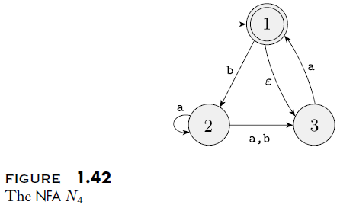
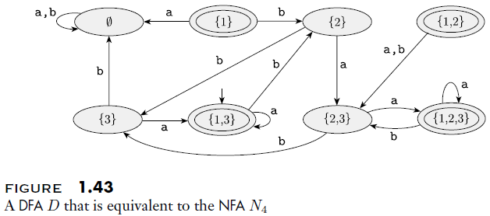
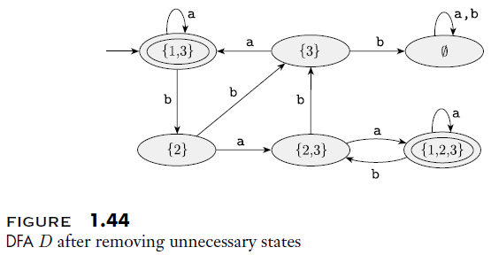
Converting an NFA to a DFA Example

Slide 15
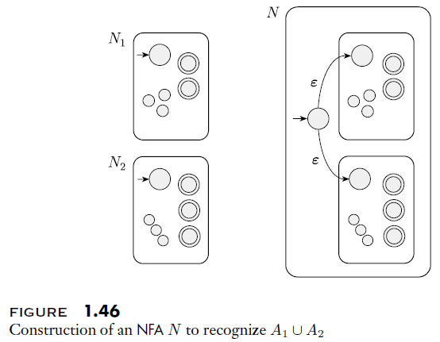
Closure Under Union (revisited)
In our previous topic, we proved that regular languages are closed under union
We showed that if a DFA M₁ accepts language A₁ and a DFA M₂ accepts language A₂, we can construct a DFA M that accepts A₁ ∪ A₂
Now that we know that NFAs have the same power as DFAs, leading to our second definition of regular languages
We can thus apply an alternative proof
We can show that if an NFA N₁ accepts language A₁ and an NFA N₂ accepts language A₂, we can construct an NFA N that accepts A₁ ∪ A₂
The figure to the right helps to explain this (we will also look at the actual proof)

Slide 16
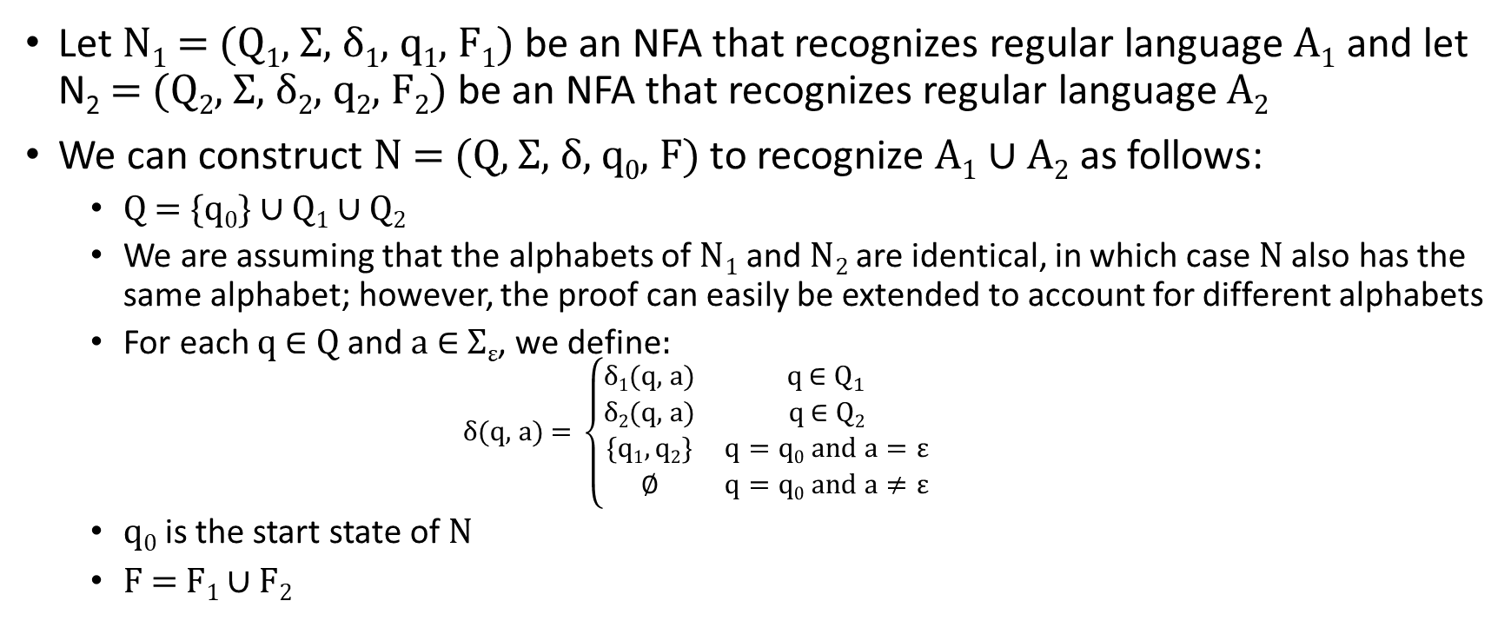
Proof of Closure Under Union with NFAs
Let N₁ = (Q₁, Σ, δ₁, q₁, F₁) be an NFA that recognizes regular language A₁ and let N₂ = (Q₂, Σ, δ₂, q₂, F₂) be an NFA that recognizes regular language A₂
We can construct N = (Q, Σ, δ, q₀, F) to recognize A₁ ∪ A₂ as follows:
  Q = {q₀} ∪ Q₁ ∪ Q₂
  We are assuming that the alphabets of N₁ and N₂ are identical, in which case N also has the same alphabet; however, the proof can easily be extended to account for different alphabets
  For each q ∈ Q and a ∈ Σ_{ε}, we define:
    $$\text{δ}\text{(}\text{q}\text{, }\text{a}\text{) = }\left\{\begin{matrix}\text{δ}\text{1}\text{(}\text{q}\text{, }\text{a}\text{)} & q \text{∈} Q_{1} \\ \text{δ}\text{2}\text{(}\text{q}\text{, }\text{a}\text{)} & q \text{∈} Q2 \\ \{q1, q2\} & q=q0 and a=ε \\ ∅ & q=q0 and a≠ε\end{matrix}\right.$$
  q₀ is the start state of N
  F = F₁ ∪ F₂

Slide 17
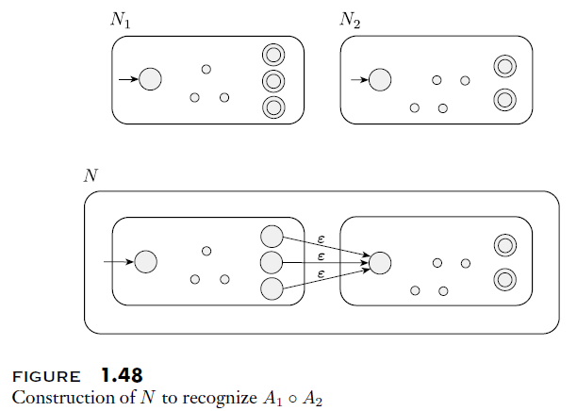
Closure Under Concatenation (revisited)
As we said in our last topic, using DFAs to prove closure under concatenation for regular languages is quite difficult
Using NFAs to prove closure under concatenation for regular languages is much simpler
We can show that if an NFA N₁ accepts language A₁ and an NFA N₂ accepts language A₂, we can construct an NFA N that accepts A₁ ∘ A₂
The figure on this slide helps to explain this

Slide 18
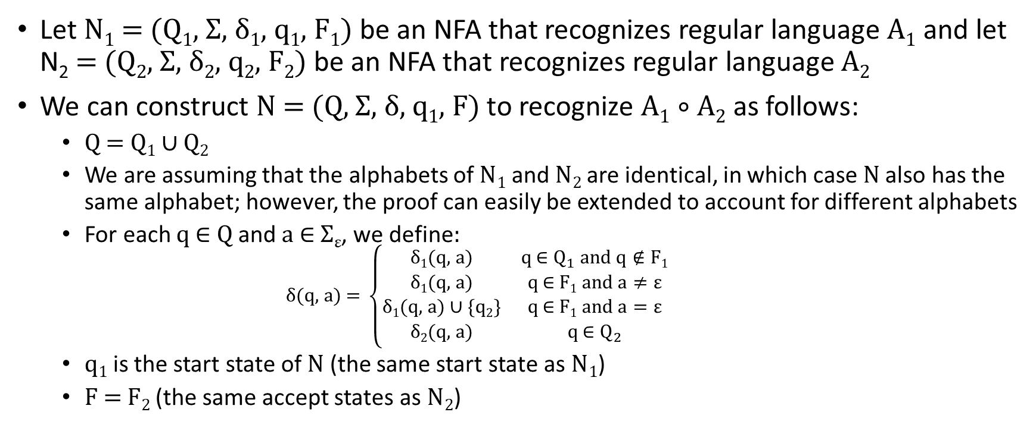
Proof of Closure Under Concatenation
Let N₁ = (Q₁, Σ, δ₁, q₁, F₁) be an NFA that recognizes regular language A₁ and let N₂ = (Q₂, Σ, δ₂, q₂, F₂) be an NFA that recognizes regular language A₂
We can construct N = (Q, Σ, δ, q₁, F) to recognize A₁ ∘ A₂ as follows:
  Q = Q₁ ∪ Q₂
  We are assuming that the alphabets of N₁ and N₂ are identical, in which case N also has the same alphabet; however, the proof can easily be extended to account for different alphabets
  For each q ∈ Q and a ∈ Σ_{ε}, we define:
    $$\text{δ}\text{(}\text{q}\text{, }\text{a}\text{) = }\left\{\begin{matrix}\text{δ}\text{1}\text{(}\text{q}\text{, }\text{a}\text{)} & q \text{∈} Q_{1} and q∉F1 \\ \text{δ}\text{1}\text{(}\text{q}\text{, }\text{a}\text{)} & q \text{∈} F1 and a≠ε \\ \text{δ}\text{1}\text{(}\text{q}\text{, }\text{a}\text{)}∪\{q2\} & q \text{∈} F1 and a=ε \\ \text{δ}\text{2}\text{(}\text{q}\text{, }\text{a}\text{)} & q \text{∈} Q_{2}\end{matrix}\right.$$
  q₁ is the start state of N (the same start state as N₁)
  F = F₂ (the same accept states as N₂)

Slide 19
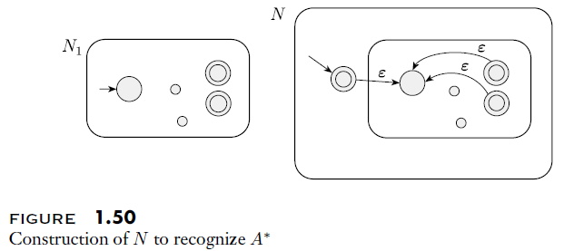
Closure Under Star (revisited)
As we said in our last topic, as with concatenation, using DFAs to prove closure under star for regular languages is quite difficult
Also as with concatenation, using NFAs to prove closure under star for regular languages is much simpler
We can show that if an NFA, N₁, recognizes a language, A, we can construct an NFA, N, that recognizes A*
The figure on this slide helps to explain this

Slide 20
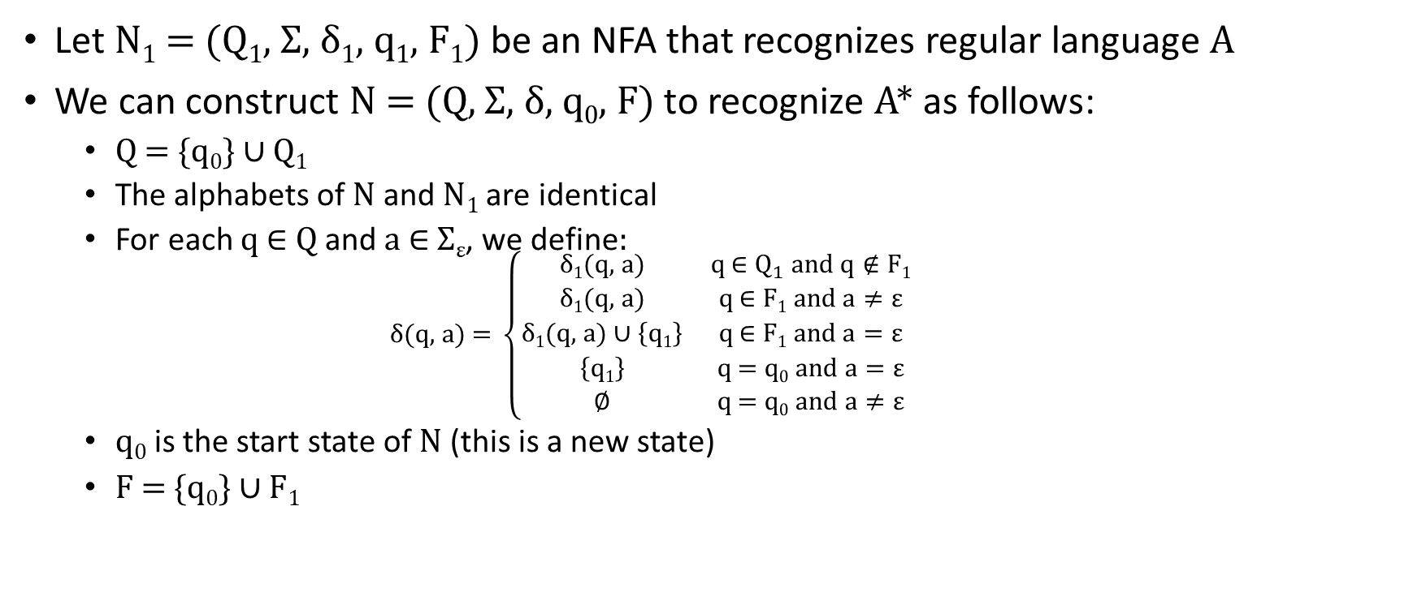
Proof of Closure Under Star
Let N₁ = (Q₁, Σ, δ₁, q₁, F₁) be an NFA that recognizes regular language A
We can construct N = (Q, Σ, δ, q₀, F) to recognize A* as follows:
  Q = {q₀} ∪ Q₁
  The alphabets of N and N₁ are identical
  For each q ∈ Q and a ∈ Σ_{ε}, we define:
    $$\text{δ}\text{(}\text{q}\text{, }\text{a}\text{) = }\left\{\begin{matrix}\text{δ}\text{1}\text{(}\text{q}\text{, }\text{a}\text{)} & q \text{∈} Q_{1} and q∉F1 \\ \text{δ}\text{1}\text{(}\text{q}\text{, }\text{a}\text{)} & q \text{∈} F1 and a≠ε \\ \text{δ}\text{1}\text{(}\text{q}\text{, }\text{a}\text{)}∪\left\{q1\right\} & q \text{∈} F1 and a=ε \\ \left\{q1\right\} & q\text{ = }\text{q}\text{0} and a=ε \\ ∅ & q\text{ = }\text{q}\text{0} and a≠ε\end{matrix}\right.$$
  q₀ is the start state of N (this is a new state)
  F = {q₀} ∪ F₁

