Slide 1
ECE461: Theoretical CS
Deterministic
Finite Automata

Slide 2
Finite Automata
In the first portion of this course, we will introduce various computational models
The first sort of model we will consider is called a finite automaton, a.k.a. a finite state machine; the plural is finite automata
This topic is based on Section 1.1 of the textbook
We will ultimately see two variations of finite automata
We will start with a deterministic version of the model, so we can refer to this as a deterministic finite automaton (DFA)
Note that the textbook does not introduce the term DFA until they introduce nondeterminism, later in the chapter
Book: "Finite automata are good models for computers with an extremely limited amount of memory"
We will see (and prove), however, that the model cannot recognize all languages
Despite their limitations, DFAs (and equivalent models) are useful for certain applications
In later topics, we will see more powerful models of computation

Slide 3
Brief Early History of Automata Theory
The concept of Turing machines was introduced by Alan Turing in a seminal 1936 paper
  Later in the course, we will learn that Turing machines are as powerful as any known formalism, and the definition of an algorithm is based on this
  However, Turing machines assume the existence of infinite memory; they are not physically realizable
One of the earliest works often cited in histories of automata theory is a paper by McCulloch and Pitts in 1943
  They proposed a model for an artificial neuron, to simulate neurons from the human brain
  Nodes in modern neural networks still have a strong resemblance to their model
  This work is often discussed in histories of AI and machine learning
The concepts of finite automata (the deterministic version) and regular expressions were both introduced in a paper by Kleene in 1951
  This paper introduced both models and also proved their equivalence
  According to some sources, Kleene was influenced by McCulloch and Pitts, and was interested in exploring models of computation that were potentially physically realizable, i.e., that used only finite memory
The nondeterministic finite automaton was introduced in a 1959 paper by Rabin and Scott
  The paper, in general, explored variations of finite automata, as well as the limitations of such models
  The same paper proved the equivalence of deterministic and nondeterministic finite automata
We will learn about nondeterministic finite automata and regular expressions in our next two topics

Slide 4
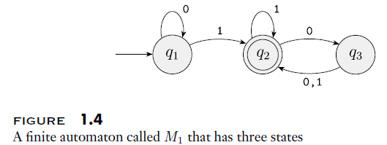
DFA Example
The figure below, from the textbook, shows a state diagram for a particular DFA that we will call M₁:
Components of the DFA indicated in the state diagram include:
  The circles represent the set of states that the machine might be in
  Double circles represent accept states (a.k.a. final states); the accept states are a subset of the states
  The arrow without a source points to the start state (a.k.a. initial state), which is a member of the set of states
  The arrows represent transitions, labeled with symbols from the machines alphabet
After processing a sequence of input, the machine accepts or rejects the input, depending on whether or not it ends at an accept state

Slide 5
Formal Definition of a DFA
We will now consider a formal definition of a deterministic finite automaton (Definition 1.5 from the textbook)
A finite automaton is a 5-tuple (Q, Σ, δ, q₀, F), where:
  Q is a finite set called the states,
  Σ is a finite set called the alphabet,
  δ : Q × Σ → Q is the transition function,
  q₀ ∈ Q is the start state, and
  F ⊆ Q is the set of accept states
The textbook points out that certain questions about deterministic finite automata can be answered by looking at the formal definition; e.g.:
  It is allowable for a DFA to have no accept states
  There must be exactly one transition from each state for each alphabet symbol
Note that the textbook still refers to DFA as finite automata, more generally, up tot his point, but this definition specifically applies to deterministic finite automata

Slide 6
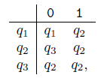
Formal Description of a DFA Example
We can now describe M₁, seen earlier as a state diagram, formally
M₁ = (Q, Σ, δ, q₁, F), where:
  Q = {q₁, q₂, q₃},
  Σ = {0, 1},
  δ can described as:
  q₁ is the start state, and
  F = {q₂}

Slide 7
Languages
As we learned in our introductory topic, a language is a set of strings
Every DFA recognizes, or accepts, a language
If A is the language recognized by a machine, M, we can say:
  A is the language of machine M
  L(M) = A
  M recognizes A
  M accepts A
The book points out that "accepts" can be used for languages or for individual strings, so they prefer to use "recognizes" for languages (I personally tend to use both terms for languages)
Note that even if a machine accepts no strings, it still recognizes a language
  This would be the empty language, which can be denoted as ∅ (the null sign)
  This is the same symbol used to represent the empty set, more generally
  Keep in mind that the empty language is different from the empty string, which can be denoted as ε
We can describe the language of M₁, from our previously example, as follows:
  L(M₁) = A = {w | w contains at least one 1 and an even number of 0s follow the last 1}

Slide 8
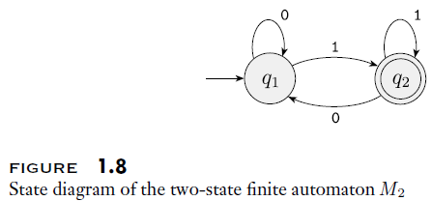
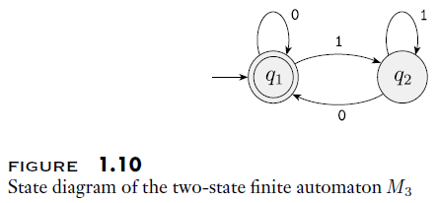
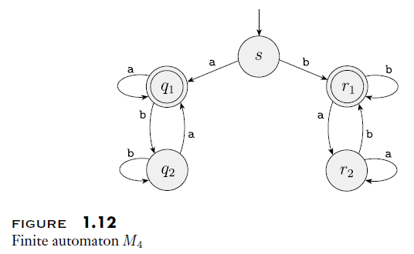
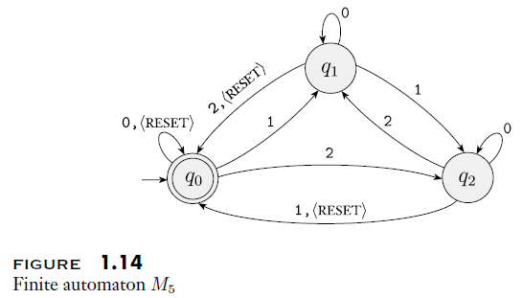
Other Examples of DFAs (from textbook)

Slide 9
Computation with a DFA
Consider some DFA, M = (Q, Σ, δ, q₀, F)
Also consider a string w = w₁w₂…w_{n}, where each w_{i} is a member of M's alphabet, Σ
Now consider applying w as the input to M (i.e., M will process the string w, one symbol at a time)
We can say that M accepts w if and only if there exists a sequence of states r₀, r₁, …, r_{n} (all members of Q) such that the following three conditions hold:
  r₀ = q₀
  δ(r_{i}, w_{i+1}) = r_{i+1} for i = 0, 1, …, n-1
  r_{n} ∈ F
This should match our intuitive understanding of how a DFA processes its input
  The first condition states that we must start at the start state
  The second condition explains that we process one symbol at a time (the next input symbol) and deterministically proceed to the appropriate state, as specified by the transition function
  The third symbol says that the machine accepts the input if we end up at an accept state (although not mentioned here, we can say that otherwise the machine rejects the input)

Slide 10
Regular Languages
A language is a regular language if and only if some DFA recognizes it
This can serve as a definition of a regular language (it is Definition 1.16 in the textbook)
In our next two topics, we will see other, equivalent definitions of regular languages
In the topic after those, we will also prove that certain languages are not regular
The textbook contains a subsection titled "Designing Finite Automata" with some helpful advice, and it steps through a couple of examples
Of course, this will only be possible if the language is regular, which isn't always obvious one way or the other

Slide 11
Regular Operations
We are defining three regular operations that can be applied to languages A and B (all part of Definition 1.23 in the textbook):
  Union: A ∪ B = {x | x ∈ A or x ∈ B}
  Concatenation: A ∘ B = {xy | x ∈ A and y ∈ B}
  Star (a.k.a. Kleene star): A* = {x₁x₂…x_{k} | k ≥ 0 and each x_{i} ∈ A}
Note that union and concatenation are binary operations, while star is a unary operation
I add:
  These definitions apply to languages in general, not just regular languages
  As far as I can tell, there is no great reason (other than historical) that these three operations are the only so-called regular operations
  For example, I have not found a logical reason that union is considered a regular operation, but intersection is not
  When we cover regular expressions, we will see that union is built into the formalism, and intersection is not (and I think that is why these are called regular operations, historically)

Slide 12
Regular Operations Example
Consider the languages A = {good, bad} and B = {boy, girl}
The book says that the alphabet for each language is Σ = {a, b, .., z}, which is valid, but it could be a smaller subset of that
We then have:
  A ∪ B = {good, bad, boy, girl}
  A ∘ B = {goodboy, goodgirl, badboy, badgirl}
  A* = {∈, good, bad, goodgood, goodbad, badgood, badbad, goodgoodgood, goodgoodbad, goodbadgood, goodbadbad, boodgoodgood, …}

Slide 13
Closure
A class of languages is closed under an operation if and only if applying the operation to two members of the class is guaranteed to result in another member of the class
We will (eventually) show that the class of regular languages is closed under union, concatenation, and star
We will start with proving closure under union (Theorem 1.25 in the textbook)
Assume that A₁ and A₂ are regular languages; we want to prove that A₁ ∪ A₂ is also regular
IMO, this is the first interesting proof in the textbook; note that the textbook often starts with what they refer to as the "proof idea", and then proceed with the more technical "proof"
In this case, the proof idea can be summarized as follows:
  By the definition of regular languages, we know that there are DFAs that recognize each regular language
  Let M₁ be a DFA that recognizes A₁, and M₂ be a DFA that recognizes A₂; we need to prove that there is also a DFA, M, that recognizes A₁ ∪ A₂
  It may seem intuitive to have M simulate M₁, and if that doesn't work, it could simulate M₂, but this approach doesn't work, because we cannot unwind the input tape
  Instead, M must effectively simulate both M₁ and M₂ simultaneously, or in parallel
  We can achieve this by creating a machine, M, such that each state of M represents a pair of states from the original machines; the first part of each pair represents a state from M₁, and the second part of each pair represents a state from M₂
  The accept states of M are the states that represent an accept state from M₁ or an accept state from M₂

Slide 14
Proof of Closure Under Union
Let M₁ = (Q₁, Σ, δ₁, q₁, F₁) be a DFA that recognizes regular language A₁ and M₂ = (Q₂, Σ, δ₂, q₂, F₂) be a DFA that recognizes regular language A₂
We can construct M = (Q, Σ, δ, q₀, F) to recognize A₁ ∪ A₂ as follows:
  Q = {(r₁, r₂) | r₁ ∈ Q₁ and r₂ ∈ Q₂} = Q₁ ⨉ Q₂
    This is the Cartesian product of sets Q₁ and Q₂
    The number of elements in Q is |Q| = |Q₁| * |Q₂| (although this notation is not in the book)
  We are assuming that the alphabets of M, M₁, and M₂ are identical; however, the proof can easily be extended to account for different alphabets
  For each (r₁, r₂) ∈ Q and a ∈ Σ, we define:
    δ((r₁, r₂), a) = (δ₁(r₁, a), δ₂(r₂, a))
    In other words, machine M is simulating what happens in both of the original machines at each step
  q₀ = (q₁, q₂)
  F = {(r₁, r₂) | r₁ ∈ F₁ or r₂ ∈ F₂} = (F₁ ⨉ Q₂) ∪ (Q₁ ⨉ F₂)
Interestingly, if we change the definition of F to be F = F₁ ⨉ F₂, we obtain a proof that the class of regular languages is closed under intersection

Slide 15
Closure Under Concatenation/Star (for now)
We could try a similar approach to prove closure under concatenation
  We could start by assuming the existence of two DFAs that recognize two languages, A₁ and A₂
  We could then try to construct a DFA that recognizes A₁ ∘ A₂
Similarly, we could try a similar approach to prove closure under star
  We could start by assuming the existence of a DFA that recognizes a language, A
  We could then try to construct a DFA that recognizes A*
It turns out these proofs would be much more difficult for concatenation or star than for union
Instead, we will put off these proofs until after we have discussed nondeterminism, as part of our next topic

