Slide 1
ECE461: Theoretical CS
Circuit Complexity

Slide 2
Brief Recap
Earlier in the course, we discussed topics related to computability theory, which relates to the question of which languages or decision problems are decidable
Our primary models of computation have been deterministic Turing machines (DTMs) and nondeterministic Turing machines (NTMs)
If we accept the Church-Turing thesis, all algorithms can be implemented by Turing machines
We have learned that computation is inherently limited, and that some languages are undecidable; an important tool in proving this has been diagonalization
Then we started to cover complexity theory, which explores which languages can be decided efficiently
We introduces time and space complexity classes
Two important time complexity classes are P and NP, which are believed to be different, but the P versus NP question has never been solved
The existence of NP-complete languages give us some insight into the question; the definition of NP-completeness relies on the concept of polynomial time mapping reducibility
In our previous topic, we were reintroduced to the concept of oracles; we learned that P and NP are the same relative to some oracles, but different relative to other oracles
This conclusion has important implications related to the limits of diagonalization

Slide 3
Circuit Complexity Overview
Section 9.3 of the textbook introduces a concept known as circuit complexity
The book defines the notion of a Boolean circuit, and an extension called a circuit family
We will see that any TM deciding a language can be converted to a circuit family
Sipser states that "researchers believe that circuits provide a convenient computational model for attaching the P versus NP and related questions"
This section also provides an alternative proof of the Cook-Levin theorem, and, in particular, that 3SAT is NP-complete
We will not cover this topic in as much detail as the textbook

Slide 4
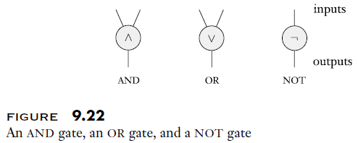
Boolean Circuits
Definition 9.21 states (I am keeping the book's exact wording, but changing the formatting a bit):
  A Boolean circuit is a collection of gates and inputs connected by wires. Cycles aren’t permitted. Gates take three forms: AND gates, OR gates, and NOT gates, as shown schematically in the following figure.
The figure referred to in the definition is:

Slide 5
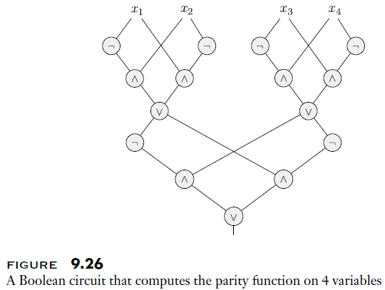
Boolean Circuit example
Although not stated in the definition, the section assumes that each Boolean circuit has a designated output gate
The book shows a few examples of Boolean circuits; we'll just look at one that determines computes the parity function of four inputs:

Slide 6
Circuit Families
Each Boolean circuit requires a fixed number of inputs
Languages, on the other hand, can contain strings of different lengths
To rectify this disparity, we can define a circuit family
Definition 9.27 states (I am keeping the wording exact, but changing the formatting):
  A circuit family C is an infinite list of circuits, (C₀, C₁, C₂, . . .), where C_{n} has n input variables. We say that C decides a language A over {0,1} if for every string w, w ∈ A iff C_{n}(w) = 1, where n is the length of w.
The size of a circuit is the number of gates it contains
A circuit is minimal if there is no equivalent circuit with a smaller size; a circuit family is minimal if all the circuits within it are minimal
The size complexity of a circuit family is a function f: N → N, were f(n) is the size of C_{n}
The depth of a circuit is the longest path from an input to the output gate
We can define depth minimal circuits and circuit families, and depth complexity, analogous to how we did for size

Slide 7
Circuit Complexity
Definition 9.28 states (I am keeping the book's exact wording):
  The circuit complexity of a language is the size complexity of a minimal circuit family for that language. The circuit depth complexity of a language is defined similarly, using depth instead of size.
Book: "The circuit complexity of a language is related to its time complexity"
Theorem 9.30 states: "Let t: N→N be a function, where t(n) ≥ n. If A ∈ TIME(t(n)), then A has circuit complexity O(t²(n))."
We are not going to cover the proof in detail, but I'll discuss the high-level details concepts
  The book explains that for any time complexity t(n) algorithm implemented by TM, M, we can represent the computation of a M on its input w as a tableau; a depiction of such a tableau is shown on the next slide
  Unlike in the past, they combine the current state and symbol it's over as one symbol in each configuration
  Assumptions are made so that the bottom left cell of the tableau contains the Boolean output of the circuit
  The book shows that a Boolean circuit equivalent to M on this sized input can be generated with a large, but constant, number of gates in each cell of the tableau
  The symbol in each cell only depends on the three cells above it (directly above, above-left, and above-right)
  The book says that lights can be placed for each possible symbol in every possible cell
  Each light will turn on when that symbol is in the cell; the figure in two slides helps to explain this
  Ultimately, M accepts w if and only if the bottom left cell indicates the accept state

Slide 8
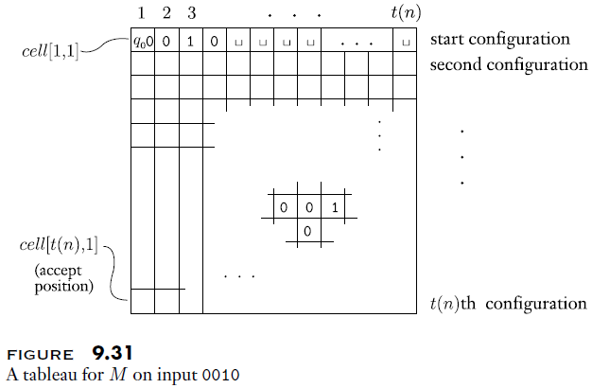
Tableau Depiction

Slide 9
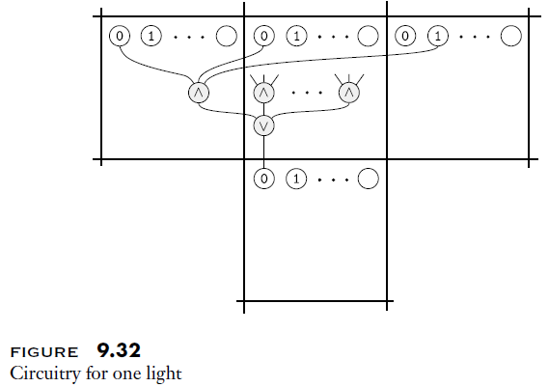
Circuitry for Lights in Cells of a Tableau

Slide 10
CIRCUIT-SAT
A Boolean circuit is satisfiable iff there exists some input that causes the circuit to output 1
The circuit-satisfiability problem "tests whether a circuit is satisfiable"
We can define the corresponding language as follows: CIRCUIT-SAT = {⟨C⟩| C is a satisfiable Boolean circuit}
Theorem 9.33 states: "CIRCUIT-SAT is NP-complete"
  The proof is somewhat short, but were just going to discuss the high-level details
  Clearly, CIRCUIT-SAT is in NP
  To show that CIRCUIT-SAT is NP-hard, consider any NP language, A
  A must have a polynomial time verifier, V, whose input has the form <x, c>, where c is a certificate proving that x is in A
  According to Theorem 9.30, we can construct a Boolean circuit equivalent to V
  The part of the circuit that corresponds to x gets filed in with the symbols of w
  The circuit is satisfiable if and only if there is some certificate, c, proving that w is in A
The book then demonstrates a polynomial time reduction from CIRCUIT-SAT to 3SAT, leading to another proof that 3SAT is NP-complete; we won't cover the details

Slide 11
Thoughts about Circuit Complexity
Directly after Theorem 9.30, before its proof, the book states:
  "This theorem gives an approach to proving that P ≠ NP whereby we attempt to show that some language in NP has more than polynomial circuit complexity"
Here are some of my personal thoughts about this:
  Personally, this approach does not seem particularly promising to me
  I don't see why this would be any easier to show that a language in NP cannot be decided by any polynomial time TM
  However, both the Arora and Barak book and the Papadimitriou book devote considerable space to Boolean circuits and circuit complexity
  Theoretical computer scientists are used to proving that classes are unequal using diagonalization
  Given that there are understood limits to diagonalization, I am speculating that there may be exaggerated interest in any possible approach that seems different
  On the other hand, I don't really trust my intuition about this

