Slide 1
ECE467: Natural Language Processing
Transformers

Slide 2
Pre-Transformer Brief Recap
Through 2017, variations of RNNs (including LSTMs) dominated the NLP literature
  We have covered how LSTMs (which could be bidirectional and/or stacked) can be applied to sequence labelling tasks (such as POS tagging) and sequence classification tasks (such as text categorization)
  Input sequences can be sequences of word embeddings or subword embeddings
Encoder-decoder networks (which were often based on LSTMs before the era of transformers) are used for sequence-to-sequence (seq2seq) tasks such as machine translation (MT)
  The encoder of such a model processes the input sequence, and the decoder generates an output sequence
  The concept of attention, which allows the decoder to focus on the portion of encoder output that seems most relevant at each time step, improves results significantly
  This type of attention, applied to an encoder and used by a decoder, is sometimes referred to as cross-attention
Most pre-transformer systems used static word embeddings, such as those produced by word2vec or GloVe
ELMo, an architecture based on LSTMs that was introduced in 2018, was a breakthrough method for producing contextual word embeddings
Note that some NLP researchers prior to 2017 experimented with convolutional neural networks (CNNs)
  CNNs were successful for some text categorization tasks, especially those involving short text sequences such as single sentences or tweets
  For MT, CNNs were sometimes used for the encoders
  We are not covering CNNs in this course, since they were never dominant in NLP

Slide 3
Shortcomings of RNNs and CNNs
RNNs (including the variations such as LSTMs) must process input sequentially
  This means that RNNs cannot be efficiently parallelized, which prevents them from getting the full benefits of GPUs
  This leads to very slow training
CNNs have problems detecting long-distance dependencies
  Long-distance dependencies refers to relationships between elements that exist relatively far apart in an input sequence
  In NLP, it is often the case that using the proper word requires knowledge of words from much earlier in the sentence, and sometimes from previous sentences
  Theoretically, with enough layers, CNNs can handle this, but in practice, they don’t work well when long-distance dependencies are significant

Slide 4
Transformers
In December 2017, a paper titled "Attention is All You Need" was presented at the 2017 Conference on Advances in Neural Information Processing Systems (NIPS)
You can find slightly different versions of the paper at various websites, some with original submission dates earlier in 2017; the version I link to from the course website was last revised in August 2023
This paper introduced a new neural architecture, developed by researchers at Google, called a transformer (sometimes capitalized, including in the original paper)
A transformer relies "solely on attention mechanisms, dispensing with recurrence and convolutions entirely" (from the Abstract of the original paper)
The current draft of the textbook discusses transformers in Chapter 8, titled "Transformers"
I have based my slides for this topic mostly on the original paper
The paper discusses the transformer as an encoder-decoder model, which is also how we will talk about it in this topic
All figures, tables, and quotations in this topic come from the original paper
In later topics, we will discuss other architectures that are based on a transformer encoder (e.g., BERT) or a transformer decoder (e.g., GPT)

Slide 5
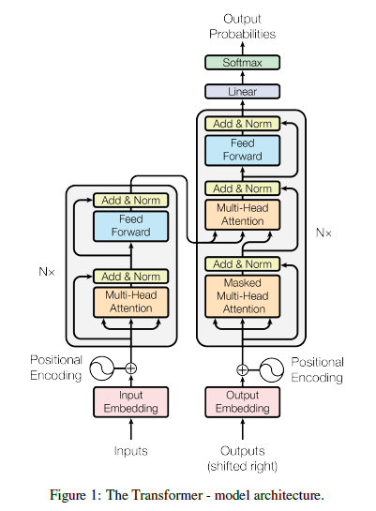
Transformer Architecture
A transformer (as it was originally introduced) is an example of an encoder-decoder network
The encoder and decoder both rely on stacked layers
  Each encoder layer has two sublayers, and each decoder layer has three sublayers
  Each encoder and decoder layer also includes residual connections, a.k.a. skip connections
  The first sublayer of each layer relies on a concept called self-attention (we will discuss this concept soon)
  The last sublayer is a point-wise (a.k.a. position-wise), fully-connected, feedforward NN (we will also discuss this soon)
  The decoder also uses cross-attention applied to the encoder output, leading to the middle sublayer
Note that several later works relying on transformers only use the encoder portion (e.g., BERT)
Others use only the decoder portion (e.g., GPT)
In this topic, we are covering transformers as explained in the original paper, for sequence-to-sequence tasks

Slide 6
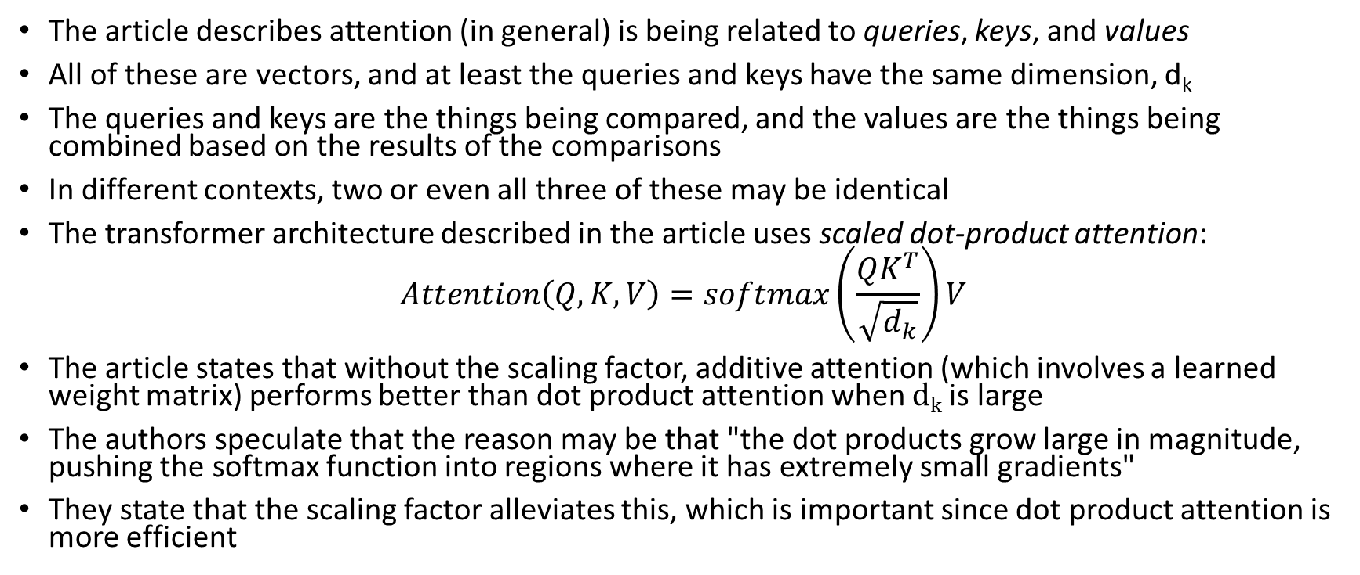
Attention (as explained in the article)
The article describes attention (in general) is being related to queries, keys, and values
All of these are vectors, and at least the queries and keys have the same dimension, d_{k}
The queries and keys are the things being compared, and the values are the things being combined based on the results of the comparisons
In different contexts, two or even all three of these may be identical
The transformer architecture described in the article uses scaled dot-product attention:
$$Attention\left(Q, K,V\right)=softmax\left(\frac{QK^{T}}{\sqrt{d_{k}}}\right)V$$
The article states that without the scaling factor, additive attention (which involves a learned weight matrix) performs better than dot product attention when d_{k} is large
The authors speculate that the reason may be that "the dot products grow large in magnitude, pushing the softmax function into regions where it has extremely small gradients"
They state that the scaling factor alleviates this, which is important since dot product attention is more efficient

Slide 7
Multi-head Attention
Attention mechanisms typically learn to focus on one aspect of the input
For many NLP tasks, there are various aspects of the input that we need to pay attention to for different reasons
For this reason, transformers use multi-head attention
  First, queries, keys, and values are linearly projected using learned mappings
  Next, attention is applied in parallel to each result
  The outputs of the various attention mechanisms are then concatenated and again projected
The figure on the next page helps explain the difference between ordinary scaled dot-product attention and multi-head attention

Slide 8
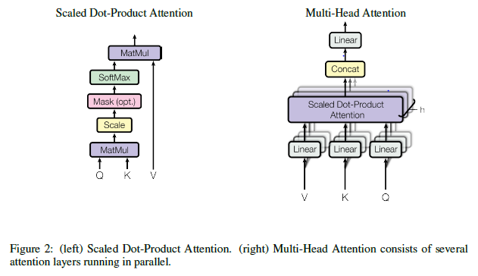
Multi-head vs Scaled Dot-Product Attention

Slide 9
The Transformer’s Encoder
The transformer’s encoder accepts the input, which is a sequence of input embeddings combined with positional encodings (to be discussed soon)
The encoder in the original paper consists of 6 identical layers, each containing two sublayers
The first sublayer is a multi-head self-attention layer
  The authors did not invent the notion of self-attention (a.k.a. intra-attention); the original transformer article cites a few sources that used it successively for specific tasks
  However, the paper claims "the Transformer is the first transduction model relying entirely on self-attention to compute representations of its input and output without using sequence-aligned RNNs or convolution"
  Each encoding is compared to every other, and the weighted encodings are added together to form an output representation (i.e., the query, keys, and values are all the same)
  A residual connection adds the input of the sublayer to its output; the sum is normalized
The second sublayer is a position-wise fully-connected feedforward neural network
  The feedforward sublayer of the encoder consists of "two linear transformations with a ReLU activation in between": FFN(x) = max(0, xW₁ + b₁)W₂ + b₂
  Weights are shared across positions within a layer, but the weights differ between layers
  As with the multi-head self-attention sublayer, a residual connection adds the input of the feedforward sublayer to its output, and the sum is normalized

Slide 10
Positional Encodings
Without positional encodings, there is no way for a transformer to make use of the order of the input
It is therefore necessary to "inject some information about the relative or absolute position of the tokens in the sequence"
The article says that they experimented with two forms of positional encodings, which led to nearly identical results
They wound up using "sine and cosine functions of different frequencies", producing vectors of the same dimension as the embeddings
These position encodings are added to the input embeddings
Note that positional encodings are only added to the input directly
However, due to residual connections, they have an effect throughout the stack

Slide 11
The Transformer’s Decoder
The transformer’s decoder also accepts its input sequence, which, like the encoder, is a sequence of embeddings combined with positional encodings
  In my opinion, the article does not adequately explain the inputs to the decoder; I found a helpful explanation here: https://medium.com/inside-machine-learning/what-is-a-transformer-d07dd1fbec04
  During training, the input sequence to the decoder is the desired output sequence of the seq2seq model, shifted to the right (as indicated in Figure 1, but in my opinion, not adequately explained in the text of the article)
  When we apply a transformer, each predicted value is used as the next input (we'll discuss this soon for machine translation)
Like the encoder, the decoder in the original paper consists of 6 identical layers
  In the decoder, each layer consists of three sublayers (in the encoder, there were only two sublayers)
  As with the encoder, the first sublayer of the decoder is a multi-head self-attention layer; unlike the encoder, this sublayer is masked (to be discussed soon)
  The second sublayer of the decoder "performs multi-head attention over the output of the encoder stack"
  Note that this is the same sort of attention we learned about in a previous topic, sometimes called cross-attention, when discussing LSTMs or other types of RNNs used for encoder-decoder networks
  The third sublayer of the decoder is the same as the second sublayer of the encoder (i.e., a position-wise fully-connected feedforward neural network)
The decoder output is fed through a linear transformation layer and then a softmax layer to predict outputs
  During training, the predicted outputs would be compared to the desired outputs to calculate a loss function
  We'll discuss how to train a transformer for machine translation on the next slide; the slide after that discusses how to apply a transformer that has already been trained for machine translation

Slide 12
Training Transformers for Machine Translation
The article discusses the results of applying their Transformer architecture to the task of machine translation (MT)
Although they don’t say it anywhere in the article, the network can be trained end-to-end using stochastic gradient descent and backpropagation
  Using a parallel corpus, sentences from the source language are fed to the encoder while translations in the target language are fed to the decoder
  The target sentences are "shifted right" (as indicated in the figure, but in my opinion, not adequately explained in the text of the article)
  As explained at the website mentioned on the previous slide, a start-of-sentence marker is inserted as the new first token (this is not mentioned in the article)
  As explained in the article, the authors "modify the self-attention sub-layer in the decoder stack to prevent positions from attending to subsequent positions"
  This masking, combined with the right-shifting, "ensures that the predictions for position i can depend only on the known outputs at positions less than i"
  Thus, during training, each sentence pair (the source sentence and target sentence) can be trained in a single pass, taking advantage of parallelization

Slide 13
Applying a Trained Transformer to MT
It is not explained in the article, but to apply the trained network, you need to run the decoder sequentially
In other words, each run of the system predicts one additional token (which in the case of MT, will be a word or subword)
The website mentioned two slides back helps to explain how this works
  For MT, during the first run, you feed in the source sentence to the encoder, and only a start-of-sentence symbol to the decoder
  The decoder predicts the first word or subword (we'll say token) of the target sentence
  The system remembers the first predicted token of the output
  During the second run, you feed in the source sentence to the encoder, and the start-of-sentence symbol plus the first predicted token to the decoder
  The decoder predicts the second token of the target sentence; the system remembers it
  The system repeats this process until an end-of-sentence symbol is predicted

Slide 14
Comparing Architectures
The table on the next page (from the original article) compares self-attention layers to convolutional layers and RNN layers
  In addition to rows for self-attention, RNNs, and CNNs, there is a row labeled "self-attention (restricted)"
  The article explains that this is for a hypothetical case where each token is compared to other tokens within a window of size r (they leave this for future work)
  The second column indicates the complexity per layer
  The third column indicates the number of sequential operations per layer (which hurts parallelizability)
  The fourth column, that they call "maximum path length", indicates the complexity of the number of layers or time steps necessary to detect long-distance dependencies
In the table, the meanings of the variables are:
  n is the length of the sequence (for NLP applications, typically the number of words or tokens)
  d is the size of each vector (typically in the hundreds)
  k is the kernel size for convolutions (we are not covering CNNs in this course)
  r is the window size for restricted self-attention (mentioned above)
The article points out that "self-attention layers are faster than recurrent layers when the sequence length n is smaller than the representation dimensionality d" (which is typically this case for NLP applications)

Slide 15
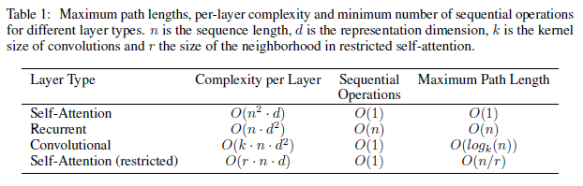
Comparing Architectures (from article)

Slide 16
Experiments in the Original Article
In the article, the authors discuss their results applying a transformer for two MT tasks
One task used the WMT 2014 English-German dataset
  For the English-German dataset, they used byte-pair encoding (BPE) for tokenization; we covered BPE during an earlier topic
  This led to about 37,000 distinct tokens in the vocabulary
The other task used the larger WMT 2014 English-French dataset
  For the English-French datasets, they used "a 32,000 word-piece vocabulary"
  This relates to the WordPiece tokenization algorithm, which was briefly mentioned, but not covered, in an earlier topic
The article discusses what hardware they used and what hyperparameters they used (e.g., the Adam optimizer, dropout, etc.)
They ran experiments with a baseline transformer as well as a "big" version with larger vectors and more heads (there may have been other differences, but the number of layers was the same)
The end of the article talks about an additional experiment using the transformer for constituency parsing; in my opinion, this is not well explained in the article, and we will not discuss it further

Slide 17
Evaluation of Experiments in Original Article
The table on the next slide (from the paper) shows that transformers beat all previous architectures for both translation tasks
The use of transformers achieved state-of-the-art results "at a fraction of the training cost" (also indicated in the table)
In the original paper, the emphasis is more about the efficiency of transformers as opposed to the accuracy
Since the publication of this paper, architectures that rely on transformers have been applied to many NLP tasks with extreme success
  For example, BERT, based on the transformer encoder, has been very successful at sequence labeling and sequence classification tasks
  GPT has been very successful at tasks involving generation
  We'll discuss BERT and related architectures in our next topic; we'll discuss GPT and related architectures in the topic after that

Slide 18
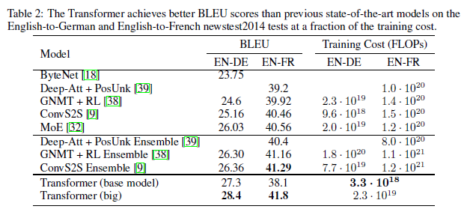
Results (from article)

