Slide 1
ECE467: Natural Language Processing
Question Answering,
Reading Comprehension, and SQuAD;
Contextual Embeddings and ELMo

Slide 2
If you are following the suggested readings…
The fist part of the course will cover question answering (QA) and a related dataset
  The current draft of the textbook no longer has a chapter devoted to question answering
  Sections 11.3 – 11.5 are related to question answering, but most of the content is not relevant to how we will cover QA in this topic; Section 11.3 covers retrieval-augmented generation (mentioned on the next slide)
  Up until February 2024, Chapter 14 was titled "Question Answering and Information Retrieval"
    Sections 14.3 – 14.4 of that draft are relevant to our coverage of the topic
    However, the QA approach described in the February 2024 draft relies on BERT, which is a transformer-based architecture
    We will cover transformers and BERT later in the course (including how BERT can be applied to QA)
  The specific QA system we will examine relies on LSTMs, and the figure we will look at summarizing the architecture comes from an earlier draft of the textbook
  We will also discuss the Stanford Question Answering Dataset (SQuAD), which is referred to throughout the February 2024 draft of Chapter 14, but is only mentioned once in the current draft
The latter part of this topic covered contextual embeddings and ELMo
  Discussion of ELMo has been mostly dropped in recent drafts of the textbook (it is referenced here and there, but no longer described)
  I have largely relied on the original ELMo paper, and there is a link to it in the schedule on the course website
  I could have made this a separate topic from QA, but QA was one of the tasks used to evaluate ELMo

Slide 3
Question Answering
The first part of this topic will cover question answering (QA); however, I would claim that the meaning of QA within the field of NLP has changed over the years
  In conventional NLP, QA was highly related to information retrieval (IR), which we covered earlier in the course (we will briefly talk about this approach over the next couple of slides)
    Systems would first search a corpus for documents relevant to the user's question
    The system would then present a segment from a document determined to likely contain the answer
  After the first NLP revolution, the literature on QA primarily dealt with finding an answer in a passage provided along with the question (we will discuss this approach in more detail)
    Some sources refer to this more specific task as reading comprehension
    The answer for this type of task is generally considered to a specific span of text within the document
    The dataset known as SQuAD, which was mentioned on the previous slide, is related to this type of task
  In modern NLP, transformer-based LLMs once again search a corpus when seeking an answer
    However, rather than presenting a segment of a document (like conventional systems), or a specific span of text (like reading comprehension systems), the system generates an answer
    This sort of approach is known as retrieval-augmented generation (RAG), and QA is not its only application
    Time permitting, we might cover RAG during the third part of the course
In this topic, we are going to cover reading comprehension approaches to QA

Slide 4
Pre-neural, IR-based, Factoid QA Systems
We will take a brief excursion to discuss methods used by conventional (pre-neural), statistical, IR-based factoid QA systems, which often consisted of several independent components
The primary focus of QA systems is typically answering factoid questions, which basically means that the answer is a short span of text (often, but not always, a named entity)
The figure on the next slide (from an earlier draft) shows a possible architecture for such a system
  The purpose of the components in the "Question Processing" box are to generate a query for an IR system, and to predict an answer type
  The "Document Retrieval" component represents a typical IR system; however, the task of QA is different than IR, since we are tasked with finding the specific answer
  The "Passage Retrieval" component splits each document into paragraphs or other smaller snippets to serve as passages that might contain an answer to the question
  Some conventional systems would then search for answers in every passage; others would choose candidate passages using statistical ML approaches
  The "Answer Extraction" box in the diagram represents the component of a system that examines one passage at a time and tries to find the answer to the original question
  If the answer type is a named entity, NER can be used to find possible answers of the right type
  On the other hand, if the question asks for a definition of something, it is more complex to find the exact span of text that specifies the answer

Slide 5
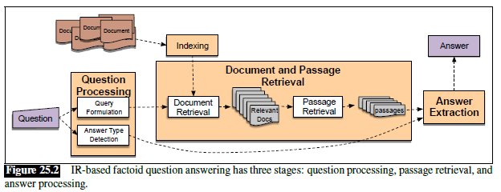
Pre-neural, IR-based, Factoid QA Architecture

Slide 6
Watson
Through the January 2023 draft of the textbook, Section 14.6 discussed the approach used by the Watson DeepQA system (typically just called Watson)
  This discussion has been dropped in more recent drafts of the textbook (although Watson is still briefly mentioned in a few locations)
  In the current draft, there is a paragraph about Watson in the "Historical Notes" section at the end of the chapter on Large Language Models
Watson is the IBM QA system that beat two of the best-ever players at Jeopardy! In 2011
  I watched one or two of those episodes live; Watson seemed extremely impressive at the time
  I find it so weird that the section of the textbook that described Watson (now dropped) was titled "Classic QA Models"
Watson could find answers (well…) in both text and knowledge bases
Like traditional QA systems, it used several components acting together, and involved sequential phases of processing
We won't discuss the technical details of this system (I may speak a bit about it in class)

Slide 7
Reading Comprehension and SQuAD
After the first deep learning revolution in NLP, much of the research related to QA limited the task to finding an answer to a given question in a specific passage of text
As mentioned earlier, this sort of QA task is sometimes referred to as reading comprehension (I have also seen it referred to as answer extraction)
One important dataset for reading comprehension is the Stanford Question Answering Dataset (SQuAD)
  The dataset consists of passages from Wikipedia and associated questions
  Questions were collected from human volunteers
  The answers are spans of texts from the passages
  The original SQuAD dataset, SQuAD 1.1, contained only answerable questions
  SQuAD 2.0 also includes unanswerable questions
  Each answerable questions contains answers from at least three humans
The figure on the next slide (from the February 2024 draft of the textbook) shows a passage from SQuAD 2.0 along with three sample questions and their answers

Slide 8
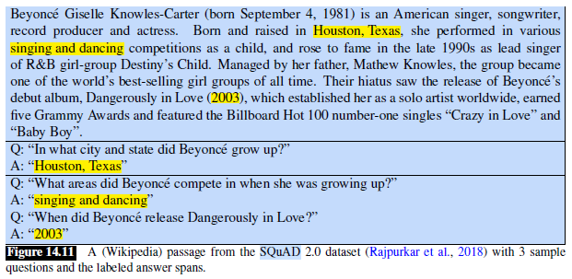
SQuAD Examples

Slide 9
SQuAD Metrics
Systems applied to SQuAD are evaluated according to two metrics
  Exact match only credits a system if the answer exactly matches one of the human answers
  The F1 score combines the precision and recall of predicted answers on a per token basis (we covered these metrics earlier in the course)
For a while, Stanford maintained a leaderboard, displaying the top systems
When Stanford switched from SQuAD 1.1 to SQuAD 2.0, both metrics dropped significantly
Later, even for SQuAD 2.0, the top systems beat human performance (but I think this always has to be taken with a grain of salt)

Slide 10
Neural QA Systems
The neural component of a QA system (really, more specifically, a reading comprehension system) processes a question and a passage that contains (or may contain) the answer
  For each word in the passage, the system predicts how likely the word is to be the start of, and how likely the word is to be the end of, the answer to the question
  Thus, this sort of approach treats QA as a sequence labelling task
  The computed probabilities can be used to predict the best answer to the question, or to decide that the passage does not contain the answer to the question
We will examine the architecture of a system called DrQA, from 2017, built on top of LSTMs
  The figure on the next slide (from the October 2019 draft of the textbook) helps to explain the architecture of the system; the few slides after that provide more details (quotations are from the earlier draft)
  Note that neural QA systems, such as DrQA, can be trained end-to-end using gradient descent and backpropagation, training with a dataset such as SQuAD
As mentioned earlier, newer drafts of the textbook, through the February 24 draft, discuss QA systems built on top of BERT (we will see how BERT can be applied to QA later in the course)
The current draft of the textbook had dropped most of the discussion of systems that treat QA as reading comprehension, and instead focuses on retrieval-augmented generation (RAG)

Slide 11
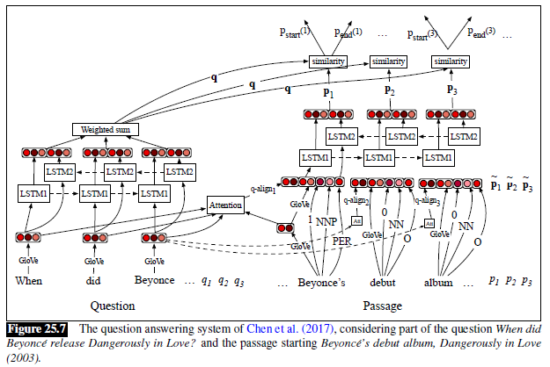
DrQA: Neural QA Example (from earlier draft)

Slide 12
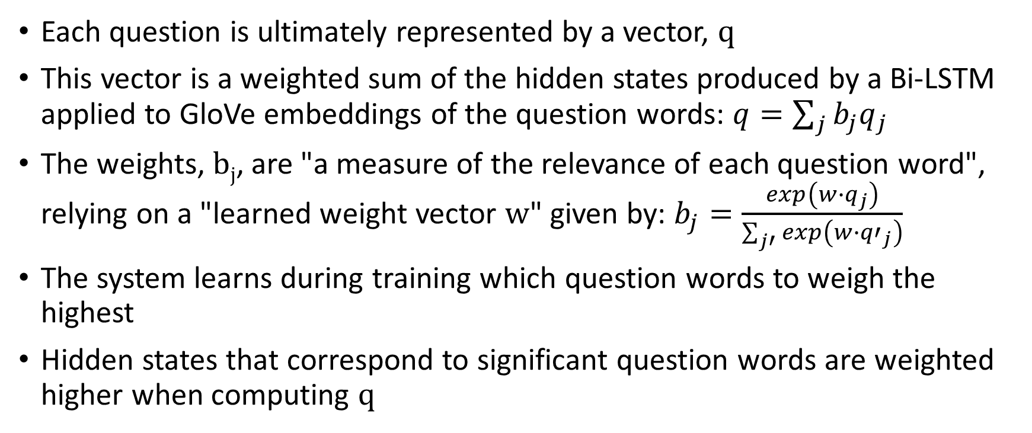
DrQA: Question Processing
Each question is ultimately represented by a vector, q
This vector is a weighted sum of the hidden states produced by a Bi-LSTM applied to GloVe embeddings of the question words: $q=\sum_{j}{b_{j}q_{j}}$
The weights, b_{j}, are "a measure of the relevance of each question word", relying on a "learned weight vector w" given by: $b_{j}=\frac{exp\left(w∙q_{j}\right)}{\sum_{j′}{exp\left(w∙{q′}_{j}\right)}}$
The system learns during training which question words to weigh the highest
Hidden states that correspond to significant question words are weighted higher when computing q

Slide 13
DrQA: Passage Processing
For each word in the passage, a complex vector is being formed consisting of a concatenation of:
  The GloVe embedding of the passage word
  A representation of the POS of the word
  A representation of the NER tag of the word
  An exact match feature, representing whether the passage word occurs in the question
  A vector created using an attention mechanism, comparing the passage word's GloVe embeddings to the embeddings of every question word
These vectors are input to a Bi-LSTM, producing hidden states for each word in the passage

Slide 14
DrQA: Predicting Probabilities
The hidden state for each word in the passage, along with with the question representation, are used to predict two probabilities:
  p_{start}(i) is the probability that the i^{th} word in the passage is the start of the answer
  p_{end}(i) is the probability that the i^{th} word in the passage is the end of the answer
If it is known that the passage contains the answer, the most likely answer can be selected based on the estimated probabilities
If some questions may be unanswerable, the system must ensure that the likelihood of the answer passes some threshold (DrQA did not attempt this)
Here is a bit of information about SQuAD results:
  According to the DrQA paper, published in 2017, the system achieved about 70% exact match and about 79% F1 score (I believe on SQuAD 1.1), which was the state-of-the-art at the time
  However, by mid-2021, according to the archived leaderboard, the best systems were achieving over 90% exact match and over 95% F1 on Squad 1.1
  Human performance on SQuAD 1.1 was about 82.3% exact match and 91.2% F1 score
  Also by mid-2021, the best systems were achieving over 90% exact match and over 93% F1 score on Squad 2.0
  Human performance on SQuAD 2.0 was about 86.8% exact match and 89.5% F1 score

Slide 15
A Problem with Word Embeddings
Word embeddings we have seen so far, such as those produced by word2vec or GloVe, do not vary based on context
As previously mentioned, these sorts of approaches produce what are called static word embeddings
However, words can have different meanings, depending on context
These differences can be vastly different or subtly different
A relevant resource from conventional NLP is WordNet, which stores many senses of English nouns and verbs, as well as relationships between senses
A relevant task is word sense disambiguation (WSD)
WSD refers to computational approaches for determining the correct meaning of a word that can have multiple senses
Intuitively, it seems that words with multiple senses should have different representations (i.e., different embeddings) in different contexts

Slide 16
Why are Static Word Embeddings Useful?
For words with multiple meanings, why are static word embeddings useful?
There are at least a few possible explanations:
  Word embeddings probably combine the representations of different senses of a word
  The most common sense of a word likely dominates the word's embedding
  More generally, the portion of the embeddings representing the correct sense of a word, in context, is probably useful, while the rest possibly acts as noise
  With stacked architectures, the lower levels may learn context-dependent representations of a word, while higher levels learn how to use them

Slide 17
Contextual Word Embeddings and ELMo
Prior to 2018, there had been various attempts to produce contextual word embeddings (a.k.a. contextualized word embeddings)
Some of these attempts were successful to an extent
A breakthrough implementation in 2018 was named Embeddings from Language Models (ELMo)
ELMo was developed by collaborators from the Allen Institute for Artificial Intelligence and from the University of Washington
ELMo, which is built upon bidirectional LSTMs, led to improved performance compared to static word embeddings for many NLP tasks (QA, sentiment analysis, NER, etc.)
ELMo was introduced in a paper titled "Deep Contextualized Word Representations" by Peters et al., originally presented at the 2018 NAACL Conference
The paper won the best paper award at the conference
My slides for this subtopic have largely been based on the original paper, which is linked to from the course website

Slide 18
Overview of ELMo
We will start with a high-level description of ELMo
At the lowest level, ELMo combines character embeddings to form initial word embeddings (we won't discuss the details of this component)
These word embeddings are sent through two layers of bidirectional LSTMs
The paper first describes the architecture more generally, such that another sort of bidirectional RNN could have been used, but their implementation uses LSTMs
ELMo is pretrained as a language model on a very large corpus of unlabeled data
The pretraining is a form of unsupervised machine learning (the method used to train word2vec was another example of unsupervised machine learning)
After the pretraining, the weights of this component are fixed, and the part that makes predictions for the language model is removed
The remaining structure replaces or augments the word embeddings fed as input to other architectures used for other NLP tasks

Slide 19
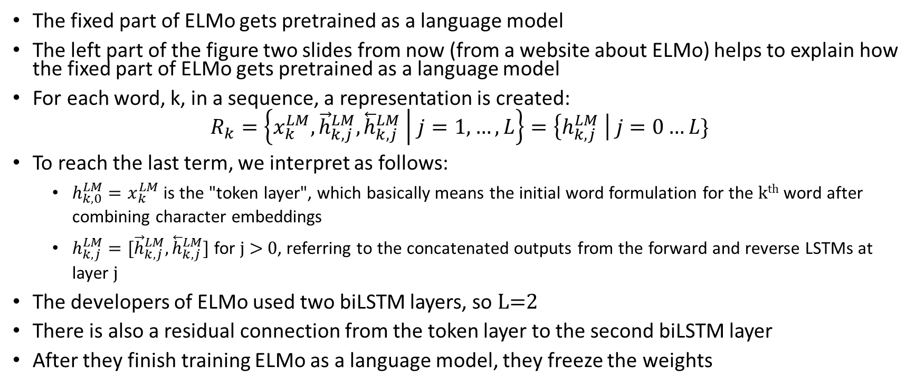
Learning the Language Model
The fixed part of ELMo gets pretrained as a language model
The left part of the figure two slides from now (from a website about ELMo) helps to explain how the fixed part of ELMo gets pretrained as a language model
For each word, k, in a sequence, a representation is created:
$$R_{k}=\left\{x_{k}^{LM},{\vec{h}}_{k,j}^{LM},{\overset{⃖}{h}}_{k,j}^{LM} | j=1,…,L\right\}=\left\{h_{k,j}^{LM} \right| j=0…L\}$$
To reach the last term, we interpret as follows:
  $h_{k,0}^{LM}=x_{k}^{LM}$ is the "token layer", which basically means the initial word formulation for the k^{th} word after combining character embeddings
  $h_{k,j}^{LM}=[{\vec{h}}_{k,j}^{LM},{\overset{⃖}{h}}_{k,j}^{LM}]$ for j > 0, referring to the concatenated outputs from the forward and reverse LSTMs at layer j
The developers of ELMo used two biLSTM layers, so L=2
There is also a residual connection from the token layer to the second biLSTM layer
After they finish training ELMo as a language model, they freeze the weights

Slide 20
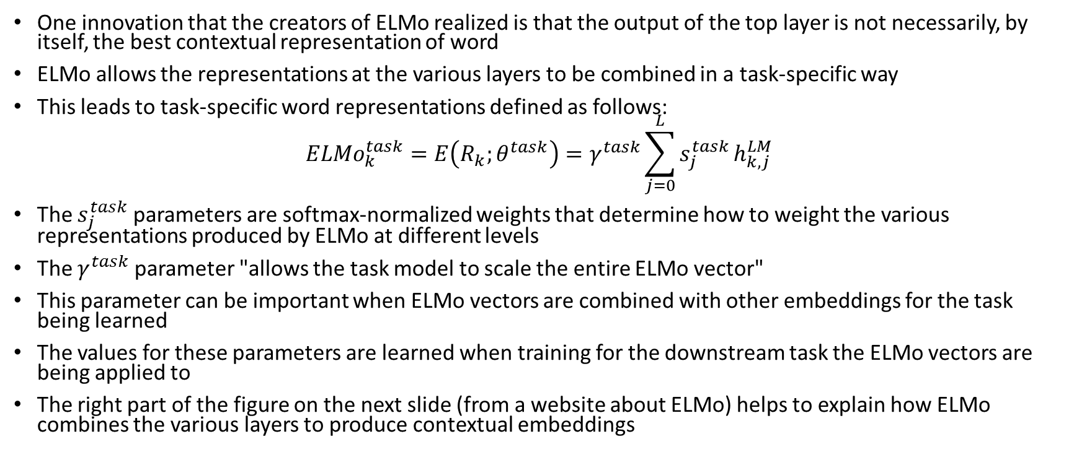
Computing the ELMo Embeddings
One innovation that the creators of ELMo realized is that the output of the top layer is not necessarily, by itself, the best contextual representation of word
ELMo allows the representations at the various layers to be combined in a task-specific way
This leads to task-specific word representations defined as follows:
$${ELMo}_{k}^{task}=E\left(R_{k};θ^{task}\right)=γ^{task}\sum_{j=0}^{L}{s_{j}^{task}}h_{k,j}^{LM}$$
The $s_{j}^{task}$ parameters are softmax-normalized weights that determine how to weight the various representations produced by ELMo at different levels
The $γ^{task}$ parameter "allows the task model to scale the entire ELMo vector"
This parameter can be important when ELMo vectors are combined with other embeddings for the task being learned
The values for these parameters are learned when training for the downstream task the ELMo vectors are being applied to
The right part of the figure on the next slide (from a website about ELMo) helps to explain how ELMo combines the various layers to produce contextual embeddings

Slide 21
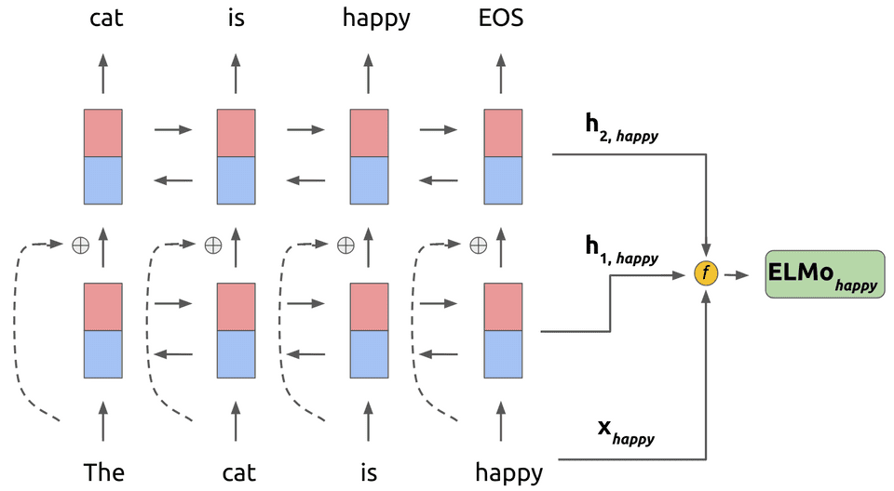
ELMo Graphical Depiction
https://www.mihaileric.com/posts/deep-contextualized-word-representations-elmo

Slide 22
Using ELMo Contextual Embeddings
As previously stated, the original layers of ELMo are trained as a language model
This leads to fixed weights for the layers that:
  First, combine character embeddings to produce original word embeddings
  Then, produce multiple layers of contextual embeddings (two, in the original paper)
The authors applied ELMo to several tasks (we'll list all of them soon, but they include NER, QA, and sentiment analysis), as follows:
  Using existing architectures for the tasks being tested, instead of (or in addition to) standard word embeddings, sentences would be fed to ELMo to produce contextual word embeddings
  The authors first recreated architectures that were reported to produce state-of-the-art results for each task, and then trained them using ELMo contextual embeddings
  The contextual word embeddings produced by ELMo involve the parameters that weight the representations at different ELMo layers and the parameter that scales the ELMo vectors
  These few parameters get learned along with of the weights of the architecture being used for the downstream task

Slide 23
Datasets and Tasks Discussed in ELMo Article
The developers of ELMo evaluated ELMo embeddings using the following datasets:
  SQuAD – We’ve already learned about this when we discussed question answering (QA) earlier in the topic; it is the Stanford Question Answering Dataset (really a reading comprehension dataset)
  SNLI – This is a textual entailment dataset; given two sentences, the system determines if the second follows from the first, contradicts it, or neither (we have not discussed this sort of task)
  SRL – This is a semantic role labeling dataset; given a sentence, answer "who did what to whom" (I used to discuss this briefly as when covering semantics, but I have dropped it from the course)
  Coref – This is a coreference resolution dataset; we briefly talked about coreference resolution when we discussed linguistic concepts
  NER – This is a named entity recognition dataset; we discussed this sort of task briefly as an example of a sequence labelling task when we covered RNNs
  SST-5 – This is a sentiment analysis dataset; given a sentence from a movie review, is it very negative, negative, neutral, positive, or very positive; this is a type of text categorization
The table on the next page (from the original ELMo paper) shows the results; the results are discussed further on the following slide

Slide 24
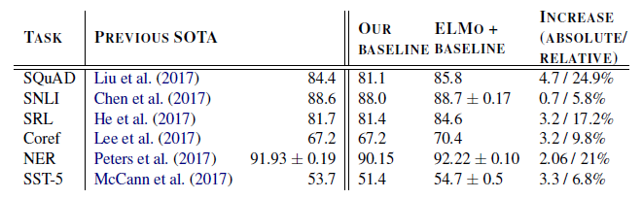
Results of Applying ELMo to Various NLP Tasks

Slide 25
ELMo Evaluation
For all tasks tested by the authors (at least those reported in the paper), ELMo led to improved state-of-the-art performance
This table only shows results from single systems
The authors also tested ensembles (by training with ELMo multiple times), and their best ensembles also beat the previous best ensembles
Two other interesting conclusions drawn by the authors, based on which ELMo layers were weighted higher for which tasks, are:
  "the higher-level LSTM states capture context-dependent aspects of word meaning"
  "lower-level states model aspects of syntax"
For all tasks they tested, combining the representations from different ELMo layers outperformed using only the output from the top level

