Slide 1
ECE467: Natural Language Processing
Feedforward Neural Networks

Slide 2
Machine Learning Approaches
Throughout the history of artificial intelligence (AI) and natural language processing (NLP), there have been many popular machine learning (ML) approaches
We covered or mentioned some ML methods during our unit on pre-deep-learning NLP
For text categorization, we covered the naïve Bayes, KNN, and Rocchio/TF*IDF approaches
It was briefly mentioned that part-of-speech tagging, two popular conventional methods were hidden Markov models (HMMs) and maximum entropy Markov models (MEMMs)
Other ML methods that were conventionally used in NLP include decision trees, support vector machines, expectation maximization, etc.
Until semi-recently, no single approach dominated; generally speaking, different ML methods seemed to perform the best for different tasks
That has changed in more recent years, as neural networks have come to dominate machine learning and NLP

Slide 3
Origins of Neural Networks
Neural networks (NNs), a.k.a. artificial neural networks (ANNs), were loosely inspired by the structure of the human brain and its neurons
From the current draft of the textbook:
  "Neural networks are a fundamental computational tool for language processing, and a very old one. They are called neural because their origins lie in the McCulloch-Pitts neuron (McCulloch and Pitts, 1943), a simplified model of the biological neuron as a kind of computing element that could be described in terms of propositional logic. But the modern use in language processing no longer draws on these early biological inspirations."
Conventionally, much of the work with NNs focused on feedforward neural networks (this will soon be explained, and it is what we will focus on for this topic)
Our coverage of feedforward neural networks is partially based on Sections 6.1 – 6.3 and Section 6.6 of the current draft of the textbook; Chapter 6 in general is titled "Neural Networks"
I have also partially relied on material from the 3rd and 4th editions of the textbook that I use for my AI course: "Artificial Intelligence: A Modern Approach" by Russell and Norvig (R&N)
The next slide shows a rough diagram of a neuron, taken from the R&N textbook (I will discuss it in class)

Slide 4
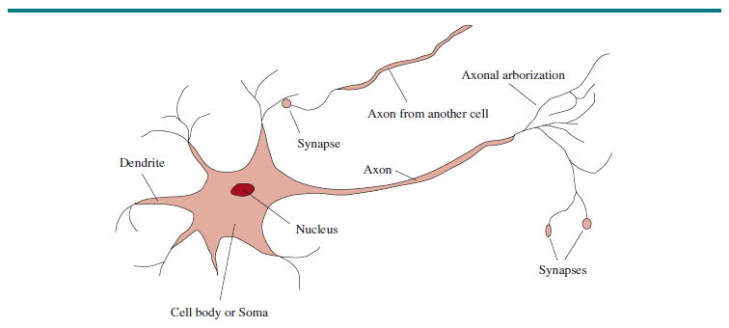
Diagram of a Neuron (Figure 1.1, R&N, Ed. 4)

Slide 5
Computer vs. Brain (from various sources)
There are roughly 10¹¹ neurons in the human brain
There are roughly 10¹⁴ synapses
Both of those estimates vary somewhat from source to source
The CPU or GPU in a typical, modern, personal computer has roughly 10¹⁰ transistors (some have 10¹¹)
RAM uses one transistor per bit for DRAM or six transistors per bit for SRAM; therefore, 32 GB of SRAM uses over 10¹² transistors
With modern NNs, we also care about the number of weights (this concept will be explained soon)
  The number of weights in some large language models is over 100 billion, so on the order of 10¹¹
  GPT-4 is rumored to have over 1 trillion weights, so on the order of 10¹²; presumably, GPT-5 has at least as many as GPT-4
The number of transistors in computers had been increasing exponentially for decades according to Moore's law; however, this pace has significantly slowed down in recent years
The brain has a much higher degree of parallelism compared to computers, although with GPUs, computers rely on more parallelism than they used to
Obviously, signals in a computer are traveling faster than signals in a brain
Relative to modern NNs, the human brain relies more heavily on feedback loops

Slide 6
Neural Network Units
Neural networks are composed of units (a.k.a. nodes or artificial neurons)
  Each unit accepts inputs and computes a weighted sum of the inputs; the weights are adjustable parameters of the unit
  A bias weight is also added (or subtracted, according to some sources)
  An activation function is applied to the weighted sum, including the bias weight
  The result of the activation function is the output, or activation, of the unit
  We will see that the weights, including the bias weights, are learned during the training of a neural network
In the original model by McCulloch and Pitts, inspired by neurons of the brain, they used a threshold instead of a bias weight
  If the sum of the weighted inputs exceeded the threshold, the node would fire
  This can easily be shown to be equivalent to using a (subtracted) bias weight and a simple threshold activation function (we will discuss activation functions soon)
The figure on the next slide shows a diagram of a neural network unit
The equations on the following slide define how the unit behaves, assuming a sigmoid activation function; activation functions, in general, will be discussed on later slides

Slide 7
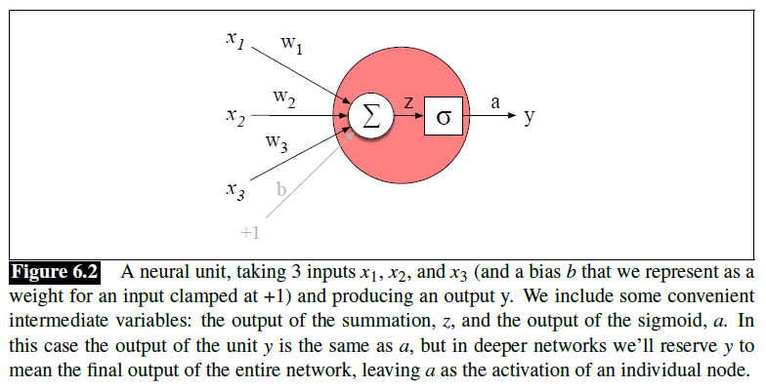
Diagram of a Neural Network Unit

Slide 8
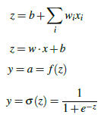
Formulas (using a sigmoid activation function)

Slide 9
Activation Functions
The activation function introduces a non-linearity, which is necessary for a neural network to represent functions that are not linearly separable
We will see later that neural networks also must contain hidden layers to represent functions that are not linearly separable
In conventional (pre-deep-learning) neural networks, two popular activation functions were the threshold function and the sigmoid function
The sigmoid function is also known as the logistic function, and another common use of this function is related to logistic regression
The figure on the next slide, taken from the 3rd edition of the R&N textbook, shows graphs explaining these conventional activation functions
Threshold activation functions are not common in deep neural networks (which we will discuss later in this topic as well as future topics)
Sigmoid activation functions are still somewhat common in certain situations; another graph of a sigmoid function (from our textbook) is shown two slides from now

Slide 10
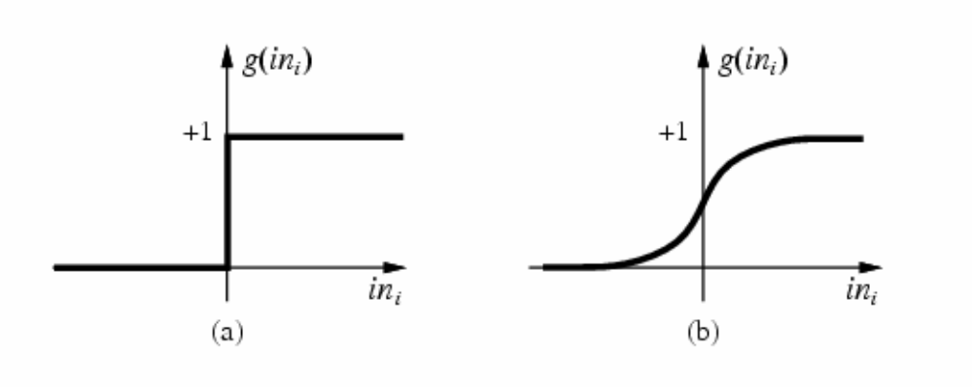
Conventional Activation Functions (R&N, Ed. 3)
Threshold Function
Sigmoid Function

Slide 11
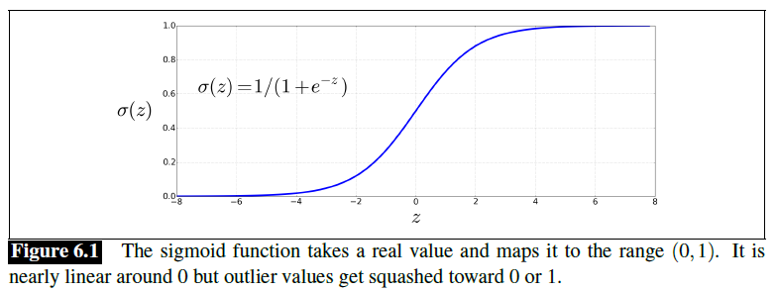
Sigmoid Function

Slide 12


Other Modern Activation Functions
Other common activation functions in deep neural networks include the tanh function and rectified linear units (ReLUs)
Formulas for these activation functions are:
Graphs of these activation functions are shown on the next slide
As mentioned earlier, sigmoid activation functions are also still somewhat common in deep neural networks, at least in certain circumstances
Textbook: "These activation functions have different properties that make them useful for different language applications or network architectures"

Slide 13
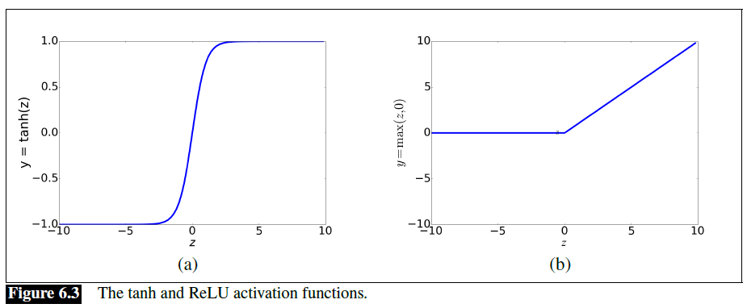
Tanh Function and ReLU

Slide 14
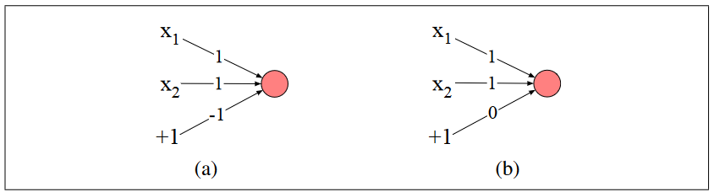

AND, OR, and NOT
Part (a) of the figure above (from our textbook) shows an AND node; part (b) shows an OR node
This assumes a threshold activation function; the book doesn’t call it that, but it shows the formula for it (note that the node does not fire at exactly 0):
Some points I would like to add:
  If we modify the bias weights in (a) and (b) to -1.5 and -0.5, respectively, then it is not relevant what happens when the weighted sum is exactly 0
  It is also easy to create a node that functions as a NOT gate; e.g., we can create a node with a single input weighted by -1 and a bias weight of 0.5
  Since we can compute AND, OR, and NOT with individual nodes, then with a network of nodes, we can compute any Boolean function

Slide 15
Perceptrons
The nodes we have seen so far are examples of perceptrons, a.k.a. single-layer perceptrons
Perceptrons can be defined as NNs which output binary values and do not contain any hidden layers (to be discussed soon), although the exact definition differs from source to source
Perceptrons are generally allowed to contain multiple nodes that share the same inputs, but each node functions completely independently of the other
So, perceptrons are only capable of representing functions that can be represented by individual nodes
Although individual nodes (and more generally, perceptrons) can represent AND, OR, NOT, and many other functions, they are severely limited
In a very influential 1969 publication, Minsky and Papert proved that single units cannot compute XOR
More generally, perceptrons can only represent linearly separable functions
It can easily be shown that a perceptron with a threshold activation function will fire if and only if w∙x > -b (the left-hand side represents a dot product of the inputs and the weights)
Positive and negative examples of linearly separable functions can be separated by hyperplanes in the input space
The figure on the next slide (from our textbook) demonstrates that hyperplanes can separate true and false instances of AND and OR, but no hyperplane separates true and false instances of XOR

Slide 16
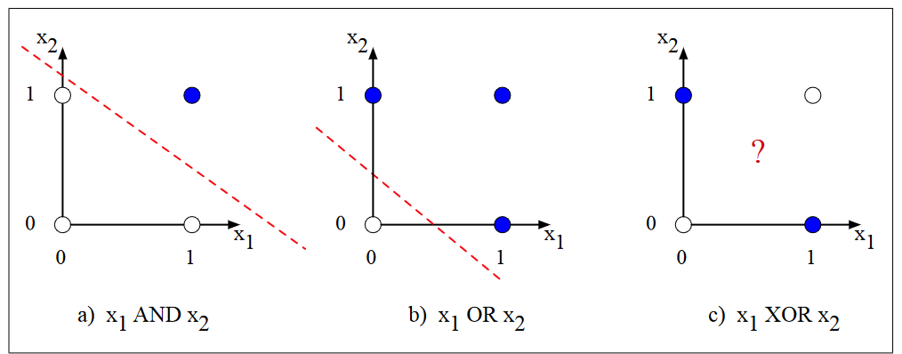
Hyperplane Examples (none for XOR)

Slide 17
Feedforward Neural Networks
One way to represent functions that are not linearly separable is by using feedforward neural networks; a.k.a. feedforward networks or sometimes multi-layer perceptrons
Some sources hyphenate feed-forward or write it as two separate words
A feedforward neural network is typically organized into layers
The output nodes (the only type in perceptrons, unless you count the inputs) constitute an output layer
Sources differ as to whether the inputs count as nodes or constitute a layer
Our textbook does refer to the inputs as an input layer, but they don’t include it when counting layers
In addition to the input layer and the output layer, there are one or more hidden layers, consisting of hidden units (a.k.a. hidden nodes)
When each node in one layer connects with every node from the previous layer, the later layer is said to be fully-connected
Typically, the inputs to a feedforward neural network do not have an activation function applied to them directly; the inputs are fed as scalars to the nodes in the first hidden layer
The next slide shows an example of a feedforward neural network with one hidden layer
Our textbook calls this a two-layer network, but some sources would consider it to be a three-layer network

Slide 18
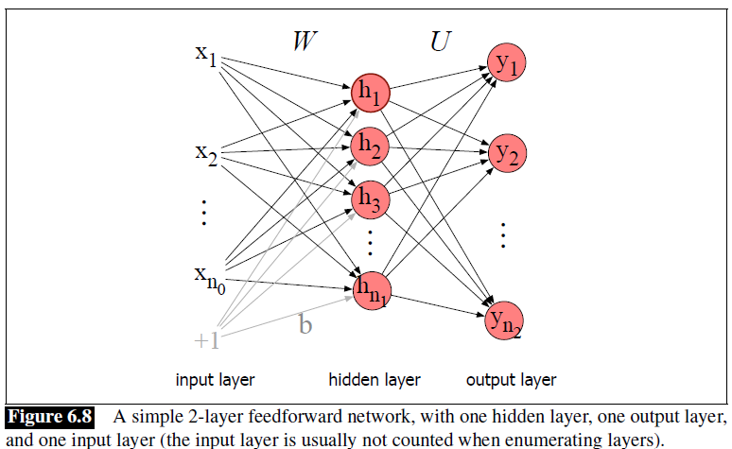
Feedforward Network with One Hidden Layer

Slide 19
Computing Values for the Hidden Layer
Note that the fixed input (in this case, +1) is connected to every node in the hidden layer, and each has its own bias weight
You could apply the equations we looked at before separately to each hidden node; alternatively, you can handle them all at once
We can think of the inputs as a vector, x, and the bias weights as a bias vector, b
We can think of the other weights between inputs and hidden nodes as a matrix, W
If the hidden nodes use a sigmoid activation function, their outputs can be computed as: h = σ(Wx+b)
Note that Wx+b is a vector, and the activation is being applied element-wise
Note: You need to be careful with how you treat rows and columns of the matrix if you are implementing a neural network using vectors and matrices
Some sources treat the vectors as column vectors, some as row vectors; some apply transposes to vectors or matrices in formulas
Conventionally, nodes were often handled one at a time, but there is a significant computational advantage of representing layers as vectors and representing weights between layers as matrices
Modern deep learning libraries, such as TensorFlow and PyTorch, take advantage of this by parallelizing computation with GPUs

Slide 20


Computing Values for the Output Layer
In many neural network architectures, the output nodes will also include bias weights connected to fixed inputs; in our first sample neural network (shown two slides ago), they do not
We can represent the intermediate output as z = Uh, where h = σ(Wx+b) as explained on the previous slide
We could apply a sigmoid function to z, as we did for the hidden layer, and for some tasks, this might make sense (in particular, if the output nodes represent binary, or independent, categories)
Another common type of output layer for modern neural networks is the softmax layer
The softmax layer converts a vector of real numbers into a vector of floating-point values between 0 and 1 that add up to 1 (which is appropriate when the output nodes represent mutually exclusive and exhaustive categories); the formula is:
The output of the softmax function is often interpreted as a probability distribution
In summary, the formulas used to calculate the values produced by the sample feedforward neural network would be:

Slide 21

Deep Feedforward Neural Networks
If a feedforward neural network has more than one hidden layer, it would generally be considered a deep neural network
Consider a neural network with n layers, not including the inputs, numbered from 1 to n
Let the i^{th} layer have incoming weight matrix W^{[i]}, bias vector b^{[i]}, activation function g^{[i]}, and output a^{[i]}; also let a^{[0]} be the input vector
Then we can implement forward propagation (the textbook calls this the forward step) as follows:
This pseudo-code allows a different activation function, g^{[i]}, to be used at each layer; 'g' is commonly used to represent a general activation function

Slide 22
Creating a Neural Network
The textbook never really discusses how you might go about creating a neural network for a task you are working on
Creating a neural network for a particular task involves:
  Choosing an architecture (e.g., the number, types, and sizes of layers); we will learn about various types of neural network architectures in future topics
  Setting hyperparameters (we haven’t talked about these yet)
  Obtaining a training set (including examples with known inputs and outputs)
  Training the neural network to learn the adjustable parameters of the network (i.e., the weights, including the bias weights); we will talk more about training shortly
  The architecture and hyperparameters are set manually, before training; optionally, they can be tuned based on a development set, a.k.a. validation set or tuning set
After the neural network has been finalized (including tuning and training), you can evaluate it using a test set

Slide 23


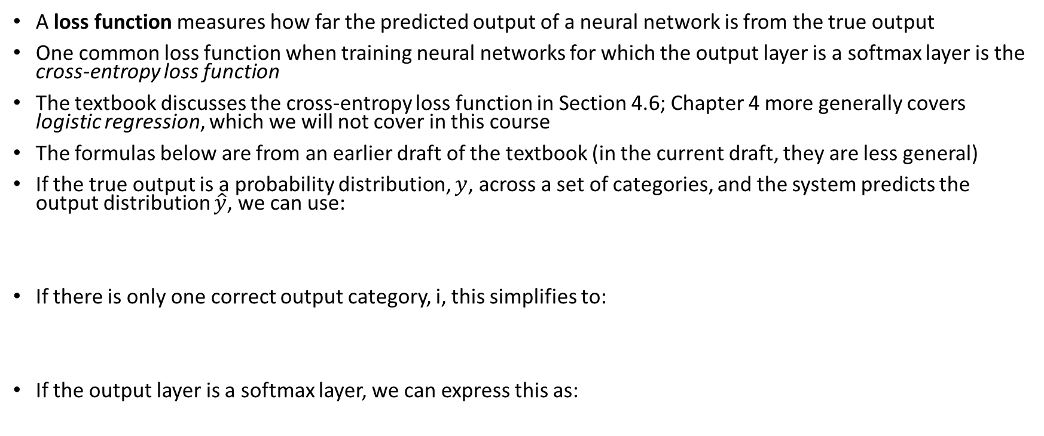
Loss Functions
A loss function measures how far the predicted output of a neural network is from the true output
One common loss function when training neural networks for which the output layer is a softmax layer is the cross-entropy loss function
The textbook discusses the cross-entropy loss function in Section 4.6; Chapter 4 more generally covers logistic regression, which we will not cover in this course
The formulas below are from an earlier draft of the textbook (in the current draft, they are less general)
If the true output is a probability distribution, $y$, across a set of categories, and the system predicts the output distribution $\hat{y}$, we can use:
If there is only one correct output category, i, this simplifies to:
If the output layer is a softmax layer, we can express this as:

Slide 24
Training Neural Networks
Before training a neural network, it is conventional to initialize all the weights to small random values (I'll briefly talk about this in class, but we will not cover it in depth)
In principle, gradient descent could be used to train the weights of a neural network
  In theory, this means that the loss function would be computed based on the entire training set
  Next, the partial derivative of the loss w.r.t. each weight in the network would be computed
  Then, each weight would be pushed in a direction to reduce the loss
In practice, stochastic gradient descent (SGD) is used instead
  One mini-batch is used at a time to estimate the gradient; each mini-batch is a set of training examples
  The size of the mini-batch is a hyperparameter of the neural network; it could be a single training example or some larger set of training examples
  Weights are adjusted for each mini-batch as opposed to the entire training set at once (we'll discuss the procedure for adjusting weights in more detail on the next slide)
It is common to loop through the entire training set multiple times, one mini-batch at a time; each pass through the training set is called an epoch
Modern implementations use vectors and matrix calculations to implement the procedure, making SGD more efficient due to parallelization

Slide 25
Adjusting Weights
Deriving the formulas to update weights going into the output nodes is relatively simple, since each weight affects one output node
Deriving the formulas to update weights into hidden layers is more complicated
The procedure to do this involves backpropagation, a.k.a. error backpropagation or backprop, to compute the partial derivative of the loss function w.r.t. each weight into hidden layers
We will only briefly discuss backpropagation for feedforward neural networks in this course
We will examine backpropagation in greater detail for recurrent neural networks when we cover that topic
Once the gradients for all weights are calculated, they are multiplied by a learning rate that controls the size of the adjustments
Modern neural networks have adaptive learning rates
Overfitting can affect all methods of ML, and it is of particular concern with deep learning due to the large number of adjustable parameters (I will talk a bit more about the concept of overfitting in class)
There are methods of regularization that can help to mitigate overfitting; for example:
  An extra term is often added to the loss function to penalize large weights
  Dropout randomly drops units or weights during training

Slide 26
Computation Graphs
Neural networks can be described using computation graphs
  These are graphical representations of processes for computing mathematical expressions
  A graph representing a forward pass shows how to compute values
  An example graph representing a forward pass for a specific formula (not a neural network) is shown on the next slide
  A graph representing a backward pass shows how to compute partial derivatives of the output with respect to each node
  An example graph representing a backward pass for the same specific formula is shown two slides from now
The computation of the gradients during the backward pass is called backward differentiation
Note that backward differentiation makes repeated use of the chain rule for differentiation
We will also see that neural networks can be represented as computation graphs; those graphs tend to look more complex
Representing neural networks as computation graphs has become more common in recent years (we'll discuss this more soon)

Slide 27
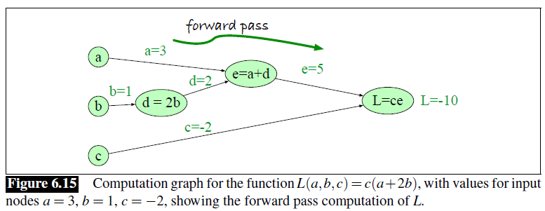
Computation Graph: Forward Pass

Slide 28
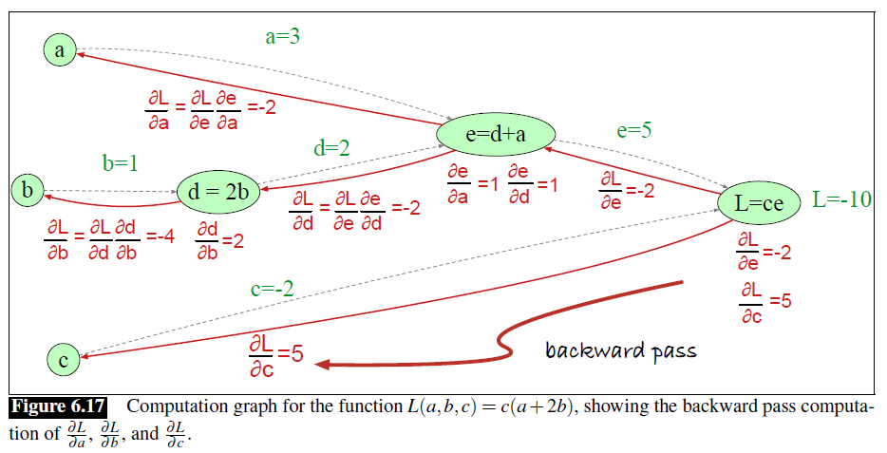
Computation Graph: Backward Pass

Slide 29
Representing NNs as Computation Graphs
The figure on the next slide (Fig. 7.15 in the current draft) shows a simple feedforward neural network represented as a computation graph
The neural network has two input nodes, one hidden layer with two ReLU nodes, and one output sigmoid node
The nodes shown in light blue represent the regular weights and bias weights
These are the adjustable parameters of the neural network that are updated during training
When a computation graph represents a neural network, backpropagation is equivalent to backward differentiation
Some modern deep learning libraries (e.g., TensorFlow and PyTorch) represent neural networks as computation graphs
When you build a neural network out of standard types of layers, and you use a standard loss function, backward differentiation can be applied automatically
You can also define your own types of layers and loss functions; if you specify how derivation works for them, backward differentiation can be applied automatically

Slide 30
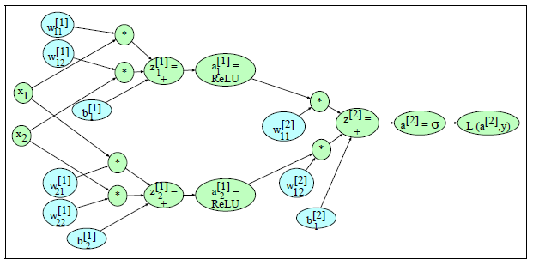
Computation Graph: Neural Network

Slide 31
Neural Networks in NLP (very briefly)
In the pre-deep-learning days of NLP, the most common type of NN used in NLP was a feedforward NN with a single hidden layer
  There was typically an input node for every distinct word in the vocabulary, and the value of the input was typically a word weight
  Therefore, for applications such as text categorization, you could think of the input layer as a TF*IDF document vector
  The number of weights between the input layer and the hidden layer was very large compared to most conventional ML methods used in NLP
  This often led to overfitting (we talked about this concept earlier)
We will see that since the start of the first deep-learning revolution in NLP, word embeddings became popular for use as inputs to neural networks
  We will learn about static word embeddings, such as those produced by word2vec, in our next topic
  For recurrent neural networks, such as LSTMs, it was common to use one word embedding as input at a time
  Transformers, on the other hand, accept embeddings for a fixed-sized span of text at a time
  We will learn about these types of neural network architectures later in the course
  Modern NLP systems rely on contextual word embeddings as opposed to static word embeddings
  Modern NLP systems also typically tokenize into subwords, which are mapped to subword embeddings (e.g., we learned about byte-pair encoding earlier in the course)

