Slide 1
ECE467: Natural Language Processing
Large Language Models (LLMs);
GPT (several variations);
Reinforcement Learning from Human Feedback (RLHF)

Slide 2
If you are following the suggested readings…
We will start this topic with a brief, general discussion about large language models
This subtopic is related to Sections 7.1 – 7.6 of the textbook; Chapter 7 is titled "Large Language Models" (although I am not basing my content on the textbook's chapter)
The majority of this topic will cover the several variations of GPT
Much of the content of my slides is based on the original papers about different versions of GPT; there are links to a few of these papers on the course website
Some of the content is based on other sources (I will strive to reference them when appropriate)
Along the way, we will discuss the called reinforcement learning from human feedback (RLHF); RLHF was an important component of the training for InstructGPT and ChatGPT
Other concepts encountered during this topic will include:
  Few-shot learning (briefly discussed in Section 7.3 of the textbook)
  Chain-of-thought prompting (briefly discussed in Section 10.4 of the textbook)
  Retrieval augmented generation (discussed in Section 11.3 of the textbook)
  Emergent abilities (not mentioned in the textbook)

Slide 3
Large Language Models
As we have learned in previous topics, a language model is a model that assigns a probability to a sequence of text
  Conventionally (before the deep learning revolutions in NLP), N-grams were commonly used for this purpose
  In modern NLP, neural language models dominate
  Traditional language models, including neural language models, work left-to-right (or right-to-left), predicting the next token in a sequence based on previous tokens
  Traditional language models can also be used to generate text one token at a time
  We have learned that BERT, on the other hand, is a masked language model; it predicts tokens given context from both sides
  Language models, in general, are pretrained based on some corpus of unlabeled natural language text using unsupervised machine learning approaches
There is no general agreement as to how big a language model must be in order to be considered a large language model (LLM)
  I have seen some sources claim that GPT-3 was the first LLM; GPT-3 contains about 175 billion parameters
  I have seen other sources list BERT, developed about two years earlier, as an LLM; recall that BERT_{LARGE} contains only 340 million parameters
  Some other sources list the original GPT (a.k.a. GPT-1), which was released a bit earlier than BERT as an LLM; GPT-1 contains approximately 117 million parameters (this was also the approximate size of BERT_{BASE})

Slide 4
Scaling Laws
One interesting observation pointed out in several papers and discussed in Section 8.8 of the textbook is that LLMs seem to obey scaling laws
  This means that performance is predictable to a high degree of accuracy as the number of parameters, the amount of training data, or the amount of computation used for training grows
  Thus, we can improve performance of an LLM in a predictable way by adding more parameters, more training data, or more iterations of training
  However, one thing that the textbook does not make clear is that this is only true for performance as a language model (i.e., for what the system is trained to do)
  Other behaviors of LLMs (i.e., how well they will perform for other tasks) are not predictable as a model grows
  Other abilities may face unpredictable diminishing returns as models grow larger, and some abilities may even get worse
  There are also examples of emergent abilities (a.k.a. emergent behaviors) of large language models; we will discuss a couple of examples later in this topic
  Note that some recent papers have challenged the notion of emergent abilities
We are not going to discuss scaling laws in further detail in this course

Slide 5
GPT-1: Basic Info
GPT, which stands for "generative pre-trained transformer", is a family of systems developed by OpenAI
The original paper that introduced the first version in 2018 was titled "Improving Language Understanding by Generative Pre-Training" by Radford et al.
Note that this paper never actually uses the acronym GPT, nor does it specify the full name of the model; but now, some sources refer to the system described in that paper as GPT-1
Also note that GPT-1 was released before BERT by a few months, and the original BERT paper refers to GPT-1 frequently (calling it OpenAI GPT)
GPT is pretrained as traditional language model, as opposed to BERT, which is trained as a masked language model
Like BERT, GPT is built upon transformers; GPT-1 has about 117 million trainable parameters
Also like BERT, GPT produces contextual embeddings, and it can be fine-tuned for other downstream tasks
In theory, the contextual word embeddings could be fed as input to unrelated architectures, but that is not how GPT-1 was used in the original work
Unlike BERT, GPT is built on a transformer decoder, as opposed to a transformer encoder
We will discuss what this means on the next slide

Slide 6
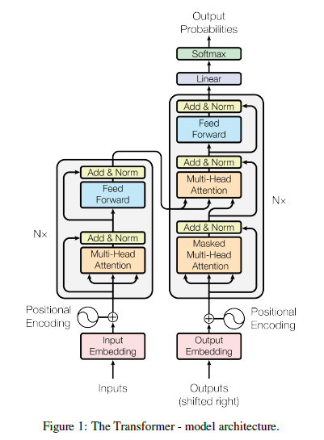
Decoder-Only Architectures
What does it mean to have a decoder-only architecture?
The figure to the right revisits the original transformer architecture from the "Attention is All You Need" paper
We discussed this figure when we covered transformers
One difference between the encoder and the decoder is that the decoder adds a middle sublayer
  This is a cross-attention layer that attends to the output of the encoder
  Clearly, this sublayer cannot exist in a decoder-only architecture (and it does not exist in GPT)
Another difference between the encoder and the decoder is that the self-attention layer in the decoder is masked
  GPT uses this sort of masked multi-head self-attention
  Thus, during pretraining, the model does not look to the right
  We will discuss the GPT-1 architecture in more detail on the following slide

Slide 7
GPT-1 Architecture and Pretraining Procedure
The GPT-1 model consists of a "12-layer decoder-only transformer with masked self-attention heads"
12 attention heads were used in the original paper
The self-attention layer is followed by a position-wise feed-forward sublayer, as explained in the original transformer paper
Other design decisions (learning rate, vector sizes, etc.) are explained in the GPT-1 paper
The model was pretrained using the BookCorpus (also mentioned during our topic in BERT)
The pretraining objecting was standard language modeling (i.e., it was trained to predict the next token, given all previous tokens)
For tokenization, byte-pair encoding (BPE) was used with an approximate vocabulary of size of 40,000
They pretrained "for 100 epochs on minibatches of 64 randomly sampled, contiguous sequences of 512 tokens"

Slide 8
GPT-1 Fine-tuning
As with BERT, the GPT-1 research used fine-tuning to apply the system to various downstream tasks
As we discussed during our topic on BERT, this is an example of transfer learning
The figure on the next slide (from the original GPT-1 paper) helps to explain how this works
  The left of the figure shows the GPT-1 model, which was pretrained as a traditional language model, as previously explained
  The architecture is slightly modified at the top, after pretraining, for various types of NLP tasks, which are cast as classification tasks
  The right side of the figure helps explain how the input is structured, and the architecture is slightly modified, for different types of downstream tasks
  We will discuss each type of task in more detail soon (in two slides)
  One interesting fact is that for all fine-tuning tasks, the fine-tuning includes language modeling (text prediction) as an auxiliary fine-tuning objective
  The paper claims that this improves generalization and accelerates convergence

Slide 9
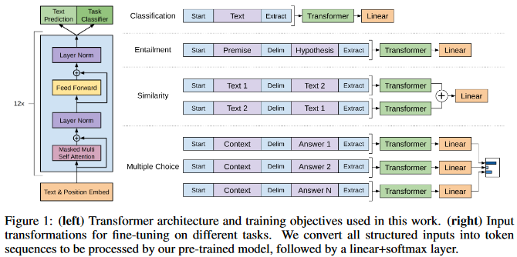
GPT-1 Architecture for Fine-Tuning

Slide 10
GPT-1 Downstream Tasks
The original paper reported evaluation GPT-1 on four types of tasks:
  Straightforward classification tasks
    The input is the text that needs to be classified
    The output of the transformer goes through a linear layer and a softmax (softmax is not shown in the figure)
  Entailment tasks
    The input included bot sentences or sequences being compared, with a delimiter in between
    The output of the transformer goes through a linear layer and a softmax
  Similarity tasks
    The researchers fed the two sequences being compared in both possible orders, with a delimiter in between
    The outputs were added elementwise before being sent through a linear layer
  Multiple choice tasks
    They include question answering in this category, where the possible answers are the choices, and they concatenate the document and question to form a context
    They feed the context followed by each possible answer, with a delimiter in between, separately through the transformer and a linear block, then apply a softmax to choose the best answer
For all tasks, the input starts and ends with special tokens, and the final hidden state of transformer (corresponding to the last input token) is passed to the linear layer

Slide 11
GPT-2 (briefly)
GPT-2 was introduced in a 2019 paper titled, "Language Models are Unsupervised Multitask Learners" by Radford et al. (all authors were from OpenAI)
The paper evaluated four model sizes of GPT; the largest was named GPT-2
GPT-2 included 48 layers and vectors of size 1600, leading to about 1.5 billion parameters
GPT-2 was trained as a traditional language model using an OpenAI dataset known as WebText, created by scraping about 45 million links
According to the GPT-2 paper, "after de-duplication and some heuristic based cleaning", the dataset "contains slightly over 8 million documents for a total of 40 GB of text"
The focus of the paper is on zero-shot performance, which means that GPT-2 was applied to various tasks without any fine-tuning (I'll discuss this more in class)
The zero-shot performance of GPT-2 was compared to zero-shot performance of other LLMs, and GPT-2 performed the best (in the zero-shot setting) for most tasks
In the appendix of the GPT-2 paper, they showed various samples of completions of random text from the WebText test set (not samples it was trained on)
These examples, showcasing the ability of GPT-2 to perform autoregressive generation of text, seemed very impressive at the time, and this even garnered considerable attention outside of the NLP community

Slide 12
GPT-3: Basic info
GPT-3 was introduced in a 2020 paper titled, "Language Models are Few-Shot Learners" by Brown et al.
  All authors were from OpenAI; one also listed an affiliation with John Hopkins University
  The paper was relatively long; 75 pages including the bibliography and many appendixes, with almost 40 pages of text before the appendixes
As with the GPT-paper, this paper evaluated several model sizes; the largest was named GPT-3
  The table on the next slide (from the original GPT-3 paper) shows pertinent information about the various model sizes evaluated in the paper
  The largest model (the one named "GPT-3") contains about 175 billion parameters (trainable weights)!
  Apart from the size, the basic architecture of GPT-3 was mostly the mostly same as the previous versions of GPT (the GPT-3 paper points out a few minor changes to the architecture)
This work also used a larger training corpus than the previous GPT papers
  The table in two slides shows the components of the corpus used to pretrain GPT as a traditional language model (which was the only training done – there was no fine-tuning)
  The dataset included English Wikipedia, two online book corpora, an expanded version of WebText (the dataset used for GPT-2), and a filtered version of a dataset known as Common Crawl
  Common Crawl is a corpus of data collected by a non-profit organization (also called Common Crawl); this corpus was originally created in 2008, and it is frequently updated

Slide 13
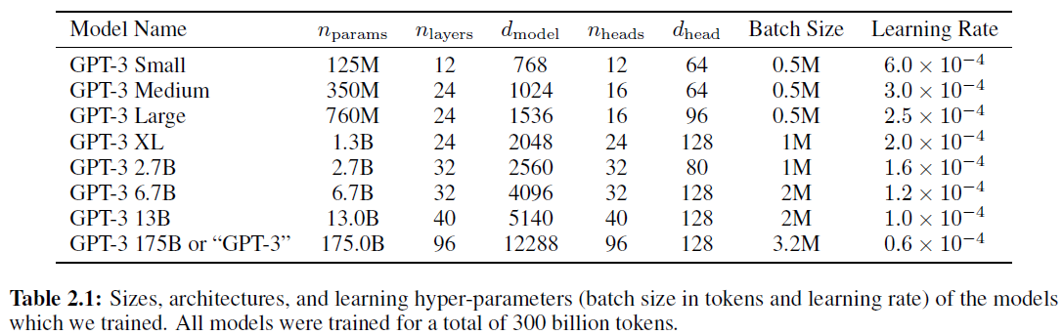
GPT-3 Model Sizes (from original paper)

Slide 14
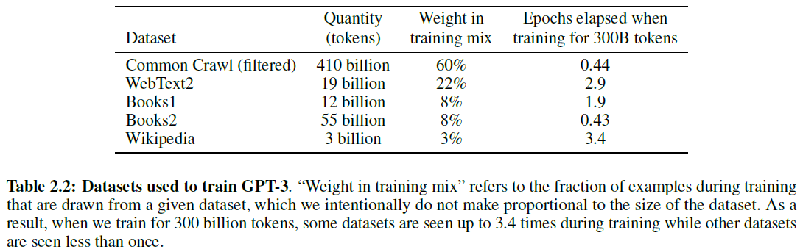
GPT-3 Training Dataset (from original paper)

Slide 15
GPT-3 Few-shot Learning
The few-shot learning concept, mentioned in the slide title, does not involve fine-tuning
Rather, a prompt given to GPT-3 (i.e., the text that it continues) shows examples of a pattern representing the type of task to solve
Basically, this method treats all tasks as autoregressive generation tasks, using clever prompts
From the abstract: "For all tasks, GPT-3 is applied without any gradient updates or fine-tuning, with tasks and few-shot demonstrations specified purely via text interaction with the model."
The figure on the next slide (from the original GPT-3 paper with the caption removed) helps explain the difference between few-shot learning vs. other forms of learning
  Zero-shot learning (the form primarily explored for GPT-2) simply prompts the system to perform a task
  One-shot learning adds a single example to the prompt, whereas few-shot learning adds a few examples (the caption states that they "typically present the model with a few dozen examples in the few shot setting")
  Fine-tuning is also shown, but was not explored with GPT-3 in this paper
GPT-3 was evaluated for many tasks, achieving impressive performance for several
  From the abstract: "…scaling up language models greatly improves task-agnostic, few-shot performance, sometimes even reaching competitiveness with prior state-of-the-art finetuning approaches"
  They even tested arithmetic; the figure two slides from now shows how model size affects performance

Slide 16
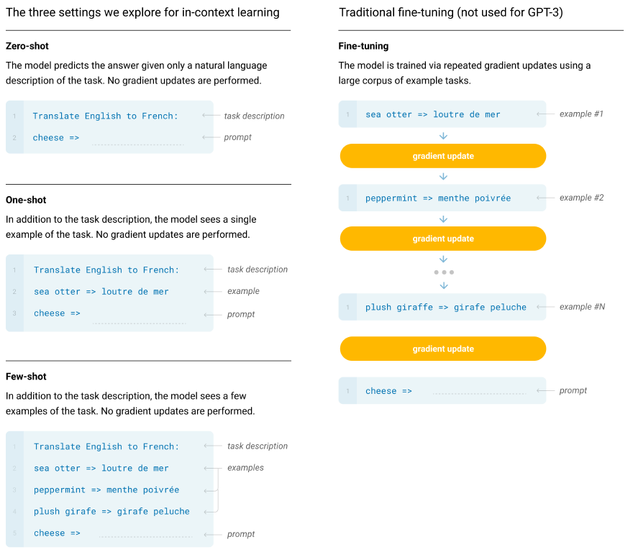
GPT-3 Few-Shot

Slide 17
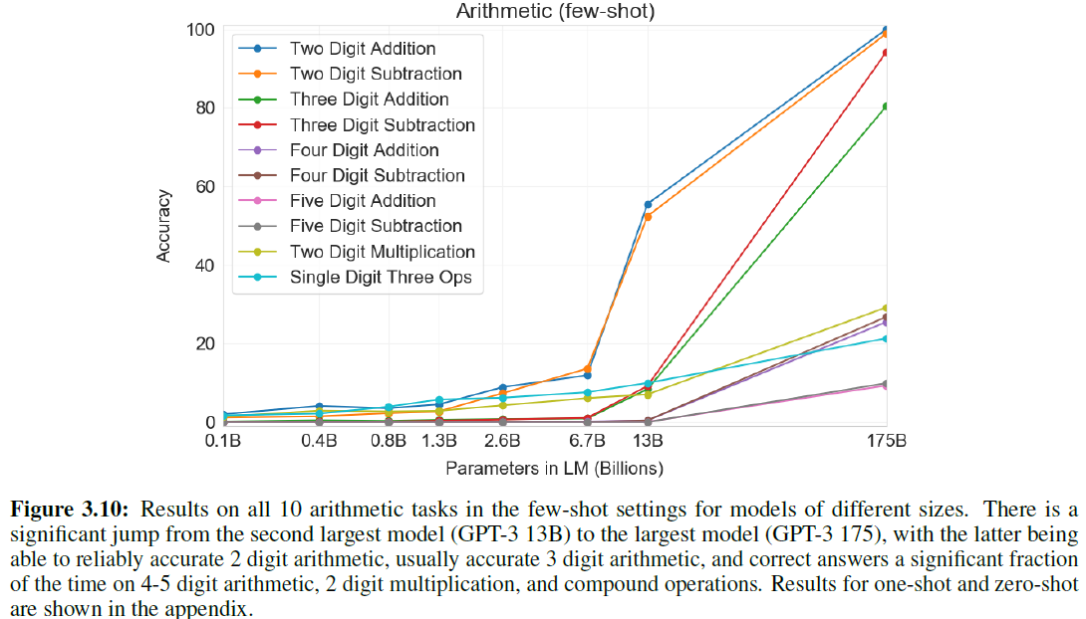
GPT-3 Arithmetic Performance

Slide 18
InstructGPT
InstructGPT, one variation of GPT-3.5, is described in the 2022 paper "Training language models to follow instructions with human feedback" by Ouyang et al.
InstructGPT is a modified version of GPT-3 that was fine-tuned to do a better job following instructions
This involved a three-step process (the figure on the next slide, from the original paper, helps to explain it):
  First, they fine-tuned the system using supervised ML, using a dataset collected from human volunteers, consisting of prompts and responses
  Next, they train a reward model using supervised ML to predict how good a response is, also based on a training set consisting of actual responses and human rankings
  Third, they use the reward model, and reinforcement learning (RL), to continue fine-tuning the system; the specific form of RL they use is called proximal policy optimization (PPO)
All together, the procedure above is known as reinforcement learning from human feedback (RLHF)
They trained three separate sizes of the model, ranging in size from 1.3 billion to 175 billion parameters (the same size as GPT-3)
Based on additional evaluation with human volunteers, the authors conclude that "labelers significantly prefer InstructGPT outputs over outputs from GPT-3"
Evan the smallest InstructGPT model produced output in response to instructions that was usually preferred to the output of GPT-3, even though the number of parameters was smaller by a factor of over 100

Slide 19
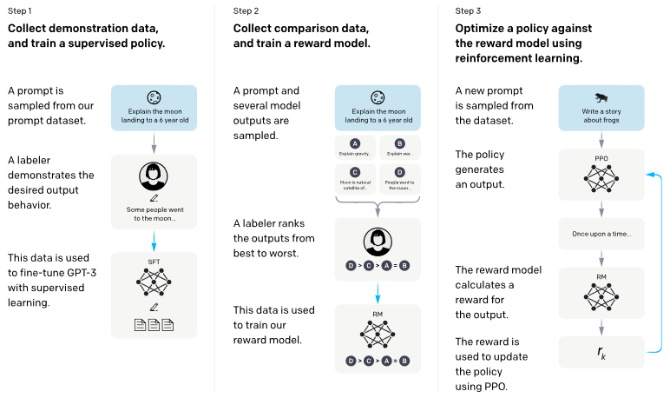
RLHF Steps (from original paper)

Slide 20
ChatGPT (briefly)
ChatGPT was released to the public in late 2022; like Instruct-GPT, the first version was a variation of GPT-3.5
As virtually everyone is aware, ChatGPT because hugely popular extremely fast
OpenAI did not release a technical paper about ChatGPT, like they did with previous versions of GPT
However, they did post some information about it on a website, available here: https://openai.com/index/chatgpt/
  The website calls ChatGPT a "sibling model to InstructGPT"
  They explain: "We trained this model using Reinforcement Learning from Human Feedback (RLHF), using the same methods as InstructGPT, but with slight differences in the data collection setup."
  They further explain, "human AI trainers provided conversations in which they played both sides"
  For the later steps, this data is combined with InstructGPT data converted to dialogue format
  To train the reward model, they had the AI trainers rank model-written responses to excerpts from the conversations trainers had with the chatbot
  The website includes the same figure that we discussed on the previous slide

Slide 21
GPT-4 and later (briefly)
OpenAI released a paper about GPT-4 titled "GPT-4 Technical Report" in March 2024
  I have not read this paper yet (including appendices, it contains 100 pages), but based on initial skimming, the paper focuses on the abilities, limitations, and safety properties (related to ethics) of GPT-4
  The last appendix is a system card, which is itself is 60 pages and has sub-appendices
  Notably, the paper does not discuss the architecture details of GPT-4
  Based on other sources, OpenAI has never officially released the size of GPT-4, but the system is rumored to have over one trillion parameters!
Based on experimentation and some initial reading, features that were introduced to GPT-4 include:
  It can browse the web
  It can interact with certain other tools
  It can write and execute code
  It can process uploaded documents
  It can create certain types of documents
  It can store important facts learned from a conversation in memory
GPT-5 was released in August 2025
  I have not read about GPT-5 yet, but OpenAI has released a system card about it
  There is also an OpenAI website about GPT-5 (describing the features, abilities, and performance attributes, not a description of the model) here: https://openai.com/index/introducing-gpt-5
  ChatGPT (free and paid versions) now use GPT-5, with paid users getting various advantages

Slide 22
Chain-of-Thought Prompting
Chain-of-thought prompting (CoT prompting) is a method to elicit better reasoning for certain types of tasks from an LLM
This has been documented in several papers, including the 2023 paper "Large Language Models are Zero-Shot Reasoners" by Kojima et al.
  There are several datasets to test a model's performance on word problems involving multiple logical or arithmetic steps, requiring common sense (e.g., CommonSenseQA)
  When fed the question as a prompt, ending with a phrase such as "The answer is", asking an LLM to continue the text, LLMs as discussed so far typically don't perform well on such tasks
  It turns out that by including a sentence such as "Let's think step by step" to the end of the prompt, instead of requesting the answer directly, the performance improves significantly
  Additionally, this generally causes the LLM to provide an explanation for the answer that is helpful for the user
  CoT prompting can also be used to improve the performance of few-shot learning
  The figure on the next slide (from the paper) shows an example of how CoT prompting leads to better answers (for both zero-shot and few-shot performance) for a particular question
  The examples in the figure used GPT-3, but the paper tested the technique with several LLMs

Slide 23
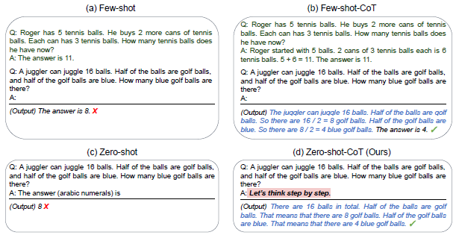
CoT Prompting Example (from paper)

Slide 24
DeepSeek
When DeepSeek released their DeepSeek-R1 system in early 2025, it quickly became a popular, open-source alternative to ChatGPT
  To train the DeepSeek-R1 model, the developers applied additional steps of training to their DeepSeek-V3 model to improve its performance on reasoning tasks
  The DeepSeek-R1 model automatically applies chain-of-thought reasoning (without being prompted to do so), and it displays its steps (that some refer to as its "thoughts") to the user
  The DeepSeek app lets you toggle between the two DeepSeek systems using the DeepThink button
DeepSeek released several papers about their models; I've read the following two:
  "DeepSeek-V3 Technical Report" by Liu et al., released in December 2024; the figure on the next slide (from this paper) shows the DeepSeek-V3 architecture
  "DeepSeek-R1: Incentivizing Reasoning Capability in LLMs via Reinforcement Learning", by Guo et al., released in January 2025
The media highly emphasized that the DeepSeek systems were trained at a fraction of the computational cost (and monetary cost) of training ChatGPT; there were a few reasons for this, including:
  Low-precision training (parts of the model use lower-precision floating-point values for efficiency)
  Multi-head latent attention (this involves mapping embeddings to a lower-dimensional space before applying self-attention)
  DeepSeek models use a mixture-of-experts architecture (we'll talk a bit more about this in two slides)
The DeepSeek-R1 paper also explores distillation of the system to smaller models (I'll briefly discuss this concept in class, but we won't cover it)

Slide 25
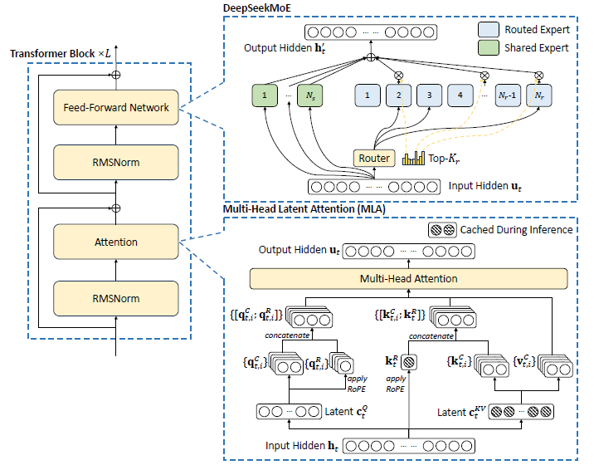
DeepSeek-V3 Architecture

Slide 26
Mixture-of-Experts (briefly)
The idea behind a mixture-of-experts (MoE) neural architecture is to have small components of the system handle different sorts of tasks
The top part of the previous slide shows that DeepSeek-V3 used a combination of shared experts and routed experts
  The shared experts are used for all tasks
  A router selects which of the routed experts to use for each token of the input
  Note that all components are composed of ordinary neural network nodes; all of it is learned based on a training set
According to the DeepSeek-V3 technical report, the model contains about 671 billion parameters, but only about 37 billion are activated for each token
Note that during training, the loss only must be backpropagated through the weights that were used for the current decision
Rumor has it that GPT-4 (and later version) also use an MoE architecture

Slide 27
Retrieval Augmented Generation (RAG)
Recall that we previously covered how some neural systems handle question answering (QA) during a previous topic
  Questions were related to a specific passage of text, and the QA system would attempt to select a span of text in the passage that answers the question; this particular type of QA is sometimes called reading comprehension
  SQuAD was a popular dataset used to evaluate systems implementing this approach to QA
Of course, it is possible to prompt a modern LLM with a question and expect it to generate a reasonable answer in response; however, there are issues with this approach
  It is also possible that LLMs can hallucinate, so users should not accept answers as truth without proper checking (this issue will not be solved by the method we are about to discuss)
  Another issue is that once the training of a particular version of an LLM is complete, its knowledge does not get updated
One modern methodology of tackling general QA in NLP is called retrieval-augmented generation (RAG)
The figure on the next slide (from the textbook) helps to explain the architecture for such an approach
  The question is used to generate a query, which is used to retrieve potentially relevant passages (this is similar to the first stage of pre-neural, conventional QA systems)
  The retrieved passages become part of a prompt to an LLM that asks the LLM to answer the question based on the passages
The figure in two slides (also from the textbook) shows how such a RAG prompt for a particular question might be formatted
As of some time in 2025, ChatGPT uses RAG by default for certain questions

Slide 28
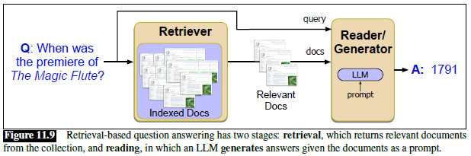
RAG Architecture

Slide 29
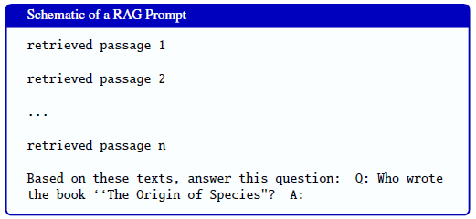
RAG Prompt Example

Slide 30
Emergent Abilities
Emergent abilities (a.k.a. emergent behaviors) of LLMs are abilities that the models only gain after they become large enough
  These are sometimes discovered after an LLM is released, sometimes by users as opposed to the developers
  Often, they are unexpected (i.e., they were not predicted ahead of time by the developers)
Few-shot learning and chain-of-thought prompting are both examples of emergent abilities
Some studies have found that these emergent abilities are not present at all when researchers investigate them using smaller models of the systems that displayed the abilities
That is, as various model sizes are tested, the ability seems to not be present at all until the model reaches a certain size; then suddenly it appears at a strong level
Some recent papers have challenged this notion; one example is the 2023 paper "Are Emergent Abilities of Large Language Models a Mirage?" by Schaeffer et al.
This paper concludes that emergent abilities appear due to the discontinuous metrics used to measure performance
Assuming emergent abilities do appear suddenly when a model reaches a certain size, this leaves researchers wondering what additional abilities might appear as models continue to grow

