Slide 1
ECE467: Natural Language Processing
Sequence-to-Sequence Tasks and
Encoder-Decoder Models;
Machine Translation; Cross-Attention

Slide 2
Review of RNNs
In our last topic, we saw how recurrent neural networks (RNNs) could be applied to sequence labelling or text categorization
For sequence labelling, every word or token gets a label; examples include POS tagging and named entity recognition (NER)
For text categorization, a sequence of text receives one label; our textbook refers to this as sequence classification when RNNs are used
In practice, variations or RNNs such as long short-term memory (LSTM) networks are used
Such variations of RNNs help to mitigate (but not completely eliminate) the vanishing gradient problem
Any of these variations can be bidirectional and/or stacked

Slide 3
Recall: RNN Equations
The equations describing what happens at each time step in a simple RNN used for sequence labelling are:
  h_{t} = g(Uh_{t-1} + Wx_{t})
  y_{t} = f(Vh_{t})
The function, g, is an activation function used at the hidden layer (e.g., tanh, sigmoid, or ReLU, although ReLU is not common in RNNs)
Often, the output layer will be a softmax layer
Generalizing for variations of RNNs (some of which use more complex structures within gated cells), we can instead write:
  h_{t} = g(h_{t-1}, x_{t})
  y_{t} = f(h_{t})
Technically speaking, for an LSTM, there should be two outputs and an extra input for each cell

Slide 4
Mapping Sequences to Sequences
Many NLP tasks involve mapping a sequence of text to another sequence of text; these are sometimes called sequence-to-sequence tasks
Examples include machine translation (MT), summarization, and (in some sense) question-answering (QA)
We will cover encoder-decoder models, also known as sequence-to-sequence (seq2seq) models, that are capable of this
The first part of this topic is based on Section 13.7, titled "The Encoder-Decoder Model with RNNs"
The middle part of this topic is partly based on Sections 12.1-12.4 and Section 12.6; Chapter 12 in general is titled "Machine Translation"
In this topic, we are leaving out some of the content from the cited sections of Chapter 12
  This is partly because in recent drafts, Chapter 12 (the chapter on MT) has been updated to deal with transformers, which we will cover later in the course, including how they can be used for MT
  For this topic, we are going to discuss RNN-based encoder-decoder architectures, including for MT (Section 13.7 of the current draft briefly covers RNN-based encoder-decoder architectures for MT)
  We are leaving out the chapter's discussions of divergences between languages (at the word and sentence levels) and approaches for tokenization because we already covered those topics earlier in the course
The last part of this topic is related to Section 13.8, titled "Attention"; the type of attention we will learn about in this topic is sometimes called cross-attention (some sources leave out the hyphen)

Slide 5
General Encoder-Decoder Network
The next slide depicts a general encoder-decoder network
Note that this diagram is not specific to machine translation or any particular task
The encoder "accepts an input sequence, x_{1:n}, and generates a corresponding sequence of contextualized representations, h_{1:n}"
  Encoders can use stacked Bi-LSTMs, GRUs (I no longer cover these), CNNs, or transformers, but for the sake of discussion, we will focus on stacked Bi-LSTMs
  The hidden states from the both directions of the top Bi-LSTM can be concatenated, or combined in some other way, to form the contextualized representations
The context vector, c, "is a function of h_{1:n}, and conveys the essence of the input to the decoder" (if the encoder is stacked, these are the hidden states at the top layer)
The decoder "accepts c as input and generates an arbitrary length sequence of hidden states h_{1:m}, from which a corresponding sequence of output states y_{1:m}, can be obtained"
We will discuss the decoder in more detail shortly

Slide 6
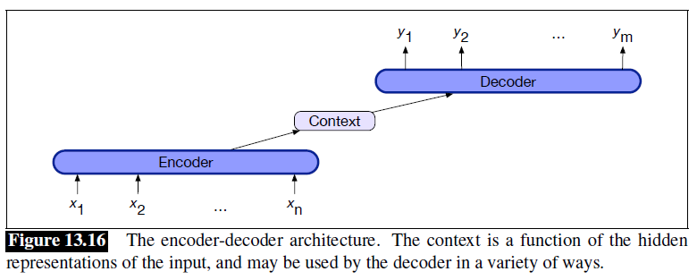
Basic Encoder-Decoder Network

Slide 7
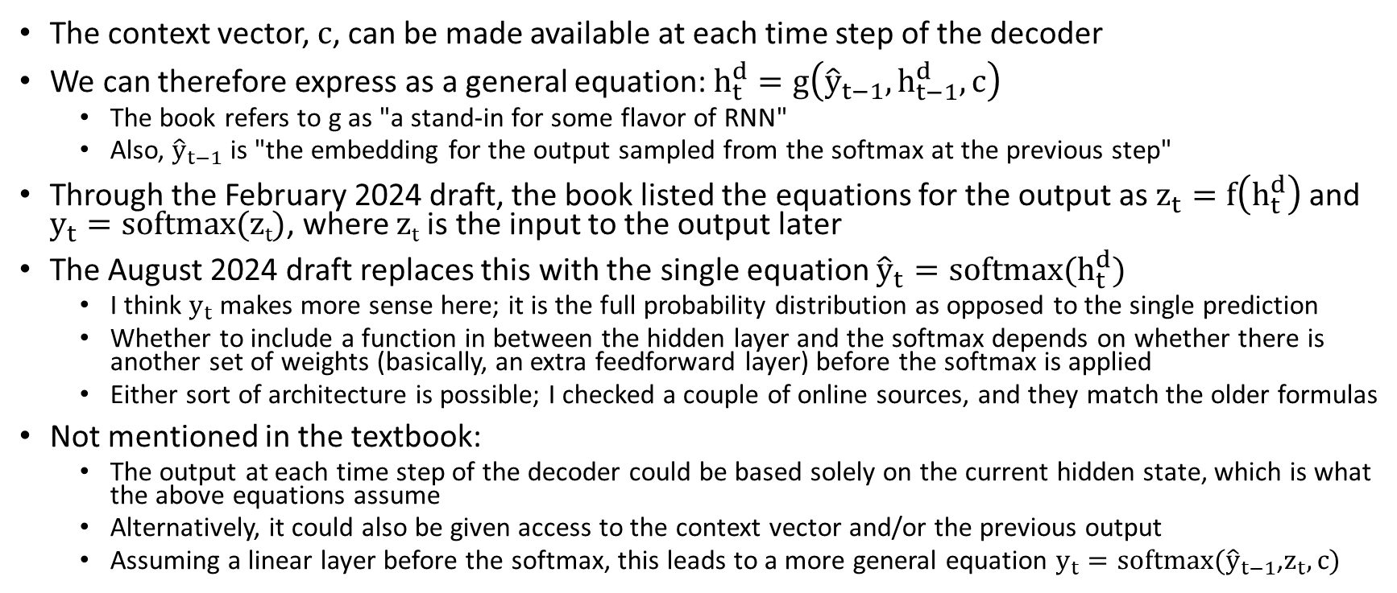
Decoder Functionality
The context vector, c, can be made available at each time step of the decoder
We can therefore express as a general equation: $h_{t}^{d}=g\left({\hat{y}}_{t−1},h_{t−1}^{d},c\right)$
  The book refers to g as "a stand-in for some flavor of RNN"
  Also, ${\hat{y}}_{t−1}$ is "the embedding for the output sampled from the softmax at the previous step"
Through the February 2024 draft, the book listed the equations for the output as $z_{t}=f\left(h_{t}^{d}\right)$ and $y_{t}=softmax(\text{z}\text{t})$, where z_{t} is the input to the output later
The August 2024 draft replaces this with the single equation ${\hat{y}}_{t}=softmax(h_{t}^{d})$
  I think $y_{t}$ makes more sense here; it is the full probability distribution as opposed to the single prediction
  Whether to include a function in between the hidden layer and the softmax depends on whether there is another set of weights (basically, an extra feedforward layer) before the softmax is applied
  Either sort of architecture is possible; I checked a couple of online sources, and they match the older formulas
Not mentioned in the textbook:
  The output at each time step of the decoder could be based solely on the current hidden state, which is what the above equations assume
  Alternatively, it could also be given access to the context vector and/or the previous output
  Assuming a linear layer before the softmax, this leads to a more general equation $y_{t}=softmax({\hat{y}}_{t−1}$,$z_{t},c)$

Slide 8
Machine Translation
The textbook defines machine translation (MT) as "the use of computers to translate from one language to another"
  Sometimes, MT by a computer is called automatic machine translation
  Of course, we are talking about natural languages here, not formal languages
The earliest, pre-statistical MT approaches used manually constructed algorithms
  Various conceptual approaches to this were summarized by the Vauquois triangle in 1968 (see the figure on the next slide, from the previous edition of the textbook)
  Note that the higher-level approaches were never actually implemented
Even before the success of deep learning in NLP, most efforts in automatic MT involved statistical MT
  Statistical MT is MT that is based on machine learning; such approaches are trained on a training set (we'll discuss training sets for MT shortly)
  I used to spend an entire topic on conventional, statistical machine translation, which generally used Bayesian approaches, but we no longer cover this
  Up until a couple of years ago, I still took a brief excursion to discuss conventional, statistical MT during this topic; I have dropped that as well (but I may say a bit about it in class)
When neural networks are used for machine translation, this is often referred to in other sources as neural machine translation (NMT)

Slide 9
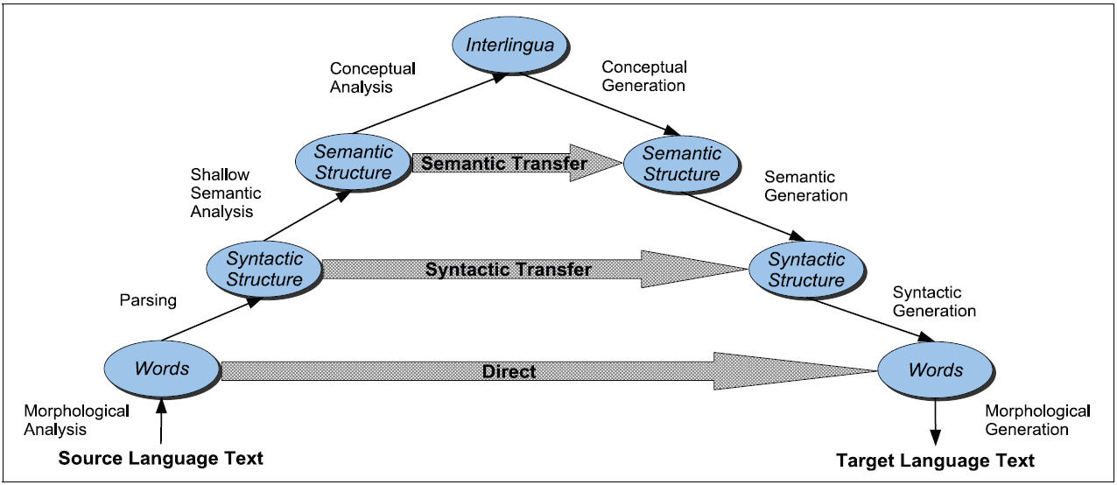
The Vauquois Triangle (from earlier edition)

Slide 10
Some Reasons that MT is Difficult
Some reasons that automatic MT is difficult include:
  A single word in the source language can have many possible translations in the target language, and sometimes the differences are subtle
  Different words in the source language can have the same translation in the target language
  Morphological rules differ between languages
  In general, good translations do not always involve one-to-one mappings of words; sometimes one-to-many, many-to-one, or many-to-many mappings are necessary
  The rules of grammar differ from one language to the next, and word order will likely need to change
  Some syntactic notions (e.g., forms of agreement, politeness levels, etc.) exist in some languages but not others
  Figures of speech differ from one language to another
  Pronoun resolution (and reference resolution in general), as well as other types of disambiguation, often comes into play; some languages leave out pronouns altogether
  Some languages may lack words or short phrases for certain concepts that exist as single words in other languages; this is called lexical gap
  Some languages have particular oddities (e.g., the existential "there" in English)
NLP practitioners have been working on this task for a long time, and in my opinion, the results only started to seem adequate over the past few years

Slide 11
Training Data for MT
Statistical machine translation (neural or pre-neural) relies on a training set in the form of a parallel corpus
A parallel corpus is also known as a multilingual corpus, parallel text, or a bitext
Such a corpus contains text in (at least) two different languages
Additionally, sentences have been aligned (either manually or in some automated fashion)
The original language for an MT task is typically referred to as the source language
The desired language (that the source language is translated to) is typically referred to as the target language
To use a parallel corpus to train an NMT model, the source and target sentences are used together
Typically, NMT models are trained using one sentence pair at a time
The book specifies that an end-of-sentence marker is appended to the end of the source sentence (in the current draft, they call it a sentence separation marker)
Really, end-of-sentence markers are generally added to both sentences
The target sentence end-of-sentence is never fed as input to the NMT model, but it is known to be the desired prediction after the last word

Slide 12
Neural Machine Translation
As mentioned earlier, when neural networks are used for MT, this is often referred to as neural machine translation (NMT)
The figure on the next slide, repeated from earlier in the topic, shows a general encoder-decoder network (not specific to MT)
Over the next few slides, we will discuss how such an architecture can be applied to MT

Slide 13
Basic Encoder-Decoder Network Revisited

Slide 14
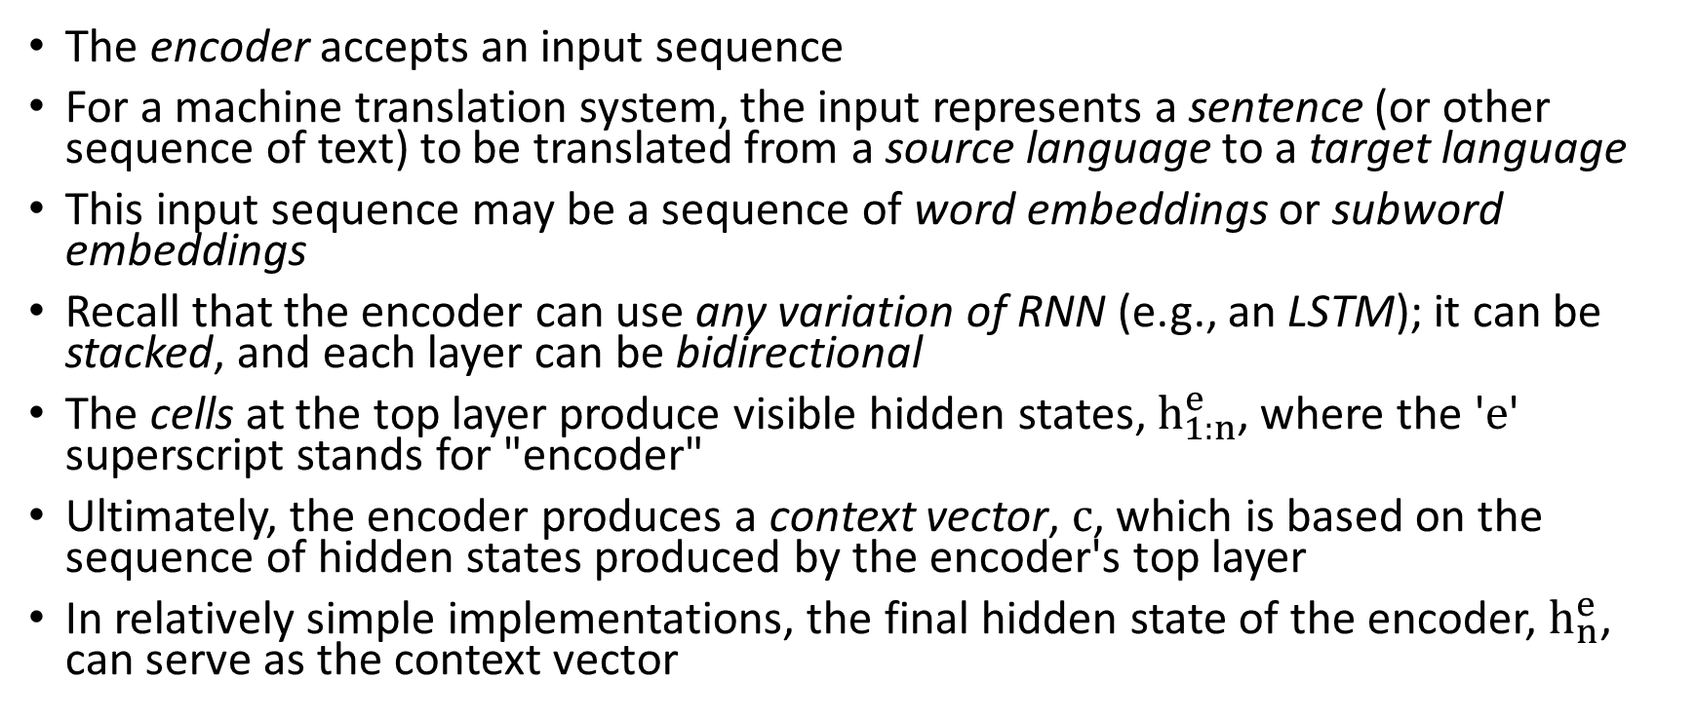
Encoder Applied to MT
The encoder accepts an input sequence
For a machine translation system, the input represents a sentence (or other sequence of text) to be translated from a source language to a target language
This input sequence may be a sequence of word embeddings or subword embeddings
Recall that the encoder can use any variation of RNN (e.g., an LSTM); it can be stacked, and each layer can be bidirectional
The cells at the top layer produce visible hidden states, $h_{1:n}^{e}$, where the 'e' superscript stands for "encoder"
Ultimately, the encoder produces a context vector, c, which is based on the sequence of hidden states produced by the encoder's top layer
In relatively simple implementations, the final hidden state of the encoder, $h_{n}^{e}$, can serve as the context vector

Slide 15
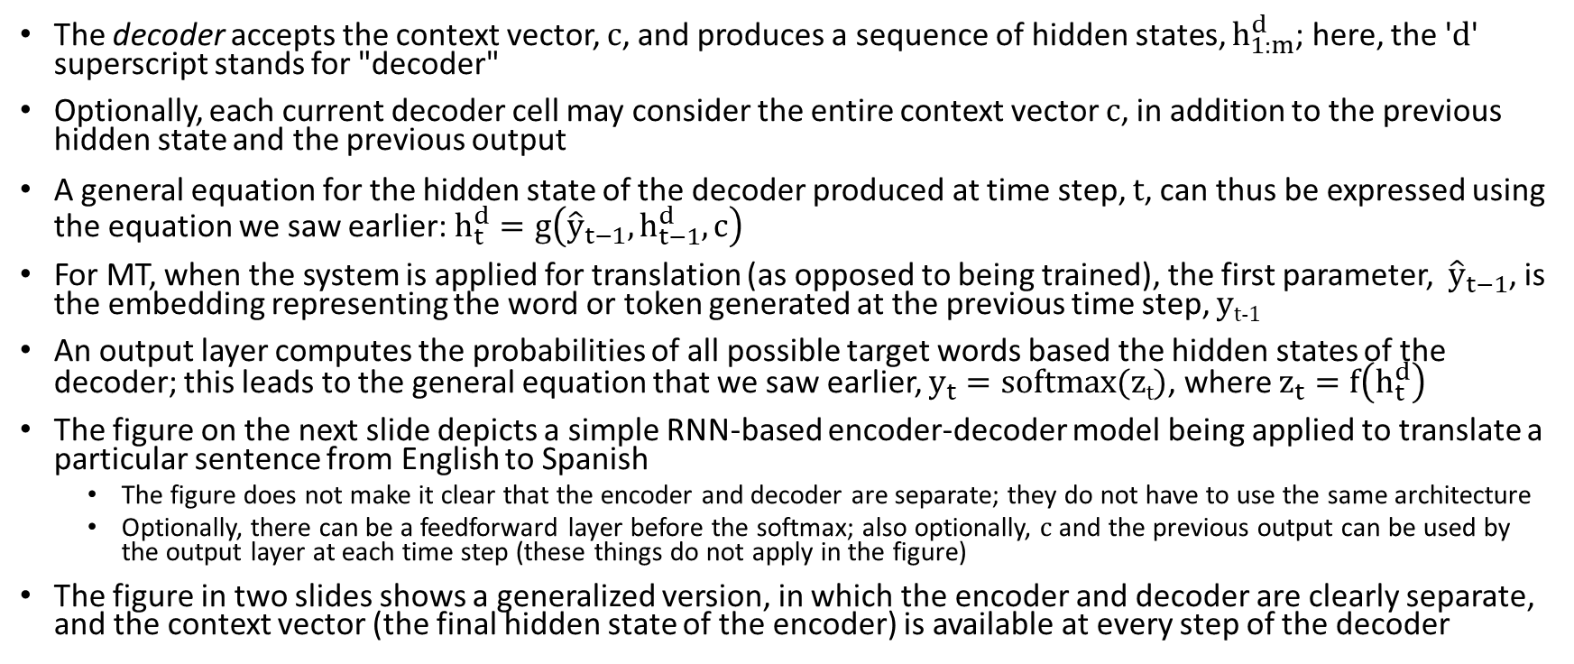
Decoder Applied to MT
The decoder accepts the context vector, c, and produces a sequence of hidden states, $h_{1:m}^{d}$; here, the 'd' superscript stands for "decoder"
Optionally, each current decoder cell may consider the entire context vector c, in addition to the previous hidden state and the previous output
A general equation for the hidden state of the decoder produced at time step, t, can thus be expressed using the equation we saw earlier: $h_{t}^{d}=g\left({\hat{y}}_{t−1},h_{t−1}^{d},c\right)$
For MT, when the system is applied for translation (as opposed to being trained), the first parameter, ${\hat{y}}_{t−1}$, is the embedding representing the word or token generated at the previous time step, y_{t-1}
An output layer computes the probabilities of all possible target words based the hidden states of the decoder; this leads to the general equation that we saw earlier, $y_{t}=softmax(\text{z}\text{t})$, where $z_{t}=f\left(h_{t}^{d}\right)$
The figure on the next slide depicts a simple RNN-based encoder-decoder model being applied to translate a particular sentence from English to Spanish
  The figure does not make it clear that the encoder and decoder are separate; they do not have to use the same architecture
  Optionally, there can be a feedforward layer before the softmax; also optionally, c and the previous output can be used by the output layer at each time step (these things do not apply in the figure)
The figure in two slides shows a generalized version, in which the encoder and decoder are clearly separate, and the context vector (the final hidden state of the encoder) is available at every step of the decoder

Slide 16
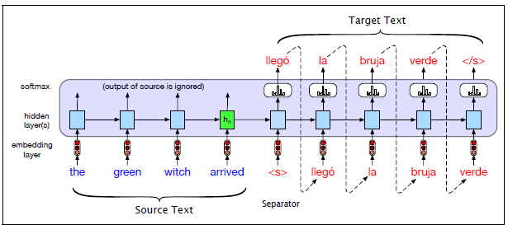
RNN-Based Encoder-Decoder for MT Example

Slide 17
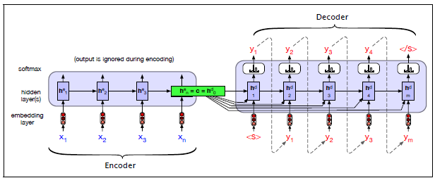
Generalized Encoder-Decoder for MT

Slide 18
Training an Encoder-Decoder for MT
As previously mentioned, to train an NMT system, we use sentence-pairs from a parallel corpus, a.k.a. a parallel text or a bitext
The source sentence, ending in an end-of-sentence marker is applied to the encoder
During training, regardless of what word the decoder predicts, the actual next word from the target sentence is typically fed to the decoder at the next time step; this is called teacher forcing
The end-of-sentence marker is never fed to the decoder as input, but it is the expected token after the last word in the target sentence
When the decoder is applied, the loss at each time step is based on the probability assigned to the true next word (if we are using the cross-entropy loss function)
Typically, the loss is averaged across all output words, and then the loss is backpropagated to update the decoder and encoder parameters
The entire encoder-decoder network can be trained end-to-end using stochastic gradient descent and backpropagation
The figure on the next slide depicts an example of a relatively simple RNN-based encoder-decoder network being trained for MT based on a single sentence-pair

Slide 19
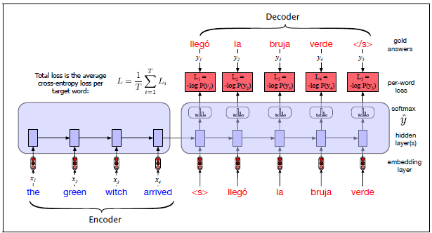
Training an Encoder-Decoder for MT Example

Slide 20
Problem with Choosing Words As We Go
We have been assuming that the decoder applies an argmax to the output of softmax to determine the most likely word at each time step
This would be an example of greedy decoding
This is not optimal to produce the best overall sentence
Book (earlier draft): "The problem is that the token that looks good to the decoder now might turn out later to have been the wrong choice"
For sequence labelling tasks, we can use algorithms such as the Viterbi algorithm to optimize tags for the entire sentence
  I used to cover the Viterbi algorithm along with hidden Markov models (HMMs) for sequence labeling, but that has been dropped from the course
  The current draft of the book explains that the Viterbi algorithm doesn't work for generation tasks involving long-distance dependencies
  Related to this, I would add that the Markov assumption doesn't hold
  Casually speaking, the Markov assumption states that the probability of a word or token only depends on the previous word or token (or the previous few words or tokens)
  This assumption is inherent to the Viterbi algorithm

Slide 21
Beam Search
One common method to improve translations (or the output of other sequence-to-sequence tasks) is to use beam search during the decoding
Beam search views the task of the decoder as a search through the state space of possible output sequences (translations, in the case of MT), but we must avoid an exponential search
At each step of decoding, beam search keeps track of the k best choices; k is the beam width or beam size
For MT, at the first step, it keeps track of the k most likely first words or tokens of the predicted translation
Using general search terminology, the k states currently comprising the beam represent the frontier of the search; the partial paths leading to these k states can be called hypotheses
Each of the k hypotheses leading to states on the frontier is fed to a distinct decoder; that is, for each of the k hypotheses, we are keeping track of separate updated states of the entire neural network
Looking at the outputs of all k softmax functions, we choose the k best updated hypotheses to store for the next time step (along with their updated full neural networks)
For MT, after T time steps, the current hypotheses represent the k best output sequences so far, representing predictions for the first T words of the translated sentence
The figure on the next slide shows an example of how the first couple of steps might proceed if k is 2
The book says that beam widths in the range of 5 to 10 are common (I think 4 or 5 used to be common)

Slide 22
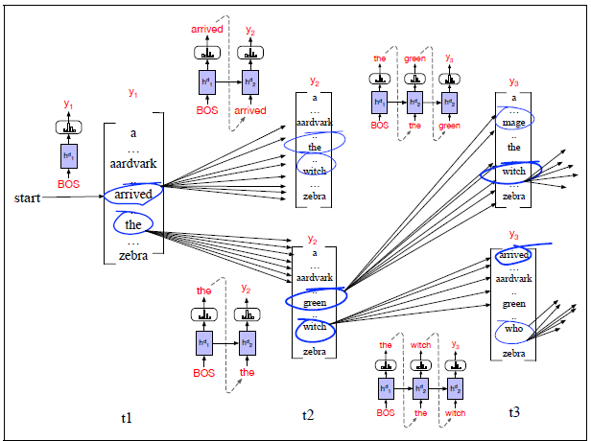
Beam Search Example

Slide 23
Terminating Beam Search
When an end-of-sentence marker is generated, the hypothesis leading to it is recorded, and the size of the beam is reduced by one
The process continues until the size of the beam is 0
At that point, we have remembered k complete hypotheses, each representing a fully translation
Based on their overall probabilities (determined by the softmax functions that predicted the target words), we can choose the best sentence
The figure on the next slide shows another example of beam search; unlike the previous figure, this one makes it clearer how the search terminates
One issue with beam search is that longer sequences tend to have lower probabilities associated with them than shorter sequences
  This is because more probabilities are being multiplied together
  In practice, we add log probabilities instead of multiplying probabilities, but the same issue occurs
  This issue can be mitigated with some sort of length normalization, such as dividing the sum of log probabilities by the number of words that have been generated

Slide 24
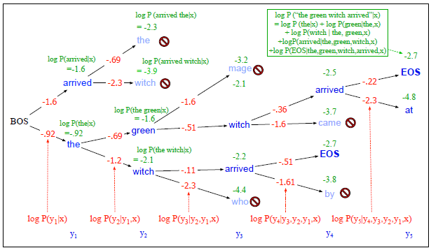
More Detailed Beam Search for MT Example

Slide 25
Evaluating MT systems
One way to evaluate MT systems is to rely on human judgements, but that is expensive and not always feasible
Another way is to use a metric
The metric that has dominated the automatic MT literature is called BLEU, which stands for Bilingual Evaluation Understudy
  BLEU compares an automatically generated translation to one or more human translations of the same source sentence to the same target language
  BLUE measures the frequencies of all N-grams, up to some specified N, that overlap with at least one of the human sentences
  These measures are combined, and there is also a penalty for brevity, without which the metric would favor short translations
  When BLEU was first created, it seemed to correlate very well with human judgements of quality
  However, after researchers started to optimize their systems specifically to maximize BLEU scores, that correlation often failed to hold
  Nonetheless, BLEU has been the dominant metric used to evaluate MT systems in NLP
The textbook also explains a similar, newer, character-based metric called chrF (we will not cover this)

Slide 26
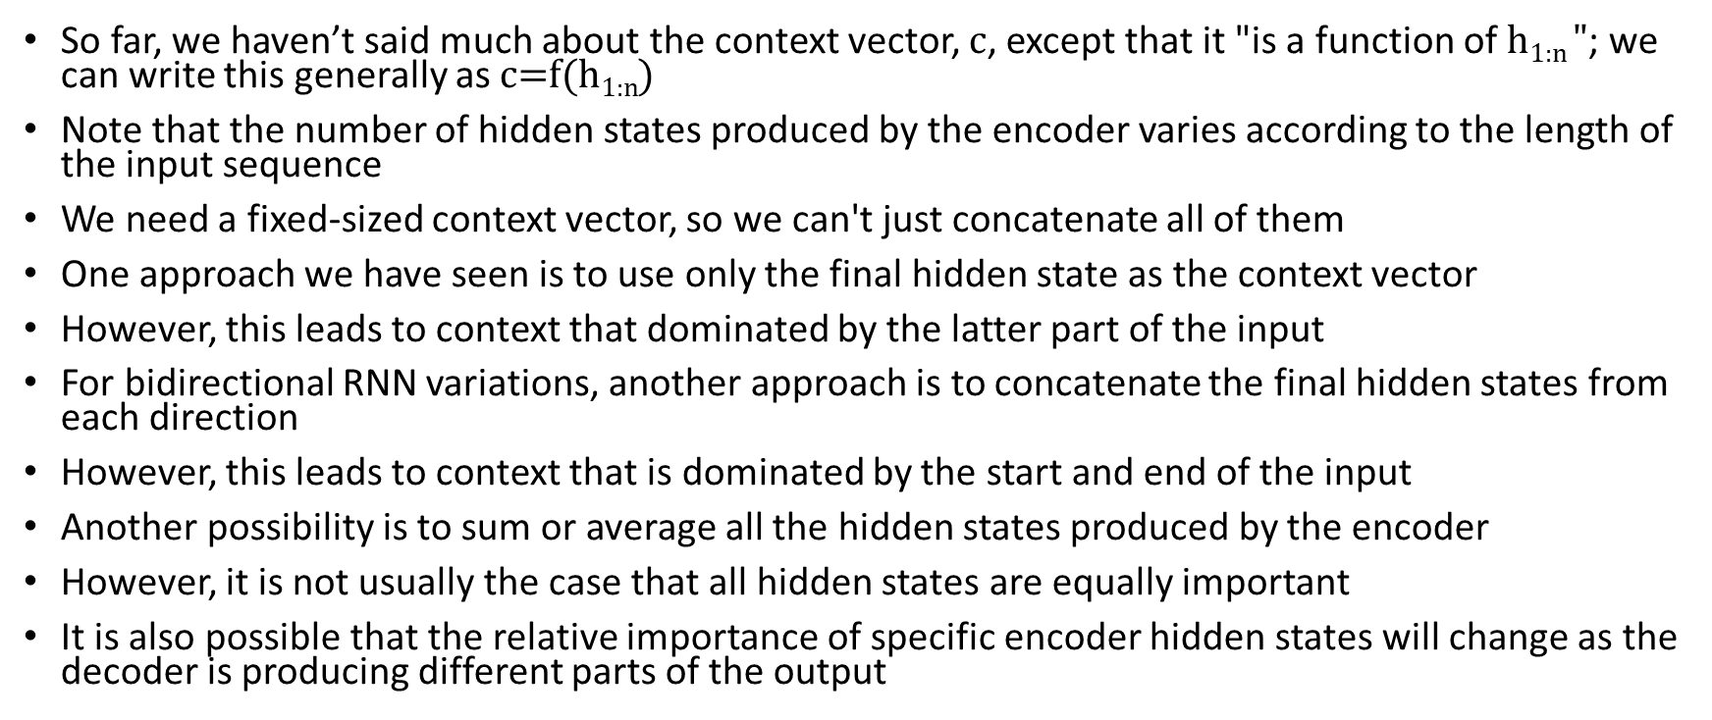
The Context Vector Revisited
So far, we haven’t said much about the context vector, c, except that it "is a function of h_{1:n} $"$; we can write this generally as c=f($\text{h}\text{1:}\text{n}$)
Note that the number of hidden states produced by the encoder varies according to the length of the input sequence
We need a fixed-sized context vector, so we can't just concatenate all of them
One approach we have seen is to use only the final hidden state as the context vector
However, this leads to context that dominated by the latter part of the input
For bidirectional RNN variations, another approach is to concatenate the final hidden states from each direction
However, this leads to context that is dominated by the start and end of the input
Another possibility is to sum or average all the hidden states produced by the encoder
However, it is not usually the case that all hidden states are equally important
It is also possible that the relative importance of specific encoder hidden states will change as the decoder is producing different parts of the output

Slide 27
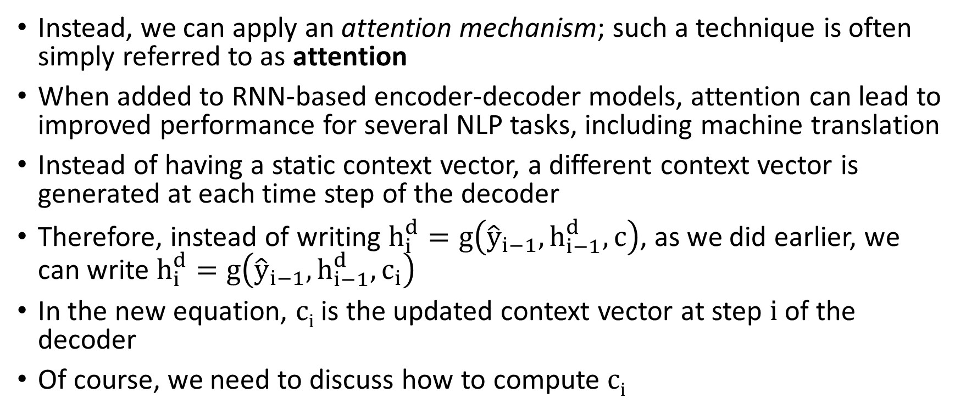
Attention
Instead, we can apply an attention mechanism; such a technique is often simply referred to as attention
When added to RNN-based encoder-decoder models, attention can lead to improved performance for several NLP tasks, including machine translation
Instead of having a static context vector, a different context vector is generated at each time step of the decoder
Therefore, instead of writing $h_{i}^{d}=g\left({\hat{y}}_{i−1},h_{i−1}^{d},c\right)$, as we did earlier, we can write $h_{i}^{d}=g\left({\hat{y}}_{i−1},h_{i−1}^{d},c_{i}\right)$
In the new equation, c_{i} is the updated context vector at step i of the decoder
Of course, we need to discuss how to compute c_{i}

Slide 28
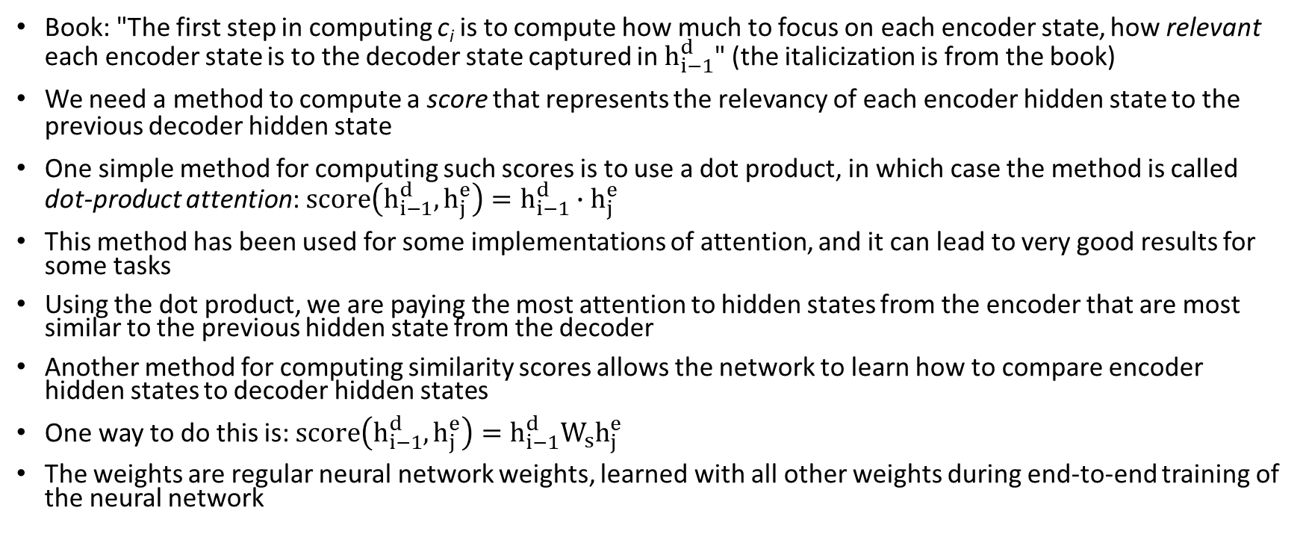
Attention: Computing Scores
Book: "The first step in computing c_{i} is to compute how much to focus on each encoder state, how relevant each encoder state is to the decoder state captured in $h_{i−1}^{d}$" (the italicization is from the book)
We need a method to compute a score that represents the relevancy of each encoder hidden state to the previous decoder hidden state
One simple method for computing such scores is to use a dot product, in which case the method is called dot-product attention:$score\left(h_{i−1}^{d},h_{j}^{e}\right)=h_{i−1}^{d}∙h_{j}^{e}$
This method has been used for some implementations of attention, and it can lead to very good results for some tasks
Using the dot product, we are paying the most attention to hidden states from the encoder that are most similar to the previous hidden state from the decoder
Another method for computing similarity scores allows the network to learn how to compare encoder hidden states to decoder hidden states
One way to do this is: $score\left(h_{i−1}^{d},h_{j}^{e}\right)=h_{i−1}^{d}W_{s}h_{j}^{e}$
The weights are regular neural network weights, learned with all other weights during end-to-end training of the neural network

Slide 29
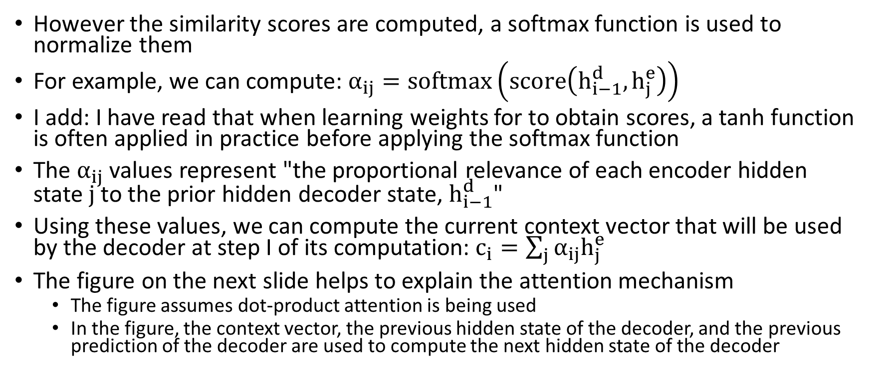
Attention: Computing the Context Vector
However the similarity scores are computed, a softmax function is used to normalize them
For example, we can compute: $α_{ij}=softmax\left(score\left(h_{i−1}^{d},h_{j}^{e}\right)\right)$
I add: I have read that when learning weights for to obtain scores, a tanh function is often applied in practice before applying the softmax function
The $α_{ij}$ values represent "the proportional relevance of each encoder hidden state j to the prior hidden decoder state, $h_{i−1}^{d}$"
Using these values, we can compute the current context vector that will be used by the decoder at step I of its computation: $c_{i}=\sum_{j}{α_{ij}h_{j}^{e}}$
The figure on the next slide helps to explain the attention mechanism
  The figure assumes dot-product attention is being used
  In the figure, the context vector, the previous hidden state of the decoder, and the previous prediction of the decoder are used to compute the next hidden state of the decoder

Slide 30
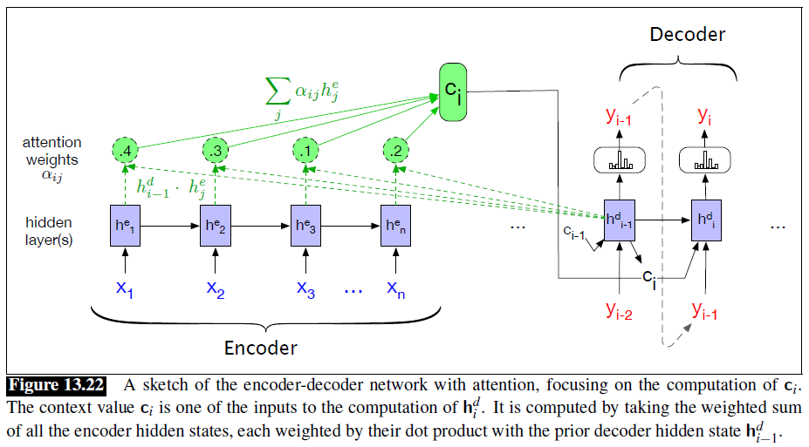
Attention: Graphical Depiction

Slide 31
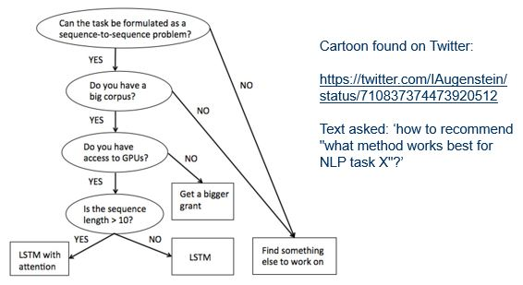
Cartoon Found on Twitter, Posted in 2016

