Slide 1
ECE365: Data Structures and Algorithms II (DSA 2)
Priority Queues and Heaps

Slide 2
Priority Queues
A priority queue is an abstract data type (ADT) that supports two operations:
  insert
  deleteMin (or deleteMax, but not both)
The insert operation inserts a new item into the priority queue
Every item has a key
The deleteMin (or deleteMax) operation returns the element with the minimum (or maximum) key
The deleteMin operation also alters the data structure, removing the element
Sometimes other operations are also implemented

Slide 3
Applications of Priority Queues
Job scheduling
Heapsort
Certain graph algorithms (covered in our next topic)
Huffman coding (covered later in the course)
The A* search algorithm (we learn about this in my Artificial Intelligence course)

Slide 4
Simple Implementations of Priority Queues
Idea 1: Use a simple linked list, inserting new nodes at the start or end
  insert would take O(1)
  deleteMin would take O(N)
Idea 2: Use a linked list, keeping it sorted
  insert would take O(N)
  deleteMin would take O(1)
There are at least as many insertions as deleteMin operations, so the first idea is probably the better of the two
However, neither idea is good, because one of the two main operations is linear in either case
Idea 3: Use a balanced binary search tree (e.g., an AVL tree)
  Both insert and deleteMin would have worst-case logarithmic time
  This is better than the first two ideas, but it is still overkill (it supports other, unnecessary operations), and it is not as efficient as the next method we will introduce

Slide 5
Binary Heaps
A binary heap, a.k.a. a heap, is a very common data structure used to implement a priority queue
Recall that "heap" also has a different meaning in computer science; it can refer to the portion of RAM where dynamic memory is located
Binary heaps support both insert and deleteMin in worst-case logarithmic time
Additionally, the insert operation has average-case constant time
A binary heap also allows building a priority queue in worst-case linear time if all data is provided at once

Slide 6
A Structural Constraint
A binary heap will be implemented using a complete binary tree
This is a binary tree in which every level of the tree is completely full, except possibly for the bottom level which gets filled from left to right
It is easy to see that a complete binary tree of height h has between 2^{h} and 2^{h+1}-1 nodes
This implies that the height of a complete binary tree with N nodes is the floor of log₂N, which is clearly O(log₂N)
If the maximum possible number of items is known, it is easy to implement a complete binary tree with a regular array
Otherwise, in C++, a vector can be used, and resized when necessary
It is common to not store any item in index 0 of the array or vector; we will see that this makes certain operations simpler to implement and a bit more efficient
The two figures on the next slide help explain how a complete binary tree can be implemented an array

Slide 7
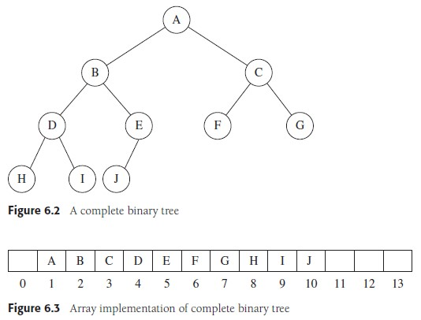
Complete Binary Tree Example
1
2
3
4
5
6
7
8
9
10

Slide 8
Array-based Complete Binary Trees
Using array-based complete binary trees, ignoring the zero index will help make operations simpler to implement and a bit more efficient
The left child of an item stored in array position i will be stored in position 2 * i
The right child will be stored in position 2 * i + 1
The index of the parent of a node in slot i is i / 2 (integer division)
Because of this, bit-shifts and occasional plus-one operations can be used to calculate indexes of parents and children

Slide 9
The Heap Order Property
As with binary search trees and AVL trees, we will impose not only the structure, but also an ordering property
For binary heaps, we will call this the heap order property
The heap order property states that the value of the key of each node must be less than or equal to the values of the keys of all children of the node
This implies that each node has a key with a value smaller than or equal to the keys of all its descendants
No node can have a key value smaller than that of the root of the tree
As with AVL trees, a basic operation may, at first, violate one of the constraints, in this case the heap order property
We cannot let a heap operation terminate until it is restored
The figure on the next slide shows examples of a valid binary heap and an invalid binary heap (i.e., a complete binary tree that is not a valid binary heap)

Slide 10
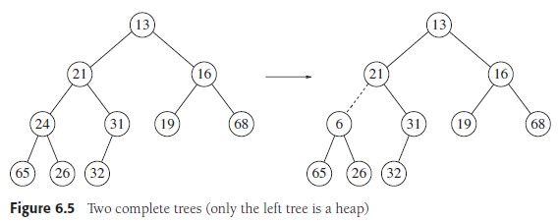
Heap Example (only the left one is valid)
X

Slide 11
Insertion and Percolate Up
To perform an insert operation into a binary heap, there is a specific place that the new item needs to be inserted to maintain a complete binary tree
However, a simple insertion may violate the heap order property if the value of the key of the new node is smaller than the key of its parent
If the heap order property is violated, the insertion operation continues by swapping the newly inserted item with its parent
This is repeated until the heap order property is restored
This strategy of fixing the heap is known as a percolate up
To make the insertion more efficient, rather than doing full swaps, elements can move down into a hole
The new element is only copied to the heap after its final location is determined
The two figures on the next slide help to explain this

Slide 12
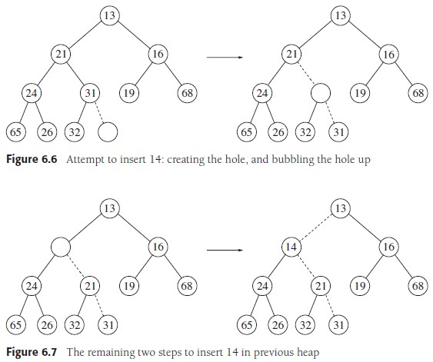
Insertion Example (insert 14)

Slide 13
Deletion and Percolate Down
To perform a deleteMin operation, we need to start by finding the element with the minimum key; that’s easy – it’s at the root!
Once this is removed, the heap is one item smaller than it was
Structurally, the last item (i.e., the right-most item at the bottom level) must be removed
We can start by moving its value to the root; however, that will very likely violate the heap order property
This element is thus exchanged with the smaller of its two children; this process is repeated until the heap order property is restored
This strategy is known as percolate down
As with insertion, we can make this more efficient by using the concept of a hole
Elements are moved up into the hole; the item that started at the last position is only reinserted when its correct location is found
The three figures on the next slide help to explain this

Slide 14
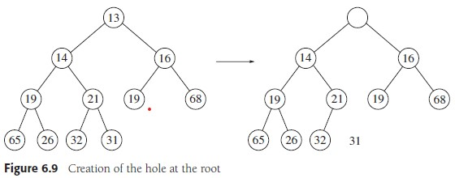
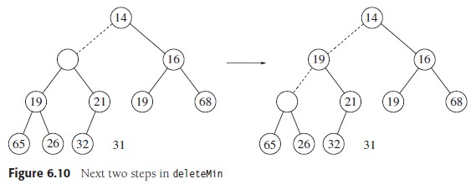
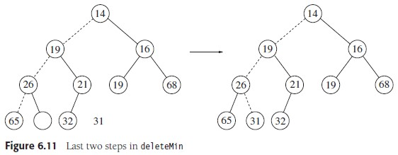
DeleteMin Example (31 is percolating down)

Slide 15
Be Careful!
There is a possible implementation error that can occur when percolating down
You can not assume that every non-leaf node will have two children
One way to tackle this is to use sentinel values guaranteed to be larger than every valid key
A simpler way to handle this is to do extra checks, verifying that the locations of the left and right child of the hole are valid locations

Slide 16
Insert and DeleteMin Complexities
Insert requires no more than log₂N comparisons
DeleteMin requires at most 2 * log₂N comparisons
Clearly, these are both worst-case O(log N) operations
However, insert is often much quicker
According to the book, the average insertion requires 2.607 comparisons
This means that the hole is percolated up 1.607 levels on average
Therefore, insert takes constant average time
We won't prove this fact about insertion, but I'll discuss it intuitively in class

Slide 17
Locating Items in a Binary Heap
Note that a binary heap contains very little ordering information
There is no way to find a particular item in the binary heap without a linear scan through the entire heap
To be able to locate items within a binary heap efficiently, you must combine the heap with another data structure such as a hash table
Note that the key used by the hash table to identify an item can be different than the key used by the binary heap to order nodes
For some of the other heap operations we will soon discuss, it may be necessary to first find the object in the heap before applying the operation
Once the position of the object is known, the decreaseKey, increaseKey, and remove operations (soon to be discussed) have worst-case logarithmic time
Note that the hash table lookup itself takes average-case constant time, but technically worst-case linear time

Slide 18
Other Heap Operations
decreaseKey
  Specifies a position (in the array) and a positive amount to decrease the value of the key; this might violate the heap order property, so it requires a percolate up
  Note that if some sort of id is specified, and not the position, then you would need a hash table (as discussed on the previous slide) or some other extra data structure to locate the item efficiently
increaseKey
  Analogous to decreaseKey
  It requires a percolate down
remove (or delete)
  One way to implement this is to first use decreaseKey to change the value to negative infinity (or to the root's key minus one) and then call deleteMin
  Another approach is to move the final item to the delete node’s location, and then percolate it up or down
buildHeap
  This takes N items as input and creates a binary heap
  One way to do this is to simply perform N insert operations; this solution requires worst-case time O(N log N), but average case time O(N), since insertions take constant average time to perform
  There is another approach that takes worst-case linear time (we will discuss this next)

Slide 19
Worst-case Linear BuildHeap
First, place the items in the array in any order
Then do the following:
  Loop i from N / 2 down to 1
  percolateDown(i)
Note that N / 2 (using integer division) is the position of the parent of the final node in the heap
The images on the next slide will aid in discussing an example

Slide 20
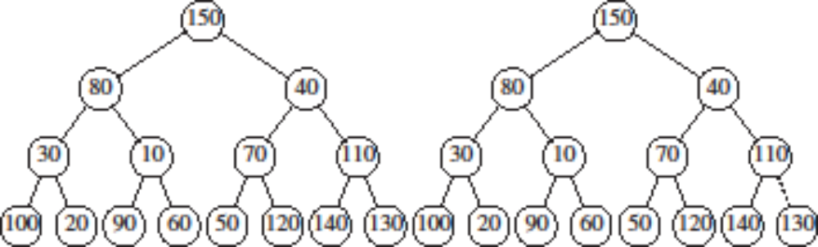
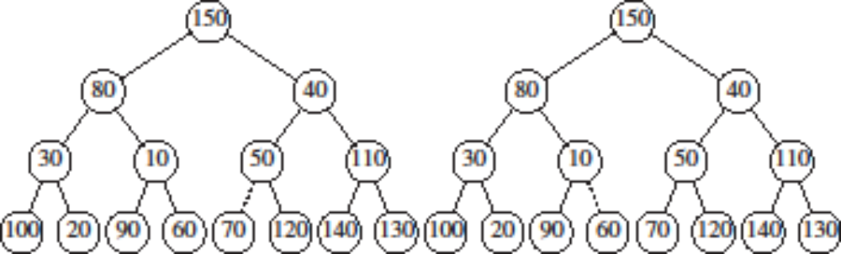
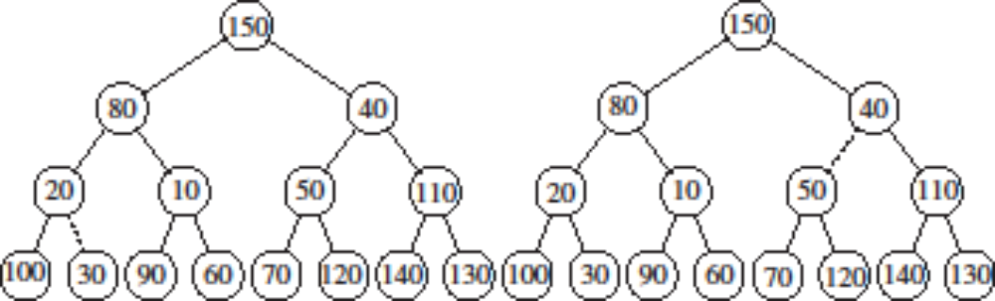
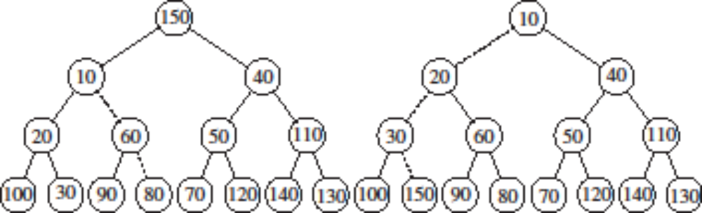
BuildHeap Example

Slide 21
Proving Worst-case Linear BuildHeap
Consider a perfect binary tree (a complete binary tree with a full final level) of height h
Such a tree has 2^{h} leaf nodes and 2^{h+1} - 1 total nodes
The sum of the heights of all the nodes is: 1*h + 2*(h-1)+ 4*(h-2) + ... + 2^{h-1}(1) + 2^{h}(0) = ∑_{i=0..h} 2^{i} * (h - i) = 2^{h+1} - 1 - (h + 1)
The textbook proves the final step algebraically
A complete binary tree is not necessarily a perfect binary tree
This formula still gives an upper bound on the sum of the heights for any complete binary tree of height h
Since any complete binary tree has at least 2^{h} nodes, it is easy to see that the sum of the heights is linear with respect to the number of nodes
Since each node will be percolated down a number of levels less than or equal to its height, the algorithm is guaranteed to be linear overall

Slide 22
Applications of Priority Queues (Revisited)
Job scheduling – Trivially simple with a priority queue
Heapsort
  First, you can apply a linear buildHeap operation (perhaps using the original memory, if the data is provided in sequential memory)
  Then, you can perform N worst-case logarithmic deleteMin operations
  Each removed item can be placed in what was the final heap location
  This would result in a reverse-sorted sequence
  If this is not what is desired, a heap supporting deleteMax (instead of deleteMin) can be used, or you can reverse the sequence at the end
Certain graph algorithms (covered in our next topic)
Huffman coding (covered later in the course)
The A* search algorithm (we learn about this in my Artificial Intelligence course)

Slide 23
d-Heaps
One possible extension of heaps is to use d-heaps instead of binary heaps
In a d-heap, each node has d children (so a two-heap is equivalent to a binary heap)
A d-heap can be much shallower than a binary heap, improving the running time of the insert operation to O(log_{d}N)
The deleteMin operation can be slower, however, requiring O(d * log_{d}N) time; if d is treated as a constant, the asymptotic running time is the same
Note that if items are stored in an array, finding parents and children can not use bit shifts for multiplication and division unless d is a power of 2
According to the textbook, there is evidence that 4-heaps may outperform binary heaps in practice

Slide 24
Merge for Priority Queues
One drawback of binary heaps is that there is no efficient way to merge two existing heaps together
This is important for certain applications (although we will not encounter any in this course)
Merging two binary heaps with the existing implementation can be done in linear time using the buildHeap operation
We will now discuss other implementations of priority queues that allow efficient (logarithmic) merges
All of these implementations involve pointers and dynamic memory allocation
Therefore, the standard operations will be slower by some constant factor
It would almost certainly not be possible to provide a logarithmic merge operation with any array-based priority queue implementation
Just concatenating two arrays requires linear time

Slide 25
Leftist Heaps
One implementation of a priority queue that supports an efficient merge is known as a leftist heap
Like a binary heap, a leftist heap is a binary tree, and it uses the same heap order property
However, it is not a complete binary tree; in fact, it is generally quite unbalanced
There is an additional property that leftist heaps must follow; this is known as the leftist heap property
  We define the null path length, NPL(x), of a node x, to be the length of the shortest path from x to a node without two children
  If x does not have two children, NPL(x) is 0
  If x is a null value, we define NPL(x) to be -1
  The leftist heap property states that for every node x in the heap, the null path length of the left child is at least as large as that of the right child
The figure on the next slide shows examples of a valid leftist heap and an invalid leftist heap (i.e., a tree that is not a leftist heap because it violates the leftist heap property)

Slide 26
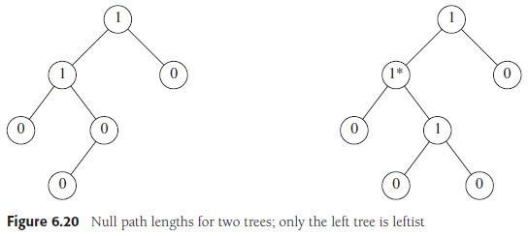
Leftist Heap Example (only the left one is valid)
X

Slide 27
Properties of Leftist Heaps
It should seem intuitive that, due to the leftist heap property, leftist heaps tend to be left heavy; that is, left paths tend to be deeper than right paths
In fact, a tree consisting of a long path of left nodes is possible
Because a leftist heap tends to have deep left paths, the right paths tend to be short
In fact, the right path down a leftist heap is as short as any path from the root to a null
This means that a leftist tree with r nodes on the right path must have at least 2^{r} - 1 nodes; i.e., N ≥ 2^{r} - 1
Therefore, a leftist heap with N nodes has a right path containing at most the floor of log₂(N + 1) nodes; i.e., r ≤ log₂(N + 1)

Slide 28
Leftist Heap Merge Operation (recursive)
First, we will examine a recursive solution for the merge of two leftist heaps
  If one of the heaps is empty, the other heap is returned
  Otherwise, we compare the roots of the two heaps
  We then recursively merge the heap with the larger root with the right sub-heap of the heap with the smaller root
  Assume that the recursive call behaves in such a way to successfully merge these two heaps (the ones passed to the recursive call) without violating either property
  This step still may violate the leftist heap property at the root of the original heap with the smaller root; this can be fixed with a simple swap of the root's children
The next four slides step through an example of this approach
The time to perform the merge is proportional to the sum of the length of the right paths
Thus, we obtain an O(log N) time bound to merge two heaps

Slide 29
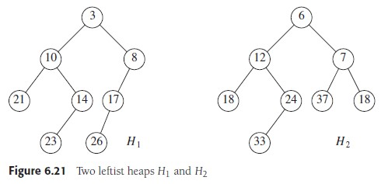
Example: Two Leftist Heaps to Merge

Slide 30
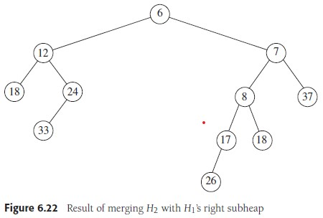
Example: Merging H₂ and H₁'s Right Sub-heap

Slide 31
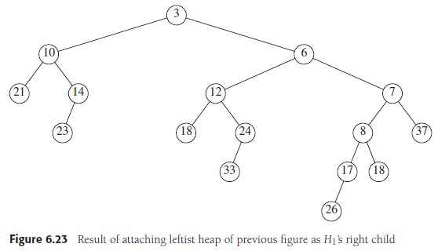
Example: Full Heap After the Recursive Step

Slide 32
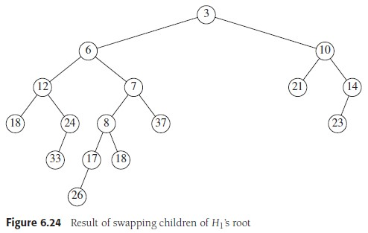
Example: Final Result of Leftist Heap Merge

Slide 33
Leftist Heap Merge Operation (non-recursive)
Next, we will examine a non-recursive solution for the merge of two leftist heaps
  First, merge the two right paths of the two leftist heaps (this is similar to the merge from mergesort, and we are keeping the nodes' left children hanging on)
  Next, we walk up the new right path, checking for violations of the leftist heap property
  When we find a violation at a node, we fix it with a swap of the node’s children
This routine does essentially the same swaps in the same order as the recursive solution
The next slide shows the result of merging the right paths of the two initial heaps from the previous example
The following slide is a duplicate of the slide before this one, showing the final result of the merge operation (so ignore the caption!)

Slide 34
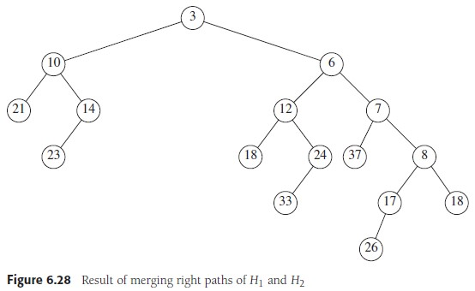
Example: Result of Merging Right Paths

Slide 35
Example: Final Result of Merge (repeated)

Slide 36
Insert and DeleteMin for Leftist Heaps
The insert and deleteMin operations for leftist heaps can be implemented using the merge operation
Insert is just a special case of merge (the new node can be treated as a one-node leftist heap)
For deleteMin, we remove the root and merge the two sub-heaps
Clearly, both operations are worst-case logarithmic

Slide 37
Skew Heaps (very briefly)
A skew heap is another implementation of a priority queue that allows an efficient method of merging
Skew heaps are binary trees with the heap order property but no structural constraint
No information is maintained concerning null path lengths
We will not discuss the details of skew heaps, but they have an interesting property
Skew heaps can become very unbalanced, and the worst-case running time of all operations is O(N)
However, it can be shown that for any M consecutive operations, starting with an empty structure and input of size N, the total worst-case running time is O(M log N)
Thus, skew heaps have O(log N) amortized cost per operation
I add: This is not as good as worst-case O(log N) operations, but it is better than average-case O(log N) operations; it is a guaranteed average

Slide 38
Binomial Queues
A binomial queue (a.k.a. binomial heap) is another implementation of a priority queue
Like leftist heaps, binomial queues guarantee worst-case O(log N) time per operation for merging, insertion, and deleteMin
They also provide the further benefit that insertions take constant average time, as with binary heaps
A binomial queue is not a single heap-ordered tree, but rather a collection of heap-ordered trees (general trees, not binary trees, that obey the heap order property)
A collection of trees is also known as a forest
Each of the heap-ordered trees in the forest is of a constrained form known as a binomial tree
A binomial tree of height 0 has exactly one node
A binomial tree, B_{k}, of height k, where k is a positive integer, is formed by attaching a binomial tree B_{k-1} to the root of another binomial tree, B_{k-1} (the one with the larger root goes lower)
Examples of binomial trees are shown on the next slide
In a binomial queue, there may be at most one binomial tree of every height

Slide 39
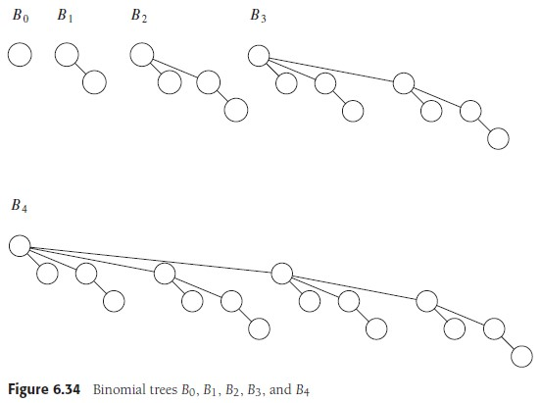
Examples of Binomial Trees

Slide 40
Properties of Binomial Trees
It is simple to see that a binomial tree of height k has exactly 2^{k} nodes
Here is an interesting (although not particularly useful) fact:
  In a binomial tree of height k, the number of nodes at depth d is the binomial coefficient _{k}C_{d} = k! / (d! * (k – d)!)
  This is related to the numbers in Pascal's triangle
We can uniquely represent a priority queue of any size by a collection of binomial trees with different sizes
This is analogous to representing a number in binary (I'll explain this in class)
As previously mentioned, in a binomial queue, we impose the heap order property on each binomial tree
We have seen that our textbook draws binomial trees leaning to the right (which is reasonably common)
Some other sources draw them leaning to the left (which I think may make more sense given the implementation details, which we will discuss later)

Slide 41
Binomial Queue Merge Operation
The process of merging two binomial queues is analogous to binary addition
  The process marches from the smallest binomial trees to the largest, in parallel, in both binomial queues
  That is, you process the B₀ trees, then the B₁ trees, then the B₂ trees, etc.
  For each k, if there are no B_{k} trees, just move on to the next value of k
  If there is a single B_{k} tree, that tree becomes part of the new binomial queue
  If there are two B_{k} trees, they combine to form a B_{k+1} tree
  If there are three B_{k} trees, two (chosen arbitrarily) are combined to form a B_{k+1} tree and the third becomes part of the new binomial queue
Combining two binomial trees takes constant time
There are O(log N) binomial trees, so the merge takes O(log N) time
The next two slides show an example of merging two binomial queues

Slide 42
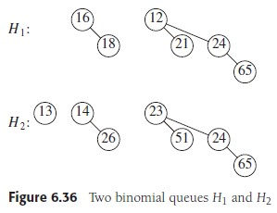
Example: Two Binomial Queues to Merge

Slide 43
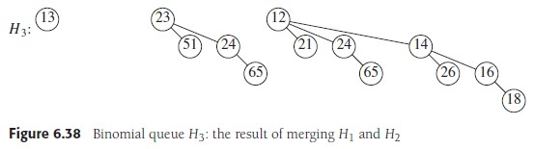
Example: Result of Binomial Queue Merge

Slide 44
Insertion for Binomial Queues
As with leftist heaps, insert is once again just a special case of merge (the new node can be treated as a one-node binomial queue)
Therefore, insert takes worst-case logarithmic time
It turns out that insert takes average-case constant time
To gain some intuition, assume there is a 1/2 probability that a tree of any particular height will be present in an arbitrary binomial queue
Then, the average insertion will terminate after two steps:
(1/2) * 1 + (1/4) * 2 + (1/8) * 3 + (1/16) * 4 + ... = 2

Slide 45
DeleteMin for Binomial Queues
Also as with leftist heaps, deleteMin for a binomial queue can be implemented using the merge operation
The node with the smallest key must be the root of one of the binomial trees (since they all obey the heap order property)
This can be found in logarithmic time by looping through the binomial trees
When we remove the root from a binomial tree, the result is a binomial queue (I will explain this in class)!
Therefore, we have two binomial queues to merge:
  One is the original binomial queue minus the binomial tree that had its root removed
  The other is the binomial queue formed by removing the root of one binomial tree
The merge is also logarithmic, so deleteMin is worst-case O(log N)
The figures on the next slide help to explain the DeleteMin operation for a binomial queue

Slide 46
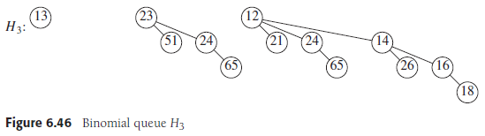
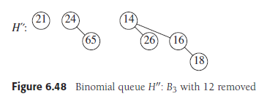
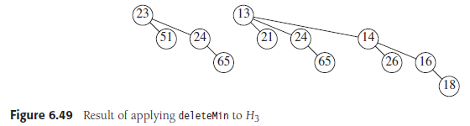
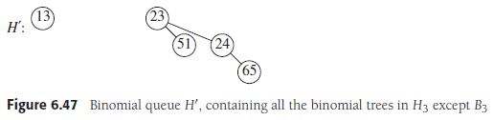
Binomial Queue DeleteMin Example

Slide 47
Implementing Binomial Queues
Nodes store the leftmost child and right sibling (which is common for general trees)
Children are arranged in order of decreasing size
The figure on the next slide helps to visualize the implementation
As mentioned earlier, some sources draw binomial trees as leaning to the left, which I think is more intuitive given this implementation detail
If each node also stores a pointer to its parent, it is not complicated to implement the decreaseKey operation to run in O(log N) time
A delete operation can then be implemented in O(log N) time as a decreaseKey followed by a deleteMin

Slide 48
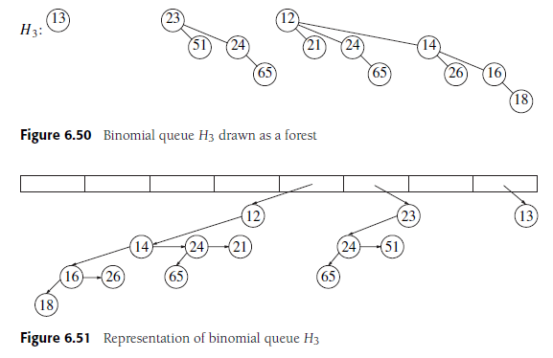
Example of Binomial Queue Implementation

Slide 49
Fibonacci Heaps (very briefly)
A Fibonacci heap is another implementation of a priority queue
We will not discuss the details of Fibonacci heaps, but they have some very nice properties
As with binomial queues, Fibonacci heaps are collections of trees
In fact, if the decreaseKey operation and the delete operation are never invoked, each tree will be a binomial tree
Generally, though, Fibonacci heaps allow a more relaxed structure
All operations that do not involve deleting an element (e.g., insert, merge, decreaseKey) run in constant amortized time
Based on another source: Insert and merge are worst-case constant; decreaseKey is worst case linear
The other major operations (deleteMin and delete) run in logarithmic amortized time; both operations are worst case linear
This data structure can lead to very efficient implementations of certain algorithms

