Slide 1
ECE467: Natural Language Processing
Linguistic Concepts:
Parts of Speech, Syntax, Semantics, Pragmatics, Discourse, Coreference

Slide 2
If you are following along in the book…
The subtopic on parts of speech (POS) is related to Section 17.1 of the textbook (which covers POS in English); we will cover this in much less detail than I used to, but it is relevant to syntax and parsing
The rest of the Chapter 17 covers POS tagging and other sequence labelling tasks; we no longer cover conventional methods for this sort of task, but we will cover how deep learning handles it later in the course
The subtopic on syntax is related to Sections 18.1 – 18.6; we will discuss context-free grammars but only briefly discuss constituency parsing
We will also briefly cover dependency grammars, related to Section 19.1
The subtopic on semantics and first-order logic is related to Appendix F (appendices are posted as separate files on the textbook's website); we will only briefly cover semantics
The subtopic on discourse and pragmatics, which we will cover very briefly, is related to Section 24.1
The subtopic on coreference is related to Section 23.1 of the textbook; we will cover this very briefly
Section 23.9 explains Winograd schemas, which relates to examples that seem hard for NLP systems; we will briefly cover this
Throughout some of the subtopics, I will also rely on various other sources; I will strive to cite them appropriately

Slide 3
Parts of Speech
This subtopic is related to Section 17.1 of the textbook, titled "(Mostly) English Word Classes"
Chapter 17, more generally, is titled "Sequence Labeling for Parts of Speech and Named Entities"
In the August 2024 draft, the chapter was moved much later in the book compared to earlier drafts, but it still covers conventional approaches to sequence labelling (we'll briefly discuss this concept later in the topic)
Parts of speech (POS) are categories for words that indicate their syntactic functions
In other sources, parts of speech are sometimes called word classes, lexical tags, or syntactic categories
The chapter starts by mentioning a few facts related to the history of parts of speech
Dionysius Thrax of Alexandra (c. 100 B.C.) is generally credited for creating a work summarizing the linguistic knowledge of his day; our textbook says it is possible that it was really someone else
Included in this work was the description of eight parts-of-speech: noun, verb, pronoun, preposition, adverb, conjunction, participle, and article
Earlier lists include those from Aristotle and the Stoics, but Thrax's became the basis for POS descriptions for the next 2000 years
POS was briefly mentioned in a previous topic, and I used to cover POS and POS tagging in much greater detail as a separate topic; we will discuss POS now, however, because it is relevant to syntax and parsing

Slide 4
Defining Parts of Speech
Traditionally, linguist's definitions of POS are based on syntactic and morphological function
That is, words in a class function similarly with respect to what can occur nearby and/or what affixes they can take
Word classes have tendencies toward semantic coherence, but not always
Consider the class of nouns, for example
  In elementary school, students might be taught that nouns are words that describe people, places, or things, but in reality, this is not always the case
  Nouns do include concrete terms (e.g., "cat", "chair"), but also abstractions (e.g., "algorithm", "beauty"), verb-like terms (e.g., "pacing"), etc.
  What defines a noun in English are things like:
    Its ability to occur with determiners (e.g., "a goat", "its bandwidth", "Plato's Republic")
    Its ability to take possessives (e.g., "IBM's annual revenue")
    For most (but not all) nouns, its ability to occur in the plural form (e.g., "goats", "abaci")
In general, linguists do not fully agree about what all the POS categories should be, or about how each part of speech should be defined

Slide 5
Open and Closed Classes of POS
POS can be divided into two broad categories: open classes and closed classes
According to the textbook, "Four major open classes occur in the languages of the world": nouns (including proper nouns), verbs, adjectives, and adverbs
Not every language has all four open classes (of course, English does)
Our textbook still mentions Korean as an example of a language that does not have adjectives, but I have learned that this is wrong (and I may tell an anecdote related to this in class)
New nouns and verbs are continually added to languages (sometimes borrowed from other languages)
Recent drafts of the 3rd edition of the textbook also considers interjections to be a "smaller open class"
Many modern tagsets (a concept that will be explained soon) include separate tags for things such as plural nouns, various tenses of verbs, etc.
We will soon see that the Universal Dependencies tagset includes interjections as an open class, and it also includes proper nouns as an open class category distinct from nouns
Closed classes (e.g., prepositions) have relatively fixed membership
Closed classes generally include function words (e.g., "of", "it", "and", "you", etc.), which tend to be very short and occur frequently

Slide 6
English Closed Classes
The closed classes differ more from language to language than do the open classes
Some of the more important closed classes in English include:
  Prepositions (e.g., "on", "under", "over", "near", "by", "at", "from", "to", "with")
  Particles (e.g., "up", "down", "on", "off", "in", "out", "at", "by")
  Determiners (e.g., "a", "an", "the", "this", "that")
  Conjunctions (e.g., "and", "but", "or", "as", "if", "when")
  Pronouns (e.g., "she", "who", "I", "others", "it")
  Auxiliary verbs (e.g., "can", "may", "should", "are")
  Numerals (e.g., "one", "two", "three", "first", "second", "third")
I used to discuss all the open and closed classes individually; I dropped that, but I will discuss the distinction between prepositions and particles

Slide 7
English Prepositions and Particles
Prepositions occur before noun phrases; semantically, they are relational, often indicating spatial or temporal relations
The combination of the preposition and the noun phrase is a prepositional phrase (we'll talk more about phrases later in this topic)
Prepositions can be literal (e.g., "on it", "before then", "by the house") or metaphorical ("on time", "with gusto", "beside herself")
Sometimes they indicate other types of relations (e.g., "Hamlet was written by Shakespeare")
A particle is a word that often resembles a preposition, but it is used in combination with a verb
They often have meanings that are not the same as the prepositions they resemble; e.g., "…she had turned the paper over."
When a verb and particle behave as a single unit, the combination is called a phrasal verb
A phrasal verb generally has a meaning separate and not predictable from those of the verb and particle; e.g., "turn down", "rule out", "find out", "go on"
The previous edition of the textbook pointed out that it is very hard to distinguish particles from prepositions algorithmically, and some tagsets do not distinguish them

Slide 8
Conventional NLP Corpora
Some sources use the term corpus (the plural is corpora) and dataset interchangeably; others use corpus in a more general sense (e.g., a corpus may contain multiple datasets)
One example from conventional NLP is the Brown Corpus
  The Brown corpus is a million-word collection of 500 written texts from different genres (newspaper, fiction, non-fiction, academic, etc.)
  The Brown corpus was assembled at Brown University in 1963-1964
  The Brown corpus has 61,805 distinct wordforms (the vocabulary size), 37,851 distinct lemmas, and 1 million wordform instances (total number of tokens)
Another example is the Switchboard corpus
  The Switchboard corpus is a spoken language corpus consisting of telephone conversations between strangers collected in the early 1990s
  The Switchboard corpus contains 2,430 conversations averaging 6 minute each
  Both audio files and transcribed text files with time alignment and other metadata are available
  The Switchboard corpus has about 20,000 distinct wordforms and about 3 million wordform instances

Slide 9
Treebanks
A treebank is a corpus in which every sentence is syntactically annotated with a parse (we will briefly cover parsing later in this topic)
Typically, words are also annotated with their POS, and sometimes morphological information
The Penn Treebank was very popular English corpus in conventional NLP
  The most recent version includes both datasets mentioned on the previous slide as well as several other English datasets
  This treebank also includes 2,499 stories from a larger Wall Street Journal collection
  It also includes samples from the Air Travel Information System (ATIS) corpus, which includes transcriptions of recorded audio of people interacting with an early airline reservation system
  The Penn Treebank is currently maintained and distributed by the Linguistic Data Consortium (LDC)
  Unfortunately, this treebank is not freely available, but Cooper Union does have access to it

Slide 10
POS Tagsets
In linguistics, a list of parts of speech is called a tagset
English tagsets include many more word classes than those we have been discussing; a few examples are:
  The Brown corpus tagset includes 87 tags (some sources claim different numbers)
  The Penn Treebank tagset includes 45 tags, according to our textbook
    Only 36 of the tags represent what we typically think of as POS
    The rest of the tags are for various types of punctuation, and I've seen different version of the tagset contain as few as 8 or as many as 12, with 9 being a common variation
  The C7 tagset includes 146 tags
The Universal Dependencies (UD) tagset, which is newer, includes only 17 tags
  The goal of the creators of the UD framework was to create resources that can be used across multiple languages
  Features can be added to make find-grained distinctions, but we will not discuss how this works
The next slide shows the 36 non-punctuation POS tags from the Penn Treebank tagset
The slide after that shows the 17 tags from the Universal Dependencies tagset

Slide 11
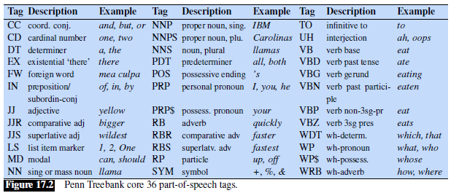
Penn Treebank Tagset (w/o punctuation)

Slide 12
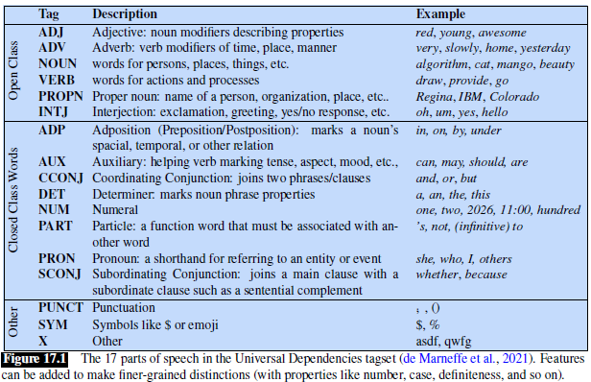
The Universal Dependencies Tagset

Slide 13
Part-of-Speech Tagging
Part-of-speech tagging (a.k.a. POS tagging or just tagging) is the process of automatically assigning a POS to each word or token in an input text
Tags are often also applied to certain types of punctuation, so POS tagging may require that appropriate punctuation marks are separated from words, but not dropped, during tokenization
Note that other text normalization steps, such as stemming or lemmatization, should not be applied
POS tagging is not at all trivial because many words can have different tags, depending on the context around them; e.g., the next slide demonstrates six tags that can be applied to "back"
Some tagging decisions are difficult to make even for humans (although experts usually agree)
Early methods of POS were rule-based (the rules could be either manually created or learned)
Later conventional NLP methods for POS tagging include hidden Markov models (HMMS) or maximum-entropy Markov models (MEMMs); I no longer cover these approaches
We will cover the use of LSTMs and transformers for POS tagging and similar tasks later in the course
The textbook claims that all such methods, implemented well, perform about the same, achieving around 97% accuracy on standard English datasets, and human performance is around the same
I add: Based on other sources, deep learning taggers are probably a bit better than MEMM taggers and HMM taggers (but I wonder if publication bias is involved), and humans make fewer obvious errors

Slide 14
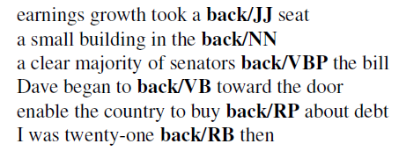
Example: Six Tags for "back"

Slide 15
Uses of POS Tagging
Knowing the POS of a word gives you information about its neighbors
For example, possessive pronouns (e.g., "my", "her", "its") are likely to be followed by nouns, while personal pronouns (e.g., "I", "you", "he") are likely to be followed by verbs
POS can tell us about how a word is pronounced (e.g., "content" as a noun vs. an adjective)
POS can also be useful for applications such as parsing, coreference resolution, and named entity recognition (the first two of these will be covered briefly later in the topic)
Some parsers used to apply POS tagging first, but most parsing algorithms (including those I used to cover) start with untagged sequences of tokens
However, it is still necessary to understand POS when learning about syntax and parsing
Corpora that have been marked with parts of speech are useful for linguistic research
In general, POS tagging used to be a common task in conventional NLP, generally as one step in a sequence of tasks towards achieving some more general goal
For morphologically complex languages, word-based POS tagging is trickier, if applicable at all

Slide 16
Syntax
According to our textbook, syntax "refers to the way words are arranged together" (e.g., to form sentences)
Wikipedia defines syntax as "the study of how words and morphemes combine to form larger units such as phrases and sentences"
In this subtopic, we will ignore morphemes, and discuss how words combine to form phrases and sentences
Linguists strive to create grammars that specify how speakers of a certain language write or talk
Note that most modern linguists consider these grammars to be descriptive, not prescriptive
For example, in the Language Instinct, Pinker writes "The way to determine whether a construction is 'grammatical' is to find people who speak the language and ask them."
Chomsky published very influential works on linguistics in the second half of the 1950s, leading to ideas that dominated linguistics for decades
His theories separated syntax from semantics (we'll discuss semantics later)
During this subtopic, will focus on phrase structure grammars, which are related to Chomsky's theories; we will also briefly discuss an alternative approach called dependency grammars
We will only very briefly touch upon parsing (I used to include an entire topic on that)
We will also briefly discuss ways in which syntax differs between languages, and consider an idea from Baker

Slide 17
Phrase Structure Grammars
The fundamental idea of phrase structure grammars is that a group of words may behave as a single unit called a phrase or constituent
Examples of categories of phrases include noun phrases, verb phrases, prepositional phrases, sentences, etc.
Phrase structure grammars are also known as constituency grammars; this is the term used by our textbook
We will use context-free grammars (CFGs) as a formalism for modeling constituency structure
  Recall that it was mentioned during a previous topic that CFGs are part of the Chomsky hierarchy (as were regular grammars, which can be described by regular expressions and can be useful for tokenization)
  It is typically wise to use the least powerful formalism that can be used to solve a task, because it generally makes it easier compared to using a more powerful formalism
  Linguists agree that CFGs are not quite powerful enough to describe certain constructs in some languages
  Nonetheless, CFGs have been the most common formalism used by linguists to represent phrase structure grammars
  Note that the textbook and some other sources use the term phrase structure grammar to refer to the CFG formalism; I am using the term more generally, the way that the textbook uses constituency grammar
  In general, I have not seen consistency in the way these terms are used

Slide 18


Phrases
As mentioned on the previous slide, a phrase, or constituent, is a group of words that form a single unit
Examples of noun phrases include: "Harry the Horse", "the Broadway coppers", "they", "a high-class spot such as Mindy's", "the reason he comes into the Hot Box", "three parties from Brooklyn"
One piece of evidence that these words group together (i.e., form constituents or phrases) is that they appear in similar syntactic environments (for example, before a verb)
Another piece of evidence is that a phrase can be moved around together in some sentences
For example, consider the various placements of the prepositional phrase "On September seventeenth" in the sentences below (these examples are from an earlier draft of the textbook):
However, you can't generally break a phrase into parts and put the parts in different places; for example, these sentences all seem wrong:

Slide 19
Context-free Grammars
Context-free grammars (CFGs) have been the most common grammatical formalism used by linguists for modeling constituent structure in English and other natural languages
A CFG consists of a set of rules, a.k.a. productions, each of which expresses a way that symbols of the language can be grouped and ordered to form a constituent
Examples from the textbook of possible rules in a CFG representing English grammar include:
  NP → Det Nominal
  NP → ProperNoun
  Nominal → Noun | Nominal Noun
The book does not state how to read these rules, but I have learned that the arrow is often read as "can have the form of" or "can consist of"
The vertical bar is the "or" symbol; it's not technically part of the CFG formalism, but it can be used as a shorthand to represent multiple rules
A CFG can also includes a lexical rules, defining a lexicon
Here are some additional possible rules from the textbook expressing facts about the lexicon:
  Det → a
  Det → the
  Noun → flight

Slide 20
CFG Terminology
The symbols that correspond to words in a language are called terminal symbols (or terminals)
Symbols that express abstractions of these (basically, types of phrases) are called non-terminal symbols (or non-terminals)
In each rule:
  To the left of the arrow, there is a single non-terminal
  To the right of the arrow, there is an ordered list, or sequence, of one or more terminals and non-terminals
Lexical rules include a POS to the left of the arrow and a word (terminal) to the right of the arrow
Every grammar must contain a designated start symbol, often called S, which in linguistics and NLP is usually interpreted as a sentence node
This rule states that a sentence can consist of a noun phrase followed by a verb phrase:
  S → NP VP
The next slide show some additional grammar rules, and the slide after that shows lexical rules; the textbook refers to this simple grammar, related to the ATIS domain (mentioned earlier) as L₀
I used to go into much more detail about sample rules for phrases of various types, but I have dropped that; however, in three slides, we'll look at additional rules for sentences

Slide 21
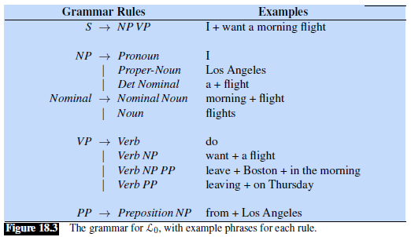
Sample Grammar Rules

Slide 22
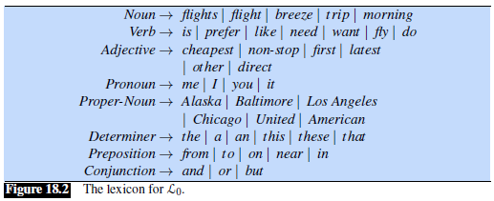
Sample Lexical Rules

Slide 23
Sample Rules for English Sentences
The book has moved its detailed coverage of sample CFG rules for English to Appendix D
I have mostly dropped this from the course, but I do want to show some (by no means all) of the possible rules for English sentences:
  S → NP VP (declarative structure)
    Example: "I prefer a morning flight."
  S → VP (imperative structure)
    Example: "Give me Sunday's flights arriving in Las Vegas from New York City."
  S → Aux NP VP (yes-no question structure)
    Example: "Do any of these flights have stops?"
  S → Wh-NP VP (wh-subject-question structure)
    Example: "Which of these flights have the longest layover in Nashville?"
  S → Wh-NP Aux NP VP (wh-non-subject-question structure)
    Example: "What flights do you have from Burbank to Tacoma Washington?"
  S → S CC S (compound sentence with a coordinating conjunction)
    Example: "I like sitting in an aisle seat, but I do not like stopovers."

Slide 24
Problems with Using CFGs for NL Syntax
There are lots of problems with using CFGs to represent the syntax rules of a natural language such as English
Despite the best attempts by linguists, CFGs wind up both over-generating and under-generating
Certain difficulties include:
  Verb subcategorization (i.e., different verbs allow different types of phrases to complement the verb)
  Subject-verb agreement (e.g., verbs need to be conjugated to match the subject)
  Case agreement (e.g., English pronouns have nominative forms as a subject and accusative forms as an object)
  In some languages there is a requirement for gender agreement
To handle the cases mentioned above, linguists must either expand the grammar (but that can make it grow exponentially), or augment the formalism
I used to discuss this in much greater detail, but I have dropped that from the course
More generally, not all words make sense in all contexts, even if a sentence is syntactically valid (this argument relates to semantics, which we will discuss shortly)
For example, consider the famous example from Chomsky: "Colorless green ideas sleep furiously."

Slide 25
Parsing
The textbook defines syntactic parsing to be "the task of assigning a syntactic structure to a sentence"
When dealing with phrase structure grammars, the task is known as constituency parsing
We will only discuss parsing briefly; I used to spend an entire topic on it
I will define the task of constituency parsing as follows: Given a CFG, and a possible sentence, determine whether the sentence is valid according to the CFG, and if so, indicate its structure
It is possible that a valid sentence may have multiple valid parses according to a CFG, in which case the sentence (and the CFG) is said to be ambiguous
Constituency parsing can be viewed as a search for an appropriate parse tree (or all appropriate parse trees) given a CFG and an input sentence
The next slide shows two possible parse trees, indicating two possible meanings, for an ambiguous sentence (a reasonable set of grammar rules is assumed, and one part of each parse tree is simplified)
Discovered parse trees can be useful for applications such as grammar checking
In conventional NLP, they could serve as an intermediate representation for semantic analysis, which was useful for conventional applications such as information extraction and question answering (QA)
Parsing is also an important task for compilers, which must parse a computer program according to a CFG representing the syntax of a programming language

Slide 26
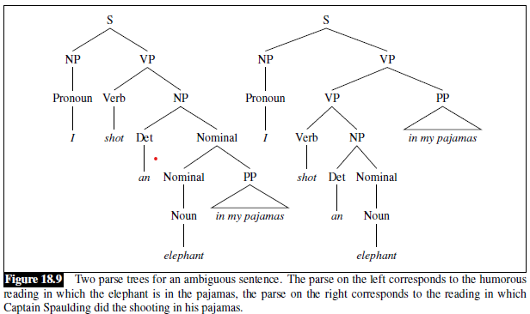
Example Parse Trees

Slide 27
Parsing Algorithms
Straight-forward approaches to parsing include top-down search and bottom-up search (I'll briefly describe these concepts in class)
Both approaches are inefficient, and with top-down parsing, care must be taken to avoid infinite loops
Chart parsers use a form of dynamic programming to remember possible parses of substrings, thus avoiding repeated calculations
  I used to cover two chart parsing algorithms; namely, the Cocke-Kasami-Younger (CKY) algorithm, and the Earley algorithm
  In recent years, I only covered the CKY algorithm, and the second project had students implement it; now, I will only very briefly discuss the CKY algorithm in class
  There are also probabilistic versions of these chart parsing algorithms
  These probabilistic algorithms rely on probabilistic context-free grammars, which our textbook covers in Appendix C; I used to cover this topic, but I have dropped it
  In theory, the probabilistic algorithms can determine the most likely parse of an ambiguous sentence (but in practice, they don't work too well, in my opinion); we will not discuss this further
The previous edition of the textbook had a small section on human parsing, where they seem to argue that humans may apply an approach similar to probabilistic parsing algorithms (the current edition dropped this)
One concept the textbook brought up in that discussion was garden path sentences
Pinker also discusses garden path sentences in "The Language Instinct", but he uses these as evidence that humans do not parse sentences similar to computers; I'll briefly talk about garden path sentences in class

Slide 28
Differences and Similarities across Languages
There are obviously many differences between different languages:
  Vocabularies are different
  We have learned that some languages are morphologically complex
  Even for languages with similar morphological rules, single words in one language may require phrases or even longer explanations in other languages
  Languages have seemingly very different syntax (we will soon look at an example)
  Some syntactic notions (e.g., forms of agreement, politeness levels) exist in some languages but not others
  Figures of speech differ from one language to another
  Some languages leave out pronouns
  Some languages have particular oddities (e.g., the existential "there" in English)
Despite this, there are certain similarities across all languages
  Probably all languages have nouns and verbs; most (if not all) have adjectives
  All languages seem to have certain types of constituents that combine to form larger constituents
  Arguably, all thoughts that can be expressed in one language can be expressed in other languages
  Chomsky wrote about what he called a "universal grammar", although the notion was never specifically defined, and it remains controversial
  We will see that languages that share certain constructs almost always share seemingly unrelated constructs

Slide 29
Comparing Japanese and English Grammar
This example is based on in Chapter 3 of "The Atoms of Language", by Mark C. Baker
Baker compares the grammars of English and Japanese based on one translated sentence
I personally consider this to be an excellent example that helped me to understand grammatical differences between languages (regardless of whether Baker's ultimate theory, which is controversial, is correct)
The book starts with the Japanese sentence, but we'll first look at the translated sentence in English:
  "Taro thinks [literally, is thinking] that Hiro showed a picture of himself to Hanako."
Next, we will look at a phonetic representation of the Japanese sentence (noting that this is not the only possible way it could have been phrased):
  "Taro-ja Hiro-ga Hanako-ni zibon-no syasin-o miseta to omette iru."
Now consider the Japanese words translated to English, but keeping the order from the Japanese sentence:
  "Taro-SU Hiro-SU Hanako-to self-POSS picture-OB showed that thinking be."
Above, "SU" is a subject marker, "OB" is an object marker, and "POSS" is a postposition indicating possession, similar to one use of the word "of" in English
Note that even if you recognized all the Japanese words, you still likely would not know the meaning of the sentence if you are not familiar with Japanese grammar rules

Slide 30
Seven Apparent Grammatical Differences
Baker points out what, at first, appear to be seven grammatical differences between English and Japanese:
  English uses prepositions and contains prepositional phrases (e.g., "to Hanako"), but Japanese uses postpositions and has postpositional phrases (e.g., "Hanako-to")
  In English, a prepositional phrase follows the modified noun (e.g., "picture of himself"), but in Japanese, a postpositional phrase precedes the modified noun (e.g., "self-POSS picture")
  In English, a preposition phrase follows the related verb (e.g., "showed … to Hanako"), but in Japanese, a prepositional phrase precedes the related verb (e.g., "Hanako-to … showed")
  In English, the object of a verb follows the verb (e.g., "showed a picture"), but in Japanese, the object of a verb precedes the verb (e.g., "picture-OB showed")
  In English, an auxiliary precedes the main verb (e.g., "is thinking"), but in Japanese, an auxiliary verb follows the main verb (e.g., "thinking be")
  In English, embedded clauses follow complementizers (e.g., "is thinking that <clause>"), but in Japanese, embedded clauses precede complementizers (e.g., "<clause> that thinking be")
  In English, the entire embedded clause including the complementizer follows the main verb, but in Japanese, the whole clause precedes the main verb (the same example applies)
The chart on the next slide (from Baker's book) summarizes these differences, which we will continue to discuss on later slides

Slide 31
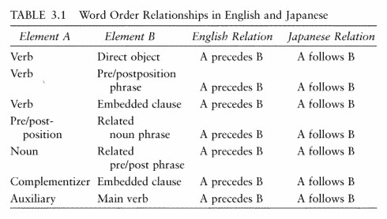
Grammatical Differences Summarized

Slide 32
Statistics Related to the Seven Differences
By itself, seeing "A precedes B" for English and "A follows B" for Japanese every time is not really that interesting, because entries from columns A and B easily could have been swapped
However, Baker then presents some interesting statistics
Baker claims that there are approximately 6,000 languages in the world
  I add: Obtaining an exact count of languages is complicated due to debates over what constitutes a language versus a dialect
  I further add: In "The Language Instinct", Pinker quotes the linguist Max Weinreich when discussing this topic: "A language is a dialect with an army and navy."
Baker then discusses the two sets of word-order patterns defined in his Table 3.1 for English and Japanese
Baker notes: "Putting aside certain minor variations, these two word-order patterns account for more than 95 percent of the languages of the world that care about word order at all."
I add: The high majority of the approximately 6,000 languages do "care about" word order; the exceptions include polysynthetic languages (such as Mohawk) and some case-marking languages
Baker continues: "Moreover, the two patterns occur in roughly equal numbers. Each type is found on every continent, and each includes more than 40% of the world's languages."

Slide 33
Baker's Explanation
In attempting to explain this seemingly unusual empirical fact, Baker then points something out
The item in column A is always a single word, while the item in column B is, or at least can be, a phrase (I add: the final row could have listed "verb phrase" instead of "verb" in column B)
Baker then describes the concepts of phrases and heads of phrases
The head of a phrase is the word that is most syntactically important to the phrase (I'll discuss this more in class; sometimes, I consider the head to be intuitive, but not always, and linguists don't always agree)
Baker's big observation is then made clear: Each items in column A becomes the head of a larger phrase formed by combining the single word from column A with word or phrase from column B
According to Baker:
  In English, the head of a phrase is almost always placed at the start of the phrase it is used to create; hence, English is known has a head-first (or head-initial) language
  In Japanese, the head of a phrase is almost always placed at the end of the phrase it is used to create; hence, Japanese is known as a head-last (or head-final) language
Baker concludes that what first appeared to be seven grammatical differences between English and Japanese is really just one difference between English and Japanese (the next slide expands on this)
This is controversial; linguists don't always agree on what the types of phrases are, or on which word is considered the head, so it is debatable whether heads always come first or last in a particular language

Slide 34
Baker's Head Directionality Parameter
Baker believes that grammars of natural languages are formed (and learned) by setting values for a relatively small set of parameters, many of which he believes have not yet been discovered
This relates to Chomsky's notion of universal grammar, mentioned earlier in the topic
Baker believes that humans have innate universal grammars with the parameters unset, and that children learn (subconsciously) the settings for them
Baker gives examples of several proposed parameters throughout "The Atoms of Language"
One example is what Baker calls "the polysynthesis parameter", distinguishing languages such as Mohawk, which is polysynthetic (as discussed in a previous topic), from languages such as English and Japanese
Related to the English vs. Japanese example, Baker defines what he calls the "head directionality parameter"
Either "heads follow phrases in forming larger phrases" (e.g., Japanese) or "heads precede phrases in forming larger phrases" (e.g., English)
Note that the fact that both languages have subjects at the start of sentences, typically followed by a verb phrase, is not a contradiction or an exception
A subject of a sentence is a phrase (specifically, a noun phrase), and the rest of the sentence is also a phrase (a verb phrase), so the head directionality parameter does not apply
The figure on the next slide (from Baker's book) depicts possible parameters; he considers this speculative

Slide 35
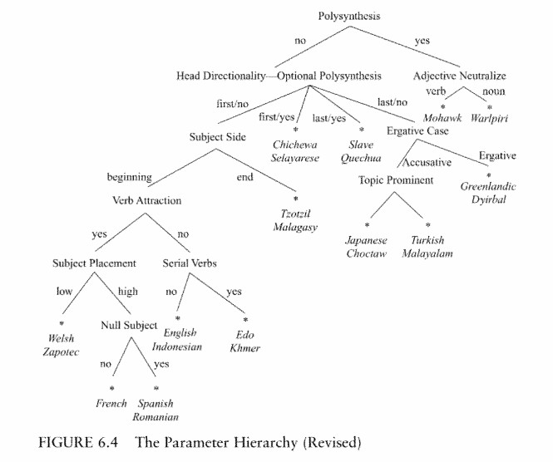
Possible Parameters (speculated by Baker)

Slide 36
Dependency Grammars
Dependency grammars offer an alternative to phrase structure grammars (a.k.a. constituency grammars)
We are only going to discuss this topic briefly, but it has become very important in modern NLP
Dependency grammars are not based on phrases
Instead, individual words are related to each other through binary grammatical relations, each between a head word and one of its dependents
The meaning of "head" here is similar to the meaning used with constituency grammars, but the notion of a phrase, a.k.a. constituent, is not as important
  I add: I don't think that proponents of dependency grammars deny that phrases exist, but they are not given much importance
  Phrases are not labeled as whole units, and there are no explicit rules for how they can be formed
As with constituency grammars, text is typically analyzed one sentence at a time

Slide 37
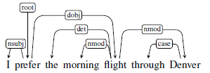
Depicting Dependency Parses
Two common conventions for graphically representing dependency parses are:
  Draw arrows from each head to its dependents (there may be 0, 1, or many arrows leaving each word, except for a special "root" symbol, which always has one outgoing arrow pointing to the head of the sentence)
  Draw arrows from each dependent to its head (every dependent has one outgoing arrow and is associated with a single head, the head of the sentence has an outgoing arrow to root, and root has no outgoing arrows)
The textbook takes the first approach; here is an example of such a dependency parse:
The arrow from "root" to "prefer" implies that "prefer" is the head of the entire sentence
Two slides from now, we will discuss the labels along the other arrows
Dependency parses can also be depicted as parse trees; the next slide shows an example of a dependency parse tree and a constituency parse tree for a single sentence

Slide 38
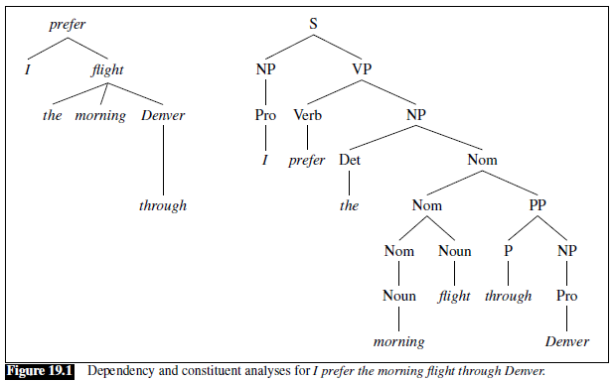
Dependency and Constituency Parse Trees

Slide 39
Dependency Relations
The arrows in a graphical depiction of a dependency parse (see the example two slides back) can include labels indicating the types of the dependencies
Different researchers have created different sets of categories with which dependencies can be labeled
The example from the book uses labels from the Universal Dependencies project (also mentioned earlier in the topic when we discussed POS)
The goal of this project is to come up with a set of labels that can be used for all the world's languages
The next slide shows a selected subset of relations form the Universal Dependencies set (including all of those used in the previous example)
As with constituency grammars, dependency treebanks have been annotated with dependency relations
Sometimes an algorithm applies labels first, and then experts correct mistakes
Such treebanks can be used to study dependency grammars or to evaluate dependency parsers

Slide 40
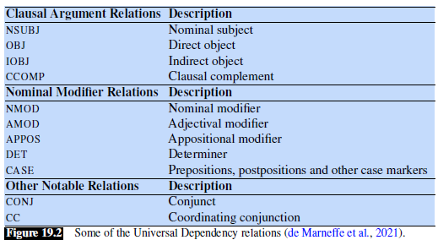
Examples of Dependency Relations

Slide 41
Spoken English
Processing spoken natural language is considerably more difficult than processing written natural language
The previous edition of our textbook discussed the grammar of spoken English, which differs in several aspects from the grammar of written English
In the context of linguistics and NLP, the main unit for spoken English is sometimes referred to as an utterance as opposed to a sentence
Differences between spoken utterances and written sentences include:
  Utterances contain a much higher frequency of pronouns
  Utterances often consist of short fragments or phrases
  There are phonological, prosodic, and acoustic characteristics
  There are various kinds of disfluencies (e.g., hesitations, fillers such as "uh" and "um", restarts, word repetitions, and repairs)
Pinker emphasizes how complex and non-grammatical spoken English can be relative to written English in "The Language Instinct"
To back this up, he discusses an excerpt from the Watergate transcripts (I'll talk about this example during our lecture)

Slide 42
Semantics
Two definitions of semantics (from dictionary.reference.com):
  "the study of meaning"
  "the meaning, or an interpretation of the meaning, of a word, sign, sentence, etc."
When a sentence's meaning is captured using formal structures the result is called a meaning representation
The next slide demonstrates three meaning representations (using three different formalisms) for the sentence "I have a car"
The types of formalisms shown in the figure are:
  First-order logic (FOL), shown at the top of the figure
  Abstract meaning representation, shown in both graph format (bottom left) and text format (bottom middle)
  Frame-based representations, a.k.a. slot-filler representation (bottom right)
Note that each of these representations can be viewed from two perspectives:
  As a representation of the meaning of a particular linguistic input (in this case, "I have a car")
  As a representation of the state of affairs in the world (or some world)
I used to spend about half of a topic covering FOL, which in my estimation was the most common formalism used to represent semantics by linguists, conventionally
Now, we will just look at a few examples of sentences expressed in FOL (I'll explain them in class)

Slide 43
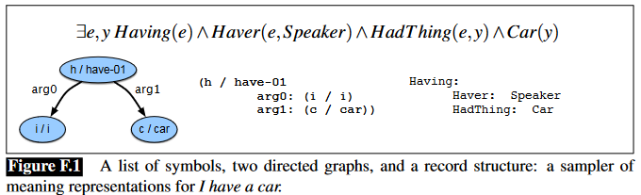
Three Meaning Representations

Slide 44
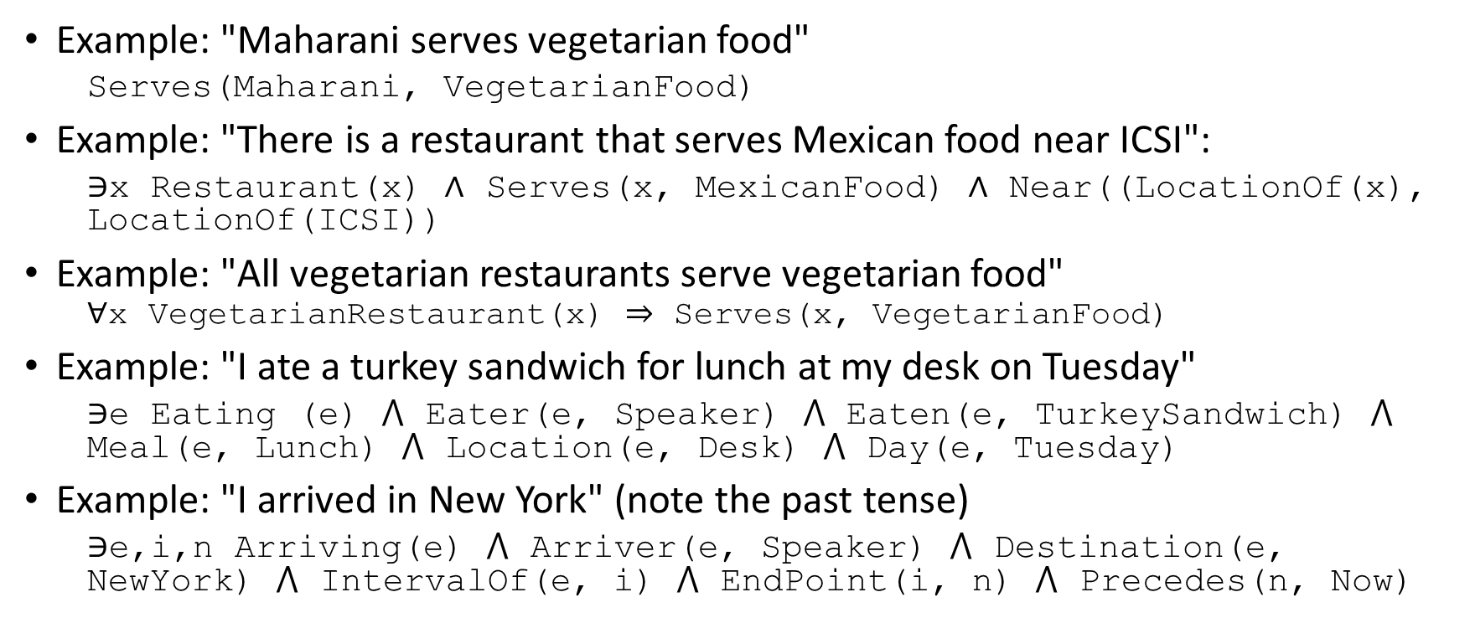
First-order Logic Examples
Example: "Maharani serves vegetarian food"
  Serves(Maharani, VegetarianFood)
Example: "There is a restaurant that serves Mexican food near ICSI":
  ∋x Restaurant(x) ∧ Serves(x, MexicanFood) ∧ Near((LocationOf(x), LocationOf(ICSI))
Example: "All vegetarian restaurants serve vegetarian food"
  $$\text{∀}\text{x} \text{VegetarianRestaurant}\text{(}\text{x}\text{) ⇒ }\text{Serves}\text{(}\text{x}\text{, }\text{VegetarianFood}\text{)}$$
Example: "I ate a turkey sandwich for lunch at my desk on Tuesday"
  ∋e Eating (e) ⋀ Eater(e, Speaker) ⋀ Eaten(e, TurkeySandwich) ⋀ Meal(e, Lunch) ⋀ Location(e, Desk) ⋀ Day(e, Tuesday)
Example: "I arrived in New York" (note the past tense)
  $\text{∋}\text{e}\text{,}\text{i}\text{,}\text{n} \text{Arriving}\text{(}\text{e}\text{)}$ $\text{⋀}$ Arriver(e, Speaker) $\text{⋀}$ Destination(e, NewYork) $\text{⋀}$ IntervalOf(e, i) $\text{⋀}$ EndPoint(i, n) $\text{⋀ }\text{Precedes}\text{(}\text{n}\text{, }\text{Now}\text{)}$

Slide 45
Some Problems with First-Order Logic
The previous edition of the textbook states the following about FOL and some alternative representations:
  "The notion that the translation of linguistic expressions into formal representations made up of discrete symbols adequately captures the notion of meaning is subject to considerable debate."
Neither the previous edition, nor the current edition, of the textbook addresses the shortcomings of FOL
I am going to list here what I consider to be a few of the most significant problems:
  The notation can get very unwieldy
  Semantic parsing (which we did not discuss) is very difficult
  There is no reasonable way to handle uncertainty
  I am skeptical that humans processing sentences create an underlying representation similar to FOL
  Symbols are being defined only in terms of other symbols
Related to the last point, let's look back at one of the FOL formulas from earlier:
  ∋e Eating (e) ⋀ Eater(e, Speaker) ⋀ Eaten(e, TurkeySandwich) ⋀ Meal(e, Lunch) ⋀ Location(e, Desk) ⋀ Day(e, Tuesday)
This makes sense to us (if we understand FOL) because we know, based on experience, what it means to be eating, and we understand the concepts of location and time, and even the concept of a turkey sandwich
We can picture a turkey sandwich, and imagine what the it tastes like; we can imagine the qualia

Slide 46
Pragmatics and Discourse
So far, we have discussed syntax and semantics
In conventional NLP (and, I would argue, most of conventional linguistics), those two topics were generally handled at the sentence level
Pragmatics – a term never mentioned in the current edition of the textbook – starts to consider context
The second edition of the textbook defines pragmatics as "knowledge of the relationship of meaning to the goals and intentions of the speaker"
A more general definition from Wikipedia states: "In linguistics and related fields, pragmatics is the study of how context contributes to meaning."
One issue that pragmatics deals with is speech acts; for example, we need to understand whether the speaker is stating a fact, asking a question, making a request, promising, commanding, etc.
Another related issue is discourse, which out textbook defines as "a coherent structured group of sentences"
More casually, we can say that a discourse is a sequence of text containing multiple sentences (or if we are dealing with spoken language, multiple utterances)
Discourses can be monologues (spoken or written from a single point of view) or dialogues (spoken or written from multiple points of view, often involving conversations)
We will only consider monologues, which are generally simpler

Slide 47
Coherence
When processing a discourse, coherence refers to how various sentences relate to one another
As mentioned, this is harder for dialogues, involving multiple speakers, partly because there are more types of speech acts (but we won't discuss that further)
We will consider only monologues, involving a single speaker; processing monologues can be useful for applications including information extraction, essay grading, summarization, etc.
The first step in interpreting discourse is discourse segmentation, which involves separating a document into a linear sequence of subtopics
The current edition of the textbook does not discuss this, and we will not cover it
Consider the following short discourses:
  "John hid Bill's car keys. He was drunk."
  "John hid Bill's car keys. He likes spinach."
In the first example, the second sentence provides an Explanation, Cause, or Reason for the first sentence; this is an example of a coherence relation
In the second example, there is no clear link (but I would claim we can contrive a context in which there would be one)

Slide 48
Coherence Relations
We have already seen an example on the previous slide of a coherence relation called Explanation
Here are examples of other types of coherence relations:
  Result: "The Tin Woodman was caught in the rain. His joints rusted."
  Parallel: "The Scarecrow wanted some brains. The Tin Woodman wanted a heart."
  Elaboration: "Dorothy was from Kansas. She lived in the midst of the great Kansas Prairies."
  Occasion: "Dorothy picked up the oil-can. She oiled the Tin Woodman's joints."
The Occasion relation occurs when the first sentence implies a change of state that is a necessary precondition of the second sentence
Sources will generally differ on the types and exact definitions of coherence relations
Coherence relations do not always simply relate sequential sentences to each other
The next slide shows an example of a discourse from the previous edition of the textbook
The figure under the passage of text graphically indicates the discourse structure of the same passage of text
Each node in the tree represents a group of locally coherent sentences

Slide 49
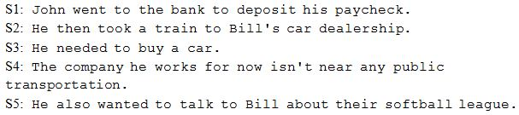
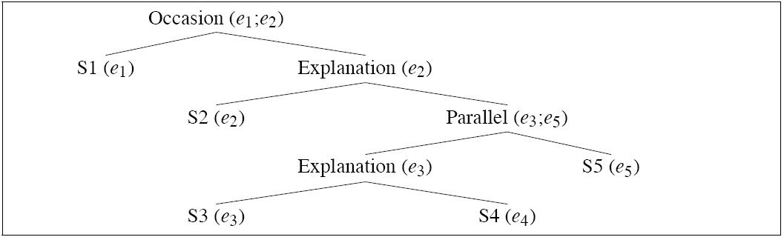
Coherence Relations, More Complex Example

Slide 50
Coreference Resolution
Reference resolution is the task of determining what entities (referents) are referred to by which expressions (referring expressions, or mentions)
Coreference resolution is the task of finding all referring expressions in a text that refer to the same entity
Reference to an entity that has been previously introduced into the discourse is called anaphora
The referring expression is called an anaphor, and the earlier term is called an antecedent
Pronominal anaphora resolution is the task of finding the antecedent for a single pronoun
Sometimes, pronouns refer to a term that is introduced after the pronoun
  In that case, the later term that the pronoun refers to is called a postcedent
  Some sources still refer to this sort of reference as anaphora, others refer to it as cataphora

Slide 51
Coreference Examples
Here is an example from the previous edition of the textbook (there is a similar, but less detailed, example in the current edition) in which all the underlined words or phrases corefer to the same person:
  "Victoria Chen, Chief Financial Officer of Megabucks Banking Corp since 2004, saw her pay jump 20%, to $1.3 million, as the 37-year-old also became the Denver-based financial-service company's president. It has been ten years since she came to Megabucks from rival Lotsabucks."
Here is another example from the previous edition of the textbook with three sets of coreferring expressions:
  "The Tin Woodman went to the Emerald City to see the Wizard of Oz and ask for a heart. After he asked for it, the Woodman waited for the Wizard's response."
Note that in the first example, the word "it" was used in a context in which there was no antecedent, and that instance of "it" did not really refer to anything
Also note that sometimes words can refer to things that are not entities; for example, in "But that turned out to be a lie" (given a proper context), the referent of "that" is a speech act
The current version of the textbook mentions some conventional methods for coreference resolution, and it also discusses a deep learning approach; we will not cover this

Slide 52
Pronominal Anaphora Resolution
Reference resolution applied specifically to pronouns is called pronominal anaphora resolution
Consider this example from the textbook (discussed in both the current and previous editions):
  (23.40) "John telephoned Bill. He lost the laptop."
  (23.41) "John criticized Bill. He lost the laptop."
Discussing this example, the textbook (current draft) argues:
  "These examples differ only in the verb used in the first sentence, yet “he” in (23.40) is typically resolved to John, whereas “he” in (23.41) is resolved to Bill. This may be partly due to the link between implicit causality and saliency: the implicit cause of a “criticizing” event is its object, whereas the implicit cause of a “telephoning” event is its subject. In such verbs, the entity which is the implicit cause may be more salient."
I do not buy this argument; consider my sentences:
  "John telephoned Bill. He answered the phone."
  "John criticized Bill. He was quite angry."
I believe that truly solving reference resolution would require reliance on real-world knowledge, a.k.a. commonsense knowledge
Although most of the conventional NLP community ignored this, we will see this was sometimes acknowledged specifically when it comes to this task of pronominal anaphora resolution

Slide 53
Winograd Schemas
Terry Winograd is a famous figure from the history of AI and NLP
Winograd has noted the importance of real-world knowledge and commonsense reasoning for pronominal anaphora resolution
Winograd schemas are examples of anaphora resolution that are simple for humans but difficult for computers
Winograd schemas include two sentences (or two short discourses) with an ambiguous pronoun and two possible antecedents; the two sentences (or discourses) differ by one word (or sometimes a short phrase)
The differing word changes what antecedent is referred to by the pronoun in question
The textbook discusses this famous example attributed to Winograd from 1972:
  "The city council denied the demonstrators a permit because they feared violence."
  "The city council denied the demonstrators a permit because they advocated violence."
A human can easily figure out who "they" refers to easily in both cases, but it is generally recognized that doing so requires real-world knowledge or sophisticated reasoning
Here is an example of a Winograd schema created by me (I'll discuss it a bit in class):
  "A customer called the waiter to their table. He asked for their check."
  "A customer called the waiter to their table. He asked for their order."

