Slide 1
ECE469: Artificial Intelligence
Simple Search

Slide 2
Problem-Solving Agents
A problem-solving agent is one type of goal-based agent
Such an agent will search for a sequence of actions that leads to a goal state; if found, the sequence of actions is said to be a solution
Such an agent often assumes that the environment is single agent, fully observable, deterministic, static, discrete, and known
Earlier editions of the textbook also listed episodic here, but I consider this debatable
We can apply a simple "formulate, search, execute" strategy for such an agent
The 4th edition splits the first part into "goal formulation" and "problem formulation"
The solution is a "fixed sequence of actions"
Solutions are executed without paying attention to percepts

Slide 3
Search Problems
A search problem can be defined by the following components:
  The initial state indicates the state of the agent’s world at the start of the problem
  The available actions: ACTIONS(s) returns the set of actions applicable in state s
  A transition model: RESULT(s, a) returns the state resulting from performing action a while in state s; we can call the resulting state a successor of s
  A set of goal states indicates what the agent is trying to achieve
  An action cost function: ACTION-COST(s, a, s’) gives the cost (known as an action cost or a step cost) of applying action a at state s to reach state s’
The third edition included a set of goal-test instead of a set of goal states (I like this better), and it included a path cost function (which typically sums step costs) instead of an action cost function
Optionally, the problem can also explicitly specify the set of states (the 4th edition includes this, but it isn't necessary, as will soon be explained)
The process of removing detail from a representation, which is common when we formulate a search problem, is called abstraction
For example, in one of the map examples we will soon look at, there are many real-world parameters are left out

Slide 4
The State Space
The set of reachable states is also called the state space
Note that some sources define state space more generally to be all plausible states, in which case some of these states may not be reachable
The 3rd edition of the textbook is clear (at least, in certain spots) that they define the state space to consist of only reachable states; in the 4th edition of the textbook, the definition is more ambiguous
Since we will define the state space to consist of only reachable states, it can be determined by the initial state, the available actions, and the transition model
The initial state is one member of the state space
The goal states are sometimes considered to be a subset of the state space, although in theory, some of these states may not be reachable
The state space can be viewed as a directed graph in which nodes represent states and edges represent actions
Earlier, we said that a solution to a search problem is a sequence of actions leading from the initial state to a goal state
We can alternatively consider a solution to be a path in the state space from the initial state to a goal state

Slide 5
Toy Problems
Toy problems are intended to illustrate various problem-solving methods
The 4th edition of the textbook calls these standardized problems (but I think this terminology is less common)
Real-world problems (e.g., robot navigation) tend to be more difficult

Slide 6
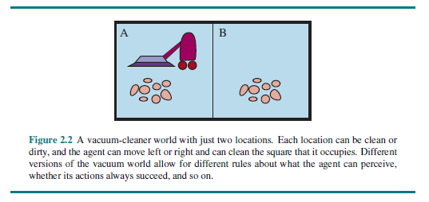
The Vacuum World Revisited

Slide 7
The Vacuum World Formulated
The vacuum world is an example of a grid world problem
The states: There are two locations/squares/cells, the agent is in one of them, and each location is or is not dirty
  Therefore, there are 8 possible states
  A larger environment with n locations would lead to n * 2^{n} states
The initial state: Any of the 8 states
The actions: Move left, move right, or clean (larger environments would have additional actions, and there are alternative formulations of this toy problem)
The transition model: Mostly intuitive, but moving left from the left cell, moving right from the right cell, and cleaning a clean cell have no effect
The goal test: Checks if both cells are clean (alternatively, we can list the goal states, i.e., all states for which every cell is clean)
The action cost: Each action costs 1, so the path cost can count the steps

Slide 8
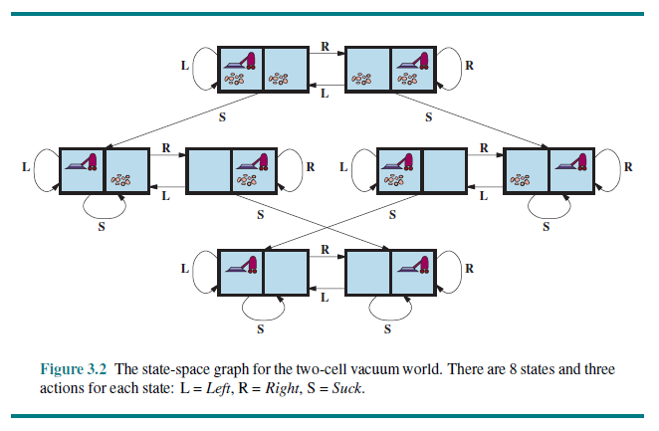
The Vacuum World State Space

Slide 9
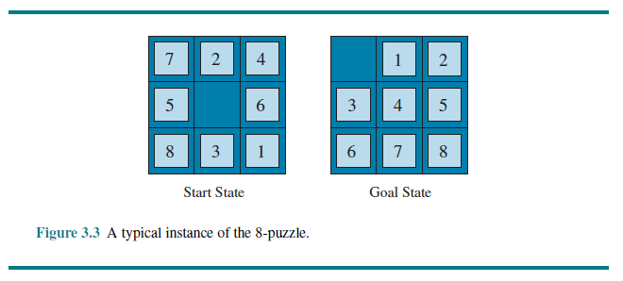
The 8-puzzle

Slide 10
The 8-puzzle Formulated
The 8-puzzle is an example of a sliding-block puzzle
The states: A state specifies the location of each of the 8 tiles and the blank
  The 8-puzzle has 9!/2 = 181,440 reachable states, and this can be solved very fast
  The 15-puzzle has about 10 trillion, or 10¹³, reachable states, and this can be solved in a few milliseconds (or today, maybe even faster) by the best search algorithms
  The 24-puzzle has about 10²⁵ reachable states; modern computers take might take hours to solve this (this statistic is a bit old, so perhaps it could be solved in under an hour now)
The initial state: Any of those states
The actions: The simplest formulation defines actions in terms of movements of the blank space (left, right, up, or down)
The transition model: Given a state and action, it specifies the next configuration
The goal test: Checks if we match the desired configuration
The action cost: Each action costs 1, so the path cost can count the steps

Slide 11
The 8-queens Problem
The 8-queens problem: Place 8 queens on a chess board such that no two queens are attacking each other
Note that the 4th edition introduces this problem in a later chapter than previous editions
The states: A state is any arrangement of 0 to 8 queens on the board (using the formulation of the problem that we consider for this topic)
The initial state: No queens are on the board
The actions: Add a queen to any empty square (for now)
Transition model: Returns the board with a new queen added to the specified square
The goal test: Checks if 8 queens are on the board with none attacking any other (note that this is an example where listing the goal states doesn't really make sense)
The action/path cost: This is of no interest for this problem
With this formulation of the problem, there are 64*63*…*57≈1.8*10¹⁴ possible sequences
A better idea: Add a queen to any square in the leftmost empty column such that it is not attacked; then there are only 2057 sequences (not all lead to solutions)

Slide 12
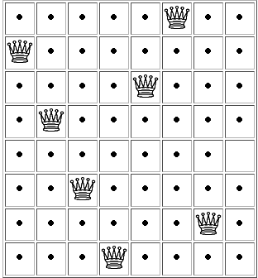
Solving the 8-queens Problem
As stated originally, there are 64*63*…*57 ≈ 1.8*10¹⁴ possible sequences
A better idea: Add a queen to any square in the leftmost empty column such that it is not attacked
Then there are only 2057 sequences (not all lead to solutions)
The state to the right (from a website that no longer exists) is one action away from a solution
This is an incremental formulation; in our next topic, we will see a complete-state formulation

Slide 13
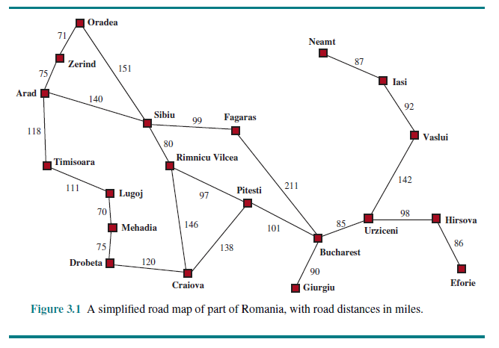
The Romania Map Problem

Slide 14
The Romania Map Problem Formulated
The Romania map problem: Get from Arad to Bucharest
The states: Each possible city constitutes a state
The initial state: The starting city (we are assuming it is Arad)
The actions: For each possible city, the traveler can go to any adjacent city
Transition model: An action moves the traveler from the current city to the specified adjacent city
The goal test: Checks if we are at the desired destination (we are assuming it is Bucharest)
The action cost: The length traveled (perhaps measured in miles); the path cost is the sum of the step costs

Slide 15
Examples of Real-World Search Problems
The airline travel problem (an example of a route-finding problem)
  Travel websites need to solve this
  The path cost should ideally consider monetary cost, flight time, waiting time, seat quality, time of day, type of airplane, frequent flyer awards, contingency plans, etc.
Driving directions (also a route-finding problem)
  GPS devices and websites that provide driving directions need to solve this
  Unlike the Romania map problem, complications that must be considered include traffic, road closures, tolls, etc.
Robot navigation: This is a generalization of route-finding; there is a continuous space and an infinite set of actions
Others real-world search problems include touring problems, VLSI layout, protein design, etc.

Slide 16
Search Trees and Search Graphs
A search tree can be generated by the initial state, the available actions, and the transition model
We can think of the search tree as being superimposed over the state space
The node corresponding to the initial state is the root of the tree
If the same state can be reached by multiple paths, then we are really dealing with a more general search graph as opposed to a search tree
If actions are reversible, or there are other cycles in the graph, this can lead to infinite loops in search implementations if we are not careful
More generally, a search graph can have redundant paths whenever there is more than one way to get from one state to another
The 3rd edition of the textbook, in my opinion, did a better job distinguishing between search trees and search graphs; the 4th edition generally uses the term search tree, even when dealing with a search graph
Each node in a search tree can be represented by a data structure with four components: its state, its parent node, the action (that took it here from the parent), and the path cost so far
It is important to remember the distinction between a node (stored in a data structure) and a state (a configuration of the world)
Multiple nodes can contain the same state

Slide 17
Expanding Nodes
We expand a node by applying all possible legal actions to generate a new set of nodes
The choice of which node to expand next depends on the chosen search strategy
The frontier (a.k.a. the open list or the fringe) is the collection of nodes that have been generated but not yet expanded
If we are considering the state space to be a tree (as opposed to a graph), each element of the frontier is a leaf node of the tree so far
The explored set (a.k.a. the closed list) keeps track of nodes that have already been expanded (so these are distinct from those on the frontier)
The reached nodes include those in the frontier and those in the explored set, and the states they contain are said to be reached states
The reached nodes include all nodes that have been generated, whether or not they have been expanded

Slide 18
Evaluating Search Algorithms
Four considerations when evaluating a search algorithm are:
  Completeness: Is it guaranteed to find a solution if one exists?
  Optimality (or cost optimality): If it finds a solution, is the solution guaranteed to be optimal?
  Time complexity: This could be measured according to actual time, number of computational steps, or number of nodes generated or expanded
  Space complexity: The memory requirements
In computer science, time and space complexity are often considered with respect to some measure of the problem difficulty, generally the size of the input
Search problems are defined by the state space (represented as a tree or graph)
Complexity for such a problem might be expressed in terms of the following parameters:
  The branching factor, b, which is the maximum number of successors of any node
  The depth, d, of the shallowest goal node
  The maximum length, m, of any path in the state space (potentially infinite)

Slide 19
Uninformed Search
In this topic, we will cover six uninformed search, a.k.a. blind search, strategies:
  Uniform-cost search
  Breadth-first-search (BFS)
  Depth-first search (DFS)
  Depth-limited search
  Iterative deepening search (IDS)
  Bidirectional search
These searches can generate successors and distinguish a goal state from non-goal state
However, they do not know if one non-goal state is more promising than another
The output of a problem-solving search algorithm is an indication of failure or a correct solution
However, some of these algorithms might enter an infinite loop and never produce output for certain inputs

Slide 20
Best-first Search
Best-first search is a general approach that can be used to implement a few of the strategies we will discuss
Best-first search starts with only the initial state, stored in a node, on the frontier
If we consider the state space to be a search tree, this node becomes the root of the tree; however, the pseudo-code we will look at (on the next slide) considers the state space to be a search graph
Best-first search decides which node to expand next based on an evaluation function
In the pseudo-code that we look at, the evaluation function, f, is used by a priority queue (the "POP" function is really a "deleteMin"), but used appropriately, the priority queue can simulate a stack or a queue
I add: Our textbook considers priority queues, stacks, and queues to all be types of queues, but this is odd
The pseudo-code returns a node containing a goal state (if it finds one) or "failure"
I add: If a goal state node is found, the parent and action attributes can be used to recover the full solution
The pseudo-code can be used to implement uniform-cost search, breadth-first search, and depth-first search
However, we will only use it for uniform-cost search, because BFS can be implemented more efficiently, and DFS usually uses a tree search (the textbook calls it a "tree-like search") to save memory
Note that this pseudo-code allows multiple nodes with the same state to appear on the frontier, so it might search from the same state multiple times; this would not lead to a bug, but it could lead to inefficiencies

Slide 21
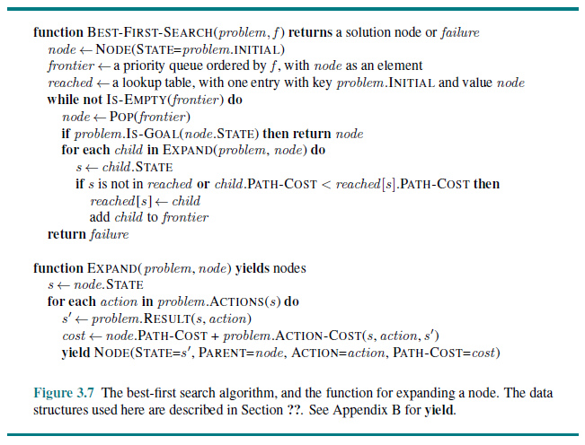
Best-first Search Pseudo-code

Slide 22
Uniform-cost Search
Uniform-cost search expands the node on the frontier with the lowest total path cost so far from the root to the current state
This can be implemented using best-first search with path cost as the evaluation function used by the priority queue (as shown on the next slide)
Uniform-cost search is the only uninformed search strategy we will cover that is optimal even if the step costs are not all identical (but they must all be positive)
This strategy would lead to the optimal solutions for problems such as the Romania map problem
Uniform-cost search is complete if all step costs are above some ε > 0
The worst-case time and space complexity can be characterized as O(b^{1+[C*/ε]}), where b is the branching factor and C* is the cost of the optimal solution
For those of you who have taken DSA II, note that uniform-cost search is essentially identical to Dijkstra's algorithm

Slide 23
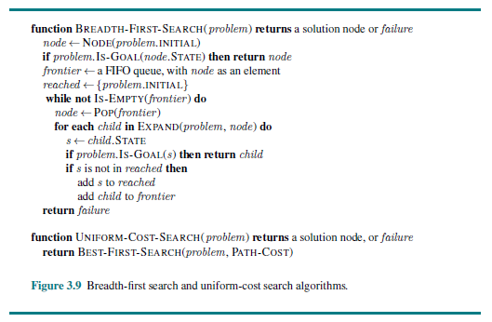
Uniform-cost Search Pseudo-code

Slide 24
Breadth-first Search
Breadth-first search (BFS) expands the root, then all successors of the root, then their successors, etc.; the version we look it will discard generated nodes with duplicate states
This could be implemented using best-first search using each node's depth as the evaluation function for the priority queue (this would make the priority queue behave like a queue)
However, this would not be efficient
  We would wind up generating nodes to the right of the shallowest goal node, and children of nodes to the left of the shallowest goal node
  This is because best-first search does not check if a node is a goal node until it is expanded, which is crucial for uniform-cost search (to make it optimal)
Typical implementations of BFS use a regular queue as opposed to a priority queue
Pseudo-code for BFS is shown on the next slide; some things to point out:
  This time, the frontier is a queue (the book calls it a "FIFO queue"), so the "POP" function is really a "dequeue", which is typically a constant time operation, whereas deleteMin would be logarithmic
  The implementation checks for goal states as soon as nodes are generated
  The "reached" set only needs to store states, without mapping them to full nodes, because the path to a state with the fewest edges will always be generated first
  The "EXPAND" function is the same as the one used with the general best-first search pseudo-code

Slide 25
Breadth-first Search Pseudo-code

Slide 26
Properties of BFS
It can easily be seen that BFS is complete (assuming a finite branching factor)
BFS finds the solution that can be reached with the minimal number of actions
BFS is optimal only if the shallowest goal node is optimal; this is the case if all we care about is the number of steps to get to a solution
I add: More generally, BFS is optimal if the path cost is a non-decreasing function of the depth of a node
BFS is not optimal for problems such as the Romania map problem; it is optimal for problems such as the 8-puzzle
The total number of nodes generated is at most 1 + b + b² + b³ + … + b^{d} = O(b^{d})
The time complexity for BFS is a major factor, but the memory requirements are an even bigger factor, as demonstrated on the next slide

Slide 27
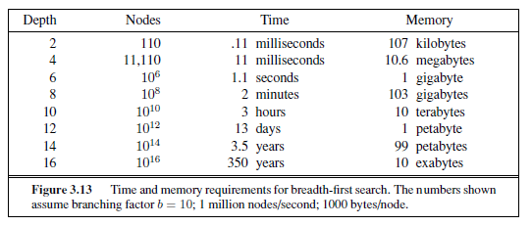
BFS Time and Memory (from 3rd Edition)

Slide 28
Depth-first Search
Depth-first search (DFS) expands the deepest node in the frontier
This could be implemented using best-first search using the negative of the node's depth as the evaluation function for the priority queue
This would make the priority queue behave like a stack
However, this would have the same memory issues as BFS
Instead, DFS is sometimes implemented as a tree search using a regular stack as opposed to a priority queue
We will consider what the book calls a "tree-like search" that does not track reached nodes but does track nodes on the current path to avoid cycles
The next slide helps to explain how DFS works, by showing the order in which nodes are generated and expanded for a particular state space, assuming the goal state is "M"
The book doesn't state it, but we must be assuming that the children of each node are generated from right to left, relative to how they are displayed in the figure
We will not look at pseudo-code for DFS yet, but later, we will look at pseudo-code for an expanded version of it

Slide 29
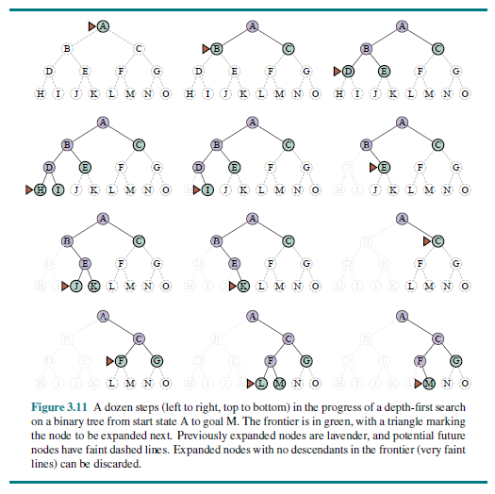
Depth-first Search Example

Slide 30
Properties of DFS
The pseudo-code we will look at shortly (for an expanded version of DFS) has a memory requirement that is O(bm)
Here, m is the maximum depth of the tree (recall that we are using a tree search, not a graph search, for DFS)
An alternative is to use a backtracking search, which has a better memory requirement of O(m)
  This sort of approach generates only one successor of each node at a time
  With backtracking search, there must be ways to determine the next successor, and to undo actions when backtracking
  Backtracking search is often implemented with recursion (we will not look at pseudo-code for this)
In general, DFS is not complete; DFS is complete for finite state spaces if it avoids cycles, although it may wind up expanding the same state many times via different paths
If DFS does not keep track of nodes on the current path, and there are cycles, DFS can get stuck in infinite loops; DFS can also get stuck in infinite loops in infinite state spaces
In general, DFS is not optimal

Slide 31
Depth-limited Search
Depth-limited search alleviates the problem of an unbounded tree by applying DFS with a depth limit, L
Nodes at the specified depth limit are treated as if they have no successors
This introduces another source of incompleteness if L < d; if L ≥ d (and there is a finite branching factor), the search is complete but not optimal
The limit, L, may be chosen based on the problem (e.g., for the Romania map problem, we can set L = 19, since there are 20 cities)
For many problems, we will not know an appropriate cutoff ahead of time
The search returns a node containing a goal state (if one is found), "failure", or "cutoff"
If the call to the routine returns "failure", there is no solution
If it returns "cutoff", then there might or might not be a solution beyond the specified depth limit
Depth-limited search has a time complexity of O(b^{L}) and a space complexity of O(b*L) assuming that all successors of expanded nodes are generated at the same time
I add: The space complexity can be improved to O(L) if one successor is generated at a time

Slide 32
Iterative Deepening Search
Iterative deepening search (IDS), a.k.a. iterative deepening depth-first search, performs sequential depth-limited searches, with depth limits 0, 1, 2, 3, etc.
Each stage (representing a separate depth-limited search) returns a solution, "cutoff", or "failure"
This strategy combines the benefits of DFS and BFS; some advantages if IDS:
  It is complete if there is a finite branching factor
  It is optimal if the path cost is a non-decreasing function of node depth
  It has the memory requirements of DFS
Many states are generated multiple times, but it turns out that this is not very costly; nodes on the bottom level are generated once, nodes on the next-to-bottom level are generated twice, etc.
Comparing the number of nodes (not including the root) generated for BFS and IDS, we have N(BFS) = b + b² + … + b^{d}, and N(IDS) = (d)b + (d-1)b² + … + (2)b^{d-1} + (1)b^{d}
Since the last term dominates, the time complexity of IDS is O(b^{d}), the same as that of BFS; the actual running time of IDS will be slightly larger than BFS, but not by much
Book (Ed. 4): "In general, iterative deepening is the preferred uninformed search method when the search state space is larger than can fit in memory and the depth of the solution is not known."
The next slide shows pseudo-code for depth-limited search and IDS

Slide 33
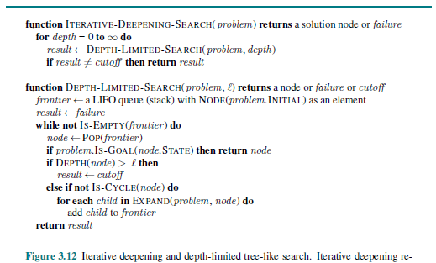
Depth-limited Search and IDS Pseudo-code

Slide 34
Bidirectional Search
Bidirectional search executes two searches simultaneously, one forward from the initial state, and another backwards from the goal state (assuming there is only one goal state)
We will assume both searches use BFS; we are not going to look at pseudo-code
Bidirectional search is only possible to search backwards if predecessors of a node are computable; this is easy if all actions are reversible (as with, e.g., the 8-puzzle or the Romania map problem)
The search must check if each new node generated is already in the other frontier
Motivation: b^{d/2} + b^{d/2} is much less than b^{d}
The time complexity is O(b^{d/2}) using BFS
The space requirement is also O(b^{d/2}); this is better than BFS but still a weakness
Assuming both searches use BFS, bidirectional search is complete with a finite branching factor; it is optimal if there are uniform step costs
Bidirectional search is difficult to implement if there are multiple goal states
The next slide summarizes properties of the uninformed search strategies that we discussed
I add: In the figure, I think that BFS, IDS, and Bidirectional Search should indicate No for optimality with a footnote, as opposed to Yes with a footnote

Slide 35
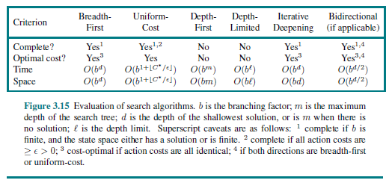
Comparing Uninformed Search Algorithms

Slide 36
Sensorless Problems
Up until now, we have been assuming that the environment is fully observable; otherwise, things get more complicated
In a sensorless problem (a.k.a. a conformant problem), the agent has no sensors
Some such problems are not solvable, but some are, using the sort of uninformed search strategies we have been discussing
The set of states an agent may be in is a belief state
In a fully observable environment, every belief state contains exactly one state
To solve sensorless problems, an agent must search in the space of belief states (the belief-state space)
A solution is a path leading to a belief state such that all members are goal states

Slide 37
Sensorless Version of the Vacuum World
The 8 states of the vacuum world have now been numbered, as shown on the next slide
States 7 and 8 are goal states
In a sensorless version of the vacuum world, the initial state (a belief state) is the set of all 8 states
There are 2⁸-1 = 255 plausible belief states (all possible subsets of the 8 real sates except the empty set)
However, only 12 belief states are reachable from the initial state
The slide after the next slide shows the belief-state space for the sensorless version of the vacuum world
Note that the action sequence [right, clean] will always lead to one of the states 4 or 8, so the belief state after these actions would contain states 4 and state 8
The action sequence [right, clean, left, clean] will always lead to one specific goal state, state 7, so the belief state after these actions would only contain state 7
We see that there are paths leading to solutions (belief states containing only goal states)
For this problem, the solution belief states happen to contain exactly one goal state; for some problems, there might be solutions leading to a belief state with multiple goal states

Slide 38
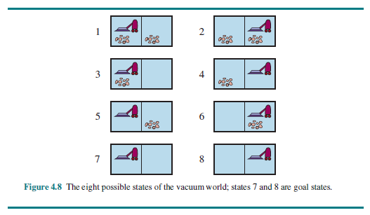
The States of the Vacuum World

Slide 39
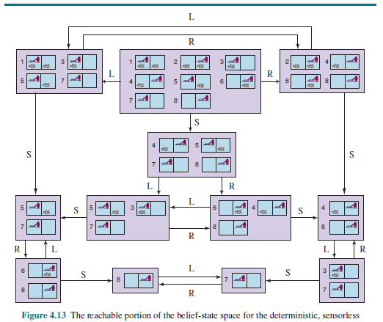
Sensorless Vacuum World Belief-state Space

