Slide 1
ECE469: Artificial Intelligence
Deep Learning and NLP

Slide 2
Natural Language Processing (recap)
Recall that natural language processing (NLP) is a subfield of artificial intelligence (AI) that deals with the processing of text specified using natural languages
Natural languages are languages that are spoken by (or written by or otherwise used by) people; e.g., English, French, Japanese, etc.
This is as opposed to formal languages, such as first-order logic or programming languages
In this course, I have divided our unit on NLP is divided into three topics; I am calling them:
  "Conventional Statistical Natural Language Processing" – This topic covered statistical NLP approaches that dominated the field until around 2013
  "Conventional Computational Linguistics" – This topic covered natural languages, in general, and approaches to processing natural languages that consider linguistics
  "Deep Learning and NLP" – This topic covers modern approaches to NLP
We have already covered conventional, statistical NLP as well as conventional computational linguistics
We are now going to cover deep learning and NLP
In addition to a chapter from our textbook (current edition), this topic is also partially based on material from parts of "Speech and Language Processing" by Jurafsky and Martin

Slide 3
Vector Space Model (recap)
We previously learned that the vector space model was a popular approach in conventional, statistical NLP
This implies that documents (or sometimes queries, categories, etc.) are represented as vectors of word weights
For example, the TF*IDF weighting scheme was extremely popular in the field for decades
Each dimension of the vector represents a word or token from the vocabulary
Tokens may be stemmed or lemmatized, but either way, two tokens are considered exact matches or completely different
A single token can be thought of as a one-hot vector
These vectors could be fed as input to conventional machine learning algorithms

Slide 4
Word Embeddings
Many modern approaches often rely heavily on word embeddings (a.k.a. word embedding vectors or word vectors)
This means that each distinct word (or, more generally, term, token, subword, character, etc.) is represented by a learned numerical vector
To gain intuition as to why a vector of values might serve as a reasonable representation of a word, recall the notion of a term-document matrix, mentioned during our discussion of information retrieval
This is a matrix in which rows represent words and columns represent documents; a simple example is shown on the next slide
In practice, we do not store the entire matrix, since it is sparse
Rather, for each term, we store an inverted index that maps each term to the documents in which it is contained
The inverted index can also include positions and/or term weights (such as TF*IDF)
It stands to reason that words with similar rows in the term-document matrix are likely to have similar meanings
The distributional hypothesis more generally predicts that words with similar semantic meaning will occur in similar contexts

Slide 5
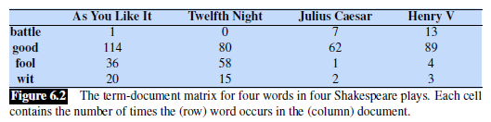
Term-document Matrix Example (from J&M)

Slide 6
Latent Semantic Analysis
The idea of representing words as vectors has a long history in NLP
For example, when I was a graduate student, latent semantic analysis (LSA) was popular
The technique would learn, based on a corpus, orthogonal vectors that could be thought of as abstract "concepts" that are important to the corpus
All text-based sequences (including, for example, documents, queries, and single words) could then be represented as weighted sums of these concepts
Without getting into any details, LSA involved the use of singular value decomposition (SVD) applied to a matrix that is related to the term-document matrix
When LSA was used in the context of information retrieval (IR), the approach was known as latent semantic indexing
While interesting, my impression was that LSA did not seem to perform as well, empirically, as other approaches for IR or other NLP tasks such as text categorization

Slide 7
Modern Word Embeddings
Starting around 2013, deep learning has transformed the field of NLP
Part of what made this possible was effective methods of learning useful word embeddings
As with some previous approaches, the idea is to create a d-dimensional vector, with a fixed d, to represent each word, or more generally term, in a vocabulary
Typically, d is in the range of 50 to 500
The break-through approach to word embeddings was word2vec, and this is the approach we will discuss in this course (but we will not cover most of the technical details)
Other approaches, including one known as GloVe, may work better for many tasks
Some approaches learn embeddings for subwords or characters, instead of words
More recently, contextual word embeddings such as those produced by BERT have led to state-of-the-art results for many NLP tasks
All these approaches involve pre-training using a large, unlabeled corpus; this is a form of unsupervised machine learning

Slide 8
Pre-word-embedding Neural Networks
Consider neural networks (NNs) applied to NLP tasks (e.g., text categorization) without word embeddings
A typical conventional approach was to have an input node for every word in the vocabulary
That is, if the size of the vocabulary is V, there would be V input nodes for the neural network; this would typically be a rather large input layer
The values of the inputs could be Boolean values, word counts, or TF*IDF weights
If the input to the neural network represents a document, the input layer could be set to the document's vector space representation
This was a bag-of-words approach; the order of the words in the input document does not affect the input to the neural network
Optionally, other input features could also be included, in addition to the words

Slide 9
Problems with Pre-word-embedding NNs
There were several problems with using NNs for NLP tasks without word embeddings
  There were a lot of weights between the inputs and the first hidden layer; this could lead to overfitting
  There is no simple way to incorporate word order into the methodology
  Even incorporating bigrams would blow up the number of input nodes
  Two very similar words are represented by entirely different nodes
  Of course, techniques such as stemming or lemmatization could be used
  However, any two tokens would be treated as either identical or totally different
It is my impression that, before word embeddings became popular, NNs did not achieve state-of-the-art results for most (possibly all) NLP tasks

Slide 10
Advantages of Word Embeddings for NNs
The number of input nodes is related to d, the dimension of the word embeddings
  For different tasks and architectures, the input might be one word embedding at a time or a fixed number of word embeddings at a time
  For convolutional neural networks (e.g., applied to sentence classification), word embeddings from one padded sentence at a time might be the input
  For recurrent neural networks, typically one word embedding at a time is used as input, and the words of a sentence are traversed in a sequence
  For transformers, the word embeddings for a sentence or other short sequence of text is typically used as input at one time
Similar (but non-identical) words will have similar word embeddings

Slide 11
Word2vec
In 2013, a team at Google (Mikolov et. al.) created and released a group of related methods for learning word embeddings
Together, these methods are known as word2vec
The principle behind both methods is related to the distributional hypothesis (mentioned earlier)
One method, called continuous bag-of-words (CBOW), learns embeddings useful to producing the current word in a text based on the surrounding context words
The other method, called the skip-gram method, learns embeddings useful to predict context words within a window of the current word
We will focus on the skip-gram method
Conceptually, either method can learn word embeddings by training a shallow neural network on an unlabeled corpus
In practice, more efficient techniques are used (we will not discuss the details in this course)

Slide 12
The Skip-gram Model Learns Two Embeddings
The skip-gram method learns two embeddings for each word, w
  One is called the target embedding, t, which basically represents w when it is the current word, or center word, surrounded by other context words
  The other is called the context embedding, c, which basically represents w when it appears as a context word around another target word
A target matrix, T, is a matrix with |V| rows and d columns that contains all the target embeddings (one per row)
The i^{th} row of T is a 1 x d vector, t_{i}, for the i^{th} word of the vocabulary, V, where d is the dimension of the word embeddings
A context matrix, C, is a matrix with d rows and |V| columns that contains all the context embeddings (one per column)
The j^{th} column of C is a d x 1 vector, c_{j}, for the j^{th} word of the vocabulary, V

Slide 13
Learning the Skip-Gram Model Matrices
During training, we only consider context words within some small window of size, L, of each target word
The probability of seeing w_{j} in the context of a target word, w_{i} (i.e., within the window) can be denoted as P(w_{j} | w_{i})
This probability is related to the dot product of the target vector for w_{i} and the context vector for w_{j}; i.e., t_{i} ∙ c_{j}
Without discussing the details of how this is done, during training:
  The target embeddings of words are pushed closer to the context embeddings of words they appear close to (within the window)
  The target embeddings of words are pushed away from other context embeddings
After training, it is possible to just use the target embeddings (i.e., the rows of the T matrix) as the final embeddings
However, it is more common to sum, average, or concatenate the target embeddings and the context embeddings (the columns of the C matrix) to produce the final vectors
The figure on the next slide (from an earlier draft of J&M) depicts an example of the T and C matrices

Slide 14
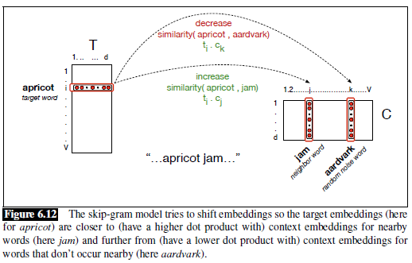
Word2vec Matrices Depiction (from J&M)

Slide 15
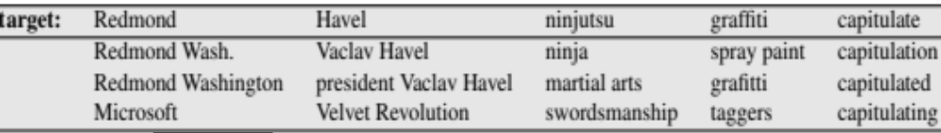
Embeddings for Word Similarity
We have learned that word2vec word embeddings are trained for the purpose of predicting nearby words
However, they turn out to be useful for many other NLP-related tasks
One thing that word embeddings can simply be used for is to compute word-to-word similarity
We can simply compute the dot product between two embeddings
We can also look for the closest embeddings in the d-dimensional space to that of any specified word
For example (from a PowerPoint presentation associated with an earlier draft of J&M):
It may seem odd that some of the terms here contain multiple words, but there are various techniques that can be applied during tokenization to treat common phrases as single tokens

Slide 16
Visualizing Word Embeddings
To help with visualization of word embeddings, the d-dimensional vectors can be mapped to two dimensions
One approach to do this is principal component analysis (PCA)
Today, a more popular method is known as t-SNE
These t-SNE plots can also help visualize differences between embeddings
Surprisingly, differences between embeddings also seem to be meaningful
An example of two t-SNE plots of word embeddings is shown on the next slide (the example is discussed further on the following slide)

Slide 17
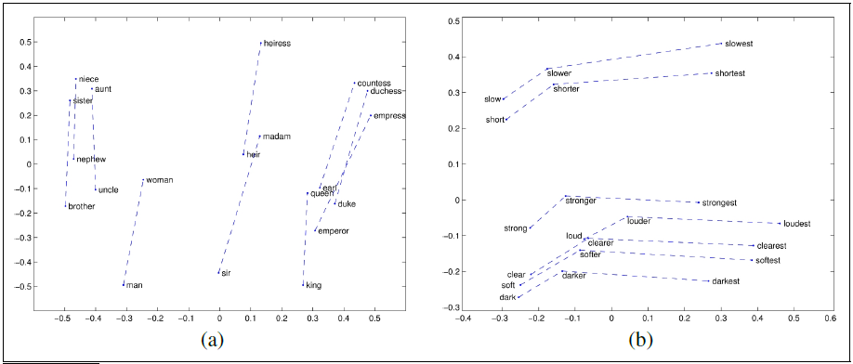
Visualizing Embeddings (t-SNE plot from J&M)

Slide 18
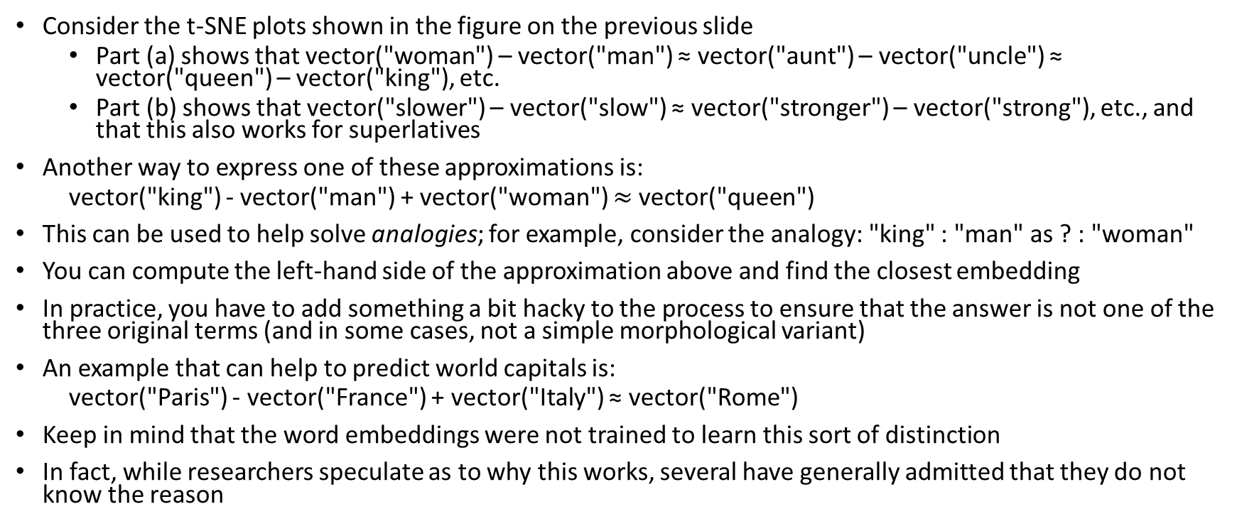
Differences Between Embeddings (examples)
Consider the t-SNE plots shown in the figure on the previous slide
  Part (a) shows that vector("woman") – vector("man") ≈ vector("aunt") – vector("uncle") ≈ vector("queen") – vector("king"), etc.
  Part (b) shows that vector("slower") – vector("slow") ≈ vector("stronger") – vector("strong"), etc., and that this also works for superlatives
Another way to express one of these approximations is:
  vector("king") - vector("man") + vector("woman") $≈$vector("queen")
This can be used to help solve analogies; for example, consider the analogy: "king" : "man" as ? : "woman"
You can compute the left-hand side of the approximation above and find the closest embedding
In practice, you have to add something a bit hacky to the process to ensure that the answer is not one of the three original terms (and in some cases, not a simple morphological variant)
An example that can help to predict world capitals is:
  vector("Paris") - vector("France") + vector("Italy") ≈ vector("Rome")
Keep in mind that the word embeddings were not trained to learn this sort of distinction
In fact, while researchers speculate as to why this works, several have generally admitted that they do not know the reason

Slide 19
Evaluating Word Embeddings
There are various ways to evaluate word embeddings; for example:
  Word similarity scores can be correlated to human judgements of similarity
  The embeddings can be evaluated with word analogy tasks
  The embeddings can be used for other, more complex tasks, and the performance on those tasks can then be evaluated
The first two tasks could arguably be considered examples of intrinsic evaluation (although I would claim this is debatable)
The third example would clearly be an example of extrinsic evaluation
Examples of tasks that rely on embeddings include sentence classification, machine translation, question answering, etc.

Slide 20
Using Word Embeddings with NNs
Word embeddings can now be used as inputs to various forms of NNs, including feedforward neural networks, convolutional neural networks, and recurrent neural networks (RNNs)
In this course, we will focus on recurrent neural networks, because these are unusually different from other neural networks, and have been used in NLP more than other fields
Until about five years ago, variations of RNNs dominated the field for many NLP tasks
More recently, transformer-based architectures have performed better for most of these tasks
Depending on the task, either pre-trained word embeddings (e.g., from word2vec) can be used, or lower layers of the networks can learn task-specific and domain-specific embeddings
For some tasks, such as POS-tagging, each input word gets mapped to a prediction
For other tasks, such as text categorization, a document or a sentence gets mapped to a category
For other tasks, such as machine translation, where we want to map an input sequence to an output sequence, an encoder-decoder model is used (this concept will be further explained later)

Slide 21
Simple RNN
A recurrent neural network (RNN) "is any network that contains a cycle within its network connections" (J&M)
We will start by covering simple recurrent networks, a.k.a. Elman networks or vanilla RNNs
A simple RNN has a single hidden layer, with outputs that lead back to its own inputs; the J&M textbook calls this a recurrent link
As with feedforward neural networks, layers can be implemented as vectors, and weights between layers can be implemented as matrices
The recurrent link can also be implemented as a matrix
The next slide shows a diagram of a simple RNN

Slide 22
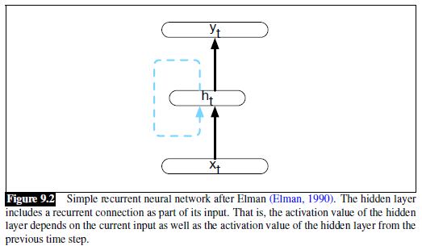
Simple RNN: Diagram (from J&M)

Slide 23
Simple RNN: Equations
The next slide shows what happens at a single iteration, or step, of the RNN as it is processing input sequentially
The equations describing what happens at each time step are:
  h_{t} = g(Uh_{t-1} + Wx_{t})
  y_{t} = f(Vh_{t})
If the output layer is assumed to be a softmax layer, we can write:
  y_{t} = softmax(Vh_{t})
Sometimes you will see additional terms in the parentheses representing bias weights; for example:
  h_{t} = g(Uh_{t-1} + Wx_{t} + b_{h})
  y_{t} = f(Vh_{t} + b_{y})

Slide 24
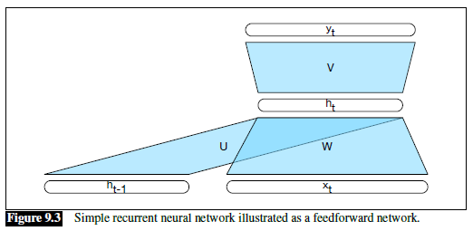
Simple RNN: Single Time Step (from J&M)

Slide 25
Simple RNN: Unrolling an RNN
It is common to depict an RNN as unrolled (e.g., see the next slide)
Basically, each time step (for some fixed number of time steps) is drawn separately
The number of depicted time steps shown in the unrolled network is arbitrary
Such a diagram helps intuit how forward inference in an RNN proceeds
When a simple RNN is applied to input, it keeps taking inputs until there are no more
The values at the hidden layers and output nodes change, but the U, W, and V matrices do not (they change during training, but not during forward inference)
As with feedforward neural networks, the network can be trained using stochastic gradient descent and backpropagation
The matrices change multiple times during the backpropagation of a single example or batch; for RNNs, this is sometimes called backpropagation through time

Slide 26
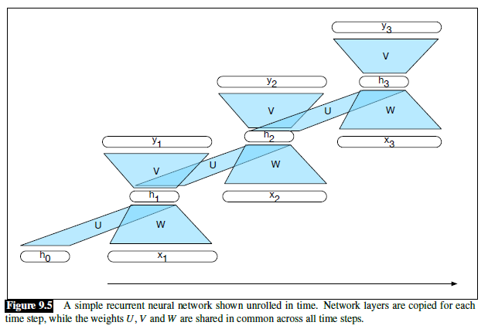
Simple RNN: Unrolled (from J&M)

Slide 27
Simple RNN: Sequence labelling
Sequence labeling refers to any task that involves categorizing every item in a sequence
One example is part-of-speech tagging (POS tagging)
See the next slide for a diagram of a simple RNN that can be used for POS tagging
The softmax layer is used to here pick the single most likely tag, given the current hidden state
The current hidden state, in turn, is based on the current word’s embedding and the previous hidden state
Recall that conventionally, hidden Markov models (HMMs) were often used for POS tagging
In general, state-of-the-art deep learning POS taggers perform a bit better than conventional POS taggers
State-of-the-art deep learning taggers do not use simple RNNs, but rather use variations of RNNs that we have not discussed yet

Slide 28
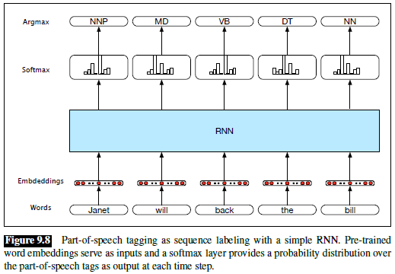
Simple RNN: POS tagging (from J&M)

Slide 29
Simple RNN: Text Categorization
Simple RNNs can be applied for text categorization (TC)
  As with other tasks we have discussed, state-of-the-art RNN results involve variations of RNNs that we haven’t yet discussed
  RNNs, in general, have mostly been successful for the categorization of short sequences of text, such as tweets or individual sentences
See the next slide for a diagram of a simple RNN that can be used for TC
  The inputs are presumably word embeddings, probably pre-trained
  Within the blue box, N hidden states are being computed, one for each word in the sequence
  It is common to think of the final hidden state, which is the input to a feedforward neural network, as representing the meaning of the text
As with all neural networks we have looked at, the network can be trained end-to-end using stochastic gradient descent and backpropagation

Slide 30
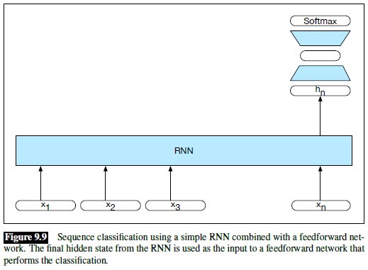
Simple RNN: TC Example Network (from J&M)

Slide 31
Stacked RNNs
A stacked RNN uses the hidden stated produced by one RNN as the inputs to the next
We can then refer to each RNN as a layer
The final RNN in the stack produces the final outputs of the stack
That is, the hidden states of the top layer can be used as outputs of the stack, perhaps sent as input to another layer, such as a softmax layer
The next slide shows a diagram of a stacked RNN
Stacked RNNs have outperformed single-layer RNNs for many tasks
The optimal number of RNN layers varies according to the task and the training set
Adding additional layers of RNNs can significantly increase the training time
The entire stack is trained at once using end-to-end training

Slide 32
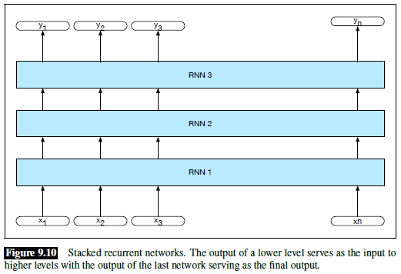
Stacked RNN Diagram (from J&M)

Slide 33
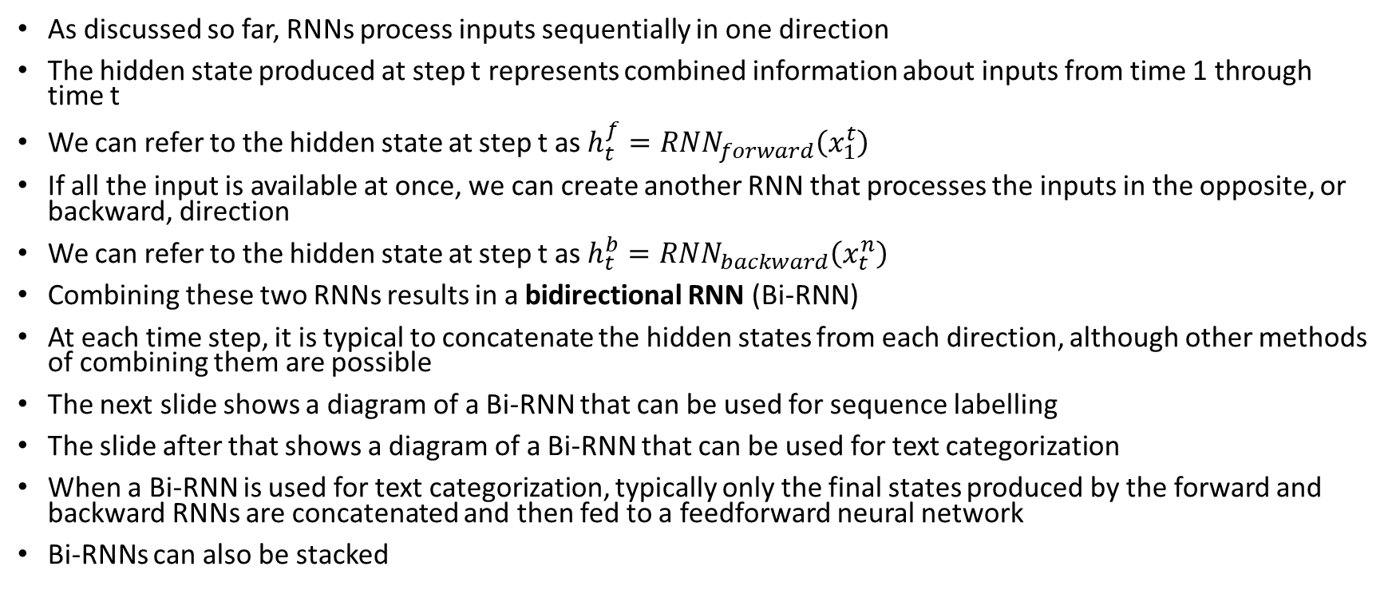
Bidirectional RNNs
As discussed so far, RNNs process inputs sequentially in one direction
The hidden state produced at step t represents combined information about inputs from time 1 through time t
We can refer to the hidden state at step t as $h_{t}^{f}={RNN}_{forward}\left(x_{1}^{t}\right)$
If all the input is available at once, we can create another RNN that processes the inputs in the opposite, or backward, direction
We can refer to the hidden state at step t as $h_{t}^{b}={RNN}_{backward}\left(x_{t}^{n}\right)$
Combining these two RNNs results in a bidirectional RNN (Bi-RNN)
At each time step, it is typical to concatenate the hidden states from each direction, although other methods of combining them are possible
The next slide shows a diagram of a Bi-RNN that can be used for sequence labelling
The slide after that shows a diagram of a Bi-RNN that can be used for text categorization
When a Bi-RNN is used for text categorization, typically only the final states produced by the forward and backward RNNs are concatenated and then fed to a feedforward neural network
Bi-RNNs can also be stacked

Slide 34
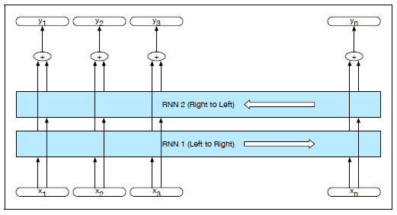
Bi-RNN for Sequence Labelling (from J&M)

Slide 35
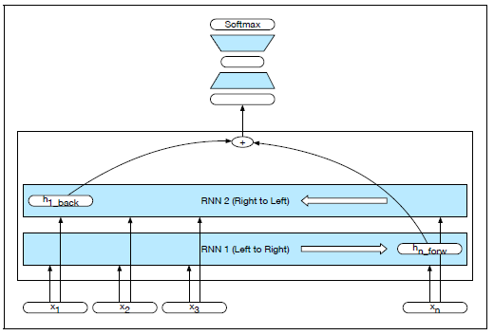
Bi-RNN for Text Categorization (from J&M)

Slide 36
The Vanishing Gradient Problem
During backpropagation, for each layer or time step that error is backpropagated, there is a multiplication taking place
Typically, these multiplications reduce the gradients; that is, the further back we go, the less significant layers or states seem to be
This leads to the vanishing gradient problem
We also discussed this issue during our topic on deep learning; it affects all deep neural network architectures (not just RNNs)
For other sorts of architectures (e.g., CNNs and feed-forward NNs), rectified linear units (ReLUs) mitigate the problem to an extent
However, ReLUs are not typically used for RNNs
There is a related problem known as the exploding gradient problem, also briefly mentioned during our topic on deep learning
That can be dealt with very simply, by just placing a cap on the gradients
Unfortunately, there is no such simple solution for the vanishing gradient problem

Slide 37
Non-local Context
Without any solution to mitigate the vanishing gradient problem, only very local context winds up being significant
I have read that, for NLP tasks, hidden states in a simple RNN are only significantly influenced by the previous two or three words
Sometimes that is not enough
Consider this example from J&M: "The flights the airline was cancelling were full."
In order to know that "were" is the appropriate word, we need to recognize that the subject of the sentence, "flights", is plural
Note that the only other noun in between, "airline", is singular

Slide 38
Long Short-Term Memory Units
Long short-term memory (LSTM) networks provide one solution for mitigating the vanishing gradient problem
Often, the network, or an entire layer, is just referred to as an LSTM
It is common to depict LSTMs graphically in terms of cells, also sometimes called units
Such depictions show the LSTM unrolled; the cell is the component of the architecture that repeats
We can also depict simple RNNs as cells, for a quick comparison
We will only discuss LSTMs briefly in this course
I am partially relying on this blog post for my slides on LSTMs: https://colah.github.io/posts/2015-08-Understanding-LSTMs
The next slide shows a diagram of an unrolled RNN in terms of cells, assuming a tanh activation function (from the LSTM blog)
The slide after that shows a diagram of an LSTM in terms of cells (from the LSTM blog); note that the cells are more complex (we'll briefly discuss the contents of each cell shortly)

Slide 39
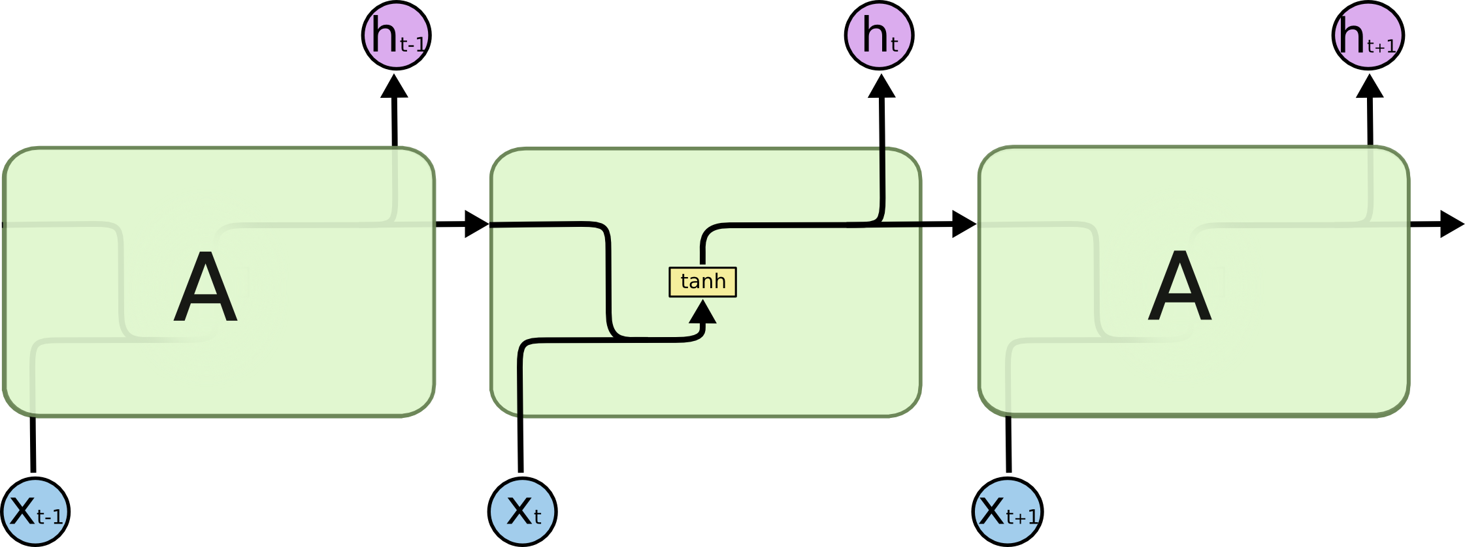
A Simple RNN Viewed in Terms of Cells
https://colah.github.io/posts/2015-08-Understanding-LSTMs

Slide 40
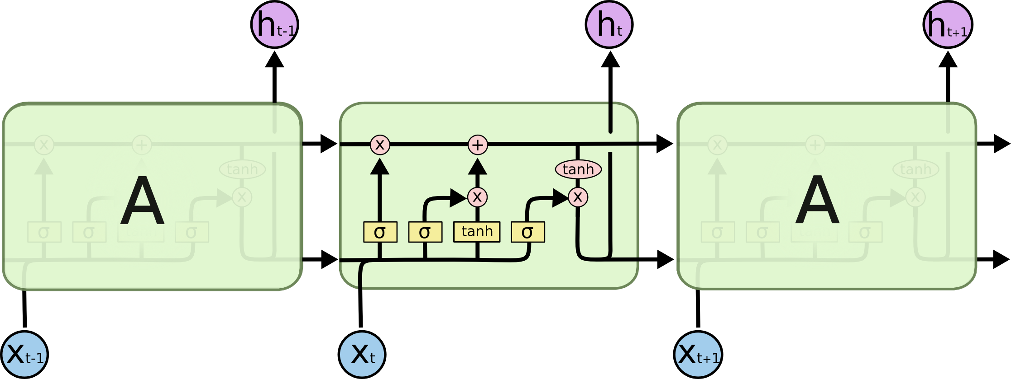
An LSTM Viewed in Terms of Cells
https://colah.github.io/posts/2015-08-Understanding-LSTMs

Slide 41
LSTM Cells
LSTM cells have two sets of values (which we can think of as vectors) that are passed between cells (really, they are being passed as feedback between one time step and the next)
One set of values (the one on top in the figure) is typically referred to as the cell state
The other set of values is the cell's hidden state
A single LSTM cell/unit accepts as input the previous cell's cell state, the previous cell's hidden state, and the current input (which is also a vector)
The cell generates an updated cell state and an updated hidden state, which are passed to the next cell (really the same unit at the next time step)
The hidden state can also serve as the cell's output (i.e., it is visible outside the cell and can be used for classification, or as input to the next stacked LSTM layer)
Certain components of each cell are referred to as gates; we are not going to discuss the gates of an LSTM cell in detail in this course (I'll talk about them a bit in class)
The gates, along with the previous hidden state and the current input, help to determine which parts of the previous cell state to keep and/or forgot
As with other NN architectures that we have covered, we can learn the weights (i.e., train the LSTM) end-to-end using stochastic gradient descent and backpropagation

Slide 42
Encoder Decoder Networks
Many NLP tasks involve mapping a sequence of text to another sequence of text
Examples include machine translation (MT), summarization, and (in some sense) question-answering (QA)
Encoder-decoder networks, also known as sequence-to-sequence (seq2seq) models, are capable of this
An example of an encoder-decoder network (from an earlier draft of J&M) is shown on the next slide
  The first portion of such a network is the encoder, which processes the input sequence, resulting in a context vector
  The second part of a network, called the decoder, starts with the context vector and generates the output sequence
We will not discuss encoder-decoder networks in detail in this course

Slide 43
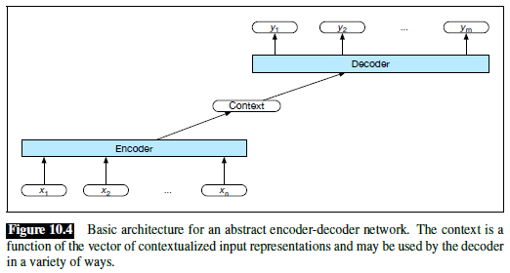
Basic Encoder-Decoder Network (from J&M)

Slide 44
Attention
One issue is that, as the output sequence is generated, the relative importance of different portions of the input sequence change
A very important concept known as attention can help to deal with this
Instead of having a static context vector, a different context vector is generated at each time step of the decoder
The figure on the next slide shows a graphical depiction of an attention mechanism (from an earlier draft of J&M)
Circa 2016, LSTMs with attention dominated the field of NLP
We will not discuss attention in detail in this course

Slide 45
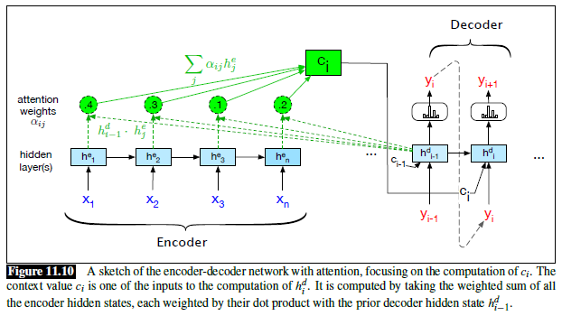
Attention: Graphical Depiction

Slide 46
Transformers
In December 2017, a paper titled "Attention is All You Need" was published by a group of researchers from Google
The paper introduces a new neural architecture called a transformer (sometimes capitalized), which does not rely on any recurrence or convolutions
The architecture of a transformer is shown on the next slide (we are only going to discuss this briefly)
As described in the original paper, a transformer is another example of an encoder-decoder network
Since the publication, variations of transformers have dominated the field of NLP
Transformers also led to the development of systems such as BERT that can produce contextual word embeddings
BERT relies on a transformer encoder, and has proven to be extremely successful for many NLP applications, typically involving classification
The GPT systems rely on a transformer decoder; these have been extremely successful for NLP applications involving generation of text
We are not going to discus transformer-based systems further in the course

Slide 47
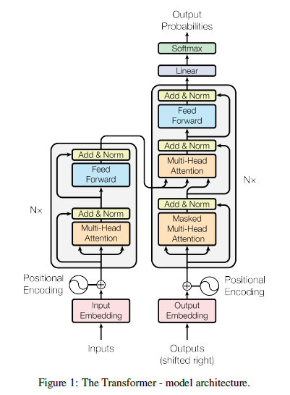
Transformer Architecture
A Transformer architecture, taken from "Attention is All You Need", is shown to the right
The encoder and decoder both rely on stacked layers
Each layer has sublayers
Some of the sublayers rely on a concept called self-attention (I will briefly discuss this in class)
Others are point-wise (a.k.a. position-wise), fully-connected, feedforward NNs
There are also skip connections around the sublayers
Note that positional encodings are added to the input and output token embeddings
This allows transformers to be dependent on word order

