Slide 1
ECE469: Artificial Intelligence
Hidden Markov Models

Slide 2
Stochastic Processes
We will be considering stochastic processes in which the values of random variables change over time according to their probability distributions
Historically, hidden Markov models (HMMs) have been very successful in AI and machine learning to deal with such processes
In recent years, other methods involving various forms of recurrent neural networks or Transformers have performed better for most of these applications
We will learn about these methods during later units of the course
The relevant sections for this topic from Ed. 4 of the textbook are Sections 14.1 – 14.3, but I am only partially relying on our textbook for this topic
I have largely based this topic on the following 2001 journal article:
  "An Introduction to Hidden Markov Models and Bayesian Networks", by Zoubin Ghahramani
Additionally, some of the information has been based on the textbook that I use for my NLP course:
  "Speech and Language Processing (3rd edition draft)" by Dan Jurafsky and James H. Martin

Slide 3
Markov ___________
The Markov property holds if the conditional probability distributions for future states of random variables, given the current state and all past states, depend only on the current state
A Markov process is a stochastic process that has the Markov property
Some sources, including our textbook, refer to this more specifically as a first-order Markov process
With a more general n^{th}-order Markov process, the probability distribution for each state depends on the n previous states
With a (regular) Markov model, the Markov assumption states that the system being modeled is a Markov process
Let X be a random variable, and at every time unit t, the state (or value) of X is X_{t}; using our textbook's notation, we can write: P(X_{t} | X_{0:t-1}) = P(X_{t} | X_{t-1})
This is called a transition model for first-order Markov processes, and the probabilities defined above are sometimes referred to as transition probabilities
We are generally assuming that the random variables and time steps are discrete, in which case the process is also known as a Markov chain
Some sources differ in the exact definitions of some of these terms

Slide 4
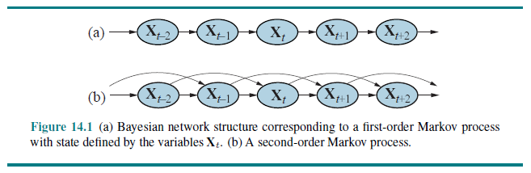
Dynamic Bayesian Networks
A dynamic Bayesian network is Bayesian network in which the nodes represent random variables at different time steps
Although the term "time steps" is commonly used, really, the nodes can refer to steps of more general sequences
All directed links in such a Bayesian network will flow forward in time (or, more generally, forward in the sequence)
Markov processes can easily be represented by dynamic Bayesian networks:

Slide 5
Hidden Markov Models
A hidden Markov model (HMM) is used when the states of X cannot be observed directly, but there are observable evidence variables, denoted by E, that are dependent on the states
The Xs in this case are therefore often referred to as hidden variables
We assume that the conditional probability distribution of each evidence variable depends only on the current hidden state; thus, we can write: P(E_{t} | X_{0:t}, E_{1:t-1}) = P(E_{t} | X_{t})
This is called a sensor model, because it can be used to explain how sensors work; the sensors can be represented by the observable evidence variables that depend on the current state
The probabilities defined above are sometimes called emission probabilities (a.k.a. output probabilities or observation likelihoods)
As with regular Markov models, the probabilities P(X_{t} | X_{t-1}) are called transition probabilities
Two other assumptions when using HMMs are:
  The hidden states are discrete with a finite domain
  The various probability distributions do not change over time (this is called the stationarity assumption)
We also need to specify P(X₀), the prior probability distribution for the initial state of X
With our model, we can compute all probabilities from the complete joint probability distribution as follows: P(X₀, ..., X_{t}, E₁, ..., E_{t}) = P(X₀)∏_{1...t}[P(X_{i} | X_{i-1}) P(E_{i} | X_{i})]

Slide 6
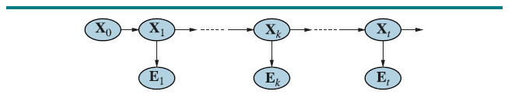
HMMs as Dynamic Bayesian Networks
HMMs can easily be represented as dynamic Bayesian networks (our textbook describes dynamic Bayesian networks more generally in a later section):
Note that many sources include an E₀, which I personally think makes more sense in most cases
However, I will follow our textbook's convention, which does not include an evidence variable corresponding to the initial state
Note that not all sources depict HMMs as a Bayesian network at all
  Some sources, instead, depict each possible value for the hidden states of an HMM as a separate node, with links between them labeled with the transition probabilities
  Separate links from each of these nodes lead to nodes representing possible values of evidence variables, and these links are labeled with emission probabilities
  The two depictions are mathematically equivalent, and we will not discuss this alternative further

Slide 7
Applications of HMMs
Some (of the many) applications that hidden Markov models have been applied to include:
  Speech recognition: The states represent the intended phonemes, and the evidence variables represent the acoustical representation of the sound
  Optical character recognition (some forms): The states represent the strokes of a pen, and the evidence variables represent a combination of location and pressure
  Machine translation: The states represent the tokens (e.g., words) in the destination language, and the evidence represents the tokens in the source language
  Part-of-speech tagging: The states represent intended parts of speech, and the evidence represents words
  Gesture recognition: For example, we have had senior project groups attempt automatic sign language recognition based on readings from flex sensors on a glove
  Various applications in bioinformatics and genomics, including gene finding and the analysis of DNA or protein sequences
Note that for some of these applications, time is replaced by position in a sequence

Slide 8
Types of Problems Solved by HMMs
We will discuss three types of problems that can be solved using an HMM:
  Determine the probability of a particular output sequence (i.e., a sequence of values for the evidence variables) given the parameters of the HMM, λ
  Determine the most likely sequence of hidden states given an output sequence and the parameters of an HMM
  Adjust the parameters of an HMM, given an output sequence or a set of output sequences (i.e., a training set), to make the output more likely
The algorithms we will cover for the first two tasks are both examples of dynamic programming algorithms
The third task is an example of a machine learning task; we will only discuss this briefly in relation to HMMs

Slide 9
Computing Probabilities of Output Sequences
Note that there can be an exponential number of sequences of hidden states that lead to a particular output sequence, so a brute force approach to this calculation is intractable
The forward algorithm first computes the probability of being in each possible state at each time, and then computes the probability of each evidence value
First, we will define a quantity known as a forward probability: α_{t}(i) = P(E_{1:t}, X_{t} = s_{i} | λ)
This is equal to the probability of seeing all the observations so far up until time t, and being in some specific state, s_{i}, given the parameters of the HMM
We can then apply the following steps:
  Initialization: α₀(i) = P(X₀=s_{i})
  Induction: α_{t}(j) = [∑_{i=1:N} α_{t-1}(i) * P(X_{t}=s_{j} | X_{t-1} = s_{i})] P(E_{t} | X_{t} = s_{j})
  Termination: P(O | λ) = ∑_{i=1:N} α_{T}(i)
My drawing on the next slide may help to visualize the process (I'll also discuss it in class)
The time complexity is O(T * N²), where T is the number of steps in the sequence and N is the number of possible states
This is because we loop both i and j from 1 to N and t from 1 to T during induction

Slide 10
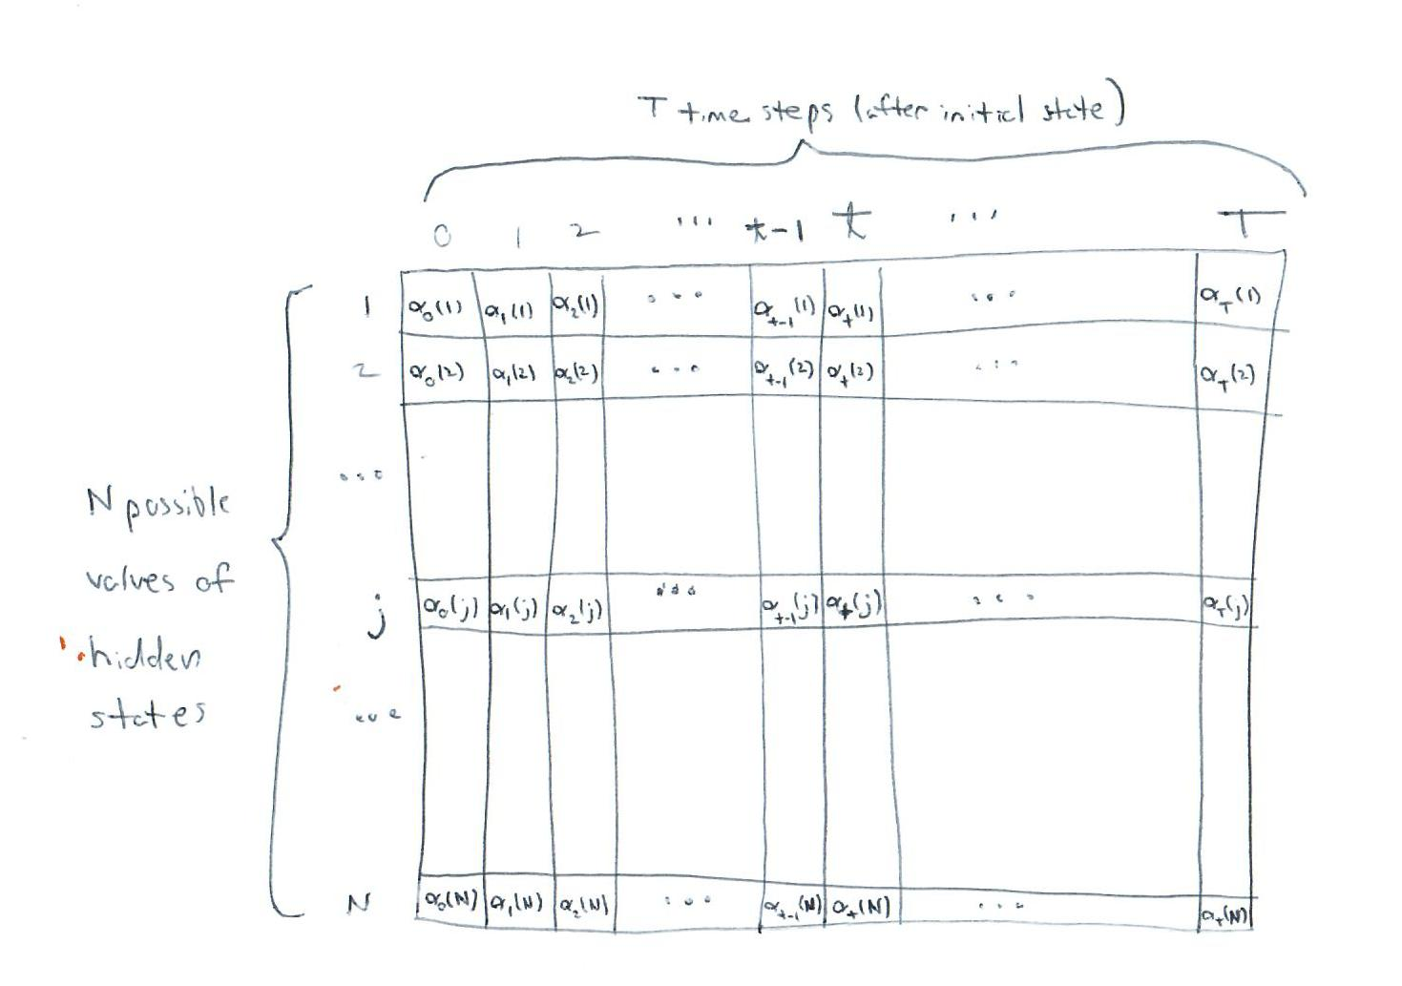
Matrix to Store All Alpha Values

Slide 11
Determining the Most Likely Hidden States
Typically, you learn the parameters of the HMM first (we’ll briefly discuss this next)
Then, you apply the trained HMM to future examples to predict the values of the hidden states given sequences of observed data; this is an example of a sequence labelling task
For example, for speech recognition, you feed the HMM sequences of labeled audio samples for training, and then you can predict the phonemes represented by later audio samples
The prediction of hidden states is typically performed using the Viterbi algorithm
Earlier, we defined the forward probability, α_{t}(i), as the probability of seeing the observations so far up until time t, and being in some specific state, s_{i}, given the parameters of the HMM
Now, we will define δ_{t}(i) as the probability of the most likely path (a.k.a. the Viterbi path) for the observations so far up until time t, and ending at state s_{i}, given the parameters of the HMM:
The procedure is very similar to the forward algorithm:
  Initialization (same as α): δ₀(i) = P(X₀=s_{i})
  Induction (we are replacing a summation with a max): δ_{t}(j) = max_{i=1:N} [δ_{t-1}(i) * P(X_{t}=s_{j} | X_{t-1}=s_{i})] P(E_{t} | X_{t}=s_{j})
  Termination (again replacing a summation with a max): P* = max_{i=1:N} δ_{T}(i)
P* is the probability of the single most likely path accounting for the observed evidence

Slide 12
Retrieving the Viterbi Path
Assuming we also want to be able to retrieve the Viterbi path (the most likely sequence of hidden states, given the evidence and the parameters of the HMM), we need two additional variables
At the induction step, for t = 1:T, we add: ψ_{t}(j) = argmax_{i=1:n} [δ_{t-1}(i) * P(X_{t}=s_{j} | X_{t-1}=s_{i})] P(E_{t} | X_{t}=s_{j})
In other words, we are remembering the previous state that led to the maximum probability for each current state
At the termination step, we add: q*_{T} = argmax_{i=1:n} δ_{T}(i)
The value of q*_{T} represents the most likely final state of the Viterbi path
We can then reconstruct the rest of the Viterbi path by looping from T-1 down to 0 and calculating: q*_{t} = ψ_{t+1}(q*_{t+1})
In other words, as we iterate backwards, we keep track of the most likely state to account for the already determined next state
The final sequence denoted by the concatenation of q*₀ through q*_{T} represents the Viterbi path
As with the forward algorithm, the time complexity of the Viterbi algorithm is O(T * N²)

Slide 13
Training an HMM
Adjusting the parameters of the HMM given a training set can be very simple or much more difficult, depending on the type of training data we are dealing with
If the training data includes labels for both hidden states and evidence variables, the learned estimates of both transition probabilities and emission probabilities are just simple ratios
We will discuss an example of a task called part-of-speech tagging, where this simple type of training is typical, during the unit of the course on natural language processing
If the training data only includes the values of evidence variables, and the domain for hidden states is known, we can use an algorithm called the Baum-Welch algorithm
The Baum-Welch algorithm is an instance of the more general expectation maximization (EM) algorithm
  Roughly speaking, we iterate back and forth between an E step and an M step
  The E-step computes probabilities of the evidence given the current parameters of the model
  The M-step re-estimates the parameters of the model to make the evidence more likely
We are not going to discuss the details of EM, but we may briefly mention it again during the machine learning unit of our course, during which we will discuss several other ML algorithms

Slide 14
Other Sequence Labelling Models
For some tasks, using maximum entropy Markov models (MEMMs) can lead to better performance than HMMs
We won’t be discussing MEMMs in this course
More recently, variations of recurrent neural networks (RNNs) such as have outperformed conventional approaches for many tasks
One such variation is known as a long short-term memory (LSTM) network
Even more recently, Transformers have outperformed LSTMs for many tasks
We’ll discuss RNNs including LSTMs, and we'll briefly discuss Transformers, during the unit on natural language processing

