Slide 1
ECE365: Data Structures and Algorithms II (DSA 2)
Algorithm Strategies

Slide 2
Algorithm Strategies
In our two DSA courses, we have discussed algorithms to solve various problems and analyzed their running times
We have not yet discussed how to solve problems ourselves (i.e., how to design algorithms to compute solutions to problems)
To a large extent, this generally involves some creativity
Also keep in mind that some problems that sound simple may not have any efficient solutions (or may not have solutions at all)
In this topic, we will discuss some general algorithm strategies that may help you to determine methods for solving a given problem
We will also discuss at least one new example of each type of algorithm
This topic has been largely based on Chapter 10 of the textbook, titled "Algorithm Design Techniques"
We will cover some of the subtopics in more detail than the textbook

Slide 3
Greedy Algorithms
The idea behind a greedy algorithm is to make a sequence of choices such that each choice seems to be the best choice possible at the time that you make it
In general, you are making locally optimal choices, perhaps with the hope of finding a globally optimal solution
Sometimes, you can then prove that the final solution will be the best solution possible; other times, this will not be the case at all
If you need an algorithm that is guaranteed to find an optimal solution, then you need to prove that the algorithm is optimal; in some cases, an inductive proof can be used
Even when greedy algorithms do not find the optimal solution (e.g., for the traveling salesman problem), they might be guaranteed or likely to find a good solution close to the optimal solution
When you use such a greedy algorithm, you are using it as a heuristic
We have already seen examples of greedy algorithms when discussing graph algorithms
These include Dijkstra's algorithm to solve the single-source shortest-path problem and Prim's algorithm for determining a minimum spanning tree

Slide 4
The Coin-changing Problem
We will start with a simple example of a greedy algorithm that we might apply to the coin-changing problem
The problem asks you to make change for a specified amount of money using the smallest number of coins possible
Some versions of the problem accept the values of available coins as part of the input
For example, if an amount is specified, and we are using U.S. currency, you can use as many quarters as possible, then dimes, then nickels, and then pennies
We will not prove it, but this greedy algorithm will lead to the best possible solution when applied to U.S. currency
However, if the types of coins available are 11-cent coins, 5-cent coins, and 1-cent coins, this solution would not lead to an optimal solution
To see this, consider making change for 15 cents

Slide 5
Simple Scheduling Problem
A simple example of a scheduling problem involves a set of jobs, j₁, j₂, … j_{N}, all with known running times t₁, t₂, …, t_{N}
To start, assume that there is a single processor available
We are assuming non-preemptive scheduling, meaning that once a job stars, it must run until completion
We want to schedule the jobs in order to achieve the minimum average completion time
A solution that is optimal is to sort the jobs in terms of their running time (from shortest to longest) and schedule them in that order
Even if there are multiple processors, you can cycle through the processors, assigning jobs in sorted order
This is also guaranteed to be optimal (we won’t prove it), although this is not necessarily the only optimal solution
However, a similar-sounding problem that asks you to minimize the final completion time when multiple processors are involved is NP-complete!

Slide 6
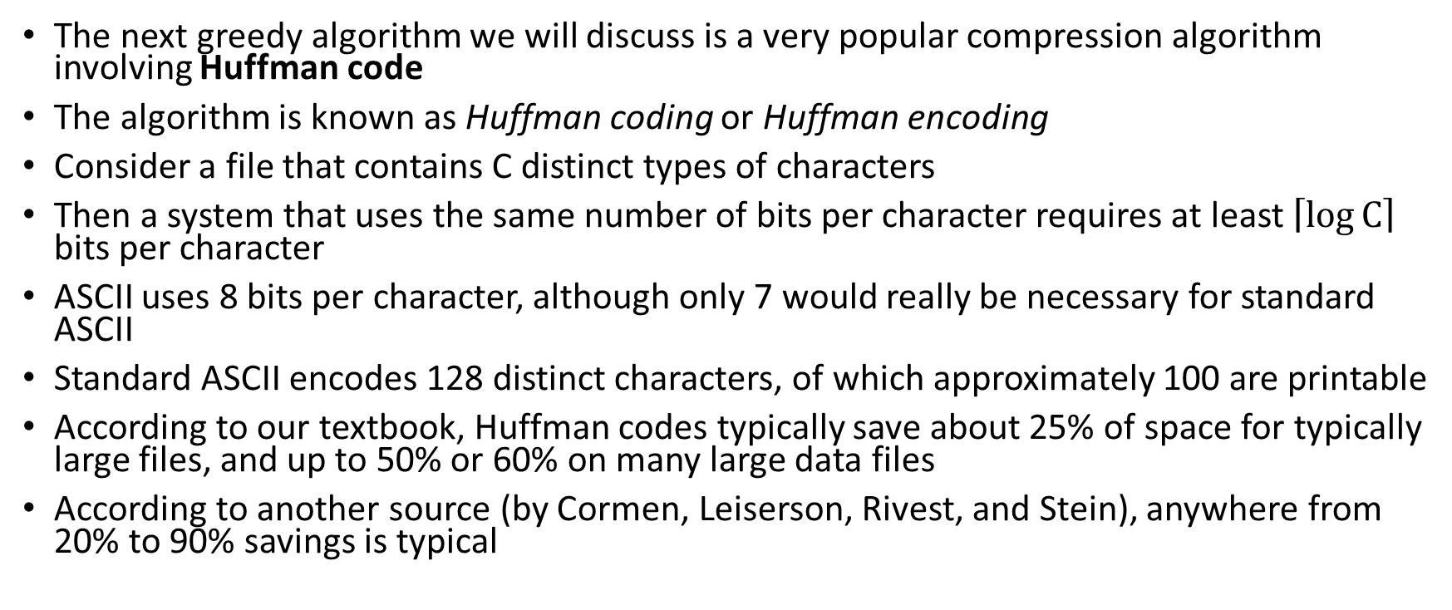
Huffman Codes
The next greedy algorithm we will discuss is a very popular compression algorithm involving Huffman code
The algorithm is known as Huffman coding or Huffman encoding
Consider a file that contains C distinct types of characters
Then a system that uses the same number of bits per character requires at least $\left\lceil \log{C}\right\rceil$ bits per character
ASCII uses 8 bits per character, although only 7 would really be necessary for standard ASCII
Standard ASCII encodes 128 distinct characters, of which approximately 100 are printable
According to our textbook, Huffman codes typically save about 25% of space for typically large files, and up to 50% or 60% on many large data files
According to another source (by Cormen, Leiserson, Rivest, and Stein), anywhere from 20% to 90% savings is typical

Slide 7
Huffman Coding Example
We will examine an example from the book that assumes the existence of only 7 distinct characters
Specifically, the distinct characters are: 'a', 'e', 'i', 's', 't', space, and newline
If the same number of bits were used for each character, 3 bits per character would be required
We will assume that the frequency of each character in the file has already been computed
In our example, we will posit that there are 10 a’s 15 e’s, 12 i’s, 3 s’s, 4 t’s, 13 spaces, and 1 newline
The figure on the next slide shows that for this case, a standard encoding would require 174 bits

Slide 8
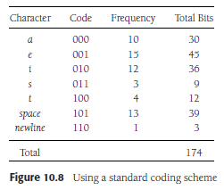
Standard Encoding Example

Slide 9
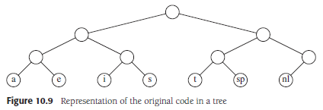
Tries
We can represent such encodings with a special type of binary tree known as a trie
In a trie, left branches represent the bit 0, right branches represent the bit 1, and characters are indicated by the leaves
Some sources allow the branches of a trie to represent more general characters, or allow internal nodes to represent characters, but that will not be necessary for Huffman coding
The standard encoding we have seen can be represented by the following trie:

Slide 10
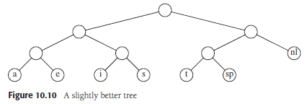
Slightly Better Trie
This is clearly not the most efficient encoding
Note that the only character with a code that starts with 11 is the newline, so the following zero does not provide any useful information
An optimal trie for encoding will always be a full binary tree (i.e., all nodes will either be leaves or have two children)
A slightly better, but still far-from-optimal, trie is as follows:

Slide 11
Prefix codes
Any encoding in which no character code is a prefix of another character code is known as a prefix code
Prefix codes also include that files encoded using them will be unambiguous
When a file has been encoded using a prefix code, we can easily decode it even though character codes may have a different lengths
Forcing a trie to indicate each distinct character as a leaf ensures that the trie represents a prefix code
The goal of Huffman coding is to find the optimal trie, i.e., the optimal prefix code
The principal behind this is to use shorter codes for frequent characters and longer codes for rare characters
The optimal trie for the example we have been dealing with is shown on the next slide
The slide after that shows that this encoding would require 146 bits to encode the file

Slide 12
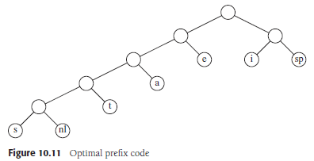
Optimal Trie Example

Slide 13
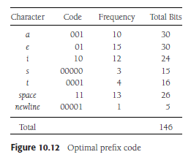
Optimal Prefix Code Example

Slide 14
Analyzing the Optimal Trie and Prefix Code
There are many prefix codes that tie for optimal
For example, swapping leaves at the same level of the trie or swapping left and right links of internal nodes lead to equally efficient encodings
In general, if each character c_{i} occurs f_{i} times and is at depth d_{i} in the trie, then the cost of the using code to encode the file is equal to ∑_{i} d_{i} * f_{i}
For this example, a standard encoding uses 174 bits, while the optimal encoding uses 146 bits
This is only a savings of 16.1%, but that is because we were only dealing with a small file that contains only 7 distinct characters
The normal ASCII character set has about 100 printable characters, but many occur very rarely, and some occur much more frequently than others

Slide 15
Huffman’s Algorithm
A greedy algorithm for finding an optimal trie was created by David Huffman in 1952 while he was a graduate student at M.I.T.
Let's say that the number of distinct characters in a text file to be compressed is C
Huffman's algorithm maintains a forest of tries; the weight of each trie is equal to the sum of the frequencies of its leaves
At the start, there are C single-node tries representing each of the characters
Through each of C-1 iterations, the two tries, T1 and T2, of smallest weight are selected (breaking ties arbitrarily)
A new trie is formed with a new root and T1 and T2 as subtrees
At the end of the algorithm, there is one trie remaining, and this is an optimal trie representing an optimal prefix encoding
This algorithm can be implemented efficiently using a priority queue (e.g., a binary heap)
The next slide shows my pseudo-code for the algorithm

Slide 16
Huffman Algorithm Pseudo-code
Huffman ( Set-of-characters C )
initialize Q as empty priority queue
for each character c in C
create a single-node trie T
T.data ← c
T.frequency ← c.frequency
Insert(Q, T)
loop |C| - 1 times
T1 ← DeleteMin(Q)
T2 ← DeleteMin(Q)
create a new trie T
T.left ← T1
T.right ← T2
T.frequency ← T1.frequency + T2.frequency
Insert(Q, T)
return DeleteMin(Q)

Slide 17
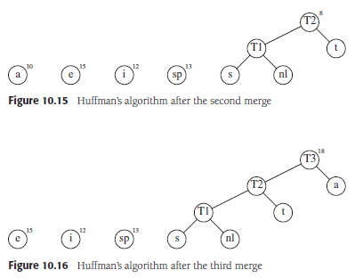
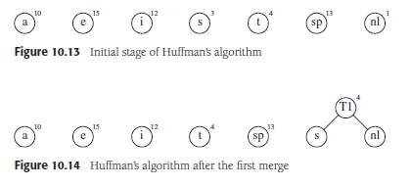
Huffman Algorithm Example (first three steps)

Slide 18
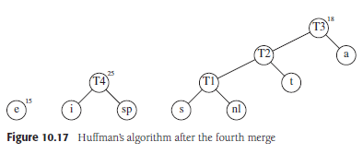
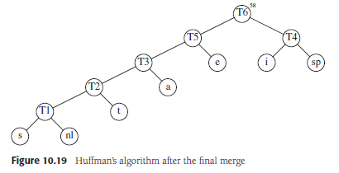
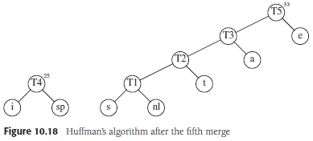
Huffman Algorithm Example (last three steps)

Slide 19
Analyzing the Huffman Algorithm
If C is the number of distinct characters, there will be C-1 iterations
Each iteration require O(log C) time (using binary heaps), so the running time of this algorithm is O(C log C)
This assumes that the frequency of each character is known
Otherwise, an additional loop is necessary at the start of the routine that takes linear time with respect to the size of the file
Although this does not change the complexity, this linear loop will probably take longer than the rest of the algorithm
This is because C is generally going to be small, and we probably won’t bother compressing a file if it isn’t large
Even if we use a simpler, quadratic implementation, O(C²), for the main Huffman routine, it will be fast

Slide 20
Why Does This Work?
We will informally discuss why this algorithm is guaranteed to produce the optimal solution
Recall that the optimal trie must be a full trie
Therefore, the deepest leaf must have a sibling (another leaf); clearly, these nodes should represent the two least frequent characters
The first pass of the algorithm therefore produces a valid part of the trie
You can then consider the merged tree to represent a meta-character with a frequency equal to the sum of the characters represented by its leaves
Therefore, the later iterations of the algorithm are correct for the same reason as the first; it is always valid to combine the two least-frequent metacharacters
Whenever we merge two trees, we are adding a bit to the representation of each leaf of both trees
Each greedy step adds the least number of bits possible to the final trie

Slide 21
Using Huffman Codes
Once the trie representing the optimal encoding is produced, it can be used to compress the file
A representation of the encoding must be included with the compressed file (either internal to the file or along with it)
  Otherwise, the decoding of the file will not be possible
  This representation could take the form of a chart that maps binary sequences to characters
  Alternatively, it could take the form of a data structure representing the trie
In some other contexts, the prefix code is determined based on a large dataset once, and then applied to future files
This is not optimal for each individual file, but it allows a single shared compression scheme to be applied to many files

Slide 22
Divide and Conquer Algorithms
The next strategy we will discuss is called divide-and-conquer
This strategy is applicable when a problem can be broken down into parts that can be solved with a similar algorithm to the original problem
There must be some way to combine the solutions to the parts to form a final solution
The parts (smaller problems) are often solved with recursion (although recursion is never necessary to implement a solution)
There also must be a base case for which a recursive call does not apply
We have already seen examples of divide-and-conquer algorithms when discussing sorting in Data Structures and Algorithms I
These include mergesort, quicksort, and quickselect
We have seen that the Master theorem can sometimes be used to determine the running time complexity of such an algorithm

Slide 23
Examples Discussed in Textbook
The textbook discusses the following divide-and-conquer algorithms:
  An algorithm for finding the closest pair of points out of a set of N points in O(N log N) time
  A worst-case linear algorithm for selection involving median-of-median-of-five pivot selection for quickselect
  An algorithm for multiplying two N-digit numbers in O(N^{1.59}) time
  An algorithm for matrix multiplication that runs in O(N^{2.81}) time
We will go over a different problem that I consider fun, although not of practical significance (and the solution is exponential)

Slide 24
Tower of Hanoi
The Tower of Hanoi is a puzzle including three sticks and disks that can be placed on them
At the start, all disks are on one of the stick, arrange from largest (at the bottom) to the smallest (at the top)
The goal is to move the disks from the starting stick to a designated destination stick, subject to the following rules:
  Only one disk can be moved at a time
  You can only lift the top disk off a stick; this disk may then be placed on another stick, as long as it does not violate the next constraint
  You can never place a larger disk on top of a smaller disk

Slide 25
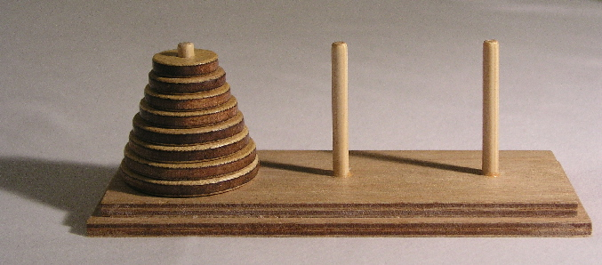
Tower of Hanoi Image (from Wikipedia)

Slide 26
Solving the Tower of Hanoi
Assume we have a Tower of Hanoi puzzle with N disks
At some point, we need to move the largest disk from the source stick to the destination stick
Before that, we must move the other N-1 disks from the source stick to the auxiliary stick
The largest disk will not affect any of the moves required to achieve that intermediate goal
After the largest disk is moved to the destination stick, when then must move the other N-1 disks from the auxiliary stick to the destination stick
In summary, we can move N disks from the source stick to the destination stick with the following steps:
  Move N-1 disks from the source stick to the auxiliary stick (this is a recursive step)
  Move the largest disk from the source stick to the destination stick
  Move N-1 disks from the auxiliary stick to the destination stick (this is a recursive step)
Note that all three of the steps listed in this solution are necessary

Slide 27
Code for Solving the Tower of Hanoi
void Tower(int n, string src, string dst, string aux)
{
if (n == 1)
cout << "Move from " << src << " to " << dst << "\n";
else {
Tower(n-1, src, aux, dst);
cout << "Move from " << src << " to " << dst << "\n";
Tower(n-1, aux, dst, src);
}
return;
}
Suppose the disks are labeled "A", "B", and "C", and there are 8 disks that must be moved from "A" to "C"; then we could call the above function as follows:
Tower(8, "A", "C", "B");

Slide 28
Analyzing the Solution
Suppose T(N) is the number of moves used to solve the puzzle with our solution when there are N disks
The equation describing the number of steps used to solve the problem can be described by the following recurrence relation:
  T(N) = 2 * T(N - 1) + O(1)
On the surface, this might look similar to the mergesort recurrence
However, note that each recursive call here is applied to N-1, not to N/2
This makes a huge difference; unlike other divide-and-conquer solutions we have seen, this is an exponential solution
We could clearly see that, as each value of T(N) more than doubles as N increases by 1
This does not mean it is a bad solution, as far as solutions to this problem go
An exponential number of moves are required to solve this problem, and it can be shown that this solution uses the fewest moves possible

Slide 29
Dynamic Programming Algorithms
The next strategy we will discuss is known as dynamic programming
Dynamic programming is related to divide-and-conquer and recursive algorithms
When dealing with straight-forward implementations of recursive algorithms, algorithms can become much less efficient than necessary if the subproblems are not independent
We’ll start by discussing implementations for computing the k^{th} value in the Fibonacci sequence (1, 1, 2, 3, 5, 8, 13, 21, 34, 55, etc.), which we discussed early in DSA 1
Really, we are computing the right-most 32-bits of values, since we are not worrying about overflow
We learned that a typical recursive solution is an exponential time solution
We also saw that a standard iterative solution is linear, and it only needs to keep track of the two previous values in the Fibonacci sequence (and the current value)
However, consider a more general recursive mathematical function for which the current value depends not only on the previous two values, but perhaps on all previous values
This can still be solved iteratively by storing all the values computed so far in an array
We can also take this approach for Fibonacci, even though it uses more memory than necessary

Slide 30
Fibonacci Implementations (from DSA1)
Recursive Solution (exponential!)
Iterative Solution (linear)
int Fibonacci(int n)
{
if (n <= 2)
return 1;
else
return (Fibonacci(n-1) +
Fibonacci(n-2));
}
int Fibonacci(int n)
{
int prev1 = 1, prev2 = 1;
int x, cur;
if (n <= 2)
return 1;
else
{
for (x = 3; x <= n; x++,
prev2 = prev1, prev1 = cur)
cur = prev2 + prev1;
return cur;
}
}

Slide 31
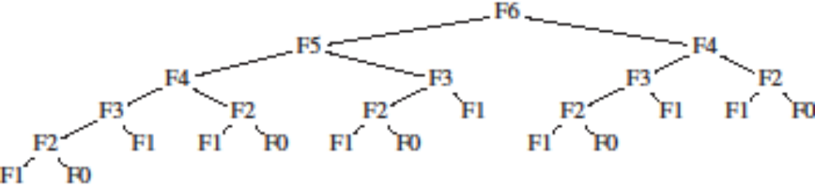
Recursive Fibonacci is Exponential
One way to show that the recursive implementation is an exponential time solution is to examine a tree representing the recursive calls; for example:
Another way involves analyzing the number of computational steps the routine requires and comparing this to the formula defining the Fibonacci sequence:
  T(N) = T(N - 1) + T(N - 2) + c
  Fib(N) = Fib(N - 1) + Fib(N - 2)
Conclusion: The simplest or most obvious way to compute something is not always the most efficient!

Slide 32
Bottom-Up Dynamic Programming
To the right, we see pseudo-code for an iterative Fibonacci implementation
This version uses linear memory, which is more than necessary
However, there are a couple of advantages:
  This version is more readable than the previous version
  This version is easily expandable to functions that rely on many previous values
This is an example of bottom-up dynamic programming, meaning that:
  We are storing the computed values in an array (or more general matrix)
  Each newly computed value depends on other values that have already been computed
Fibonacci( integer N )
if N ≤ 2
return 1
Fib[1] ← 1
Fib[2] ← 1
Loop i from 3 to N
Fib[i] ← Fib[i-1] + Fib[i-2]
return Fib[n]

Slide 33
Top-Down Dynamic Programming
To the right, we see pseudo-code for a recursive Fibonacci implementation
Although recursive, this function executes in linear time, just like the iterative solution
Any call asking for a value that has already been computed will execute in quick constant time
The array "known" could be a global array, a static variable, or a parameter passed by reference
The array must be large enough to hold N values, all initialized to all "unknown"
This is an example of top-down dynamic programming, meaning that:
  We store the computed values in an array (or more general matrix) after they are computed via recursive calls
  The start of each recursive routine checks to see if the desired value has already been computed
  If so, it just looks retrieves and returns the value
  The use of the array or matrix is called memoization
Fibonacci( integer N )
if known[N] != unknown
return known[N]
if N ≤ 2
v ← 1
else
v ← Fibonacci(N-1)+Fibonacci(N-2)
known[N] ← v
return v

Slide 34
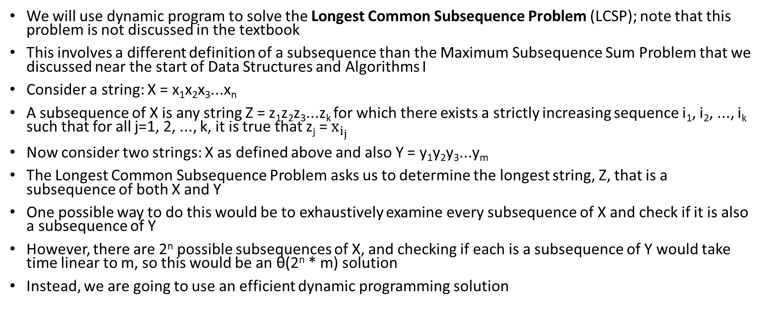
The Longest Common Subsequence Problem
We will use dynamic program to solve the Longest Common Subsequence Problem (LCSP); note that this problem is not discussed in the textbook
This involves a different definition of a subsequence than the Maximum Subsequence Sum Problem that we discussed near the start of Data Structures and Algorithms I
Consider a string: X = x₁x₂x₃...x_{n}
A subsequence of X is any string Z = z₁z₂z₃...z_{k} for which there exists a strictly increasing sequence i₁, i₂, ..., i_{k} such that for all j=1, 2, ..., k, it is true that z_{j} = $x_{i_{j}}$
Now consider two strings: X as defined above and also Y = y₁y₂y₃...y_{m}
The Longest Common Subsequence Problem asks us to determine the longest string, Z, that is a subsequence of both X and Y
One possible way to do this would be to exhaustively examine every subsequence of X and check if it is also a subsequence of Y
However, there are 2^{n} possible subsequences of X, and checking if each is a subsequence of Y would take time linear to m, so this would be an θ(2^{n} * m) solution
Instead, we are going to use an efficient dynamic programming solution

Slide 35
Solving the LCSP
To solve the problem, we are going to use a matrix M with n+1 rows (numbered 0 through n) and m+1 columns (numbered 0 through m)
M[i, j] represents the length of the longest common subsequence of the strings x₁x₂x₃...x_{i} and y₁y₂y₃...y_{j}
We start by filling in the first column and first row with zeros; this is because the length of the longest common subsequence is 0 if one of the two strings is empty
We are going to fill in the rest of the matrix one row at a time, from top to bottom, filling each row from left to right
  Let's say we want to fill in a particular slot M[i, j] and we have already filled in all the slots above this slot and all the slots to the left of this slot in the current row
  We can then say that if x_{i} == y_{j}, M[i, j] must equal M[i-1, j-1] +1
  Otherwise, M[i, j] will be the maximum of M[i-1, j] and M[i, j-1]
At the end of the algorithm, the length of the longest common subsequence is stored at the bottom right of the matrix, in M[n, m]
Note that this is clearly a O(n * m) time algorithm
This is a bottom-up approach; a top-down approach is also possible

Slide 36
LCSP Pseudo-code
LongestCommonSubsequence ( String X, String Y )
n ← length(X)
m ← length(Y)
loop i from 0 to m
M[0,i] ← 0
Loop i from 0 to n
M[i,0] ← 0
Loop i from 1 to n
Loop j from 1 to m
if X_{i} == Y_{j}
M[i, j] ← M[i-1, j-1] + 1
else if M[i-1, j] ≥ M[i, j-1]
M[i, j] ← M[i-1, j]
else
M[i, j] ← M[i, j-1]

Slide 37
LCSP Example
Consider finding the longest common subsequence of X = "wired" and Y = "world"
The matrix would then be 6 x 6, initialized as follows:
 |  |  | w | o | r | l | d
 |  | 0 | 1 | 2 | 3 | 4 | 5
 | 0 | 0 | 0 | 0 | 0 | 0 | 0
w | 1 | 0
i | 2 | 0
r | 3 | 0
e | 4 | 0
d | 5 | 0

Slide 38
LCSP Example (continued)
We not loop through the rows one at a time from left to right one at a time, starting at position (1, 1)
Since the two ‘w’s match, this entry becomes M[0, 0] + 1 = 1
 |  |  | w | o | r | l | d
 |  | 0 | 1 | 2 | 3 | 4 | 5
 | 0 | 0 | 0 | 0 | 0 | 0 | 0
w | 1 | 0 | 1
i | 2 | 0
r | 3 | 0
e | 4 | 0
d | 5 | 0

Slide 39
LCSP Example (continued)
Next, we fill in position (1, 2)
The ‘w’ and ‘o’ do not match, so this is max(M[0, 2], M[1, 1]) = 1
 |  |  | w | o | r | l | d
 |  | 0 | 1 | 2 | 3 | 4 | 5
 | 0 | 0 | 0 | 0 | 0 | 0 | 0
w | 1 | 0 | 1 | 1
i | 2 | 0
r | 3 | 0
e | 4 | 0
d | 5 | 0

Slide 40
LCSP Example (continued)
We continue filling in row 1
 |  |  | w | o | r | l | d
 |  | 0 | 1 | 2 | 3 | 4 | 5
 | 0 | 0 | 0 | 0 | 0 | 0 | 0
w | 1 | 0 | 1 | 1 | 1
i | 2 | 0
r | 3 | 0
e | 4 | 0
d | 5 | 0

Slide 41
LCSP Example (continued)
We continue filling in row 1
 |  |  | w | o | r | l | d
 |  | 0 | 1 | 2 | 3 | 4 | 5
 | 0 | 0 | 0 | 0 | 0 | 0 | 0
w | 1 | 0 | 1 | 1 | 1 | 1
i | 2 | 0
r | 3 | 0
e | 4 | 0
d | 5 | 0

Slide 42
LCSP Example (continued)
We continue filling in row 1
 |  |  | w | o | r | l | d
 |  | 0 | 1 | 2 | 3 | 4 | 5
 | 0 | 0 | 0 | 0 | 0 | 0 | 0
w | 1 | 0 | 1 | 1 | 1 | 1 | 1
i | 2 | 0
r | 3 | 0
e | 4 | 0
d | 5 | 0

Slide 43
LCSP Example (continued)
Now, we start the next row at position (2, 1)
Since the ‘i’ and ‘w’ do not match, we again take the maximum of the value to the left and the value above
 |  |  | w | o | r | l | d
 |  | 0 | 1 | 2 | 3 | 4 | 5
 | 0 | 0 | 0 | 0 | 0 | 0 | 0
w | 1 | 0 | 1 | 1 | 1 | 1 | 1
i | 2 | 0 | 1
r | 3 | 0
e | 4 | 0
d | 5 | 0

Slide 44
LCSP Example (continued)
We continue filling in the row 2
 |  |  | w | o | r | l | d
 |  | 0 | 1 | 2 | 3 | 4 | 5
 | 0 | 0 | 0 | 0 | 0 | 0 | 0
w | 1 | 0 | 1 | 1 | 1 | 1 | 1
i | 2 | 0 | 1 | 1
r | 3 | 0
e | 4 | 0
d | 5 | 0

Slide 45
LCSP Example (continued)
We continue filling in the row 2
 |  |  | w | o | r | l | d
 |  | 0 | 1 | 2 | 3 | 4 | 5
 | 0 | 0 | 0 | 0 | 0 | 0 | 0
w | 1 | 0 | 1 | 1 | 1 | 1 | 1
i | 2 | 0 | 1 | 1 | 1
r | 3 | 0
e | 4 | 0
d | 5 | 0

Slide 46
LCSP Example (continued)
We continue filling in the row 2
 |  |  | w | o | r | l | d
 |  | 0 | 1 | 2 | 3 | 4 | 5
 | 0 | 0 | 0 | 0 | 0 | 0 | 0
w | 1 | 0 | 1 | 1 | 1 | 1 | 1
i | 2 | 0 | 1 | 1 | 1 | 1
r | 3 | 0
e | 4 | 0
d | 5 | 0

Slide 47
LCSP Example (continued)
We continue filling in the row 2
 |  |  | w | o | r | l | d
 |  | 0 | 1 | 2 | 3 | 4 | 5
 | 0 | 0 | 0 | 0 | 0 | 0 | 0
w | 1 | 0 | 1 | 1 | 1 | 1 | 1
i | 2 | 0 | 1 | 1 | 1 | 1 | 1
r | 3 | 0
e | 4 | 0
d | 5 | 0

Slide 48
LCSP Example (continued)
Now we start filling in row 3 in a similar fashion
 |  |  | w | o | r | l | d
 |  | 0 | 1 | 2 | 3 | 4 | 5
 | 0 | 0 | 0 | 0 | 0 | 0 | 0
w | 1 | 0 | 1 | 1 | 1 | 1 | 1
i | 2 | 0 | 1 | 1 | 1 | 1 | 1
r | 3 | 0 | 1
e | 4 | 0
d | 5 | 0

Slide 49
LCSP Example (continued)
Now we start filling in row 3 in a similar fashion
 |  |  | w | o | r | l | d
 |  | 0 | 1 | 2 | 3 | 4 | 5
 | 0 | 0 | 0 | 0 | 0 | 0 | 0
w | 1 | 0 | 1 | 1 | 1 | 1 | 1
i | 2 | 0 | 1 | 1 | 1 | 1 | 1
r | 3 | 0 | 1 | 1
e | 4 | 0
d | 5 | 0

Slide 50
LCSP Example (continued)
When we get to cell (3, 3), the ‘r’s match, so this cell takes the value of M[2, 2] + 1 = 2
 |  |  | w | o | r | l | d
 |  | 0 | 1 | 2 | 3 | 4 | 5
 | 0 | 0 | 0 | 0 | 0 | 0 | 0
w | 1 | 0 | 1 | 1 | 1 | 1 | 1
i | 2 | 0 | 1 | 1 | 1 | 1 | 1
r | 3 | 0 | 1 | 1 | 2
e | 4 | 0
d | 5 | 0

Slide 51
LCSP Example (continued)
We continue filling in row 3
 |  |  | w | o | r | l | d
 |  | 0 | 1 | 2 | 3 | 4 | 5
 | 0 | 0 | 0 | 0 | 0 | 0 | 0
w | 1 | 0 | 1 | 1 | 1 | 1 | 1
i | 2 | 0 | 1 | 1 | 1 | 1 | 1
r | 3 | 0 | 1 | 1 | 2 | 2
e | 4 | 0
d | 5 | 0

Slide 52
LCSP Example (continued)
We continue filling in row 3
 |  |  | w | o | r | l | d
 |  | 0 | 1 | 2 | 3 | 4 | 5
 | 0 | 0 | 0 | 0 | 0 | 0 | 0
w | 1 | 0 | 1 | 1 | 1 | 1 | 1
i | 2 | 0 | 1 | 1 | 1 | 1 | 1
r | 3 | 0 | 1 | 1 | 2 | 2 | 2
e | 4 | 0
d | 5 | 0

Slide 53
LCSP Example (continued)
Now we fill in row 4
 |  |  | w | o | r | l | d
 |  | 0 | 1 | 2 | 3 | 4 | 5
 | 0 | 0 | 0 | 0 | 0 | 0 | 0
w | 1 | 0 | 1 | 1 | 1 | 1 | 1
i | 2 | 0 | 1 | 1 | 1 | 1 | 1
r | 3 | 0 | 1 | 1 | 2 | 2 | 2
e | 4 | 0 | 1
d | 5 | 0

Slide 54
LCSP Example (continued)
Now we fill in row 4
 |  |  | w | o | r | l | d
 |  | 0 | 1 | 2 | 3 | 4 | 5
 | 0 | 0 | 0 | 0 | 0 | 0 | 0
w | 1 | 0 | 1 | 1 | 1 | 1 | 1
i | 2 | 0 | 1 | 1 | 1 | 1 | 1
r | 3 | 0 | 1 | 1 | 2 | 2 | 2
e | 4 | 0 | 1 | 1
d | 5 | 0

Slide 55
LCSP Example (continued)
Now we fill in row 4
 |  |  | w | o | r | l | d
 |  | 0 | 1 | 2 | 3 | 4 | 5
 | 0 | 0 | 0 | 0 | 0 | 0 | 0
w | 1 | 0 | 1 | 1 | 1 | 1 | 1
i | 2 | 0 | 1 | 1 | 1 | 1 | 1
r | 3 | 0 | 1 | 1 | 2 | 2 | 2
e | 4 | 0 | 1 | 1 | 2
d | 5 | 0

Slide 56
LCSP Example (continued)
Now we fill in row 4
 |  |  | w | o | r | l | d
 |  | 0 | 1 | 2 | 3 | 4 | 5
 | 0 | 0 | 0 | 0 | 0 | 0 | 0
w | 1 | 0 | 1 | 1 | 1 | 1 | 1
i | 2 | 0 | 1 | 1 | 1 | 1 | 1
r | 3 | 0 | 1 | 1 | 2 | 2 | 2
e | 4 | 0 | 1 | 1 | 2 | 2
d | 5 | 0

Slide 57
LCSP Example (continued)
Now we fill in row 4
 |  |  | w | o | r | l | d
 |  | 0 | 1 | 2 | 3 | 4 | 5
 | 0 | 0 | 0 | 0 | 0 | 0 | 0
w | 1 | 0 | 1 | 1 | 1 | 1 | 1
i | 2 | 0 | 1 | 1 | 1 | 1 | 1
r | 3 | 0 | 1 | 1 | 2 | 2 | 2
e | 4 | 0 | 1 | 1 | 2 | 2 | 2
d | 5 | 0

Slide 58
LCSP Example (continued)
Now we fill in row 5
 |  |  | w | o | r | l | d
 |  | 0 | 1 | 2 | 3 | 4 | 5
 | 0 | 0 | 0 | 0 | 0 | 0 | 0
w | 1 | 0 | 1 | 1 | 1 | 1 | 1
i | 2 | 0 | 1 | 1 | 1 | 1 | 1
r | 3 | 0 | 1 | 1 | 2 | 2 | 2
e | 4 | 0 | 1 | 1 | 2 | 2 | 2
d | 5 | 0 | 1

Slide 59
LCSP Example (continued)
Now we fill in row 5
 |  |  | w | o | r | l | d
 |  | 0 | 1 | 2 | 3 | 4 | 5
 | 0 | 0 | 0 | 0 | 0 | 0 | 0
w | 1 | 0 | 1 | 1 | 1 | 1 | 1
i | 2 | 0 | 1 | 1 | 1 | 1 | 1
r | 3 | 0 | 1 | 1 | 2 | 2 | 2
e | 4 | 0 | 1 | 1 | 2 | 2 | 2
d | 5 | 0 | 1 | 1

Slide 60
LCSP Example (continued)
Now we fill in row 5
 |  |  | w | o | r | l | d
 |  | 0 | 1 | 2 | 3 | 4 | 5
 | 0 | 0 | 0 | 0 | 0 | 0 | 0
w | 1 | 0 | 1 | 1 | 1 | 1 | 1
i | 2 | 0 | 1 | 1 | 1 | 1 | 1
r | 3 | 0 | 1 | 1 | 2 | 2 | 2
e | 4 | 0 | 1 | 1 | 2 | 2 | 2
d | 5 | 0 | 1 | 1 | 2

Slide 61
LCSP Example (continued)
Now we fill in row 5
 |  |  | w | o | r | l | d
 |  | 0 | 1 | 2 | 3 | 4 | 5
 | 0 | 0 | 0 | 0 | 0 | 0 | 0
w | 1 | 0 | 1 | 1 | 1 | 1 | 1
i | 2 | 0 | 1 | 1 | 1 | 1 | 1
r | 3 | 0 | 1 | 1 | 2 | 2 | 2
e | 4 | 0 | 1 | 1 | 2 | 2 | 2
d | 5 | 0 | 1 | 1 | 2 | 2

Slide 62
LCSP Example (continued)
As we fill in the final cell, at position (5, 5), the two ‘d’s match, so this becomes M[4, 4] + 1 = 3
 |  |  | w | o | r | l | d
 |  | 0 | 1 | 2 | 3 | 4 | 5
 | 0 | 0 | 0 | 0 | 0 | 0 | 0
w | 1 | 0 | 1 | 1 | 1 | 1 | 1
i | 2 | 0 | 1 | 1 | 1 | 1 | 1
r | 3 | 0 | 1 | 1 | 2 | 2 | 2
e | 4 | 0 | 1 | 1 | 2 | 2 | 2
d | 5 | 0 | 1 | 1 | 2 | 2 | 3

Slide 63
LCSP Example (continued)
We are done
The length of the longest common subsequence of "world“ and "wired" is 3, the value of M[5, 5]
 |  |  | w | o | r | l | d
 |  | 0 | 1 | 2 | 3 | 4 | 5
 | 0 | 0 | 0 | 0 | 0 | 0 | 0
w | 1 | 0 | 1 | 1 | 1 | 1 | 1
i | 2 | 0 | 1 | 1 | 1 | 1 | 1
r | 3 | 0 | 1 | 1 | 2 | 2 | 2
e | 4 | 0 | 1 | 1 | 2 | 2 | 2
d | 5 | 0 | 1 | 1 | 2 | 2 | 3

Slide 64
Retrieving the Longest Common Subsequence
We can also use the matrix to recover the longest common subsequence itself in time that is O(m+n)
This algorithm applies assuming that M has already been filled by the previous algorithm
You start at the bottom right of the matrix, M; that is, at position (n, m)
You will move up or left or both after each iteration and stop when you hit the top row or left column
If, at position (i, j), it is the case that X_{i} == Y_{j}, then this character is part of the subsequence
Then, we will append the character to the subsequence, and we move up and to the left
Otherwise, you need to decide if you move up one row or left one column
We move to the choice that has the larger value, breaking ties by moving up (because that’s what the previous algorithm did)
This can be implemented recursively or iteratively

Slide 65
Retrieving the Subsequence Pseudo-code
LongestCommonSubsequence ( String X, String Y, Matrix M )
i ← length(X)
j ← length(Y)
subsequence ← empty string
while i > 0 and j > 0
if X_{i} == Y_{j}
subsequence ← X_{i} + subsequence
i ← i - 1
j ← j - 1
else if M[i-1, j] ≥ M[i, j-1]
i ← i - 1
else
j ← j - 1

Slide 66
Retrieving the Subsequence Example
The colored slots are the ones traversed by the algorithm
Blue slots represent non-matches (we move up or left)
Red slots represent matches (the letters are part of the subsequence)
 |  |  | w | o | r | l | d
 |  | 0 | 1 | 2 | 3 | 4 | 5
 | 0 | 0 | 0 | 0 | 0 | 0 | 0
w | 1 | 0 | 1 | 1 | 1 | 1 | 1
i | 2 | 0 | 1 | 1 | 1 | 1 | 1
r | 3 | 0 | 1 | 1 | 2 | 2 | 2
e | 4 | 0 | 1 | 1 | 2 | 2 | 2
d | 5 | 0 | 1 | 1 | 2 | 2 | 3

Slide 67
The Submarine/Number-line Puzzle
We’ll discuss a solution next week!

Slide 68
Randomized Algorithms
The next strategy we will discuss is randomized algorithms; i.e., algorithms that rely on randomness
Strictly speaking, though, modern-day computers are incapable of true randomization
According to Papadimitriou's "Computational Complexity", I am not correct; he writes, "In some very real sense, computation is inherently randomized."
His reasoning is unusual: "It can be argued that the probability that a computer will be destroyed by a meteorite during any given microsecond of its operation is at least 2⁻¹⁰⁰."
I disagree with this particular reasoning (it was probably a joke)
However, perhaps it can be argued that, due to quantum physics, one cannot really be absolutely certain what a computer will do
However, when dealing with a theoretical computer, true randomness is not possible; this will become clearer during our final topic

Slide 69
Pseudo-random Number Generators
Of course, many applications must appear to exhibit random behavior (e.g., games)
Interestingly, randomization can also be useful to implement certain algorithms with efficient expected running times (we will soon see an example)
All modern programming languages include routines to generate pseudo-random numbers
Often, you will hear these referred to as random number generators (I will call them that also), but it would be more accurate to call them pseudo-random number generators
Most modern programming languages offer some built in functionality to produce pseudo-random numbers
In C and C++, you can use the "rand" function, for example, which returns a pseudo-random integer from 0 to RAND_MAX (inclusive)
Modern versions of C++ also provide classes that offer more flexible abilities, and that produce pseudo-random numbers with better properties
Some languages offer a function that returns a pseudo-random fraction from 0 to 1 (typically not inclusive of 1) instead
Either method can be used to produce values in other ranges
For example, to produce a pseudo-random integer in the range of MIN to MAX (inclusive), you can use: rand() % (MAX-MIN+1) + MIN

Slide 70
Seeds
We will soon see that random number generators rely on a global variable that changes each time it is used
The initial value of this global variable is called a seed (we can also use this as a verb; i.e., we can seed the random number generator)
C and C++ provide a function called "srand" which allows us to set the seed; for example: srand(12345);
The entire sequence of pseudo-random numbers that are generated is determined based on this seed in an unpredictable way
If the seed were actually random, this would be all that was necessary; but this is impossible
Fortunately, all that matters is that the seed is different every time
Therefore, a common solution is to seed the random number generator with a value representing the date and time
For example, C and C++ provide a function called "time", which returns a number representing the date and time down to the nearest second
We can use this to choose a useful seed; for example: srand(time(nullptr));
Some programming languages automatically seed the random number generator in a similar way
Note that we should only seed the pseudo-random number generator once, at the start of the program

Slide 71
Pseudo-random Number Generator Example
The textbook discusses and shows code for a pseudo-random number generator
We will look at a simpler one, shown to the right
This is from "The C Programming Language" by Kernighan and Ritchie (K&R)
Note that srand simply sets a global variable to the specified seed
The rand function updates the global and uses it to produce a pseudo-random number
I have heard that this is not a particularly good pseudo-random number generator
Even if rand returns the same value twice, this does not mean that the sequence will repeat
However, if the value of next repeats, then the sequence starting at that point will repeat
unsigned long int next = 1;
int rand(void)
{
next = next * 1103515245 + 12345;
return (unsigned int) (next/65536) % 32768;
}
void srand(unsigned int seed)
{
next = seed;
}

Slide 72
Good Pseudo-random Number Generators
There are several desired properties for pseudo-random number generators; for example:
  The period of numbers before repetition should be long
  Sequences of generated numbers should be uniformly distributed
  Subsequences of generated numbers should be uncorrelated
  The generator should be efficient
If the first three properties are not present, the result of a program relying on the generator might be too predictable

Slide 73
Examples of Randomized Algorithms
The book discusses two examples of randomized algorithms (we will not cover these in detail)
The first example involves a data structure called skip lists
  This algorithm involves a linked lists, where some nodes contain more than link (the specific number is chosen pseudo-randomly), each pointing a different number of nodes ahead
  The data structure can support insertion and search in expected O(log N) time
  Note that this is a bit different than average-case O(log N) time
  Expected time depends on the random numbers, where as average-case depends on the input
  For some algorithms, skip-lists can be more efficient than balanced binary search trees
The second example a randomized algorithm to test if a number is prime
  If the algorithm says no, then the number is definitely not prime
  If the algorithm says yes, then the number of prime with high probability
  By repeating the algorithm multiple times, we can reduce the probability of an error to something negligible
  Interestingly, there is a known algorithm to definitively test if a number is prime in polynomial time
  On average, the randomized algorithm is faster
In DSA 1, we discussed the possibility of using random pivots for quicksort
Many games rely on pseudo-randomness for various purposes

Slide 74
The 8-Queens Problem
We are going to discuss an example that comes up fairly early in my Artificial Intelligence (AI) course
The 8-queens problem challenges us to place 8 queens on a chessboard such that no two queens are attacking each other
A brute force approach would have to check 64*63*…*57 ≈ 1.8*10¹⁴ possible sequences
A smarter startegy would recognize that one queen has to be placed in each column, and it can backtrack as soon as two queens attack each other
Then there are only 2057 sequences (not all lead to solutions)
This sort of search is simple on a modern computer
We are going to look at a randomized algorithm that does a better job scaling up to the more general N-queens problem
The solution that we will cover is also an example of a greedy algorithm!

Slide 75
Hill Climbing
Hill climbing (a.k.a. greedy local search) is a search strategy that iteratively replaces the current state with its best neighboring state
When no neighbor is better than the current state, the search is finished
We will apply hill-climbing to the 8-queens problem
  Using our knowledge of the problem, we can start by randomly placing one queen in each column
  At each step, we will allow movements of any queen to any other square in the same column; therefore, there will always be 56 possible moves or actions
  The "best neighbor" is the state which has the smallest number of pairs of queens attacking each other
  Optionally, if no move improves the situation, we can allow sideways moves, which may allow us to improve the situation after multiple moves

Slide 76
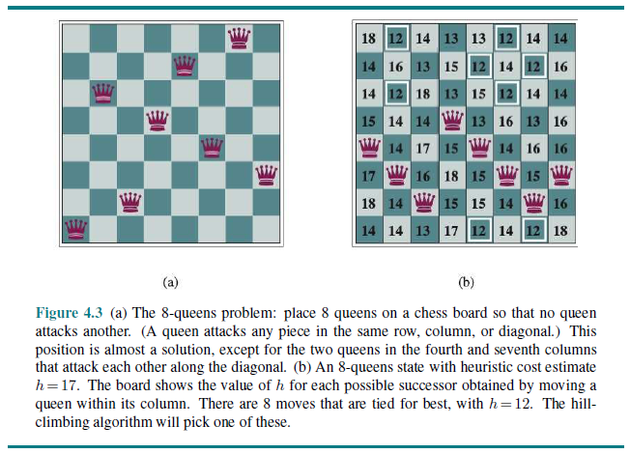
Hill Climbing for 8-queens Problem Example
Figure from "Artificial Intelligence: A Modern Approach, 4th Edition" by Russell and Norvig

Slide 77
Hill Climbing for 8-queens Problem Results
When hill climbing is applied to the 8-queens problem without sideways moves:
  There is only about a 14% chance of success (i.e., it gets stuck about 86% of the time)
  When there is a success, it takes an average of about 4 moves
  When it gets stuck, it takes an average of about 3 moves
When hill climbing is applied to the 8-queens problem, and up to 100 sideways moves are allowed:
  There is about a 94% chance of success (i.e., it gets stuck about 6% of the time)
  When there is a success, it takes an average of about 21 moves
  When it gets stuck, it takes an average of about 64 moves

Slide 78
Random-restart Hill Climbing
Of course, we want an algorithm that can solve the 8-queens problem every time
We can virtually guarantee this with random-restart hill climbing
The approach is simple; apply hill climbing (with or without sideways moves); if it gets stuck, start over!
If a single hill climbing search has a probability p of success, then the expected number of restarts is 1/p – 1
The expected number of steps is the cost of a successful iteration plus 1/p – 1 = (1-p)/p times the cost of a failure
The expected number of steps for the 8-queens problem is approximately 25 if up to 100 sideways moves are allowed and 22 moves if they are not
According to the Russell and Norvig AI textbook (4th edition), this solution can find a solution for up to three million queens in seconds!

Slide 79
The Submarine/Number-line Puzzle
Imagine a number-line, infinitely long in both directions, with all integers demarcated
Somewhere on that number-line, at some finite integer location, there exists a submarine
The submarine has a finite, integer velocity that will never change
Therefore, at every time unit, the position of the submarine will be some finite integer
You are given an infinite supply of bombs!
At every time unit, you may drop one bomb at one integer location
In response, you will be told one of two things; either "you hit the submarine" or "you did not hit the submarine"
The submarine/number-line puzzle asks you to come up with a strategy that is guaranteed to eventually hit the submarine

Slide 80
Exhaustive Search
We are going to solve the submarine/number-line puzzle using an exhaustive search, a.k.a. brute-force search
For previous problems we encountered, we may have mentioned an exhaustive search strategy before discussing a more efficient solution
What makes exhaustive search interesting for the submarine/number-line puzzle is that it may seem like there is no solution at all
First, we will formalize the problem a bit
  Let s be the starting position of the submarine; we know s is a finite integer
  Let v be the constant velocity of the submarine; we know v is a finite integer
  We need a strategy that helps us choose where to drop a bomb at each time, t
  We’ll arbitrarily start t at 0, and count the number of time units that have passed
If at any time, t, we drop a bomb at the position s + v*t, we will hit the submarine
Therefore, we need a strategy that tries out all (s, v) pairs

Slide 81
Submarine/Number-line Puzzle Solution
There are multiple ways we can iterate through all possible (s, v) pairs, where both s and v are integers
For example, consider an x-y plane, where the x-axis represents s and the y-axis represent v
Then start at the middle, and spiral out
Alternatively, consider an infinitely big grid, where the rows represent values of s, and the columns represent values of v
Order the rows and columns as follows: 0, 1, -1, 2, -2, 3, -3, etc.
Then loop through one diagonal at a time, starting with the top left (0, 0); then (0, 1), (1, 0); then (0, -1), (1, 1), (-1, 0); etc.

Slide 82
Backtracking Search
Our textbook does not specifically cover exhaustive search as an algorithm strategy
However, they says that backtracking search "amounts to a clever implementation of exhaustive search, with generally unfavorable performance"
The go on to explain that performance is relative, and for some tasks, there may not be more efficient choices
What backtracking search adds to exhaustive search is pruning, meaning that you can sometimes skip possibilities that cannot lead to a solution
For example, if we solved the 8-queens problem by placing one queen on the board at a time, without constraints, that would be exhaustive search
If we stop whenever two queens attack each other, back up, and try another path, that would be backtracking search
The book talks about two applications of backtracking search
One is known as the turnpike reconstruction problem, which we will skip

Slide 83
Minimax Search
The other example of backtracking search discussed in the textbook is minimax search with alpha-beta pruning for game playing
This will be repetitive for those of you who have taken, or are taking, the AI course (and we will cover it in less depth now, of course)
All figures from my slides for this subtopic come from the AI textbook (I like those figures better than the ones in the DSA book for this topic)
Minimax search is a strategy that can be used for deterministic, turn-taking, two-player, zero-sum games of perfect information
We will label the two players playing the game is MAX and MIN; only one can win (or the game can be a draw)
We will start by considering a hypothetical game tree for a simple game
In such a game tree, it is conventional to depict MAX with upward pointing triangles, and MIN with downward pointing triangles
Then, we will consider at a game tree for tic-tac-toe, which is also the example game used in the DSA book; in such a game, it is possible to explore the entire game tree

Slide 84
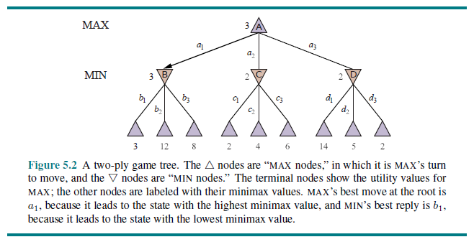
Minimax Values Example

Slide 85
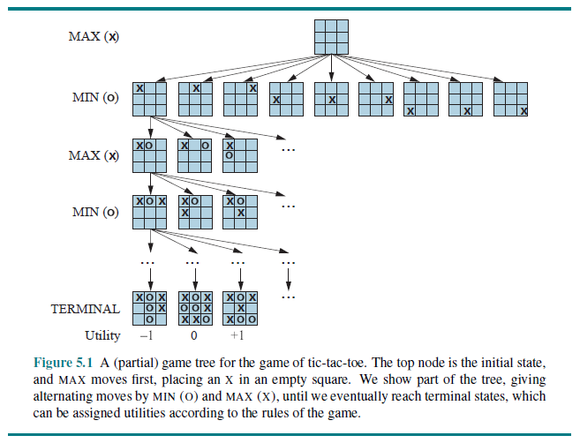
Example Game Tree: Tic-Tac-Toe

Slide 86
Calculating Minimax Values
A minimax search computes the minimax value of each node in the game tree recursively, as follows:
  MINIMAX (s) =
    UTILITY(s) if IS-TERMINAL(s); i.e., if s is a terminal state (leaf)
    max_{aεACTIONS(s)} MINIMAX(RESULT(s, a)) if TO-MOVE(s) = MAX
    min_{aεACTIONS(s)} MINIMAX(RESULT(s, a)) if TO-MOVE(s) = MIN
Note that the game tree is never actually stored as a data structure; the links in the figure represent recursive function calls that are made recursively
For a game like tic-tac-toe, the algorithm can proceed through entire game trees, all the way to the leaves, and calculate minimax values for every possible position
The minimax decision (the move that is made) using this function maximizes the worst-case scenario
The opponent may not make the move you expect, but if not, you will do at least as well as you predicted based on the minimax search

Slide 87
Minimax Search Complexity
This algorithm, as we have covered it so far, performs a complete DFS of the game tree; thus, it is an example of an exhaustive search
Assume the maximum depth of the game tree is m and there are at most b legal moves per state
Then the time complexity of the search is O(b^{m})
The space requirement is O(b * m) if all moves are generated at once
The space complexity can be reduced to O(m) if one legal move is generated at a time
We can only search entire game trees for very simple games

Slide 88
Alpha-Beta Pruning
A major problem with minimax search as described so far is that the number of game states is exponential with respect to the number of moves
A search that adds alpha-beta pruning returns exactly the same move as a full minimax search; with alpha-beta pruning, this is a backtracking algorithm
However, it does not consider, or even generate, the majority of the nodes in the game tree in most cases
To implement this strategy, two new search parameters need to be added:
  α = the value of the best choice for MAX (i.e., the highest value) along the current path
  β = the value of the best choice for MIN (i.e., the lowest value) along the current path
With these changes, the search is known as alpha-beta search, a.k.a. minimax search with alpha-beta pruning
In practice, alpha-beta pruning can allow you to search 50% to 100% deeper in the tree in a given amount of time; this can greatly improve a program's play

Slide 89
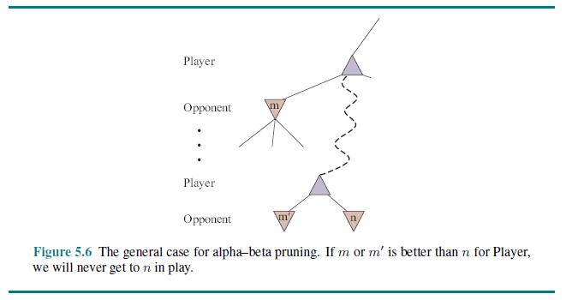
Alpha-Beta Explanation

Slide 90
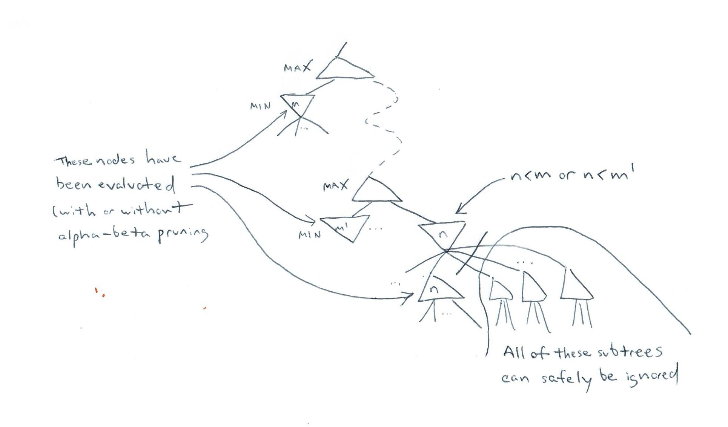
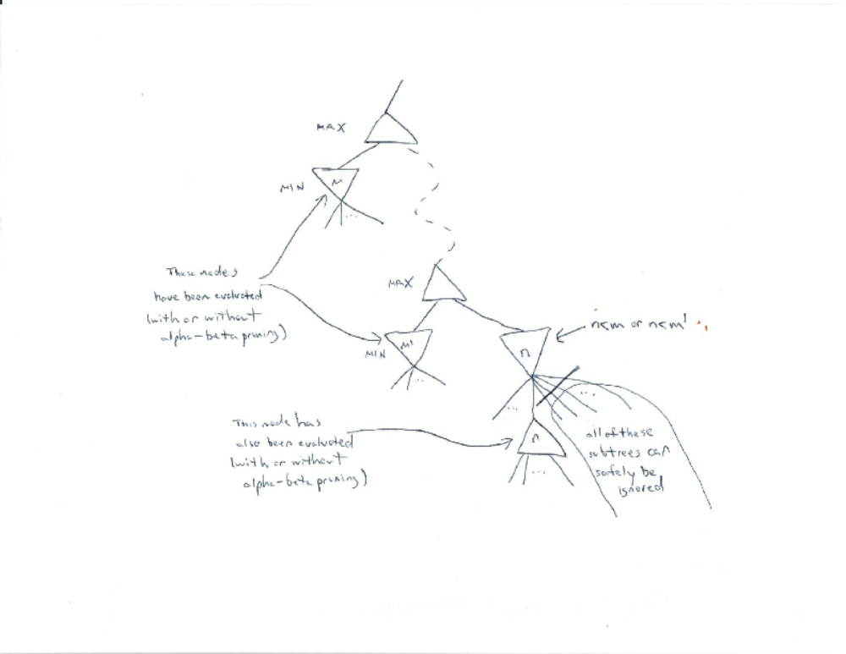
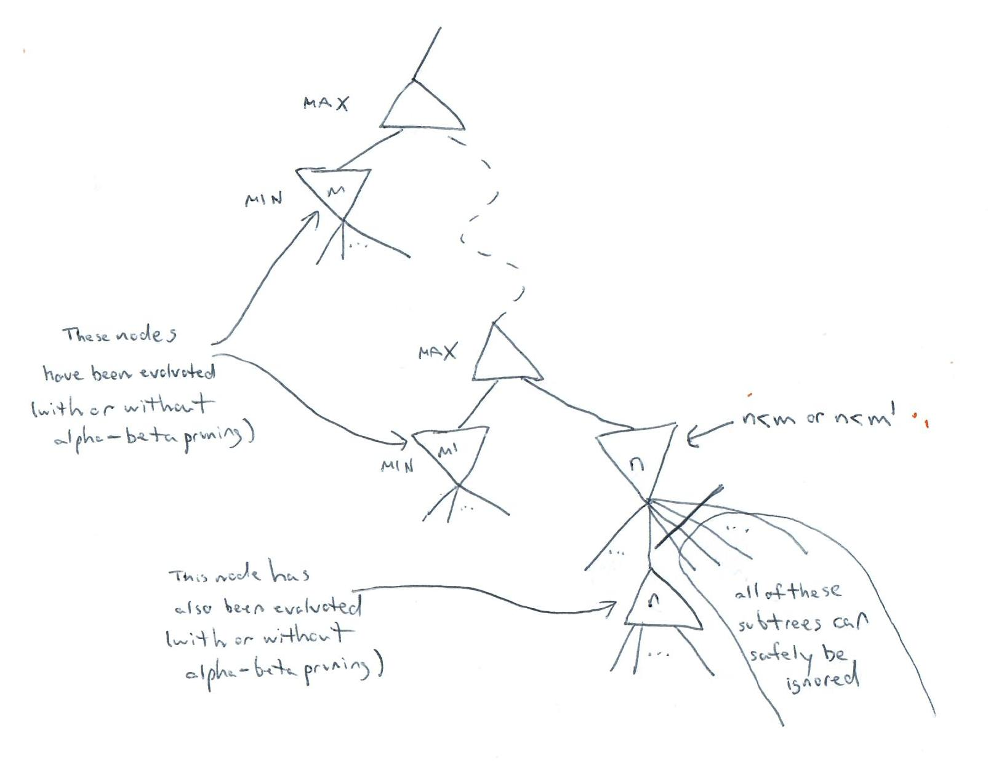
Alpha-Beta Explanation Augmented

Slide 91
And The Rest…
Even with alpha-beta pruning, it is not feasible to search entire game trees for games like chess, checkers, or Othello
One possibility is to search to a specified depth limit, at which point an evaluation function, a.k.a. heuristic function, is applied
  The evaluation function should order moves based on their goodness, and it must be zero-sum
  No non-definite win should get a score as high as a definite win, and no non-definite loss should get a score as low as a definite loss
  Conventionally, evaluation functions have been manually constructed, but in recent years, they have been learned for some games using reinforcement learning
Alternatively, if each move has a specified time limit, iterative deepening can be applied
  This means that there are sequential depth-limited searches (the previous idea) to depths 1, 2, 3, etc.
  If the time runs out in the middle of one search, it stops, and the move chosen based on the previous depth-limited search is selected
A transposition table is a hash table that stores evaluations of positions that have been searched up to a particular depth; this can be used to avoid redundant searches
There are many other potential improvements

