Slide 1
ECE469: Artificial Intelligence
Deep Learning

Slide 2
Deep Learning
In addition to a couple of sections from our textbook, this topic is also partially based on an article called "Deep Learning" by LeCun, Bengio, and Hinton from 2015
Technically speaking, the term deep learning, at least as originally conceived, can relate to many different machine learning methodologies
The term was defined to refer to models with many different levels or layers
These days, the term is almost always is used in relation to deep neural networks, and is often defined to be synonymous with this
Feedforward neural networks are generally considered deep if there are two or more hidden layers
Some modern, deep neural networks have over 100 layers
Deep neural networks have been successful for many tasks for which conventional neural networks and other ML methods have not; a few examples include:
  One of the first breakthroughs with deep neural networks involved the use of convolutional neural networks for object recognition in images
  Several NLP-related tasks that have benefited from variations of recurrent neural networks, and later, transformers; such tasks include automatic machine translation and caption generation
  There have also been huge successes with games, including Go and no-limit Texas Hold’em, by combining deep neural networks with reinforcement learning

Slide 3
Pre-training
Some deep neural networks use pre-training as a form of unsupervised machine learning
One use of pre-training is to train autoencoders (the figure on the next slide shows an example)
  Autoencoders are feedforward neural networks trained on unlabeled data, where the output is the same as the input
  A simple autoencoder can have a single hidden layer, which is smaller than the size of the input
  This hidden layer can be thought of as a learned feature vector representation of the input
  Later versions of the neural network will remove the output layer, and use the learned connections from the input layer to the hidden layer to compress data representation
  Multiple hidden layers can be used in more complex autoencoders
  The left half can be thought of as an encoder and the right half can be thought of as a decoder (we'll talk more about encoder-decoder architectures during our NLP unit of the course)
  In the late 2000s, this form of pre-training helped prevent overfitting when deep neural networks were trained using supervised machine learning applied to small datasets
  This is less important when enough manually labeled data is available for supervised learning
In natural language processing (NLP), pre-training can be used to learn word embeddings for words or subwords in a language, or to learn language models

Slide 4
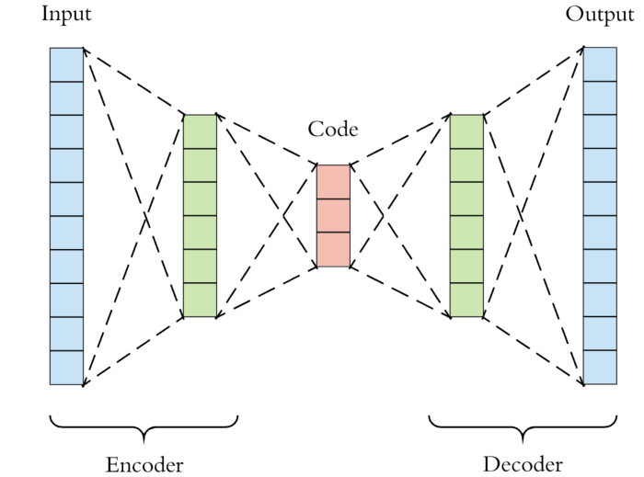
Autoencoder Example
Figure from https://towardsdatascience.com/applied-deep-learning-part-3-autoencoders-1c083af4d798

Slide 5
Overfitting, Dropout, and Regularization
Recall that a feedforward neural network computes a function of its input, and we can think of the weights of a neural network as adjustable parameters of the network
Note that deep neural networks typically have many more parameters (i.e., weights) than shallow neural networks
Deep convolutional neural networks often have tens of millions of parameters
In the field of NLP, some deep transformer-based neural networks have hundreds of billions of parameters!
In earlier days of machine learning, having too many parameters, compared to the number of training examples, was considered a recipe for overfitting with any ML model
One potential benefit of autoencoders is that they reduce the number of parameters of the network, which is probably why they help to reduce overfitting
Another method used to prevent overfitting in deep neural networks is dropout
This roughly means that nodes or connections are ignored, or turned off, with a certain probability, during each training pass
This helps to prevent any single node or link from becoming too dominant
Another method used to prevent overfitting is to include a regularization term that penalizes large weights in the cost function (the regularization term typically gets added to the loss function)

Slide 6
Vanishing and Exploding Gradients
Two problems associated with deep neural networks are the vanishing gradient problem and the exploding gradient problem
To implement backpropagation, we ultimately need to compute the gradient of a loss function (or a more general cost function) with respect to each adjustable weight
To compute this, we backpropagate error from an output layer to previous layers one at a time; in the process, we repeatedly multiply by gradients of nodes' outputs with respect to their inputs
If these gradients are all greater than one, the overall gradient can explode, leading to huge adjustments and dominant weights early in the network; fortunately, this can be mitigated by simply capping gradients
If the gradients are all smaller than one, the overall gradient can vanish, and this is harder to deal with
The most common activation function for deep neural networks (at least in CNNs) is the rectified linear unit (ReLU), as described during our previous topic
It is speculated that one reason for the benefit of this activation function is that it helps to mitigate the vanishing gradient problem
Residual connections, a.k.a. skip connections, also help to mitigate this problem; this means that some layers receive inputs from additional prior layers in addition to the previous one
The figure on the next slide shows the architecture of a popular model that includes residual connections

Slide 7
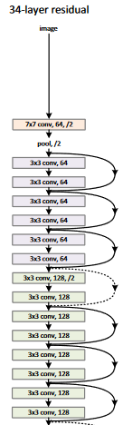
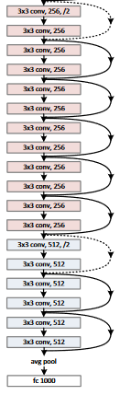
Example: ResNet-34 Architecture (split figure)
Figure from "Deep Residual Learning for Image Recognition" by He et. al.

Slide 8
Convolutional Neural Networks
One type of deep neural network that has been very successful for image recognition tasks (and various other tasks) is known as a convolutional neural network (CNN)
The early stages of a convolutional neural network often alternate between convolutional layers and pooling layers
Typically, the pooling layers apply either max pooling or average pooling
Each convolutional layer and pooling layer is organized into feature maps
The units in one feature map are connected to local patches in the feature maps of the previous layer and share a single filter, a.k.a. kernel
The pooling layers then take the maximum or average of a local patch of units from a feature map
Neighboring units within a pooling layer look at shifted, and sometimes overlapping, regions of units from the previous layer
The number of steps that the kernel slides is called the stride
The figures on the next three slides help to explain these concepts

Slide 9
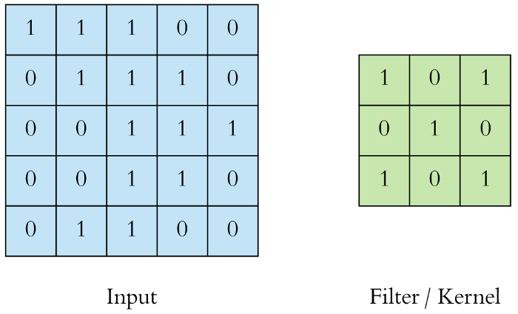
Example Kernel
https://towardsdatascience.com/applied-deep-learning-part-4-convolutional-neural-networks-584bc134c1e2

Slide 10
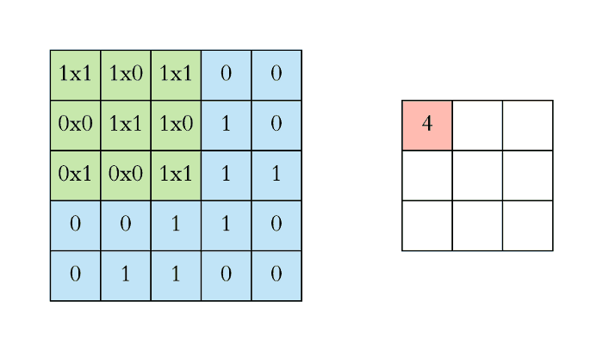
Example Convolution
https://towardsdatascience.com/applied-deep-learning-part-4-convolutional-neural-networks-584bc134c1e2

Slide 11
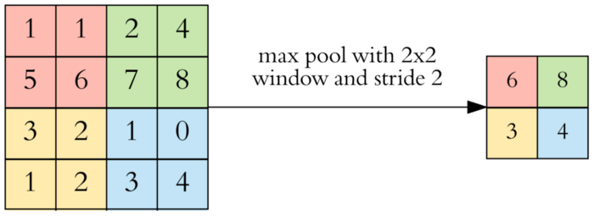
Example Max Pool
https://towardsdatascience.com/applied-deep-learning-part-4-convolutional-neural-networks-584bc134c1e2

Slide 12
CNNs Applied to Images
In the early 2010s, some of the earliest, huge successes of deep neural networks were related to object recognition in images
As you move across the layers of a deep CNN, the earlier layers detect instances of low-level details within images; later layers detect instances of higher-level details
When applied to an image, for example, the early layers of a CNN may detect edges, then later layers may detect certain shapes, even later layers may eventually detect objects, etc.
In other cases, layers may detect the presence of more general, abstract features
The organization allows the detection of an object anywhere within the image at any rotational angle
CNNs applied to images can often handle raw data (i.e., pixel values), and the early layers of these networks can be thought of as feature detectors
At the end of a CNN, there may be a fully connected layer (a.k.a. a dense layer), the same type of layer used in a conventional, feedforward neural network, leading to the outputs
For classification into mutually exclusive categories, there may be a softmax layer at the end, possibly after a fully connected layer
One major benefit of CNNs is that they remove the necessity for feature selection
However, it is often necessary to experiment with architectures and manually adjustable hyperparameters

Slide 13
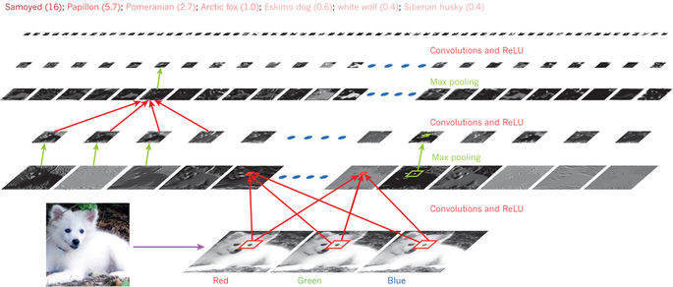
CNN Applied to an Image Example
Figure from "Deep Learning" by LeCun, Bengio, and Hinton

Slide 14
Recurrent Neural Networks
Variations of recurrent neural networks (RNNs) have had a lot of success in the field of natural language processing
The inputs might be embeddings of sequential words or subwords in a sentence or longer span of text
Ordinary RNNs suffer greatly from the vanishing gradient problem
Variations involving long short-term memory units (LSTMs) mitigate the problem to some extent
A concept called attention can lead to significant additional performance gains
In recent years, transformers rely on a notion known as self-attention, without the need of convolutions or recurrent layers
We will learn about these topics when we cover deep learning for NLP

Slide 15
Other Aspects of Deep Learning
Some enormous neural networks are trained on very large datasets, typically one mini-batch at a time
In some cases, the initial layers of a neural network trained for one task can be used as the starting layers for another task; this is an example of transfer learning
Many deep learning networks are not trained with a fixed learning rate, but rather with an adaptive learning rate (e.g., Adam optimization)
As mentioned in our previous topic, when dealing with deep neural networks, it is customary to think of layers as vectors and weights between layers as matrices
For some types of layers and weight configurations, when dealing with multi-dimensional arrays with more than two dimensions, we call those tensors
Modern neural network libraries make it easy to piece together common types of layers, to specify cost functions, to specify hyperparameters, etc.
They also allow programmers to specify new types of nodes, layers, cost functions, etc.
If the programmer specifies formulas for the needed gradients for backpropagation when custom nodes or cost functions are used, the rest of backpropagation can be automated
If the network is specified as a computation graph, automatic differentiation may be possible
Modern libraries take advantage of GPUs, making training much faster due to high levels of parallelization

