Slide 1
ECE469: Artificial Intelligence
Intelligent Agents

Slide 2
Agents
Book: "An agent is anything that can be viewed as perceiving its environment through sensors and acting upon that environment through actuators"
A percept is an agent's perceptual inputs at any given instant
A percept sequence is the complete history of percepts
An agent's choice of action can depend on the entire percept sequence, plus whatever prior knowledge the agent had
An agent's behavior can be described by an agent function mapping the percept sequence to an action
Given any agent function, you can imagine a large (possibly infinite) table describing it
I add: Two possible caveats are agents that sometimes perform random actions and agents operating in non-discrete environments
An agent program implements the agent function

Slide 3
Vacuum-cleaner Agent
The next slide depicts a simple version of a vacuum-cleaner world in which a vacuum-cleaner agent might exist
One simple agent function for such an agent (which could be described with a table) is:
  If the current square is dirty, clean it
  Otherwise, move to the other square
This might be rational under certain assumptions, but not otherwise (it depends, at least, on the performance measure)
Performing actions in order to modify future percepts is called information gathering; e.g., looking both ways before crossing the street
A related concept is exploration; e.g., if the vacuum-cleaner agent's initial environment is unknown, it can start off moving around to create a map
The definition of a rational agent (which we discuss shortly) requires an agent to learn as much as possible from what it perceives

Slide 4
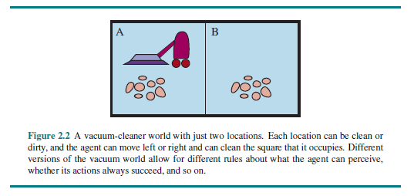
The Vacuum-cleaner World

Slide 5
Rational Agents
Book: "A rational agent is one that does the right thing" (but what that means is not always obvious)
A performance measure is used to evaluate agents
It is better to design a performance measure according to what you want in an environment rather than how you think an agent should behave
For example, for the vacuum cleaner agent, it is better to evaluate it based on having a clean floor as opposed to how much dirt it cleans
What is rational at a given instant depends on four things:
  The performance measure
  The agent's prior knowledge of the environment
  The percept sequence
  The allowable actions
Definition of a rational agent:
  "For each possible percept sequence, a rational agent should select an action that is expected to maximize its performance measure, given the evidence provided by the percept sequence and whatever built-in knowledge the agent has."

Slide 6
Task Environments
According to the textbook, task environments "are essentially the problems to which rational agents are the solutions"
A task environment includes the performance measure, the environment, the agent's actuators, and the agent's sensors (PEAS)
The book uses an automated taxi driver as an example of a complex agent and discusses its task environment
  The environment consists of roads, traffic, pedestrians, customers, potholes, weather, etc.
  The actuators include the steering mechanism, the accelerator, the break, signals, the horn, displays, etc.
  The sensors might include cameras, sonar, a speedometer, GPS, an odometer, engine sensors, a keyboard or other input devices, etc.
  The performance measure may depend on safety, speed, legality, comfort of trip, friendliness, maximization of profits, etc.

Slide 7
Categorizing Task Environments
Task environments can be categorized along the following dimensions
  Fully observable versus partially observable
  Deterministic versus stochastic (versus strategic)
    The 4th edition of the textbook changes the term "stochastic" to "nondeterministic", and says they only use "stochastic" when explicit probabilities are used; However, other places, they revert to "stochastic"
    The 4th edition also drops the term "strategic", but I think this distinction is very important
    The book points out that in many real-world situations, deterministic but partially observable environments often must be treated as stochastic; whether they are really deterministic is a moot point
  Episodic versus sequential
  Static versus dynamic (versus semidynamic)
  Discrete versus continuous
  Single-agent versus multi-agent (other agents can be cooperative, competitive, or mixed)
  Known versus unknown (strictly speaking, this is not a property of the task environment, but rather the agent's knowledge of it)
The figure on the next slide shows how various task environments can be categorized, but some of these labels are debatable

Slide 8
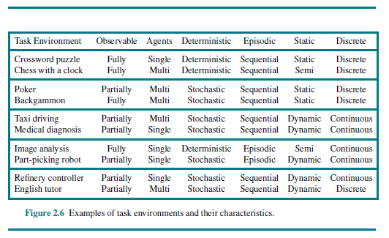
Examples of Task Environments

Slide 9
Types of agents
Types of agents:
  Simple reflex agents
    Each action depends only on the current percept
    Actions can be based on a lookup table or determined by simple rules; randomness is allowed
  Model-based reflex agents
    These agents keep track of parts of the world they observe to handle partially observable environments
    They maintain an internal state (e.g., a map)
    Such agents can rely on a transition model (indicating how the world works and how actions affect the environment) and a sensor model (indicating how percepts indicate the state of the world)
  Goal-based agents
    These agents have goals describing desirable situations; search and planning are used to achieve goal
    Even when they perform the same actions as a reflex agent, the reasoning is philosophically different
  Utility-based agents
    These agents have a utility function that maps a state (or sequence of states) to a number indicating an associated degree of "happiness"
    Note that goals are binary; they are either achieved or not achieved
Agents can either use hard-coded rules to make decisions, or they can learn the rules

Slide 10
Agent Representations
Types of agent representations (related to expressivity or complexity):
  Atomic representations - each state of the world is indivisible
  Factored representations - each state is comprised of a fixed set of variables, or attributes, each of which has a value
  Structured representations - each state includes a set of objects and their relationships that can be described
A more expressive representation can capture everything that a less expressive one can plus more
We can also distinguish between localist representations and distributed representations
  A localist representation means that there is a one-to-one mapping between concepts and memory locations (e.g., in a computer or a brain)
  A distributed representation means that each concept is spread over multiple locations
  A local representation could be more error prone (e.g., if a few bits are garbled); distributed representations may be more robust

