Slide 1
ECE469: Artificial Intelligence
Feedforward Neural Networks

Slide 2
Neural Networks and Brains
A neural network (NN), a.k.a. artificial neural network (ANN), is a machine learning model loosely inspired by (at least originally) the human brain
NNs are discussed in discussed in Chapter 21 of the 4th edition of the textbook, titled "Deep Learning"
The 3rd edition of the textbook devoted only one section to NNs, Section 18.7
Although there was significantly less space devoted to NNs overall, the 3rd edition went deeper into some of the low-level details about neural network units, and I am including material from both editions in my slides
From the (even earlier) 2nd edition of the textbook: "A neuron is a cell in the brain whose principal function is the collection, processing, and dissemination of electrical signals"
The 3rd edition of the textbook talks about "the hypothesis that mental activity consists primarily of electrochemical activity in networks of brain cells called neurons"
Both the 3rd and 4th editions (in Chapter 1) state that "a collection of simple cells can lead to thought, action, and consciousness"
The 3rd edition states this as a hypothesis; the 4th edition says it is "now widely accepted"
We will question this conclusion during our final topic of the course!
Although (most) modern neural networks are no longer modeled after the human brain, I still think it is worthy to look at a high-level diagram of a neuron (seen on the next slide)

Slide 3
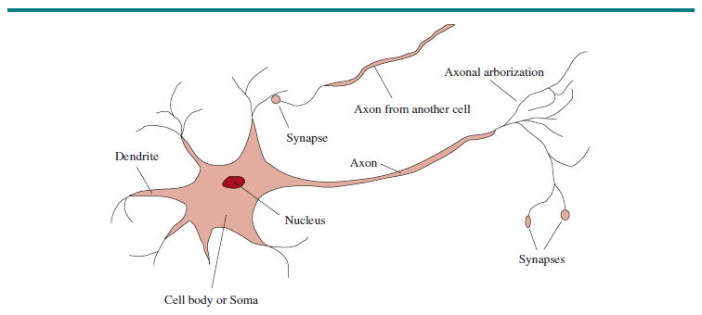
Diagram of a Neuron (Figure 1.1!)

Slide 4
Computer vs. Brain
There are roughly 10¹¹ neurons in the human brain
There are roughly 10¹⁴ synapses
Both of those estimates vary somewhat from source to source
A modern computer has roughly 10¹⁰ transistors
The number of transistors in computers had been increasing exponentially for decades roughly according to Moore's law
However, this pace has slowed in recent years
The brain has a much higher degree of parallelism compared to computers, although with GPUs, computers rely on more parallelism than they used to
Relative to modern NNs, the human brain also relies more heavily on feedback loops

Slide 5
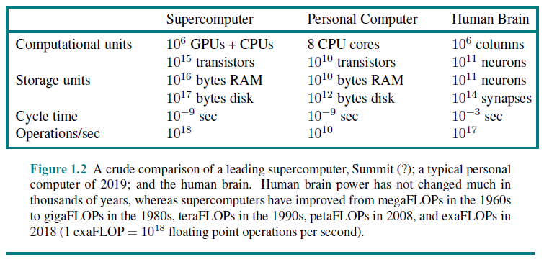
Computer vs. Brain (more details)

Slide 6
Units in a Neural Network
The figure on the next slide shows a simple, mathematical model of a neuron, which can also serve as a unit (a.k.a. node) in a neural network
  Each unit multiplies incoming numerical inputs by weights
  A special weight called a bias weight is connected to a fixed input
  The weight sum of inputs (including the bias weight times the fixed input) is applied to an activation function
  The result of the activation function is the output of the unit, also called its activation
This is similar to the original model of a neuron proposed by McCulloch and Pitts in 1943, but they used a threshold instead of a bias weight
  With a simple threshold function as the activation function, the output is 1 if the weighted sum of inputs exceeds the threshold, and 0 otherwise; we can call such a unit a threshold unit
  If the fixed input in our model is -1 instead of +1, the bias weight is equivalent to the threshold
  We can say that a threshold unit fires when the weighted sum of its inputs exceeds the threshold
More realistic models of neurons have been developed as part of the field of computational neuroscience
AI is generally more interested in developing neural networks that work well for certain tasks

Slide 7
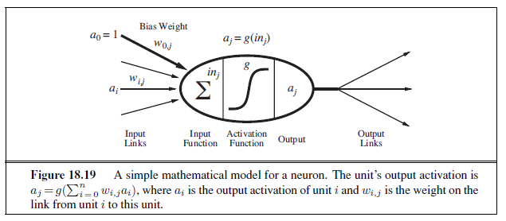
Mathematical Model of Neuron (from 3rd Ed.)

Slide 8
Some Common Activation Functions
The figure on the next page plots the following four commonly used activation functions in three graphs:
  The sigmoid function (a.k.a. the logistic function): g(x) = σ(x) = 1 / (1 + e^{-x})
  The rectified linear unit function (ReLU): g(x) = ReLU(x) = max(0, x)
  The softplus function: g(x) = softplus(x) = log(1 + e^{x})
  The tanh function: tanh(x) = [(e^{2x}-1)/(e^{2x}+1)]
The other activation functions are related to each other:
  The derivative of the softplus function is the sigmoid function
  The tanh function is a scaled, shifted version of sigmoid: tanh(x) = 2σ(2x) – 1
  The softplus function can be thought of as a differentiable approximation of ReLU
  The sigmoid function can be thought of as a differentiable approximation of the threshold function (not shown in the figure)

Slide 9
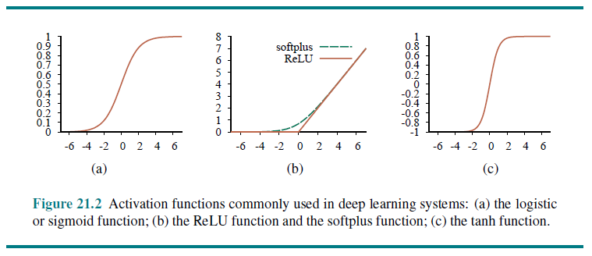
Four Common Activation Functions Plotted

Slide 10
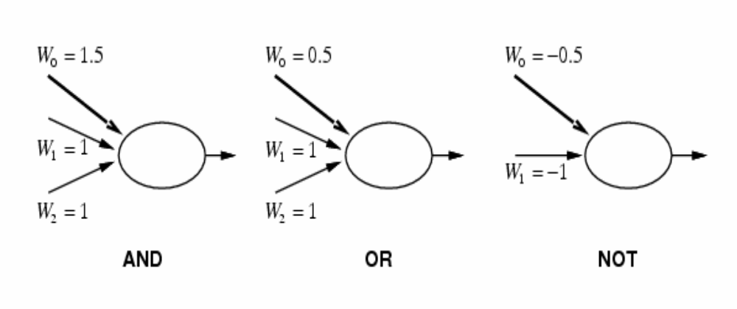
AND, OR, NOT
Single threshold units (which are no longer common) can be used to represent AND, OR, and NOT, as depicted in this figure from the 2nd edition of the textbook
We are assuming that the inputs are 1 (meaning true) or 0 (meaning false); we are also assuming here that the fixed input is a₀ = -1
This means that a network of such units can represent any Boolean function of its inputs

Slide 11
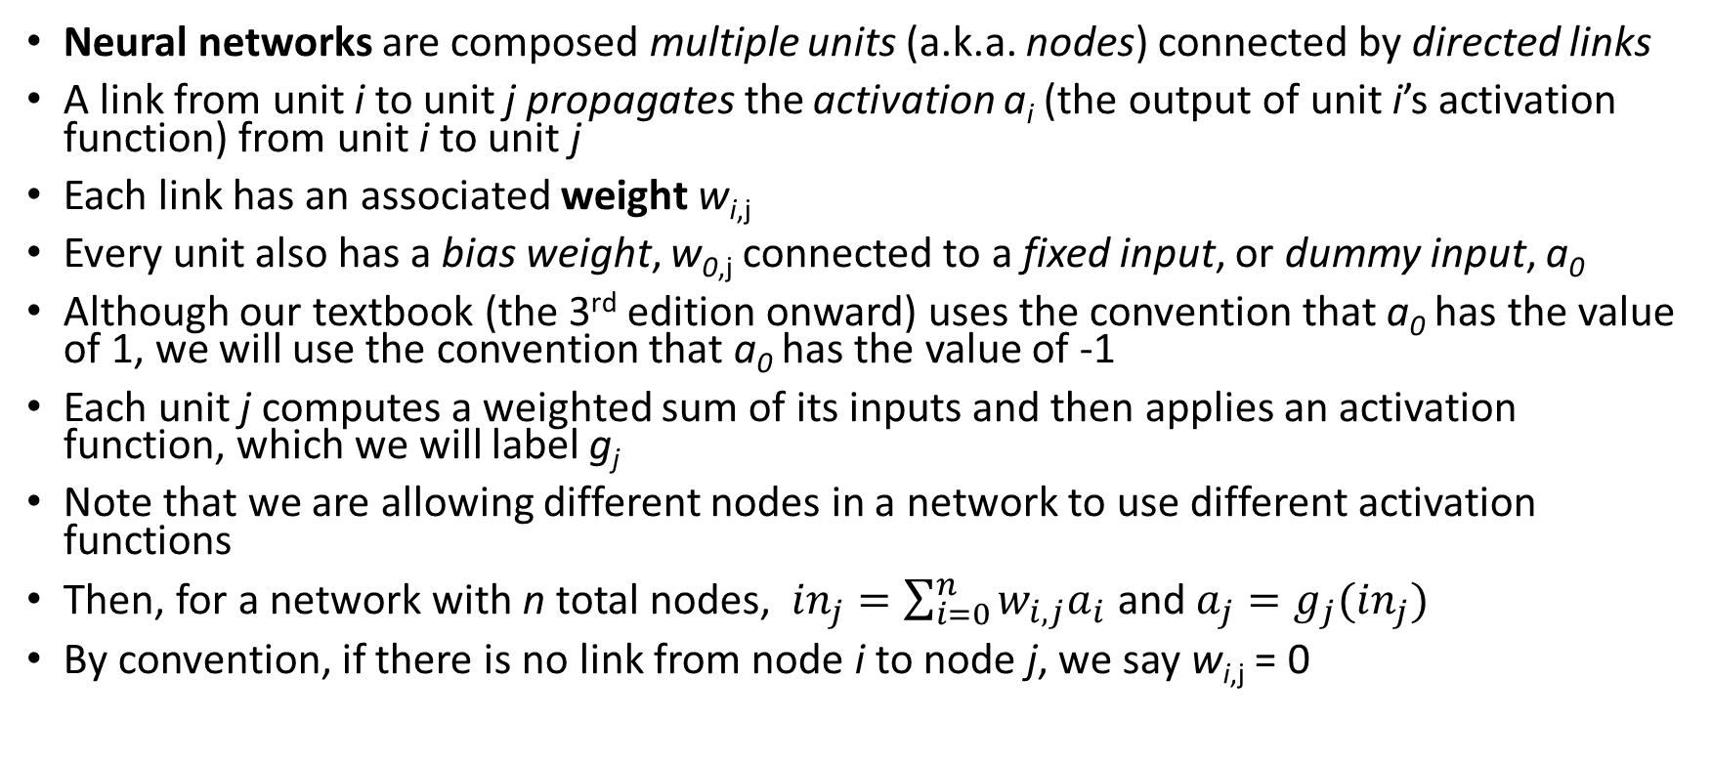
Neural Networks
Neural networks are composed multiple units (a.k.a. nodes) connected by directed links
A link from unit i to unit j propagates the activation a_{i} (the output of unit i’s activation function) from unit i to unit j
Each link has an associated weight w_{i,j}
Every unit also has a bias weight, w_{0,j} connected to a fixed input, or dummy input, a₀
Although our textbook (the 3rd edition onward) uses the convention that a₀ has the value of 1, we will use the convention that a₀ has the value of -1
Each unit j computes a weighted sum of its inputs and then applies an activation function, which we will label g_{j}
Note that we are allowing different nodes in a network to use different activation functions
Then, for a network with n total nodes, ${in}_{j}=\sum_{i=0}^{n}{w_{i,j}a_{i}}$ and $a_{j}=g_{j}({in}_{j})$
By convention, if there is no link from node i to node j, we say w_{i,j} = 0

Slide 12
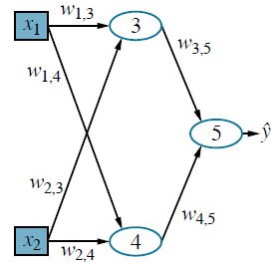
Neural Network Example
To the right, we see an example of a neural network
The bias weights and fixed inputs are not shown here for simplicity
As is common convention, the input nodes are shown as boxes
  Some sources assume that activation functions are applied directly to the inputs
  We will not (neither does the textbook)
Other units are shown as ovals
This neural network has a single output, ŷ, which is the activation of unit 5

Slide 13
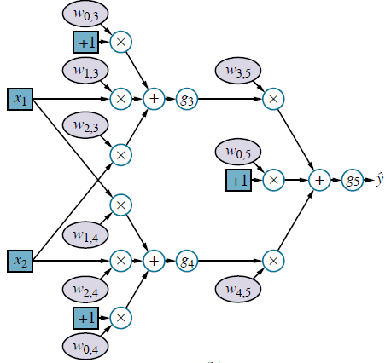
Computation Graph Example
Computation graphs can be used to represent general mathematical computations
Some nodes represent values, others represent mathematical operations
In modern sources, neural networks are often depicted as computation graphs
  The example on the right is equivalent to the neural network from the previous slide
  Color codes can distinguish adjustable values (e.g., weights) from other values (e.g., inputs)
  The g-nodes represent activation functions
Some modern neural network libraries take advantage of computation graph representations
  NN functionality can be implemented in a general way for computation graphs
  Any NN that can be represented as a computation graph can be easily trained and tested

Slide 14
Categories of Neural Networks
The two main categories of neural networks are feedforward neural networks and recurrent neural networks (RNNs)
A feedforward network has connections only in one direction, and therefore it is an example of a directed acyclic graph
Such a network represents a function of its current inputs
An RNN passes the outputs of some nodes back to their inputs (either directly or indirectly)
This means that there are cycles in the computation graph, and feedback in the neural network
In this topic, we will focus on feedforward networks
We'll discuss various types of RNNs during our unit on natural language processing

Slide 15
Layers
Conventionally, feedforward neural networks are usually arranged in layers
A common type of layer is a fully connected layer, meaning that each unit in the layer has an incoming link from every unit in the previous layer
Some modern feedforward neural networks also include residual connections, a.k.a. skip connections
This means that units at some layers receive input from additional prior layers (not just the previous one)
Sources differ on whether the inputs constitute a layer (e.g., our textbook does not count the inputs when counting the number of layers)
We will consider the input layer to be a layer consisting of the input nodes, and we will include it when counting layers; however, we will not apply activation functions to the inputs
The output nodes constitute the output layer; the nodes in this layer do have activation functions applied
In between the input layer and the output layer, there can be one or more hidden layers containing hidden units

Slide 16
Perceptrons
Neural networks without hidden layers are called perceptrons; sometimes they are called single-layer perceptrons (by sources that don't count the inputs as a layer)
The input units in perceptrons are directly connected to units at the output layer
Note that the output nodes are independent of each other, although they share common inputs, since each weight in the network affects only a single output
We can therefore limit our discussion to perceptrons with just one output unit, which basically means we are dealing with one node at a time
We have already seen that threshold perceptrons can represent AND, OR, and NOT
A perceptron can also represent the majority function by setting w₀ = n/2 (assuming a₀ = -1) and all other w_{i} = 1, where n is the number of inputs
A decision tree would need θ(2^{n}) nodes to represent the majority function!
However, there are many Boolean functions that a perceptron cannot represent

Slide 17
Limitations of Perceptrons
In a very influential 1969 publication, Minsky and Papert proved that perceptrons cannot represent XOR
More generally, perceptrons can only represent linearly separable functions
Let the vector, x, represent the inputs to a threshold unit (including the fixed input), and the vector, W, represent the incoming weights (including the bias weight); then the node fires if and only if W∙x > 0
The equation W∙x = 0 defines a hyperplane in the input space, so the perceptron returns 1 if and only if the input is on one side of the hyperplane
The figure on the next slide (from the 3rd edition of the textbook) show that perceptrons can represent AND and OR; such functions are linearly separable
The third part of the figure, however, shows that a threshold perceptron cannot represent XOR, which means that this function cannot be represented or learned; sigmoid perceptrons are similarly limited
It was this sort of limitation, discussed by Minsky and Papert in their highly influential 1969 paper, that led to a near total abandonment of research on neural networks until the mid-1980s
Threshold perceptrons do have a nice advantage: There is a simple, fast learning algorithm that will quickly fit a perceptron to any linearly separable training set
Feed-forward NNs with fully connected hidden layers (sometimes called multilayer perceptrons) do not have the limitations as perceptrons; however, in 1969, a method for training them was not widely recognized

Slide 18
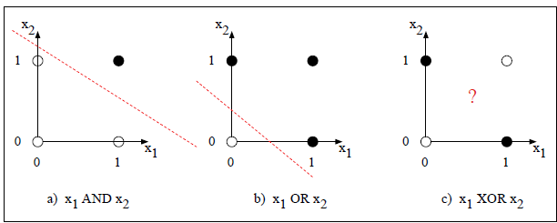
Hyperplane Examples (none for XOR)

Slide 19
Feedforward NNs with Hidden Layers
Adding hidden layers effectively enlarges the hypothesis space that a neural network can represent
This also assumes that the hidden nodes use non-linear activation functions
Before the era of deep learning, it was typical to use neural networks with exactly one hidden layer
Any continuous function of inputs can be represented with a single hidden layer
With two hidden layers, discontinuous functions can be represented as well
If vector x represents the input to the network, and W represents the weights of the network, the network computes a function h_{W}(x)
The weights can be considered parameters of the network
Adjusting the weights changes the function; this will be used for learning

Slide 20
Classification with Neural Networks
As with other machine learning models, when neural networks are used for supervised machine learning, they are generally trained on a training set
  We have learned that a training set consist of a collection of examples of input/output pairs
  For classification, a.k.a. categorization, each example specifies a label indicating the category of the example
  When a neural network is used for classification, it is typical to have each category represented by one output node
We will first consider a neural network being used for k-way Boolean classification, meaning that each of the k output units represents a separate decision
  If an output unit fires, that represents the prediction that the example belongs to the corresponding class
  In the case of a sigmoid unit, we'll say it fires of the output is greater than 0.5
Things are a bit more difficult when dealing with k mutually exclusive and exhaustive categories
  If sigmoid units are used at the output layer, you would have to check which one outputs the highest value
  With modern neural networks, when performing classification with mutually exclusive and exhaustive categories, it is common to make the output layer a softmax layer

Slide 21
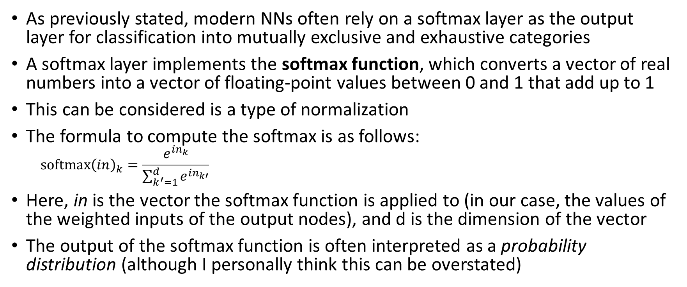
Softmax
As previously stated, modern NNs often rely on a softmax layer as the output layer for classification into mutually exclusive and exhaustive categories
A softmax layer implements the softmax function, which converts a vector of real numbers into a vector of floating-point values between 0 and 1 that add up to 1
This can be considered is a type of normalization
The formula to compute the softmax is as follows:
  $${softmax\left(in\right)}_{k}=\frac{e^{{in}_{k}}}{\sum_{k^{′}=1}^{d}{e^{{in}_{k′}}}}$$
Here, in is the vector the softmax function is applied to (in our case, the values of the weighted inputs of the output nodes), and d is the dimension of the vector
The output of the softmax function is often interpreted as a probability distribution (although I personally think this can be overstated)

Slide 22
Loss Functions for Neural Networks
As we have discussed, the weights of a neural network are adjustable, and this can be used for learning
The main idea behind the algorithm we will cover is to adjust the weight to minimize some measure of error on the training set
We can minimize a loss function, or a more general cost function that also includes a regularization term
When the output units are sigmoid units (typical for Boolean classification), a common loss function is sum of squared error, a.k.a. the L₂ loss function:
When the output layer is a softmax layer, and the outputs represent a probability distribution, a common loss function is the cross-entropy loss function
We will use sum of squared error for our loss function
However, the basic algorithm that we cover for learning neural networks is general, and works regardless of the loss function used

Slide 23
Sum of Squared Error
The sum of squared error, or L₂ loss, when a neural network is applied to a single training can be computed as follows:
  Loss(h_{W}) = L₂(y, h_{W}(x)) = |y – h_{W}(x)|² = ∑_{k} (y_{k} – a_{k})²
In this formula:
  h_{W}(x) is the output of the neural network, with weights W, applied to input vector x
  y is the desired output vector, specified by the training example
  |y – h_{W}(x)|² is the square of the Euclidean distance between the two vectors
  This is equivalent to ∑_{k} (y_{k} – a_{k})², where we are looping through the dimensions of the vector and squaring the difference at each dimension
  Here, y_{k} is the value of the k^{th} dimension of y, and a_{k} is the activation of the k^{th} output node

Slide 24
NN Learning Algorithm: General Idea
Decide the topology of your neural network and start with randomly initialized weights
Given a training set of examples with labeled inputs and outputs:
  For each example in the training set, use forward propagation to determine the predicted output of the neural network for the example
  Measure the loss by comparing this output to the true output
  Compute the gradient of the loss with respect to each weight in the network
  Modify the weights in the network to reduce the loss
The entire process (for the entire training set) is repeated multiple times (each iteration is called an epoch) until there is some sort of convergence
The gradient of the loss with respect to the weights can be calculated for a single example, a mini-batch of examples, or the entire training set
  If the entire training set is used, the process is called gradient descent
  If small batches or individual examples are used, the process is called stochastic gradient descent (SGD)
  The word 'stochastic' generally implies that the examples or mini-batches are picked randomly, although this is not necessarily the case

Slide 25
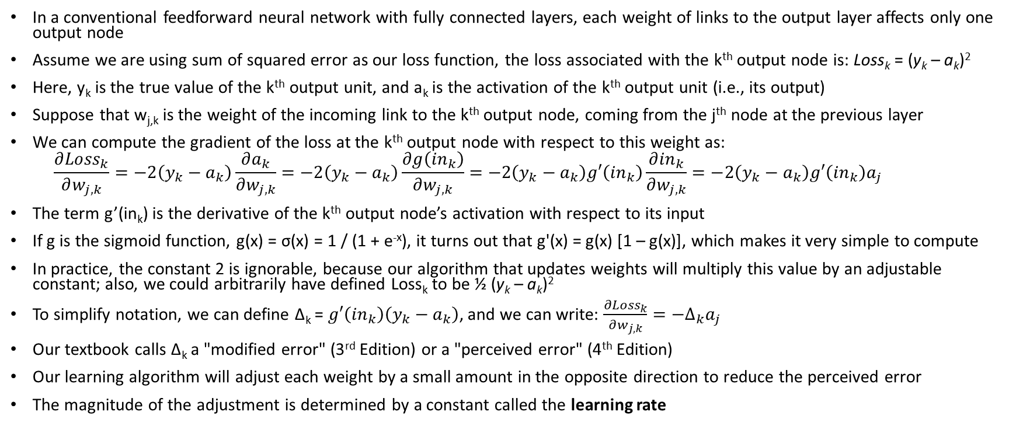
The Gradient of Weights to the Output Layer
In a conventional feedforward neural network with fully connected layers, each weight of links to the output layer affects only one output node
Assume we are using sum of squared error as our loss function, the loss associated with the k^{th} output node is: Loss_{k} = (y_{k} – a_{k})²
Here, y_{k} is the true value of the k^{th} output unit, and a_{k} is the activation of the k^{th} output unit (i.e., its output)
Suppose that w_{j,k} is the weight of the incoming link to the k^{th} output node, coming from the j^{th} node at the previous layer
We can compute the gradient of the loss at the k^{th} output node with respect to this weight as:
  $$\frac{∂{Loss}_{k}}{∂w_{j,k}}=−2\left(y_{k}−a_{k}\right)\frac{∂a_{k}}{∂w_{j,k}}=−2\left(y_{k}−a_{k}\right)\frac{∂g\left({in}_{k}\right)}{∂w_{j,k}}=−2\left(y_{k}−a_{k}\right)g′\left({in}_{k}\right)\frac{∂{in}_{k}}{∂w_{j,k}}=−2\left(y_{k}−a_{k}\right)g′\left({in}_{k}\right)a_{j}$$
The term g’(in_{k}) is the derivative of the k^{th} output node’s activation with respect to its input
If g is the sigmoid function, g(x) = σ(x) = 1 / (1 + e^{-x}), it turns out that g'(x) = g(x) [1 – g(x)], which makes it very simple to compute
In practice, the constant 2 is ignorable, because our algorithm that updates weights will multiply this value by an adjustable constant; also, we could arbitrarily have defined Loss_{k} to be ½ (y_{k} – a_{k})²
To simplify notation, we can define Δ_{k} = $g′\left({in}_{k}\right)\left(y_{k}−a_{k}\right)$, and we can write: $\frac{∂{Loss}_{k}}{∂w_{j,k}}={−∆}_{k}a_{j}$
Our textbook calls Δ_{k} a "modified error" (3rd Edition) or a "perceived error" (4th Edition)
Our learning algorithm will adjust each weight by a small amount in the opposite direction to reduce the perceived error
The magnitude of the adjustment is determined by a constant called the learning rate

Slide 26
Updating Weights to Hidden Layers
Updating weights to output nodes is all that is necessary for a perceptron
However, for neural networks with hidden layers, we also must update weights leading to hidden nodes
This is more difficult for at least two reasons
  First, these weights affect multiple output nodes
  Second, the appropriate values, and therefore the error values, for the hidden nodes are unknown (i.e., in a training set, only input values and output values are indicated)
The first revival of neural nets occurred in the mid- to late-1980s due to backpropagation
This technique was originally discovered in the 1960s
  For example, Bryson and Ho published a paper related to backpropagation in 1969
  However, the technique went largely unnoticed until much later
We are focusing on feedforward neural networks with fully connected layers
However, backpropagation with stochastic gradient descent is applicable to all modern forms of NNs

Slide 27
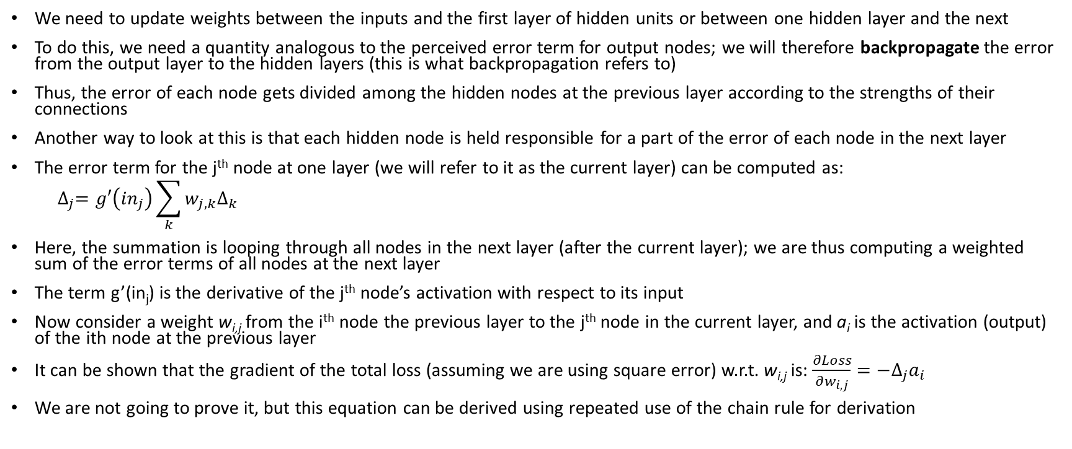
Backpropagation
We need to update weights between the inputs and the first layer of hidden units or between one hidden layer and the next
To do this, we need a quantity analogous to the perceived error term for output nodes; we will therefore backpropagate the error from the output layer to the hidden layers (this is what backpropagation refers to)
Thus, the error of each node gets divided among the hidden nodes at the previous layer according to the strengths of their connections
Another way to look at this is that each hidden node is held responsible for a part of the error of each node in the next layer
The error term for the j^{th} node at one layer (we will refer to it as the current layer) can be computed as:
  $$∆_{j}=g′\left({in}_{j}\right)\sum_{k}{w_{j,k}∆_{k}}$$
Here, the summation is looping through all nodes in the next layer (after the current layer); we are thus computing a weighted sum of the error terms of all nodes at the next layer
The term g’(in_{j}) is the derivative of the j^{th} node’s activation with respect to its input
Now consider a weight w_{i,j} from the i^{th} node the previous layer to the j^{th} node in the current layer, and a_{i} is the activation (output) of the ith node at the previous layer
It can be shown that the gradient of the total loss (assuming we are using square error) w.r.t. w_{i,j} is: $\frac{∂Loss}{∂w_{i,j}}={−∆}_{j}a_{i}$
We are not going to prove it, but this equation can be derived using repeated use of the chain rule for derivation

Slide 28
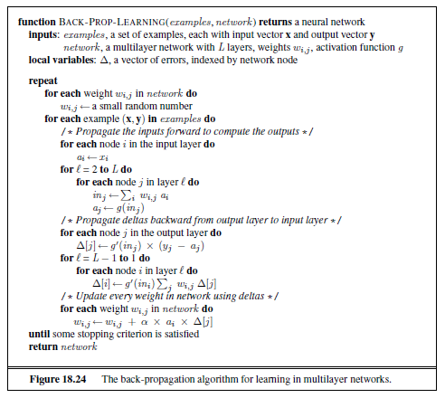
Back-Propagation Pseudo-code (from 3rd Ed.)
To the right, you see pseudo-code for the backpropagation algorithm
This trains a given neural network based on a training set consisting of labeled examples
The pseudo-code assumes squared error is used as the loss function
Each iteration of the repeat/until loop does one full epoch of training
  Each epoch loops through the entire training set, using one example at a time
  There is no randomization of the order
The indexes are a bit sloppy (I will explain them)
There are a couple of errors (I fixed them)
The pseudo-code with my comments and fixes will be posted on the course website

Slide 29
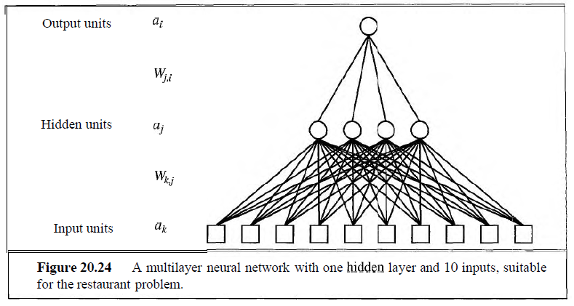
NN for the Restaurant Problem (from 2nd Ed.)

Slide 30
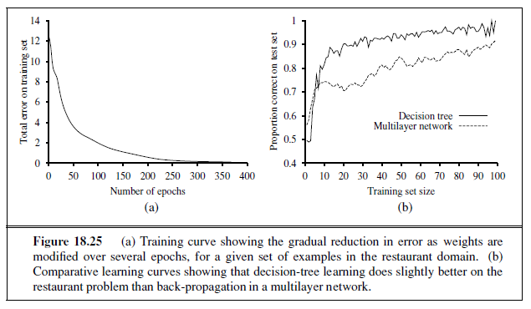
Applying an NN to the Restaurant Problem

Slide 31
Conventional NNs and Overfitting
Like all statistical machine learning methods, conventional neural nets are subject to overfitting when there are too many parameters in the model (i.e., if there are too many hidden units)
If there are too few hidden nodes, the network won't be able to learn well either
A certain amount of twiddling is often needed to get the network structure right; for example:
  You need to manually experiment both with the number of hidden nodes and with the learning rate to find values that work well for a given problem
  If you are considering networks with multiple fully connected hidden layers, you also need to experiment with the number of layers and the number of nodes in each layer
  With deep neural networks, there are different types of layers, possibly different activation functions at different layers, and even very different categories of network architectures
  The learning rate (if static) should be a somewhat small constant; for example, in conventional NNs, a good value might be somewhere between 0.01 and 0.1 if a sigmoid function is used for the activation function
  You can use a validation set or cross-validation to determine the various hyperparameters
  You can also use a validation set or cross-validation to help with feature selection; conventionally, this is a very important component of any machine learning approach
  The initial values of the weights can also make a significant difference; often, initial weights are randomly generated, for example as fractions between 0 and 1

Slide 32
Representing NNs with Vectors and Matrices
With modern neural networks, it is common represent all the nodes in a layer with a single vector
Then all the weights between two consecutive layers can be represented with a matrix
For example, one example formula from Ed. 4 of the textbook representing what happens in a fully connected feedforward neural network with one hidden layer is: h_{W}(x) = g⁽²⁾(W⁽²⁾g⁽¹⁾(W⁽¹⁾x))
  The vector x is the input vector
  The matrix W⁽¹⁾ is the weight matrix representing the weights between the inputs and the hidden layer
  The function g⁽¹⁾ is the activation function for nodes in the hidden layer (it applies pointwise to the vector representing the inputs to the hidden layer)
  The matrix W⁽²⁾ is the weight matrix representing the weights between the hidden layer and the output layer
  The function g⁽²⁾ is the activation function for nodes in the output layer (it applies pointwise to the vector representing the inputs to the output layer)
This allows the use of linear algebra libraries to implement neural networks; modern neural network libraries are built on top of these
Such libraries are highly optimized, allowing for faster training and testing; they allow for parallelization of operations, which can take advantage of modern GPUs
This all becomes more important when training very large neural networks; such training is referred to as deep learning, which we will discuss as a separate topic

