Slide 1
ECE469: Artificial Intelligence
Intelligent Agents

Slide 2
Agents
Book: “An agent is anything that can be viewed as perceiving its environment through sensors and acting upon that environment through actuators”
A percept is an agent's perceptual inputs at any given instant
A percept sequence is the complete history of percepts
An agent's choice of action can depend on the entire percept sequence, plus whatever prior knowledge the agent had
An agent's behavior can be described by an agent function mapping the percept sequence to an action
Given any agent function, you can imagine a large (possibly infinite) table describing it
I add: Two possible caveats are agents that sometimes perform random actions and agents operating in non-discrete environments
An agent program implements the agent function

Slide 3
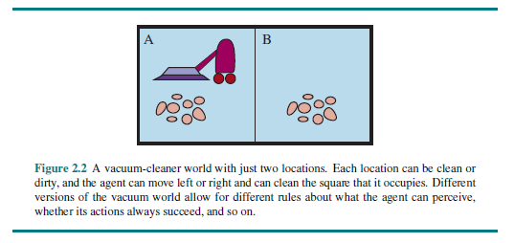
The Vacuum-cleaner World

Slide 4
Rational Agents
Book: “A rational agent is one that does the right thing”
A performance measure is used to evaluate agents
It is better to design a performance measure according to what you want in an environment rather than how you think an agent should behave
For example, for the vacuum cleaner agent, it is better to evaluate it based on having a clean floor as opposed to how much dirt it cleans
What is rational at a given instant depends on four things:
  The performance measure
  The agent's prior knowledge of the environment
  The percept sequence
  The allowable actions
Definition of a rational agent:
  “For each possible percept sequence, a rational agent should select an action that is expected to maximize its performance measure, given the evidence provided by the percept sequence and whatever built-in knowledge the agent has.”

Slide 5
Vacuum-cleaner Agent
One simple agent function for a vacuum-cleaner agent (which could be described with a table) is:
  If the current square is dirty, clean it
  Otherwise, move to the other square
This might be rational under certain assumptions, but not otherwise (it depends, at least, on the performance measure)
Performing actions in order to modify future percepts is called information gathering; e.g., looking both ways before crossing the street
A related concept is exploration; e.g., if the vacuum-cleaner agent's initial environment is unknown, it can start off moving around to create a map
The definition of a rational agent requires it to learn as much as possible from what it perceives

Slide 6
Task Environments
According to the textbook, task environments “are essentially the problems to which rational agents are the solutions”
A task environment includes the performance measure, the environment, the agent's actuators, and the agent's sensors (PEAS)
The book uses an automated taxi driver as an example of a complex agent and discusses its task environment

Slide 7
Categorizing Task Environments
Fully observable versus partially observable
Deterministic versus stochastic (or strategic)
Episodic versus sequential
Static versus dynamic (or semidynamic)
Discrete versus continuous
Single-agent versus multi-agent
Known versus unknown (strictly speaking, this is not a property of the task environment, but rather the agent's knowledge of it)

Slide 8
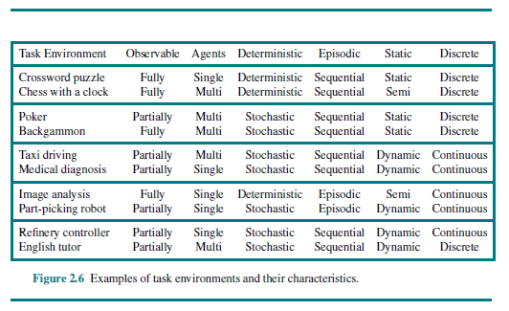
Examples of Task Environments

Slide 9
Types of agents
Types of agents:
  Simple reflex agents - each action depends only on the current percept
  Model-based reflex agents - handle partially observable environments by keeping track of parts of the world that it observes
  Goal-based agents - have goals describing which situations are desirable
  Utility-based agents - have a utility function that maps a state (or sequence of states) to a number describing an associated degree of "happiness"
Agents can either use hard-coded rules to make decisions, or they can learn the rules

Slide 10
Agent Representations
Types of agent representations (related to expressivity or complexity):
  Atomic representations - each state of the world is indivisible
  Factored representations - each state is comprised of a fixed set of variables, or attributes, each of which has a value
  Structured representations - each state includes a set of objects and their relationships that can be described
A more expressive representation can capture everything that a less expressive one can plus more
We can also distinguish between localist representations and distributed representations
  A localist representation means that there is a one-to-one mapping between concepts and memory locations
  A distributed representation means that each concept is spread over multiple locations
  A local representation could be more error prone (e.g., if a few bits are garbled); distributed representations may be more robust

